Slide 1
HIV Prevention Program Stewardship
9 November 2023
HIV Multi-Sector Leadership Forum
Susie McLean, Senior Advisor HIV Prevention, Global Fund

Slide 2
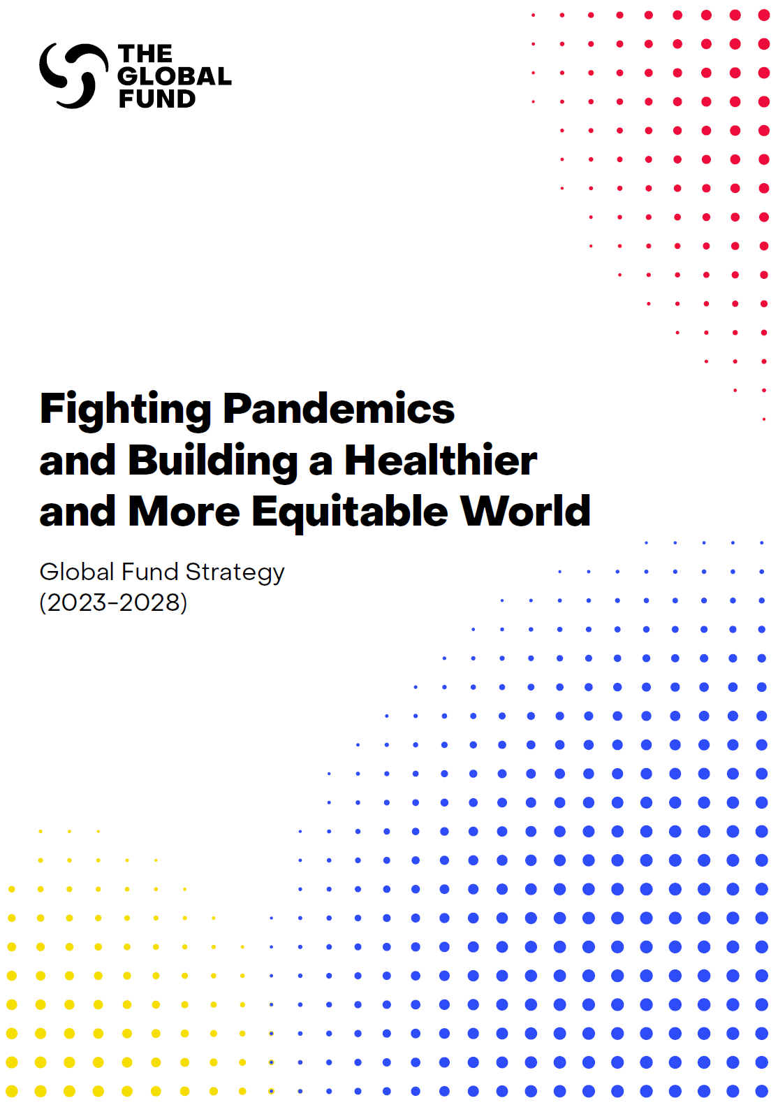
GF strategy (2023-2028) commitments
Focus on access to & use of combination HIV prevention options
Accelerate access to and effective use of precision combination HIV prevention, with behavioral, biomedical, and structural components tailored to the needs of populations at high risk of HIV infection, especially key and vulnerable populations:
Close gaps in HIV prevention coverage
Accelerate access to and use of new HIV prevention options
Evolve and expand the range of platforms for access to and delivery of people-centered HIV prevention

Slide 3
New GF strategy (2023-2028)
HIV Prevention commitments
Accelerate access to and effective use of precision combination prevention, with behavioral, biomedical, and structural components tailored to the needs of populations at high risk of HIV infection, especially key and vulnerable populations:
Close gaps in HIV prevention coverage
Accelerate access to and use of new HIV prevention options
Evolve and expand the range of platforms for access to and delivery of people-centered HIV prevention
Focus on KP + sexual partners in all geographies & AGYW + male sexual partners in SSA
Increase access to critical prevention interventions (condoms, PrEP, harm reduction)
Address factors that increase vulnerability and barriers to public health services
Better coordinate investments within multisectoral programs incl. social protection & education (e.g., to support CSE)
Support countries to strengthen data systems for HIV prevention

Slide 4
New GF strategy (2023-2028)
Focus on access to & use of combination prevention options
Accelerate access to and effective use of precision combination prevention, with behavioral, biomedical, and structural components tailored to the needs of populations at high risk of HIV infection, especially key and vulnerable populations:
Close gaps in HIV prevention coverage
Accelerate access to and use of new HIV prevention options
Evolve and expand the range of platforms for access to and delivery of people-centered HIV prevention
Support access to affordable new HIV prevention options, e.g., new PrEP formulations, long-acting OST, technologies that provide dual protection against HIV & pregnancy
Total market approach (mobilizing public and private sector capacities)
Support the development of policy, regulatory & programmatic enablers for new options
Support demand creation, incl. prevention communication to increase the knowledge, skills & power of people at risk to choose + use the best HIV prevention options for them

Slide 5
New strategy (2023-2028)
Focus on access to & use of combination prevention options
Accelerate access to and effective use of precision combination prevention, with behavioral, biomedical, and structural components tailored to the needs of populations at high risk of HIV infection, especially key and vulnerable populations:
Close gaps in HIV prevention coverage
Accelerate access to and use of new HIV prevention options
Evolve and expand the range of platforms for access to and delivery of people-centered HIV prevention
Leverage the strengths of public sector, community, civil society and private sector delivery systems for greater differentiation, innovation, and sustainability of HIV prevention efforts.
Support prevention approaches through non-traditional and non-facility-based platforms, especially community-based and community-led services, SRHR services, and online, pharmacy-based, and other easy-to access services.
New technologies will be leveraged for improved health communication & demand creation.

Slide 6
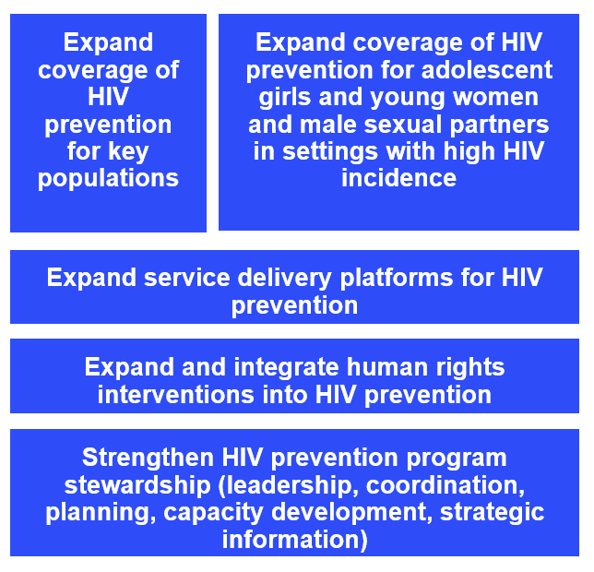
HIV Information Note
Guidance for the 2023 – 2025 funding cycle
Includes:
Program Essentials: Standards for program design and coverage. It are key evidence-based interventions and approaches to address the ambitious goals set out in the HIV global strategy & support countries to achieve their national targets.
Interventions that are prioritized to have HIV impact

Slide 7
HIV Prevention Program Essentials
HIV primary prevention | 1. Condoms and lubricants are available for all people at increased risk of HIV infection 2. Pre-exposure prophylaxis (PrEP) is available to all people at increased risk of HIV infection, and post-exposure prophylaxis (PEP) is available for those eligible 3. Harm reduction services are available for people who use drugs ​ 4. Voluntary medical male circumcision (VMMC) is available for adolescent boys (15+ years) and men in WHO/UNAIDS VMMC priority countries
Relevant program essentials should be reinforced by demand creation activities to inform, increase uptake and support adherence. Note that all programming must be human rights-based, gender-responsive and informed by and respond to an analysis of inequities.

Slide 8
GF HIV Information Note 2022 – key priorities for HIV Prevention
Expand coverage of combination HIV prevention for key populations and their sexual partners in all epidemic settings: Provision of male and female condoms and lubricants; Provision of PEP and PrEP (incl. new modalities) as recommended by WHO; SRH/STI interventions provided as part of HIV prevention services, and HIV prevention interventions provided as part of SRH service delivery; Provision of harm reduction services for PWID; Priority interventions for people in prisons and other closed settings; Provision of prevention commodities and services supported by targeted health communication, structural interventions or social enablers; Activities to assess, prevent and respond to security-related risks faced by KPs Expand coverage of combination HIV prevention for AGYW and male sexual partners in settings with high HIV incidence: Provision of male and female condoms and lubricants; Provision of PEP and PrEP as recommended by WHO; SRH/STI interventions provided as part of HIV prevention services, and HIV prevention interventions provided as part of SRH service delivery; Provision of counselling and support on HIV prevention, sexual and reproductive health and rights and family planning; Provision of voluntary medical male circumcision (VMMC) for adolescent boys (15+ years) and men in VMMC priority countries; Provision of commodities and services combined with risk reduction counselling; Biomedical and behavioral interventions supported by structural interventions or social enablers to increase access to services and reduce HIV vulnerability; targeted HIV prevention campaigns and CSE*; Social protection interventions*
*In settings with high to very high incidence (>1%)

Slide 9
GF HIV Information Note 2022 -key priorities for HIV Prevention (cont.)
Expand service delivery platforms for HIV prevention: Combination of public sector (health facility), community-based and community-led, and private sector delivery systems; Expanded platforms for community-based and peer outreach-based HIV prevention programs and services; Integrated models for improved HIV prevention and sexual health outcomes; Use of Virtual platforms to extend outreach, expand service delivery and mitigate stigma; Pharmacies (community/private) and other easy access points; MMD of HIV prevention commodities Expand and integrate human rights interventions into HIV prevention Strengthen HIV prevention program stewardship: Program planning, design and delivery including target-setting, costing and operational planning; technical working groups and national and sub-national coordination and review mechanisms; last mile supply and distribution systems for prevention commodities; HIV prevention product introduction and scale-up and strengthening of total market approaches; capacity development to support prevention program management and delivery; integration of HIV prevention and SRH communication, health promotion and service delivery; monitoring of prevention outcomes, performance reviews and use of data for micro-planning and problem solving

Slide 10
New GF module (modular framework) Prevention Program Stewardship
Activities related to strengthening national prevention program stewardship to achieve scale and precision of prevention service delivery. For example:
• Development of national prevention strategies, plans and programs including target setting, costing, defining investment needs and operational planning.
• Management, coordination and oversight of prevention programs, technical working groups, national and subnational coordination and review mechanisms.
• Differentiated and scalable HIV prevention demand generation and service delivery models. • Last mile supply and distribution systems for prevention commodities.
• HIV prevention product introduction, strategic positioning and strengthening of total market approaches.
• Community-based or community-led prevention models for outreach, social contracting and safety of programs with key populations and young women.
• Capacity development including building individual skills, institutional and systems capacity such as defined functions, quality assured processes and standard operating procedures.
• Integration of HIV prevention communication and service delivery with health promotion and services for SRHR and other related services.
→ Activities related to monitoring and collect HIV prevention-specific data, including population size estimation, hotspot mapping, risk assessment, socio-behavioral surveys, market and program analytics, monitoring of prevention outcomes, program reviews, financial analysis, etc., should be included in the module “RSSH: Monitoring and Evaluation Systems”. → Activities related to the national disease specific plans should be included under the module "RSSH: Health Sector Planning and Governance for Integrated People-centered Services" and intervention "Integration/coordination across disease programs and at the service delivery level".

Slide 11
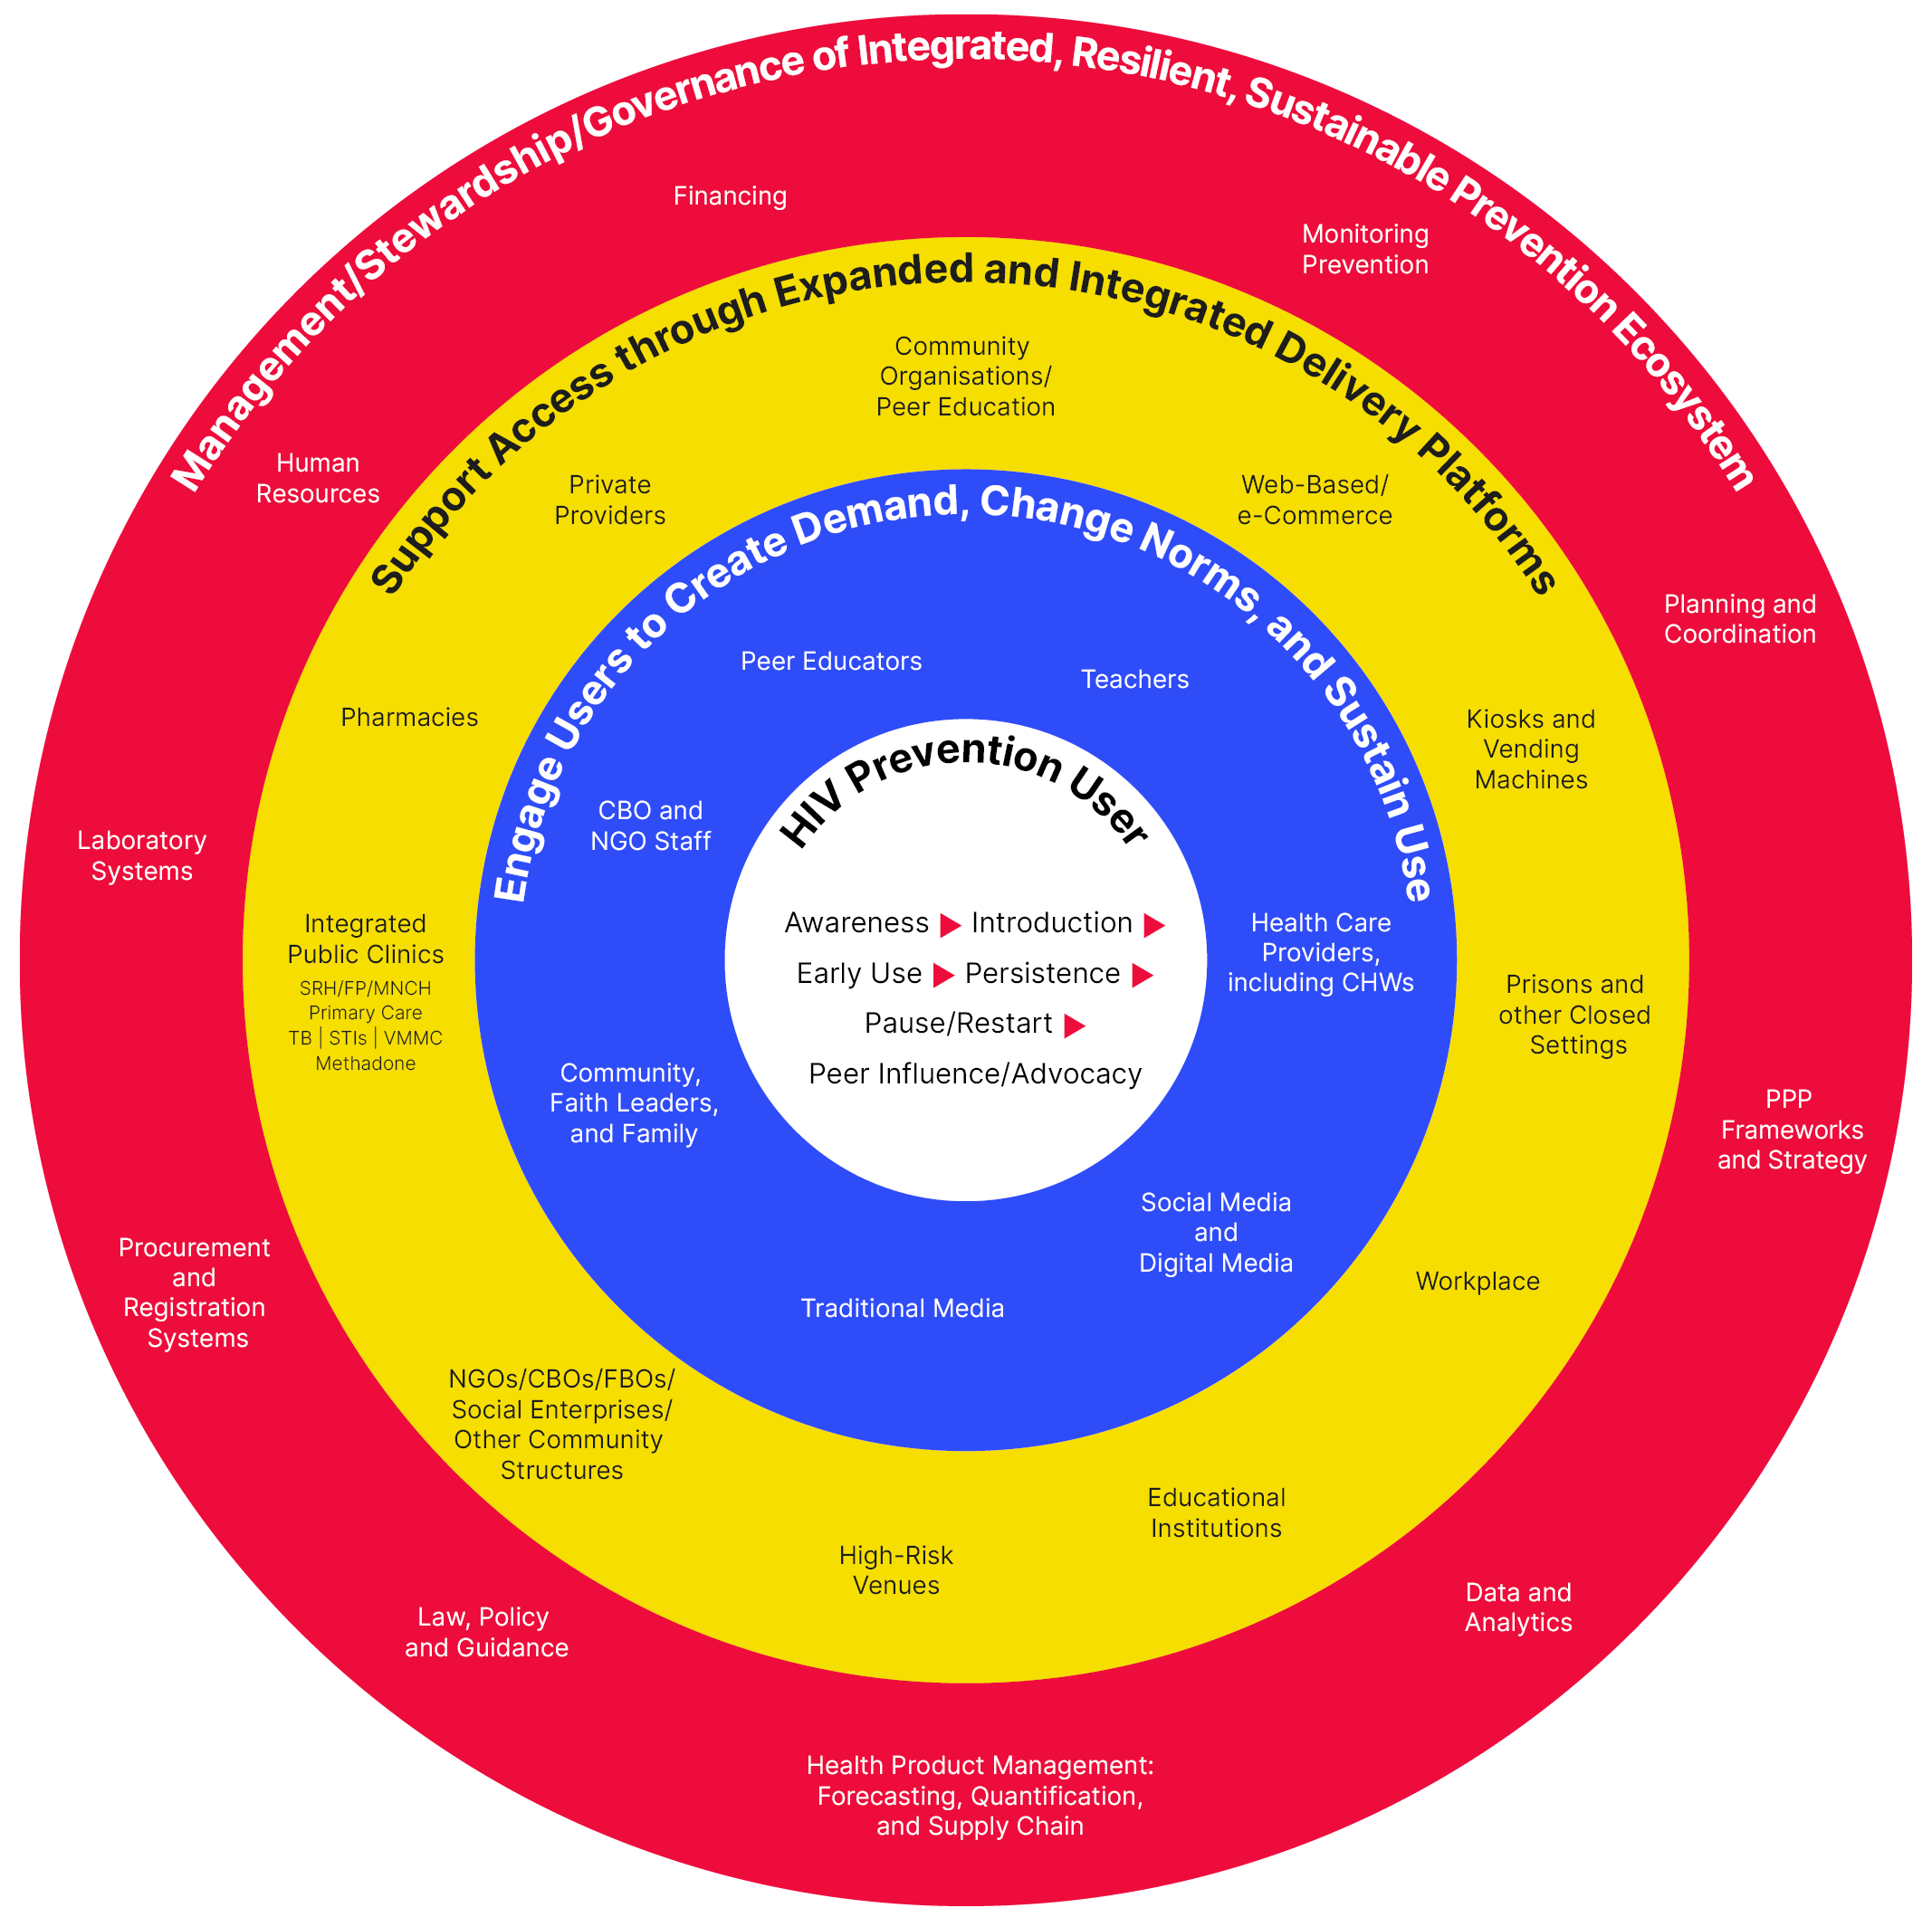
Expanded and Integrated HIV Prevention “Ecosystem”
Notes:
An HIV prevention ‘ecosystem’ includes an HIV prevention user at the core.
Their HIV prevention journey is enabled by demand creation interventions, and services or ‘access platforms’ delivering HIV prevention (and other) products and services.
Management, stewardship and governance are important elements of an integrated HIV prevention program.
CBOs Community Based Organizations | CHWs Community Health Workers
FBOs Faith Based Organizations | FP Family Planning
MNCH Maternal Neonatal Child Health | NGOs Non-Governmental Organizations
PPP Public Private Partnerships | STIs Sexually Transmitted Infections
SRH Sexual and Reproductive Health | TB Tuberculosis
VMMC Voluntary Medical Male Circumcision

