Slide 1

Key insights from 2024 Global HIV Prevention scorecards
Webinar 31 October 2024

Slide 2
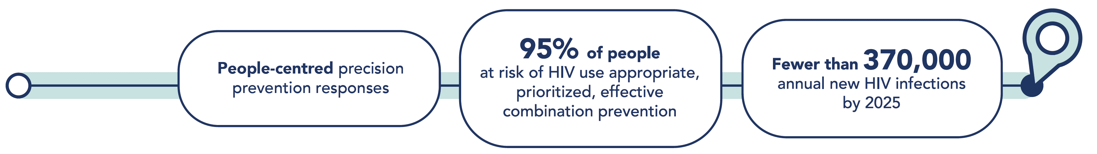
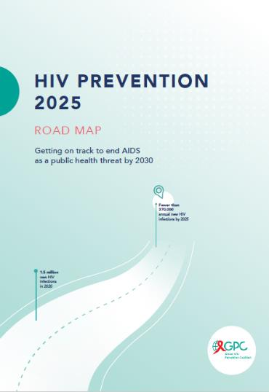

What Will Success Look Like
The 2025 high-level HIV prevention targets and commitments
An 82.5 % reduction compared to 2010
Notes:
Fewer than 370,000 new infections translates into more than 80% reduction compared to 2010.

Slide 3
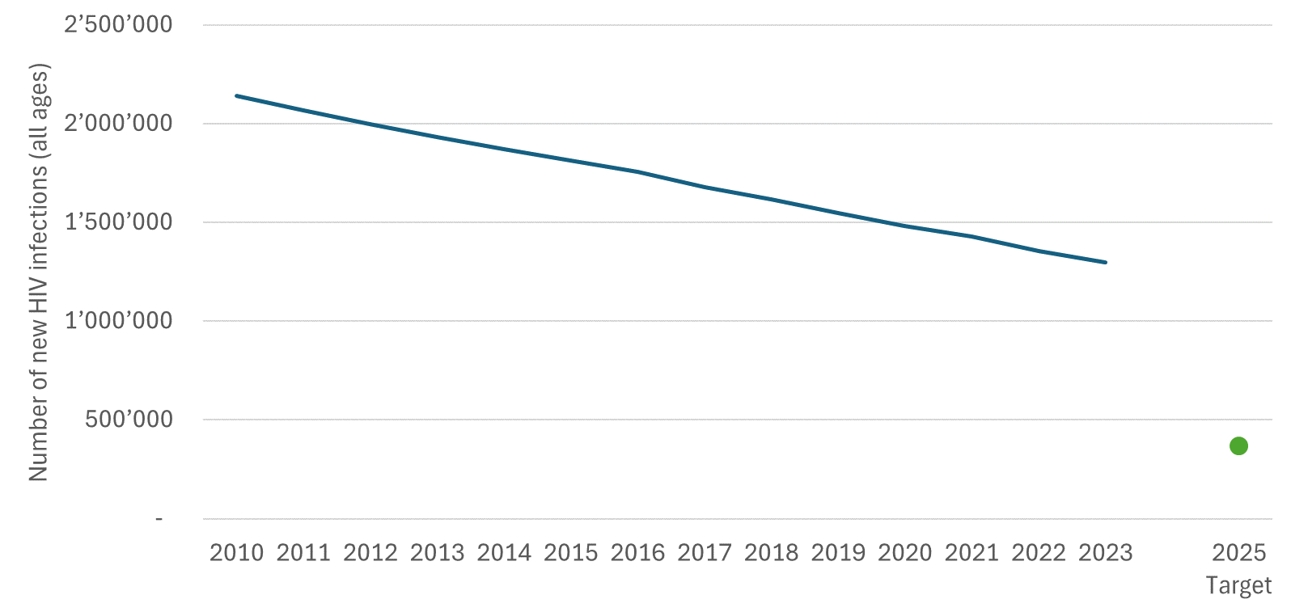
1.3 million new HIV infections in 2023: more than 3 times the 2025 target
Notes:
Background:
Lenacapavir: PURPOSE 1 study has announced results for cisgender women; full data analysis not available yet (Wednesday Gilead has a late breaker on Len).
PURPOSE 2, which included cisgender men and transgender women, started 3 months after PURPOSE 1. Results not yet available.
Access schemes that include low and middle income countries, including in sub-Saharan Africa, but also middle income countries in Asia-Pacific and Latin America given the KP epidemic who may otherwise miss out on lowest prices.

Slide 4
Declines in new infections in sub-Saharan Africa, but not fast enough. Global targets will be missed, primarily due to stagnation in other regions
Change in the numbers of people (all ages) acquiring HIV, by region, 2010–2023
HIV has risen in eastern Europe and central Asia, the Middle East and North Africa and Latin America - only slow declines in Asia-Pacific
Source: UNAIDS epidemiological estimates, 2024 (https://aidsinfo.unaids.org/).

Slide 5
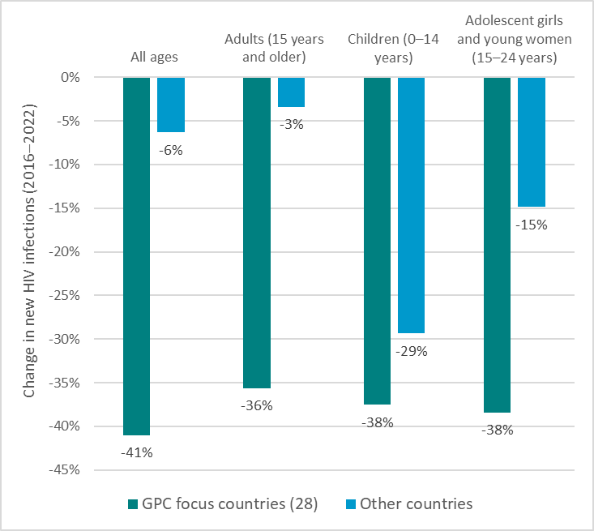
New HIV infections declined faster in GPC focus countries than other countries globally (2016-2023)
Note: Direct attribution of progress to GPC membership is not possible. However, the collective intensive efforts of governments, communities and international funders in these focus countries over the past decade likely explains the accelerated progress.

Slide 6
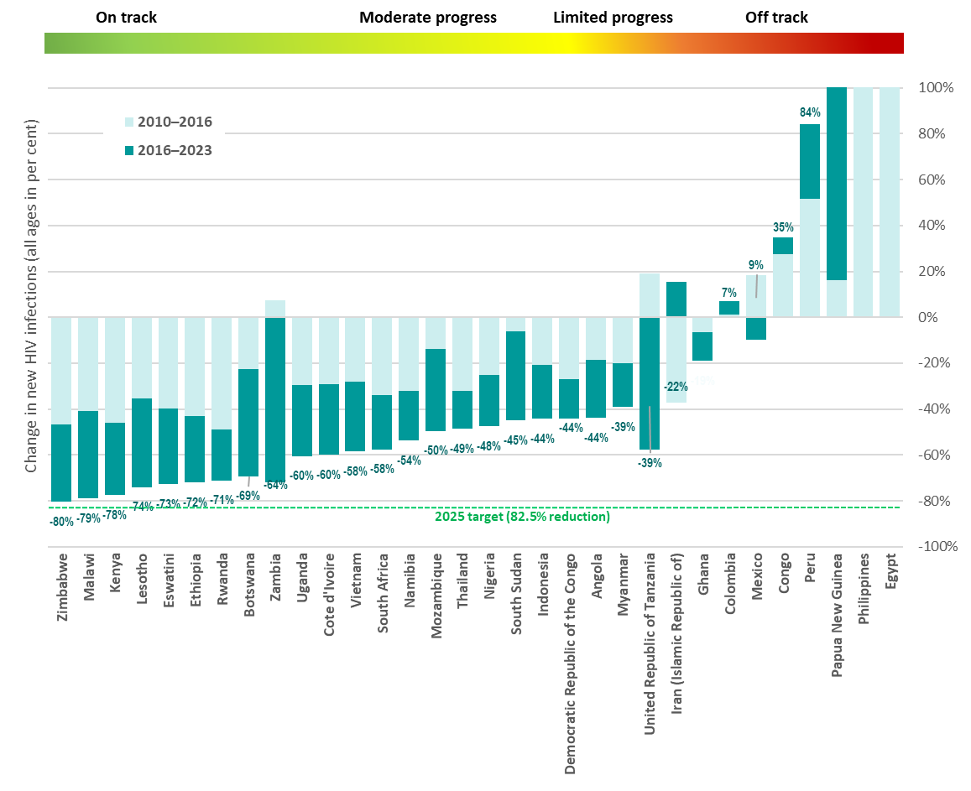
Large variation of progress
104% | 543%| 609% .../... ..../... .../...
Eight GPC focus countries have reduced their annual number of new HIV infections by at least 66% since 2010.
The majority of countries need to accelerate to achieve 2025 targets.
*No 2024 estimates reported for Brazil, Cameroon and Central African Republic

Slide 7
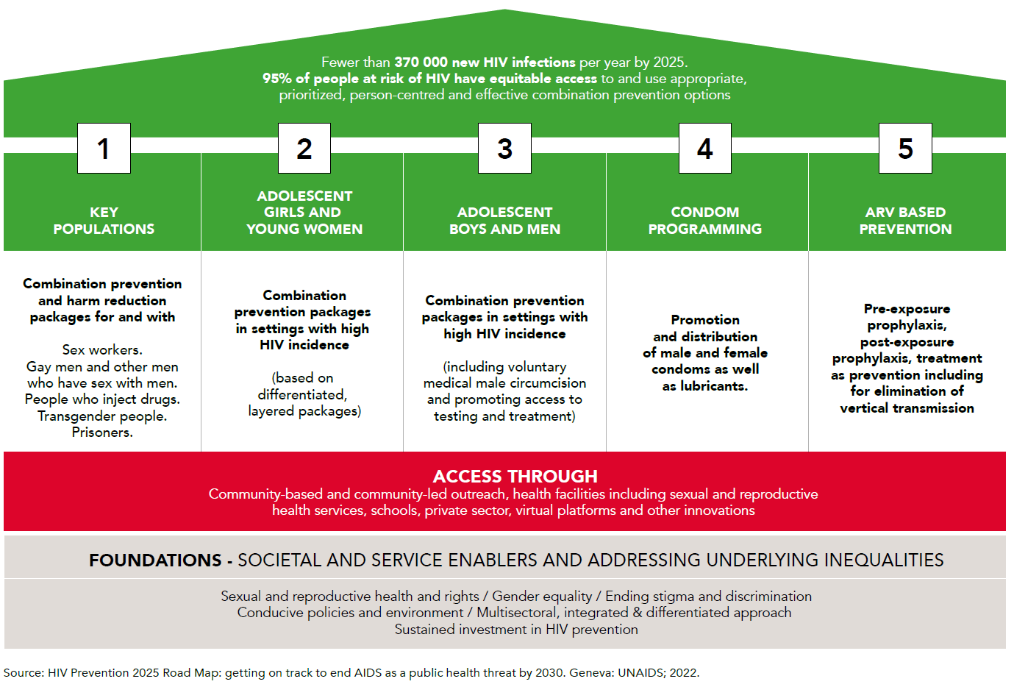
Five priority pillars, access platforms and foundations guiding the response

Slide 8
Despite progress made, prevention is off track to meet 2025 targets
Pillar | Indicator |  | Benchmark in line with 2025 targets | 2023 reporting
Key populations | Percentage who received at least two HIV prevention interventions in the previous 3 months | Sex workers | 90% | 55%
 |  | Gay men and other men who have sex with men | 90% | 30%
 |  | People who inject drugs | 90% | 40%
Adolescent girls and young women | Locations with moderate and high HIV incidence with a programme for adolescent girls and young women |  | 90% | 52%
 | Condom use with non-regular partners among young women |  | 80% | 38%
Boys and men | Annual number of voluntary medical male circumcisions |  | 5 million | 2 529 595
Condoms | Condom use with non-regular partners among men |  | 80% | 63%
ARV-based prevention | Percentage of people living with HIV receiving antiretroviral therapy |  | 90% | 77%
 | Number of people who used PrEP at least once in 2022 |  | 21 200 000 | 3 512 471
Increasing
slowly overall (but not consistently)
Decreasing over the past 6 years
Increasing in most countries
Increasing rapidly, but far from target
^{[1]} Global 2025 targets for condom use vary by level of HIV incidence in a geographical area and by individual risk. They are set at 95% for people at highest risk and 70% and 50% for people a moderate and low risk. Since data presented here are for a population at high risk (people with non-regular partners) in an entire country, a benchmark of 80% has been included as a proxy for the targets.
^{[2]} The benchmark of 21.2 million users is based on the global PrEP targets, which translate into 10.6 million person-years of PrEP. An assumed average duration of PrEP use of 6 months per year thus yields the benchmark of 21.2 million users.
Source: UNAIDS epidemiological estimates, 2024 www.aidsinfo.unaids.org.

Slide 9
Good country examples in all pillars: Countries with steeper declines with progress in treatment and primary prevention

Slide 10
Prevention with key populations (countries with mixed epidemics): Good examples (more for sex work), but major gaps in scale, access and data overall

Slide 11
Prevention with key populations (GPC focus countries with concentrated epidemics): Several countries with consistent programmes and data, but major gaps in coverage and outcomes overall (larger for gay men and other men who have sex with men, people who inject drugs, transgender people)

Slide 12
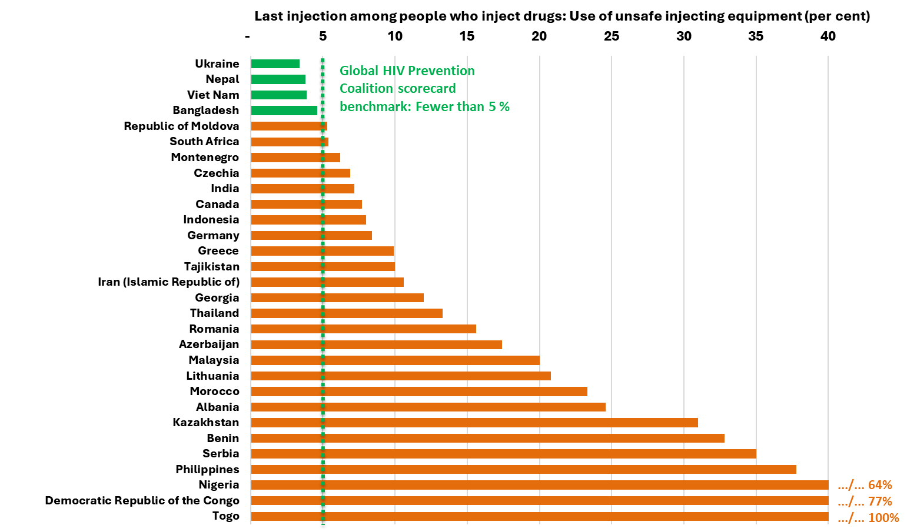
Access to safe injecting equipment remains too low
Four countries above GPC scorecard benchmark show it can be done

Slide 13
Key populations – structural barriers and enablers (GPC focus countries with mixed HIV epidemics) - Packages in place for sex workers & men who have sex with men but incomplete - large gaps for other populations - Lack of data on stigma in health care - Criminalization persists

Slide 14
Key populations – structural barriers and enablers (GPC focus countries with concentrated epidemics) - Packages in place but incomplete - Lack of data on stigma in health care - Criminalization persists, most widely for sex work and drug use

Slide 15
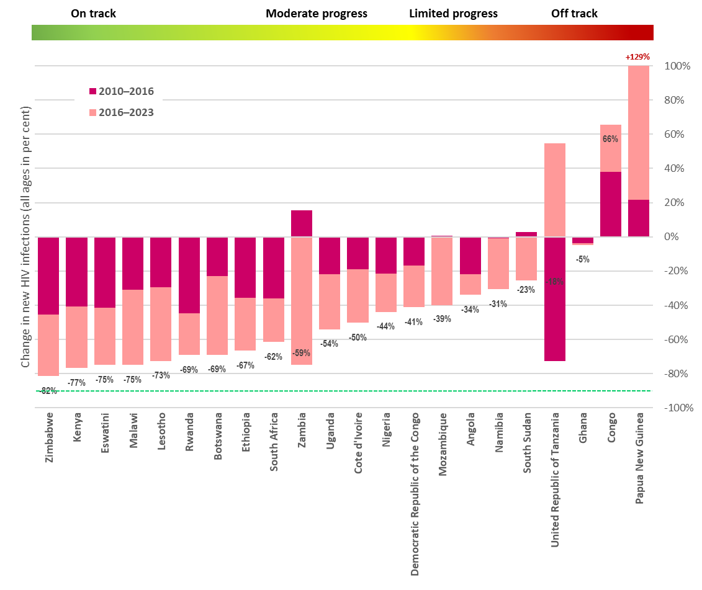
Adolescent girls and young women: Declining new HIV infections, but with great variation
Trends broadly aligned to adult trends
8 countries with declines of more than 2/3
4 countries with stagnating or rising trends
Declines slower than among male peers

Slide 16
Adolescent girls and young women: Behavioral and condom use patterns
Great variation in condom use between countries, but declines in condom use among young women and men in countries with recent surveys
Young women lag behind men in condom access in some countries
Increases in coverage of layered AGYW programmes in districts with high HIV incidence in AGYW focus countries of PEPFAR and GF – lack of data and programmes in others

Slide 17
Adolescent girls and young women – selected structural barriers (GPC focus countries with mixed epidemics) - Variation in completion of secondary education - CSE policies in place (implementation?) - Six countries with age of access restrictions for all below age 18

Slide 18
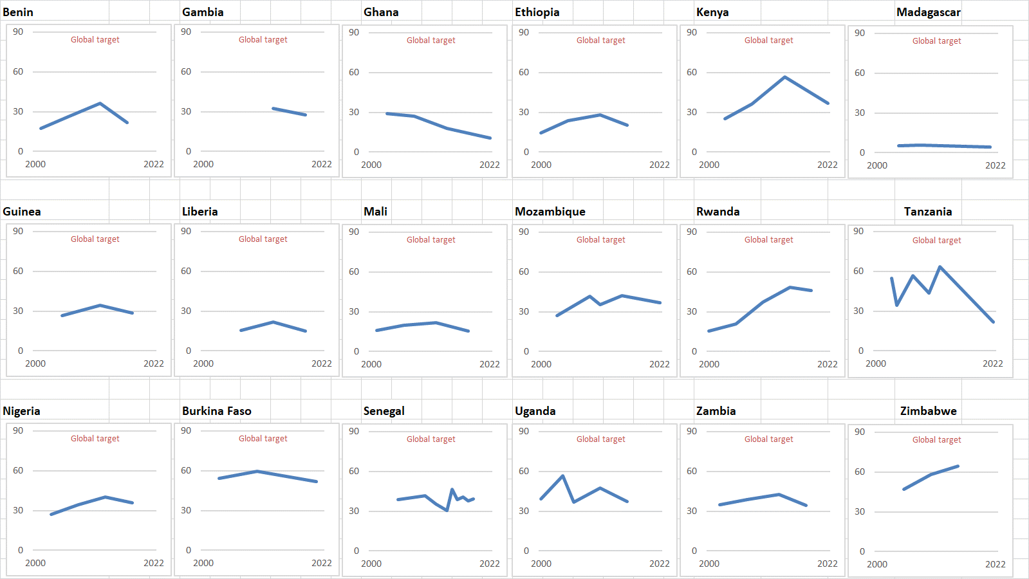
Condoms: Gains made are being lost: Declines in condom use
Condom use at last higher risk sex (with a non-marital, non-cohabiting partner) [Women, 15-49]
Inequities in access
Women and men with lower income in Africa consistently left behind

Slide 19
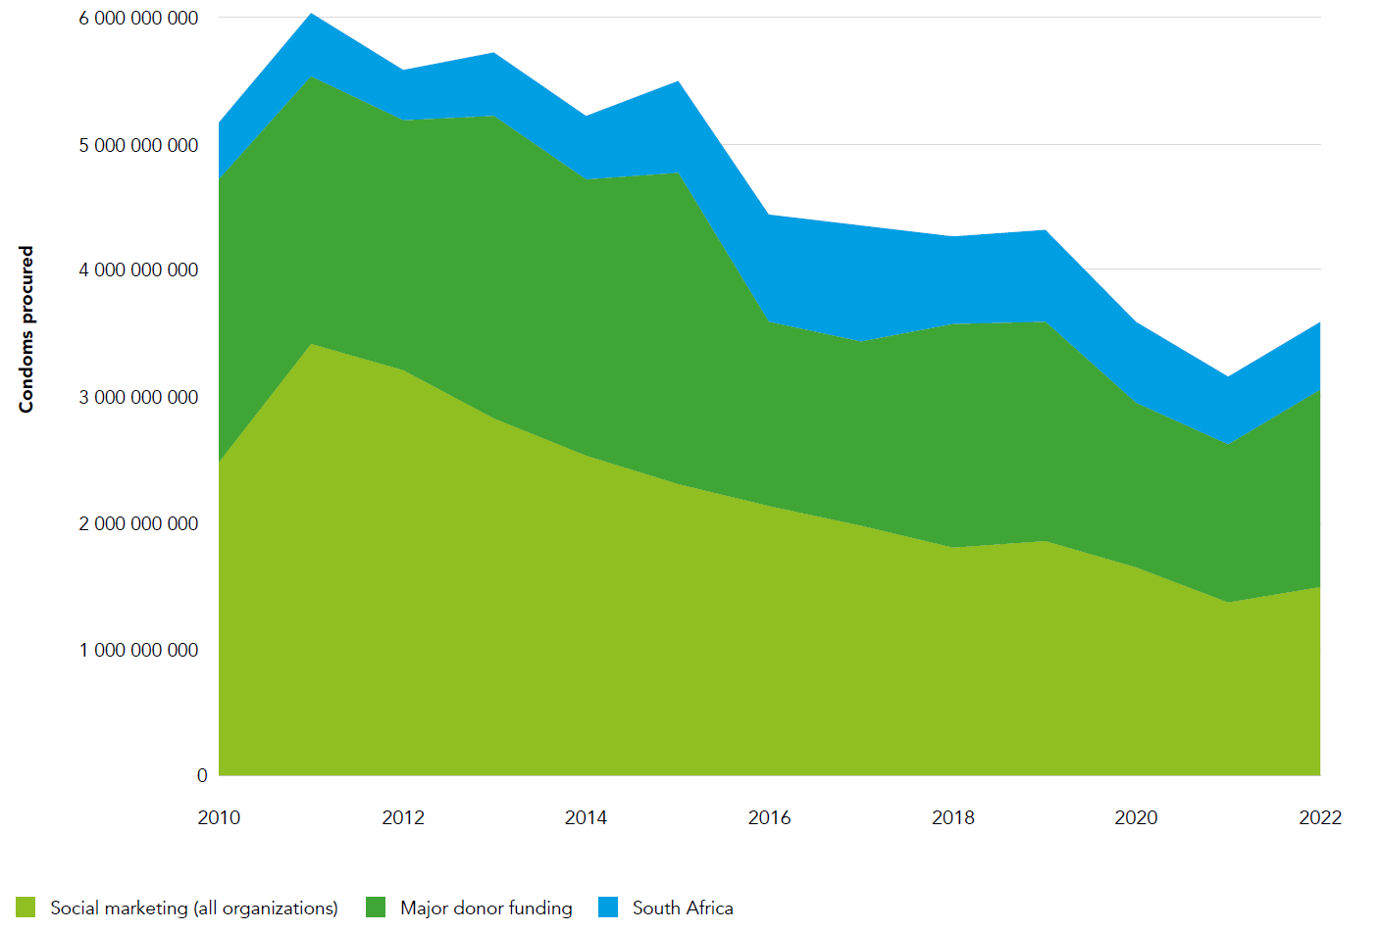
Trends in condom distribution via major condom procurers and distributors, 2010-2022
Declining investment and volumes in condom procurement and social marketing
A 27% reduction comparing 2010-16 and 2016-2022
A 37% reduction from the peak
Social marketing volumes reduced by half

Slide 20
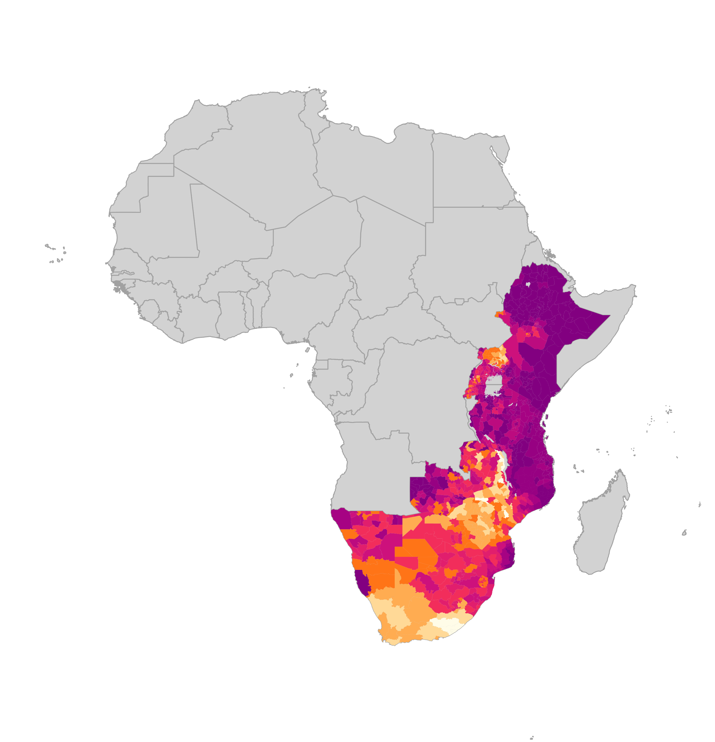
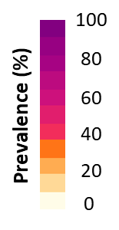

37.5 million men and boys accessed VMMC package of services by 2023 - But VMMC, other prevention and treatment coverage for men & boys remains far from targets
Number of men and boys accessing VMMC package of services
Estimated coverage of VMMC among men 15-49
Integrated male SRHR for boys and men including HTS/ART and gender-transformative approaches
No full recovery after COVID-19
Sources: Coverage maps- special analysis by Avernir Health through the UNAIDS-led VMMC data workstream. Analysis done using DMPPT2 Tool and integrated 3MC model using data up and until 2023. VMMC progress over time: UNAIDS Global AIDS Monitoring, 2023; www.aidsinfo.unaids.org)

Slide 21
Growing numbers of people using PrEP: 3.5 million in 2023, but this is just 16% of estimated global need
Number of people using PrEP in 2023, relative to 2025 targets
Source: UNAIDS epidemiological estimates, 2024. www.aidsinfo.unaids.org.

Slide 22
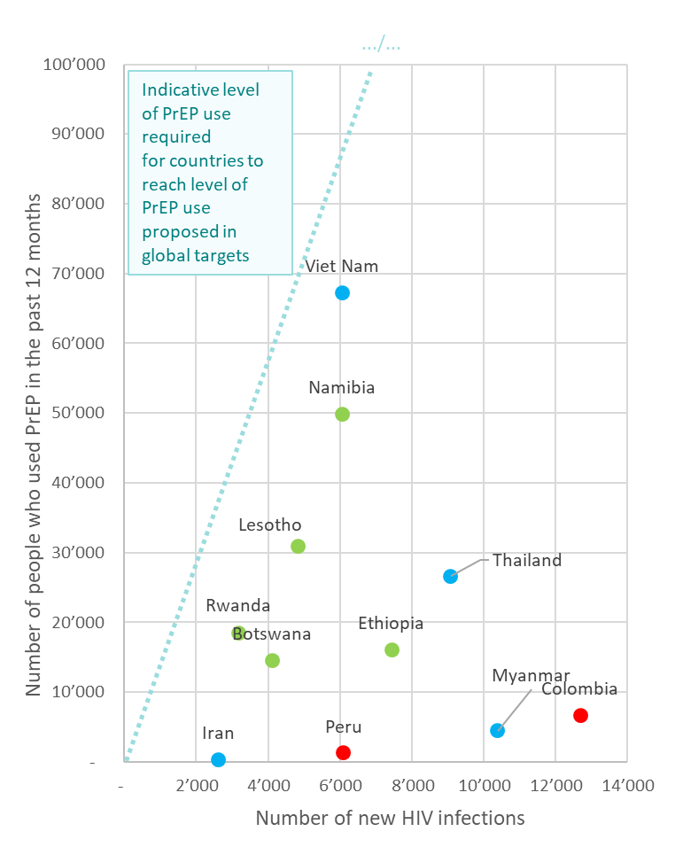
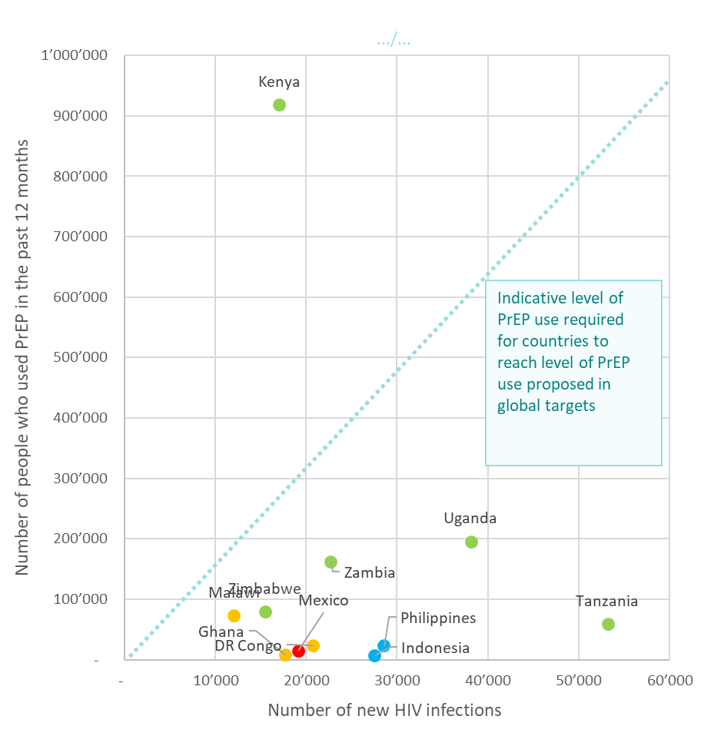
Smaller epidemics Larger epidemics
Some countries are getting close to the level of PrEP coverage implied in global targets, but the majority are far below

Slide 23
In summary: Programmatic outcomes improved in four of five priority pillars, but major gaps remain in all
More areas with high HIV incidence have programmes with AGYW
Small increases in coverage of programmes with key populations (even though this is limited to KPs with available data, in particular sex workers, in a number countries with available data, and coverage stagnates in other areas)
An additional 20 million men accessed VMMC since the onset of the GPC (even though uptake declined after 2020 in a context of declining funding)
Rapid increases in the number of people using PrEP (but large gaps to targets remain)
Condom distribution and use continues to decline in several countries with recent data (but more recently increases in GF investments into condoms in GC6 and GC7)

Slide 24
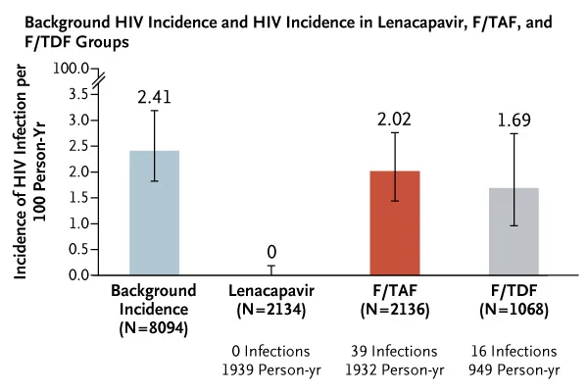
The Urgency of Now: Accelerating long-acting PrEP choice & innovation
Access to PrEP is increasing but only in a few countries
Landmark results for PURPOSE 1 study of lenacapavir as PrEP: 100% efficacy reported in cisgender women in Uganda and South Africa
To accelerate the scale-up:
Ensuring the affordability, availability, and access of different PrEP options and PEP
Swiftly adopting decentralized and community delivery models
Enabling legal and policy environments conducive to large-scale implementation.
Notes:
Background:
Lenacapavir: PURPOSE 1 study has announced results for cisgender women; full data analysis not available yet (Wednesday Gilead has a late breaker on Len).
PURPOSE 2, which included cisgender men and transgender women, started 3 months after PURPOSE 1. Results not yet available.
Access schemes that include low and middle income countries, including in sub-Saharan Africa, but also middle income countries in Asia-Pacific and Latin America given the KP epidemic who may otherwise miss out on lowest prices.

Slide 25
A moment of opportunity: A renewed prevention push to turn around the prevention crisis
People-centered and rights-based
Relevant prevention choices
A combination prevention investment push
More prevention users: ↑ to 95% of people in need
Fewer people acquiring HIV: ↓80%

Slide 26
Thank you

