Slide 1

OVERVIEW of Technical Assistance Needs

Slide 2
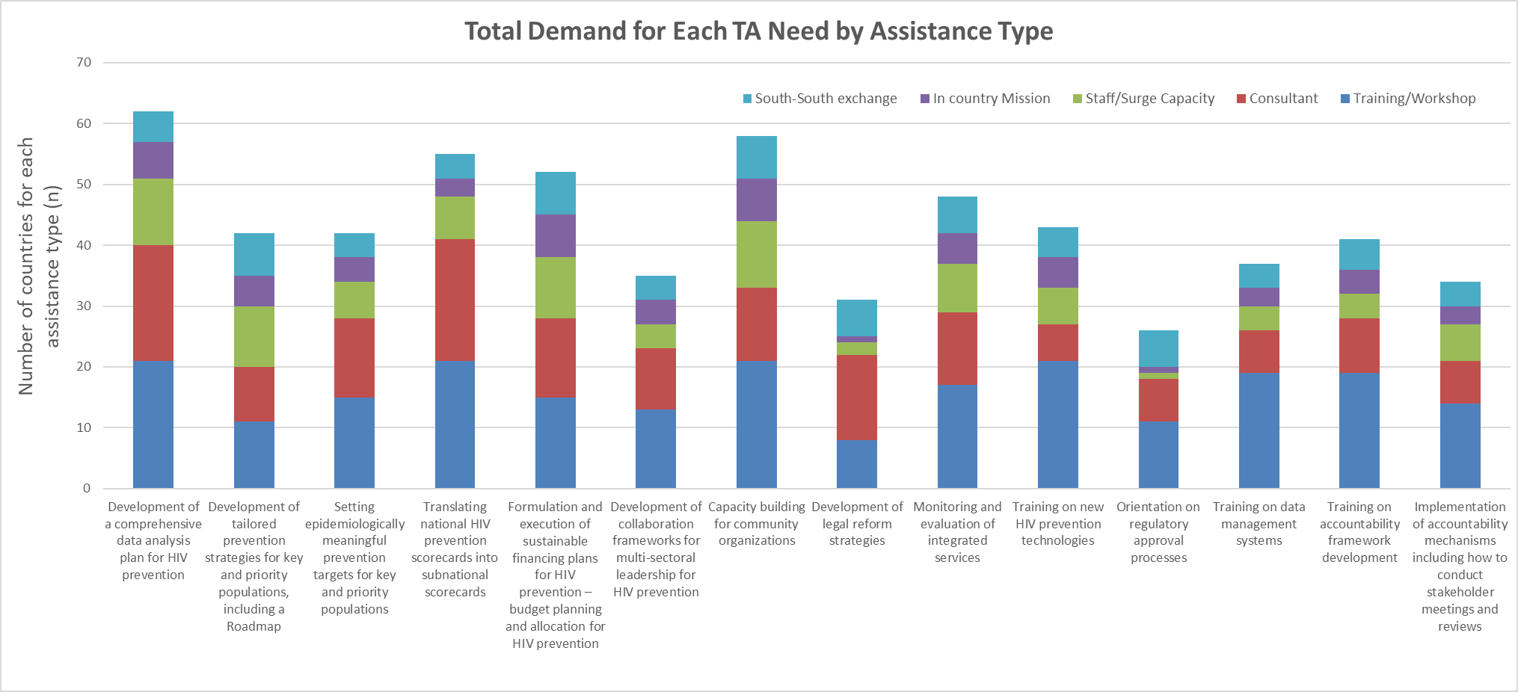
Notes:
Huge thank you and acknowledgement of Lycias Zembe who did the heavy lifting – analysing the scorecards including the data I’m presenting here, and a big thankyou to the country teams for supplying this data
Technical Assistance Needs were asked as part of Survey
And provides the country-identified critical support needs across technical areas that are essential for strengthening HIV prevention efforts.
This is data from 33 countries: Angola Brazil Cameroon Central African Republic Colombia Côte d’Ivoire Democratic Republic of the Congo Egypt eSwatini Ethiopia Ghana India Indonesia Iran Kenya Lesotho Madagascar Malawi Mozambique Myanmar Namibia Nigeria Pakistan Peru Philippines South Africa South Sudan Thailand Uganda Ukraine United Republic of Tanzania Zambia Zimbabwe
Countries were able to select any number of technical assistance areas, and any number of modes of assistance type for each technical assistance area, with some countries selecting only a few options and others selecting multiple
This reflects the diversity of countries within the GPC.

Slide 3
Notes:
Same data presented differently
Angola Brazil Cameroon Central African Republic Colombia Côte d’Ivoire Democratic Republic of the Congo Egypt eSwatini Ethiopia Ghana India Indonesia Iran Kenya Lesotho Madagascar Malawi Mozambique Myanmar Namibia Nigeria Pakistan Peru Philippines South Africa South Sudan Thailand Uganda Ukraine United Republic of Tanzania Zambia Zimbabwe

Slide 4
Key Findings from THE HIV Prevention Roadmap 2024 Technical Assistance Needs Survey
High Demand for Training/Workshops:
Training/Workshop support consistently the most requested form of TA across multiple TA categories, reflecting a strong need for skill-building and knowledge transfer at all levels.
Significant Need in Data Analysis and Target Setting:
High levels of demand were observed for assistance in developing comprehensive data analysis plans and setting epidemiologically meaningful targets for key and priority populations, indicating a focus on strengthening data-driven HIV prevention strategies.
TA in these areas primarily centers around Consultants and Training/Workshops.
Interest in Subnational Scorecard Translation:
Numerous requests for support in translating national HIV prevention scorecards into subnational scorecards reflect a push toward localized monitoring.
Requests for both Training/Workshops and In-Country Missions indicate a need for hands-on, contextualized support to achieve this.
Notes:
Target setting dove tails with the

Slide 5
Sustainable Financing and Resource Mobilization:
Formulating and executing sustainable financing plans is identified as a critical need, particularly with Consultants and budget planning TA as high-demand categories, suggesting prioritization of financial planning to support sustainable HIV prevention.
Emphasis on Community Capacity Building:
Community organization capacity building surfaced as a significant need, with interest in South-South exchanges to enable peer learning and regional expertise sharing.
Requests span across Training/Workshops and Consultants, underscoring a focus on enhancing local implementation capacity.
Key Findings from THE HIV Prevention Roadmap 2024 Technical Assistance Needs Survey

Slide 6
Key Findings from THE HIV Prevention Roadmap 2024 Technical Assistance Needs Survey
Legal and Regulatory Needs for New Prevention Technologies:
Demand for training on regulatory approval processes and legal reform strategies for HIV prevention underscores the importance of navigating policy and regulatory frameworks for effective prevention technology rollout.
High Interest in Monitoring and Evaluation (M&E):
Support for monitoring and evaluation of integrated services shows a broad interest in strengthening the feedback loop for HIV prevention outcomes.
Strong demand for Consultants and Workshops, emphasizing need for strategic and practical M&E training.
Notes:
Regulation and understanding processes particularly important in the context of new technologies for prevention and testing, including LA PrEP and HIVST
Additional areas of TA requested by countries included:
Support with PSATs
Social contracting
CLM
By understanding these needs—spanning from data analysis and strategic target setting to community capacity building and sustainable financing—we can better align our technical assistance efforts to maximize impact.
The results reveal not only high-demand areas but also the preferred modalities of support, giving us clear direction for effectively mobilizing resources and expertise across the HIV prevention landscape.
Needs feature in the support requested via TSM, TADG, and other mechanisms.

Slide 7
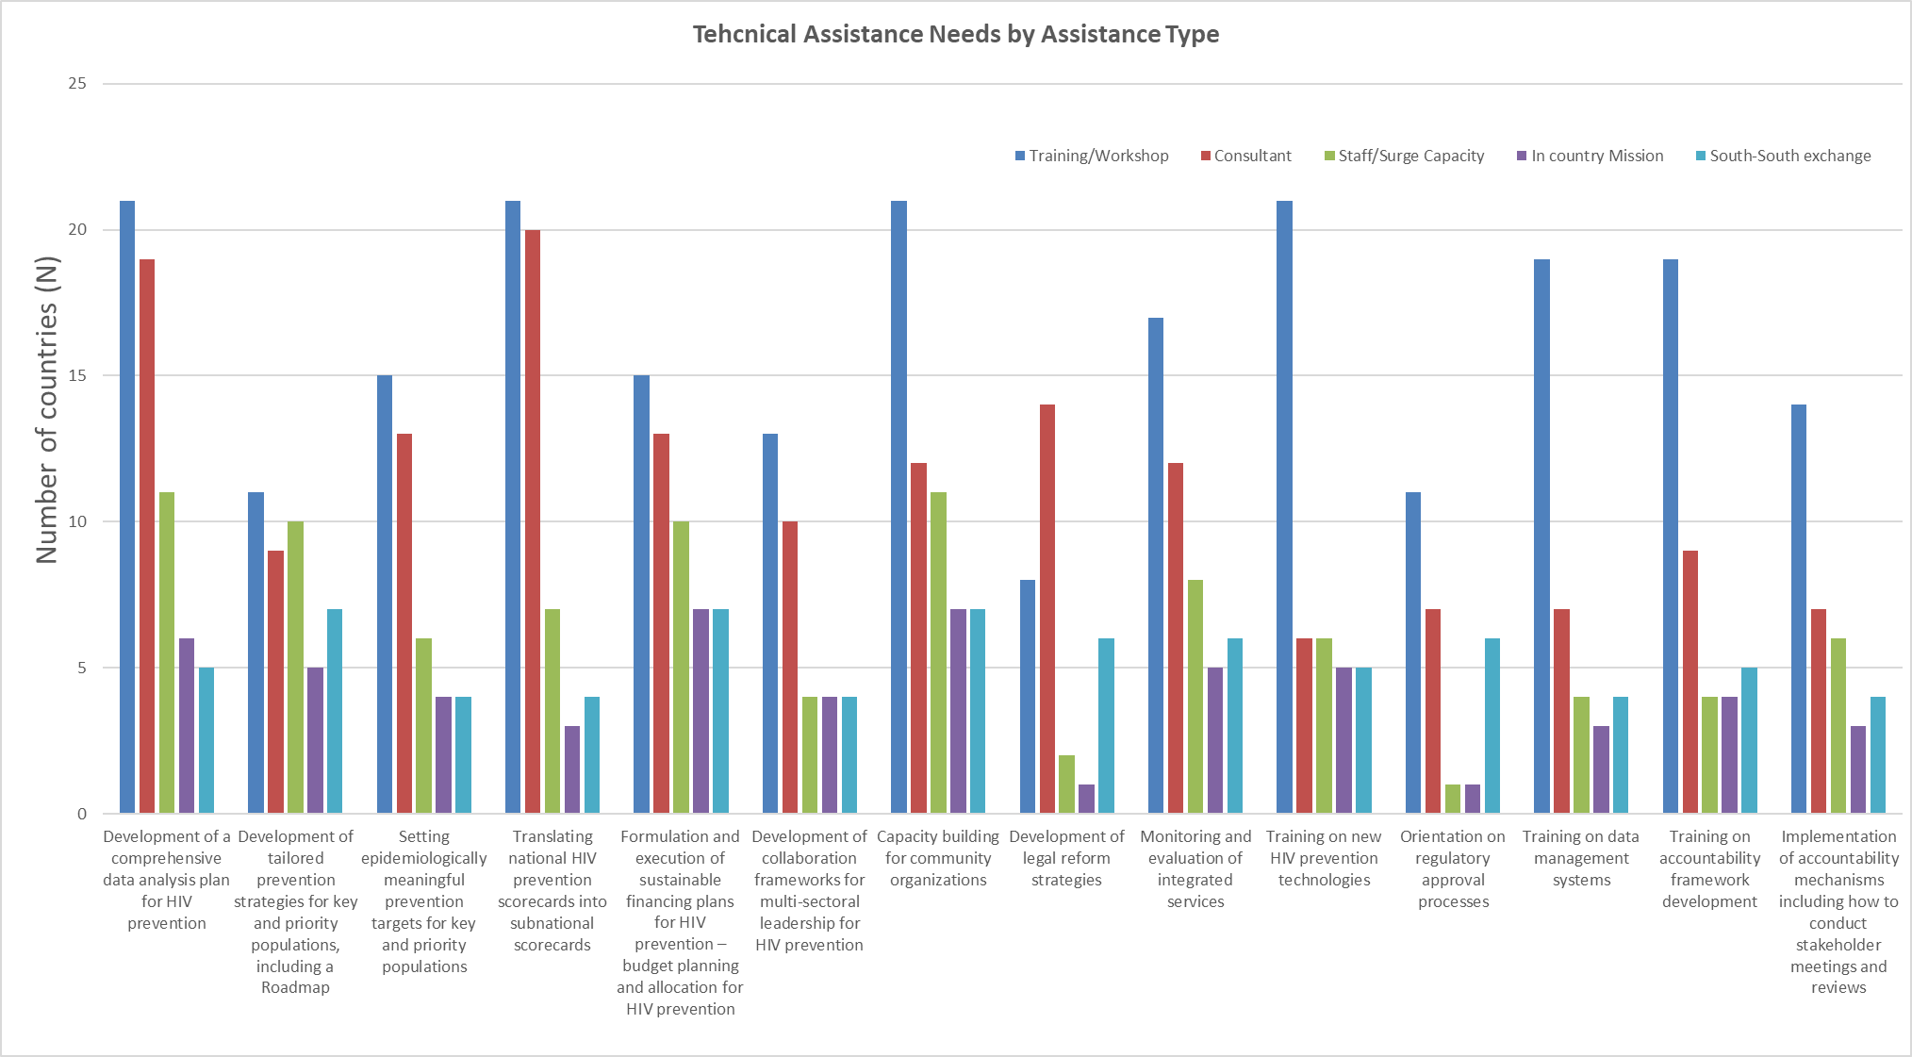
Notes:
Technical Assistance Needs were asked as part of Survey
And provides the country-identified critical support needs across technical areas that are essential for strengthening HIV prevention efforts.
By understanding these needs—spanning from data analysis and strategic target setting to community capacity building and sustainable financing—we can better align our technical assistance efforts to maximize impact. The results reveal not only high-demand areas but also the preferred modalities of support, giving us clear direction for effectively mobilizing resources and expertise across the HIV prevention landscape.

