Slide 1
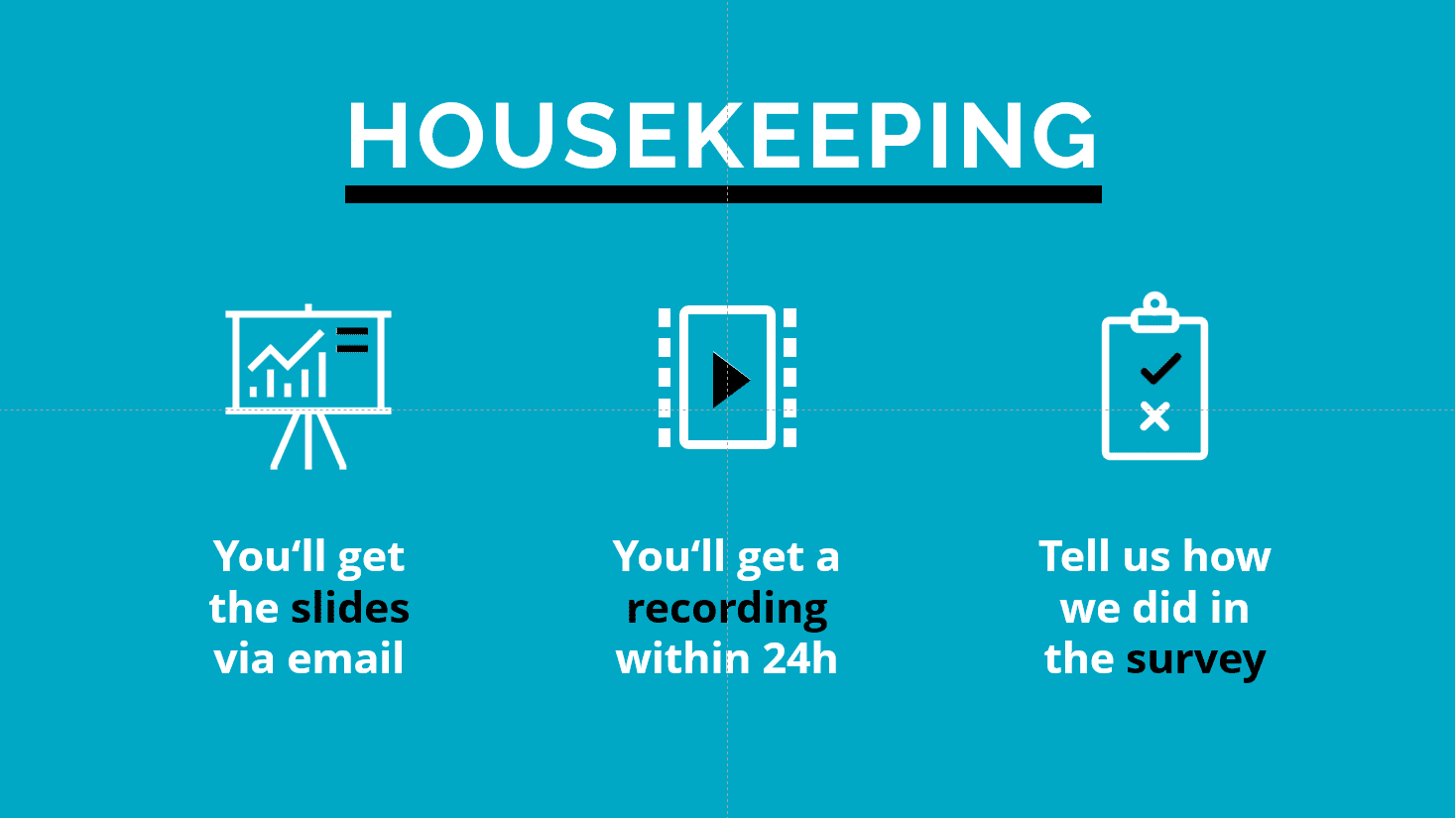


The Global HIV Prevention Coalition Monitoring and Reporting
Key findings from the updated 2024 HIV Prevention Scorecards and HIV Prevention Roadmap country survey
Welcome
You will get all the slides after the webinar
Let us all engage and have a good discussion
Date: 31 October 2024
Time: 13h30 – 15h00 CET
Languages: English, French, Portuguese, Spanish
In your meeting/webinar controls, click Interpretation
Click the language that you would like to hear

Slide 2
Global HIV Prevention Monitoring and Reporting
Scorecards Dissemination Webinar
Lycias Zembe
Global HIV Prevention Coalition, UNAIDS, Geneva
NAC Managers Meeting
31 October 2024

Slide 3
National prevention reviews: How analytical tools fit together
1. Overview & synthesis Start with synthesis available in GPC scorecards and understand gaps towards global targets
Global HIV Prevention Coalition Scorecards
STEWARDSHIP
Strategy, management, systems
(Road map survey)
POLICIES
Policies, structural barriers
(NCPI)
OUTPUTS
Program coverage
(GAM, program & survey data)
OUTCOMES
Prevention service use, behaviour (GAM, surveys)
IMPACT
HIV incidence
(HIV estimates, PHIA …)
2. Analyze progress along the results chain & inequities
Further examine data sources, disaggregate, analyze inequities in progress
3. Estimate prevention needs
Understand detailed needs of populations and for key intervention areas
Key population size estimates & prevention denominators
Estimates of girls & women at higher risk of HIV and associated factors
Estimates of boys & men at higher risk of HIV, VMMC decision-making tool
Condom needs estimation tool
PrEP target setting tools
4. Granular program analysis
Through prevention self-assessment tools (PSATSs) for the 5 pillars
Key population PSAT
Adolescent girls & young women PSAT
Boys & men /VMMC PSAT
Condom PSAT
ARV-based prevention /PrEP PSAT
5. Other cross-cutting analytics
Dig deeper based on country needs
Prevention cascade analyses, qualitative ‘audits’ of new infections, program evaluations, …

Slide 4
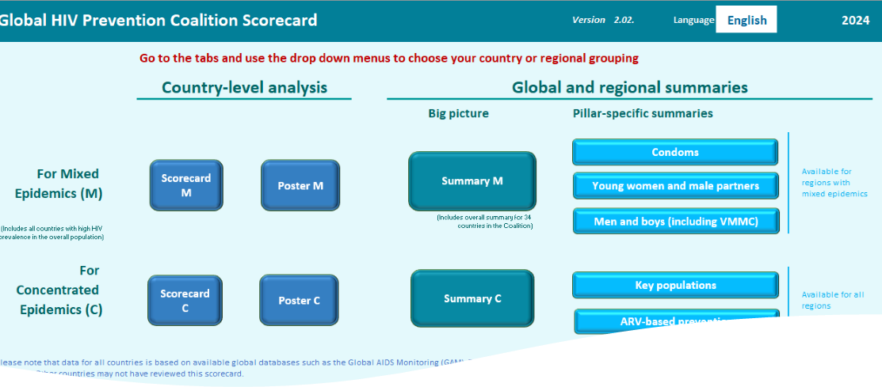
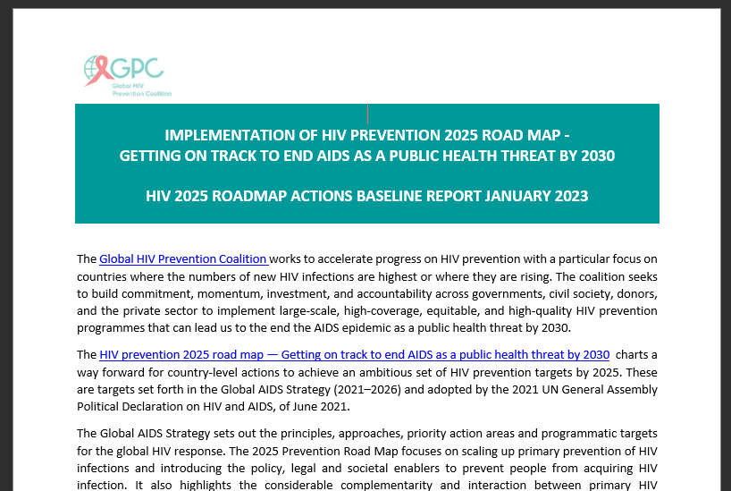


Monitoring progress in implementing the 2025 HIV Prevention Road Map
Data, both quantitative and qualitative, from various sources, predominantly GAM – program output, outcomes, and impact indicators
1
Country-reported responses (subjective) based on a survey questionnaire covering the 10 Roadmap actions – multiple choice and few text-based questions
The structure followed the 10 Roadmap 2025 actions and attempts to capture all the pillars where relevant
Each section attempts to drill down on specific roadmap actions in line with the milestones in the Roadmap document
2
Notes:
Open-Ended Questions (Text Input) – 20 questions
Multiple Choice Questions (Checkbox and Radio Buttons) – 32 questions

Slide 5
What are the Global HIV Prevention Scorecards
A tool or resources developed by synthesizing HIV prevention data from various sources into meaningful HIV prevention programming dashboards

Slide 6

For which countries is the Global HIV Prevention Scorecards Tool available?
Technically, the scorecards tool is available for all countries that report data to the UNAIDS Global AIDS Monitoring (GAM) platform.
However, the degree of their completeness is depended on GAM reporting completeness for that country.

Slide 7
Rationale of the prevention scorecards
What it wants to… | What it does NOT want to …
Summarize existing data | Not create new reporting
Provide an orientation & be an entry point for comparison | Not ignore difference in context
Stimulate learning from high-performing programs | Not pass final judgements
Encourage digging deeper: Supply, demand, structural, sub-national | Not be an end in itself

Slide 8
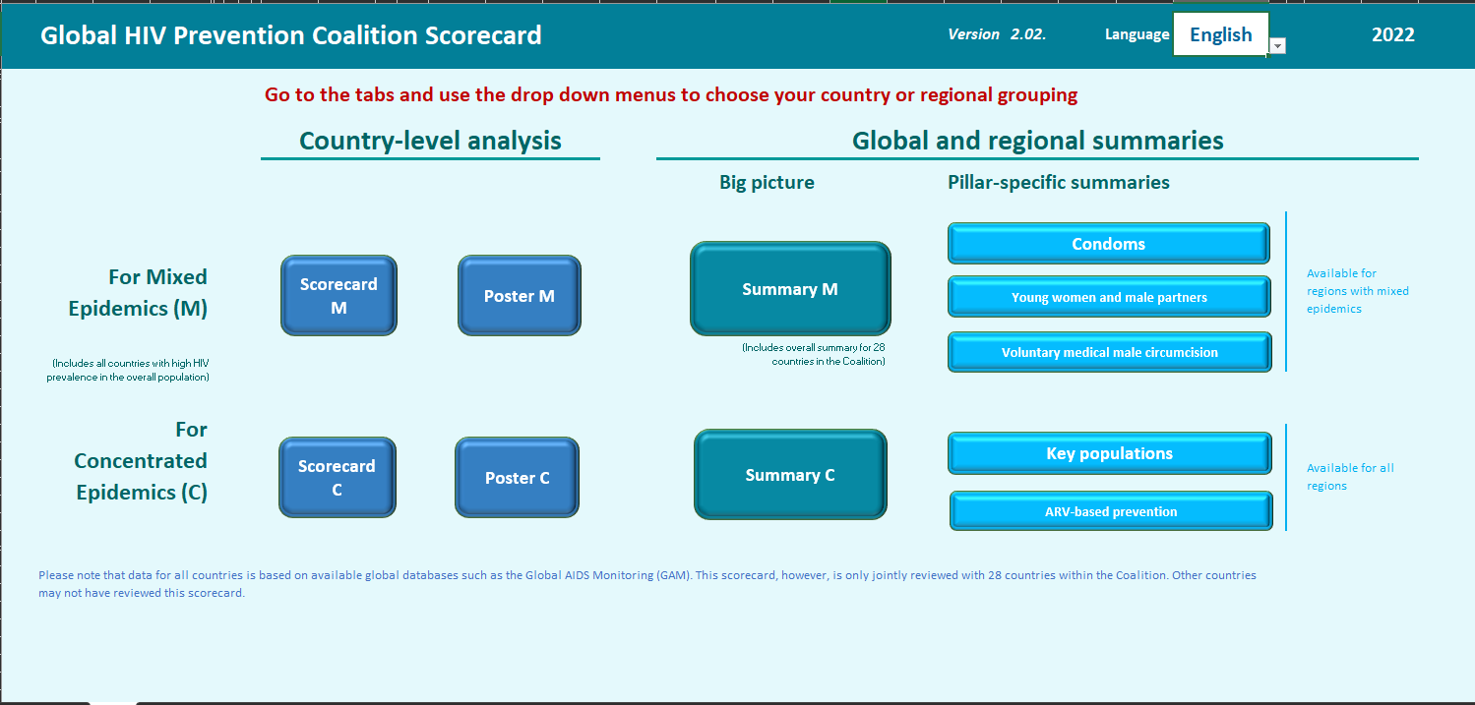
How is the Global HIV Prevention Scorecards Tool organized?
2024
Check year: remember reporting lags by a year
Select language: French, English, Spanish, Portuguese

Slide 9
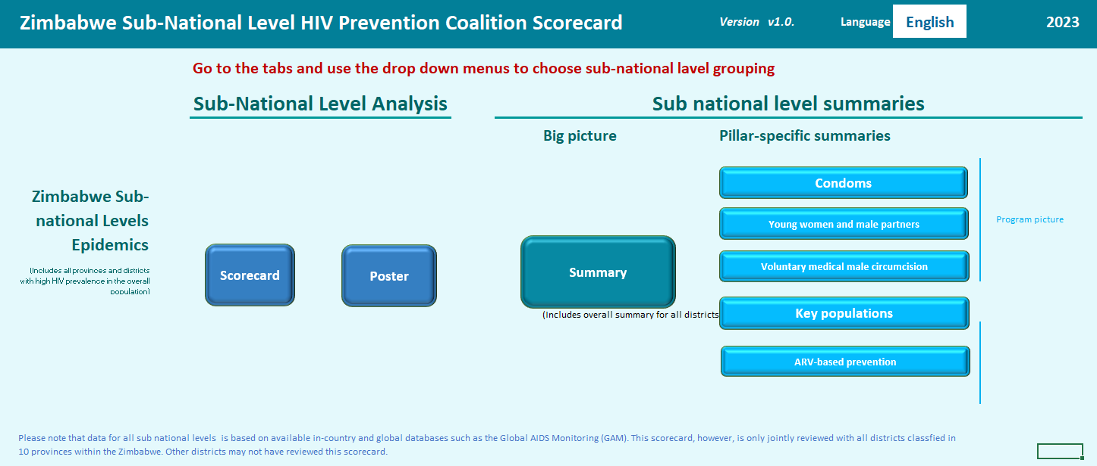


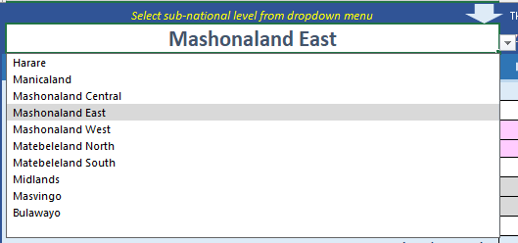

Subnational HIV Prevention Scorecards: Local Insights Driving Targeted Action
Definition: Tools that provide localized data to track, assess, and improve HIV prevention efforts at regional and community levels.
Why sub-national scorecards
Granularity: Captures local-level performance, identifying specific gaps and successes in HIV prevention interventions.
Actionable Data: Facilitates targeted strategies by focusing resources on areas with low coverage or poor outcomes.
Engagement: Empowers local stakeholders (governments, health workers, communities) to make informed decisions.

Slide 10
Example of a country Scorecard - Zimbabwe
Output (coverage)
Outcome (service use/behaviour)
Impact
Summary scores provide an indication of progress on a particular HIV prevention pillar

Slide 11
Example of a country poster – D.R Congo
New infections trend chart
HIV prevalence by age and population
Policy and structural barriers summaries
10 Roadmap actions overview
Program coverages for AGYW
SRHR linkages
Overview of the five prevention pillars
Vertical transmission stacked bar analysis

Slide 12
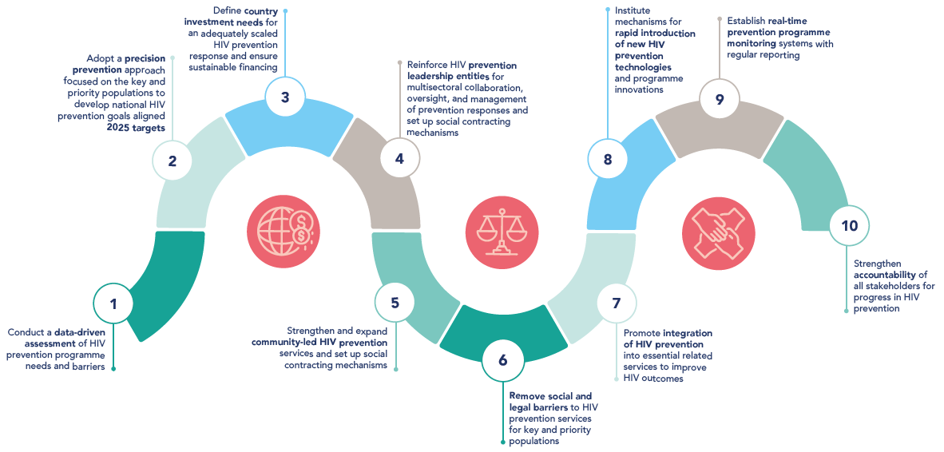
HIV Prevention Roadmap 10 Point Action Plan

Slide 13
Why is a Road Map survey conducted?
provides a systematic way to assess the implementation of key actions in the 2025 HIV Prevention Road Map.
Document where countries are in relation to the 10-Point Action Plan of the 2025 HIV Prevention Road Map
Highlighting where progress has been made and identify remaining gaps
The GPC is also a platform for cross-learning; compiled survey results allow comparability across countries

Slide 14
How the survey was conducted
The survey was shared with 38 GPC countries
Recipients in each country included:
UNAIDS Country Directors,
UNAIDS HIV prevention focal points,
UNFPA representatives,
UNFPA HIV prevention focal points,
National AIDS Commission Directors and their HIV prevention focal points,
Ministry of Health HIV Prevention Focals points,
UNAIDS RST Directors and their HIV Prevention Focal points
One response per country compiled by the HIV prevention TWG under the leadership of the National AIDS Councils or National AIDS Control Program or the prevention leadership entity.
Government programs verify all results before analysis and dissemination

Slide 15
Countries response rates and data analyses
Complete submissions
Angola | Egypt | Kenya | Nigeria | Uganda
Brazil | eSwatini | Lesotho | Pakistan | Ukraine
Cameroon | Ethiopia | Madagascar | Peru | United Republic of Tanzania
Central African Republic | Ghana | Malawi | Philippines | Zambia
Colombia | India | Mozambique | South Africa | Zimbabwe
Côte d’Ivoire | Indonesia | Myanmar | South Sudan
Democratic Republic of the Congo | Iran | Namibia | Thailand
Analysis was done on N = 33/38 GPC countries done

Slide 16
Road Map Survey Response Scoring
Road Map Action 2. Adopt a precision prevention approach to develop national HIV prevention Goals and aligned 2025 targets
A thorough scoring method was used that considered all the different parts of a Road Map Action, as suggested in the 2025 HIV Prevention Road Map.
This helps to identify the precise gap among aspects of a Road Map Action that a country may require assistance to address.
Q# | Road map action component being assessed | Score | Lesotho | Uganda | South Africa
2.1 | > developed a prevention Road map or plan | -> 0.5 | 0.5 | 0.5 | 0
2.2 | > Set granular HIV prevention targets | -> 0.2 | 0.2 | 0 | 0.2
2.3 | > Translate national targets to subnational targets | -> 0.06 | 0.06 | 0 | 0.06
2.4 | > Differentiated HIV prevention packages | -> 0.08 | 0 | 0.08 | 0
2.5 | > Packages for AGYW where relevant | -> 0.08 | 0.08 | 0.08 | 0.08
2.7 | > SOPs or implementation guides in place for relevant pillars | -> 0.08 | 0.08 | 0.08 | 0.08
Overall score |  | 1.0 | 0.9 | 0.7 | 0.5

Slide 18
Progress on completion on each Road map Action by GPC countries
In 2024, more countries are using data, adopting people centered planning for prevention and defining investment needs.
More countries are also preparing the ground for new prevention technologies
Note nearly enough is being done on service integration, having an accountability framework, or removing social and legal barriers
National institutions to lead coordinated HIV prevention programs, Community led service delivery and Prevention program monitoring systems are works in progress / areas for intensified support

Slide 19
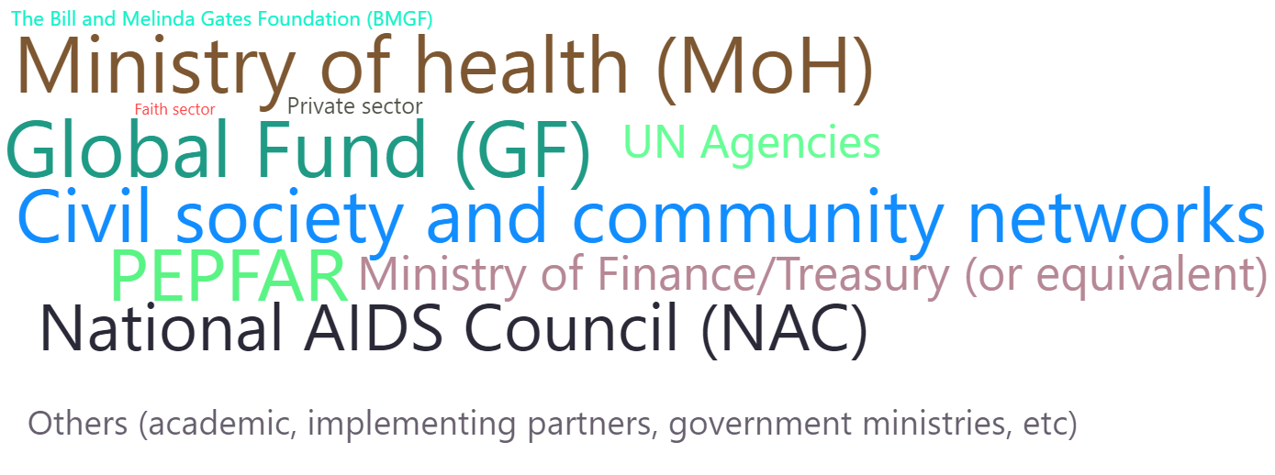
Countries are having HIV Prevention funding dialogues, and key partners and sectors are being engaged

Slide 20
THANK YOU!
Lycias Zembe: zembel@unaids.org
Notes:
Fewer than 370,000 new infections translates into more than 80% reduction compared to 2010.

