Slide 1

Tools to support Lenacapavir introduction
February 2026

Slide 2
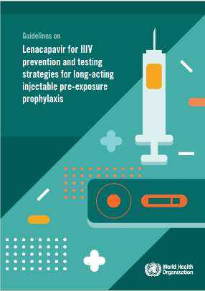
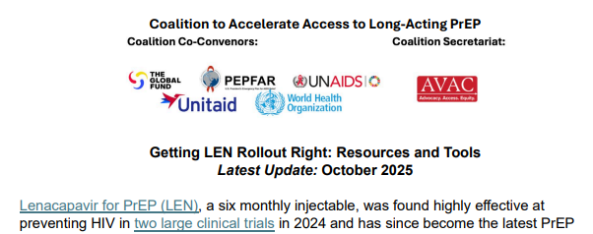
What Resources and tools are available for lenacapavir implementation?
Normative guidance (see also WHO Global PrEP Network webinar – Aug 2025)
WHO Guidelines on lenacapavir for HIV prevention and testing strategies for long acting pre-exposure prophylaxis
Planning
Modelling for impact and cost-effectiveness
Provider training (see also WHO Global PrEP Network Webinar – Oct 2025)
Site assessment templates and checklists
Monitoring and evaluation
Others:
Trackers
Clearing houses (PrEPWatch)
Technical working group SOPs
Lessons and “birds eye views”
https://www.prepwatch.org/wp-content/uploads/2025/10/LEN-Tools-Compendium.pdf
Notes:
LEN-Tools-Compendium.pdf
AVAC\s PrEP watch has done an amazing job of collating tools,
Compendium of tools available

Slide 3

Adaptable standard operating procedures for LEN as PrEP
Adaptable SOP to support the development and adoption of national SOPs
Incorporates the WHO recommendations and guidance on LEN, as well as guidance from the WHO implementation tool for pre-exposure prophylaxis of HIV infection: provider module for oral and long-acting PrEP
Covers: Overview of PrEP and LEN, Initiation, follow-up, management in specific situations, who can deliver PrEP and where
https://www.prepwatch.org/wp-content/uploads/2025/08/GENESIS_SOP-Injectable-Lenacapavir-15.08.2025-FINAL.pdf

Slide 4
UPCOMING: Blueprint for accelerating the introduction of LEN as PrEP as part of HIV combination prevention at the country level
Provides practical and pragmatic guidance for countries considering lenacapavir introduction, taking countries step by step through the planning stages with reference to key questions and considerations, key tools and resources available to support decision making stages, and outcomes at each stage
The blueprint is the ‘how/where to start’, irrespective of initial LEN supply and takes into consideration different experience levels of countries
Will include detailed discussion and guidance on tools for modelling targets, impact and cost-effectiveness
Based on consultations with countries and regions including ministries of health, implementers, clinicians, communities and key partners about what countries need to effectively (and to accelerate) introduction of LEN PrEP

Slide 5
Draft – do not cite
LEN introduction blueprint: pathway to implementation
PHASE 1
Preparatory activities
PHASE 2
PHASE 3
PHASE 4
PHASES 5
Situational analysis
Preliminary decisions
Governance setup
Regulatory approval
Planning & Design
Design service delivery model
Target setting
Develop protocols & SOPs
Training design
M&E framework development
Resource planning
Cost-effectiveness and impact modelling
Regulatory approval
Securing product supply
Pre-implementation readiness
Provider training
Supply procurement
Community engagement
Demand creation activities
Data systems setup
Final preparations
Stakeholder engagement
Cost-effectiveness and impact modelling
Site selection
Early LEN Implementation
Community led monitoring
Supportive supervision
Real-time learning
Adaptive management
Service delivery initiation
Scale-Up
Scale-up plan
Full rollout
M&E
Note: Phases 1-3 are the core implementation period. Phase 0 is preparatory. Phases 4-5 focus on learning, scale-up planning, and national rollout.

Slide 6




PROVIDER TRAINING TOOLKIT ON USE OF ORAL AND LONG-ACTING HIV PRE-EXPOSURE PROPHYLAXIS (PREP)
Suite of training materials to train providers on delivery of all 4 WHO recommended PrEP products: oral, DVR, CAB-LA, LEN
Based on the WHO PrEP Implementation Tool: provider module for oral and long-acting PrEP with updates for Lenacapavir
See our previous Webinar (October 2025) for a sneak peak!
Learn more at:
jhpiego.org/HIVPrEPToolkit

Slide 7

WHO-JHPIEGO PROVIDER TRAINING TOOLKIT ON USE OF ORAL AND LONG-ACTING HIV PREP
This training toolkit is designed to help clinicians gain the knowledge and skills to provide all WHO recommended HIV PrEP methods over 4 modules:
Lesson 1:
Lesson 3:
1
3
PrEP Product Formulations and Evidence for Protection Against HIV
Administration and Dosing
2
4
Lesson 2:
Lesson 4:
Determining Clinical Eligibility/ Assessing for Contraindications
Follow-up Care and Side Effects Assessment/Management

Slide 8

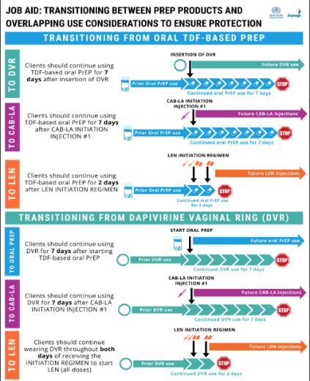
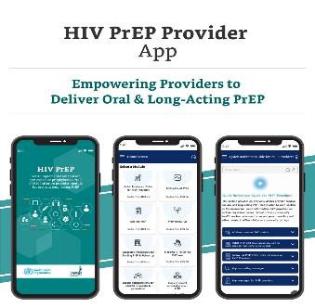
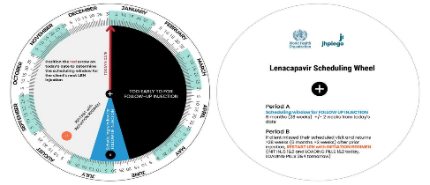
WHO-JHPIEGO PROVIDER TRAINING TOOLKIT ON USE OF ORAL AND LONG-ACTING HIV PREP
Each lesson has a link for digital learning
Open Google Drive Folder hosts all classroom-based learning materials:
Job Aids
Downloadable and editable ppt for in-person or hybrid training
Contact info@jhpiego.org for direct access to digital files to utilize on national LMIS systems
Complementary mobile application (HIV PrEP Provider) for access to WHO guidance and interactive clinical tools

Slide 9
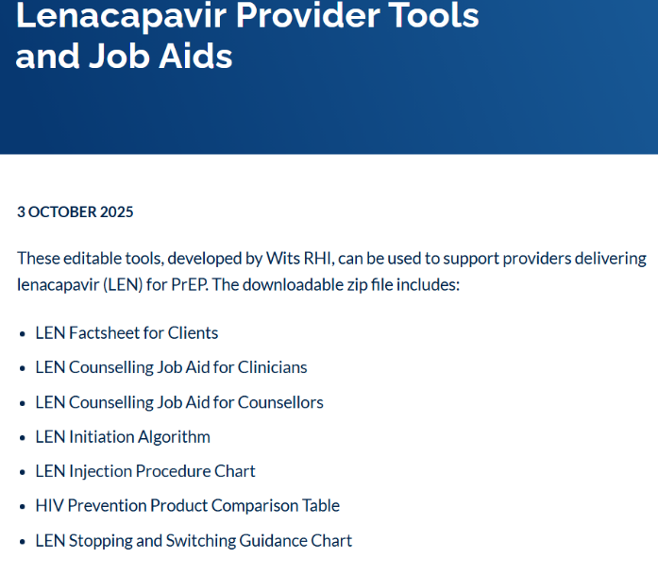

https://www.prepwatch.org/resources/lenacapavir-provider-tools-and-job-aids/

Slide 10
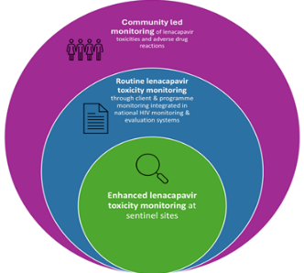
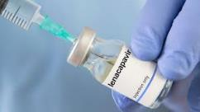
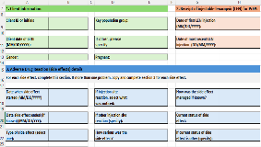
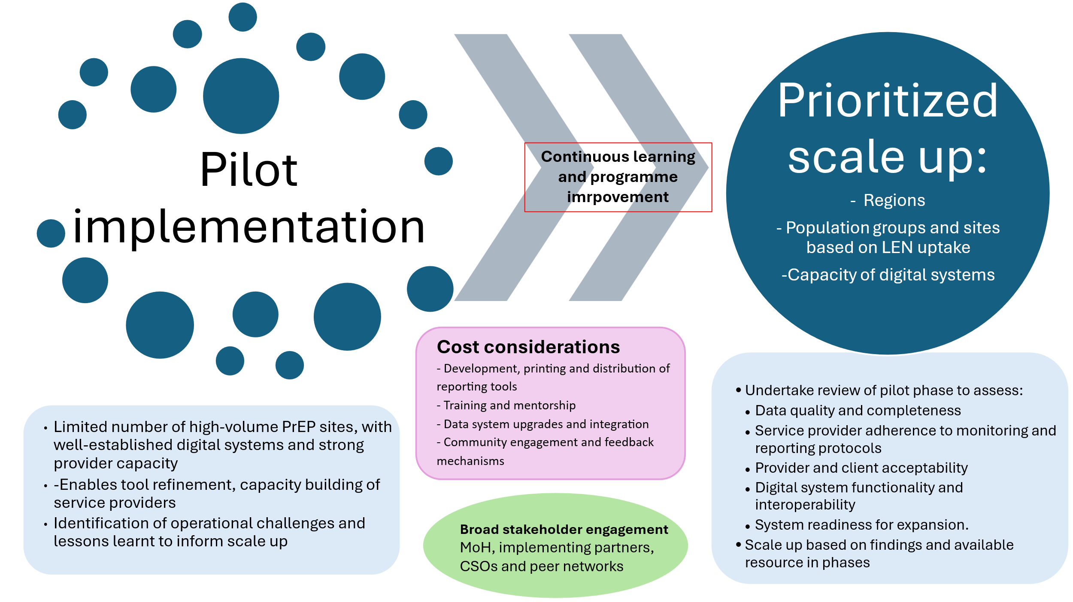
WHO LEN safety and toxicity monitoring toolkit
Toolkit key components​
Guiding principles: person-centred, equity-focused, integrated and ethical monitoring
Adaptable practical suite of tools
Toolkit is adaptable to country contexts and available for easy integration
Implementation guidance
Includes: site selection, data collection, data management, analysis and use, considerations for digital systems and use of digital tools, training and phased rollout strategies with key implementation steps
Enhanced toxicity monitoring: proactive data collection at sentinel sites (high volume PrEP sites) using standardized tools and digital systems to generate good quality data with denominators (primary recommended approach)
Routine monitoring: integration of LEN toxicity monitoring indicators in HIV programme monitoring and M&E system to complement enhanced monitoring at sentinel sites if resources and country capacities allow
Community led monitoring: peer led reporting and feedback to capture user experiences and complement enhanced monitoring
Annexes include ADR reporting forms, minimum dataset for LEN toxicity monitoring for digital data systems, community ADR reporting tools and summary of main drug-drug interactions & recommended clinical management
Draft document
Notes:
Limited real-world safety data on adverse drug reactions associated with LEN including specific populations (e.g. adolescents, pregnant women, gender diverse people).
So WHO is developing a toolkit that provides practical guidance for countries to monitor the safety and toxicity of injectable LEN for PrEP.
Developed drawing on WHO guidance and expert input from pharmaco-epidemiologists, country programme managers & PrEP implementers to ensure practical implementation considerations are incorporated.
Toolkit provides structured methods and tools to monitor anticipated and unanticipated ADRs including rare ADRs or those that emerge over to ensure safety during implementation
Includes annexes with practical tools such as standardised adverse drug reaction reporting forms, minimum datasets for digital systems, and community led monitoring tools, that can be adapted by countries to support national adoption and safe programme roll-out.

Slide 11
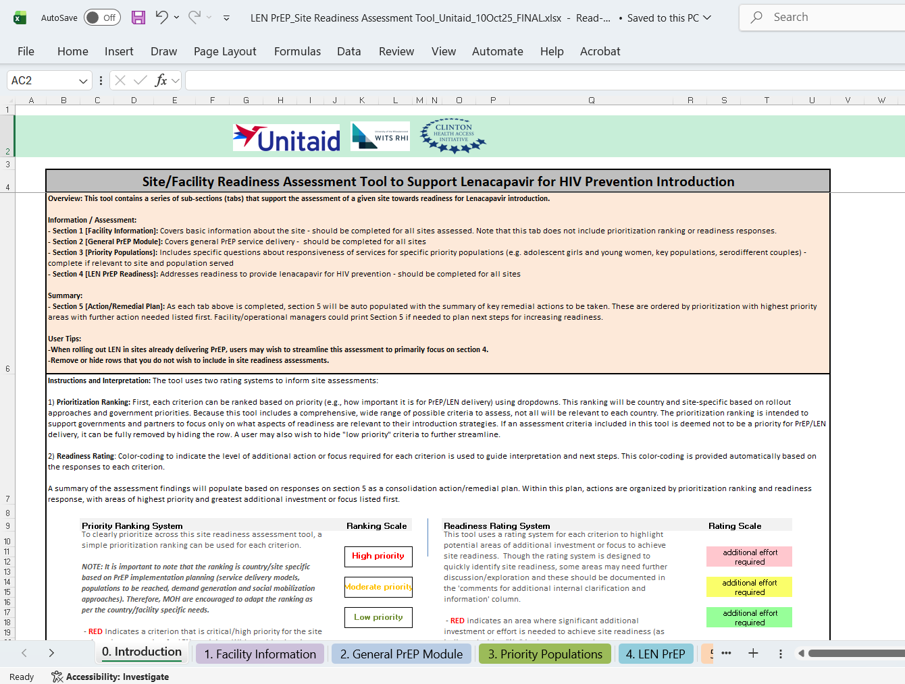
Site readiness assessments
Site / facility readiness assessment tool to support LEN introduction (developed by Wits RHI with support from CHAI and Unitaid)
Facility level checklist and SOP template (coming soon)
PrEP site implementation and new product readiness assessment tool (developed by MOSAIC for CAB-LA)
Notes:
Site/Facility Readiness Assessment Tool to Support Lenacapavir for HIV Prevention Introduction - PrEPWatch

Slide 12

What tools are available to help quantify the need and the impact?
Model/Tool | Key Features & Advantages | Limitations
Goals | Deterministic model of HIV transmission to address key questions for strategic planning Applied worldwide for UNAIDS Global AIDS Strategy, Resource Needs modeling, national strategic plans, investment cases and Global Fund applications Most countries have already received training to use the model | Not fully age-structured Limited network dynamics Large number of country files means less attention to each No sub-national estimates
PrEP-it | Decision-making and analysis tool for target setting, cost forecasting, estimating impact, and commodity forecasting. Can be applied at national, sub-national, donor, implementer or site level, multiple PrEP methods Currently available for 48 countries | Doesn’t model incidence over time Doesn’t address every planning need for PrEP programs Doesn't support all L&MIC settings
Gates Foundation simple model | Simple equations to estimate impact, cost-effectiveness, and budget impact of HIV prevention interventions Allows for multiple interventions and heterogeneity in risk | Doesn’t include the complexity of dynamic models, including lack of indirect effects of preventing an infection Costs and health metrics are averages across populations
Naomi and SHIPP tool | Bayesian small-area estimation model that provides sub-national estimates of HIV incidence, prevalence, and ART coverage Stratified by sex and 5-year age group (SHIPP tool also by behavioral categories) Provides short-term projections for program planning Webtool used annually by 39 countries available at naomi-spectrum.unaids.org Sub-national HIV Estimates in Priority Populations Tool | GPC | Extrapolates spatial incidence from prevalence of viraemia Complex and computationally intensive to run Direct measures of HIV incidence at small areas impractical Is a model input for programmatic decision-making
Unitaid-supported forecasting tools | Checklist of key product-specific supply chain considerations Simple, adaptable quantification tool to allow for country-specific inputs and accounting for current stock for supply chain forecasting Unitaid and partners working on the global forecast for manufacturers’ engagement (especially with generics), building on in-country projections | Tools in ongoing development Specific to individual country needs
GPC package for prevention prioritization | Slide deck on right populations, interventions, locations, modalities and cost for prevention Simple spreadsheet to roughly estimate cost-effectiveness of different options Both are available at: Supporting Prioritization in the Context of HIV Funding Cuts | GPC | Cost-effectiveness spreadsheet requires reliable country-specific inputs and is not a dynamic model tracking intervention interactions

Slide 13
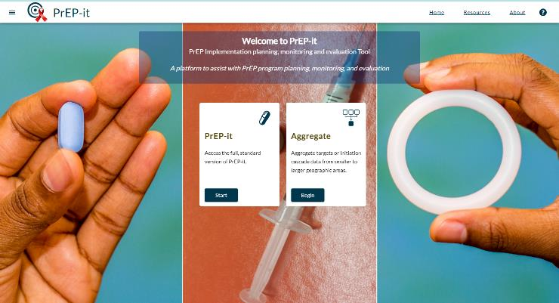
PrEP-it: PrEP Implementation, monitoring and evaluation Tool
www.Prep-itWeb.org
PrEP-it is a decision-making and analysis tool
Applied at the national, sub-national, donor, implementer or site level
Incudes multiple PrEP methods: oral PrEP, DVR, CAB-LA and LEN
4 modules: Target setting, estimating impact, cost forecasting and ARV forecasting
Target-setting by population group
Based on population coverage or direct entry of initiations
Annual and monthly initiation targets, accounting for continuation and scale up
Disaggregate targets by age, sex, and subnational area
Cost forecasting and analysis
Costs by visit type – account for different continuation rates and visit schedules by population
Cost per HIV infection averted by population and method
Forecast PrEP product needs
PrEP-it is freely available to anyone who wants to use it, including government officials, donors, PrEP implementers, and researchers.

Slide 14
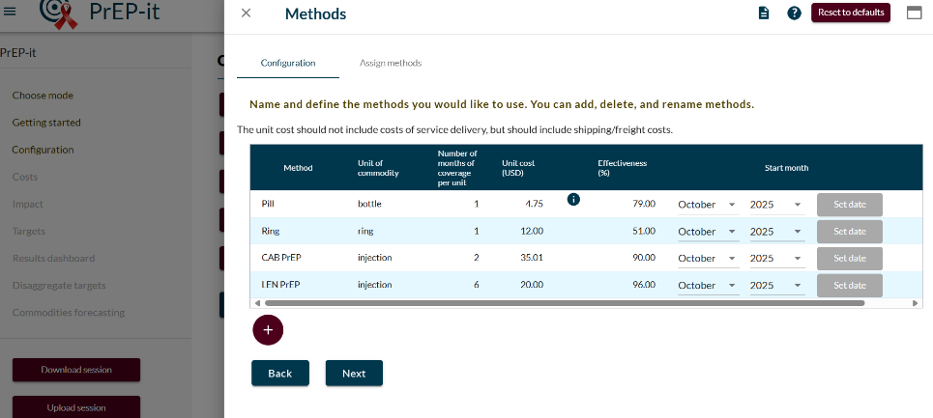
Upcoming update: PrEP-it SHIPP
Sub national Estimates in Priority Populations tool (SHIPP) has estimates for 35 countries
SHIPP outputs, by five-year age group, sex, and district:
Behavioral proportions (% of each age group in each category)
HIV-negative population size
Estimated new HIV infections
HIV incidence rates
PrEP-it SHIPP leverages population size and incidence estimates to facilitate national-level target-setting based on the risk of acquiring HIV.
Set targets by incidence category
Very high: >3% incidence
High: 1% to 3% incidence
Moderate: 0.3% to 1% incidence

Slide 15
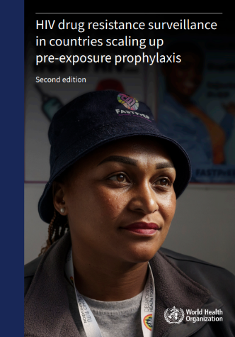
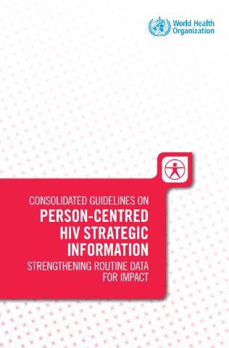
Monitoring and evaluation
Consolidated guidelines on person-centred HIV strategic information: strengthening routine data for impact
Minimum data set and priority indicators
HIV drug resistance surveillance in countries scaling up PrEP (April 2025)
WHO Guidance and toolkit
MOSAIC HIV Drug Resistance Monitoring Program
Tools and Materials

Slide 16
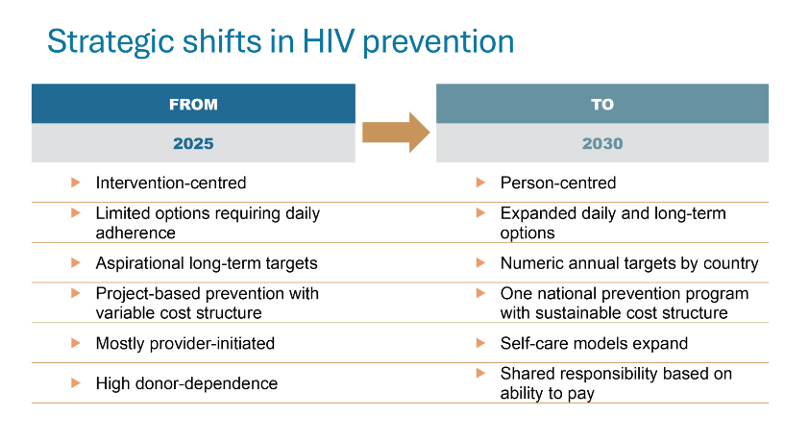







PREVENTION 2030 A Global Access Framework for Country-Led HIV Responses
Draft – do not cite
Will be complementary to the new Global AIDS Strategy, sustainability plans and other global efforts

Slide 17





FROM ZERO DRAFT GPC 2030 Access Framework – DO NOT CITE
40+20 by 2030: Key numeric targets for reducing HIV incidence
40 | + | 20 | + | 50 | MILLION | Women & girls, boys & men in areas with high HIV reached with prevention |  | 90% of people in need use prevention options
 |  |  |  | 35 | MILLION | Key populations reached with prevention
 |  |  |  | 6 | BILLION | Condoms for HIV prevention
MILLION |  | MILLION |  |  |  |  | = | 90% of people living with HIV virally suppressed
 |  |  |  | 7 | MILLION | People who inject drugs access harm reduction options
 |  |  |  | >20 | % | of domestic HIV funding goes to prevention
People living with HIV on treatment |  | People using PrEP options |  | People reached with combination prevention programs (behavioral, biomedical and structural elements with additional population-specific sub-targets) |  |  |  | 90% reduction in new HIV acquisitions from 2010 to 2030
Contribution of other HIV response targets, enablers and systems

