Slide 1
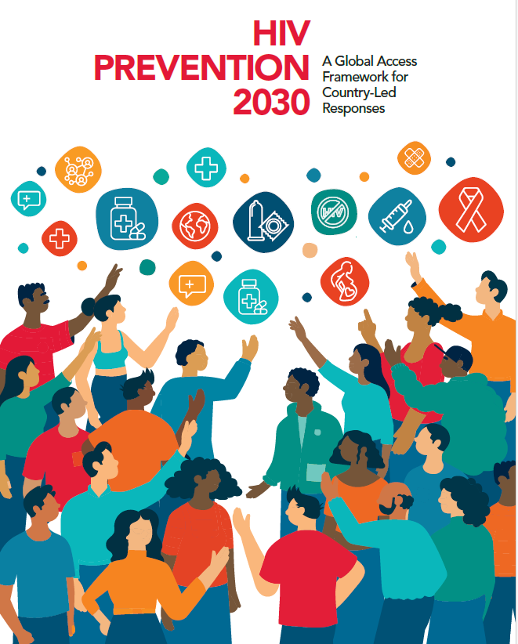

Prevention tools and Guidance to support GC8: an overview
Heather-Marie Schmidt
Advisor, HIV Prevention Programme Implementation
schmidth@unaids.org
Webinar: April 2026

Slide 2
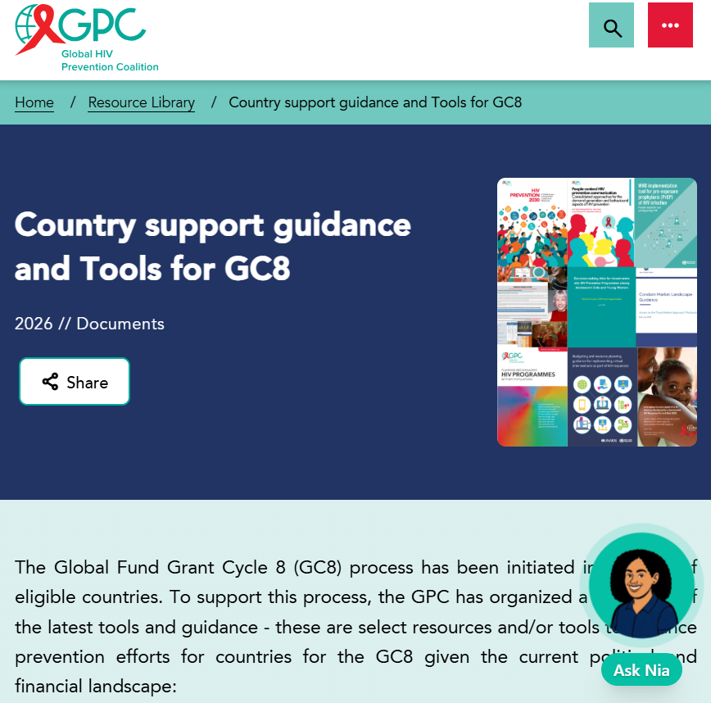
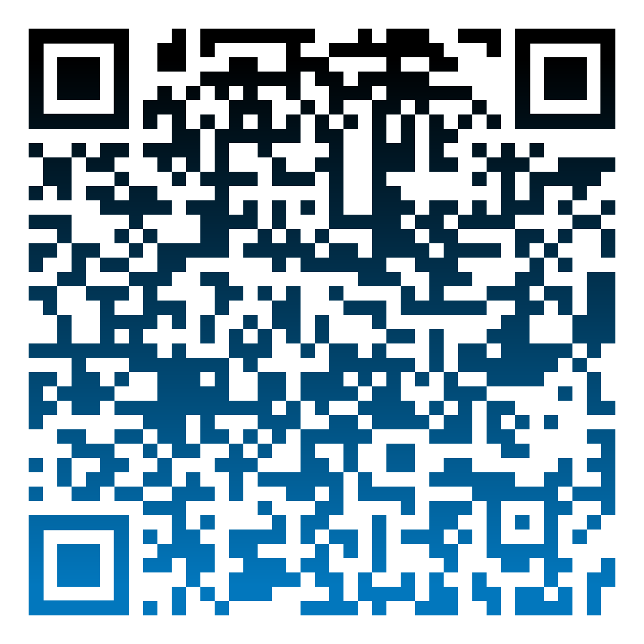
GPC resource hub compiles guidance and tools useful for GC8

Slide 3
Overview of prevention guidance and tools relevant to GC8: Navigating what to use for what purpose
Thematic area | Guidance | Planning and management tools | Analytical tools
Country target setting, prevention plans and systems | HIV Prevention 2030. A Global Access Framework for Country-Led Responses Multi-sectoral stewardship of HIV prevention (coming soon) | Supporting Prioritization in the Context of HIV Funding Cuts | GPC Template for 2030 country prevention access plans (coming soon) | Prevention Needs Estimates Tools - The collection Country and Global HIV Prevention Scorecards Sub-national HIV Estimates in Priority Populations Tool (SHIPP Tool) Five HIV prevention self-assessment tools (PSATs) Checklist for prevention in GC8 proposals (coming soon)
People-centred prevention communication and demand generation | People-centred HIV prevention communication: Consolidated approaches for the demand generation and behavioural aspects of HIV prevention Virtual interventions in response to HIV, sexually transmitted infections and viral hepatitis: policy brief | Budgeting and resource planning guidance for implementing virtual interventions as part of HIV responses
Key populations | Consolidated guidelines on HIV, viral hepatitis and STI for key populations | Planning and Managing HIV programmes with key populations
Women & girls | HIV prevention among adolescent girls and young women - Guidance | Decision-making aid for investments into HIV prevention programmes among adolescent girls and young women
Men & boys | Men and HIV: evidence-based approaches and interventions. A framework for person-centred health services | Brief on sustainability of voluntary medical male circumcision programmes (coming soon)
Condom programming | Total Market Approach Playbook for Sustainable Condom Access | Total Market Approach Playbook for Sustainable Condom Access Toolkit to Design Social Media Campaigns that Promote Condom Use | Condom Needs Estimation Tool
ARV-based prevention | Guidelines on lenacapavir for HIV prevention and testing strategies for long-acting injectable pre-exposure prophylaxis | Tools to support Lenacapavir introduction | PrEP-it - needs estimation tool

Slide 4
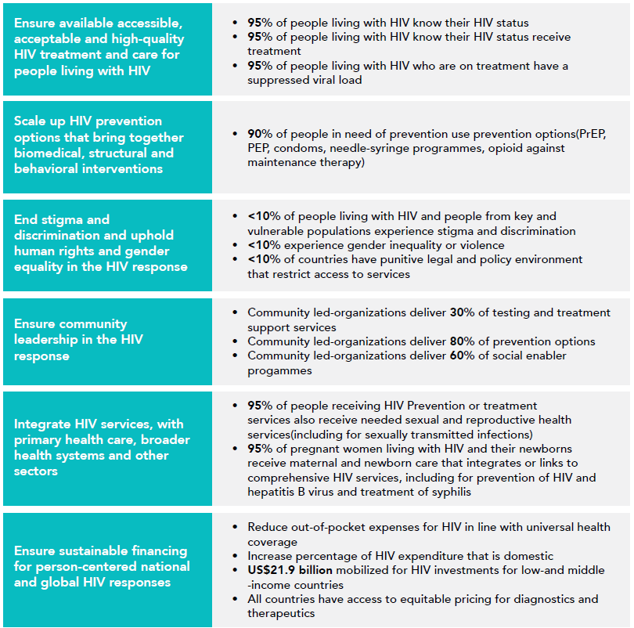

Global AIDS Strategy
2026-2031
2030 Global AIDS Targets

Slide 5
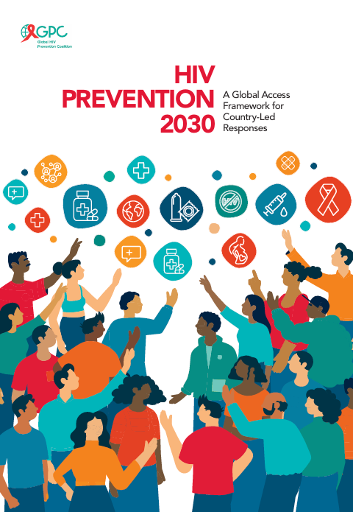
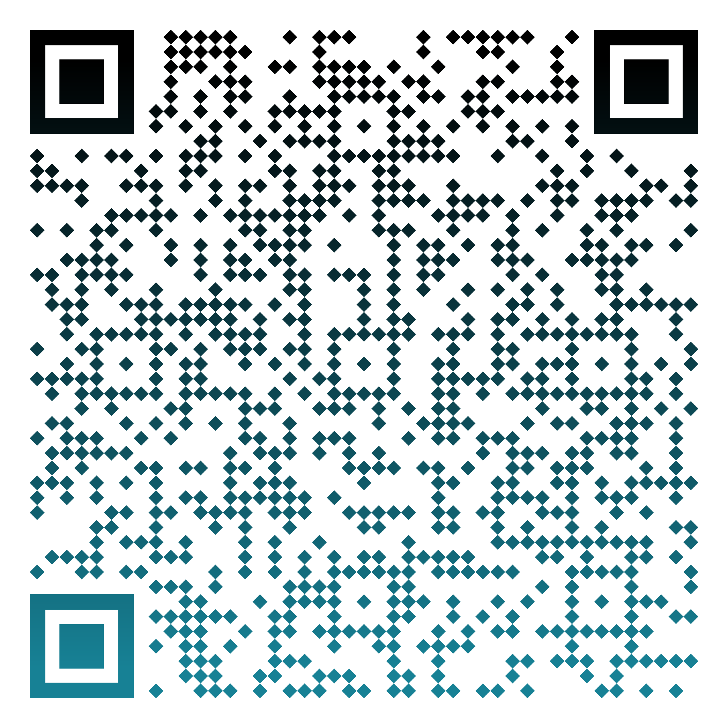
How do we achieve a bold vision for HIV prevention in a global funding crisis?
New Guidance
The Global Access Framework makes strategic shifts in the framing, leverages the GAS 2026-2031 targets and provides a new approach to prevention needs estimates
Grounded in a person in need of HIV prevention making choices is centred, supported by sustainable prevention programmes incorporating behavioural, systems, structural and biomedical with multisector stewardship
Will enable
  more granular & more systematic analysis of need across populations and prevention options
  annual tracking of progress at all levels
  prioritization and alignment
Revised state-of-the-art country prevention
plans are needed to chart the way to 2030
Notes:
Released Marc
Includes helpful planning tools e.g. a prevention 2030 planner checklist, example granular needs estimates target table
h 2026

Slide 6


Zooming in on 2030 programmatic primary prevention targets within GAS 2026-2031
Denominators
Outputs
Outcomes
Impact
People in need of HIV prevention
Young people and adults
(in areas with elevated HIV)
Key populations
(sex workers, gay men and other men who have sex with men, transgender people, people who inject drugs, people in prisons and other closed settings)
People living with HIV
95% of people in need of prevention reached with HIV prevention
90%* of people in need of prevention use effective prevention options
Translated into:
95% of people reached with person-centred prevention programs*
95% of country distribution need met for condoms, PrEP, PEP, needles, syringes, OAMT
90% of adolescents and young people receive CSE
80% of people-centred HIV prevention programmes for key populations delivered by community-led organizations
Achieved through trusted health, community, virtual and other sector platforms for women & girls, men & boys in settings with high HIV and five key populations
Translated into thematic targets:
80% condom use with non-regular partners
Up to 80% use of ARV-based prevention – PEP/PrEP including long-acting products in line with epidemiology** and people’s choices
Population-specific targets:
90% of boys & men accessed VMMC in 15 priority countries
95% of people who inject drugs use safe injecting equipment, 50% of people who inject opioids on OST
95% condom use at paid sex among sex workers and their clients
New HIV infections reduced by 90% in 2030 compared to 2010
Improved health, community, education & social support systems, legal environments
80% HIV prevention options delivered by community-led organizations
HIV treatment as prevention:
90% of all people living with HIV have suppressed viral loads
* People-centred programs in line with programmatic guidance include services, access to prevention options, actions to address structural barriers and tailored prevention communications addressing behavior and norms
** For PrEP targets, indicative HIV incidence thresholds by sub-populations will be updated and simplified, while maintaining the principle of a differentiated approach.
Primary HIV prevention targets
Other critical HIV, health & development targets

Slide 7
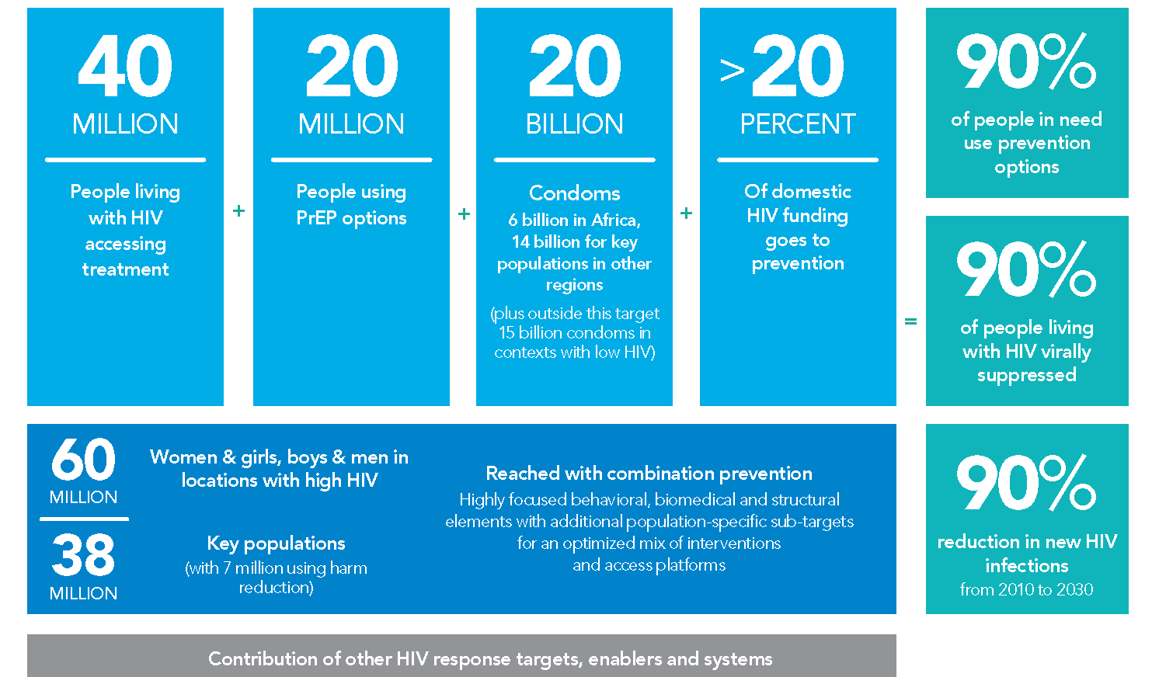



Alternative presentation – DO NOT CITE
40+20 by 30: Top line numeric milestones for reducing new HIV infections

Slide 8
Alternative presentation – DO NOT CITE
The key innovation will be country-owned needs estimates & milestones based on granular data: Illustrative country example
1.1 MILLION | + | 350 THOUSAND |  | + | 85 MILLION |  | + | >20PERCENT | = | 90% of people in need use prevention options
People living with HIV accessing treatment |  | People using PrEP options |  |  | Condoms |  |  | of domestic HIV funding goes to prevention |  | 90% of people living with HIV virally suppressed
And this could be translated into district targets as well |  | 1.3 MILLION | Women & girls, boys & men in locations with high HIV |  |  | Reached with combination prevention Highly focused behavioral, biomedical and structural elements with additional population-specific sub-targets for an optimized mix of interventions and access platforms |  |  |  | 90% reduction in new HIV infections from 2010 to 2030
 |  | 80 THOUSAND | Key populations (with 9 500 using harm reduction) |  |  |  |  |  |  | 90% reduction in new HIV infections from 2010 to 2030
Contribution of other HIV response targets, enablers and systems

Slide 9
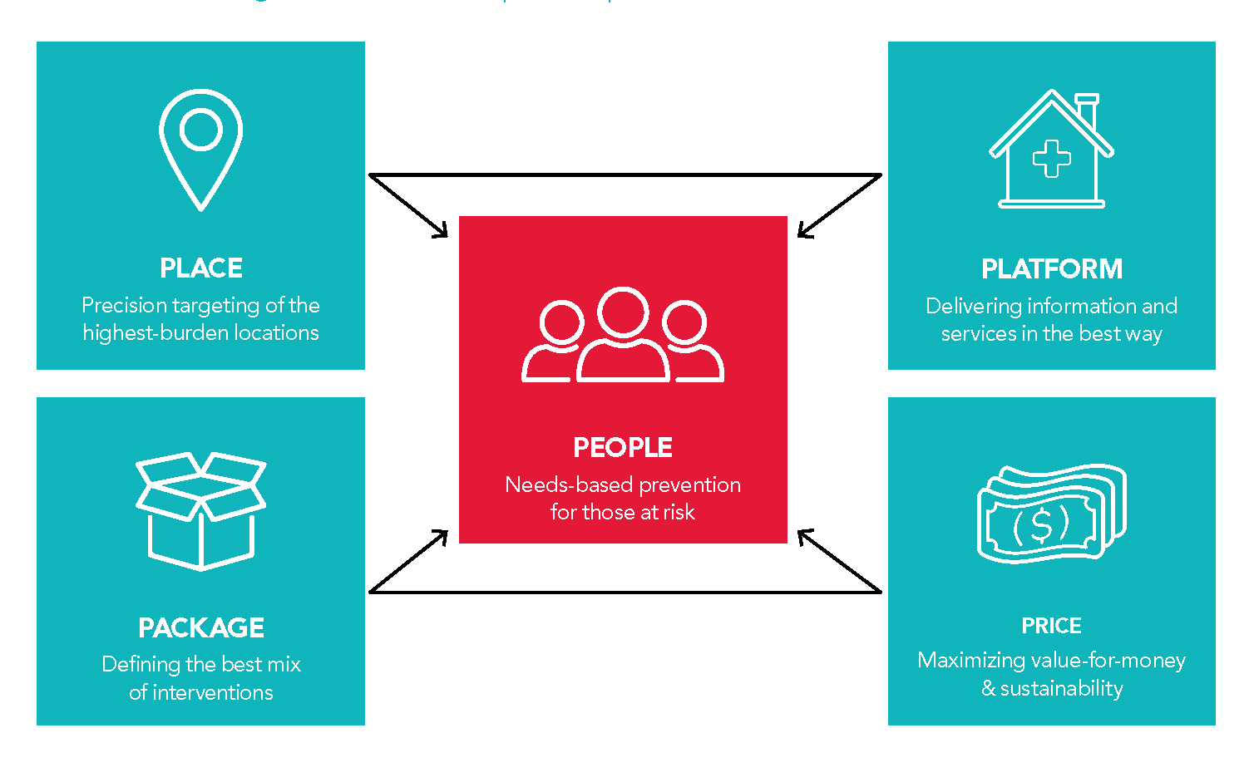
Scalable and sustainable prevention to 2030 and beyond.
5 Ps of prioritization: people, places, packages, best platforms, prices
Notes:
With high HIV incidence, add more interventions. BUT provide access to individuals actively seeking prevention choices

Slide 10

Access
Communities
Choice

Slide 11

Global AIDS Strategy 2026-2031
2030 Global AIDS Targets
Ensure available accessible, acceptable and high-quality HIV treatment and care for people living with HIV
95% of people living with HIV know their HIV status
95% of people living with HIV know their HIV status receive treatment
95% of people living with HIV who are on treatment have a suppressed viral load
By 2030, reduce new HIV infections by 90% from 2010 and continued 5% decline per year after 2030
……..
Reduce AIDS-related deaths by 90% from 2010
……..
Ensure sustainability of the HIV response after 2030
Scale up HIV prevention options that bring together biomedical, structural and behavioral interventions
90% of people in need of prevention use prevention options(PrEP, PEP, condoms, needle-syringe programmes, opioid against maintenance therapy)
End stigma and discrimination and uphold human rights and gender equality in the HIV response
<10% of people living with HIV and people from key and vulnerable populations experience stigma and discrimination
<10% experience gender inequality or violence
<10% of countries have punitive legal and policy environment that restrict access to services
Ensure community leadership in the HIV response
Community led-organizations deliver 30% of testing and treatment support services
Community led-organizations deliver 80% of prevention options
Community led-organizations deliver 60% of social enabler progammes
95% of people receiving HIV Prevention or treatment services also receive needed sexual and reproductive health services(including for sexually transmitted infections)
95% of pregnant women living with HIV and their newborns receive maternal and newborn care that integrates or links to comprehensive HIV services, including for prevention of HIV and hepatitis B virus and treatment of syphilis
Integrate HIV services, with primary health care, broader health systems and other sectors
Ensure sustainable financing for person-centered national and global HIV responses
Reduce out-of-pocket expenses for HIV in line with universal health coverage
Increase percentage of HIV expenditure that is domestic
US$21.9 billion mobilized for HIV investments for low-and middle -income countries
All countries have access to equitable pricing for diagnostics and therapeutics
The targets will be disaggregated as appropriate be gender, age and key population
PEP: post-exposure prophylaxis PrEP: pre-exposure prophylaxis
Notes:
What will the Strategy enable us to achieve? The actions recommended in the Strategy are aimed at enabling countries to achieve the 16 top-line targets towards ending AIDS as a public health threat by 2030.
Some of these targets are new – the consolidated HIV prevention target, the integration and financing targets.
Whereas some are proposed to be extended – the 95’s, the 10’s and the 30-80-60 as these were not achieved in 2025.

Slide 12
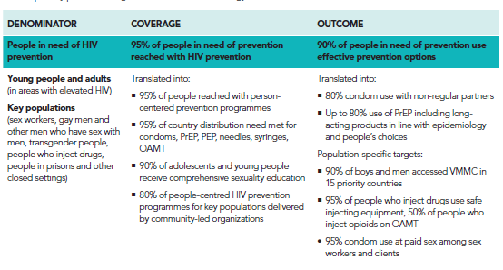
Global AIDS Strategy 2026-2031: 2030 primary prevention targets

Slide 13
New Guidance
How do we achieve a bold vision for HIV prevention in a global funding crisis?
New set of targets
New approach to prevention needs estimates
Will enable:
  more granular & more systematic analysis of need across populations and prevention options
  annual tracking of progress at all levels
  prioritization and alignment
A new era, a new framework
  Strategic shift on prevention framing
  Country-led, streamlined, sustainable models & costs
  Revised state-of-the-art country
  prevention plans are needed to
  chart the way to 2030

Slide 14
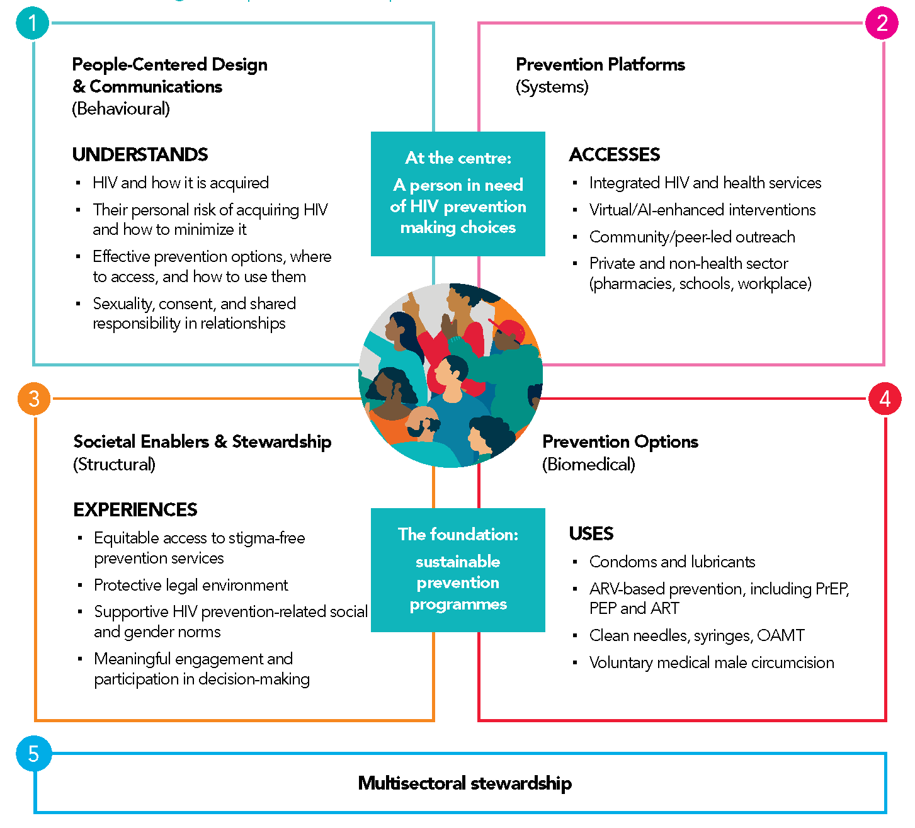
A person- centred prevention framework
But not everything for everyone
Carefully chosen biomedical, behavioral,
structural elements

