Slide 1




Voluntary Male Medical Circumcision
for HIV Prevention:
Lessons Learned from the Accelerated Scale up in
Southern and Eastern Africa
Emmanuel Njeuhmeli, MD, MPH, MBA
Senior Biomedical Prevention Advisor
and Co-Chair PEPFAR Male Circumcision Technical Working Group
Office of HIV/AIDS / Global Health Bureau,
US Agency for International Development
AIDS 2014 – Stepping Up The Pace

Slide 2
Efficacy of Male Circumcision for STI Prevention from the RCTs
Tobian JAMA 2011

Slide 3
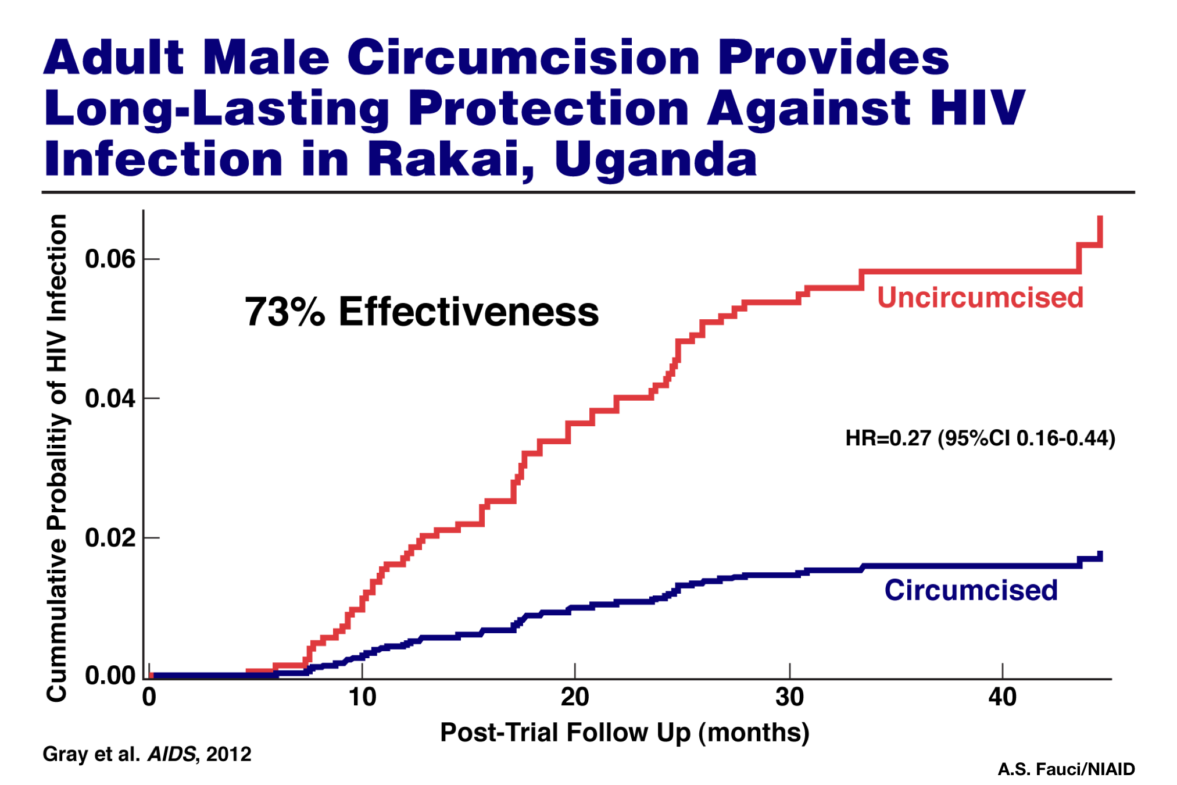
Adult Male Circumcision Provides Long-Lasting Protection Against HIV Infection in Rakai, Uganda

Slide 4
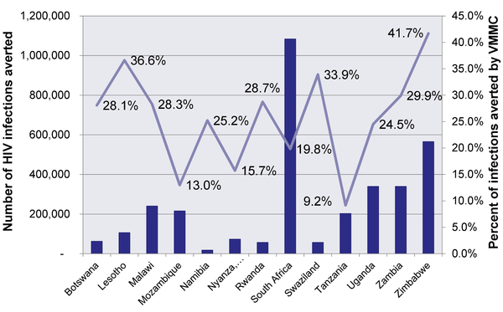
Cumulative Number and Percentage of HIV Infections Averted between 2011 to 2025 by Scaling Up VMMC
Hankins C, Forsythe S, Njeuhmeli E (2011) Voluntary Medical Male Circumcision: An Introduction to the Cost, Impact, and Challenges of Accelerated Scaling Up. PLoS Med 8(11): e1001127. doi:10.1371/journal.pmed.1001127
http://www.plosmedicine.org/article/info:doi/10.1371/journal.pmed.1001127

Slide 5
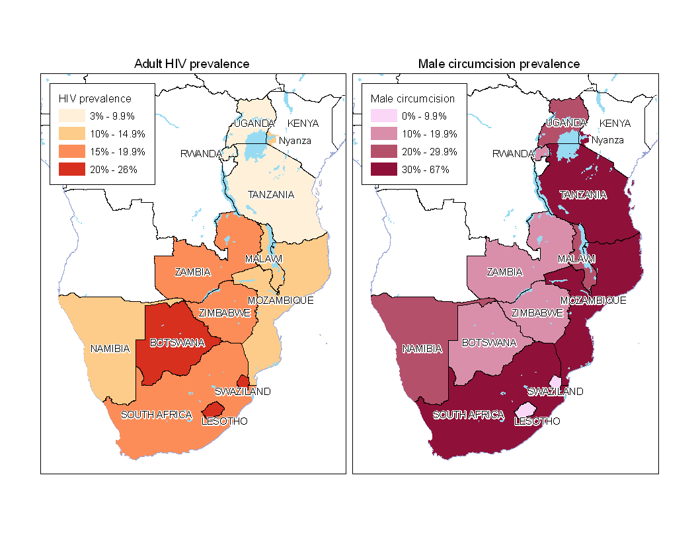
VMMC Priority Countries as Recommended by WHO-UNAIDS
Njeuhmeli E, Forsythe S, Reed J, Opuni M, et al. (2011) Voluntary Medical Male Circumcision: Modeling the Impact and Cost of Expanding Male Circumcision for HIV Prevention in Eastern and Southern Africa. PLoS Med 8(11): e1001132. doi:10.1371/journal.pmed.1001132
http://www.plosmedicine.org/article/info:doi/10.1371/journal.pmed.1001132

Slide 6
Minimum Package of Services
Male circumcision is always part of a package of prevention services:
Provider-initiated HIV counseling and testing, including couples HTC
Screening (and treatment) of STIs
Age-appropriate counseling on risk reduction, including reduced number and concurrency of sexual partners, delaying/abstaining from sex
Provision and promotion of correct and consistent use of condoms (male and female)
Active referral and linkage to HIV care/treatment/support services, including other HIV prevention services
Post-operative clinical care and reinforced education/ counseling
Notes:
Interventions for male circumcision should include a minimum package of prevention services which include:
Pre-operative provider-initiated HIV testing and counseling routinely provided on-site for all men and, where possible, their female partners;
Active exclusion of symptomatic STIs and syndromic treatment when indicated;
Provision and promotion of correct and consistent use of condoms;
Post-operative wound care and abstinence instructions;
Age-appropriate counseling on risk reduction, including reducing number and concurrency of sexual partners, delaying/abstaining from sex, and provision and promotion of correct and consistent use of condoms and;
Active linkage to other HIV prevention, treatment, care and support services as needed.

Slide 7
“Neither the elegance of the science nor the strength of the effect predict the ease of implementation” David Stanton
PEPFAR-UNAIDS 2011 Publications in PLOS Medicine: Signpost the way forward to accelerate the scaling up of VMMC service delivery safely and efficiently to reap individual- and population-level benefits www.ploscollections.org/VMMC2011
Former Secretary of State Hillary Clinton set the goal for PEPFAR to help achieve an AIDS Free generation. VMMC along with increase coverage of treatment and PMTCT were identified as key priorities interventions to help achieve that
President Barack Obama challenge PEPFAR to support 4.7 Million VMMC by end of 2013
PEPFAR-WHO-UNAIDS-BMGF-World Bank collaboration to launch the WHO-UNAIDS Joint Strategy Action Framework for Acceleration of the Scale-Up of VMMC

Slide 8
Njeuhmeli E, Forsythe S, Reed J, Opuni M, et al. (2011) Voluntary Medical Male Circumcision: Modeling the Impact and Cost of Expanding Male Circumcision for HIV Prevention in Eastern and Southern Africa. PLoS Med 8(11): e1001132. doi:10.1371/journal.pmed.1001132 http://www.plosmedicine.org/article/info:doi/10.1371/journal.pmed.1001132

Slide 9
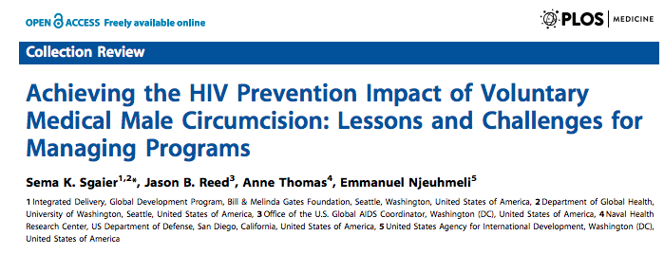
Voluntary Medical Male Circumcision for HIV Prevention: Improving Quality, Efficiency, Cost Effectiveness, and Demand for Services during an Accelerated Scale-up

Slide 10
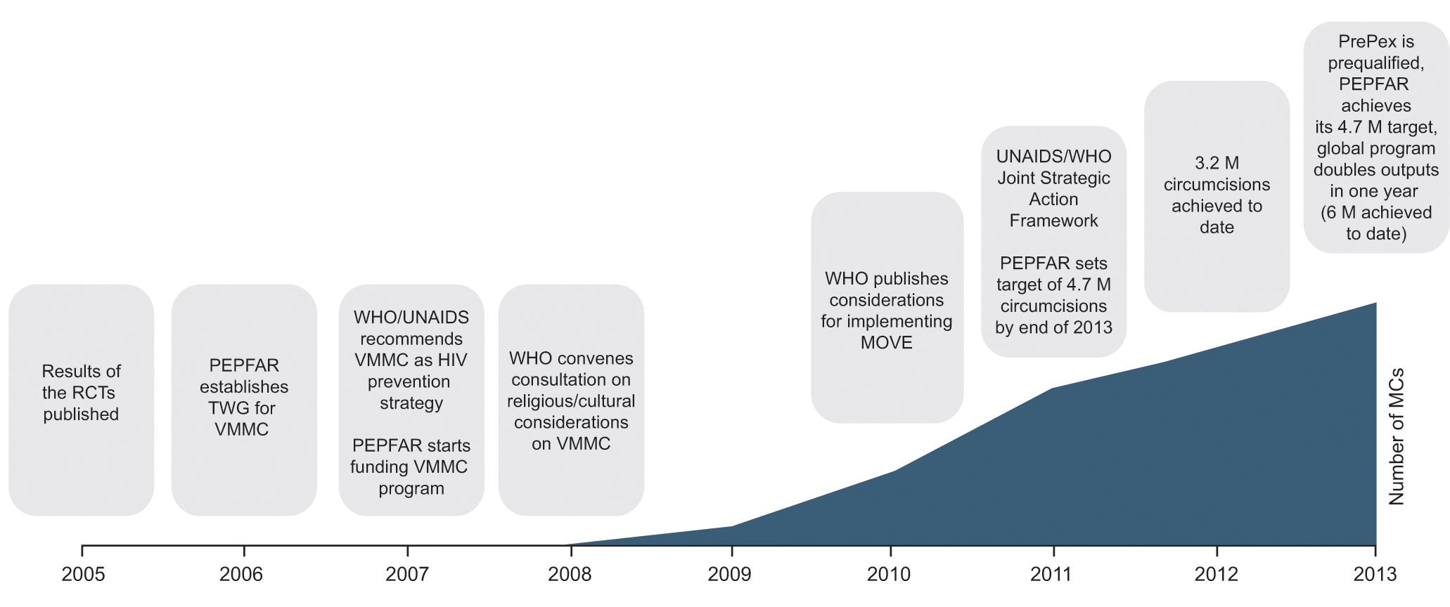
Timeline and Key Milestones of the Voluntary Medical Male Circumcision Program in 14 Priority Countries
Sgaier SK, Reed JB, Thomas A, Njeuhmeli E (2014) Achieving the HIV Prevention Impact of Voluntary Medical Male Circumcision: Lessons and Challenges for Managing Programs. PLoS Med 11(5): e1001641. doi:10.1371/journal.pmed.1001641
http://www.plosmedicine.org/article/info:doi/10.1371/journal.pmed.1001641

Slide 11
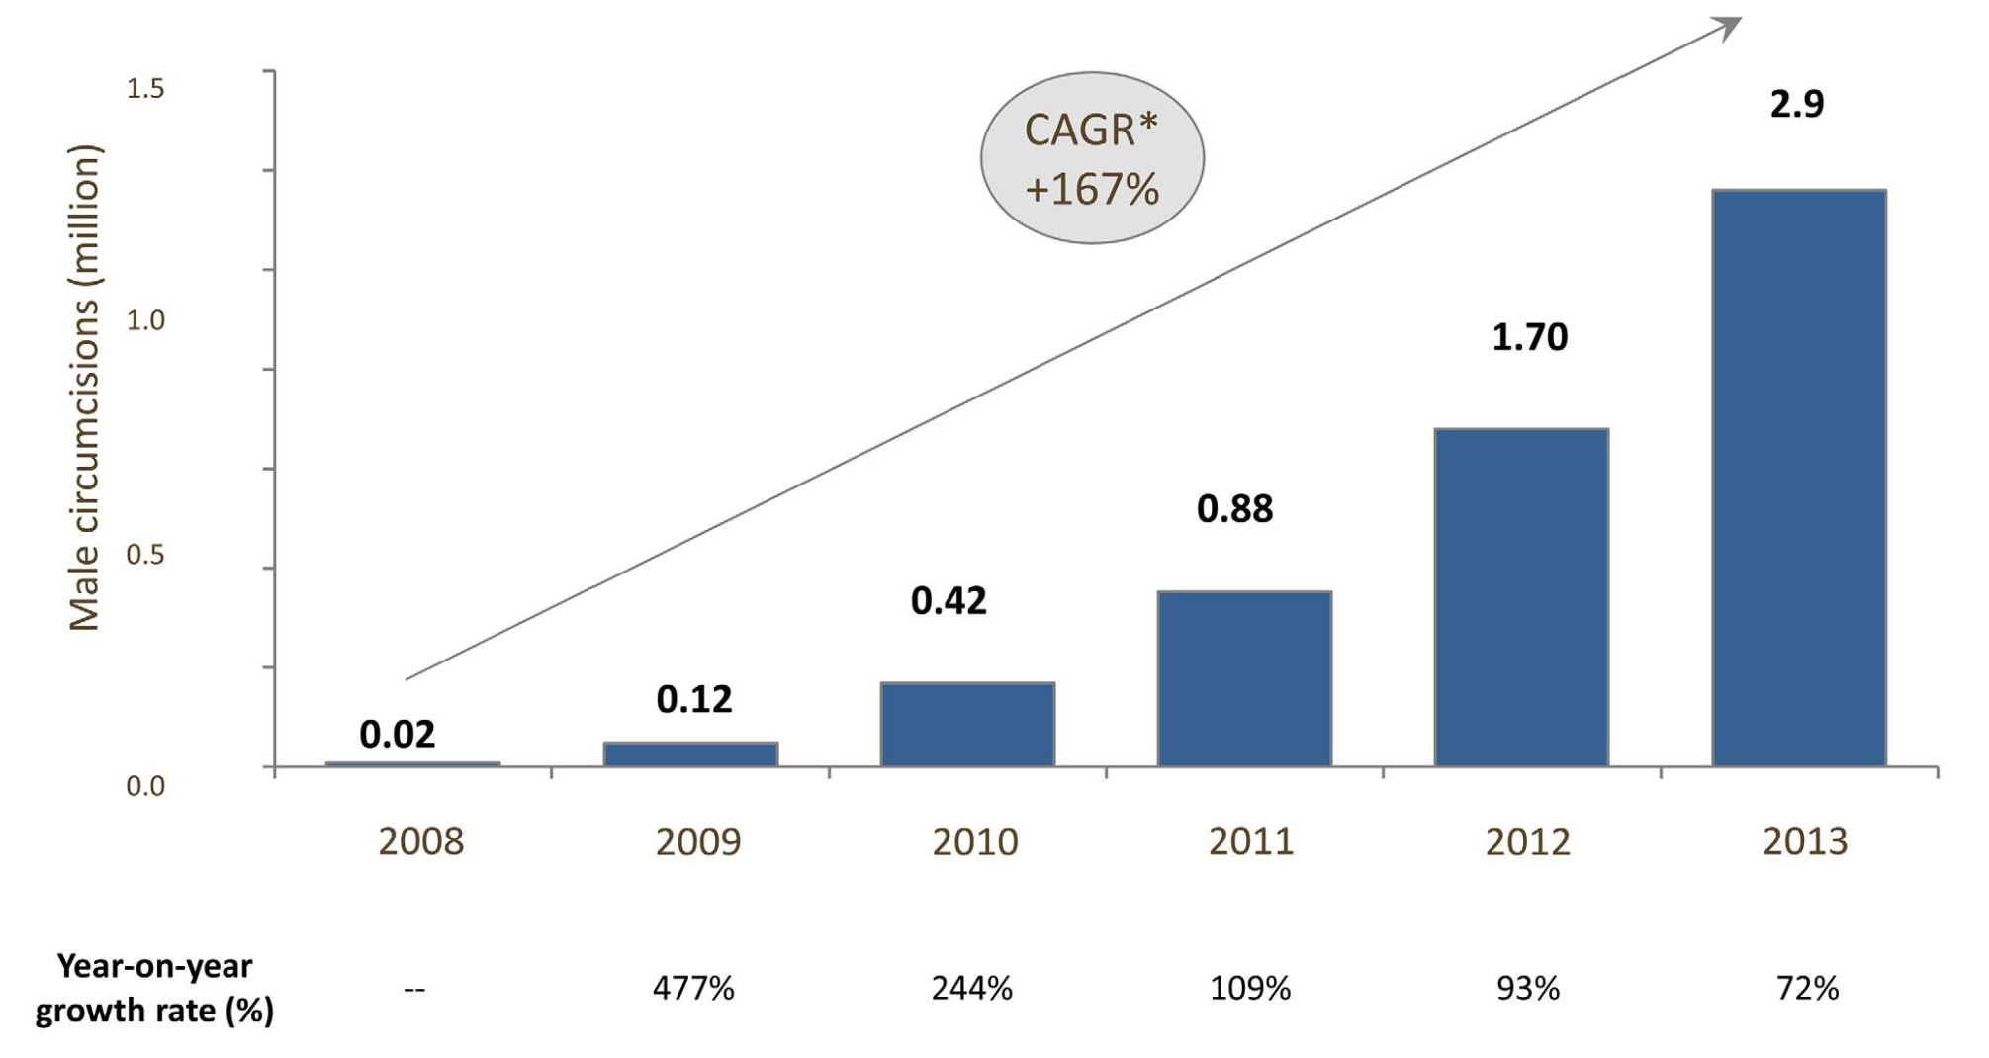
Scale-up of VMMC Program and Coverage in
14 Priority Countries, Aggregate, 2008–2013
Sgaier SK, Reed JB, Thomas A, Njeuhmeli E (2014) Achieving the HIV Prevention Impact of Voluntary Medical Male Circumcision: Lessons and Challenges for Managing Programs. PLoS Med 11(5): e1001641. doi:10.1371/journal.pmed.1001641
http://www.plosmedicine.org/article/info:doi/10.1371/journal.pmed.1001641

Slide 12
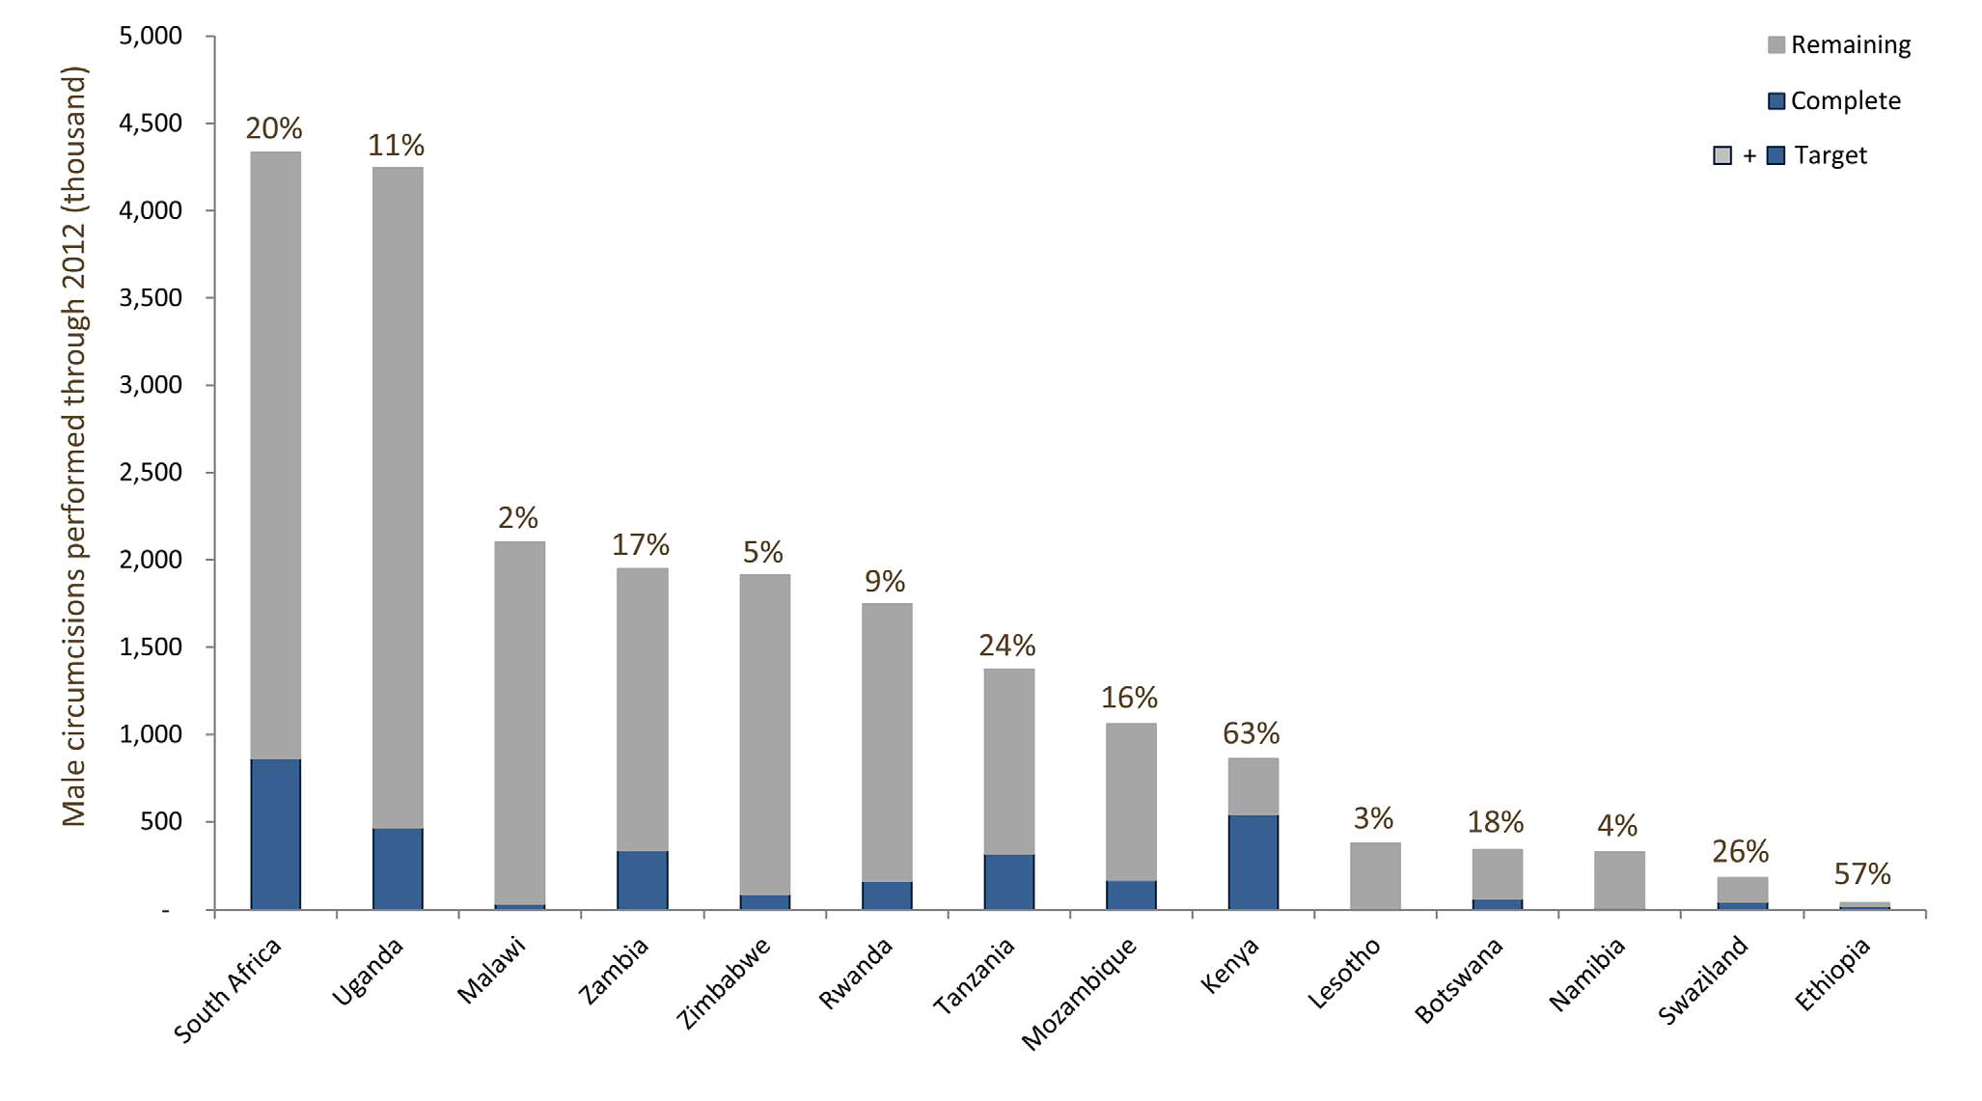
Scale-up of VMMC Program and Coverage
in 14 Priority Countries, 2008–2012
Sgaier SK, Reed JB, Thomas A, Njeuhmeli E (2014) Achieving the HIV Prevention Impact of Voluntary Medical Male Circumcision: Lessons and Challenges for Managing Programs. PLoS Med 11(5): e1001641. doi:10.1371/journal.pmed.1001641
http://www.plosmedicine.org/article/info:doi/10.1371/journal.pmed.1001641

Slide 13
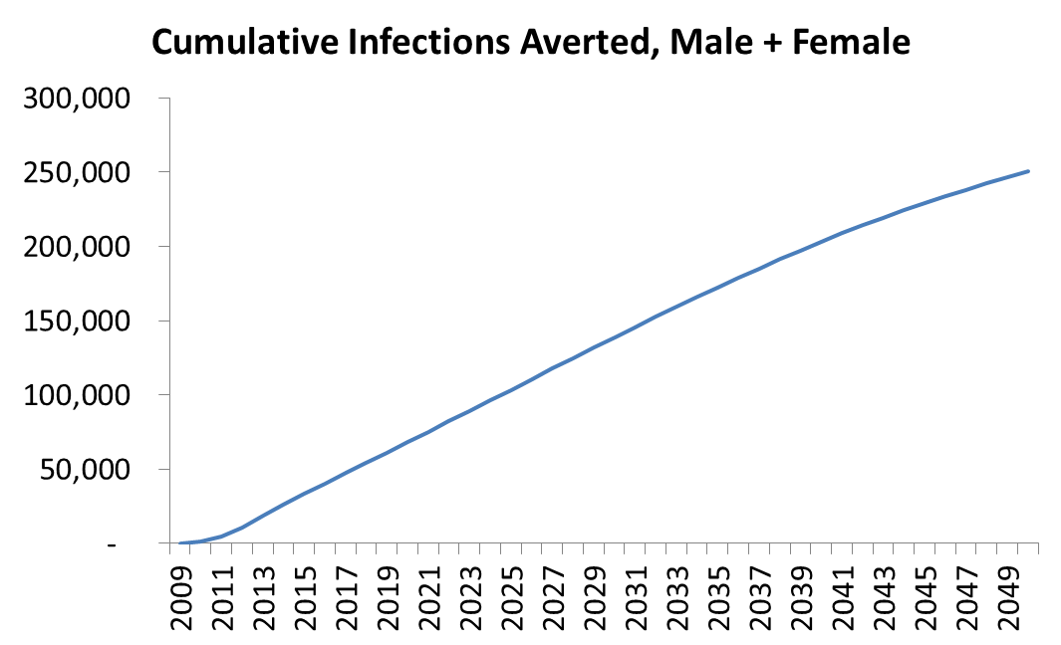
Infections Averted by Program Circumcisions to Date
South Africa
Uganda
By end of Q1 2014 for South Africa and end of 2013 for Uganda, the two countries have circumcised over 1.3 M and over 1M men respectively. Even if there were no more VMMC after that, the circumcision performed to date would avert an estimated 140,000 and 230,000 infections by 2030, and an estimated 250,000 and
630,000 infections by 2050 respectively in these two countries.
Sources: USAID Health Policy Project Unpublished data obtain using DMPPT 2.0 Model
Notes:
By the end of Q1 2014, implementers in South Africa had circumcised over 1.3 million men. Even if there were no more circumcisions after that, the circumcisions performed to date would avert an estimated 140,000 infections by 2030, and an estimated 250,000 infections by 2050.
Infections averted used the South Africa Goals model, comparing MC prevalence from NDoH, PEPFAR, and Global Fund circumcisions (NDoH program reporting data FY 2009-2013) with a scenario in which MC prevalence was maintained at levels based on the 2008 HSRC survey, before PEPFAR program circumcisions started.
MC prevalence from program circumcisions was derived as follows:
Between 2010 and 2012, the VMMC program circumcised the following numbers of clients:
2010 2011 2012 2013
140,000 348,000 443,000 415,000
These numbers were divided by the Male population age 15-49 from DemProj and added to the MC prevalence of the prior year.
2010 2011 2012 2013
28,840,594 29,160,604 29,483,952 29,822,393 population
After 2013, program circumcisions were stopped. It was assumed that it would take 35 years (the width of the age group) for the MC prevalence to return to the baseline MC prevalence level from 2010.
By the end of reporting year 2013, PEPFAR implementers in Uganda had circumcised over 1 million men. Even if there were no more circumcisions after that, the circumcisions performed to date would avert an estimated 230,000 infections by 2030, and an estimated 630,000 infections by 2050.
Infections averted used the Uganda Goals model (as created for Investment Case exercise), comparing MC prevalence from PEPFAR circumcisions (PEPFAR program reporting data 2009-2013) with a scenario in which MC prevalence was maintained at levels based on the 2004-5 AIDS Indicator Survey, before PEPFAR program circumcisions started.
MC prevalence from PEPFAR circumcisions was derived as follows:
MC prevalence from the beginning of the model through 2009 was based on 2004-5 AIDS Indicator Survey, before PEPFAR program circumcisions started. Between 2010 and 2013, the PEPFAR program circumcised the following numbers of clients:
2010 2011 2012 2013
9,052 57,132 352,039 742,978
These numbers were divided by the Male population age 15-49 for the respective years from DemProj, and the resulting percentage was added to the MC prevalence of the prior year.
After 2013, program circumcisions were stopped. It was assumed that it would take 35 years (the width of the 15-49 year age group) for the MC prevalence to return to the baseline MC prevalence level from 2004-5.

Slide 14
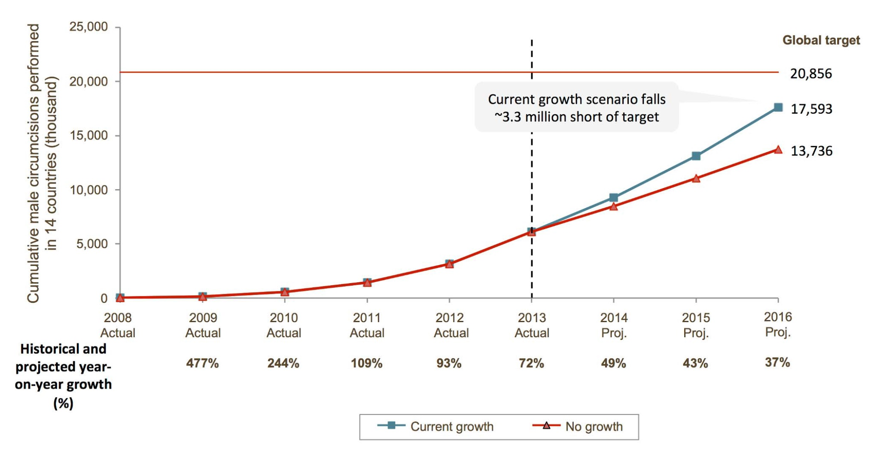
Scale-up of VMMC Program and Coverage
in 14 Priority Countries: Growth Scenarios, 2008−2016
Sgaier SK, Reed JB, Thomas A, Njeuhmeli E (2014) Achieving the HIV Prevention Impact of Voluntary Medical Male Circumcision: Lessons and Challenges for Managing Programs. PLoS Med 11(5): e1001641. doi:10.1371/journal.pmed.1001641
http://www.plosmedicine.org/article/info:doi/10.1371/journal.pmed.1001641

Slide 15
Age Distribution of VMMC Clients in Tanzania, Swaziland and Malawi
Client age distribution: PEPFAR implementation data from 2013 from Tanzania, Swaziland, and Malawi
Population age distribution: DMPPT 2.0 model for Tanzania, Swaziland, and Malawi
Notes:
In addition, many countries were finding that over a third of the clients being circumcised were not even falling within the 15-49 year age group of the target population, and that it was difficult to reach men above the age of 25, who were believed to be key for immediate impact on reducing new HIV infections.

Slide 16
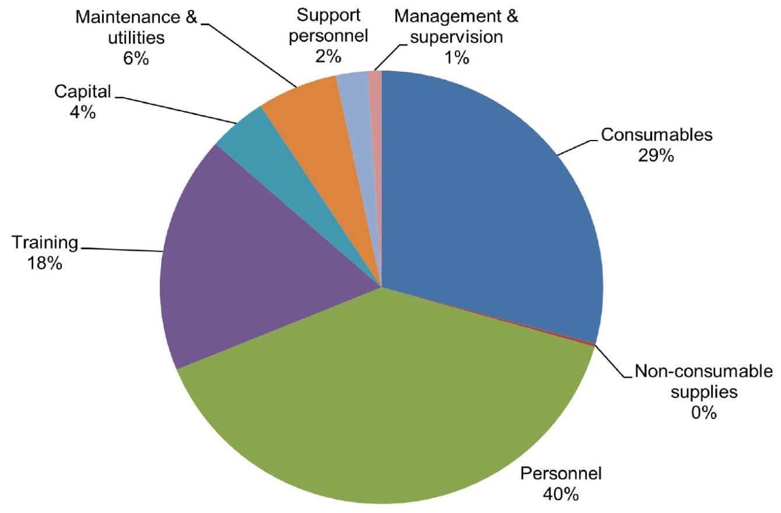
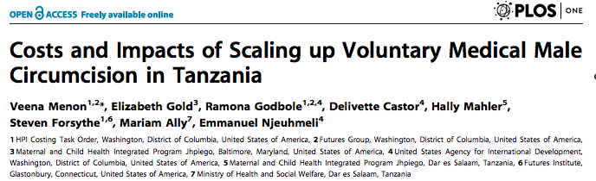
Cost drivers of VMMC in Tanzania, 2010–2011

Slide 17
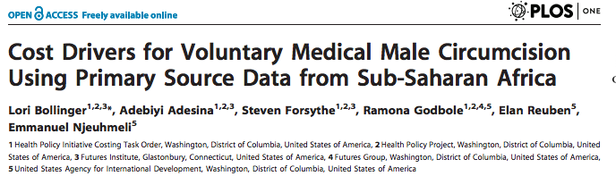
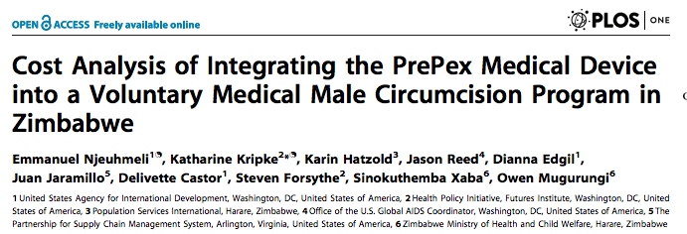

Slide 18
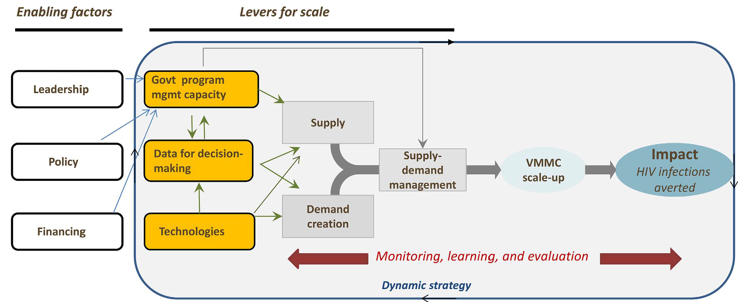
Enabling Factors and Levers to Achieve
Scale and Impact for the VMMC Program
Sgaier SK, Reed JB, Thomas A, Njeuhmeli E (2014) Achieving the HIV Prevention Impact of Voluntary Medical Male Circumcision: Lessons and Challenges for Managing Programs. PLoS Med 11(5): e1001641. doi:10.1371/journal.pmed.1001641
http://www.plosmedicine.org/article/info:doi/10.1371/journal.pmed.1001641

Slide 19
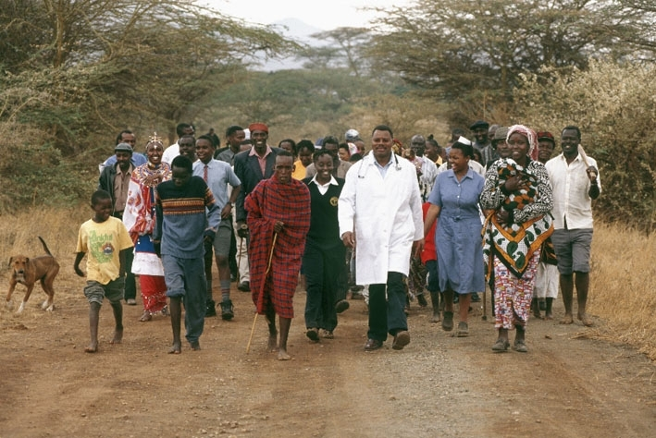
“It’s about the people”
THANK YOU

