Slide 1
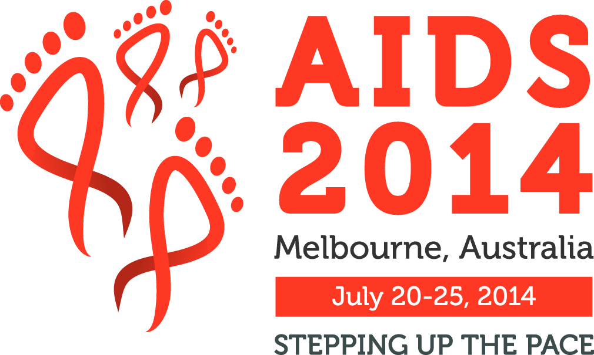









Experience with PrePex Device Use with Adults and Adolescents in Pilot Implementation and Active Surveillance from Zimbabwe, Zambia and South Africa
Karin Hatzold, MD, MPH
IAC Satellite
“Can New Technology improve efficiency in VMMC and EIMC Scale Up”
Melbourne, Australia, 22.07.2014

Slide 2
The ‘Ideal’ Medical Device for VMMC
Effective, safe, inexpensive, highly acceptable
No injection of local anesthesia
Minimal discomfort/pain
No sutures (bloodless)
Cause minimal disruption in daily activities
Does not require physician to place/remove device
Single provider could place device; single provider could remove device
Sterile environment not required (no cutting of living tissue)
Self detaching if left in place beyond recommended time
Low Adverse Events

Slide 3
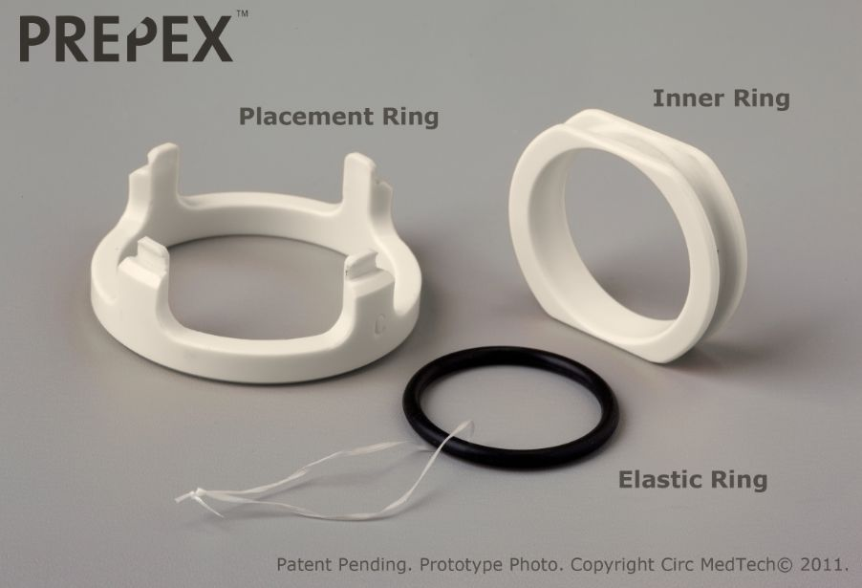
PrePex VMMC Device
The safety and efficacy of the PrePex™ device for VMMC was demonstrated in studies in Rwanda, Uganda and Zimbabwe
Conditional prequalification of the device for use in adults >18 years by WHO/TAG in April 2013.
Following pre-qualification pilot implementation studies were conducted in most 14 VMMC priority countries funded by PEPFAR and BMGF

Slide 4
Overview of Pre-Pex Studies
Pilot Implementation Study Zambia, 499 adults
Pilot Implementation Study South Africa, 341 adults, 89 adolescents
Pilot Implementation Study Zimbabwe, 603 adults, use of primary care nurses at primary health care level
Adolescents Bridging Study Zimbabwe, 402 adolescents 13-17 years
Active Surveillance Zimbabwe, 1000 adults

Slide 5
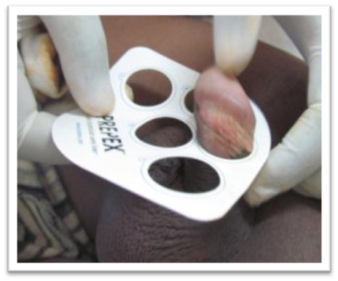
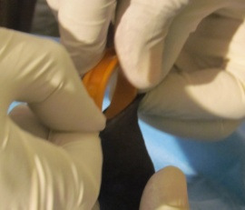
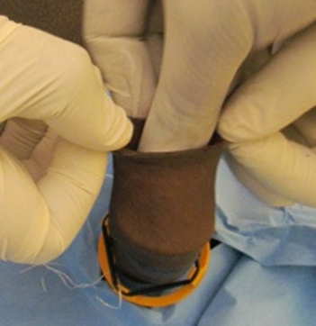
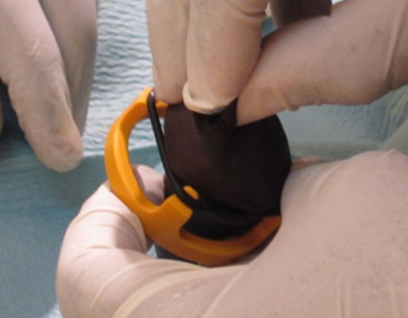
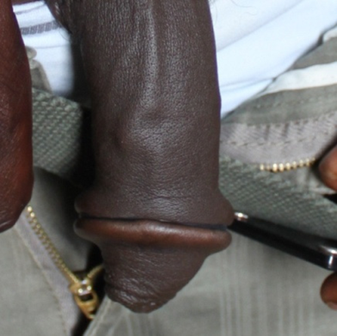
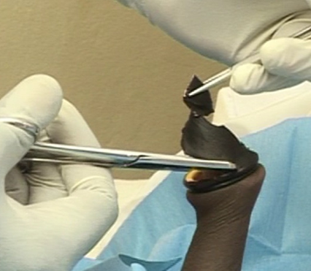
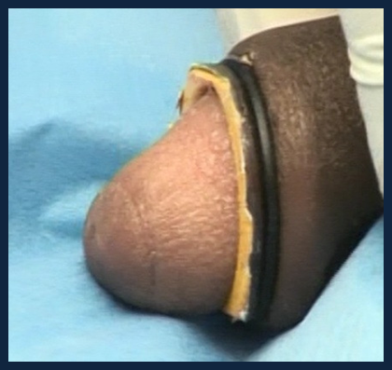
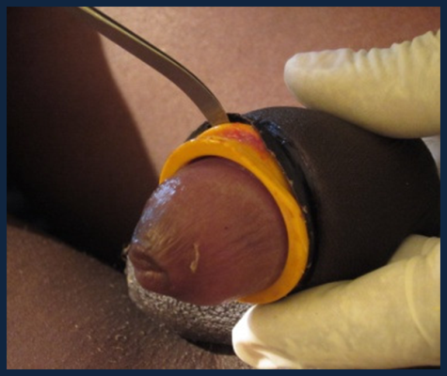
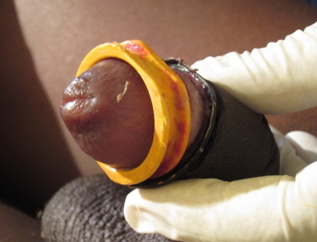
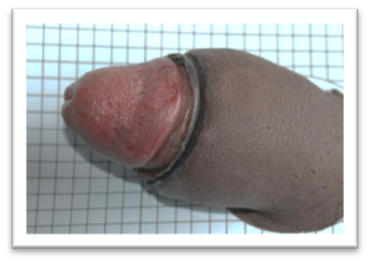
PrePex Device Procedures
PrePex Device Application
1. Measure
2. and 3. Placement of Inner Ring
4. Placement of elastic ring
5. Penis after placement
PrePex Device Removal
1. and 2. Excision of foreskin
3. and 4. Removal of Inner Ring
5. Penis after removal device & foreskin

Slide 6
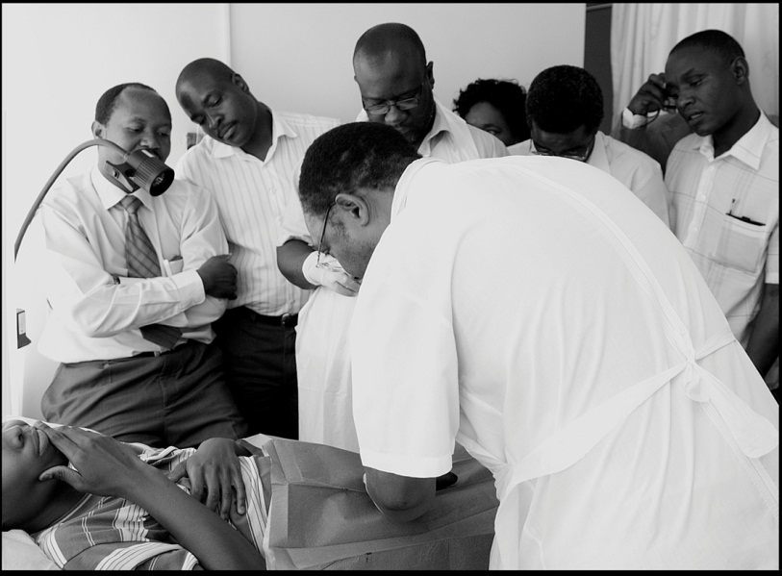
PrePex- Advantages
Easy to use, task-shifting
Quick, simple training of nurses and other cadres
Fast procedures
One-time use / disposable device elements, 10 sizes
Sterile environment not required at device application
No need for injectable anaesthesia at application/removal
Necrosis principle, no cutting and loss of blood
Inner ring oversized to accommodate erections
Faster return to normal activities
Good cosmetic outcome

Slide 7
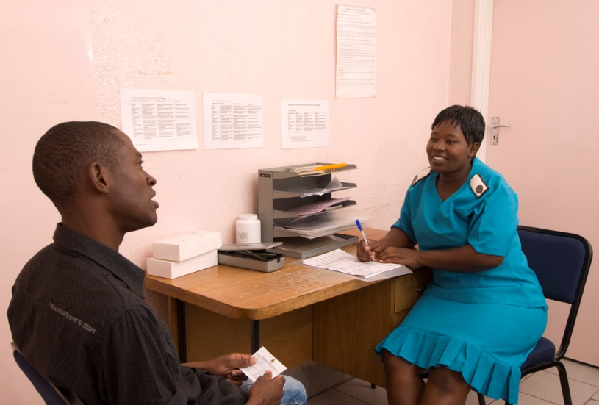
PrePex-Challenges
Male Circumcision completed only after device removal ( two visits)
Longer healing period, Longer abstinence period
Limited eligibility,
Self-removal by client
Device displacements
Surgical Back-up
Cost of the device, cost comparison with surgical procedure
Pain management while wearing the device and at removal

Slide 8
Pilot Implementation Study and Bridging study South Africa
3 Sites 341 adults, 89 adolescents, July 2013 – April 2014
11 moderate and severe adverse events, AE rate: 2.6%
Acceptability
Pain – “Looks less painful”
Comfort – “More comfortable than surgery ”
Safety – “It is safer than surgical circumcision ”
Infection – “Infections are minimal”
Convenience – “Carry on with daily routines”
Time – “Faster than surgical circumcision”
Healing Time
Adult Men: Mean Healing Time 52.4 days ( SD = 6.68), Median= 56 days
Adolescents: Mean Healing Time 49.3 days ( SD = 8.38), Median= 49 days
Safety, effectiveness and acceptability of the PrePex device for adult male circumcision in South Africa : Limakatso Lebina, Noah Taraburekera, Minja Milovanovic, Karin Hatzold, Scott Billy, Miriam Mhazo, Nkeko Tshabangu, Victoria Kazangarare, Millicent Makola, Neil Martinson
Notes:
Bleeding
Infection
Displacements/Self-Removal (3)
Wound Dehiscence
Voiding
Swelling

Slide 9
Pilot Implementation Study Zambia
2 sites in Lusaka, October 2013 – April 2014, PrePex conducted by nurses
AE rate: 2% (95% CI: 1.0%-3.7%)
20 moderate/severe AEs among 10 participants, all resolved
Healing Time: 63% (95% CI 0.49-0.77) healed by Day 42, 77% by Day 56
Acceptability
95% very satisfied with the cosmetic results
98% would recommend PrePex to friends and family
+ Procedure less painful than expected
+ Will improve penile hygiene, good penile appearance
- Pain and odour while wearing the device
Safety, effectiveness and acceptability of the PrePex device for adult male circumcision in Zambia: Paul J. Feldblum, Bruce Bvulani, Catherine Hart, Prisca Kasonde, Namwinga Chintu, Jaim Jou Lai, Valentine Veena
Notes:
Displacements/early device removal followed by Sleeve resection surgical circumcision
Bleeding
Oedema;
Wound Dehiscence
Infection
Pain;
Voiding
Delayed wound healing

Slide 10
Pilot Implementation Study Zimbabwe
601 adult males enrolled between April 25 and September 10, 2013
Four health facilities at provincial, district and community level
PCNs performed VMMC
AE Rate 0.3%: Two self-removals on day two and day three, dorsal slit surgical procedure
Pain
90% participants experienced pain at device removal
84 % Mild
4% Moderate
2% Severe
Time to complete wound healing
Safety and efficacy of the PrePexTM device for male circumcision performed by primary care nurses at primary health care level in Zimbabwe: Dr. Gerald Gwinji; Prof. Mufuta Tshimanga, Mr Tonderayi Mangwiro, Dr. Owen Mugurungi, Dr. Karin Hatzold, Dr. Munyaradzi Murwira, Mr. Christopher Samkange, Mr. Sinokuthemba Xaba,

Slide 11
Adolescents Bridging study Zimbabwe
400 adolescents 13-17 years
8 August 2013 and 27 February 2014, Harare, Nurse providers
35.9 % ( 51.9% - 13.3%) medical ineligibility
Moderate/Severe AE rate 0.5%
Voiding, Swelling and blistering of foreskin, requiring early removal day 5
Insufficient skin removal, surgical circumcision on day 90
Mean healing time was 31.9 days (SD=5.47),
31.2 days ( 13-14 years) versus 32.6 days ( 15-17 years), P= 0.03
25% required smaller device sizes, size 12-20
98 % Satisfied with procedure
Reasons for non-eligibility by age
Safety profile of PrePexTM male circumcision device in adolescents aged 13-17 years in Zimbabwe M.Tshimanga, K. Hatzold, O. Mugurungi, T. Mangwiro, S. Xaba, P. Chatikobo, M. Murwira, G. Gwinji

Slide 12
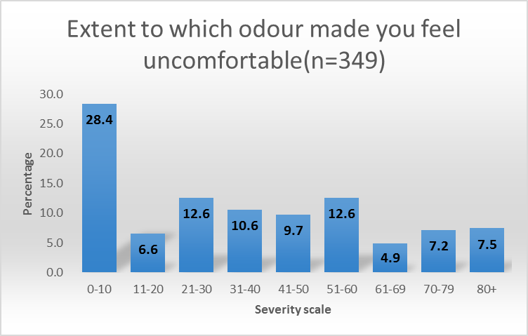
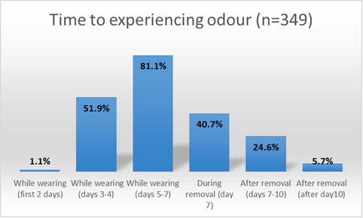
Active Surveillance Study Zimbabwe (1)
1000 adult males, 6 sites, 31 March – 31st of May, 2014
Acceptability: Overall: 46% ( 32% - 65%)
7% excluded: Phimosis, Tight Foreskin, Tight Frenulum, STIs
5 clients (0.5%) had device self-removals/displacements
5 clients (0.5%) requested early removal on day 5/6 because of pain
9.7 % had moderate ( pain score 6) pain at removal
Odour: implications on providers, clients, environment
PrePex Active Surveillance: Dr Owen Mugurungi, Ms Getrude Ncube, Mr Sinokuthemba Xaba, Mr Webster Mavhu, Dr Karin Hatzold, Dr Frances Cowan, Mr Christopher Samkange; Professor Mufuta Tshimanga, Dr Ngonidzashe Madidi

Slide 13
Active Surveillance Study Zimbabwe (2)
83.3% Highly Satisfied
377/402 (93.8%) would recommend PrePex to their peers
24/402 (6%) would not recommend PrePex to their peers
23/24 experienced high level of pain
21/24 reported being uncomfortable with odour at some stage in the PrePex procss

Slide 14
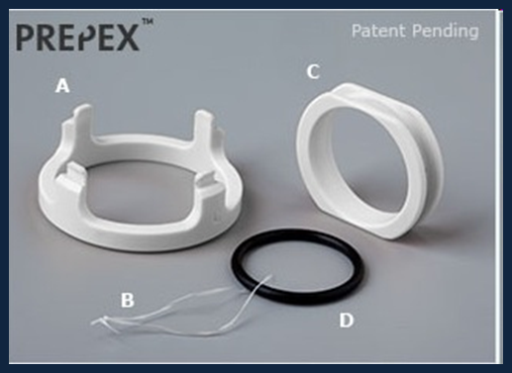
Conclusions
PrePex is safe and efficacious in adults and adolescents
Primary Care Nurses at primary health care level can use device safely
Mean Healing time in adults is longer than with surgical procedure
Self-removal/Displacements require surgical back-up/training in dorsal slit method
High pain scores especially at device removal
High medical ineligibility in adolescents 13-17 years
Acceptability: 50% when option is offered, differs by site and geographic area
Earlier device removal on day 5 or day 6?

Slide 15
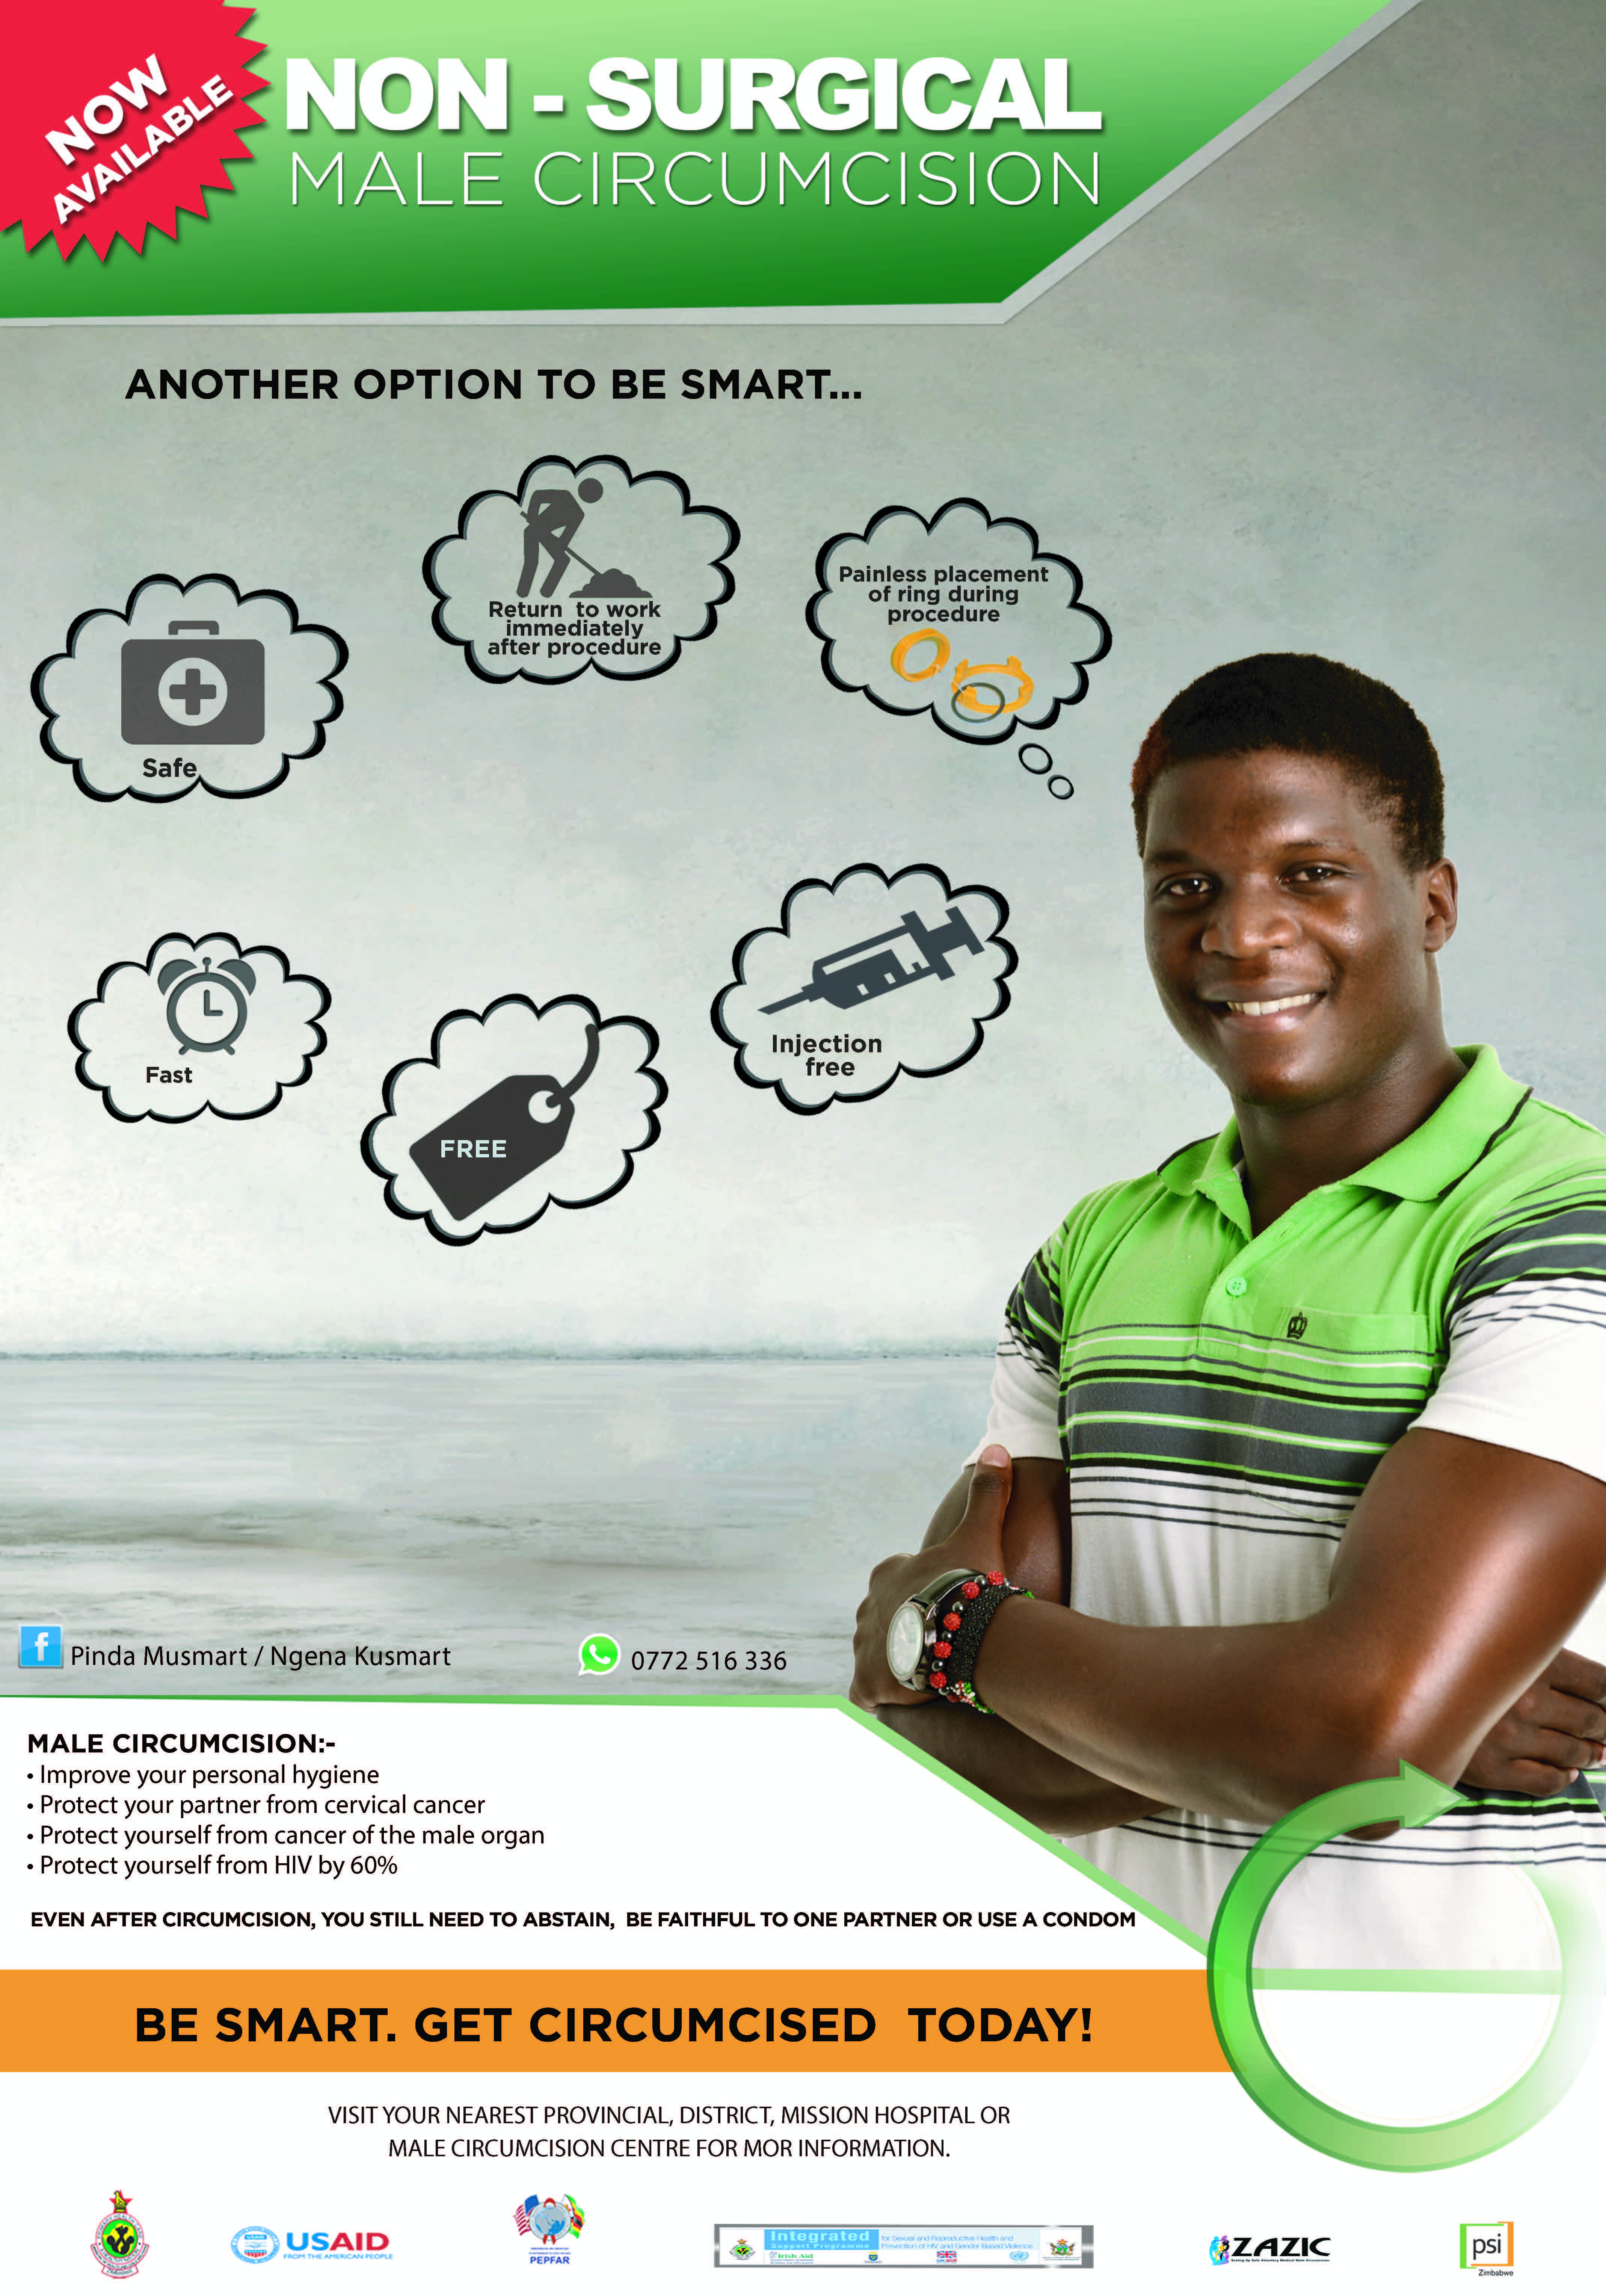
Recommendations
PrePex can be scaled up alongside surgical procedure
Address Pain Management
Local Anaesthesia at removal
Improved pain management while wearing the device
Address Odour
Assess acceptability issues through qualitative research
Intensify counseling
Self-Removal
Sexual Abstinence
What to expect pain/odour
Specific marketing campaign for PrePex
Need to address price of the device

Slide 16
Acknowledgements
Zimbabwe Pilot Implementation and Bridging Study:
Dr. Gerald Gwinji; Prof. Mufuta Tshimanga, Mr Tonderayi Mangwiro, Dr. Owen Mugurungi, Dr. Karin Hatzold, Dr. Munyaradzi Murwira, Mr. Christopher Samkange, Mr. Sinokuthemba Xaba,
Zimbabwe Active Surveillance:
Dr Owen Mugurungi, Ms Getrude Ncube, Mr Sinokuthemba Xaba, Mr Webster Mavhu,
Dr Karin Hatzold, Dr Frances Cowan, Mr Christopher Samkange; Professor Mufuta Tshimanga, Dr Ngonidzashe Madidi,
Zambia Study Team
Paul J. Feldblum, Bruce Bvulani, Catherine Hart, Prisca Kasonde, Namwinga Chintu, Jaim Jou Lai, MP¹, Valentine Veena
South Africa Study Team
Limakatso Lebina, Noah Taraburekera, Minja Milovanovic, Karin Hatzold, Scott Billy, Mirriam Mhazo, Nkeko Tshabangu, Victoria Kazangarare, Millicent Makola, Neil Martinson
Bill and Melinda Gates Foundation
PEPFAR, USAID
Population Services International Zimbabwe
ZICHIRE Zimbabwe
CeSSHAR Zimbabwe
University Zimbabwe
Society of Family Health Zambia
FHI360
Population Council Zambia
University Teaching Hospital, Lusaka, Zambia
Society of Family Health South Africa
Perinatal HIV Research Unit, Faculty of Health Sciences, University of the Witwatersrand, Johannesburg South Africa

