Slide 1
Overview of programmatic priorities and latest WHO recommendations and guidance for key populations
Orientation and action planning workshop on new Global Prevention Coalition countries
Kigali, 24-26 October 2-34
Maeve B. de Mello, BSc, PhD (pronouns she/her/hers)
Technical Officer – Key Populations & STI Prevention
Testing, Prevention and Population Unit
Global HIV, Hepatitis and STIs Programmes
demellmae@who.int

Slide 2
Outline
Political commitments to address key populations
Epi data recap
New WHO consolidated guidelines for KP
  Prioritizing interventions for impact by KP
  New recommendations for service delivery
  Selected existing critical recommendations for impact
  Enabling environment
Concluding remarks

Slide 3
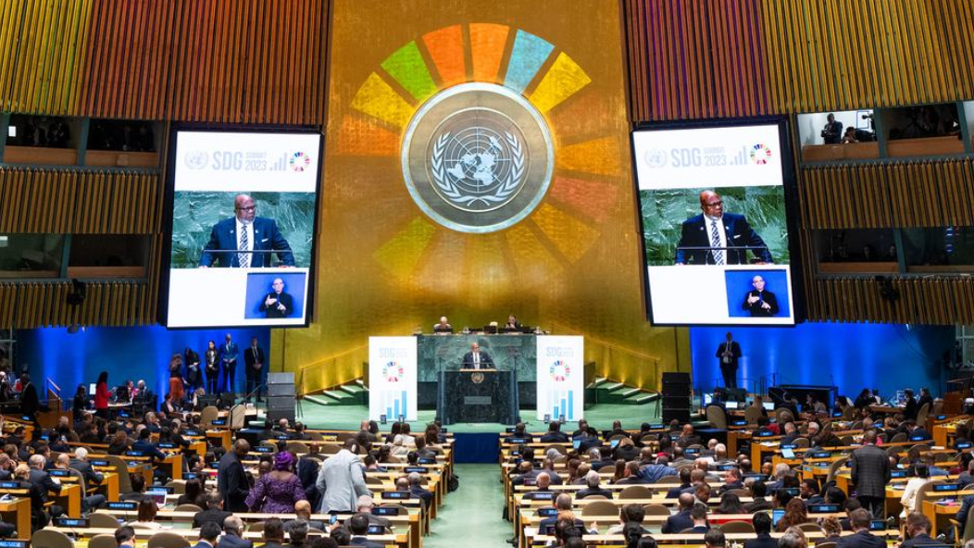
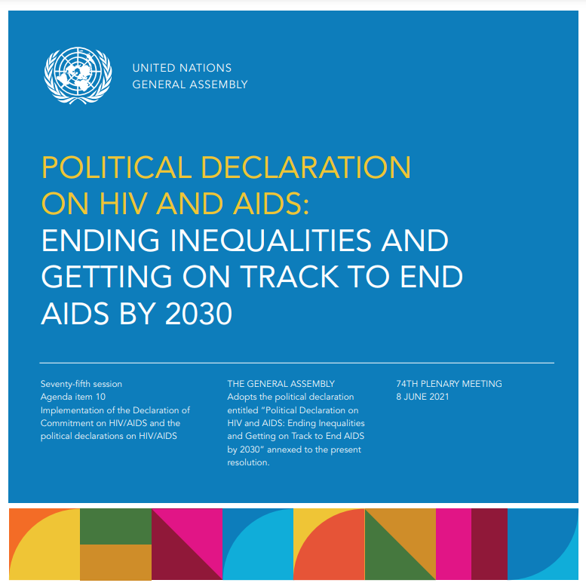


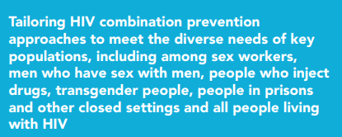
High level political commitments
The 2030 Agenda for Sustainable Development pledged that “no one will be left behind” and also “to reach the furthest behind first”

Slide 4
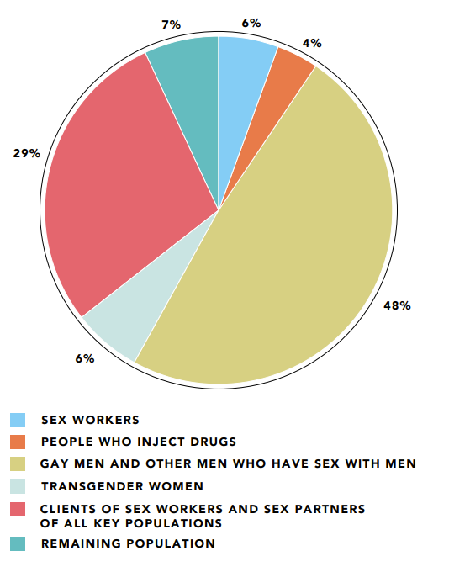
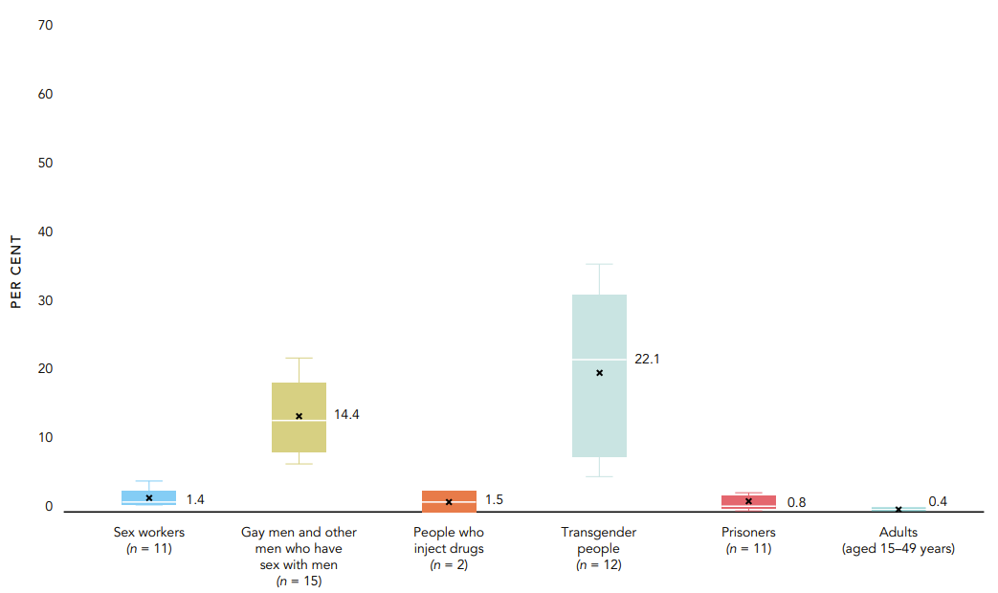
Distribution of acquisition of new HIV infections by population, Latin America, 2021
HIV prevalence among key populations compared with adults (aged 15–49 years), reporting countries in Latin America, 2017–2021
SW: 3.5 x greater
MSM: 36 x
PWID: 3.8 x
Trans people: 55.3
Prisoners: 2 x
64%
Source: In Danger: UNAIDS Global AIDS Update 2022 https://www.unaids.org/en/resources/documents/2022/in-danger-global-aids-update

Slide 5
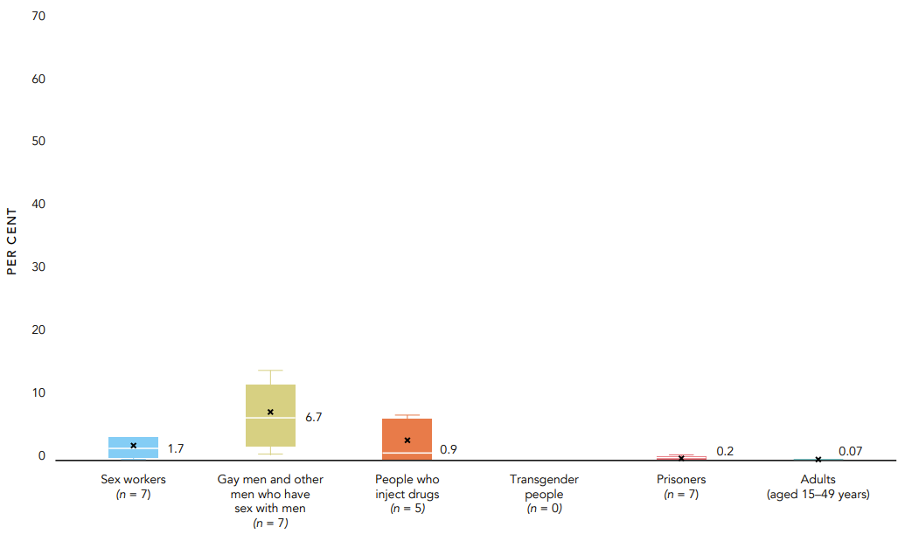
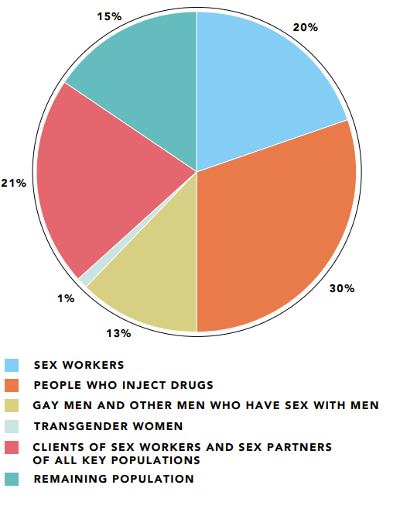
Distribution of acquisition of new HIV infections by population, Middle East and North Africa, 2021
HIV prevalence among key populations compared with adults (aged 15–49 years), reporting countries in Middle East and North Africa, 2017–2021
SW: 24.3 x
MSM: 95.7 x
PWID: 12.8 x
Trans people: no data
Prisoners: 2.8 x
85%
Source: In Danger: UNAIDS Global AIDS Update 2022 https://www.unaids.org/en/resources/documents/2022/in-danger-global-aids-update

Slide 6
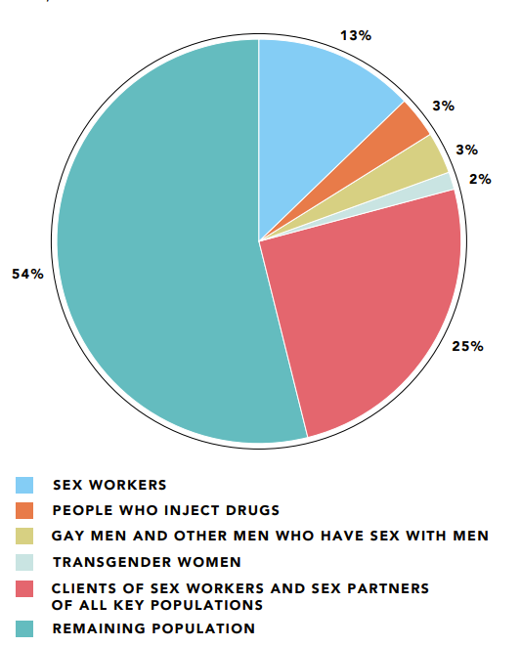
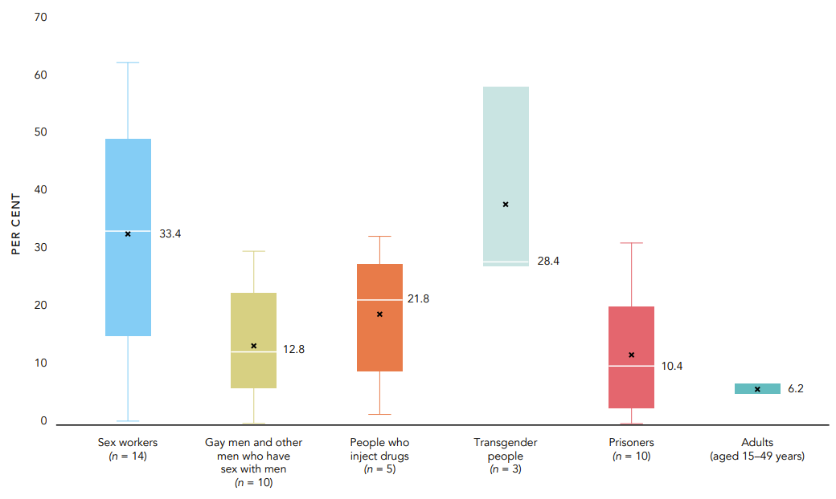
Distribution of acquisition of new HIV infections by population, Eastern and Southern Africa, 2021
HIV prevalence among key populations compared with adults (aged 15–49 years), reporting countries in Eastern and Southern Africa, 2017–2021
SW: 5.4 x
MSM: 2 x
PWID: 3.5 x
Trans people: 4.6 x
Prisoners: 1.7 x
46%
Source: In Danger: UNAIDS Global AIDS Update 2022 https://www.unaids.org/en/resources/documents/2022/in-danger-global-aids-update

Slide 7
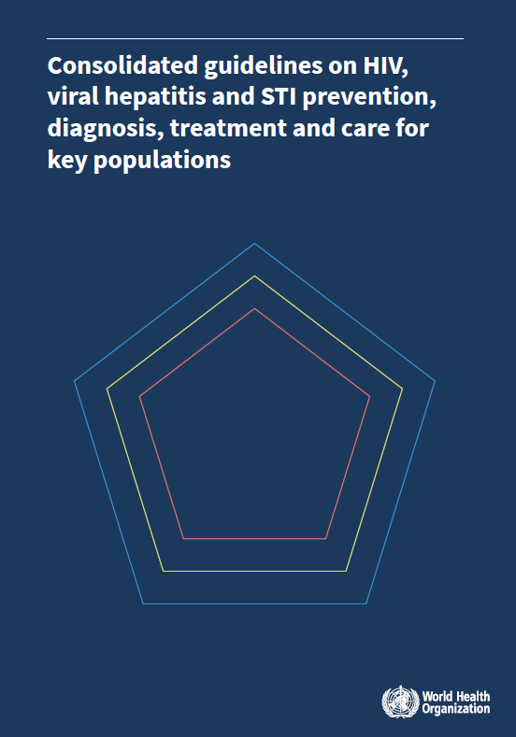
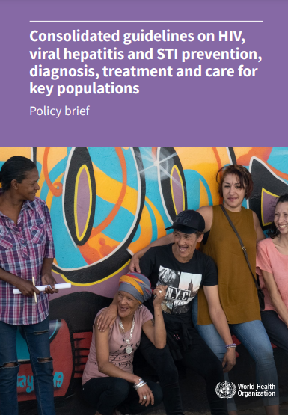
HIV, viral hepatitis and sexually transmitted infections epidemics - inextricably linked (syndemics)
Genital herpes: 3x higher risk of HIV acquisition¹
Syphilis: 2x higher risk for HIV acquisition & transmission²
T. vaginalis infection: 1.5x higher of HIV acquisition³
HPV: WLHIV have 6x higher risk of developing cervical cancer⁴

Slide 8
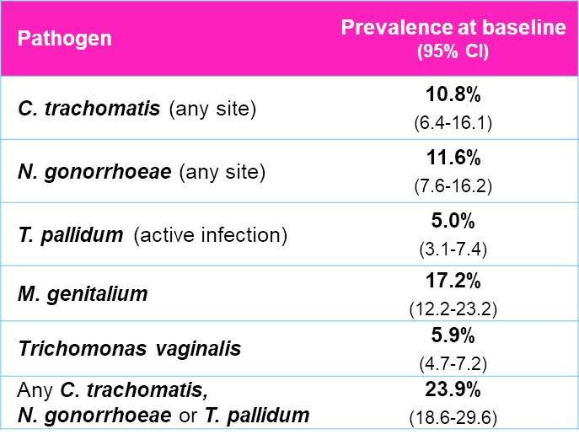
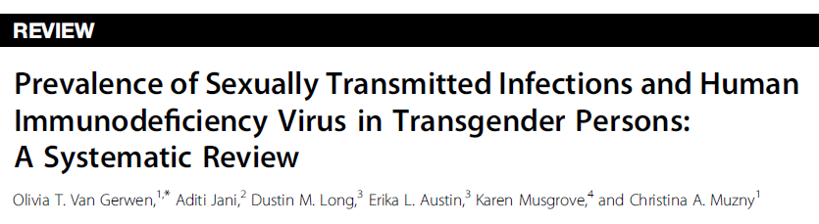
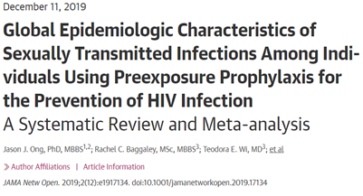

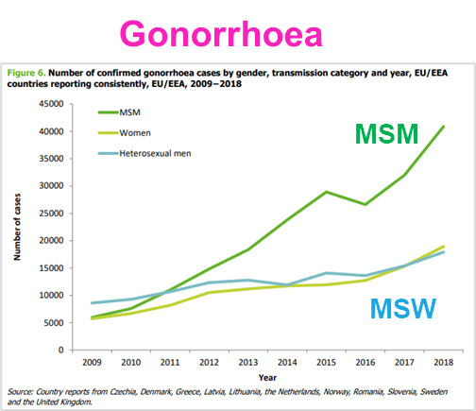
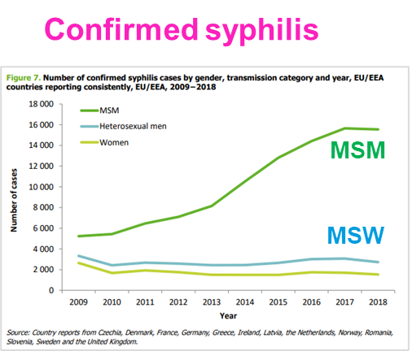
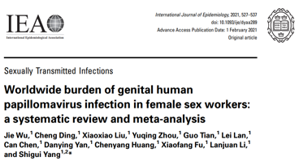
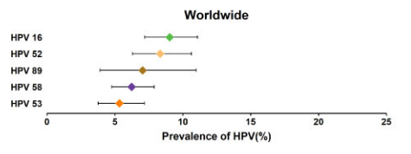

STIs prevalence and incidence are very high among key populations
High baseline STI prevalence among PrEP users (mostly MSM)
High STI prevalence among trans men and trans women
Pathogen | Trans men | Trans women
C. trachomatis | 1.2 - 11.1% | 2.7 - 24.7%
N. gonorrhoeae | 0 – 10.5% | 2.1 - 19.1%
T. pallidum (syphilis) | 0 – 4.2% | 1.4 - 50.4%
Surveillance data from EU/EEA
4-fold higher HPV prevalence among FSW

Slide 9
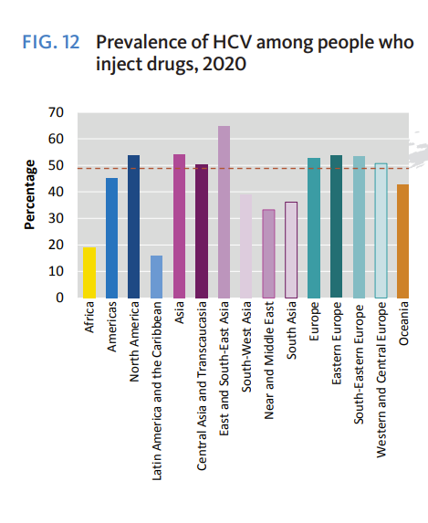
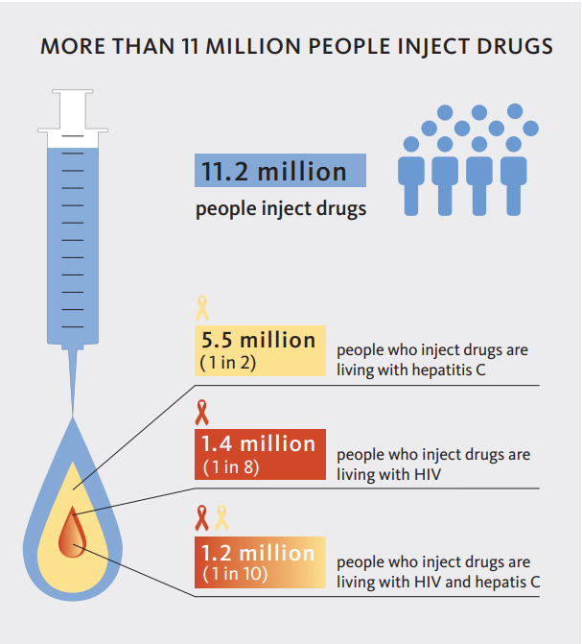
In 2021, 1 in every 2 people who inject drugs were living with hepatitis C

Slide 10
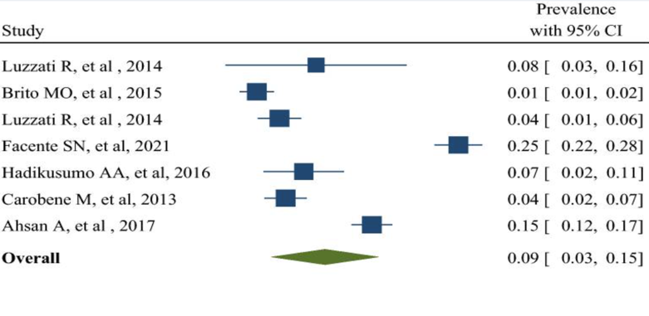
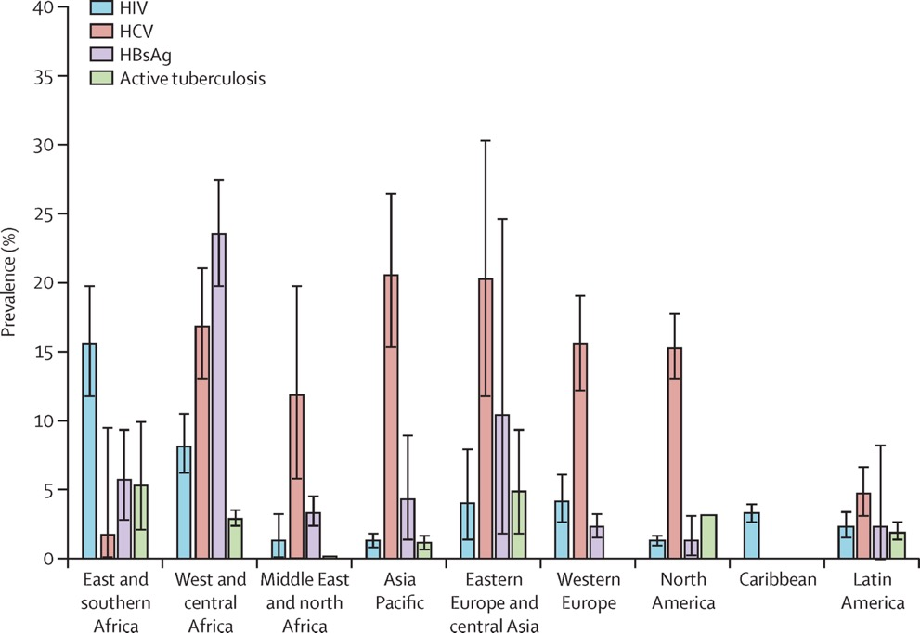
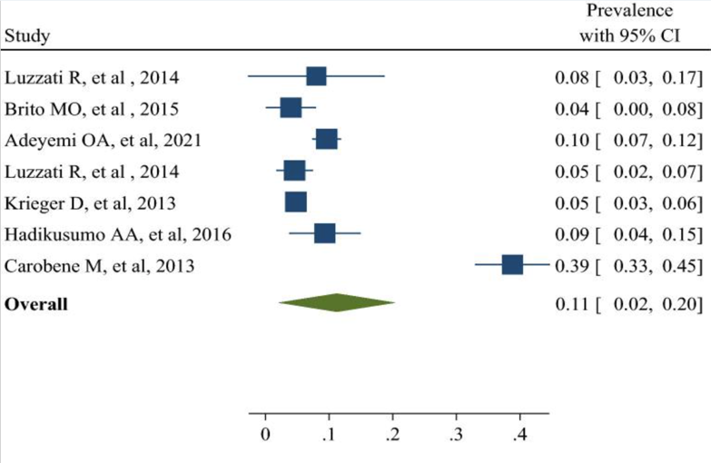
Regional prevalence of HIV, HCV, HBV (HBsAg), and active TB in prisoners, 2005-2015
High prevalence of HCV and HBV in trans and gender diverse people
Pooled prevalence of HCV: 9%
Pooled prevalence of HBV: 11%
Moradi G et al. The prevalence of hepatitis C and hepatitis B in lesbian, gay, bisexual and transgender populations: a systematic review and meta-analysis. Eur J Med Res. 2022 26;27(1):47..

Slide 11
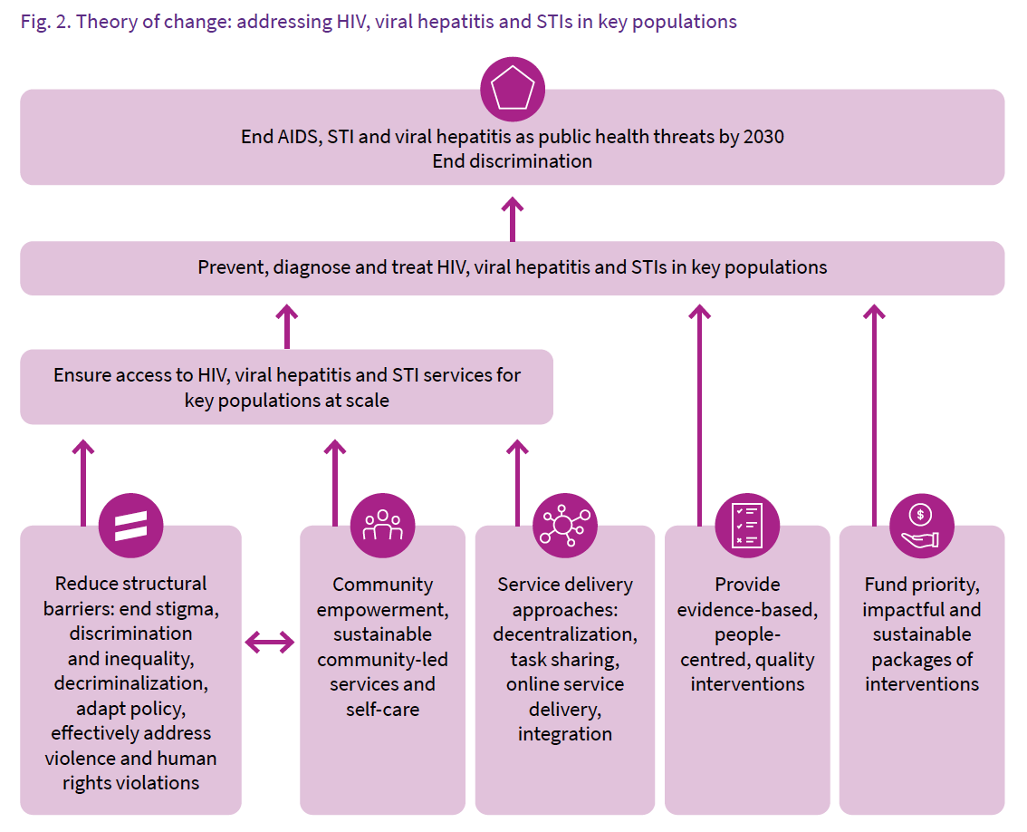
How we can optimize the response to HIV, viral hepatitis and STIs in key populations

Slide 12
Prioritizing interventions
Essential for impact: enabling interventions
interventions recommended to address structural barriers to health services access for key populations.
Essential for impact: health interventions
interventions which have a demonstrated direct impact on HIV, viral hepatitis and STIs in key populations.
Essential for broader health
health sector interventions to which access for KP should be ensured, but which do not have direct impact on HIV, viral hepatitis or STIs.
Supportive interventions
other interventions which support the delivery of health sector interventions, such as creating demand, providing information and education.

Slide 13
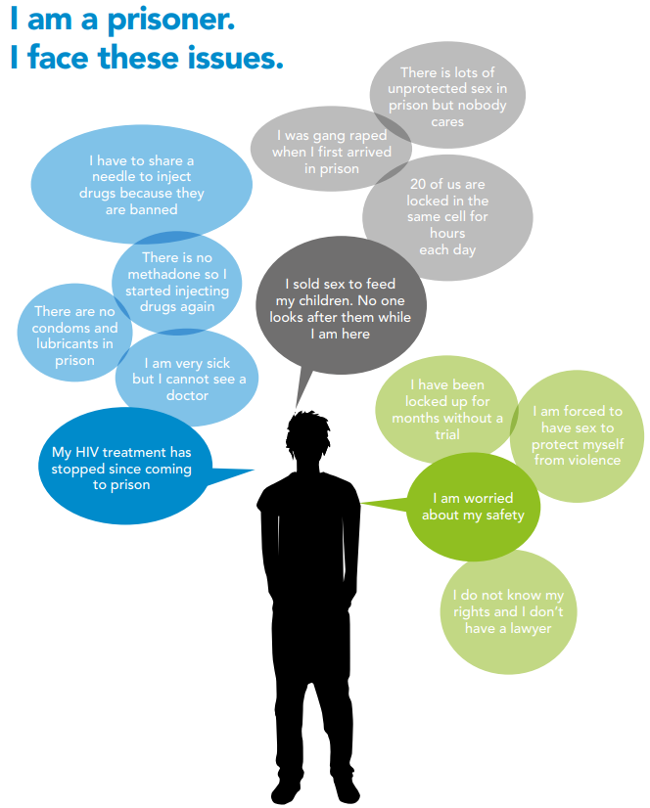
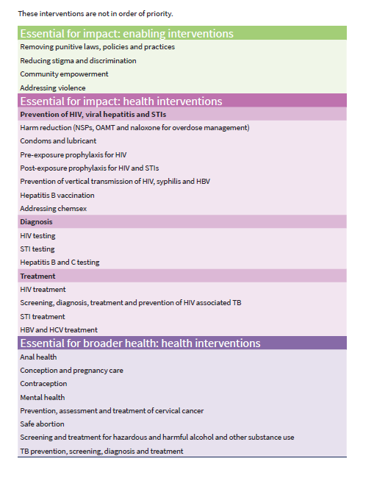
Source: Unaids. The gap report, 2014

Slide 14
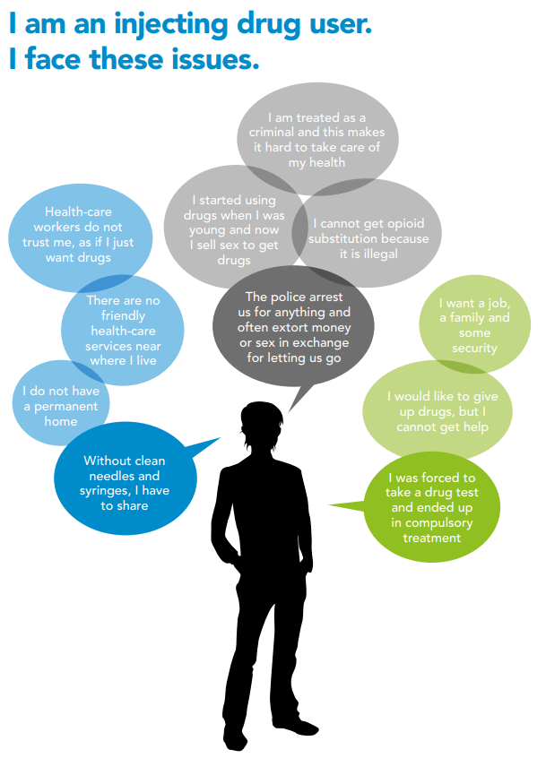
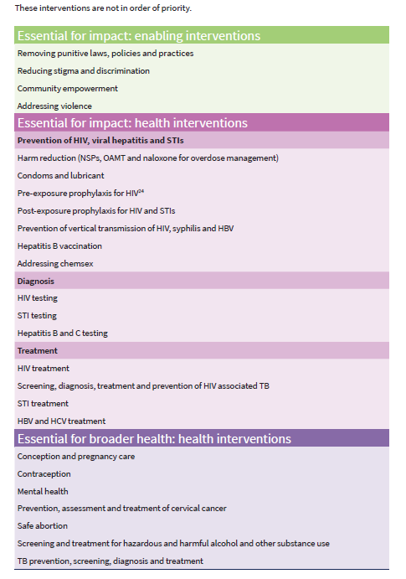
Source: Unaids. The gap report, 2014

Slide 15
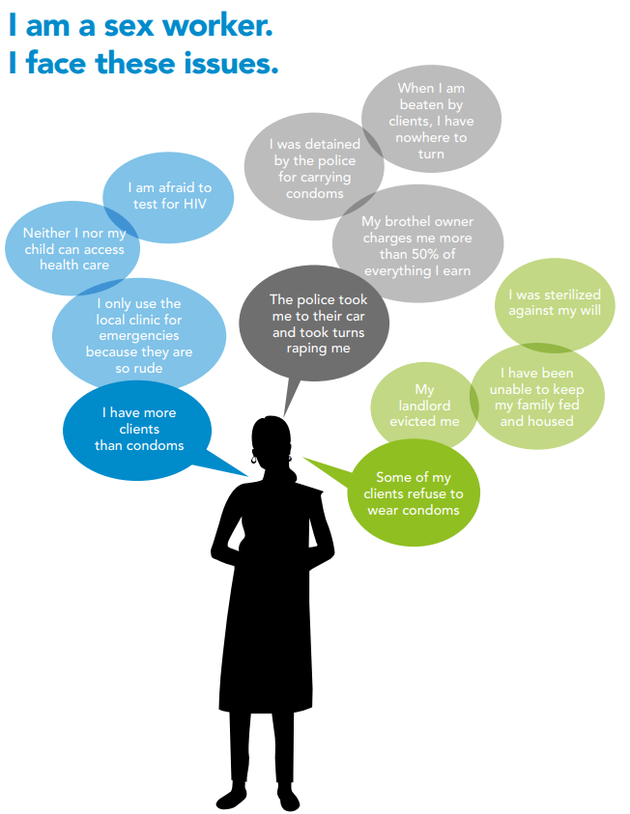
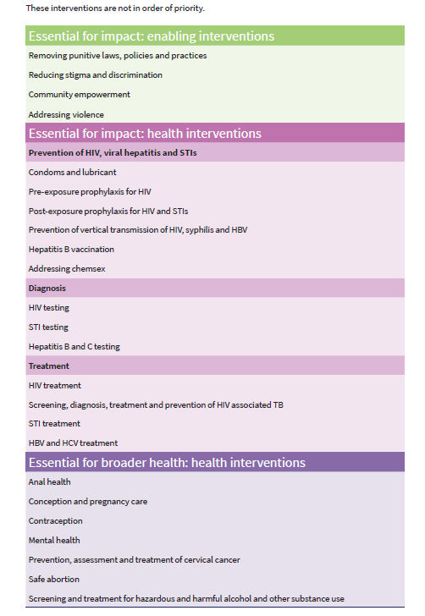
Source: Unaids. The gap report, 2014

Slide 16
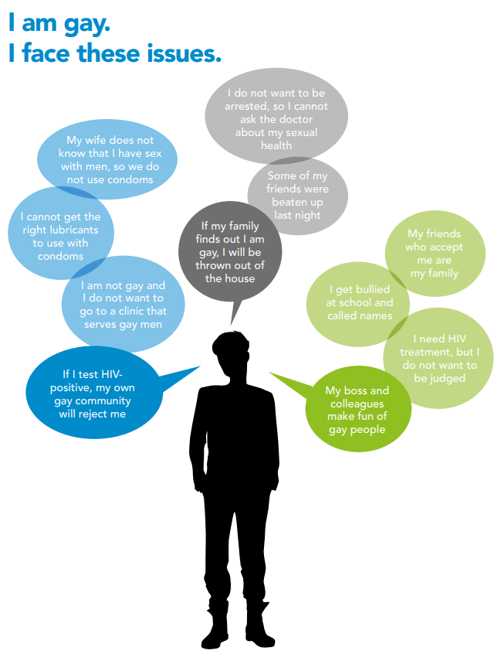
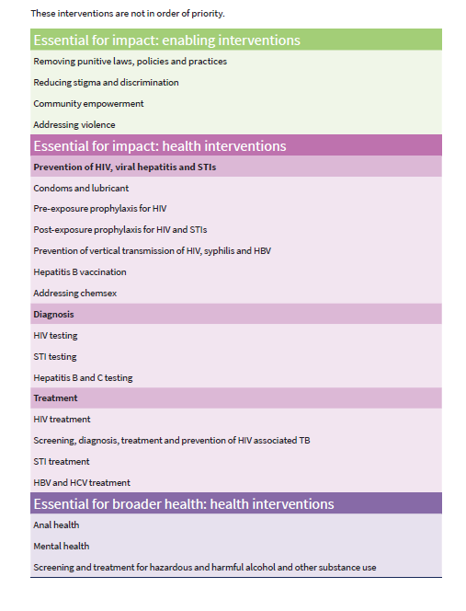
Source: Unaids. The gap report, 2014

Slide 17
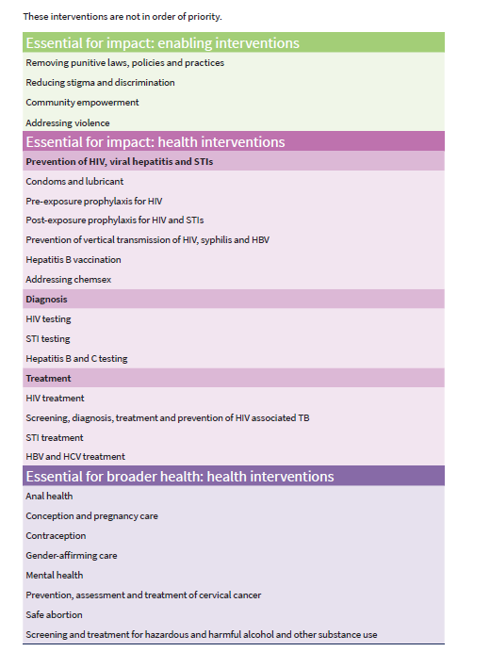
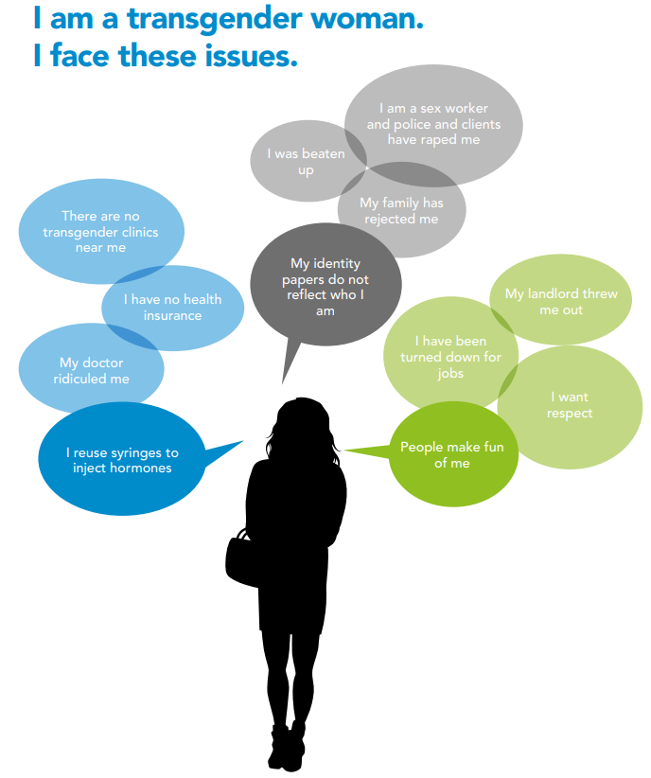
Source: Unaids. The gap report, 2014

Slide 18
Essential for impact: health interventions
Prevention
Harm reduction
Condoms and lubricant
Diagnosis
HIV testing services
Hepatitis B and C testing
Treatment
HIV treatment
HBV and HCV treatment
PrEP for HIV
PEP for HIV and STIs
Vertical transmission of HIV, syphilis and HBV
Hepatitis B vaccination
Addressing chemsex
STI testing
HIV/TB
STI treatment

Slide 19
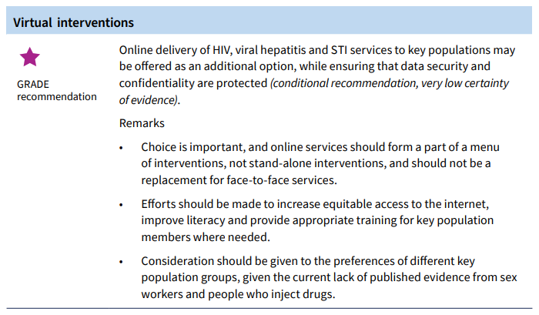
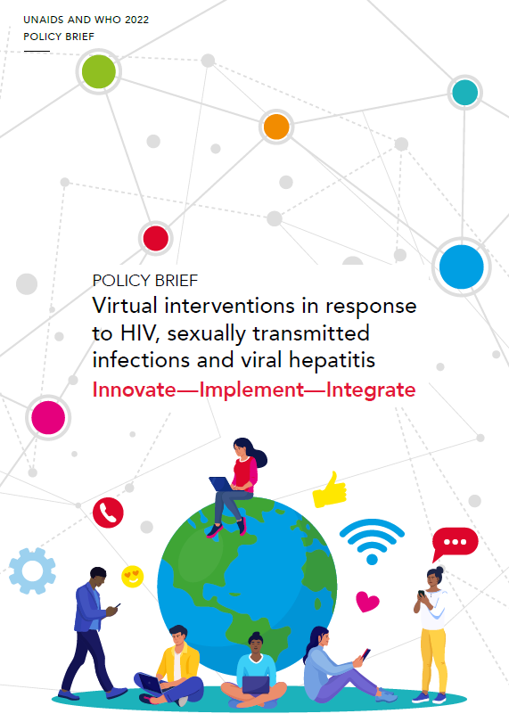

New recommendations on service delivery: Online delivery

Slide 20
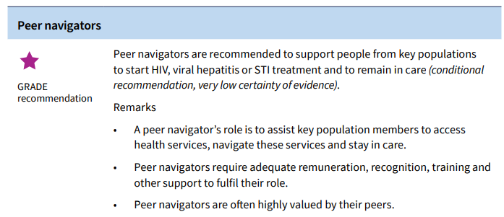
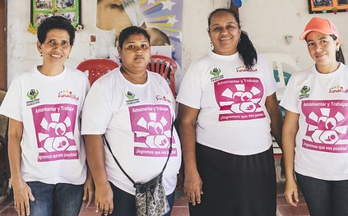

Slide 21
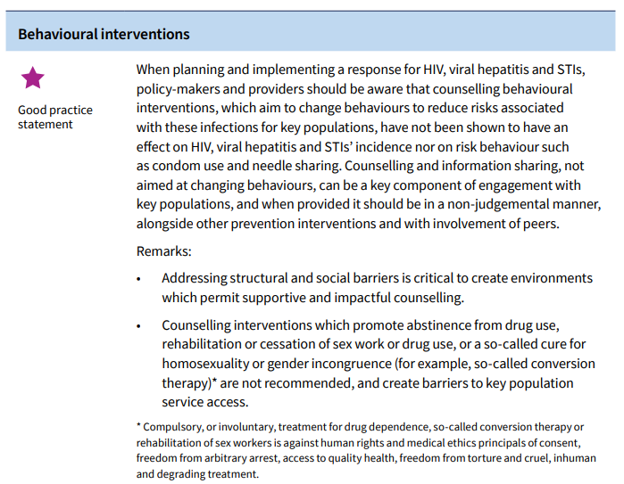
Counselling interventions to change people’s behaviours to reduce risk of HIV infection have not shown to have an effect on incidence nor on risk behaviours
*Counselling is defined here as a non-judgemental interactive process between a trained health care worker or lay provider and a client during which information is exchanged and support is provided so that clients can make informed decisions, design a plan and take action to improve their health.

Slide 22
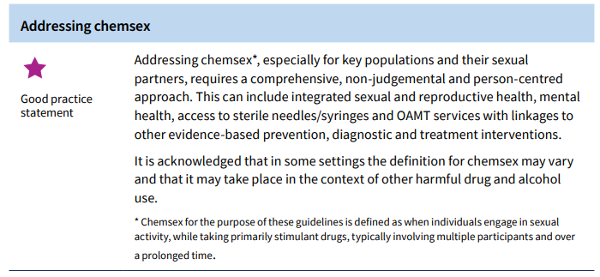

Chemsex is of growing concern due to potential harms such as HIV, STIs, hepatitis C, other drug and injection related harms and mental health issues
OAMT: opioid agonist maintenance therapy

Slide 23
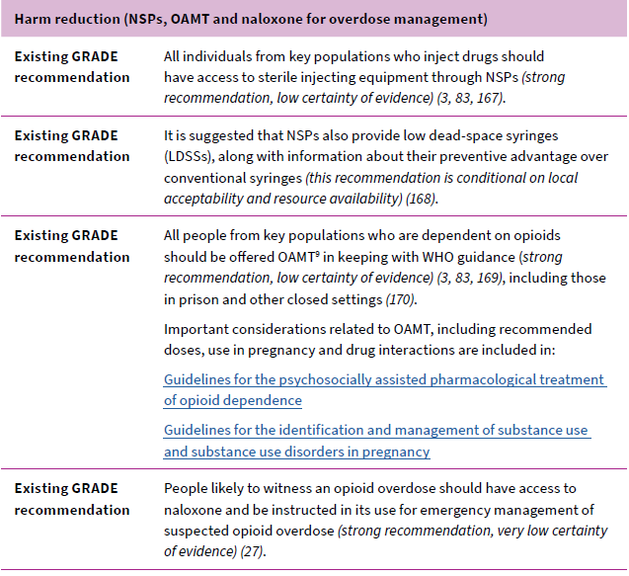
Effective harm reduction strategies for PWID
Needle/syringe programmes
Reduce transmission of HIV and viral hepatitis
do not increase injecting drug use
do not lead to discarded syringes in the community
Improve the health of people who inject drugs
Naloxone is an opioid antagonist which reverses the effects of opioids
It can prevent death in people who have overdosed on opioids
There is limited availability of naloxone in many settings
Community and pharmacy distribution of naloxone increases access and availability

Slide 24
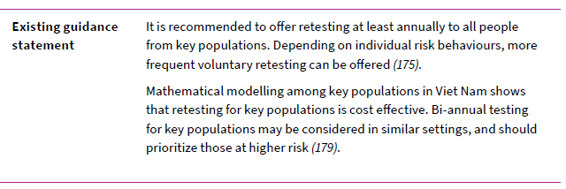
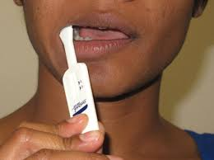
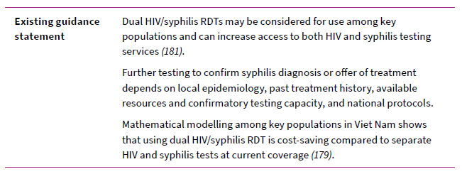
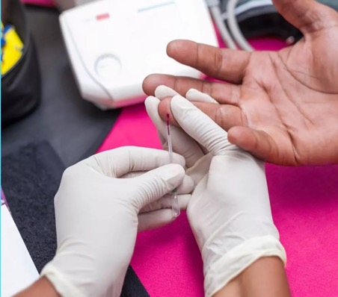
Retesting frequency and dual HIV/syphilis rapid diagnostic tests for KP

Slide 25



Social network testing
What are social network-based HTS approaches?
Social network testing:
may increase HIV diagnoses and identify additional people with HIV
may increase the acceptability of HIV partner services
feasible to implement
can be an efficient use of resources when they focus on people with high ongoing HIV risk
seldom result in social harm or adverse events.
Sexual network
Drug injecting
Social contacts
HIV+ or HIV –
Key populations

Slide 26
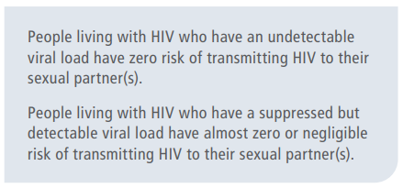
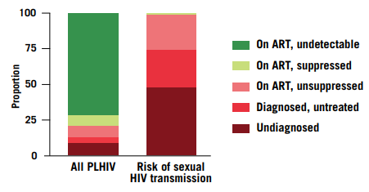

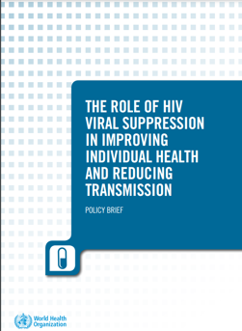
NEW: U=U

Slide 27
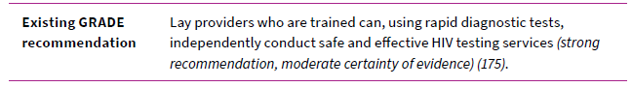
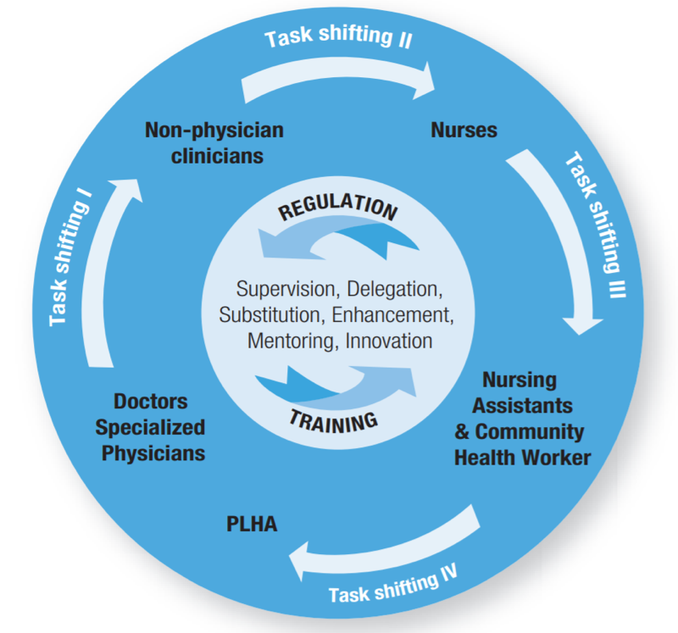


2008
2008
2006

Slide 28


ART service delivery recommendations: applying to KP
ART initiation may be offered outside the health facility | …including at community-based clinics operated for and by KP
Clinical visits every 3-6 months, preferably 6 months if feasible | …with no restrictions related to gender, employment, drug use or criminalisation
ART dispensing every 3-6 months, preferably 6 months if feasible

Slide 29

Push toward status neutral approach to health services
Re-engagement critical as majority of transmission are from chronic/established infections i.e., untested, unlinked or disengaged (AIDS2022)
Vannakit JIAS 2020: https://bit.ly/2E8oFjL

Slide 30

Essential for impact: enabling interventions
Removing punitive laws, policies and practices
Reducing stigma and discrimination
Community empowerment
Addressing violence

Slide 31



Slide 32


Removing punitive laws, policies and practices
 | Overarching good practice and guidance statements
Existing good practice statement (adapted) | Countries should work toward decriminalization of drug use/injecting, drug possession, sex work, same-sex activity and nonconforming gender identities, and toward elimination of the unjust application of civil law and regulations against people who use/inject drugs, sex workers, men who have sex with men and trans and gender diverse people
Existing guidance statement | Laws, legal policies and practices should be reviewed and, where necessary, revised by policy-makers and government leaders, with meaningful engagement of stakeholders from key population groups, to allow and support increased access to services for key populations

Slide 33


Reducing stigma and discrimination
Overarching good practice and guidance statements | Overarching good practice and guidance statements
Existing good practice statement | Countries should work towards implementing and enforcing anti-discrimination and protective laws, derived from human rights standards, to eliminate stigma, discrimination and violence against people from key populations .
Existing good practice statement | Policy-makers, parliamentarians and other public health leaders should work together with civil society organizations in their efforts to monitor stigma, confront discrimination against key populations and change punitive legal and social norms
Existing guidance statement | Health services should be made available, accessible and acceptable to people from key populations, based on the principles of medical ethics, avoidance of stigma, non-discrimination and the right to health

Slide 34

Community empowerment
Good practice and guidance statements
Existing guidance statement | Key population-led groups and organizations should be made essential partners and leaders in designing, planning, implementing and evaluating health services
Existing good practice statement | Programmes should implement a package of interventions to enhance community empowerment among key populations
^{[1]} Please note, in the WHO guideline: Prevention and treatment of HIV and other sexually transmitted infections for sex workers in low and middle-income countries: recommendations for a public health approach, WHO recommended a package of interventions to enhance community empowerment among sex workers. This was a strong recommendation with very low quality of evidence. In 2014, all WHO recommendations related to key populations were consolidated, and a new good practice statement developed to expand this recommendation to all key population groups, as included above.

Slide 35

Eliminating violence
Good practice statement
Violence against people from key populations should be prevented and addressed in partnership with key population-led organizations. All violence against people from key population groups should be monitored and reported, and redress mechanisms should be established to provide justice.

Slide 36

Concluding remarks
Increasing geopolitical tension against KP, particularly gay men, MSM and TGD people
Need for multisectoral approach and cross-UN to address structural barriers and critical enablers
Power and resilience of the health workforce: DO NO HARM, do what it is right to do!
Power and resilience of communities: community-based services; lay provider testing, peer navigators
Effective interventions to reach KP: HIV self-testing, network testing, virtual interventions
One size does not fit all: KP clinics vs general health services

Slide 37

Thank you!
Need a re-focus on effective interventions:
Stop doing things without impact,
Fast scale-up those which can make a difference!

Slide 38


TPP we’re here to help
Boys, men, VMMC and adolescents - Wole AMEYAN ameyanw@who.int
Key populations – Annette VERSTER VersterAn@who.int, Antons MOZALEVSKIS mozalevskisa@who.int, Maeve Brito de MELLO demellmae@who.int
STIs – Maeve Brito de MELLO demellmae@who.int, Erica SPIELMAN spielmane@who.int
Viral Hepatitis – Niklas LUHMANN luhmannn@who.int
PrEP/PEP – Michelle RODOLPH rodolphm@who.int, Mateo PROCHAZKA NUNEZ prochazkam@who.int
Stigma & discrimination Antons MOZALEVSKIS mozalevskisa@who.int, Erica SPIELMAN spielmane@who.int
Virtual interventions Purvi SHAH ShahP@unaids.org (joint WHO-UNAIDS position)
Testing - JOHNSON, Cheryl Case johnsonc@who.int; Maggie BARR-DICHIARA barrdichiaram@who.int, Céline LASTRUCCI (testing, lab & DSD) lastruccic@who.int; Alisa MONROE-WISE monroewisea@who.int (PS)
General (team lead) Rachel BAGGALEY baggaleyr@who.int

