Slide 1

Performance of the ShangRing for
Medical Male Circumcision in
Studies in Kenya and Zambia
Dr. Tim Mastro for the Study Team
AIDS 2014
Melbourne, Australia
22 July 2014

Slide 2
Voluntary Medical MC (VMMC) programs
Male circumcision (MC) reduces HIV acquisition in men by 60%
Countries with high HIV prevalence and low MC prevalence targeted for MC program scale-up
Program scale-up slow in some target countries
Few trained clinicians a major obstacle
Simpler methods could:
  shorten training time
  shorten procedure times
  hasten task-shifting to non-physician providers
  attract more men to seek MC

Slide 3
Advantages of MC devices
Can be done by trained clinical officers and nurses (task shifting)
Task shifting → larger program volume
Shorter procedure time → more men circumcised
No sutures
Bleeding, infection adverse events (AEs) are rare
Faster return to normal activities
Better cosmetic outcome
Notes:
I’ll try to summarize some of the key advantages shared by leading MC devices over conventional surgical MC methods.

Slide 4
Limitations of MC devices
Requires wear for 7 days & return visit
Surgical back-up required
  anatomical problems exclude some men
  wound dehiscence may require suturing
  attempted self-removal or dislodgment can require surgical MC to treat resulting AEs
Longer healing time → potential for increased HIV acquisition or transmission
Further training needed for all providers
Multiple device sizes needed → inventory issues
No information on longer-term post-MC experience
Notes:
But we know that there are important disadvantages too.

Slide 5
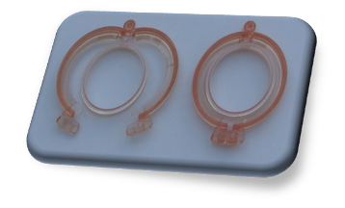
ShangRing device for MC
Collar-clamp type device
Over 600,000 used in China since 2007
European CE mark, 2008
U.S. FDA marketing approval, 2013
Under review for WHO pre-qualification
No suturing
Injection anesthesia required
Notes:
One of the best-studied MC devices is the ShangRing. It has been used to circumcise hundreds of thousands of Chinese men and boys.
It is a collar-clamp type of device.

Slide 6
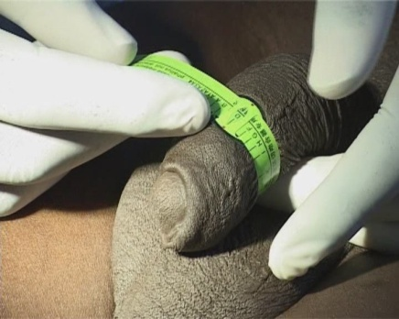
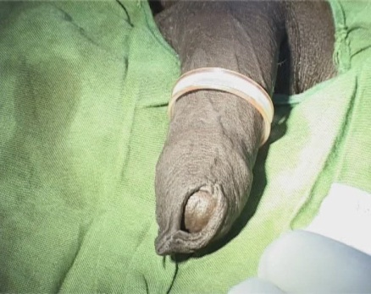
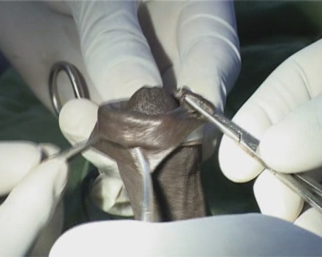
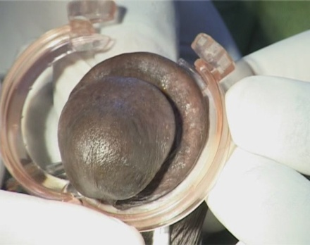
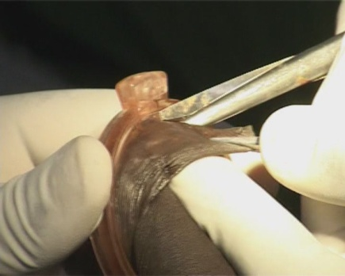
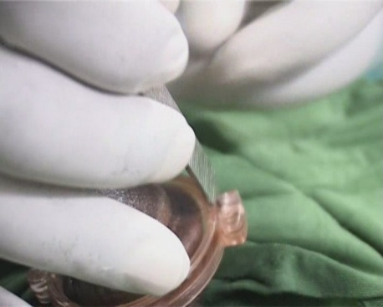
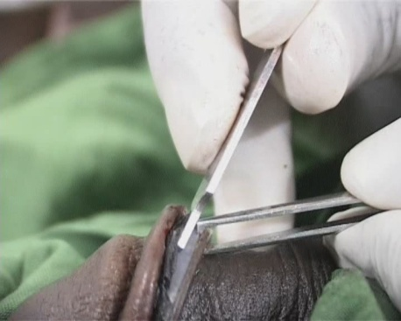
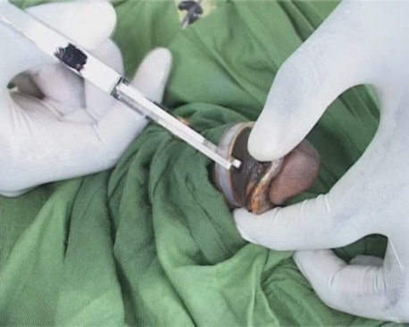
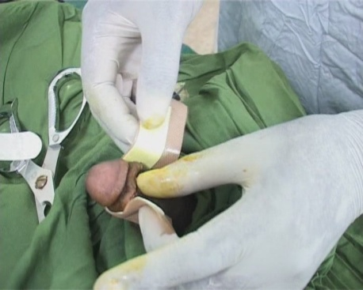
ShangRing circumcision & removal
ShangRing Circumcision
1. Measure
2. Place inner ring
3. Evert foreskin
4. Place outer ring
5. Cut
ShangRing Removal at 7 Days
1. Open outer ring
2. Separate inner ring from scab
3. Cut inner ring
4. Apply bandage
Notes:
Anesthesia injected (not pictured here)
Penis circumference is measured at the coronal sulcus
Inner ring is placed
Foreskin is everted back over the inner ring
Outer ring is clamped, sandwiching the foreskin between the rings
Foreskin is removed
Clamp is removed after ~ 7 days
Special tool opens the outer ring
Lidocaine spray facilitates separating the inner ring from the wound
Inner ring is cut and discarded
Bandaging is standard

Slide 7






Collaborative ShangRing studies
Time to Removal (N=50), Kenya 2010
  Barone et al, JAIDS 2012
Randomized Controlled Trial (N=400), Kenya and Zambia, 2011
  Sokal et al, JAIDS 2014
Field Study, Kenya and Zambia (N=1200), 2012
  Sokal et al, JAIDS in press
Notes:
With funding from the Gates Foundation, FHI 360 has partnered to conduct three ShangRing studies in Kenya and Zambia.

Slide 8
Common study objectives
Primary
  safety of ShangRing circumcision during routine adult MC (outcome: circumcision-related AEs)
Secondary
  time to complete healing (outcome: time measured in days after placement, not removal)
  client acceptability (outcomes: post-MC pain, faster return to normal activities, overall satisfaction with ShangRing MC)
  provider preferences (outcome: preference for ShangRing MC technique)
Notes:
The primary objective was to evaluate safety of Shang Ring circumcision during routine adult male circumcision service delivery. We looked at adverse event rates and occurrence of device-related incidents.
Secondary objectives were to evaluate client acceptability, provider preferences and healing in HIV-positive men, with the outcomes noted on the slide.

Slide 9
Mean times (minutes): 3 studies
 | Ring Placement | Ring Removal | Surgical
Time to Removal Study | 6.5 | 2.5 | n/a
RCT | 7.1 | 3.1 | 20.3
Field Study | 6.4 | 3.4 | n/a

Slide 10
Safety: AEs in 3 ShangRing studies
 | TTR n=50 | RCT n=195 | Field n=1149 | Total (%) n=1394
SEVERE
Post-op pain | 0 | 0 | 1 | 1 (0.07)
Wound dehiscence | 0 | 0 | 1 | 1 (0.07)
MODERATE
Infection | 3 | 0 | 2 | 5 (0.4)
Wound dehiscence | 3 | 6 | 9 | 18 (1.3)
Wound edema | 0 | 1 | 1 | 2 (0.1)
Post-op pain | 0 | 0 | 3 | 3 (0.2)
Insufficient skin removal | 0 | 0 | 1 | 1 (0.07)
TOTAL | 6 | 7 | 18 | 31 (2.2)
Notes:
The table summarizes moderate and severe AEs only. Mild events are those considered to be normal following any male circumcision procedure, and do not require clinical intervention.

Slide 11
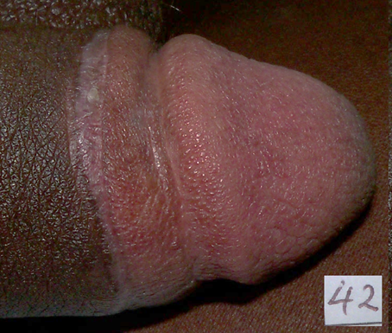
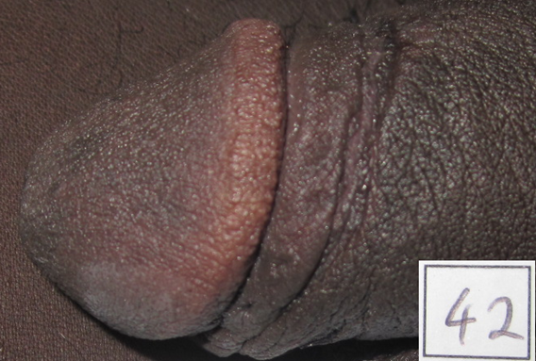
Complete healing at 42 Days: 3 studies
Time to Removal 94.5%
RCT
ShangRing: 76.8%
Conventional Surgery: 85.3%
(p<0.001)
Field Study
HIV-pos: 85.7%
HIV-neg: 87.3%
Notes:
Important to mention that certification of complete healing is a subjective measure. In fact, healing times were quite different between the Kenyan and Zambian providers in the RCT, with the Zambians more conservative. Zambian providers were again more conservative than the Kenyans in the field study.
In the RCT, the difference in mean days to complete healing was highly significant (p<0.001).
The median days to complete healing did not differ.

Slide 12
Acceptability parameters: 3 studies
 | Time to Removal | RCT | Field Study
Client very satisfied w appearance | 88% | 96% | 95%
Provider preference for Ring | 100% | 100% | 90%

Slide 13
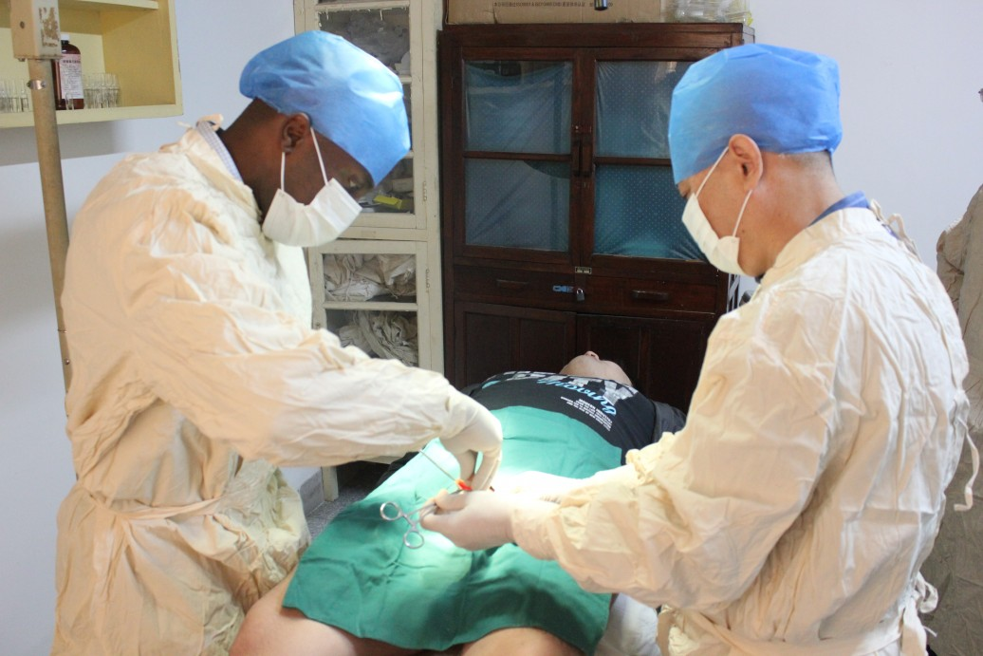
Summary of 3 ShangRing studies
Excellent safety profile
Healing with Shang may take modestly longer than after surgical MC, but importance unclear
ShangRing was well-liked by participants and strongly preferred by providers
Notes:
We found that the Shang Ring had an excellent safety profile. This has also been the case with studies in China as well as in Rakai, Uganda.
It was easy for non-physicians to use the ShangRing in routine service delivery in a variety of settings, and there was a strong preference for the ShangRing over conventional methods of male circumcision
The ShangRing was well accepted by participants, with the vast majority very satisfied with their ShangRing circumcision
The evidence to date suggests that the Shang Ring could facilitate rapid roll-out of voluntary medical male circumcision for HIV prevention in Africa.

Slide 14
Planned study #1: longer-term follow-up
Western Kenya
Recruit 200 men circumcised using ShangRing during prior field study 1-2 years earlier
  Assess cosmetic result
  Query AEs in the interim
  Acceptability to main sexual partner
  Condom use
  Determine men’s long-term satisfaction with ShangRing MC
Notes:
WHO interested in the issue of longer-term follow-up. We agreed that we could locate participants in one of our clinical ShangRing studies in western Kenya.
We expect to initiate the small study this summer.

Slide 15
Planned study #2: fewer ring sizes in Zambia
ShangRing comes in 14 adult sizes; we think fewer sizes will suffice
Fewer sizes could reduce inventory issues with stock-outs and cost
Planned RCT with 500 men in 2 Lusaka clinics
  Control arm: have all sizes available
  Treatment arm: half of the sizes available
  Compare AE rates, healing time
  Assess satisfaction/acceptability in each arm
Notes:
The inventor of the ShangRing, Mr. Shang, believes that the entire array of ring sizes is necessary to safely and comfortably fit all men. Others are skeptical. We plan to test if results will be similar with a lesser number of ring sizes used.

Slide 16
Planned study #3: field study in Malawi
Current Malawi VMMC program in early, catch-up stage
Volume low, M&E inconsistent, few trained providers
Will conduct study in Blantyre with 500 men
  Community mobilization and generating demand in 18-49 y.o. age group will be key
  Training by experienced Zambian providers
  Surgical back-up at district hospital
  Measure safety, effectiveness and acceptability
Notes:
Malawi is one of the countries that has been slow to scale-up their VMMC program. Relatively few procedures have been done, beginning in 2011. The Gates Foundation wants us to introduce and observe the performance of the ShangRing there.
CDC is doing a similar study of the PrePex device elsewhere in Malawi.

Slide 17
Potential Future Research on ShangRing
Safety and effectiveness of device for adolescents
  smaller sizes available for ShangRing, down to infant
  revised “no-flip” technique for adolescents
  pilot study completed, need bridging study
Early infant male circumcision (EIMC)
  suitability of ShangRing for infant MC in Africa
  compare with other common clamp devices (e.g. Gomco, Mogen)
Compare with PrePex device for adult, adolescent MC

Slide 18
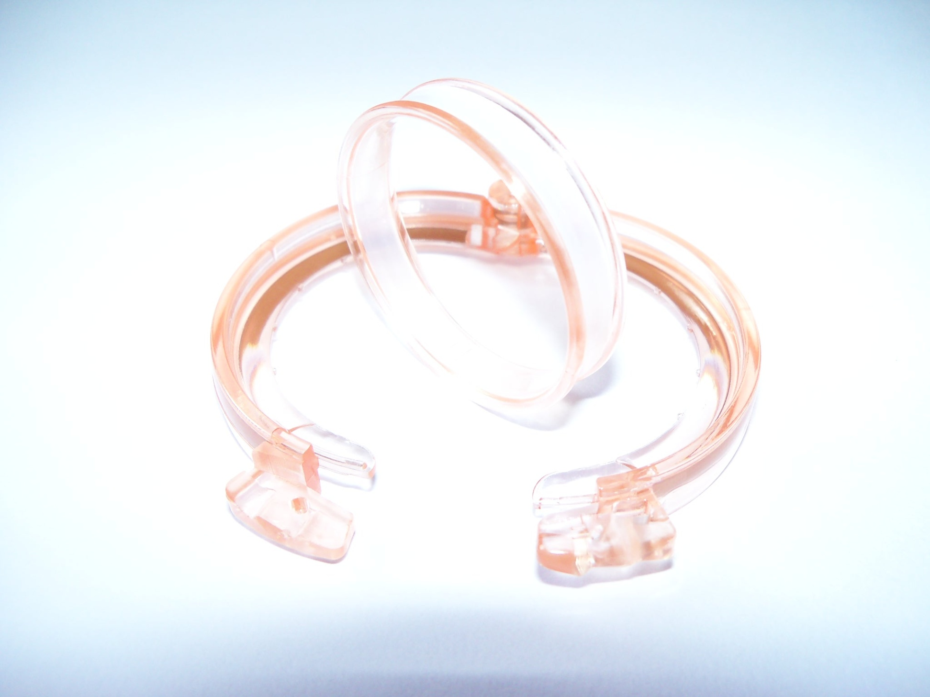
Acknowledgements
EngenderHealth
Weill Cornell
FHI 360
Quentin Awori
Mark Barone
Sharone Beatty
Jared Moguche
Paul Perchal
Carolyne Onyancha
Daniel Ouma
Rosemary Were
Marc Goldstein
Richard Lee
Philip S. Li
John Bratt
Stephanie Combes
Catherine Hart
Jaim Jou Lai
Prisca Kasonde
Mores Loolpapit
David Sokal
Michael Stalker
Valentine Veena
Debra Weiner
Merywen Wigley
Zude Zyambo
Kenya
Zambia
Alex Aduda
Ojwang Ayoma
Peter Cherutich
Jackson Kioko
Nicholas Muraguri
Ojwang Lusi
Jairus Oketch
Raymond Otieno
John Wekesa
Kasonde Bowa
Daniel Mashewani Christopher Mubuyaeta
David Mulenga
Mulima Muzeya
Robert Zulu
Supported by a grant from the Bill & Melinda Gates Foundation to FHI 360
Notes:
I would like to acknowledge all of the many people who worked on the study, who are listed here on this slide
And thanks to the Bill & Melinda Gates Foundation who supported this work, and continue to support it.

