Slide 1






Quality of Voluntary Medical Male Circumcision Services during Scale-Up: A Comparative Process Evaluation in Kenya, South Africa, Tanzania and Zimbabwe
Dr. Dino Rech

Slide 2
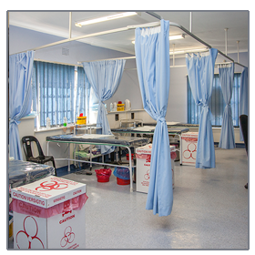
Overview of Presentation
Background
Study objectives
Methodology
Results
Conclusion

Slide 3
Background
Voluntary medical male circumcision (VMMC) has been shown to reduce the risk of HIV transmission in heterosexual men by approximately 60%.
Data from modeling research suggests that 80% VMMC coverage in 13 Eastern and Southern African countries could avert 3.4 million new HIV infections within 15 years.
    Njeuhmeli, E. et al. (2011). Voluntary medical male circumcision: Modeling the impact and cost of expanding male circumcision in Eastern and Southern Africa. PLoS Med 8(11): e1001132

Slide 4
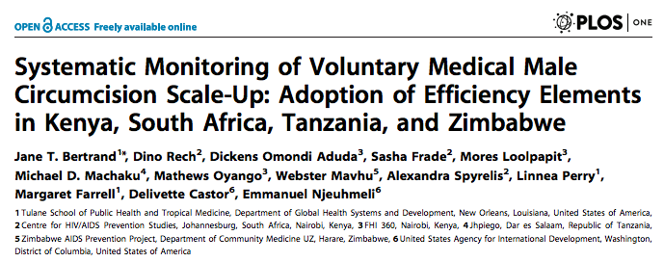
Study Objectives
To assess the effect of the scale-up on the quality of the VMMC programme
To examine the quality of VMMC services among four African countries (South Africa, Tanzania, Kenya and Zimbabwe) over two years of programme scale-up

Slide 5
SYMMACS Methodology
Process evaluation in four countries in southern and eastern Africa active in VMMC scale-up:
  Kenya, South Africa, Tanzania, and Zimbabwe
Two serial cross-sectional samples of VMMC service delivery sites
  Data collected in 2011 and 2012 using same instruments
Included fixed, outreach and mobile sites (where they existed)
  Kenya: only country that had mobile sites

Slide 6
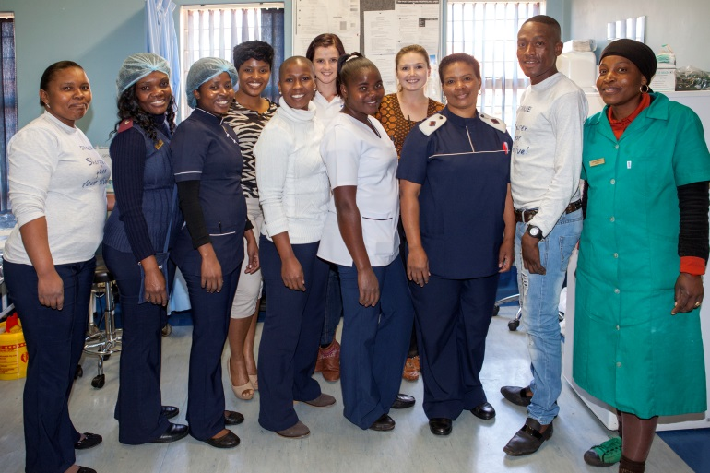
Data Collection Instruments
1-a: A quality-assessment (QA) of the VMMC site (shortened version of the WHO QA tool)
1-b: Observation of 10 VMMC procedures per site, including timing of each operation
2: Interviews with the primary and secondary VMMC service providers on days of visit

Slide 7
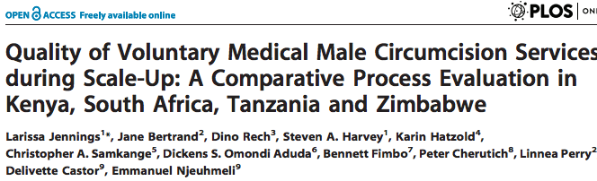
Key Findings across 4 Countries
  Marked increase in number of VMMC sites between 2011 and 2012
  Pronounced seasonal variation in peak periods for VMMC (which vary by country)
  Countries adopted between 3-5 of the 6 surgical efficiency elements
    Forceps guided surgical method and task sharing were the only elements adopted by all countries
Country-specific QA trends (2011 versus 2012):
  South Africa: rapid expansion of sites led to decreased quality of services
  Zimbabwe showed improvement on multiple items
  Kenya and Tanzania – no significant change

Slide 8
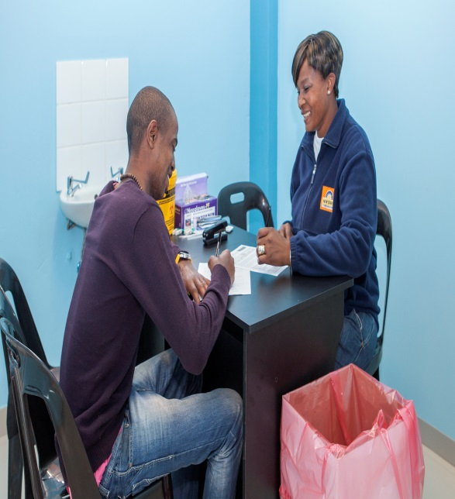
Key Findings across 4 Countries
Overall strengths of program
Group education on HIV prevention widely available
Generally high marks on quality of surgical procedure
Improvements in information systems by 2012
General areas for improvement
Inadequate recording of adverse events
Lack of emergency equipment on sites
Absence of guidelines on site

Slide 9
Key Findings in South Africa
Rech D, Spyrelis A, Frade S, Perry L, Farrell M, et al. (2014). Implications of the fast evolving scale-up of Adult Voluntary Medical Male Circumcision for Quality of Services in South Africa
Link: http://www.plosone.org/article/info%3Adoi%2F10.1371%2Fjournal.pone.0080577
  Achievements:
    Functioning client information systems
    Good surgical technique
  Main challenges:
    Monitoring of Adverse Events
    External supervision
    Post-operative counselling
    Infection control issues
  Elements of efficiency not yet in use
    Task-shifting

Slide 10
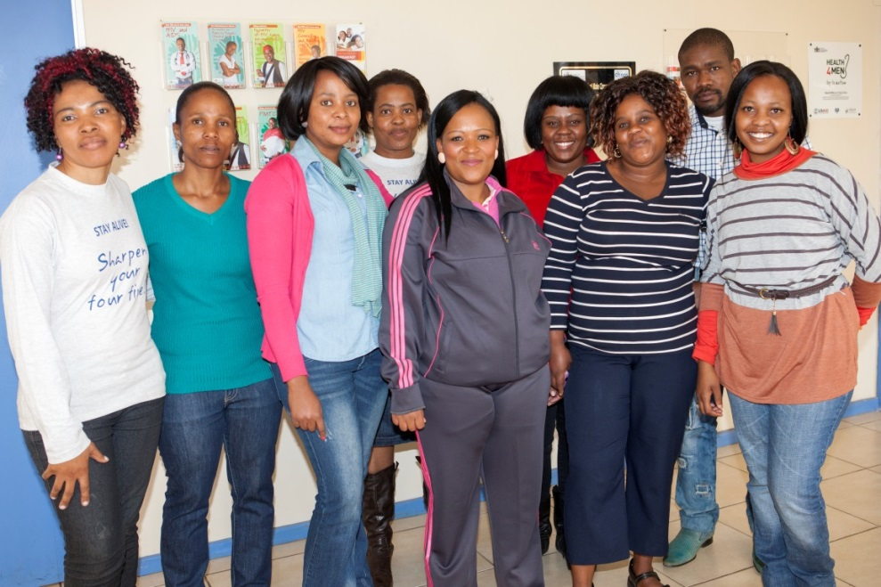
SYMMACS Operations Research Programme Impact
Annual Program evaluation conducted by country teams utilizing SYMMACS Findings and interim results.
Real-time program and policy changes considered and implemented as a result.

Slide 11
USAID Applying Science to Strengthen and Improve Systems(ASSIST)
ASSIST project provides technical support to the Ministry of Health – Uganda (MOH) to improve quality of VMMC
For example:
    Uganda
South Africa:
    Now implementing
    CQI
Indicator | January 2013 (base-line) | Apr-14
Percentage of clients that return within 48 hours after Circumcision | 18% (7sites) | 68% (27 sites)
Percentage of clients that attend VMMC health education with their partners (as couples) | 0% (1 site) | 31% (14 sites)
Number of sites that collect data on type, grade and rate of adverse events | 30% (9 sites) | 90% (27 sites)
Percentage of clients with documented informed consent prior to circumcision | 83% (19 sites) | 100% (27 sites)
Percentage of clients screened for STIs prior to circumcision | 81% (19 sites) | 100% (27 sites)
Byabagambi, J., Nkolo, E. K., Marks, P.,et al. (2014). Improving Quality of Voluntary Medical Male Circumcision Through Continuous Quality Improvement (CQI) Approach : Uganda’s Experience

Slide 12
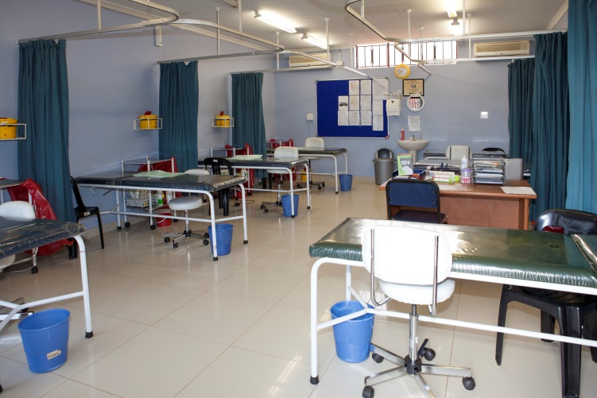
Conclusion
Scaling up VMMC programs is an important strategy in the prevention of HIV infection in Sub-Saharan African countries.
The overall scale-up has over extended human resources, which in turn has negative effects for both the original sites and the expanded program.
Given the potentially significant contribution of VMMC in decreasing HIV transmission, monitoring quality is critical in identifying and eliminating gaps in care during introductory and scale-up periods.

Slide 13


The USAID | Project SEARCH, Task Order No.2, is funded by the U.S. Agency for International Development under Contract No. GHH-I-00-07-00032-00, beginning September 30, 2008, and supported by the President’s Emergency Plan for AIDS Relief. The Research to Prevention (R2P) Project is led by the Johns Hopkins Center for Global Health and managed by the Johns Hopkins Bloomberg School of Public Health Center for Communication Programs (CCP)

