Slide 1



Annex C (Situation Analysis): SA Resource Deck

Slide 2
Condom Situation Analysis – Country Name
How to use this Resource Deck:
This deck is intended to accompany the Situation Analysis Guidance, which provides a step-by-step approach for completing a Situation Analysis for condom programming in support of the development of Strategic Operational Plans that achieve and sustain high levels of condom use for the prevention of HIV, other STIs, and unwanted pregancies.
The Situation Analysis is intended to enable planners and decision-makers to identify priorities and broad areas of intervention using the best available evidence and the collective knowledge of national experts.
The deck includes tips and sample slides that are intended to suggest ways to present your data and insights. These can be adapted for your data and context.
It is not expected that every Situation Analysis will include all of the types of data included here. A shorter deck may be desirable depending on the strategic planning process.
Date

Slide 3
Executive Summary
Provide a brief description of the process for developing the situation analysis and the high level findings most relevant to setting priorities within the plan.

Slide 4
Structuring the Situation Analysis Deck
To facilitate development of the Strategic Operational Plan and program targets, the analysis is organized using the model Results Framework developed by UNAIDS and UNFPA
Goals: Understanding the health need. Data collected here focuses on epidemiology, HIV & STI incidence and prevalence, and the unmet need for family planning. This helps the program focus on whom the condom market (public, NGO, and commercial) must serve to have the most health impact.
Higher-Level Outcomes: Analyzing trends in condom use. Data collected here provides an understanding of which priority populations the condom market is currently serving (or failing to serve).
Lower-Level Outcomes: Identifying the drivers of condom use. Data collected focuses on the supply and demand barriers to use, as well as the challenges in program stewardship that affect supply and demand.
Activities: Landscaping interventions. Data collected here contributes to an understanding of who is implementing which interventions for which priority populations as well as to identify strengths, weaknesses, and gaps in the current response.

Slide 5
National Condom Strategy: Model Results Framework
Reduction in new HIV infections
Reduction in STI infections
Reduction in unintended pregnancies
Impact
Impact
Increased condom use by priority groups
Outcomes
Outcomes
Improved knowledge, risk perception, attitudes, norms, self-efficacy and condom use skills
Sustainable systems in place for supply, demand & management of condom programs & markets
Increased condom availability
Reach & quality of evidence driven demand generation increased
Program stewardship strengthened
Condom supply and distribution improved
Outputs
Outputs
Demand Generation Activities
Program Stewardship Activities
Supply Strengthening Activities
Activities
Activities

Slide 6
Outline Health need Condom use Use vs. Need Factors that drive use Demand Supply Program Stewardship Activities

Slide 7
Outline Health need Condom use Use vs. Need Factors that drive use Demand Supply Program Stewardship Activities

Slide 8
HIV – Key questions & data sources
Health Need
Data & Sources
Questions | Data sources
Who is most at risk of HIV infection? Where is HIV incidence and prevalence highest? Are there particular geographic areas or groups or behaviors that contribute the highest number of new infections? How has this changed over the last 5-10 years? Are there groups that are achieving high levels of viral load suppression? | MOH reports DHS https://www.statcompiler.com/ Modes of Transmission Studies Population-based HIV Impact Assessment (PHIA) https://phia-data.icap.columbia.edu/ Other targeted studies National plans for HIV UNAIDS https://www.unaids.org/en/topic/data, http://aidsinfo.unaids.org/ USAID COP Key informant interviews with government and market actors provide qualitative data that gives context to the quantitative data.

Slide 9
Other STIs – Key questions & data sources
Health Need
Data & Sources
Questions | Data sources
Who is most at risk for STIs? Where is the incidence of other STIs highest? Are there particular geographic areas or groups or behaviors that contribute the highest number of new infections? How has this changed over the last 5-10 years? | MOH reports DHS https://www.statcompiler.com/ Other targeted studies National plans for STI prevention and management Key informant interviews with government and market actors provide qualitative data that gives context to the quantitative data.

Slide 10
FP – Key questions & data sources
Health Need
Data & Sources
Questions | Data sources
Which geographic areas or groups have shown the highest preference for condoms as a family planning method? How has this changed over the last 5-10 years? | MOH reports DHS https://www.statcompiler.com/ National plans for RH & FP FP 2020 https://www.familyplanning2020.org/measurement-hub https://www.un.org/en/development/desa/population/publications/pdf/family/ContraceptiveUseByMethodDataBooklet2019.pdf Key informant interviews with government and market actors provide qualitative data that gives context to the quantitative data.

Slide 11
Health Need: Example slides

Slide 12
Health Need
Health Need – High level insights – Examples
Example Insights
Nearly all new HIV infections in adults are sexually transmitted.
Incidence among sex workers and their clients disproportionately high
Low levels of viral suppression achieved by treatment programs => the vast majority of PLHIV can transmit HIV through sex.
The number of people who can infect others is increasing (there were more new HIV infections than the increase in number of people on treatment).
Other STIs are a substantial health problem, reducing productivity and straining public health resources.
Condoms are the most used family planning (FP) method for unmarried women and are an important part of the method mix to reduce unmet need for contraception.

Slide 13
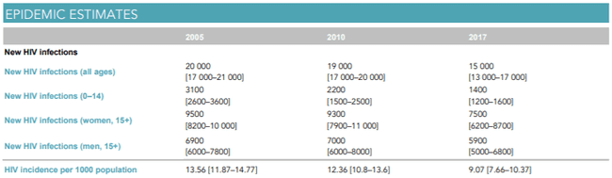
Lesotho: HIV Incidence
Health Need
Example Slides
Insights:
1. > 90% of new infections in ages 15+
2. New infections more than 25% higher among women
Source: UNAIDS https://www.unaids.org/sites/default/files/media_asset/unaids-data-2018_en.pdf

Slide 14
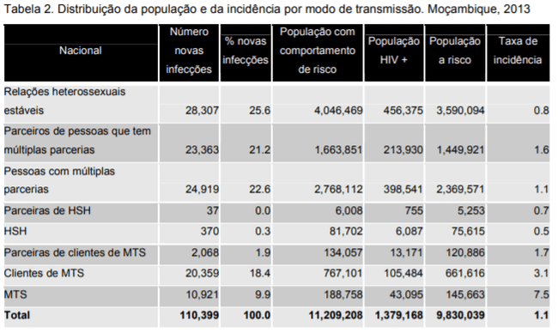
Health Need
Mozambique
HIV incidence by mode of transmission
Example Slides
Insights:
Substantial proportion of new infections in stable relationships
But paid sex (sex workers and their clients) still represents a large proportion of incidence – and the highest incidence rate
MTS = Female sex workers
Source: Modes of transmission study (2013)
See important note on this slide
Notes:
Note that the MOT model is a static model, ie does not reflect dynamic effects (“downstream transmissions”), ie which populations are more likely to pass on new HIV infections, so it is important to interpret results with caution. See https://www.ncbi.nlm.nih.gov/pmc/articles/PMC4069382/ for a discussion.
Dynamic models like Spectrum, GOALS, AEM, Optima and various academic models consider these dynamics. However, even with a dynamic model showing annual new HIV infections in different groups does not show long-term dynamics. Hence, in order to understand long-term transmission dynamics, it is good to complement the annual distribution of new HIV infections with long-term population attributable fractions.

Slide 15
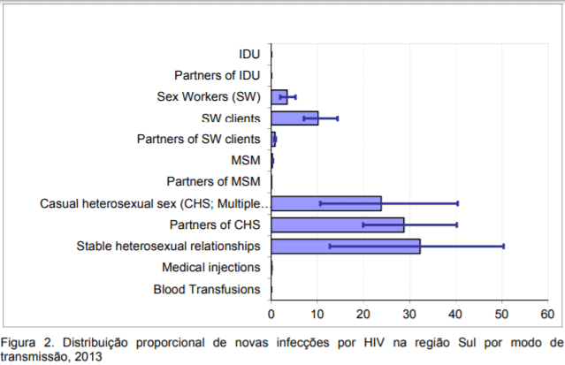
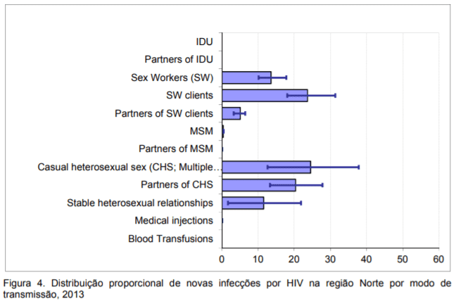
Health Need
Mozambique
HIV incidence by mode of transmission & region
Example Slides
Insights:
Similar modes of transmission across regions
Incidence in stable relationships higher in South
Incidence in sex work higher in the North
Source: Modes of transmission study (2013)
See important note on this slide
Notes:
Note that the MOT model is a static model, ie does not reflect dynamic effects (“downstream transmissions”), ie which populations are more likely to pass on new HIV infections, so it is important to interpret results with caution. See https://www.ncbi.nlm.nih.gov/pmc/articles/PMC4069382/ for a discussion.
Dynamic models like Spectrum, GOALS, AEM, Optima and various academic models consider these dynamics. However, even with a dynamic model showing annual new HIV infections in different groups does not show long-term dynamics. Hence, in order to understand long-term transmission dynamics, it is good to complement the annual distribution of new HIV infections with long-term population attributable fractions.

Slide 16
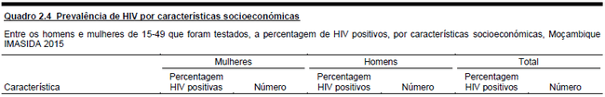

Health Need
Mozambique
HIV prevalence by SES quintile
Example Slides
Insights:
Prevalence generally rises with SES quintile in both men and women.
Source: IMASIDA (2015)

Slide 17
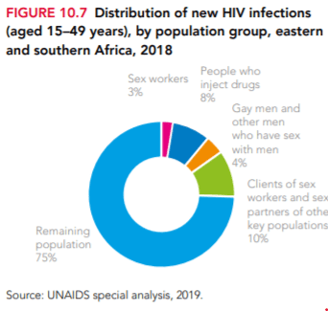
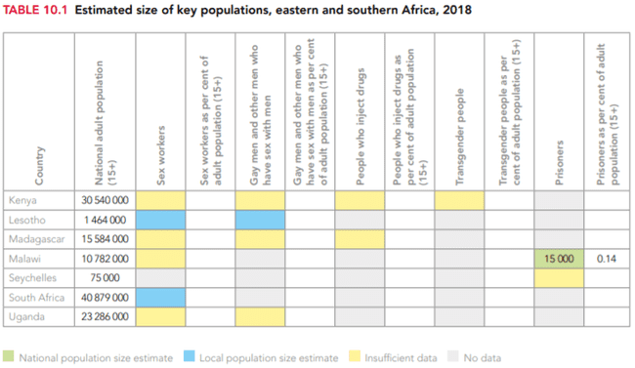
Incidence by priority pop – regional view
Health Need
Example Slides
From: https://www.unaids.org/sites/default/files/media_asset/2019-global-AIDS-update_en.pdf

Slide 18
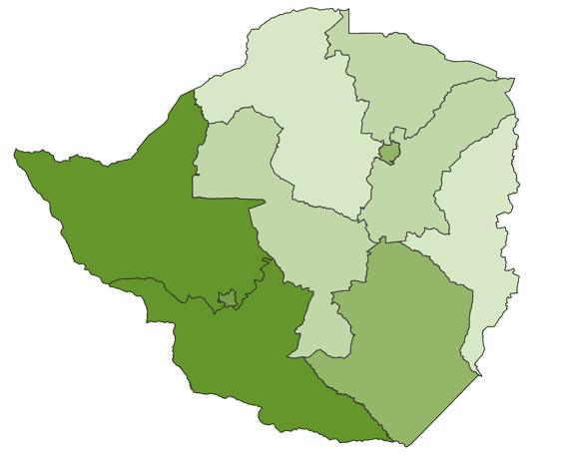
Health Need
Zimbabwe
HIV prevalence by region
Example Slides
Harare
13%
Insights:
Prevalence varies by region with the highest prevalence in the southwest
MSW
11.8%
MSC
12.9%
MSE
12.9%
MBN
18.8%
MID
12.7%
MNL
10.2%
MVG
13.7%
Bulawayo
16.5%
MBS
20.4%
Source: ???

Slide 19
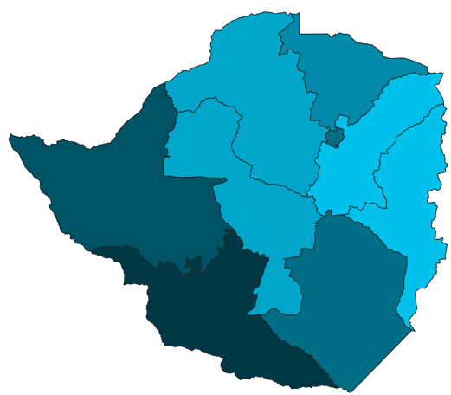
Health Need
Zimbabwe
HIV+ men achieving viral load supression
Example Slides
Harare
54.9%
Insights:
A smaller proportion of men have achieved viral load suppression, most likely as fewer men are aware of HIV+ status.
This means that half of HIV+ men in some provinces are at risk of transmitting HIV.
MSW
50.8%
MSC
53%
MSE
43.5%
MBN
58%
MID
52.6%
MNL
50.4%
MVG
56.8%
Bulawayo
61.4%
MBS
61.5%
Source: ???

Slide 20
Malawi – Distribution of STIs
Health Need
Example Slides
Insights:
Incidence peaks for men and women at 25-29 – but remains relatively elevated for women into older age groups.

Slide 21
Health Need
Mozambique
Condoms as a contraceptive method
Example Slides
Condoms are an important method for unmarried women
Fonte: IMASIDA (2015)
Notes:
A taxa de prevalência contraceptiva (TPC) é definida como a percentagem de mulheres casadas que recorrem a métodos contraceptivos. Actualmente, a TPC para Moçambique é de 27%, sendo que 25% das mulheres casadas usam métodos contraceptivos modernos e 2% usam um método tradicional. Os métodos contraceptivos modernos mais usados pelas mulheres casadas são as injecções (13%), a pílula (6%) e o preservativo masculino (2%).
As mulheres não casadas mas sexualmente activas são mas propensas a usar o uso de métodos contraceptivos. Metade usam um método contraceptivo moderno. O preservativo masculino (20%) e a as injecções contraceptivas (13%) são os métodos mais usados neste grupo.

Slide 22
Outline Health need Condom use Use vs. Need Factors that drive use Demand Supply Program Stewardship Activities

Slide 23
Condom Use – Key questions & data sources
Condom Use
Data & Sources
Questions | Data sources
What is the current level of condom use? Is use decreasing or increasing, and in which populations? How does use compare to other countries in the region? Is condom use equitable across population segments? Where is the biggest opportunity to deliver sustained health impact by increasing condom use? (There are many indicators for condom use. Condom use “at last sex” in various partnerships (e.g., non-regular, paid) is recommended.) What is the total need for condoms? Is the total need growing? How large is the gap between use and need? Is use growing as a % of need? Which population segments are the drivers of condom need? Which population segments have the largest gaps between use and need? | DHS https://www.statcompiler.com AIS IBSS PMA Surveys https://www.pma2020.org/survey-topics Other (usually subnational) surveys conducted as part of projects. Condom needs estimation tool https://hivpreventioncoalition.unaids.org/resource/condom-needs-and-resource-requirement-estimation-tool/ Key informant interviews with government and others active in the condom market

Slide 24
Condom use: Example slides

Slide 25
Condom Use
Condom Use – High level insights – Examples
Example Insights
Condom use is low relative to countries in the region and below the global goal of 90%
Condom use is especially low in paid sex, where the HIV incidence rate is highest (only 31% of men reported using a condom in last paid sex; nearly 30% of new infections are among sex workers and their clients).
Although condom use increased in previous decade, the rate of increase has slowed in recent years and appears to be leveling off at low rates among some priority groups (e.g., among young men engaging in pre-marital sex).
The difference in condom use has grown between those in the highest wealth quintile and those in the lowest in recent years, indicating persistent equity gaps.
There are also significant disparities in condom use across provinces, including high incidence provinces, suggesting an opportunity to target resources to high-need areas.
Condom use for family planning has increased among youth in the last five years.

Slide 26
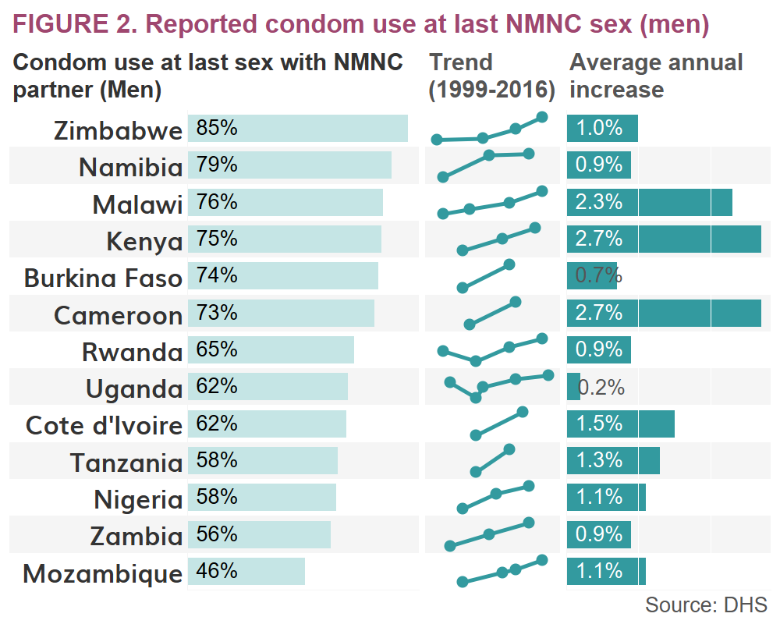
Condom Use
Condom use in context of the SSA region
Example Slides
Insights:
Slow increases in condom use across all countries regardless of level of use
Important to set realistic targets for growth in the short-term in pursuit of 90% condom use over the long-term
Cited from MGH Challenges and Recommendations Report

Slide 27
Condom Use
Mozambique
Condom use in men – slow growth, getting slower
Example slides
Sources: DHS, INSIDA, IMASIDA

Slide 28
Condom Use
Mozambique
Condom use by province
Example slides
Fonte: IMASIDA (2015)

Slide 29
Condom use in paid relationships
Regional context
Condom Use
Example slides
Source: StatCompiler (Measure DHS)

Slide 30
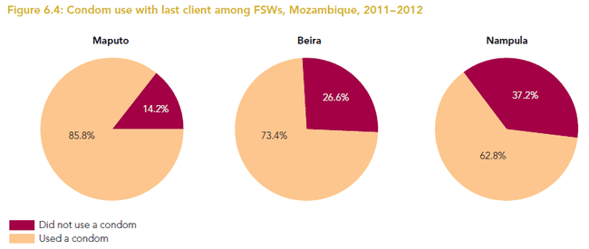
Condom Use
Mozambique
Condom use in female sex workers
Example slides
Source: IBBS (2012)

Slide 31
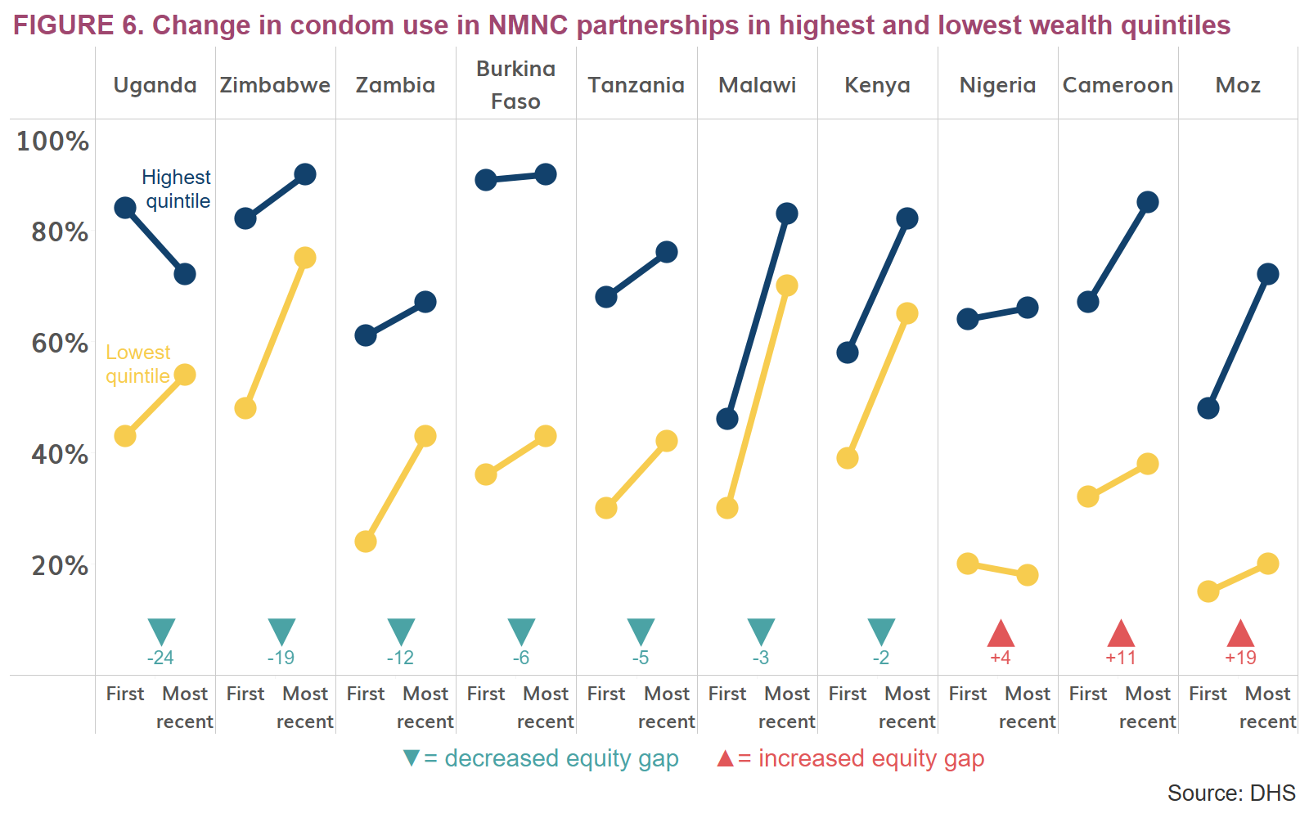
Condom Use
Equity gap in the regional context
Example slides
Insights:
Several countries have achieved modest improvements in equity
Cited from MGH Challenges and Recommendations Report

Slide 32
Condom Use
Mozambique
Persistent rural-urban equity gap in condom use
Example slides
33%
26%
24%
25%
Gap increased from 24% in 2003 to 33% in 2015 due to faster increases in urban areas
Gap increased from 25% in 2003 to 26% in 2015 due to faster increases in urban areas; rural use remarkably low in 2003
Sources: DHS, INSIDA, IMASIDA

Slide 33
% sexually active individuals reporting higher-risk sex and % reporting condom use at last higher-risk sex by rural/urban
Condom Use
Zimbabwe – Lower use in rural areas
Example Slides
Higher-Risk Sex in the Last Year
Condom Use at Last Higher-Risk Sex
Notes:
Source: DHS StatCompiler 2015
Left graph:
Numerator: Individuals reporting a higher-risk partner (non-married/non-cohabitating) in the last year
Denominator: Individuals reporting sexual activity in the past year
Right graph:
Numerator: Individuals reporting use of a condom at last sex with higher-risk partner
Denominator: Individuals reporting sex with a higher-risk partner in the last year

Slide 34
Better educated report moderately higher use
Condom Use
Zimbabwe – Inequity across education levels
Example Slides

Slide 35
Nigeria Trends in Condom Use: Who is the market failing?
Condom Use
Example Slides
Young women and girls, Youth, and the general population
Sexually Active Female Youth aged 15-24:
Report low condom use (at 45%) compared to male youth (63%). At 41%, use is lower in rural areas, and in South South (39%), North East (41%) and North Central (41%). (NARHS)
1% of young women reported having sexual intercourse with more than one sexual partner in the 12 months preceding the survey, which increases with education and wealth. (DHS). Just 41% of those young women used a condom at last sex. (2013 DHS)
Age Mixing an Issue: Among young women who had sexual intercourse in the 12 months preceding the survey, 39% had sexual intercourse with a man 10 or more years older than them. (2013 DHS). While the absolute number of young women engaging in high risk sexual relationships is low, they are particularly vulnerable due to age mixing & lower condom use.
Young Men
Just 56% of all respondents report using condom in last sexual act w/boy/girl friend, and 55% with non-marital partner. (NARHS)
Young men are four times as likely as young women to report having two or more sexual partners in the 12 months preceding the survey (4%), and is higher among those age 23-24 (11%), those with more than a secondary education (10%), and those in the highest wealth quintile (6%). (NARHS) 51% of those men used condom at last sex.
13% of men report having two or more sexual partners – nearly 60% of those men were not married. (2013 DHS). At 20% overall, condom use for these men was far higher for the wealthiest quintile (44%) vs. poorest (just 1.2%) and urban (36%) vs. rural (11%)
Notes:
While 5% of men reported ever paying for sexual intercourse, 2% reported paying for sex in the 12 months preceding the survey. (DHS) Rates were higher in the states of the South South (3.4%) and South East (2.4%) (DHS)
Of those that paid for sex, 66% used a condom at last sex (2013 DHS)
Condom use by men who paid for sex is highest among those age 20-24 (77%), those who have never been married (70%), and those living in urban areas (75%). The proportion of men reporting that they used a condom the last time they paid for sex increases with increasing wealth.
Young persons sexual behavior and use:
1 percent of young women reported having sexual intercourse with more than one sexual partner in the 12 months preceding the survey. The likelihood of young women having multiple sexual partners increases with increasing education and wealth. (DHS)
41% of young women age 15-24 who had two or more partners in the 12 months preceding the survey used a condom the last time they had sexual intercourse (DHS)
Young men are four times as likely as young women to report having two or more sexual partners in the 12 months preceding the survey (4%), and is higher among those age 23-24 (11%), those with more than a secondary education (10%), and those in the highest wealth quintile (6%).
51% of those men used condom at last sex.

Slide 36
Outline Health need Condom use Use vs. Need Factors that drive use Demand Supply Program Stewardship Activities

Slide 37
Condom Use
Definitions
Use vs Need
Term | Definition
Theoretical need | Number of condoms needed to protect a given percentage of sex acts in a given population (e.g., number needed to protect 90% of sex acts in discordant couples).
Universe of need (U of N) | Total number of condoms needed to protect ALL at-risk sex acts (usually calculated at country level).
Use | Number of condoms used in sex acts in a given period (usually estimated based on population-size estimates, assumptions about frequency of sex, and self-reported condom use). Sometimes referred to as “Demand”.
Wastage | Percent of procured condoms that end up not getting used either due to problems at the system level (expiration, loss at the warehouse) or non-use by the end user (including breakage).
Consumption | Number of condoms used plus wastage in a given period.

Slide 38
Use vs. Need Analysis: Example slides

Slide 39
Uganda Current Condom Use Against Total Need
Use v Need
Example Slides
Approximately 60% of condom needs in the Uganda market are met from a supply perspective.
The 125m condom gap between existing use and current need is costed at $4.5m (for commodities alone). Substantial investments in demand creation, distribution also required to ensure supply translates to use.
Need to unpack why condoms distributed are not correlating to use.
~175 million condoms distributed in 2016
Against total annual targeted need of ~300 million
Use estimates based on existing market size of commercial (estimated), public, and social marketing sectors as reported by UHMG & program data.
Need per UNAIDS Condom Needs Estimation Tool:
https://hivpreventioncoalition.unaids.org/resource/condom-needs-and-resource-requirement-estimation-tool/

Slide 40
Zimbabwe - Needs, Supply, & Use not in balance
Use v Need
Example Slides
Theoretical Need
~98 million condoms used/sold in 2017
Distributed
About 173 Million Condoms are needed every year to cover 90% high risk sex acts, plus wastage
About 122 million condoms / year are distributed in Zim every year
And 98 million condoms used annually
Used
Distributed
Esimates based on UNAIDS/UNFPA condom needs estimation tool v 3.01
https://hivpreventioncoalition.unaids.org/resource/condom-needs-and-resource-requirement-estimation-tool/
Theoretical Need
Notes:
Source: UNAIDS Calculator- needs & targets tab
To be figured out with Brian

Slide 41
Zimbabwe Need is driven by HIV-affected couples – who are they?
Condom Use
Use vs Need
# Condoms required in 2018
# Condoms required in 2018
Esimates based on UNAIDS/UNFPA condom needs estimation tool v 3.01
Notes:
Source: Original PPT from Noah / UNAIDS calculator
Replace with new estimates from UNAIDS calculator

Slide 42
But it is not a SUPPLY problem: Distribution exceeds condoms used by ~24m /year
Zimbabwe - Needs, Supply, & Use not in balance
Use v Need
Example Slides
Indicator
Total condom needs (Universe of need + 28% wastage) | 173,019,379
Universe of need (sex acts) estimated using Condom Needs Tool | 135,171,390
Volume units sold & distributed per various sources | 122,500,000
Consumption estimated using Condom Needs Tool based on DHS reported use + 28% wastage | 98,369,439
Unused volume beyond 28% wastage consider not procuring these | 24,130,561
Value of unused volume @ $0.04 per condom | $965,222
Esimates based on UNAIDS/UNFPA condom needs estimation tool v 3.01

Slide 43
Mozambique Universe of need, supply, consumption
Use v Need
Example Slides
199 million condoms needed to protect 100% of at-risk sex acts (Universe of need or “U of N”)
110 million condoms supplied in 2018 (public sector + social marketing + commercial sector)
112 million condoms consumed (use + wastage) based on reported behaviors and estimated frequency of sex
Esimates based on UNAIDS/UNFPA condom needs estimation tool v 3.01
Notes:
Source: UNAIDS Calculator- needs & targets tab
To be figured out with Brian

Slide 44
Outline Health need Condom use Use vs. Need Factors that drive use Demand Supply Program Stewardship Activities

Slide 45
Demand – What to ask and where to find it
Demand
Data & Sources
Questions | Data sources
What behavioral factors are most closely associated with condom use? What do we know about those behavioral factors in each of our priority groups? How do they differ across the priority groups? What are user and non-user perceptions of the condoms available in the market (public, social marketing, commercial)? Do they have a preference for a certain type of condom? What is their willingness-to-pay for condoms? | DHS Surveys for general population by the DHS Program https://www.statcompiler.com PHIA Surveys for general populations by Columbia University Bio-behavioral Surveys (BBS) for Key Populations Tracking Results Continuously (TraC) Surveys by PSI Other (usually subnational) surveys conducted by projects Key informant interviews

Slide 46
Demand Example slides

Slide 47
Demand
Demand – High level insights – Example
Example Insights
Inadequate demand creation for many priority populations (low reach & intensity)
Insufficient segmentation of populations at risk, i.e., targeted messaging
Insufficient data to develop insights for demand creation strategies for priority populations
Lack of standardized messaging and approaches for each population
Restrictive policies (e.g.,restrictions on advertising and on condom promotion in schools Insufficient capacity of health services providers to stimulate behavior change
Inadequate funding to support condom promotion programs, especially in rural areas
Limited coordination among partners = overlap and missed opportunities
Increased awareness of HIV treatment and male circumcision have added complexity to the programming environment and likely contributed to reduced motivation to use condoms

Slide 48
Zimbabwe Barriers to condom use - based on key informant interviews
Demand
Example Slides
Cultural norms
Condoms are associated with promiscuity
Belief that man should are responsible for bringing condoms to sexual encounters
Religious barriers – some religious institutions do not believe in condom use
Knowledge of condoms
Lack of knowledge of how to use condoms
Lack of knowledge of where to access condoms
Economic Challenges
Transactional sex often makes it difficult for girls/women to refuse condom use – short-term incentives seem greater than risk
Public sector brand
Poor perception of condom sector brand quality
Poor judgement
Sexual encounters aren’t always planned – it’s the heat of the moment
Substance abuse
Affordability
Aspirational brands aren’t’ always affordable
Risk perception
Low risk perception in long-term relationships

Slide 49
Zimbabwe Barriers/Motivators for Condom use – Immersion Study
Demand
Example Slides
Female Barriers | Male Barriers
Lack of skills & knowledge to use condom Agency – ability to negotiate condom use w/partner, empowered to propose condom Societal stigma around condom use – purchase, & ‘good girls don’t have sex’ (rural) Responsibility is the man to bring condom Limited access outside of facilities/clinics (primarily urban) Smell of free condoms (Panther) | Lack of skills & knowledge to use condoms limited access outside of facilities/clinics Societal stigma around use (pick up) Low perceived value of free Religious barriers Smell of free condoms (Panther) Alcohol (abuse)
Female Motivators | Male Motivators
Risk Perception leads to condom use (friends on treatment) Fear – of pregnancy, HIV Social Support (peers) | Risk Perception leads to condom use Social Support (peers)

Slide 50
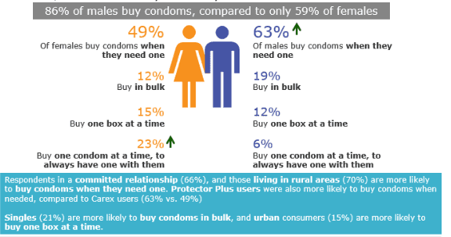
Zimbabwe Condom Purchasing Behavior
Demand
Example Slides
Notes:
Source: PP Need States Report

Slide 51
Zimbabwe Key Findings from Protector Plus Brand study
Demand
Example Slides

Slide 52
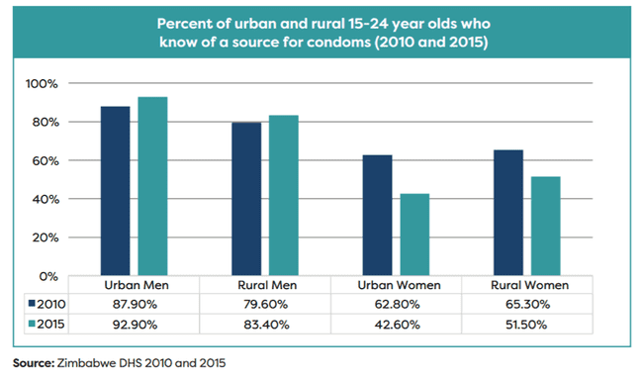
Women are less likely to know a source for condoms Women are about ½ as likely to know of a source of condoms than men, and that is declining
Demand
Zimbabwe
Example Slides
Women are about ½ as likey to know of source of condom

Slide 53
Mozambique Comprehensive knowledge on prevention
Demand
Example Slides
Percentage of 15-49 year olds who agree
Source: IMASIDA (2015)
Notes:
Muitos adultos moçambicanos não têm conhecimento correto sobre as maneiras que o HIV pode e não pode ser transmitido. 3 em cada dez pessoas têm conhecimento abrangente do HIV e SIDA.

Slide 54
Mozambique Knowledge of HIV prevention methods
Demand
Example Slides
% of 15-49 year olds who know that it is possible to reduce the risk of HIV transmission through condom use and limiting sexual partnerships to one unifected person
Decrease!
Notes:
O conhecimento dos dois principais métodos para prevenir o HIV é maior nos homens do que nas mulheres. 56% dos homens e 47% das mulheres sabem que é possível de reduzir o risco de contágio com HIV usando preservativo E limitando as relações sexuais a um único parceiro não infectado. Este representa uma diminuição no conhecimento comparado com inquéritos anteriores.

Slide 55
Demand
Mozambique
Knowledge ≠ use (or is not sufficient)
Example Slides
Insights:
Provinces with highest knowledge do not have the highest use
What else is influencing condom use?
Source: IMASIDA (2015)

Slide 56
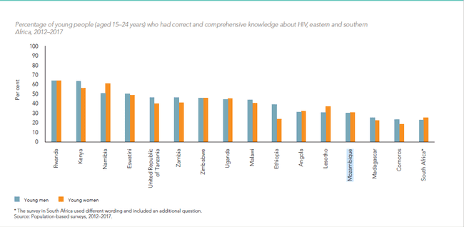
Demand
Comprehensive knowledge
Regional context
Example Slides
Source: UNAIDS Data

Slide 57
Uganda Affordability of Condoms
Demand
Example Slides
Limited evidence exists to map affordability of condoms, but suggests more people can afford to pay than currently do
Despite 64% of armed services personnel citing affordability of sold condoms, 75% receive free – a misalignment of free condoms targeting those that can pay.
Data supports that while many Ugandans can afford to pay for condoms, they prefer free – not unusual in an environment where accessing free condoms becomes the norm. For example - Of those that reported buying condoms, 54% reported that the condoms were not affordable – indicating they’d prefer to pay less, but had in fact purchased.
UHMG’s willingness to pay data puts Protector at 900 shillings, and slightly less for Lifeguard – approximately what they are paying on average at retail.
Using dkt’s ‘rule of thumb’ for affordability (.25% of GNI for one CYP) condoms do break that barrier after ~500 shilling pack. But when compared to anecdotal cost per transactional sex (to 10,000 shilling), condom are within the affordability range for most types of SW.
Notes:
Please add sources…

Slide 58
Willingness to pay in the context of the region
Demand
Example Slides
What would free condom users do if free condoms were not available?
(% of free condom users)
Source: WILLINGNESS TO PAY FOR CONDOMS IN FIVE COUNTRIES: KENYA, NIGERIA, SOUTH AFRICA, ZAMBIA, AND ZIMBABWE SEPTEMBER 2018
https://aidsfree.usaid.gov/sites/default/files/resources/2018.9.19_af-wtp-condom-report.pdf

Slide 59
Outline Health need Condom use Use vs. Need Factors that drive use Demand Supply Program Stewardship Activities

Slide 60
Supply – What to ask and where to find it
Supply
Data & Sources
Questions | Data sources
Where do users get their condoms? Consider free public sector condoms, subsidized socially-marketed condoms, and commercially-priced condoms. How many condoms does each sector distribute and what has been the trend over the last 3-5+ years? What are the causes of disruptions in that period? What % of outlets in each channel have condoms? How frequent are stock-outs? What are the reasons for stock-outs? What are the steps in the distribution chain in each sector? Where do bottlenecks occur? Which additional market actors could be involved in the distribution chain? What are the gaps, if any, in ‘last kilometer’ distribution? Include post-facility distribution, distribution in non-traditional outlets (bars, guesthouses) or hard-to-reach areas. How many brands are available in the commercial and social marketing sector, in what volumes, by type of outlets, and at what prices? What are the contributions of donors and other sources of funding? What are commitments for years to come? How reliant is condom supply on donors given the strength or weakness of the commercial sector? | MOH LMIS, supply chain department, central medical stores records NAC NGOs involved in community-based distribution Social marketing organization’s sales records and distribution surveys Retail audits if available Select commercial actor data (helpful to estimate volumes, brands). Market observations DKT’s social marketing statistics (which show country-by-country data going back more than a decade) https://www.dktinternational.org/contraceptive-social-marketing-statistics/ Key informant interviews with market actors are critical here to validate reported data, find out about other data sources, and deepen understanding of how distribution channels function

Slide 61
Supply Example slides

Slide 62
Supply
Supply – High level insights – Examples
Example Insights
Oversupply and untargeted distribution of free condoms is leading to wastage
Insufficient planning and oversight of post-facility distribution of free condoms
Reducing stock-outs in rural areas (public, social marketing, and commercial) still a challenge
Substantial growth of commercial brands in past five years presents an opportunity to build on
Socially-marketed condoms likely crowding out commercial sector in urban areas
Condom supply still highly-dependent on external sources of funding (Global Fund for public sector condoms)
Little known about coverage levels of key outlets required to eliminate availability as a barrier to use.

Slide 63



Supply
Market Structure in Mozambique (2018)
Example Slides
Who pays
Importation
Distribution Channels
Principal consumers
UNFPA
61.6 million
$1.5 million
Public Sector
(CMAM)
92 million
Central Warehouse
Provincial Store
District Stores
(147)
~60 million
Health Centers
(~1,600)
Rural
Key Populations
Provincial Store
Provincial Store
Provincial Store
Central Warehouse
Provincial Store
Funding and Technical Support
Provincial Store
Rural
KP
Youth
Provincial Store
USAID
through
PSM
(Chemonics)
45.1 million
$1.0 million
Provincial Store
Hospitals
NGO
CBO
CHW
Central Warehouse
Garantia de qualidade
Provincial Store
CPCS (11)
-> (CDCS)
29 million
Provincial Store
Provincial Store
Other Donors
Social Marketing
PSI 13 million
Urban incl.
KP & Youth
Distributors and Wholesalers
Barracas
Jeito
Kama Sutra ~500K
Durex
Bars
Sales Revenue
(Consumers)
Social Marketing
DKT 4 million
Playboy
Bombas Gas.
Control
Urban, wealthier
Prudence
Fiesta
Dr. Long
Supermarkets
Commercial
1.2 milhões
Rocky ~500K
Farmácias
GFATM
70 m for 2019/20
(X0,000)
Public (Free), Social Marketing (Subsidized), Commercial
Source: MGH

Slide 64
Zimbabwe
Journey of a condom Public Sector
Supply
Example Slides

Slide 65
Nigeria Snapshot of Condom Market
Supply
Example Slides
Social Marketing Sector
~58%+ of market
Public Sector – Free & Near Free
~23% market
Commercial Market
~19% plus of market
Dynamic market supporting access to affordable, diverse condom brands. Condom market characterized as developing based on market performance indicators, existing use and acceptability of condoms indicators.
USG, GF, UNFPA (& DFID, CIDA) most recently WB primary funders of free procurement. GoN provided limited budget support for condoms. UNFPA has long supported / coordinated condom procurement targeting FP needs.
Free distribution targeting HIV prevention efforts fairly recent – surge in free driven by WB & USG procurements last 2 years.
USAID distribution totaled ~2.5 m in 2016, projected 30-35 million 2017 & 18. Distribution limited to implementing partners
HIV free targets KPs and included in MPPI. However, MPPI does not have defined # condoms/contact.
UNFPA support to MoH & states target distribution through public sector clinics; last mile distribution reportedly improving.
NACA distributed 62m WB funded, UNFPA procured condoms through 2016. Follow up required to determine status, stock in states.
Free distribution widely appreciated by KPs
SFH created widespread affordable access supporting use of condoms last 30+ years. Well established distribution w/33 reps driving coverage. Supporting some communications. Moving ~140m condoms in 2016, off of 208 m in 2012. SFH has good coverage as measured by retail audit & studies.
Moving toward financial sustainability through portfolio of cross subsidized brands – target toward commodity sustainability is 2019. DFID funding for condom SM ended 2015, but no cost extension supported through Dec 16.
Graduating Gold Circle includes recent & planned price increases, tightened trade margins, shift f rom 4 to 3 pack, intro of Gold Circle Flex @ 100-150+ as premium brand.
SFH supporting targeted free distribution to KP through USAID and GF funding.
DKT entered market 2 years ago with launch of Kiss, a youth focused, regional brand promising to shake the market up. Priced just below Gold Circle, and fiesta, priced at N100 w / multiple variants. Together total distribution ~50m condoms/year.
DKT states portfolio through cross subsidization is commodity cost recoverable, although Kiss does not recover full COGS.
DKT has broad distribution through 45 sales reps serving 45,000 direct customers. According to FP watch, brands don't yet have coverage of GS but reported to be growing.
Nearly 100 brands on market at any given time.
Products range from high end Durex, with vested interest & sustained investment in market, to 8-10 importers committed to own brands or ‘franchises’, to brief, punctuated presence by suit-case importers. Many brands come and go.
Given large number of unregistered condoms size of commercial sector still a estimated & WiP.
Aside from Durex, commercial sector making little investment in promotion – efforts focus on distribution.
Source: MGH

Slide 66
Zimbabwe Market Depth – Sector Contribution
Supply
Example Slides
Overall volumes distributed have increased 30% last decade – an annual growth of about 2.5% per annum.
AHF supports distribution of free to universities and colleges in 2019 – 2m / year.

Slide 67
Cameroon Depth of the Condom market– Total volume / size of the market
Supply
Example Slides
40% growth in Condom market in last 10 years, largely driven by commercial sector, and free distribution. SM sales largely flat over 10 year period. Robust commercial market, showing impressive growth, indicates potential.
~31%
~35%
~34%
The total estimated market size of ~70 million condoms/year is considerably less than the 143 million estimated as used.
Likely size of commercial sector is underestimated: Condoms are imported and not registered at customs. Commercial sector likely larger than the 24 m estimated.
Data compliments of ACMS & UNFPA’s RH interchange. Commercial market size estimated through ACMS retail studies and analysis of customs data. ’Free’ aligned to procurement in given year, not distribution. 2016 data estimated.
Notes:
Estimating current condom use (based on behavioral data such as reported condom use, # partners, & population size estimates) establishes a market – or condoms used - of 142 million condoms. Data from Social Marketing, Free Distribution, and commercial sector estimates existing market size of ~ 70 million. How to explain the difference?
The Commercial market is LARGER than currently estimated.
Likely that quantities of condoms are brought into country and not registered with customs. This can occur as “filling space” on containers, or to greater extent.
Divergence in views on how prevalent this is. A leading brand on the market appears to be ‘Super Alex’ – but unclear whether this brand is brought in legally.
Population and behavioral estimates . The JHU study, for example, estimates 98,000 SW, who have on average 109 partners a week. The condom use, at self reported rates, would be 360 million condoms /year for this population alone.

Slide 68


Uganda Number of brands and price points on market Updated from PSI/PACE/UHMG market landscaping activity from UHMG retail audit, market observations
Supply
Example Slides
Majority of brands priced in the subsidized space, representing 75%+ of commercial market share. 28 brands present on market (per UHMG TMA update)
Condom O & Trust playing in the COGS recovery space with ~11% market share
Trust & Lifeguard occupying similar price points.
Hot Pink (leaked free)
LifeGuard
Blue Gold
Rough Rider
Lifestyles
Durex
Condom O
Moods
0
1,000
2,000
3,000
4,000
5,000
6,000
7,000
8,000
Male Latex (leaked free)
Trust
Romantic Rubber
Protector
85+% commercial market share maintained by subsidized condoms and leaked free condoms.
Source: UHMG Retail Audit (2015), PMA2020 (2015)

Slide 69
Cameroon Are Social Marketed Condoms affordable?
Supply
Example Slides
ACMS has not adjusted consumer price since launch (did shift from 4 pack to 3 pack in 2010, and recently tightened margins to trade).
Both SW and MSM report (anecdotally) condoms are affordable.
- ”they can easily afford buying for themselves, the condoms are everywhere’ msm
“Prudence is affordable. If we don’t get free, we will go back to paying for them.”
Priority: Need for Willingness to pay study to better understand purchase behavior in a changing market
The relative cost of social marketed condoms is decreasing
Effective price increase
GNI data per WB; relative cost of CYP determined by 100 condoms @ estimated CFA USD exchange rate relative to GNI/capita
Notes:
Relative to Gross National Income per capita, condoms are more affordable (about half the relative cost) of 10 years ago. Lack of active price management means cost of commodities are not recovered, and subsidy wasted on those that don’t require it.
A willingness & ability to pay study will be more accurate if it includes KP, and an analysis of which demographics are already willing to pay full price for condoms, and which are not. This could help researchers to overcome one challenge with willingness to pay studies: consumers often underestimate their willingness to pay in practice.
Willingness & ability to pay studies, by population segment, are required to predict how price adjustments would affect uptake. Further research would be needed after price adjustment. In order to confirm that uptake has been unaffected (or correct course if uptake has been affected). For example, consumers in Kenya have been willing to pay more for malaria RDTs than studies suggested they would.

Slide 70
Zimbabwe Brands, Channels and Price Points
Supply
Example Slides
Brand | Channels | Pack Size | Price
Panther | Hospitals and clinics, NGOs,Workplace, Tertiary Institutions, Liqour (esp. Rural), Lodges, | 1 | $0
Icon Gold | Tertiary Institutions | 1 | $0
Love | Tertiary Institutions | 1 | $0
Protector Plus | Liquor, Service Stations, Pharmacy, Supermarkets, General dealers, Wholesalers, Workplace, Tertiary Institutions, Vendors | 4 | $0.50
Carex | Liquor, Service Stations, Pharmacy, Supermarkets, Wholesalers, Workplace, Tertiary Institutions, Vendors | 3 | $1.50 - $2
Fantasy | Liquor, Service Stations, Pharmacy, Supermarkets, Workplace, Tertiary Institutions, Vendors | 3 | $0.50
Durex | Liquor, Service Stations, Pharmacy, Supermarkets, Vendors | 3 | $2 - $3.50
Rough Rider | Liquor, Service Stations, Pharmacy, Supermarkets, Vendors | 3 | $2-$4
Playboy | Liqour, Service Stations | 3 | $1.50 - $2

Slide 71
Zimbabwe Brands, Geographical Availability
Supply
Example Slides
Brand | Geographical Presence | Availability Scale (1-5)
Panther | Nationwide (Urban, Rural, Mining, Border Towns, Growth Points) | 5
Icon Gold | Selected Urban Areas (with Tertiary Institutions) | 1
Love | Selected Urban Areas (with Tertiary Institutions) | 1
Protector Plus | Urban, Mining, Border Towns, Growth Points and selected rural areas | 4
Carex | Urban (selected areas), Mining, Border Towns | 3
Fantasy | Urban | 3
Durex | Urban (Selected areas) | 1
Playboy | Urban (Selected areas) | 1

Slide 72
Zimbabwe Market Depth - Value
Supply
Example Slides
The low and flat market value doesn’t signal a vibrant, growing, healthy market….
And indicates modest opportunities for the commercial sector.
Total Market Value of ~$2.5 million / year has stagnated and even declined.
While PP price doubled in 2017 – which we would expect would grow market value - decrease in volumes didn’t add to market value
Commercial sales have declined over last decade.

Slide 73
Supply
Mozambique
Social marketing sales in decline
Example Slides
Source: MGH analysis of DKT contraceptive social marketing statistics

Slide 74
Zimbabwe Role of SM and Free have flipped in last decade Despite a more sustainable SM sector, the overall market is growing MORE reliant on donor subsidy – and less sustainable.
Supply
Example Slides

Slide 75
Zimbabwe Source and Brand of Condom Last Used among Men by Province
Supply
Example Slides
Source of condom last used by province (men)
Brand of condom last used by province (men)
Notes:
Source: Tabulations of 2015 DHS data
CAVEAT: DHS tabulations are weighted, but may have slight differences from other analyses of DHS data due to different procedures for missing data, etc. Should be taken as trend data rather than exact reported figures.

Slide 76
Zimbabwe Source & Brand of Condom Last Used among Women by Wealth Quintile Higher quintiles of users are less likely to get condoms from the public sector, but still are using PP in large numbers.
Supply
Example Slides
Source of condom last used by quintile (women)
Brand of condom last used by quintile (women)
Notes:
Source: Tabulations of 2015 DHS data
CAVEAT: DHS tabulations are weighted, but may have slight differences from other analyses of DHS data due to different procedures for missing data, etc. Should be taken as trend data rather than exact reported figures.

Slide 77
Zimbabwe Private company profile
Supply
Example Slides
 | Brands | General Coordination | Distribution | Policy | Demand Creation | Consumers
Issues | Elecare are the importers of the Carex and Fantacy brands of condom. The brands are scented and come in different variants. | No genuine coordination in the market until recently. Now part of the TWG and TSG which meets annually. The government is now recognizing us. . | Carex and Fantasy are distributed through the retail sector, Pharmacies, Wholesalers, Forecourt, and bars Recently their condoms are now being distributed in colleges and university. | The regulatory issues have made a number of players closing shop. The duty and tax are prohibiting, Durex is the ONLY one that has survived. | Advertise on face books , our cars are branded, instore adverts. Working with students in terms of building entrepreneurship[ students are selling our products at the campus. They are now very popular “Carex Champions. On the Fantasy we have rebranded the packaging because we realized people were not confident in buying condoms. So the new packaging is more attractive and you cant notice they are condoms. We Moved from promoting condoms as prevention but NOW as for and pleasurable. | Reaching out to students. Our brands appeal to them . We also have a captured community, the Middle income and above..
Challenges | We are private company so stocks are lost during Testing by MCAZ. From each batch they take about 1400 for testing – that’s a lot of money lost. MCAZ sometimes takes months before we receive certification. | PSI must not think we are in competition with them. The TMA not yet fully working though efforts are in place, we are committed to the cause. | We use own transport fuel challenges, costs associated with it Forex is a major problem, we have been queueing at RBZ but condoms not given priority. So now we have a tanker in Durban waiting for the past 2 months. The challenges are many, at the border ZIMRA wants cash | Our products are not exempted from duty and tax, | Marketing is an issue, we are limited in what we can do.no finances to do all the activities we want. | The price of the condom sometimes its high to the consumer, we have no choice since we want to make a bit of profit after covering expenses.

Slide 78
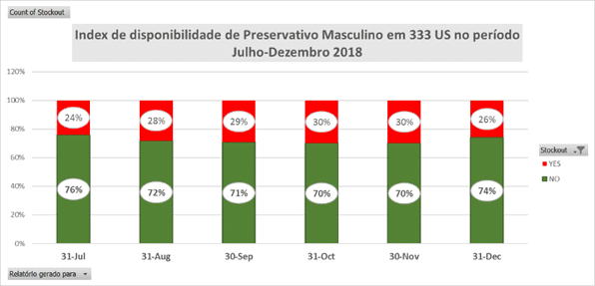
Mozambique
Public sector snapshot of availability
Supply
Example Slides
Condom availability maintained at average of 72% of outlets in the sample during the period.
Improvement in December after support from UNFPA in distribution from provincials level to district level.
Source:
Adapted by MGH from MoH presentation provided to Commodity Technical Working Groupin May 2019

Slide 79
Uganda Public Sector Free Distribution
Uganda unique in public sector distribution complemented by the Alternative Distribution Mechanism (ADM) run through UHMG – an opportunity to target free condoms through two distinct channels
20% free condoms run through NMS to public health facilities & on to MoH supported community outreach (VHT)
80% free distributed through the Alternative Distribution Mechanism supported by UHMG.
Key findings:
Quantification supporting procurement driven by total need, and projected at unrealistic growth in use.
Little to no coordination of ADM free at national level to district & community. Over 160 NGOS pick & distribute where they see fit; no report back to who, where, how distributed.
Push based system ensures that public facilities plagued by over/under stockage, dispensers often stocked out. Little to no report back to National Medical Stores on inventory levels.
Poor quantification, coordination, planning, & monitoring at district level through both channels
Little to no segmentation driven by need /ability to pay – a shotgun approach to distribution leading to ad hoc supply, SM brands next to free, etc.
Uganda Cares maintains 340 dispensers at various line ministries for MoH staff (salaried employees that presumably can afford condoms, maintains 200 other outlets & supports ad hoc distribution to public Health Centers - in addition to distribution at HIV C&T, C&T

Slide 80
Uganda A highly donor dependent condom market
Supply
Example Slides
Condom market is 93% reliant on external donor funding
Market Reliance on Subsidy - 2016
 | Volumes distributed | % subsidy supporting condoms | Value
Free Distribution | 146,000,000 | 100% | $5,256,000
Protector (UHMG) | 6,363,600 | 71% | $212,120
Lifeguard (MSU/MSI) | 13,356,050 | 46% | $300,511
Commercial + tier 2 SM brands | 3,595,972 | 0%
 | 169,315,622 | 92% | $5,768,631
Compare to Nigeria at 52% reliant on subsidy, and Cameroon at 38%.
Countries that do rely on free to drive use (i.e. South Africa) generally allocate state budget for commodities.
Low cost recovery of Protector SM Brand contributing to dependency on subsidy. Protector also benefits from ~$1.6 m annually in marketing, distribution, programmatic & admin support.
As relative contribution of SM has declined since 2010, so has the commercial value of the total market
Ref – programmatic data
Source: MGH

Slide 81
Outline Health need Condom use Use vs. Need Factors that drive use Demand Supply Program Stewardship Activities

Slide 82
Stewardship – What to ask and where to find it
Stewardship
Data & Sources
Questions | Data sources
Is there a national condom strategy that includes prioritized activities based on available evidence? Is the condom strategy used? Is there a budget for it? Are there effective coordination mechanisms to align market actors with common objectives, and actively manage to those objectives? Are specific government agencies and individuals responsible for condom programming? Do they have sufficient resources and capacity? Is there a favorable regulatory environment for condom programming? Are condoms on the essential drugs list? What are the quality control systems? What taxes & tariffs are relevant to condoms? Do stakeholders know how to navigate the system? Are there restrictions on advertising or interventions in specific settings or distribution to specific populations ? Is there a strong program analytics program that regularly collects, analyzes, and disseminates data to all stakeholders to enable continuous improvement? | KII will be the most useful approach here. For KII with government, it will be helpful to review key documents in advance (e.g. national plans, reports, TOR for coordination bodies, relevant policies).

Slide 83
Stewardship Example slides

Slide 84
Stewardship
Stewardship – High level insights – Examples
Example Insights
Out-of-date condom strategy results in lack of prioritization and alignment of stakeholders/donors around common approaches and goals
Technical working groups are not providing the value-added coordination necessary to invigorate condom programming across a wide range of entities and organizations supporting and implementing a variety of program components.
The lack of a functional monitoring and evaluation plan results in absence of data (program analytics) to inform condom programming. Gaps include: timely data on changes in condom use (national data is five years old; recent subnational data is not available); factors influencing condom use such as motivation, perceived availability, and social support not measured; no data on accessibility of condoms for priority groups.
Regulations and policies hinder commercial actors from reaching potential (e.g., high testing fees and tariffs on imported condoms)
Lack of a coordinated approach to resource mobilization (beyond condom procurement, which has been effective) results in missed opportunities to include condom programming in funding requests.

Slide 85
Uganda Status of stewardship functions in support of the total market
Stewardship
Example Slides
Market Stewardship
Planning & Coordination: Structures such as the CCU/CCC exist, including newly formed ’TMA Steering committee,’ Condom focal point bring big potential.
But poorly funded, moderately supported, and underutilized – from national to district level.
Strategies & assessments not translating to resourced work plans lead by focal points.
Quality Assurance
NDA is a bottleneck to condom supply as they cannot test fast enough – resource constrained.
While WHO approved quality testing, sampling strategies + testing constraints results in condoms stuck in warehouses, often for months, while testing takes place.
Impacts public sector, social marketing, commercial.
Commodity Forecasting
Demand-driven forecasts needed. Quantification supporting procurement is thoughtful process, but factors in overly aggressive assumptions in growing use (to 100% by 2019).
Over budgeting for procurement at times results in condoms in warehouses; latest rec to shift condom funds to ARV to fill gap.
Opportunity to improve input from TMA perspective.
Financing
Excess subsidy supporting free distribution, poorly targeted
Information
Lack of behavioral data is inhibiting informed decision making with KP & high risk sex in GP.
Market data promising (UHMG TMA data) but room to improve sharing, analysis to inform decisions.
Informal Rules
Stigma surrounding condom use, sex, and HIV appear to inhibit condoms use.
Need to unpack stigma
Notes:
Quality Assurance: FHI recommended NOT to test condoms already pre-shipment tested, which is in accordance with Intl testing standards, but instead concentrate on testing privately imported condoms; this alone with alleviate the bottleneck. NDA chose not to accept this recommendation. Batch testing also recognized as significant and costly barrier to ensure quality – particularly for commercial sector, which may bring in small quantities of condoms, but with multiple batches in shipment.
While Market Stewardship structures are in place, capacity and support required to execute.

Slide 86
Uganda Capability Assessment of GoU in Stewarding a TMA
Stewardship
Example Slides
The right structures and bodies are in place to support GoU stewardship of a TMA. The Condom Coordinating Committee (CCC) has diverse set of market actors (with exception of commercial sector) regularly contributing and meeting, led by focal point.
The stewardship role involves collecting and analyzing data to better understand the entire market; engaging sectors and actors to coordinate efforts; monitoring and regulating the quality of commodities; and monitoring progress along TMA indicators toward a sustainable, healthy market. The framework below was leveraged in the rapid assessment of the readiness of the GoU and partners to steward markets*.
Policy & Dialogue
Understand the Market
Regulatory support
1
2
3
Activities include Data Collection, Analysis, Management, Dissemination & Application
Factors supporting this element include mandate & governance to support a TMA, sufficient funding resources to support TMA governance (CCC); recognized need for TMA, M&E, and HR
Factors here look at regulatory support for condom TMA, legal framework to support, and funding sources.
Under leadership of UHMG and w/early support of PSI/PACE – as well as other studies - the data/evidence exists to develop comprehensive TMA strategy for Uganda.
However, that data is not informing a coherent TMA strategy. Capacity to UHMG can support GoU to adopt comprehensive TMA strategies that drive decisions – including right sizing free and supporting more sustainable SM sector– in future.
At national level, the CCC condom focal point is currently facing funding constraints – was paid for by CDC, but uncertain moving forward. At district level, condom focal points have multiple other duties preventing them from providing much oversight to condom programming.
While TMA as concept understood and is adopted in new strategy, pushed for by focal point, lack of understanding to translate to activities.
Advocacy requires to ensure TMA is understood and embraced up-stream – with MoH and parliament. Advocacy should be supporting a specific ask – 1) clarify the role of free and how to best use free for pops that need it, 2) allocating GoU funding for condoms.
Currently no GoU funds are allocated to support procurement of free. Given the reliance of externally driven donor funding in support of free condoms in supporting use, that puts supply at extremely high risk.
* Adapted from the Abt Associates: Total Market Approach Stewardship Capacity Assessment Report. http://www.rhsupplies.org/uploads/tx_rhscpublications/Total_Market_Approach_Stewardship_Capacity_Assessment_Report_-_07_31_15.....pdf
Notes:
Need to develop advocacy strategy in support of sustainable condom use, strategically tackling role of free in the market, particulalry with some in government that believe condoms are a right (but are unable/willing to fund that right). Take advocacy for a TMA upstream in government to build support & underline imperative of urgent action.
Define & support condom TMA priorities – developing vision of sustainable market, future role of each sector, and prioritized activities to deliver on strategy.
Build capacity of CCC & key stakeholders to lead a TMA. Focus efforts to on 1) translating market intelligence to decisions & action plans 2) enhanced coordination across sectors 3) aligned regulatory efforts (role of free) 4) advocacy strategies in place and enacted.
Develop and regularly manage progress against key market indicators
Facilitate the sharing of key information and strategies, particularly market intelligence, with stakeholders and market players.
Improve coordination among SM-ers.
Bring private sector to the table to benefit from TMA efforts, or at least, represent their interests at GTTP meetings.

Slide 87
Stewardship
Zimbabwe – MOH Stewardship Status
Example Slides
 | Policy | General Coordination | Funding | Evaluation | Strategy
Issues | Policy on treatment of condoms as an essential drug Inter-ministerial coordination | Technical Support Group UNFPA – UN technical partner TSG – include social sector, private sector and public sector, NGOs in comprehensive condom programming | Sources of funding donor dependent We want as government to move towards sustainability and not rely on Donor. | Condom programmes required to be monitored and evaluated Dependence on ZDHS for monitoring statistics | A costed strategy and operational plan in place (2016-2020) The strategy embraces TMA
Challenges | Private sector condoms not treated as essential drugs Attract duty of 5% and VAT of 15% (cost of condoms is passed on to consumers, making the product unaffordable) Lack of inter-ministerial coordination on condom policies | Lack of adequate understanding of the TMA concept by members of the TSG No adequate human resources for Government to effectively perform its stewardship role | Dwindling resources to support a comprehensive programme No government funding towards condoms Sustainability of programme very important since donor funding is dwindling Limited condom brands for the public sector Funding gaps for demand generation, leading to product wastage as a result of low uptake Lack of funding for M&E, research and marketing Downsizing of operations by PSI leading to commodities not reaching very far | Lack of more focused researches to generate monitoring indictors, last focused review was last carried out in 2012 Lack of complementary researches to better understand programmatic problems Country does not Understand what is happening with regards to targeting. The commercial sector is better at least they seem to understand their market. | No targeting for public and social condoms Lack of data that speaks to the market No data to target products to appropriate consumers Poor private sector participation in strategic formulation Strategy is not adequately funded Low information outreach in rural areas

Slide 88
Regulatory Barriers – 5 country comparison
Stewardship
Example Slides
 | Registration | Import permit | Clearance | Taxation | Total cost of $50,000 shipment
Kenya | Long but somewhat similar process in cost and time | PVoC expedites process | Requirement to ship by rail creates delays, clogged ports. | 16% VAT, 1.5% RDL, IMS, 2% duties | $62,411 25% cumulative regulatory costs
Zambia |  | Pre-shipment in country testing sometimes required |  | No VAT, duties | $50,107 0% cumulative regulatory costs
Nigeria |  | Fairly smooth process | Manageable regulatory process BUT port delays onerous | Low (5% VAT) | $57,250 5% cumulative regulatory costs
Zimbabwe |  | No reported challenges | High post shipment testing cost | 15% VAT & duty waiver/ exemption for NGOs | $60,525 21% cumulative regulatory costs
South Africa | No requirements to register | One time registration to import. | 3 days plus occasional inspections (~10% shipments) | 15% VAT | $57,500 15% cumulative regulatory costs
 |  | Low cost Efficient process High predictability | Medium cost Mostly efficient process Somewhat predictable | High cost Long times Low predictability
 |  | POSITVE | MODERATE | NEGATIVE
Source: AIDSFree

Slide 89
Outline Health need Condom use Use vs. Need Factors that drive use Demand Supply Program Stewardship Activities

Slide 90
Activities – What to ask and where to find it
Activities
Data & Sources
Questions | Data sources
Interventions Which priority populations are currently being reached by interventions and in which geographic areas? What percent of the priority population is being reached and with what intensity (how often)? What is the nature of the interventions? What is the funding level and time period for these interventions? Have interventions resulted in increased condom use? Have they been evaluated? Where are the gaps and challenges? Where are the opportunities to expand reach, coverage, or population? Are condoms integrated into FP and HIV treatment/other prevention activities? Donor funding Which donors are supporting condom programming? For how long? Are they supporting demand creation or only condom purchase? What are their future plans? | Interventions KII Project reports and independent evaluations Donor plans such as the COP (which can be particularly helpful to understand reach of KP) NAC and MOH annual reports Donor funding KII Donor reports RHSC commodity exchange site (https://www.unfpaprocurement.org/rhi-home )

Slide 91
Activities Example slides

Slide 92
Zimbabwe Demand Creation Activites
Activities
Example Slides
 | UNFPA | PS Z | AHF | PSI | Pvt Sector (Elecare)
Target Population | Young people Key Populations General population Discordant couples | Adolescents Men and women of reproductive age | Male and female students in tertiary institutions | Young People 18-24 High risk men Key populations | Young people General population who can afford
Communication objectives | To increase uptake of condom use among the target groups to reduce HIV infections and for FP | To increase access to family planning methods, including dual protection (male and female condoms) | To increase availability of access to different condoms brands to young people To increase access to male condoms for students tertiary institutions | To increase uptake of condoms across target groups To increase self efficacy to use condoms | To increase access to private sector condom brands for different condom markets
Geographic coverage & channels | Focus on 20 districts IPC through Behaviour Change facilitators Condomize campaigns Promotional materials | Road shows Mobile outreach IEC | Static sites (centres of excellence) Outreach services International Condom Day (14 Feb 2018) Sports galas at tertiary institutions | Mass media (radio jingles; & newspapers) Condom/pleasure nights Mid-media (Tertiary bashes, Sports tournaments in DREAMS districts) Integration with New Start and VMMC | Product promotions in bars and supermarkets Social media Tertiary college music shows Exhibitions at national events, e.g. World AIDS Day
Funding |  |  |  | US$500, 000.00

Slide 93
Zimbabwe – Summary of Activities AHF
Activities
Example Slides
Key Objectives & description | Funding Timelines & levels | Issues of concern
1. Have an MOU with Ministry of health to set up Centres of excellence to improve the quality of health and oi clinics at referral hospitals like Parirenyatwa , Mpilo Hospital and Mutare. 2. HIV prevention and treatment and care and support. 3. Have an obligation to support Ministry of health in prevention , treatment and care support. 4. On prevention AHF provides public sector condoms. 5. By augmenting the supply in the public sector. | 1. FUNDING and PROCUREMENT done at Global level , AHF provides orders. For 2019 20 million condoms. 2.Have activities on brand creation not only focused on their brands but condoms in general through the radio. 3. commemoration of the international Condom day by promoting all condoms. 4. during the Condomise promotion we noticed that young people need the new trendy condoms. 5. Two brands LOVE and ICON GOLD. No duty no VAT . 6.Quality Assurance is however a must. | 1. Condoms are not reaching the hard to reach areas. 2. Lack of knowledge by facilities on quantifying their condom needs. Areas Of priority 1.Distributed in Tertiary institutions, which are risk areas. 2. distribution is prioritized and focused . 3. Outreach programs ( no capacity for wide coverage) 4. Tertiary institutions request as per need. 5. Condoms are placed at different points at the campus.

Slide 94
Zimbabwe – Summary of Activities Chemonics
Activities
Example Slides
Key Objectives & description | Funding Timelines & levels | Issues of concern
Part of the Global Health supply Chain Funded by USG but condoms funded by PEPFAR specifically for HIV prevention. . There is a fund specifically for condoms (Condom Fund ) that sits in Washington. Each year they propose a quantity and budget based on historical consumption or uptake. orders the USA. Procure and distribute Public sector condoms both Male condom and Females condoms -FC2 Also procure for PSI Protector Plus | 1. Prepares a budget that covers procurement, shipping , testing by FHI360, project for next year's quantities using historical data. 2. Quantities procured yearly roughly 100million. 3. USAID work with these projections , forecasting is done by Ministry of health, NATPHARM and ZNFPC with technical assistance from CHEMONICS projects. 4. the quantification team meets twice a year February and August to set out assumptions for quantification. 5. These organisations include Ministry, ZNFPC, NATPHARM and interested donors. Assumptions are on data inputs to come up with demand and supply projections. over purchasing done to cater for variances. Cost estimates are also done.... 6. USAID pays for all landed costs 7. USAID also funds through CHEMONICS distribution of condoms through provision of vehicles to NATPHARM , repairing and maintenance including drivers. They have 24 trucks at NATPHARM | 1. FUNDING - NO PROBLEM NO GAPS 2. PROCUREMENT: a few minors challenges that of the three pre-qualified manufacturers ONLY one is left because the other two had quality changes on the Panther. This has created a supply risk. 3. NOW one left is not registered for the Panther with MCAZ. 4. Shipping No issues 5. Storage: space issue- volumes of condoms escalating yearly - male condom occupy the bulk of space. The storage problem is at central level and facility as well. 6. some facilities not covered by the new system.. 7. There is need to expand the coverage and fill in gaps left by Social marketing. 8. Distribution not reaching beyond health facilities. 9. How do we keep social marketing condom viable?

Slide 95
Zimbabwe – Summary of Activities USAID
Activities
Example Slides
Key Objectives & description | Funding Timelines & levels | Issues of concern
-Supporting Condom Programming, procure 99% of the Public sector condoms through CHEMONICS, provides technical support to Ministry, supporting ministry of Health to rebrand public sector condoms, PSI to coordinate the research on the samples provided, Procure Social marketing condoms for PSI(orders are provided by PSI) | Funding has gone down, countries encouraged to be self sufficient on condoms procurement and demand creation. Social marketing in the market to be self sustaining from current distribution, demand creation and marketing--from sales. BUT NOT HR. USAID contribution straddles across the continuum of care. USAID believe in TMA and are committed to fund as long as there are consensus among players | Country cannot be donor dependent, Government to meet the Abuja declaration, Government not showing commitment to the burden of HIV through prevention, Donors doing their part government should do theirs by removing Duty, Vat and Testing costs on Condoms. Government to recognize condoms as essential drugs for all condoms (NOT JUST Public and SM Condoms) The current 2019 budget does not mention condoms.. Policy inconsistence among ministries - need to have alignment of policies. - speak with one voice EXAMPLE both Ministries of Education and Ministry of Health on supplying condoms to adolescents in schools

Slide 96
Nigeria The Donor Landscape Supporting Condom Interventions
Activities
Example Slides
 | USAID/USG | DFID | UNFPA | Global Fund
Key Objectives & description | Supporting Cascade of Prevention to Treatment. Primary prevention partners include Heartland Alliance and SFH, targeting KP. | Enhancing Nigeria’s Response to HIV and AIDS (ENR) was a six year Integrated HIV Prevention and Institutional Strengthening Program, funded by the DFID. SFH played a leading role on the project. | Technical Support and Provision of Key FP & HIV prevention Commodities, distributed through Federal and State supply chain to public facilities. | GF HIV NFM (2015 – 2017) to SFH. HIV prevention among key pops in 11 key states. Component includes provision of condoms targeting KP through SFH to CBOs. Assoc for RH, NACA also prevention recipients.
Funding Timelines & levels | SFH: 5 year $45.6m award through May 2017, HA operating at similar levels. | While the project ended 2014, SFH received a 2 year, no cost extension through the end of 2016. Total investment in the project was 118m GBP, of which SFH (and support for condom social marketing) was 60% of that. | Awaiting data to determine funding support for 2017 and beyond. | NFA 2015 through 2017.
Commodity Commitments | USG procured 90 m condoms targeting specific key populations, with aim to distribute through implementing partners. | An additional order of 200m condoms, paid from Program income, will continue to support sustainable SM efforts. Thereafter SFH is expected to transition to sustainable, cost recoverable condom by end of 2018. SFH currently SM ~140m condoms/year. | Imported 46.5 m condoms in 2013, 115.6 m in 2014; no procurement in 15/16. UNFPA procured 150m condoms made available through WB loan, distributed through NACA and SACA.
Priority Pops | Key Pops – SW, MSM, PWID, some work w/male clients. | General Pop in underserved areas, rural focus, Key Pops. | WRA, General pop | SW, MSM, male clients
Notes:
DKT receives funding from Gates, Children’s Investment Fund, anonymous donor, DKT investment.

Slide 97
Examples of Summary Findings

Slide 98
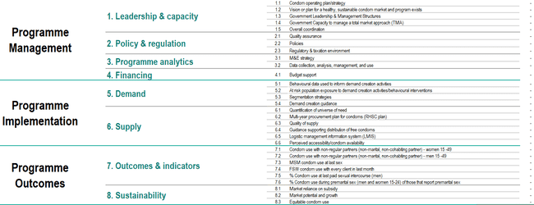
Program Self-Assessment Tool (PSAT) Summary
This is the Summary Page of the PSAT, which was developed to assist countries in identifying strengths and weaknesses in their condom programs. It also provides a useful resource for summarizing many findings from the Situation Analysis.

Slide 99
Total Market Constraints – summarized using PSI’s Production-to-Use Assessment Tool
 |  | IMPORTERS | DISTRIBUTORS/ WHOLESALERS | Retailers |  | CONSUMERS
Distribution somewhat inefficient. CORE SUPPLY & DEMAND FUNCTION | PRODUCT
 | PRICE | A barrier cited by one commercial importer is fluctuating price of condoms due to 1) volatile currency fluctuations and 2) manufacturer raw material fluctuations. | Excessive profit taking through trade is a problem, but is exasperated by poorly priced SM brands. For example, the total mark-up of Trust through trade is 359%. Lifeguard and Trust, which is sold at a price twice as high to distributors, is moved through distribution twice as efficiently – meaning MSI and PACE is able to recoup twice as much program to reinvest in programs.
 | PLACE |  |  | Social marketing brands are widely available at retail, although stock outs of SM brands and fluctuating availability appears to be a challenge. Free distribution is highly sporadic – with free being ‘everywhere’ at times, and ‘nowhere’ at others - driven by shot gun approach to distribution, challenges in supply chain, dispenser supply maintenance.
 | PROMOTION |  |  |  | While CHC harmonizes communications, evidence gaps prevent understanding factors contributing to use (or barriers to use) across populations and behavior. Without up to date prioritized factors of use communications and interventions are running blind. Programmers fill the gap with anecdotes and past experience.
SUPPORT | INFORMATION / COORDINATION | Lack of behavioral data and factors of use inhibiting informed decision making – with KP, & high risk sex in GP. Market data promising (UHMG TMA data) but room to improve sharing, analysis to inform decisions. Data that does exist in not widely shared, disseminated, jointly analyzed.
 | PROCUREMENT | Demand driven forecasts needed. Quantification supporting procurement is thoughtful process, but is supply driven, and factors in overly aggressive assumptions in growing use (to 100% by 2019). Over budgeting for procurement at times results in condoms in warehouses; latest rec to shift condom funds to ARV to fill gap. Opportunity to improve input from TMA perspective.
 | QUALITY ASSSURANCE | NDA is a bottleneck to condom supply. While WHO approved quality testing, sampling strategies + testing constraints results in condoms stuck in warehouses, often for months, while testing takes place. Impacts public sector, social marketing, commercial.
 | Financing Functions | Excess subsidy supporting free (at procurement) distribution, which is poorly targeted . SM (Protector) brands delivering too much subsidy through value chain from excess margins)
 | CAPACITY | While TMA widely understand, CCC/MoH, implementing partners require sustained support to transition TMA from concept to reality, developing holistic vision of healthy market (appropriate role of free, SM, and commercial) and specific activities to get there.
RULES | POLICY AND REGULATIONS | Unwritten policy of ’free’ condoms as a right – but not funding allocated to support procurement.
 | Informal Rules and norms |  |  |  |  | Stigma surrounding condom use, sex, and HIV appear to inhibit condoms use. Need to unpack stigma
Notes:
The above identified market constraints leverage PSI’s production to use spectrum to highlight market weakness, summarized on the ’donut’ above.

