Slide 1





More Than Just a Cut: Voluntary Medical Male Circumcision Programs Can Address Low HIV Testing and Counseling Usage and ART Enrollment among Young Men: Lessons from Lesotho
Virgile Kikaya, MD, MPH, MSc
Jhpiego Lesotho
Notes:
EN: Please include MCHIP and USAID logo on this slide. The overall PPT deserve a good editing and formatting

Slide 2
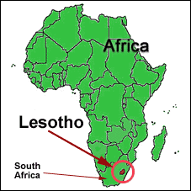
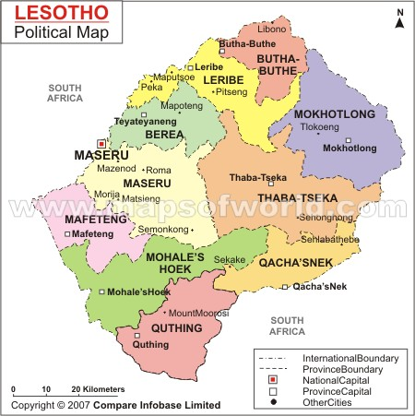
The Lesotho Context
Population: 1.8M (census 2006)
23.8% urban vs 76.2% rural
Population growth rate: 2.5 (1986); 1.5 (1996); close to 0 (2006)
Capital: Maseru, landlocked in South Africa
Economy: Minimal arable land, migrant mine workers, textiles
Notes:
Migrant mine workers with TB cannot be resent and therefore will hide their diseases
EN: Please include references for the data

Slide 3
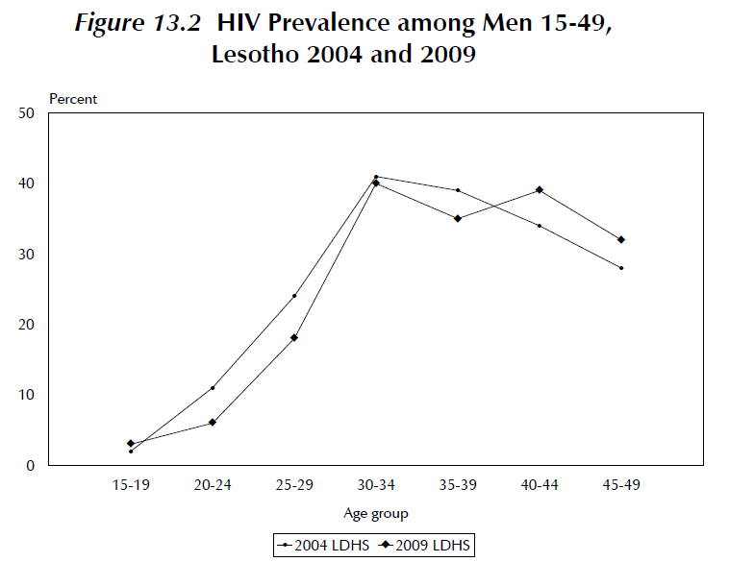
Lesotho HIV Epidemic
>360,000 people living with HIV
HIV prevalence: 23%
Over 25,000 new HIV infections annually, stable
TB/HIV co-infection: 74%
HIV prevalence among sex workers, men who have sex with men, and injection drug users is unknown; prisoners–31%; factory workers–42.7%
Heterosexual transmission of HIV: 97% of new infections
Program data
Lesotho NAC (2009) Lesotho HIV prevention response and modes of transmission analysis
Notes:
EN: Could you please center the graph? Also, please include references

Slide 4
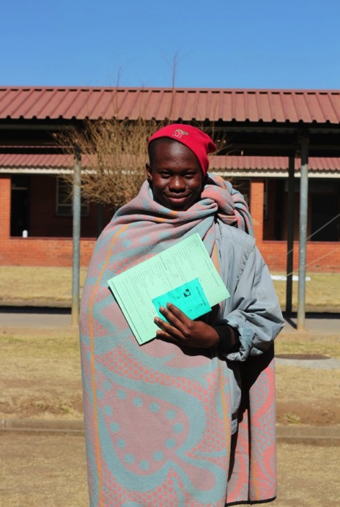
Lesotho HIV Epidemic:
Status of the Response
  About 24% of men had an HIV test (DHS 2009)
  59% adult coverage of ART
  72% of patients enrolled in treatment are retained after first year of initiation
  Nearly 3 out of 4 (74%) ART patients have a CD4 count less than 250 at the time of initiation of treatment
* Program data
Notes:
EN: Please include the reference of these data at the bottom

Slide 5
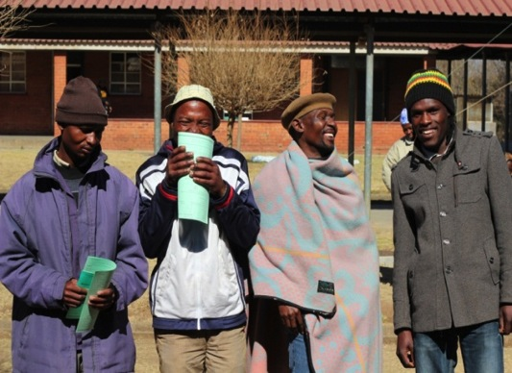

VMMC Program in Lesotho
Modelling shows 5 MCs can avert 1 HIV infection*
Services are health facility-based: Hospitals and health centers (potential for continuum of care)
VMMC free of charge
Package of services: HIV testing and counseling, STI screening and treatment, condom provision, health education, and linkage to HIV care and treatment
*Njeuhmeli E, Forsythe S, Reed J, Opuni M, Bollinger L, et al. (2011) Voluntary Medical Male Circumcision: Modeling the Impact and Cost of Expanding Male Circumcision for HIV Prevention in Eastern and Southern Africa. PLoS Med 8(11): e1001132. doi:10.1371/journal.pmed.1001132
Notes:
EN: Please include reference for the modeling data

Slide 6
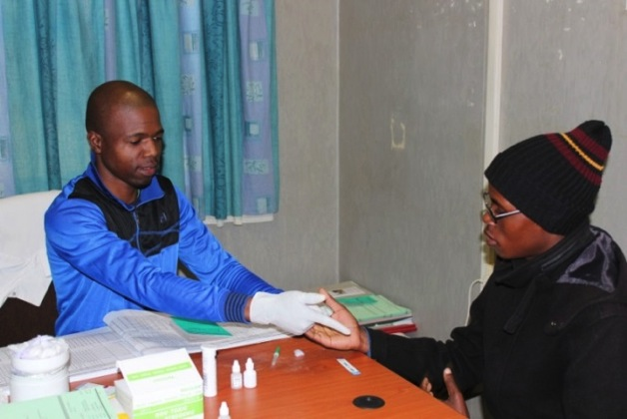
VMMC Program in Lesotho:
Key Results March 2012–June 2014
National coverage of MCs: more than 60,000 (national target: 300,000)
More than 80% of clients are under 24; more than 95% test for HIV
HIV-positive: 6% (20% at adult clinic)
Low rate of adverse events: 0.8–1.0%
310 doctors, nurses, and counselors trained
* Program data
Notes:
EN: Source of the data. If it was included in the PLOS article, you can use that article as reference

Slide 7
Objective and Methods of the Review
To describe the potential role of MC as an entry point to improve the identification of HIV-positive men and ensure their active referral and linkages with care and treatment in the Lesotho program.
VMMC program data at Mafeteng District Hospital were collected from March through December 2012.
VMMC clients testing positive for HIV were traced to ascertain whether they:
Presented at the ART clinic;
Had a CD4 count; and
Enrolled in treatment.
Clients who were not found enrolled at Mafeteng Hospital were traced through phone calls to ascertain if they enrolled in treatment at another facility.
Kikaya V, Skolnik L, Garcı´a MC, Nkonyana J, Curran K, et al. (2014) Voluntary Medical Male Circumcision Programs Can Address Low HIV Testing and Counseling Usage and ART Enrollment among Young Men: Lessons from Lesotho. PLoS ONE 9(5): e83614. doi:10.1371/journal.pone.0083614
Notes:
EN: Include reference (PLOS article)

Slide 8
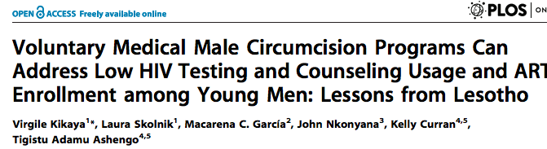
Results
A total of 1,906 clients were tested for HIV at VMMC services at Mafeteng hospital from February–December 2012
Testing in the VMMC clinic represented 65% of all males tested at Mafeteng Hospital
1,035 clients were tested for HIV in other services in the hospital during the same period
Notes:
EN: Same comment about reference (use the PLOS article as reference)

Slide 9
Results, cont.
VMMC clients found positive at MC site: 72 (100%)
VMMC clients who received a CD4 count during VMMC services (all registered for ART clinic services): 45 (62.5%)
Mean CD4 count result was 302 [195–685]
VMMC clients who did not receive a CD4 count during VMMC services and were asked to return later: 27 (37.5%)
VMMC clients eligible for treatment: 40 (55.6%)
VMMC clients not eligible for treatment: 5 (7.0%)
VMMC clients who were not traced: 16 (22.2%)
VMMC clients who were traced: 11 (15.2%)
Out of 446 clients who tested HIV-positive in the hospital, 72 (16%) were tested at the VMMC site. Of these 72, 23 were between 25 and 29 (32%) and 19 were between 30 and 34 (26%).
VMMC clients who received a CD4 count and were enrolled in care and treatment: 4 (5.5%)
VMMC clients who did not receive a CD4 count and were not enrolled in care and treatment: 7 (9.7%)
Notes:
EN: reference

Slide 10
Discussion
This review suggests that clients who test positive for HIV and receive a CD4 count while seeking MC services are likely to enroll in HIV care and treatment (counseling for adherence to HIV treatment).
Hospital staff who are capable of initiating ART and providing VMMC services contribute to the success of active referral.
Regular review of VMMC data and follow-up of HIV-positive clients will help support linkages with HIV care and treatment.
It is important to have a point of care CD4 available in the facility, preferably within the VMMC site.
Kikaya V, Skolnik L, Garcı´a MC, Nkonyana J, Curran K, et al. (2014) Voluntary Medical Male Circumcision Programs Can Address Low HIV Testing and Counseling Usage and ART Enrollment among Young Men: Lessons from Lesotho. PLoS ONE 9(5): e83614. doi:10.1371/journal.pone.0083614
Notes:
EN: reference

Slide 11
Conclusion
VMMC provided at health facilities presents an opportunity to increase HIV diagnoses and treatment uptake among men.
An investment in client follow-up and an adequate referral system between VMMC and ART clinics are needed.
Ensuring that clients who test positive are immediately enrolled in HIV care and treatment is a key factor for future compliance.
In high HIV prevalence settings such as Lesotho, the national MC program offers unprecedented opportunities to identify men who are HIV-infected and previously undiagnosed.
Kikaya V, Skolnik L, Garcı´a MC, Nkonyana J, Curran K, et al. (2014) Voluntary Medical Male Circumcision Programs Can Address Low HIV Testing and Counseling Usage and ART Enrollment among Young Men: Lessons from Lesotho. PLoS ONE 9(5): e83614. doi:10.1371/journal.pone.0083614
Notes:
EN: reference

Slide 12
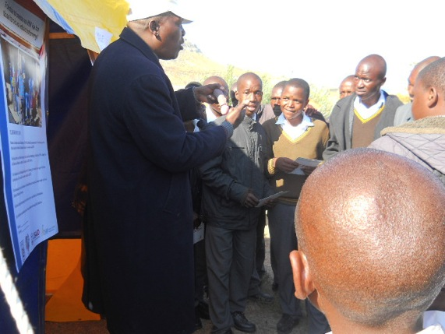
Reference
Voluntary medical male circumcision programs can address low HIV testing and counseling usage and ART enrollment among young men: Lessons from Lesotho. PLOS ONE 9(5): e83614. doi:10.1371/journal.pone.0083614
Contributing authors:
  Virgile Kikaya
  Laura Skolnik
  Macarena C. García
  John Nkonyana
  Kelly Curran
  Tigistu Adamu Ashengo

Slide 13
This presentation was funded by the United States President’s Emergency Plan for AIDS Relief (PEPFAR) through the United States Agency for International Development’s (USAID’s) Maternal and Child Health Integrated Program, under Cooperative Agreement #GHS-A-00-08-00002-00. The opinions herein are those of the authors and do not necessarily reflect the views of PEPFAR or USAID.

