Slide 1
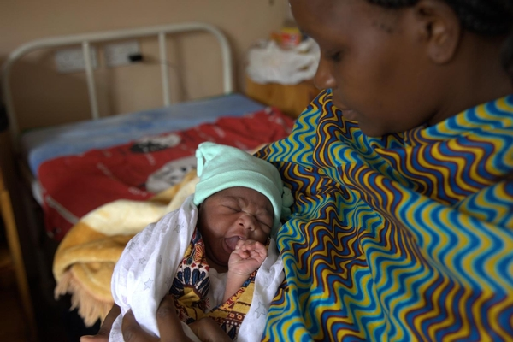
20th International AIDS Conference
Melbourne, Australia. 22nd July 2014
STEPPING UP THE PACE
Stocktaking Assessment of EIMC in Southern and Eastern Africa
Dr Susan Kasedde
Senior HIV Specialist
UNICEF, NYHQ
Melbourne Room 1
18.30h – 20.30h

Slide 2
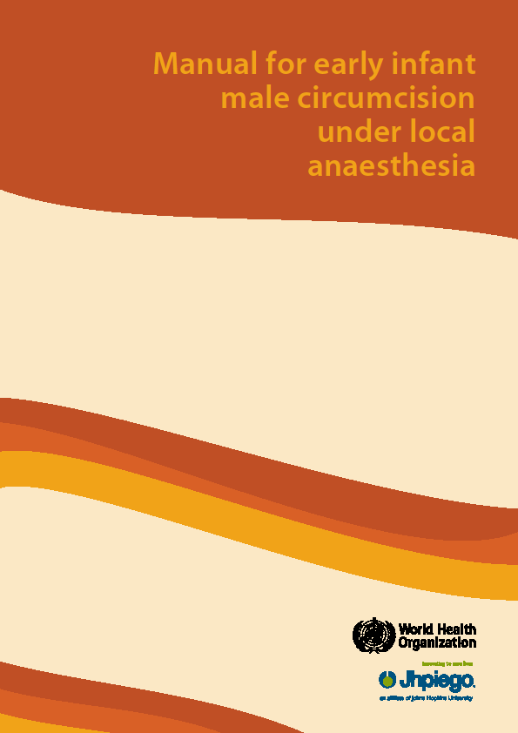
Background: Why EIMC?
Procedure is simpler
Healing is faster
Adverse events are rarer
Reduced infant UTI risk
Builds a sustainable intervention for HIV/STIs
However, infants cannot give consent
Not recommended in pre-term or low birth weight infants or infants with genital abnormalities
“Manual for early infant male circumcision under local anaesthesia,” WHO, Jhpiego, 2010
Notes:
Sustainability phase

Slide 3
Definition of EIMC For Stocktaking Report
National program
Medical not traditional
Conducted between 0-60 days from birth

Slide 4

Objectives
Understand acceptability, feasibility, safety, technical concerns, policy and strategic plans, current implementation, trends, and safety studies in 14 focus countries;
Assess the perspectives of MoHs and implementing partners regarding EIMC scale up;
Identify barriers to and opportunities for scale up including best practices, innovative models, funding and research;
Assess the opportunity for EIMC to be offered as part of MNCH and routine immunization services;

Slide 5
Methodology
Rapid assessment in 14 MC priority countries
Qualitative data collection through interviews
Quantitative data collection through data collection form and desk reviews
Standard interview questionnaire for key informants

Slide 6
Findings

Slide 7
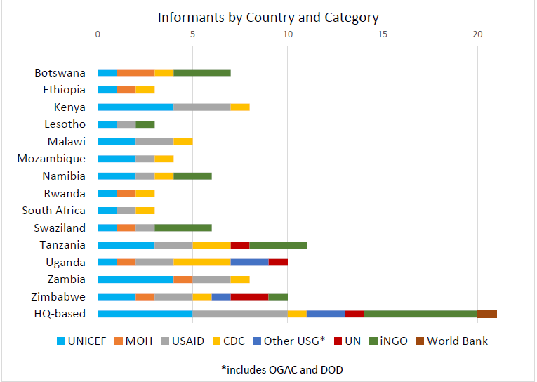
Profile of Respondents
87 respondents interviewed in the 14 countries (3-7 from each country)
21 respondents interviewed at global level

Slide 8
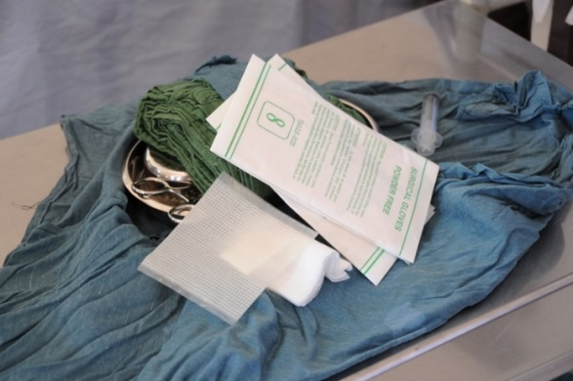
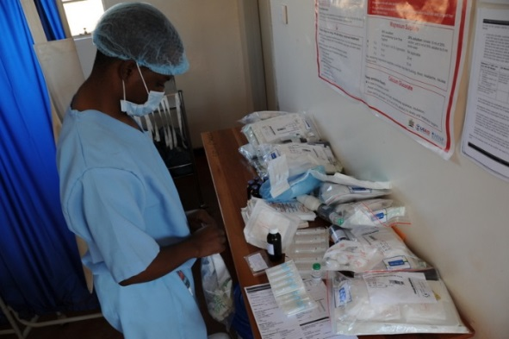
Current implementation status
National Program | Pilot programs | Active planning / strategy development | No programs / plans
Swaziland | Botswana | Namibia | Ethiopia
 | Kenya | Rwanda | Malawi
 | Lesotho | Zambia | Mozambique
 | Tanzania |  | South Africa
 | Zimbabwe |  | Uganda

Slide 9
EIMC as part of routine MNCH service
Advantages
General
Easy to reach parents and babies
Normalize procedure faster and make it more efficient
More sustainable overtime
MNCH
Safe health services
Would strengthen MNCH system, including uptake of services
Existing trust in the MNCH system and services
EPI
High immunization rates
Catch those deferred EIMC at birth
Could reach infants born at home
More EPI outlets than MNCH services
Considerations/ challenges
General
- When newborn health visit are not facility based
Limited human resources
Negative impact on facility visits
MNCH
High volume MNCH, low facility delivery
New service impact on weak systems
Staff resistance?
Fathers do not attend MNCH services
EPI
Coverage varies
Limited follow-up opportunity
Additional work for and limited skills of EPI staff

Slide 10
Acknowledgements
Carmine Bozzi, Senior Partner, Akeso Associates
Raleigh Watts, Senior Partner, Akeso Associates
Alyson Shumays, Research Analyst, Akeso Associates
Robert C. Bailey, PhD, MPH, Technical Advisor, Akeso Associates
Phillip Nieburg, MD, MPH, Technical Advisor, Akeso Associates
Tin Tin Sint, UNICEF
Rene Ekpini, UNICEF
Craig McClure, UNICEF
Emmanuel Njeuhmeli, USAID

Slide 11

Thank you

