Slide 1
ARV Based Prevention
Overview, Trends, Guidance

Slide 2
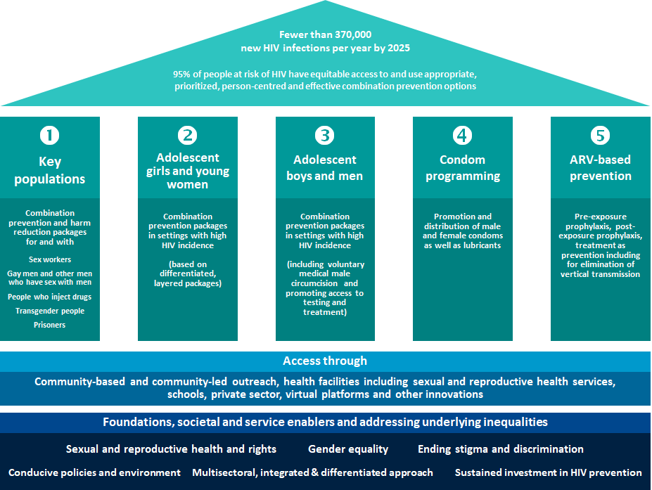
Prevention Pillars
Road Map
Focuses on scaling up primary prevention of HIV infections and on introducing policy, legal and societal enablers
Highlights complementarity and interaction between primary HIV prevention, testing, treatment and the prevention of vertical transmission of HIV

Slide 3
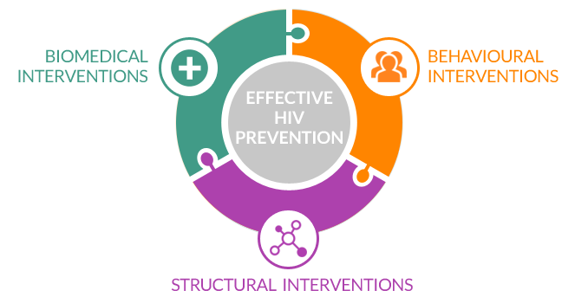
ARV based prevention as part of prevention as part of combination HIV prevention
  Pre - Exposure Prophylaxis
  Post Exposure Prophylaxis
  Treatment as Prevention
  Prevention of vertical Transmission

Slide 4

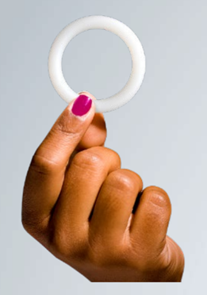
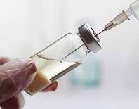
Pre-Exposure Prophylaxis - PrEP
WHO has recommended 3 PrEP products for people at substantial risk of acquiring HIV
  Oral PrEP containing tenofovir (2015)
  Dapivirine vaginal ring (2021)
  Long acting injectable cabotegravir (2022)
Notes:
In the presentation focus on biomedical prevention:

Slide 5
How are countries doing on PrEP ?
Uptake of PrEP increased to an estimated 2.4 M users worldwide in 2022. Global target is 10 M

Slide 6

Uptake of PrEP since 2018 across new GPC countries
Source: UNAIDS Global AIDS Monitoring, 2022 (see https://aidsinfo.unaids.org/).

Slide 7
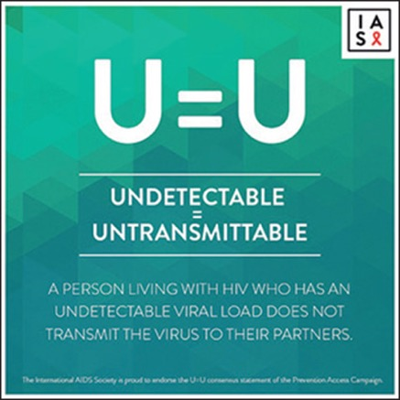
Treatment as Prevention
Effective HIV Treatment is effective prevention
Awareness is increasing
Notes:
Slow uptake and at times controversial, increasing campaigns and attention within the region are starting to

Slide 8
Treatment coverage and Viral Load Suppression
Indicator | Rwanda | South Sudan | Colombia | Egypt | Madagascar
% of all PLHIV diagnosed | 95 | id | 0 | 74 | id
% of all PLHIV on ART | 92 | 32 | id | 47 | 18
% of all PLHIV virally suppressed | 90 | id | 0 | 39 | id
% of all PLHIV virally suppressed (women 15+) | 91 | id | 0 | 44 | id
% of all PLHIV virally suppressed (men 15+) | 89 | id | 0 | id | id
% of National PrEP need met (%) | id | 1 | id | id | id

Slide 9
Prevention of Vertical Transmission

Slide 10
MTCT rate 5%
% of HIV-positive pregnant women receiving ART 98%
Estimated number of births to WLHIV 6700
Estimated number of new child infections due to VT 350
Rwanda

Slide 11
MTCT rate 26%
% of HIV-positive pregnant women receiving ART 53%
Estimated number of births to WLHIV 7 300
Estimated number of new child infections due to VT 1 900
South Sudan

Slide 12
Thank You !

Slide 13
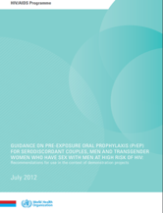
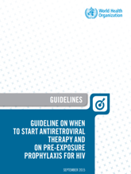

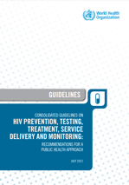
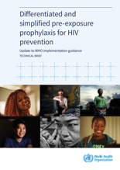
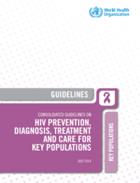
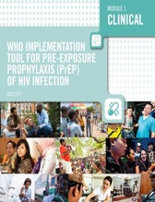
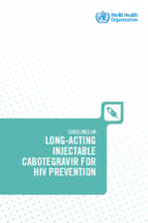
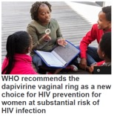
WHO recommendations & guidance on PrEP
ED-
PrEP
Upcoming: Updates to PrEP impl. tool
PrEP for SDC, MSM & TG (conditional rec in the context of demo projects)
PrEP for people
at substantial HIV risk (strong rec)
Updates on oral PrEP + dapivirine vaginal ring
2012 2014 2015/16 2017 2019 2021 2022 2023
PrEP for MSM
(strong rec); other KP
(conditional rec)
no recommendation for PWID
Imp tool
DPV-VR
CAB-LA
Notes:
To support increasing, has released new guidance to make PrEP simpler, and more differentiated and to offer choice

