Slide 1






September 4, 2014
Improving VMMC Program Efficiency Through Age and Geographic Prioritization
Katharine Kripke
John Stover
Emmanuel Njeuhmeli
AIDS 2014 – Stepping Up The Pace

Slide 2
Progress Toward VMMC Targets
Sgaier SK, Reed JB, Thomas A, Njeuhmeli E (2014) Achieving the HIV Prevention Impact of Voluntary Medical Male Circumcision: Lessons and Challenges for Managing Programs. PLoS Med 11(5): e1001641. doi:10.1371/journal.pmed.1001641
http://www.plosmedicine.org/article/info:doi/10.1371/journal.pmed.1001641
Notes:
In 2013, the 14 priority countries for VMMC were about ¼ of the way toward reaching the target of 21 million VMMCs among clients age 15-49 by 2016. There was a concern that there might not be enough resources—financial or human—to enable the countries to reach their targets.

Slide 3
Age Distribution of VMMC Clients
Client age distribution: PEPFAR implementation data from 2013 from Tanzania, Swaziland, and Malawi
Population age distribution: DMPPT 2.0 model for Tanzania, Swaziland, and Malawi
Notes:
In addition, many countries were finding that over a third of the clients being circumcised were not even falling within the 15-49 year age group of the target population, and that it was difficult to reach men above the age of 25, who were believed to be key for immediate impact on reducing new HIV infections.

Slide 4
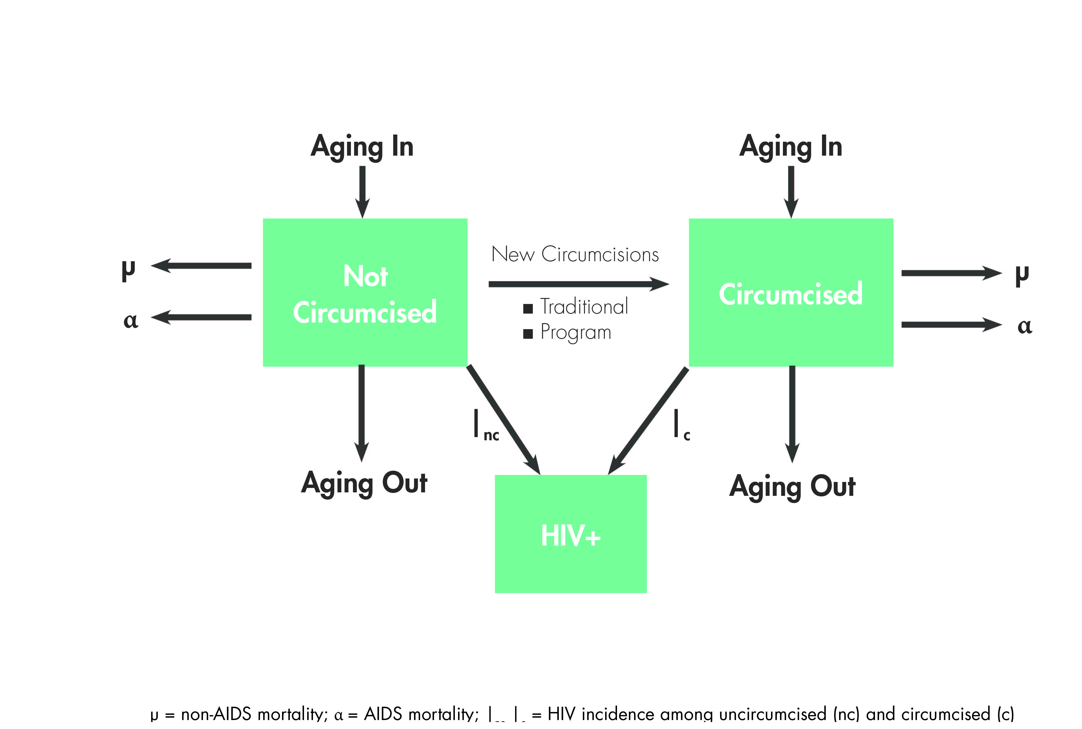
DMPPT 2.0 Model Structure
Notes:
HPP was requested to create a model that could track the impact of circumcising different age groups of clients, in order to help us better understand the impact of the high numbers of 10-19 year olds and low numbers clients over age 25, and how the program could be better focused to maximize impact with less investment.

Slide 5
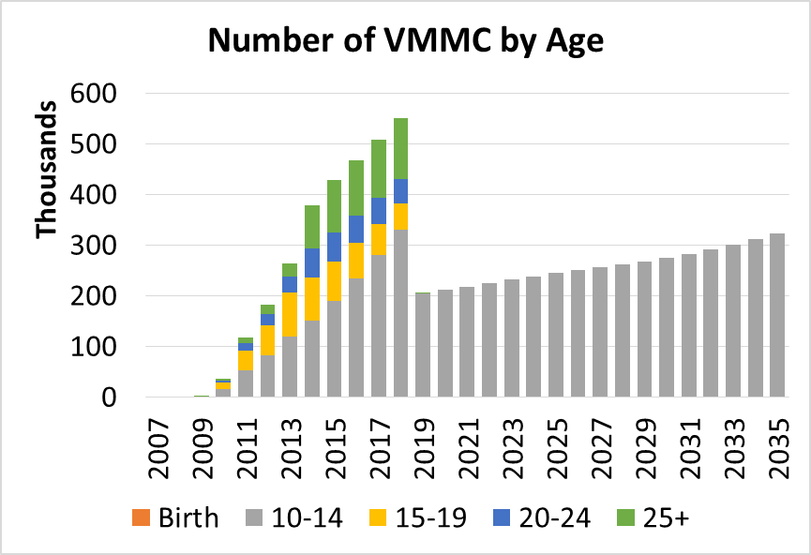
Age Distribution of VMMC Based on Target Strategy in Tanzania, Targeting Ages 10–49
 | Baseline MC Prevalence | Target Coverage in 2018
EIMC | 5% | 5%
10–14 | 22% | 80%
15–19 | 40% | 80%
20–24 | 49% | 80%
25–29 | 41% | 80%
30–34 | 46% | 80%
35–39 | 47% | 80%
40–44 | 43% | 80%
45–49 | 37% | 80%
50–54 | 37% | 37%
55–59 | 37% | 37%
Total MCs during scale-up, 2013–2018: 2.8 million
Total MCs during maintenance, 2019–2028: 2.3 million
Notes:
The model allows users to set targets for scale-up of VMMC separately for different 5-year age groups, as well as EIMC. It calculates the numbers of circumcisions in each age group to reach and maintain the specified targets, and the impact in terms of HIV infections averted among males and females, total cost, cost per infection averted, and number of circumcisions per infection averted.

Slide 6
Model Limitations
Modeled projections of impact depend on the HIV incidence projections input into the model
  Incidence projections/data are not available for all subpopulations of interest (district level projections, risk groups, etc.).
  Longer-term projections are sensitive to the assumed trends in HIV incidence over the next few decades.
  Models projecting impact of other interventions, e.g., treatment scale-up, are vulnerable to similar uncertainties around HIV incidence assumptions.
Models are populated by inputs that are subject to uncertainty and assumptions, e.g., baseline MC prevalence, unit costs, and discount rate.
Notes:
This slide was added by the PEPFAR VMMC TWG.

Slide 7
Model results do not reflect important programmatic considerations and experiences.
Scale-up strategies should also be based upon:
  Resources available: staff, space, and funding
  Challenges mobilizing demand: some groups may be easier to reach
  Broader benefits of VMMC platform with value for all ages: HIV testing and counseling, risk-reduction counseling, condoms, linkages to other programs
  Policy realities related to parity in access to services or political commitments for equitable scale-up
Notes:
This slide was added by the PEPFAR VMMC TWG.

Slide 8
Model Data Requirements
Incidence, prevalence, and population data (Spectrum AIM or Goals)
Percent circumcised in base year by age (DHS, AIS, or similar surveys)
Age distribution of circumcisions performed by year (national program data)
Unit cost of adult/adolescent VMMC (costing studies)
Unit cost of ART (costing studies)
Discount rate (assumption)

Slide 9
Logic Tree Applied to Address the Value of Sub-population-specific Targeting
Effectiveness of VMMC
Immediacy of impact
Magnitude of impact
Programming efficiency
Programmatic feasibility
Program cost
Number of VMMCs per HIV infection averted
Focus of modeling work
How fast incidence rate is reduced
Number of HIV infections averted
Cost of VMMC program
Depends on whether the program has viable models to reach the sub-group
Notes:
This slide was created by the PEPFAR/HPP and Gates/University of Qatar teams during a consultation about the models. The next three slides (10-12) were also designed by this group, and we were specifically asked to present the analysis in this way.

Slide 10
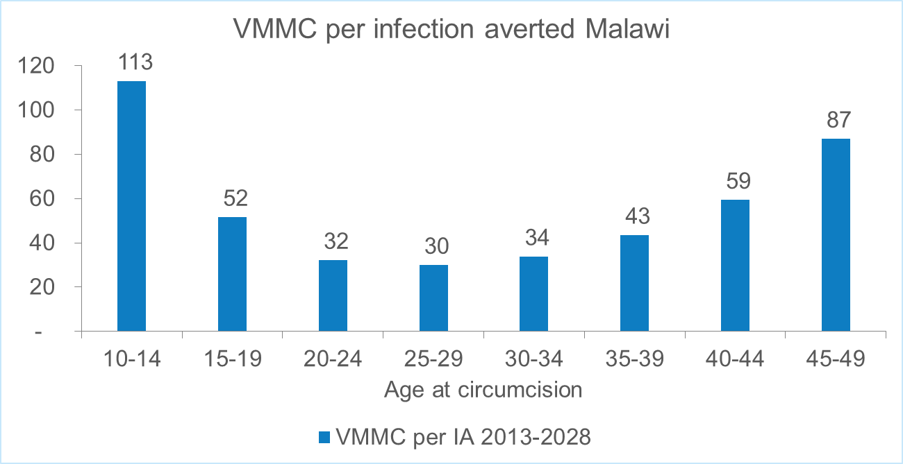
Effectiveness of VMMC:
Age-specific Targeting in Malawi
Notes:
In the next several slides, I will walk you through the age-targeting analysis, using Malawi as an example.
This analysis represents fictitious scenarios in which circumcisions are performed only in the specific age group depicted. For example, on the left, only 10-14 year olds are circumcised. Then we see the impact on the entire population projected out over time, as these circumcised boys are followed as they age. The chart shows an analysis for Malawi over the period 2013-2028. Over this time period, the greatest effectiveness is between the ages of 20 and 34.

Slide 11
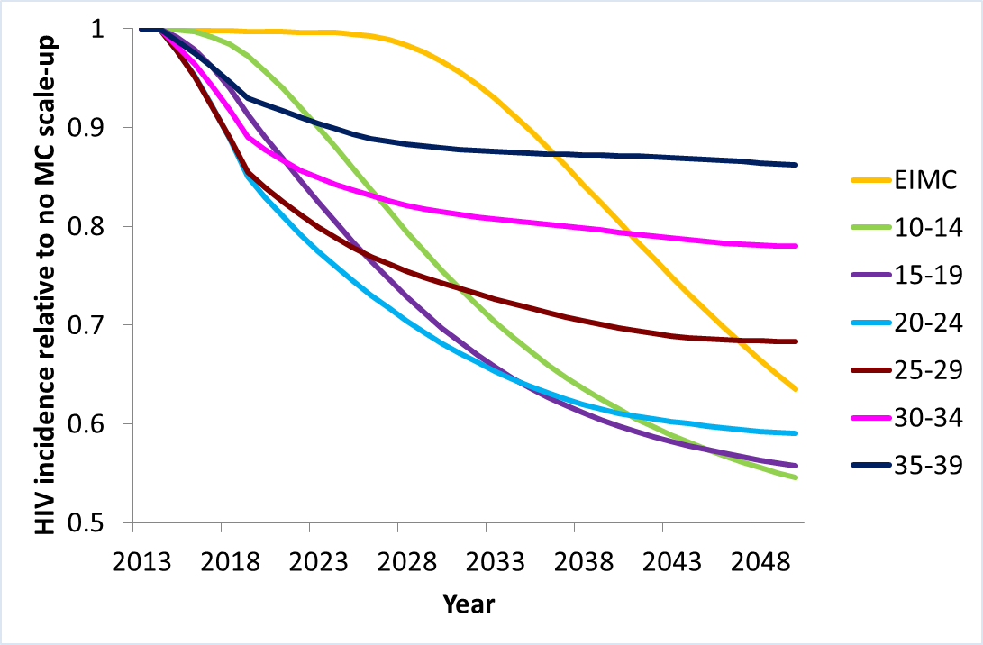
Malawi: Immediacy and Magnitude of Reductions in HIV Incidence Based on VMMC Client Age
Notes:
Here again we are looking at the same fictitious scenarios as before, where each line represents a circumcision strategy targeting only that age group. The reductions in incidence are in the entire population, not just in that age group. The age group listed in the legend is only who is getting circumcised. Again it is tracking the boys who are circumcised as they age over time.
Each line represents the reduction in incidence comparing the scale-up strategy depicted compared with no scale up. The most rapid initial reductions in incidence are among the 20-24 and 25-29 year age groups, while the greatest magnitude reduction in incidence over the long term come from circumcising 10-14 and 15-19 year olds.

Slide 12
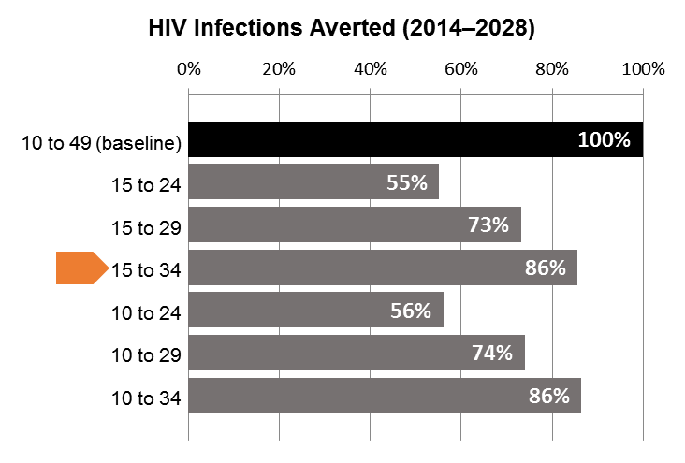
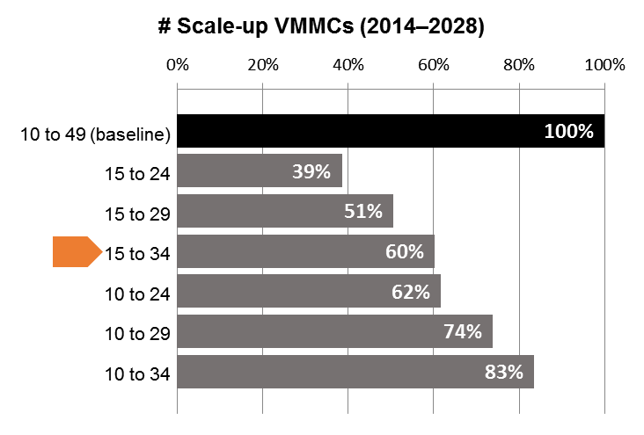
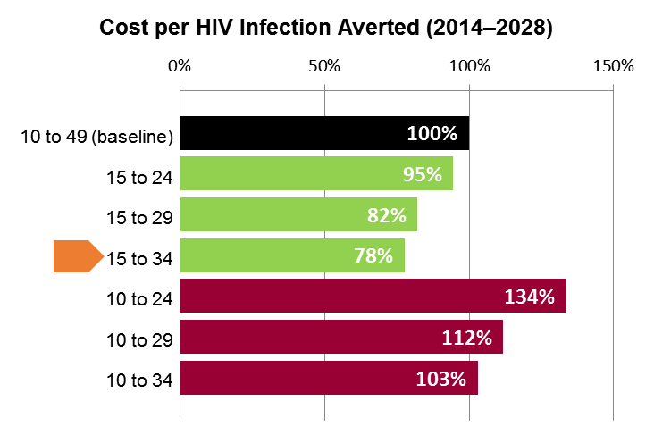
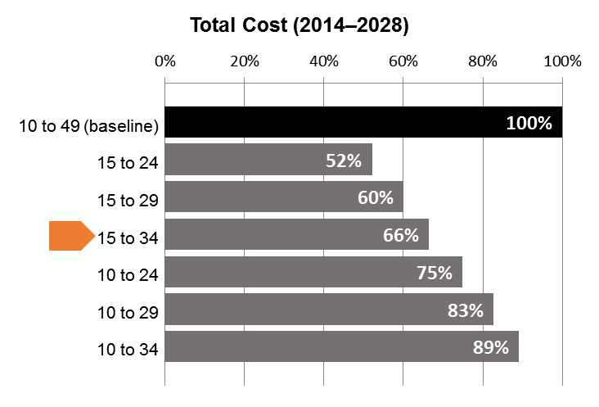
Malawi: VMMC Impact and Program Cost
Notes:
Here we are looking at what might be some real age targeting strategies, with combined age groups. You can see that the most efficient strategy in terms of cost in this table is targeting the 15-34 year age group (look at cost per infection averted, lower left panel). If we focus on the age groups that start with 10, you can see that there are no gains in cost efficiency in the age groups starting with 10 years old.
Please note that the results in this slide used the same unit cost regardless of the age of the client. If you vary the unit cost so that it increases with the older men, for example, you might get different results in terms of the most cost-effective ages to target. We looked at this for South Africa, and large differences in cost by age of client resulted in small changes in the most cost-effective age groups to target.

Slide 13
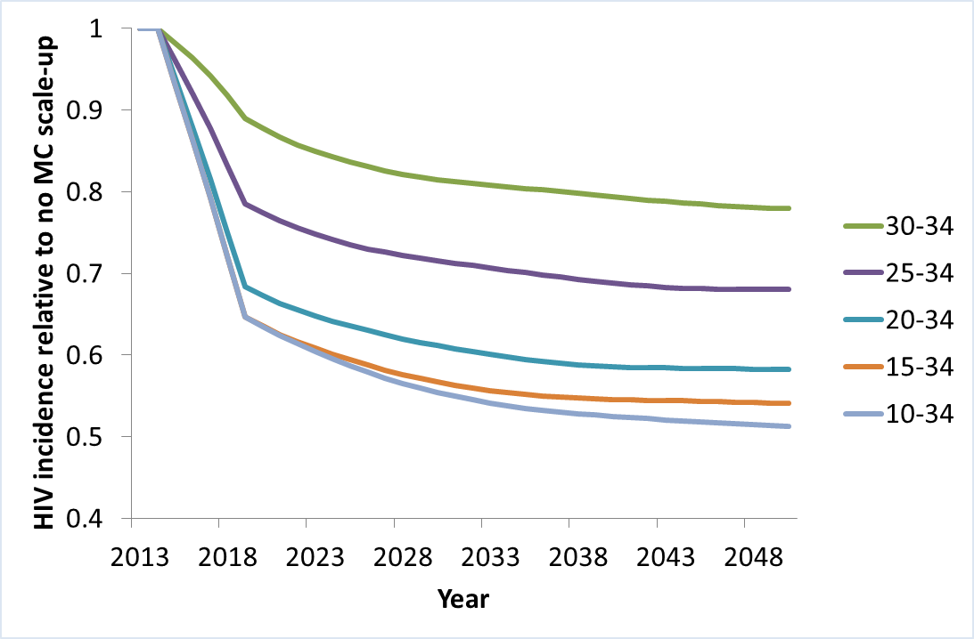
Malawi: What is the impact of adding the lower age groups?
Notes:
Here we are looking at different age targeting strategies that progressively add the younger age groups. You can see that additional reductions of HIV incidence are achieved when adding the younger age groups to those who are circumcised.

Slide 14
Age Prioritization Across Countries
INDICATOR | MALAWI | TANZANIA | SWAZILAND | SOUTH AFRICA | UGANDA
VMMC/IA | 20–34 | 15–29 | 15–34 | 20–34 | 20–34
Immediacy of impact | 20–29 | 15–29 | 20–29 | 20–34 | 20–29
Magnitude of impact | 10–19 | 10–19 | 10–24 | 10–19 | 10–19
Cost-effectiveness | 15–34 | 15–29 | 15–29 | 15–34 | 15–34
New country age target | 10–34 | 10–34 | TBD | TBD | TBD
Notes:
This slide summarizes the results of the analyses in the five countries where DMPPT 2.0 analyses have been conducted. Malawi and Tanzania have made policy decisions about age targeting as a result of the analyses; the other countries are still in the process of considering the implications.

Slide 15
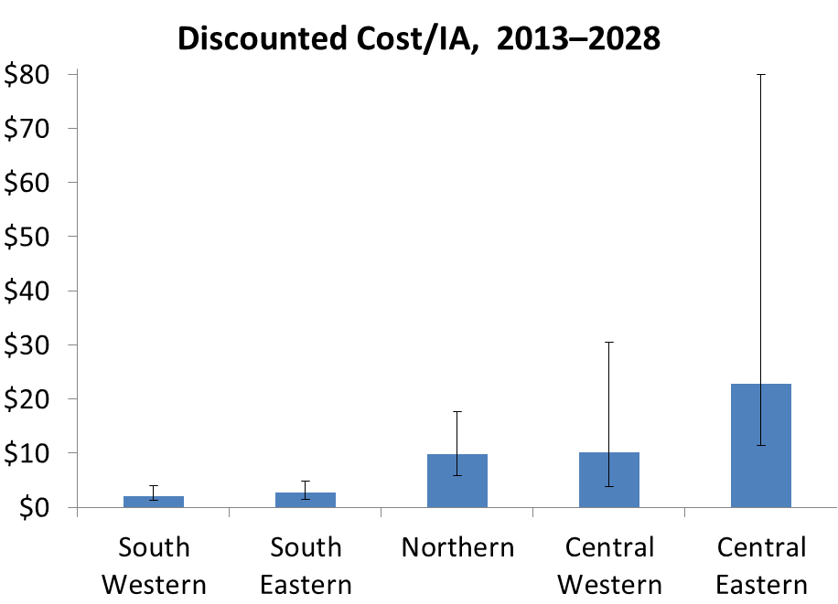
Discounted Cost/Infection Averted Across Zones in Malawi, 2013–2028
Notes:
In addition to age of client, we also looked at the impact and cost-effectiveness of focusing on specific sub-national regions. Again we are using Malawi as an example. We also conducted subnational analyses in Tanzania, South Africa, and Uganda.
Here you can see that the cost-effectiveness of focusing on different zones in Malawi has wide variation, with the two southern zones coming out as being the most cost-effective. The black bars represent the uncertainty of the estimates based on the uncertainty of the HIV incidence projections that were input into the DMPPT 2.0 model.

Slide 16
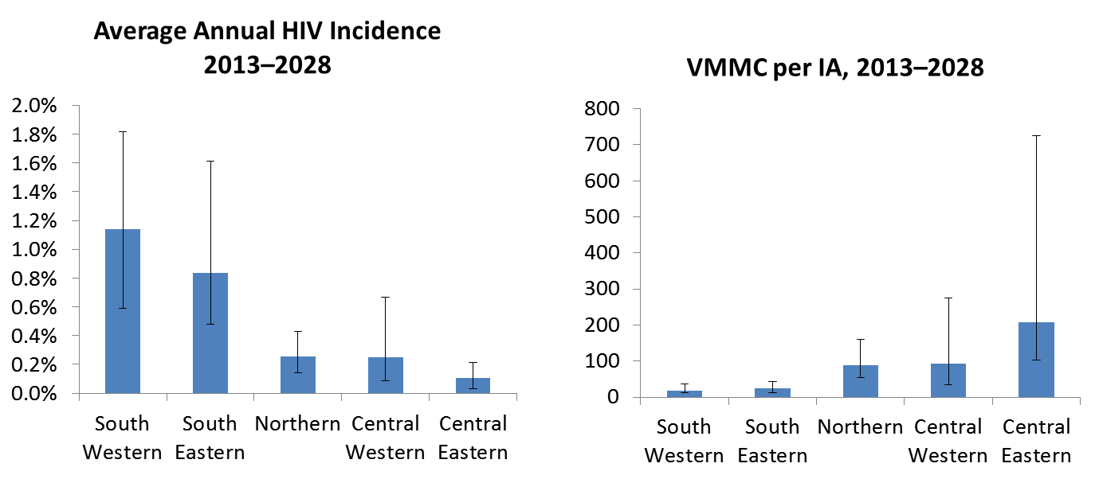
HIV Incidence is Inversely
Related to VMMC/IA
Notes:
Why would cost-effectiveness vary among the zones? The cost-effectiveness is related to the number of VMMCs per infection averted, which in turn is inversely related to the incidence. The higher the HIV incidence, the fewer circumcisions need to be performed to avert one HIV infection, making the VMMC program more cost-effective and impactful.

Slide 17
Prioritizing Populations Using Incidence vs. Prevalence
Prevalence
  Many decisionmakers prioritize sub-populations (such as subnational regions or age groups) based on HIV prevalence in those populations.
  Prevalence is a function of both incidence (new infections) and deaths; once ART is introduced, increases in prevalence are caused by a combination of new infections and higher survival.
Incidence
  Prevention programs will have the greatest impact where incidence is highest.
  Prevalence is a poor proxy for incidence, especially once ART is introduced in a population.
  Incidence is difficult to measure directly but can be estimated using data from HIV surveillance combined with information about ART and PMTCT programs.
  Projections of incidence into the future are based on assumptions about what will happen with the epidemic, and are therefore subject to high levels of uncertainty.
  This uncertainty affects projections of all prevention interventions to the same degree.

Slide 18
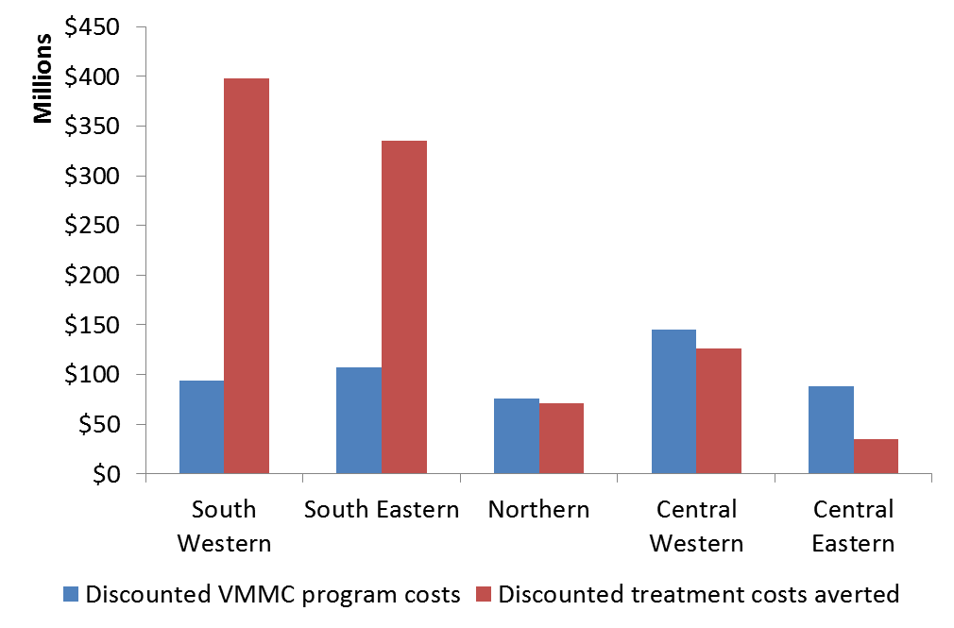
VMMC Program Costs vs. Treatment Costs Averted in Malawi Zones, 2013–2028
Notes:
Here you can see how the different Zones vary in terms of cost savings from treatment costs averted. With these particular assumptions of the cost of VMMC and the cost of treatment, in some of the Zones the VMMC program is cost saving, and in other Zones it is not. These results are sensitive to assumptions about the relative cost of the VMMC program vs. the cost of treatment.

Slide 19
Conclusions
The DMPPT 2.0 model has been applied in Malawi, Tanzania, Swaziland, South Africa, and Uganda, to assist with VMMC strategy and operational planning.
Countries are selecting new VMMC scale-up targets by focusing on age groups and geographic regions that maximize impact on HIV incidence and cost-effectiveness, based on country priorities and implementation realities.
  Immediate impact on HIV incidence is generally achieved by focusing on older age groups, whereas long-term magnitude of impact is achieved by focusing on 10–19-year-olds.
  Greatest cost-effectiveness is achieved by focusing on people ages 15–29 or 15–34, depending on the country.
  Countries may wish to continue to circumcise 10–19-year-olds while increasing outreach to men ages 20–34.
Where HIV incidence data or projections are available, it is preferable to prioritize populations for HIV prevention based on incidence rather than prevalence.

Slide 20
Acknowledgments (1)
This modeling exercise is being conducted in Malawi, Tanzania, Swaziland, Uganda, Zambia, and Zimbabwe under the technical leadership of
  Emmanuel Njeuhmeli, USAID/Washington
  Sema Sgaier, BMGF
  Jason Reed, OGAC
  Katharine Kripke, Health Policy Project, Futures Institute
The DMPPT 2.0 model was developed by John Stover of the Health Policy Project, Futures Institute, funded by PEPFAR through USAID
The ASM model was developed by Laith Abu Raddad and Susanne Awad of Weill Cornell Medical College in Qatar, with funding from BMGF
BMGF is leading the modeling exercise in Zambia and Zimbabwe
PEPFAR, through USAID, is leading the modeling exercise in Tanzania, Malawi, Swaziland, South Africa, and Uganda

Slide 21
Acknowledgments (2)
The Malawi modeling was done under the leadership of
  Frank Chimbwandira and Amon Nkhata, Ministry of Health
  Zebedee Mwandi, USAID/Malawi
The Tanzania modeling was done under the leadership of
  Jackson Lija and James Juma, Tanzania National AIDS Control Program (NACP)
  Erick Mlanga, USAID/Tanzania
We would like to acknowledge the following colleagues for their key contributions for this activity
  Andreas Jahn, Malawi Ministry of Health
  Bennet Fimbo and Edward Maswanya, Tanzania VMMC Operational Plan Team
  Malawi and Tanzania Male Circumcision Technical Working Groups
  PEPFAR team in Malawi, especially Wezi Msungama, Faustin Matchere, and Martin Mtika
  Olive Mtema (Futures Group, [FG]), Chaitra Gopalappa (Futures Institute, [FI]), Carel Pretorius (FI), Steven Forsythe (FI), Alexander Paxton (FG), and Bernice Kuang (FG) of the Health Policy Project
  Hally Mahler and Dorica Boyee, MCHIP/Tanzania
  PEPFAR Male Circumcision Technical Working Group, particularly Naomi Bock, Carlos Toledo, Dan Rutz, and Stephanie Davis of CDC/Atlanta; Anne Thomas of DoD; Catey Laube of OGAC; and Kim Ahanda and Elizabeth Gold of USAID/Washington

Slide 22
Thank You!
www.healthpolicyproject.com
The Health Policy Project is a five-year cooperative agreement funded by the U.S. Agency for International Development under Agreement No. AID-OAA-A-10-00067, beginning September 30, 2010. The project’s HIV activities are supported by the U.S. President’s Emergency Plan for AIDS Relief (PEPFAR). It is implemented by Futures Group, in collaboration with CEDPA (part of Plan International USA), Futures Institute, Partners in Population and Development, Africa Regional Office (PPD ARO), Population Reference Bureau (PRB), RTI International, and the White Ribbon Alliance for Safe Motherhood (WRA).
The information provided in this document is not official U.S. Government information and does not necessarily represent the views or positions of the U.S. Agency for International Development.

