Slide 1

Comparison Study of EIMC Devices and Pilot Implementation in Botswana
Rebeca M. Plank, MD MPH
Brigham and Women’s Hospital /
Botswana-Harvard School of Public Health AIDS Institute Partnership

Slide 2
Early Infant Male Circumcision (EIMC): Safety and Sustainability
Minimal bleeding
No sutures
Fast healing ~ 7-10 days
Low complication rate
By the time an adult decides, he may be infected
No loss of time from school or work
No risk of sex before healing
Can be performed by nurses and midwives
Can be done in almost any clinical space
But a device is always recommended

Slide 3
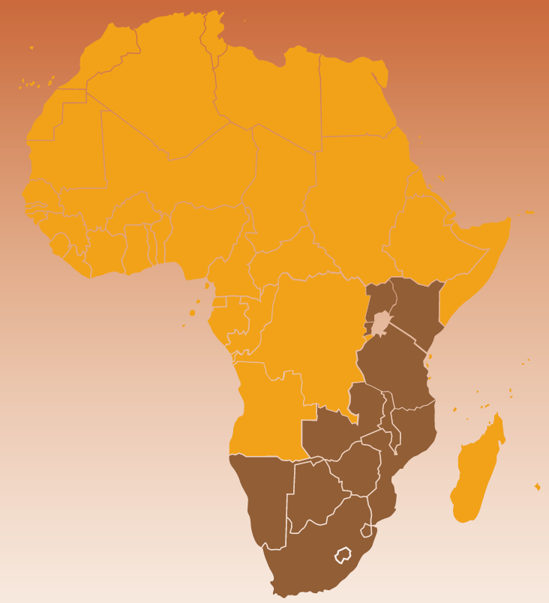
WHO recommends that MC be offered for HIV prevention based upon “compelling evidence”
“Neonatal circumcision is a less complicated and risky procedure than circumcision performed in young boys, adolescents or adults [and] countries should consider how to promote neonatal circumcision in a safe, culturally acceptable and sustainable manner (WHO / UNAIDS, 2007).”

Slide 4
Clinical Study
Determine actual uptake of EIMC
Theoretical acceptability was high (>90%)
Estimate relative feasibility and safety of EIMC devices
Complication rate
Estimate relative advantages of different EIMC devices for sustainable scale-up
Human resources
Supply chain management
Cost

Slide 5
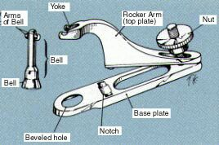
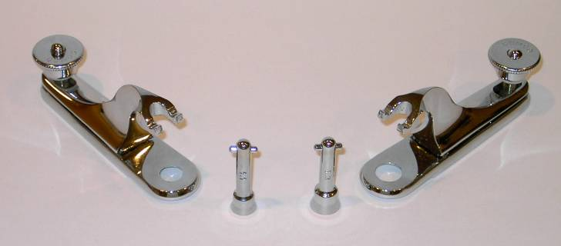
Gomco Clamp

Slide 6
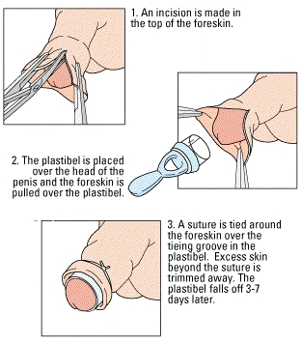
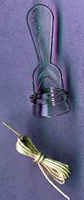
Plastibell

Slide 7
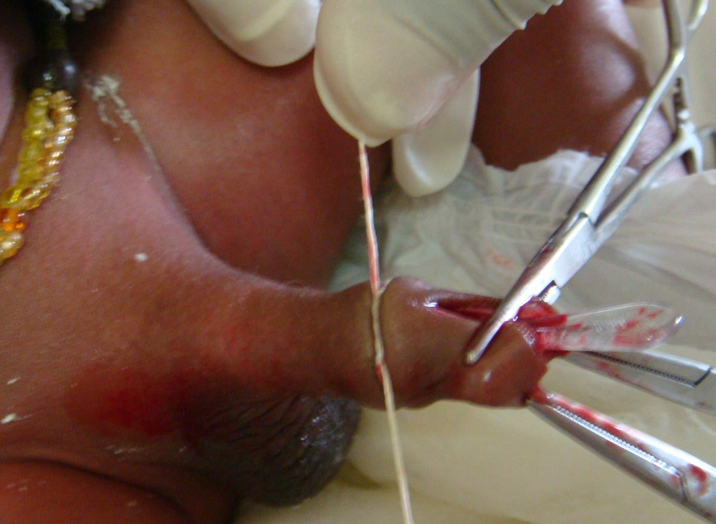

Slide 8
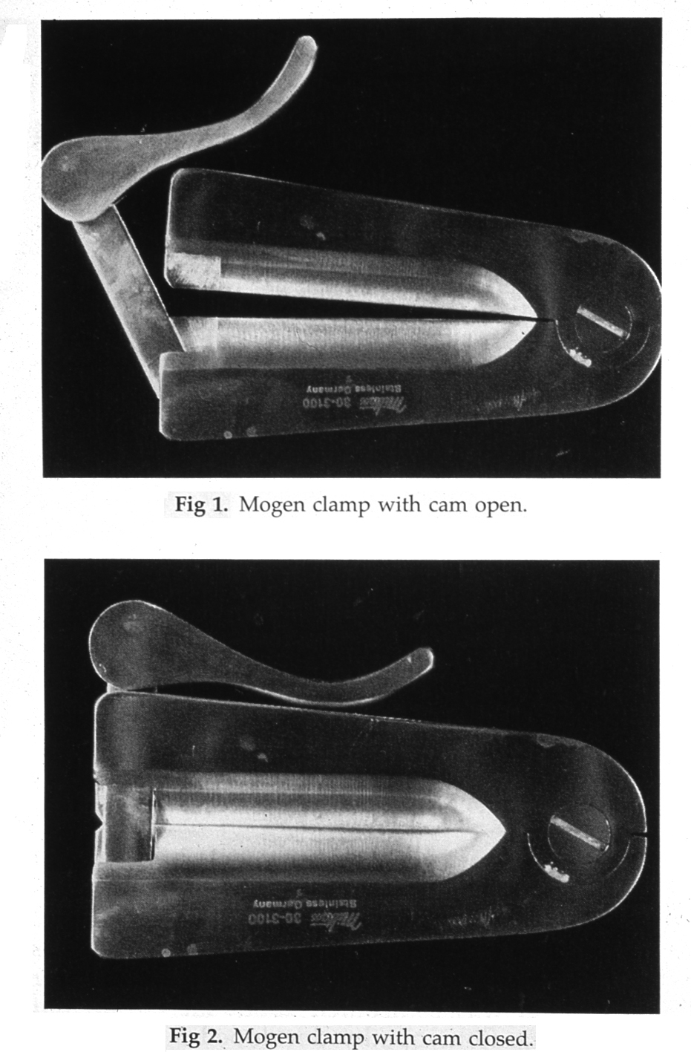
Mogen Clamp

Slide 9
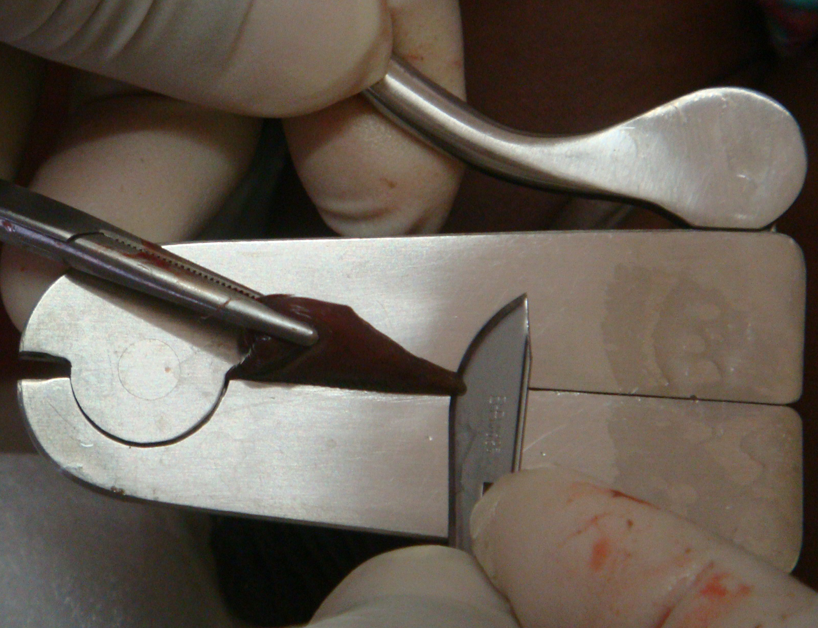

Slide 10
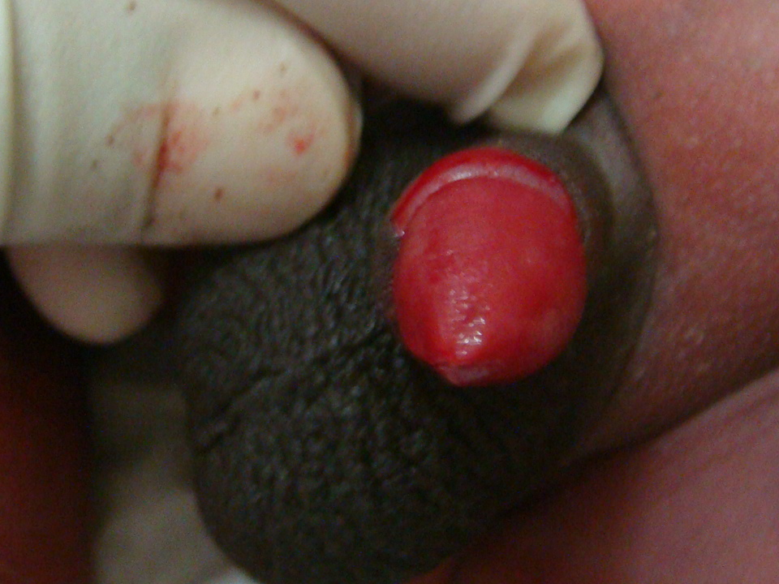

Slide 11
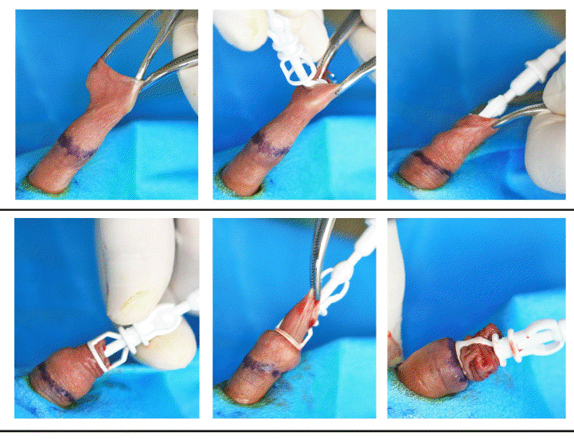
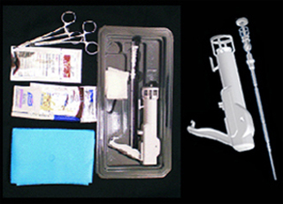
AccuCirc
Like the Plastibell, there is a “bell” that protects the glans, but not retained
Device acts as the clamp and blade, but also shields
Comes in a complete sterile kit
Blade is retained in the device preventing reuse

Slide 12
Study Design
Randomized trial Mogen (n=153) and Plastibell (n=147)
Single-arm evaluation of AccuCirc in same population (n=151)
Based on rate of major complications 0.2%, we calculated 12,750 infants per arm would be required to detect a doubling in complication rate

Slide 13
Table 1: Potential Adverse Events
Bleeding
Bleeding: Requires anything beyond initial post-procedure local pressure (Minor adverse event) Suture (Moderate adverse event) Separate clinic visit or infant hospitalization for bleeding at the circumcision site (Major adverse event) Surgical intervention (Major adverse event) Transfusion (Major adverse event)
Infection
Infection believed to be definitely or probably related to the EIMC procedure (as identified by study staff): Local (Minor adverse event) Systemic (Major adverse event)
Structural
Removal of too much or incorrect tissue; or removal of too little tissue necessitating repeat procedure (Major adverse event)
Other
Other major directly-related adverse events (e.g. penile torsion, problem with urination requiring medical attention, other)

Slide 14
Aim 1: Actual Uptake
 | Mochudi |  | Moleps |  | Gabs |  | Total
Eligible and approached | 143 |  | 241 |  | 384 |  | 768
Number agreed to questionnaire | 129 | 90.2% | 163 | 67.6% | 255 | 66.4% | 547 | 71.2%
Total Circumcised | 100 | 77.5% | 102 | 62.6% | 100 | 39.2% | 302 | 55.2%
Number circ TODAY | 76 | 76.0% | 48 | 47.1% | 40 | 40.0% | 164 | 54.3%

Slide 15
Aim 2: Complications by Device
 | Mogen (n=153) N (%) | Plastibell (n=147) N (%) | AccuCirc (n=151) N (%)
Bleeding | 5 (3.2) | 0 | 6 (4)
Minor | 5 | 0 | 5 (3.3)
Mod / Severe | 0 | 0 | 1 (0.7)
Infection | 0 | 0 | 1 (0.7)
Too Little Skin Removed | 23 (14.7) | 4 (2.7) | 0
< ½ glans visible | 12 (7.6) | 1 (0.7) | 0
Too Much Skin Removed | 0 | 0 | 0
Retained device | N/A | 2 (1.3) | 0
Incomplete incision | N/A | N/A | 3 (2)

Slide 16
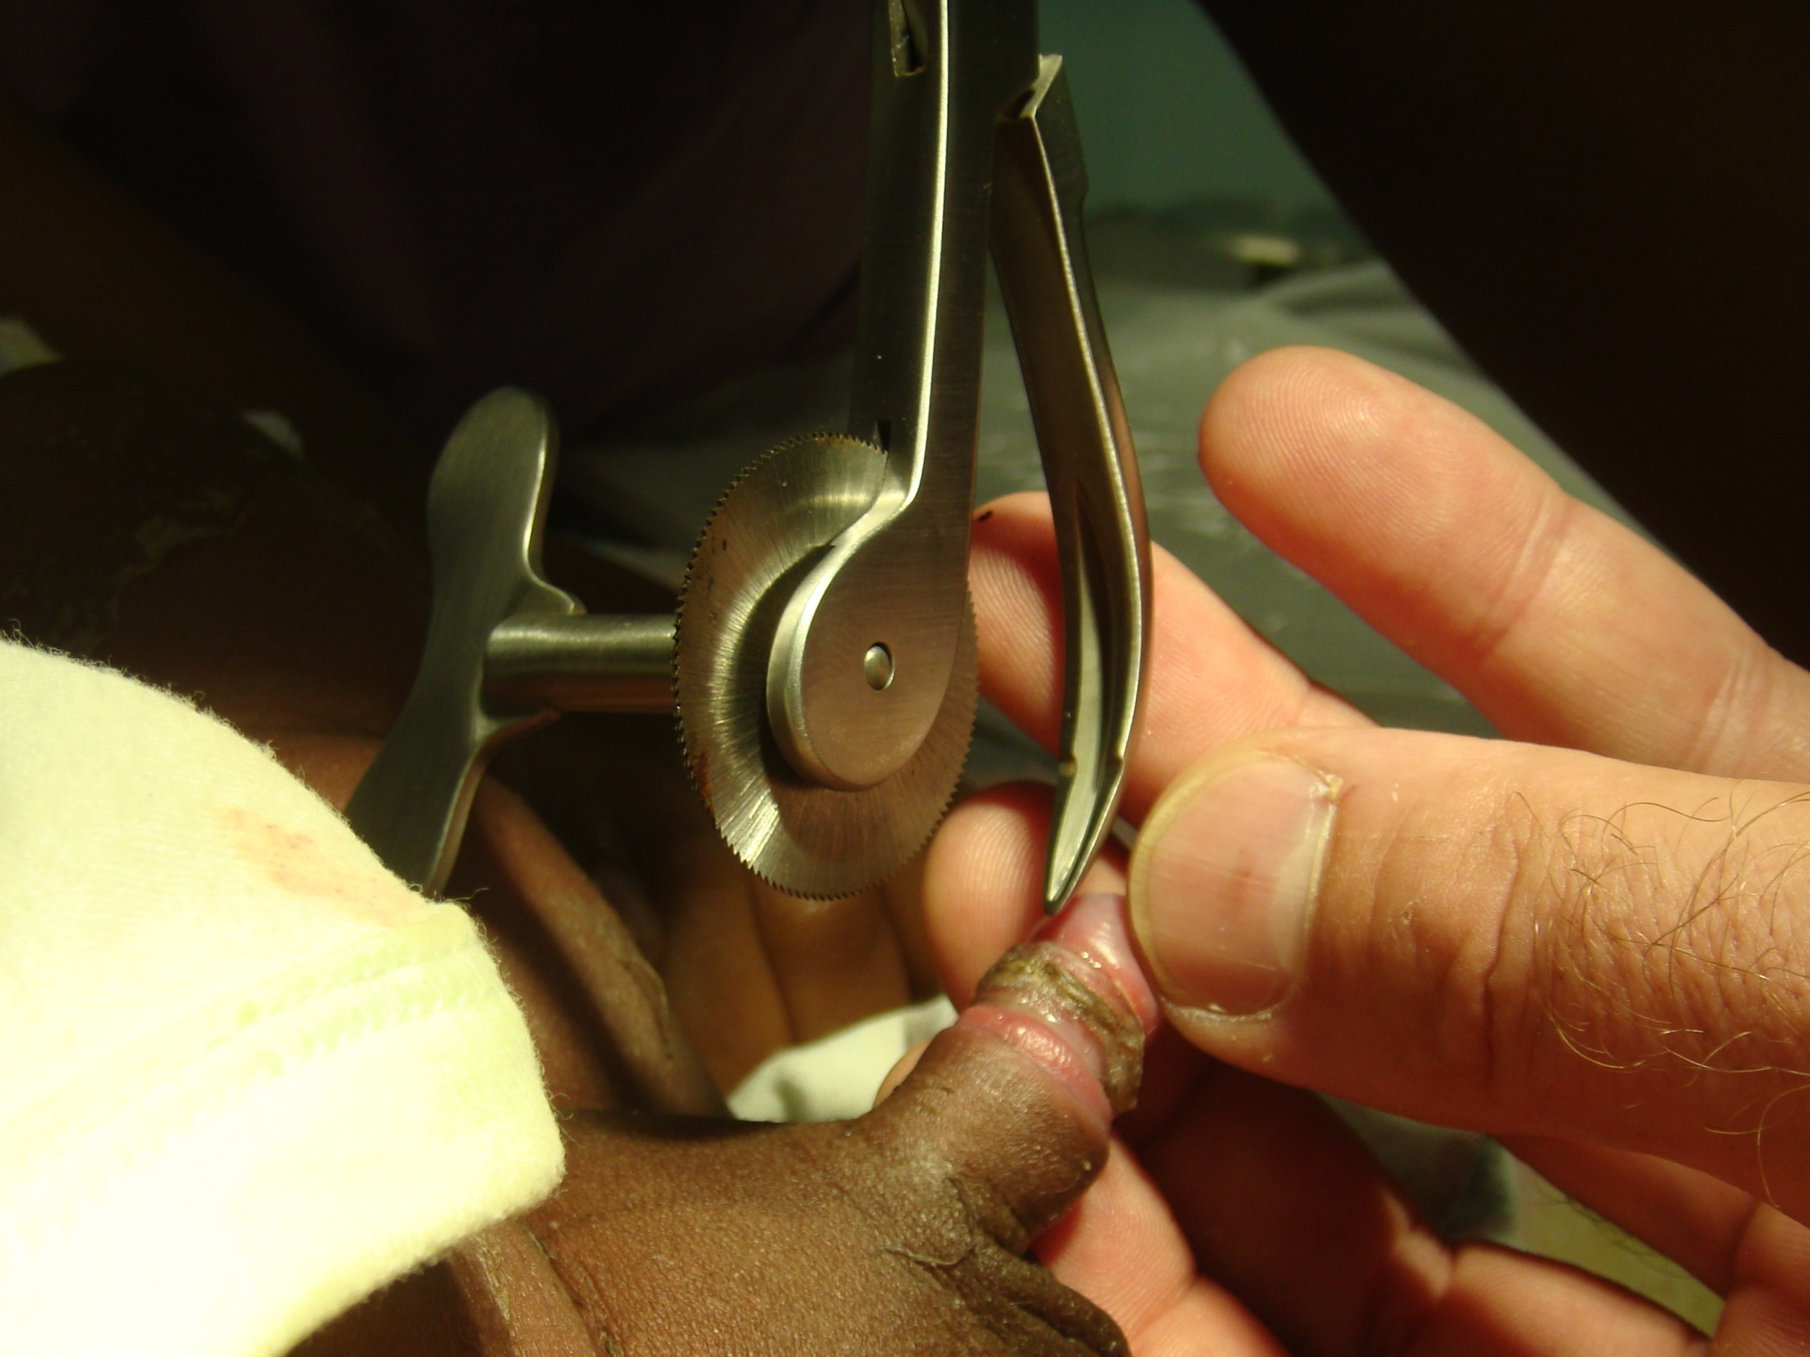

Slide 17
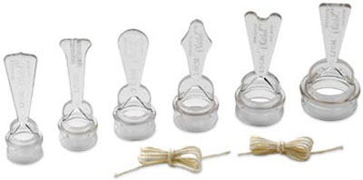
Reported Complications from Others
Bode, et al. J Pediatr Urol. 2010;6(1):23-7

Slide 18
Aim 3: Relative Advantages
Inherent safety and predictability
Elective procedure dependent on provider comfort and enthusiasm
Ease of training
Volume differs from adults
Supply chain management and instrument processing
Periphery
Cost

Slide 19
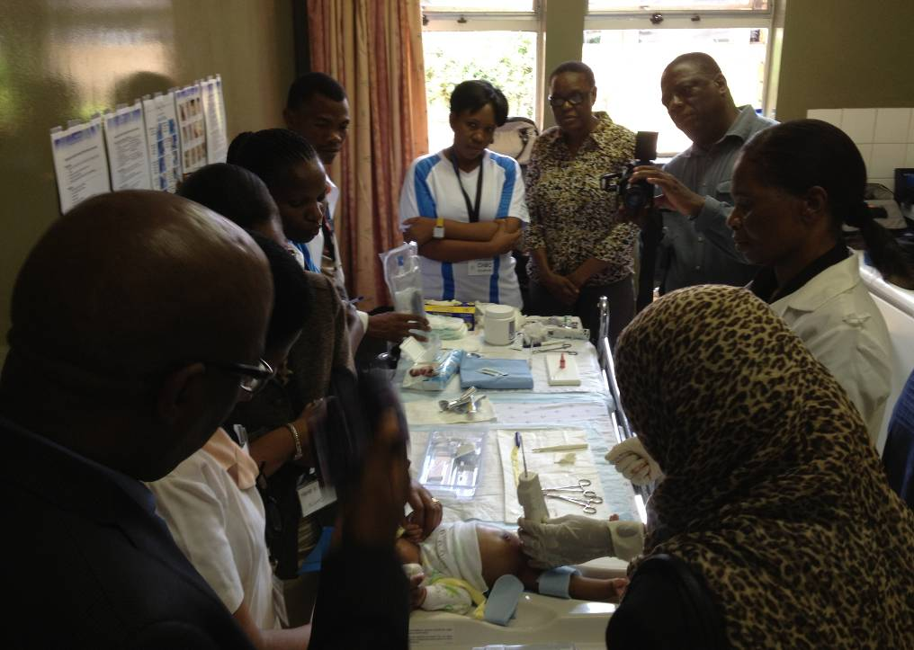

Slide 20
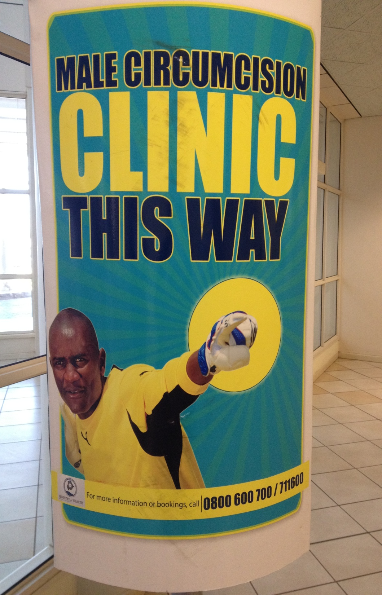
Thank you

