Slide 1

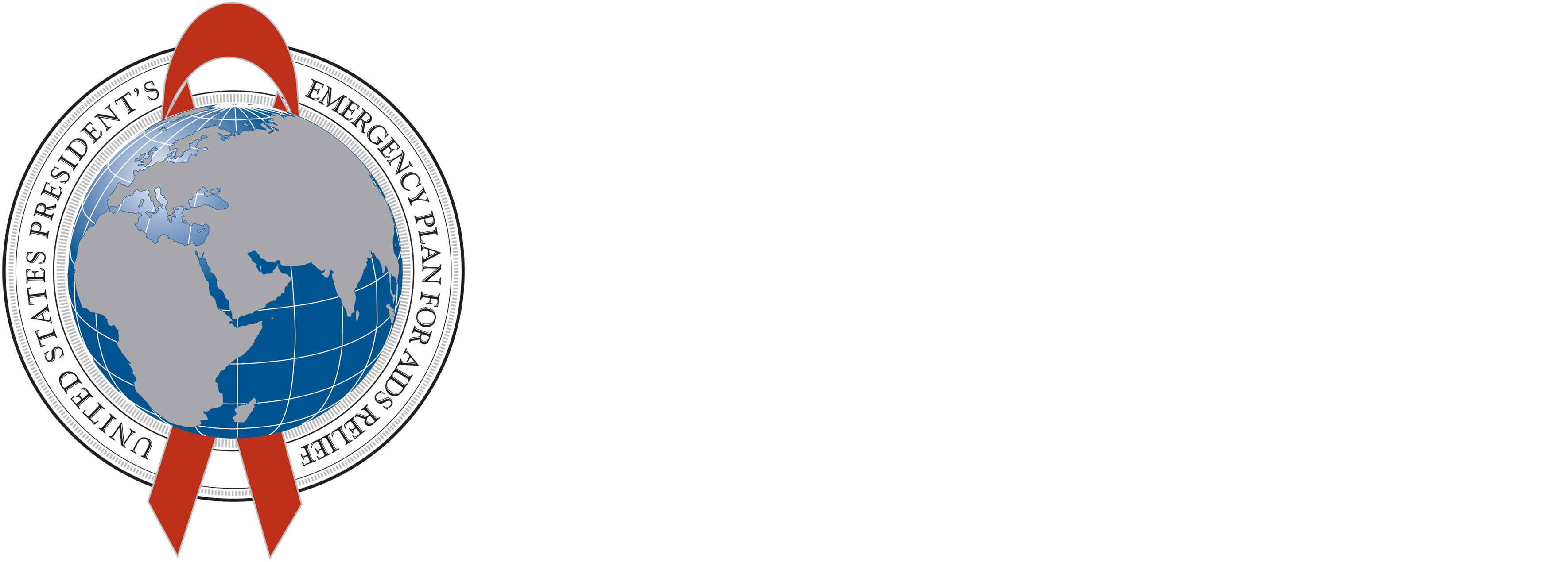



Creating Demand during Accelerated Scale-up of VMMC
Karin Hatzold, MD, MPH, Population Services International
Kim Seifert Ahanda, MPH, USAID
Elizabeth Gold, MA, HC3

Slide 2
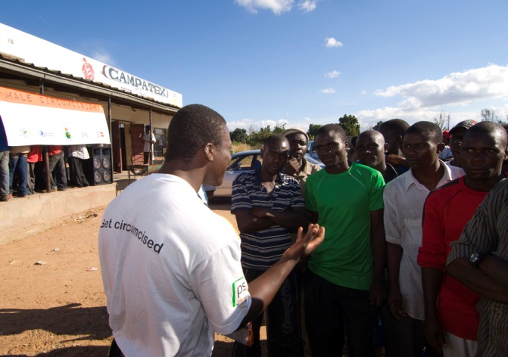
Key Elements
Sustained demand essential for scale up
Balance between demand and supply
Evidence based, tailored communication and demand creation strategies
VMMC Communication Continuum
Service Delivery Modalities

Slide 3
Behavioral Determinants
Barriers
Motivators
Pain
Fear of operation/complications
Fear of HIV test
Myths & Misconception
Partner refusal
Abstinence period
Cultural and Religious Factors
HIV/STI Prevention
Hygiene
Sexual Performance
Appealing to women
“Being part of the group ”
Mavhu W, Buzdugan R, Langhaug LF, Hatzold K, Benedikt C, et al. (2011) Prevalence and factors associated with knowledge of and willingness for male circumcision in rural Zimbabwe. Trop Med Int Health 16: 589–597.

Slide 4
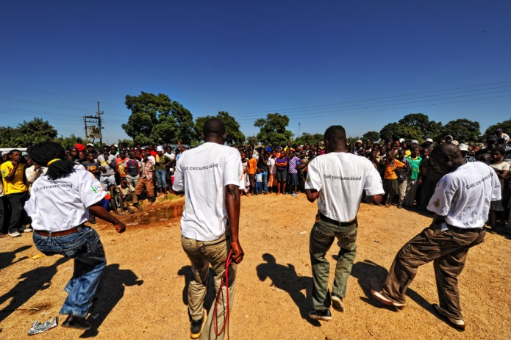
VMMC Demand Creation Approaches
Community Mobilization
Mass & Social Media
M-Health/IT
School Campaigns
Workplace Mobilization
Peer Education & Support
VMMC Champions
Engaging traditional and political leaders

Slide 5
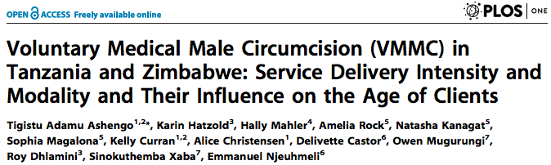
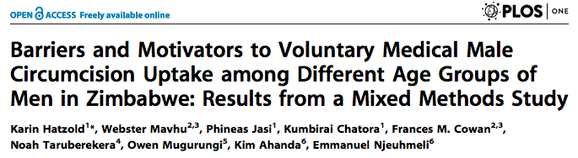
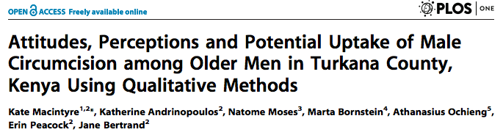
PLOS Collection 2014

Slide 6
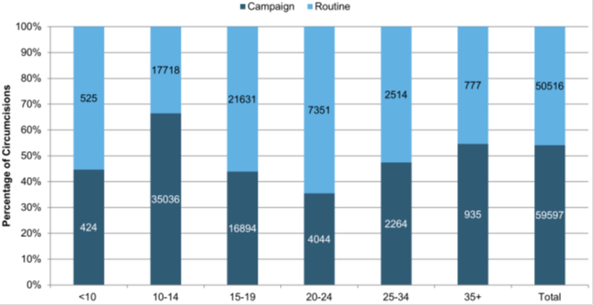
Service Delivery Intensity and Modality
Tanzania & Zimbabwe
Client age profile during VMMC Campaigns and Routine Service delivery
Tanzania: Cultural preference for circumcision at young age and influence of peer pressure
Zimbabwe: Improved opportunities and access during school holiday campaigns for young clients
Formative Research, understanding of cultural preferences, social norms to guide design of service modalities in VMMC scale up
Tanzania
Ashengo TA, Hatzold K, Mahler H, Rock A, Kanagat N, et al. (2014) Voluntary Medical Male Circumcision (VMMC) in Tanzania and Zimbabwe: Service Delivery Intensity and Modality and Their Influence on the Age of Clients. PLoS ONE 9(5): e83642. doi:10.1371/journal.pone.0083642

Slide 7
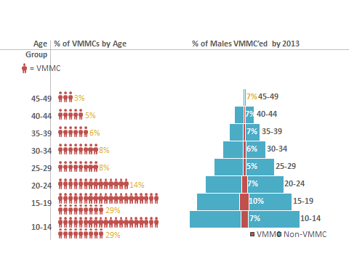
Age Distribution among VMMC clients in Zimbabwe
% of males circumcised by 2013
Source: BMGF based on PSI VMMC program data and population data extracted from Spectrum

Slide 8
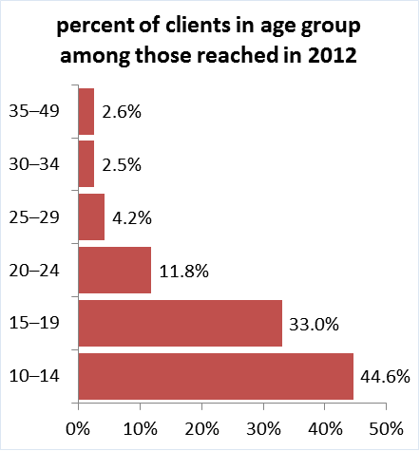
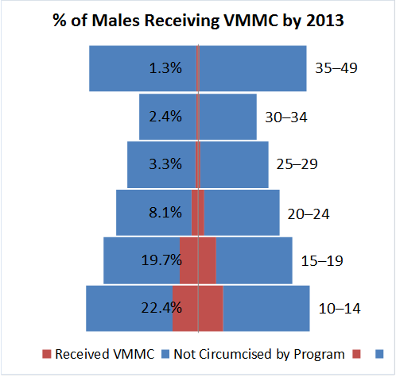
Age Distribution among VMMC clients in Tanzania
Source: PEPFAR/USAID Health Policy Project based on program data provided by MCHIP in Tanzania and population data extracted from Spectrum.”

Slide 9
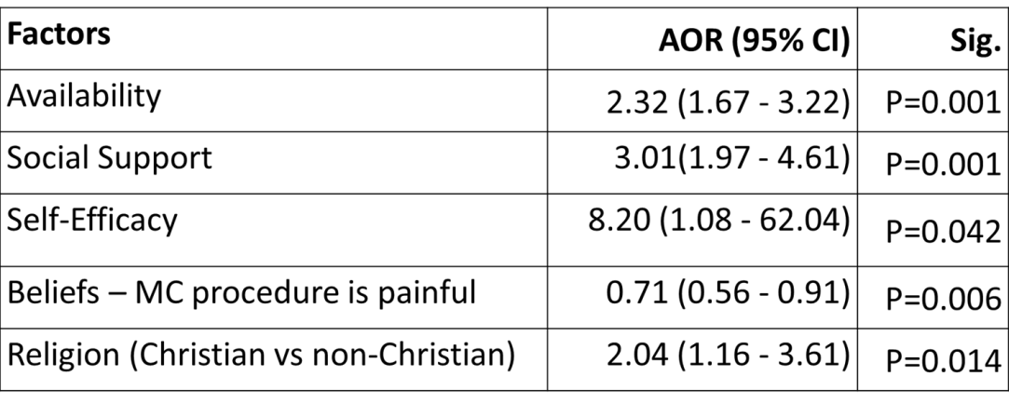
Age Specific Barriers and Motivators to VMMC - Zimbabwe
Results/Conclusions:
Differences in motivators and barriers among different age groups
Emphasize on non-HIV Prevention benefits
Involve Women as influencers for their partners and sons
Radio and TV combined with interpersonal communications using peers and community health care workers/mobilisers
Predictors of VMMC Uptake
Hatzold K, Mavhu W, Jasi P, Chatora K, Cowan FM, et al. (2014) Barriers and Motivators to Voluntary Medical Male Circumcision Uptake among Different Age Groups of Men in Zimbabwe: Results from a Mixed Methods Study. PLoS ONE 9(5): e85051. doi:10.1371/journal.pone.0085051

Slide 10
I did it…Why haven’t you? I am doing it… Join Me
Famous musical celebrities and radio personalities to increase social support among peers and partners
Celebrities as role models
Promoting Non - HIV benefits of VMMC
  Personal hygiene
  Reduction of risk of cervical cancer for the partner
  Addressing issues of Pain and Healing period
Hatzold K, Mavhu W, Jasi P, Chatora K, Cowan FM, et al. (2014) Barriers and Motivators to Voluntary Medical Male Circumcision Uptake among Different Age Groups of Men in Zimbabwe: Results from a Mixed Methods Study. PLoS ONE 9(5): e85051. doi:10.1371/journal.pone.0085051
Notes:
using the celebrities with the objective of creating a positive norm

Slide 11
Attitudes and Potential Uptake of VMMC among older men Kenya -Turkana
29 FGDs and 69 in depth interviews
Barriers: Stigma against foreign cultural practise, low risk perception, cultural norms, perceived lack of infrastructure
Facilitators: Desire to be “modern”, Protection against HIV, Hygiene, Role model to younger men
HIV prevention benefits vs. cultural practice
We used to hear our parents say ‘it’s the Pokot, Samburu, Borana and
Somali who circumcised.’ But somewhere between there emerged this ‘‘Lokwakel’’ (HIV/AIDS), which wiped out families leaving destitute children. We cried and we decided to circumcise because it was important for us to take care of ourselves and our families. (Circumcised man, age 37)
Macintyre K, Andrinopoulos K, Moses N, Bornstein M, Ochieng A, et al. (2014) Attitudes, Perceptions and Potential Uptake of Male Circumcision among Older Men in Turkana County, Kenya Using Qualitative Methods. PLoS ONE 9(5): e83998. doi:10.1371/journal.pone.0083998

Slide 12
Key Recommendations
Communication informed by evidence, constant monitoring and adaptation
Consider the Influence of Cultural and Societal norm
Tailor approaches by age segment
Messages based on motivators beyond HIV prevention
Importance of peers & influencing audiences, role models, Women
Early and ongoing community engagement
School campaigns effective among young age groups
Distinguish health benefits of VMMC from traditional male circumcision

Slide 13
Acknowledgements
OGAC, PEPFAR, USAID , DFID, Bill and Melinda Gates Foundation
PSI, MCHIP, R2P, HPP
MOH from the study countries: Kenya, Tanzania, Zimbabwe
Emmanuel Njeuhmeli and Kim Seifert Ahanda, USAID
Elizabeth Gold, Lynn Van Lith and Kim Martin, HC3
Tigistu Adamu Ashengo, Karin Hatzold, Hally Mahler, Amelia Rock, Natasha Kanagat, Sophia Magalona, Kelly Curran, Alice Christensen, Delivette Castor, Owen Mugurungi, Roy Dhlamini, Sinokuthemba Xaba, Emmanuel Njeuhmeli
Karin Hatzold , Webster Mavhu , Phineas Jasi , Kumbirai Chatora, Frances M. Cowan, Noah Taruberekera , Owen Mugurungi , Kim Ahanda , Emmanuel Njeuhmeli
Kate Macintyre, Katherine Andrinopoulos, Natome Moses, Marta Bornstein, Athanasius Ochieng, Erin Peacock, Jane Bertrand

