Slide 1

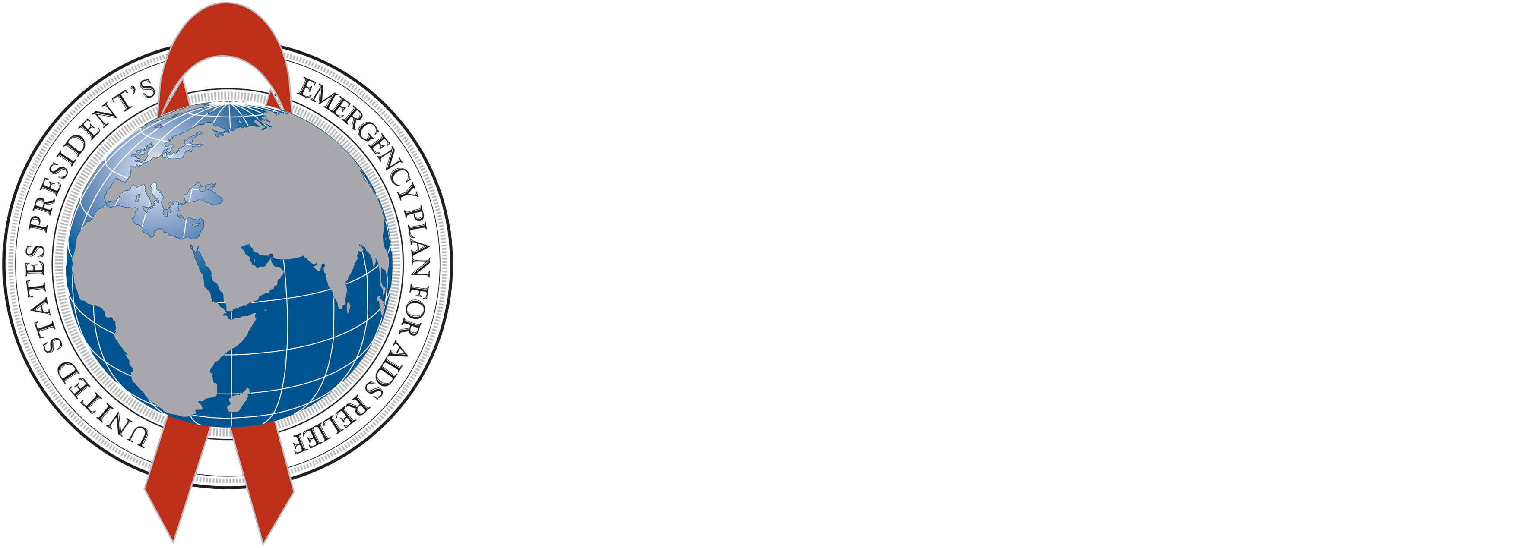

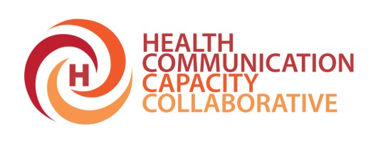


Evidence Review: What Do We Know about the Needs of Adolescent Voluntary Medical Male Circumcision Clients?
July 2014
Lynn M. Van Lith, MPA Johns Hopkins Bloomberg School of Public Health
Center for Communication Programs

Slide 2
Acknowledgements
Aaron Tobian (PI), JHU
Maria Smelyanskaya, JHU-CCP
Beth Mallalieu, JHU-CCP
Michelle Kaufman, JHU-CCP
Arik Marcell, JHU
Karin Hatzold, PSI
Maria Elena Figueroa, JHU-CCP
Emmanuel Njeuhmeli, USAID
Kim Seifert-Ahanda, USAID
Adolescent VMMC TAG

Slide 3
Team Effort: Technical Advisory Group and In-country Partnership
Notes:
The Technical Advisory Group, comprising 19 members listed here, represent a broad range of organizations and disciplines encompassing many aspects of VMMC. Members are acknowledged experts in the fields of epidemiology, public health, health communication, adolescent health, program management, and VMMC service delivery. TAG members include:
In addition to the TAG organized at the headquarter level, we of course want to partner with MOH’s at the country-level.

Slide 4
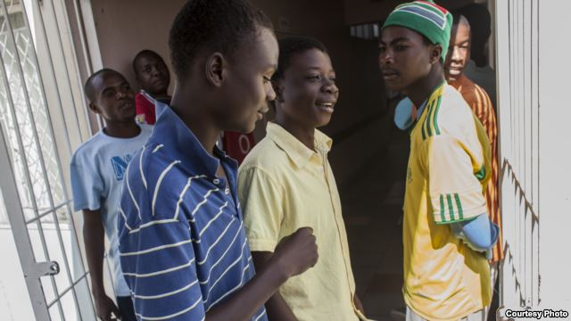
Making VMMC Services Adolescent Friendly
Little known about quality health service delivery to boys and young men
Reproductive health and HIV prevention services – traditionally targeting women
Quality VMMC – opportunity to engage young males in a lifetime of preventive activities
Notes:
We’ve heard from the previous presenters (Karin and Katharine) that a large # of adolescents are coming for VMMC and yet…little known about the health communication/counseling aspects in particular.

Slide 5
Putting Evidence to Practice
Goal: gain better understanding of whether VMMC programs adequately meet adolescent needs in age-appropriate ways by exploring counseling, communication and client-provider interaction disaggregated by age.
Does not address clinical aspects of service delivery
Focus on in-service communication and counseling
South Africa, Tanzania, Zambia, Zimbabwe
Notes:
Explain overarching adolescent VMMC assessment for which this literature review was one of the first steps.

Slide 6
Phase 1: Lit Review
Methodology
PubMed
Scopus
JStore – database with regionally focused literature
Emailed colleagues in South Africa, Tanzania, Zambia and Zimbabwe to request in-country studies
Published in and after 1990

Slide 7
Key Constructs for Adolescent VMMC Search
Boys and Young Men in Sub-Saharan Africa
Adolescent Health Services
Provider and Client Perspectives/Youth Friendly Services
VMMC
Existing Programs Targeting Adolescents
Notes:
I don’t have time to share all of the search terms used but suffice it to say that we were exploring these key constructs….

Slide 8
Criteria for Articles in Literature Review
Describe at least 1 of the following:
Difference between how adolescent boys and adolescent girls can be educated about HIV and SRH
Accessed VMMC services and included boys
Analyzed provider/educator/parent and adolescent perspectives on the quality of health services and made mention of boys
Discussed VMMC and included younger men and adolescents in the analysis

Slide 9
Search Results
Records identified through database searches (n =1,224)
Records after duplicates were removed (n =966)
Records excluded due to policy focus, topic irrelevance and/or unrelated outcomes in abstract (n =740)
Abstracts screened (n =966)
Full-text articles assessed for eligibility (n = 226)
Full text articles excluded due to lack of direct relevance to topic (n =175)
Articles included in synthesis (n =88)

Slide 10
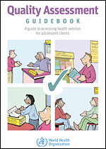
Practical Guidance
6 practical guides from WHO and PEPFAR on VMMC and adolescent health services to find information pertaining to VMMC and adolescents
6 papers from partners that provided implementation guidance
Notes:
We also included some practical guidance and unpublished papers shared by countries which were relevant.
******It is important to mentioned that it is preliminary data that are still being review by countries for input.

Slide 11
VMMC Specific Findings
Role of parents, families and educators:
In Zambia, parents first source of info on VMMC for 61% of adolescents; Almost all FGD participants from non-circumcising districts would take sons for VMMC if they knew more about it
In Tanzania, fathers who would not get circumcised themselves, but would take sons
Women key encouraging force behind VMMC for husbands, sons
Adolescents still play a key role in decision-making
Notes:
Given the limited time I have today, I will only focus on the VMMC-specific findings though there are additional findings related to male adolescent health more broadly defined also captured in the review.
Now let’s move to the VMMC-specific findings related to adolescents and youth.
In terms of the role of parents, families and educators: Reviewed literature demonstrates multiple benefits of parental involvement. Conflicting results were available in regards to comparing fathers’ and mothers’ attitudes towards and involvement in adolescent sex education. Family environment in general, however, is instrumental in adolescent feelings of self-worth, thus impacting risk-taking behavior. In a study in South Africa, low family self-esteem was significantly associated with increased likelihood of alcohol use and risky sexual behavior for both sexes. (Wild, Flisher, Bhana, & Lombard, 2004)
Parents were found to be the first source of information about VMMC for 61% of adolescents in a study in Zambia (Friedland, Apicella, Schenk, Sheehy, & Hewett, 2013). In Kenya, women were the key encouraging force behind circumcision of both partners and sons. (Lanham, L'Engle, Loolpapit, & Oguma, 2012) In Zambia, nearly all of the FGD participants from non-circumcising districts reported that they would take their sons to be circumcised at a health facility if they were provided with information on positive and negative aspects of the procedure and the advantages associated with it. (Lukobo & Bailey, 2007) In the same study, parents also said that the procedure should be free or not cost more than a certain amount.
Some studies suggest that while both adolescents and parents see adolescents as key decision-makers (Jayeoba et al., 2012; Schenk et al., 2012) in whether or not they will undergo circumcision, the majority of youth make the final decision on whether or not to circumcise just prior to entering the clinic. (Schenk et al., 2012)

Slide 12
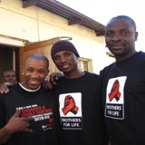
VMMC Specific Findings
Barriers that may prevent parents from taking children for VMMC
Fear of pain
Tribal and religious aversions
Cost
Parents in some Tanzanian tribes thought circumcised sons would be embarrassing
Among Xhosa men in SA, knowledge of VMMC benefits widespread, but only 16% of fathers would encourage sons to undergo VMMC
Notes:
Within Barriers: A study in Tanzania (Downs et al., 2013) confirms tribal and religious aversions that parents might have to circumcision. Downs and colleagues find that women and men in certain Tanzanian tribes found it embarrassing if their sons were circumcised. Among Tanzanian Christians circumcision was considered too modern of an intervention that might lead to promiscuity. Involving Christian religious leaders in promoting VMMC for younger men might be essential in countries, where the majority of population is Christians. Addressing these religious and cultural concerns with parents is also essential. Cost was found to be a barrier for older men and for parents of adolescents considering VMMC. (Lissouba et al., 2011; Lukobo & Bailey, 2007)
In settings, where traditional circumcision is practiced, fathers can serve a barrier to sons obtaining MMC, because of religious and traditional beliefs. A study among Xhosa men in South Africa showed that despite rather advanced knowledge of benefits of MMC, only 16% of fathers were willing to allow their sons to undergo medical circumcision. (Mark et al., 2012)

Slide 13
VMMC Specific Findings
What do young men know, believe and want from VMMC: Misconceptions, motivators and barriers
Concerns of sexual desire, sexual satisfaction and infertility
Traditions and rituals
Lack of understanding of protective factors
Understanding the procedure and process
Most boys (>50%) in Zambia and Swaziland reported NOT being “very comfortable” with VMMC prior to surgery
In Rwanda, 37% of adolescents could not identify what was involved in the procedure.
Notes:
Within What do adol boys want to know: While studies that focus on adolescents and VMMC are rare, several general sexual education and reproductive health studies indicate curiosity on the part of adolescent boys about VMMC. In one study boys were asking about the link between male circumcision, the production of sperm, the ability to impregnate, and wanted to know if uncircumcised boys can get an erection and achieve penetration and whether circumcision increases sexual desire.(Ahlberg et al., 2001) In another study, in a setting where circumcisions were not prevalent, boys wondered about the link between circumcision and the risk of HIV and impregnating a girl. Some boys believed that not only the process of circumcision, but the associated rituals of initiation were protective against HIV.(L. Warenius et al., 2007)
While informational campaigns have educated many about VMMC, they have not reached all and/or have provided conflicting information. In Rwanda 37% of adolescents interviewed could not identify what was involved in the MMC procedure (Gasasira et al., 2012). In another study in Botswana, older boys (15-17) were more likely to know what MMC represented. (Jayeoba et al., 2012) Traditional circumcision practices also impact opinions about VMMC among adolescents. FGD participants aged 12-14 in Mankweng – a city in Limpopo province of South Africa – where traditional circumcision is performed, expressed the belief that circumcisions in clinical setting lack the components that educate boys about male role models and that boys who undergo them are “men being like women” because they miss out on traditions and rituals. (Ragnarsson, Onya, Thorson, Ekström, & Aarø, 2008)
Significant lack of understanding of protective factors and confusion about impact on partner’s health was reported by both adult men and adolescent boys in Zambia and Swaziland. (Friedland et al., 2013) A 3-year follow up study in Uganda found a reduction of condom use significant among younger men who underwent VMMC. (Kong et al., 2012) And in a study in Malawi, young men cited a desire to have access to more women as their main motivation to circumcise. (Ngalande et al., 2006) In Kenya, however, young men associated circumcision with potential reduction in penis size and sensitivity, thus feeling that the procedure will make them and their partners enjoy sex less. (Obure, Nyambedha, Oindo, & Kodero, 2009)
Within Understanding the procedure: A study in Zambia and Swaziland (Friedland et al., 2013) focused on what VMMC clients have retained from counseling sessions before and after undergoing the procedure. Surveying 266 adolescents aged 13 to 17 and 915 adults (aged over 18) in two countries Friedland and colleagues established that after receiving counseling and having parents sign the consent forms less than half of adolescents in both countries were “very comfortable” with their decision to proceed with MMC (46% in Zambia and 48% Swaziland).

Slide 14
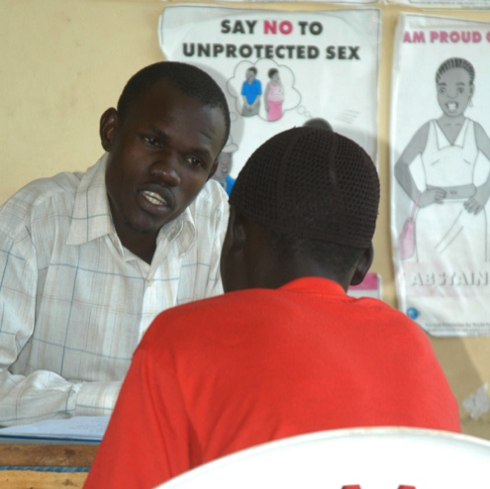
VMMC Specific Findings
Counseling
In Zambia and Swaziland, comprehension of VMMC procedure much lower among adolescents than adults
While adolescents found some pre-procedure counseling effective, significant confusion about protective factors remained
Both measured by a 10 question test
Notes:
Both points are from same study
Within Counseling: When compared to adults, adolescents in Zambia and Swaziland (Friedland et al., 2013) scored significantly lower on the 10 question test that aimed at assessing the client’s comprehension of VMMC procedure, protective factors associated with VMMC, and risk factors associated with HIV and STIs in circumcised men. Respondents also commented on the absence of information on whether circumcision was protective to women and there was significant confusion about HIV and STI risk reduction.
while adolescent VMMC clients find some aspects of pre-procedure counseling effective, significant confusion and misconceptions about the protective factors remain. A study in Zambia and Swaziland (Friedland et al., 2013), for example, demonstrated that both adult men and adolescents were confused about the impact of MMC on HIV and STI transmission, as well as about the reduction of cervical cancer prevalence. Counseling seems to impart information that it sometimes contradictory or confusing. While clients in the study by Friedland and colleagues retained numeric information (most remembered 60% associated with the reduction of STI and HIV risk) many struggled to identify what that information actually meant. Descriptive concepts – like the fact that the foreskin tends to trap bacteria – were more likely to be comprehended by clients. This necessitates a review of counseling materials to ensure that counseling provides information that adolescent clients can comprehend and interpret correctly; for most reduction of risk meant being impervious to disease. This is especially important, since motivation to circumcise for both parents of adolescents and adolescent clients themselves comes from the desire to reduce the risk of STI and HIV. (Gasasira et al., 2012; Jayeoba et al., 2012)
In conclusion, It is evident that misconceptions and confusion exists about effects of VMMC especially among adolescent boys and younger men.

Slide 15
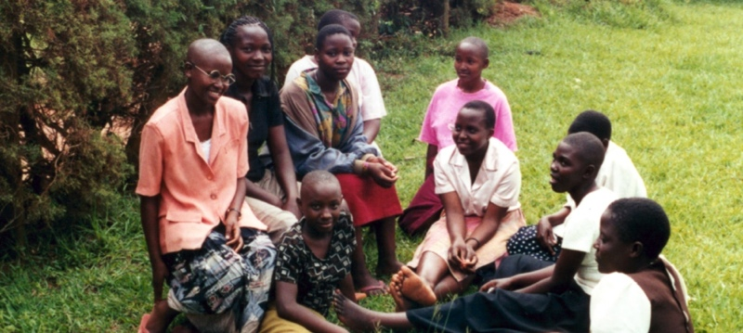
Summary
Parents play a role in decision-making about VMMC
In South Africa, VMMC in clinical setting lack traditional components so men miss out
Retention of information among young clients from counseling often incorrect; calls for improved counseling services and follow up
Further research and study is needed
Notes:
From here we will move to the next phases of the adolescent VMMC assessment which include both a qualitative data collection phase and a quantitative data collection phase.
Emphasize the spirit of partnership in which we hope to jointly carry out this assessment with the MOH, UNICEF, WHO, USAID, CDC, DOD and all implementing partners in country.

Slide 16
Questions? lynn.vanlith@jhu.edu

