Slide 1



“Stylish Man” Campaign
Amos Zikusooka
JHU/CCP
Uganda
1
Notes:
Emmanuel: Could you remove the “Monitoring, Reporting and Quality of Services” at the bottom of Jason Title?

Slide 2
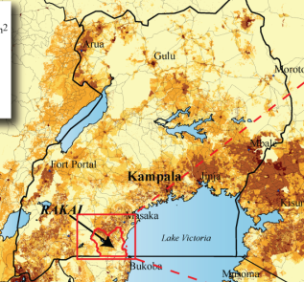
The Stylish Man Campaign
A community mobilization, multimedia and demand generation campaign in Rakai district, SW Uganda
Mass media: district-wide implementation
Community mobilization nested within the 50-village longitudinal Rakai Community Cohort Study (RCCS)
Funded by Bill & Melinda Gates Foundation
Implemented by the Rakai Health
  Sciences Program (RHSP) and
  the Johns Hopkins Center for
  Communication Programs (JHU▪CCP)
2

Slide 3
Campaign Overview
Target Audience: Men 25-45 years
Spouses & successful business men/community leaders (as influencers)
Campaign goals/approach:
Demedicalize SMC and HIV prevention, and reposition HIV services as stylish and desirable for the modern Ugandan man.
Make learning fun and stylish.
  Hypothesis: If men come to see SMC, HCT, PMTCT, condom use and ART as attributes of a stylish, modern Ugandan man, they will be more likely to adopt these services.
3

Slide 4
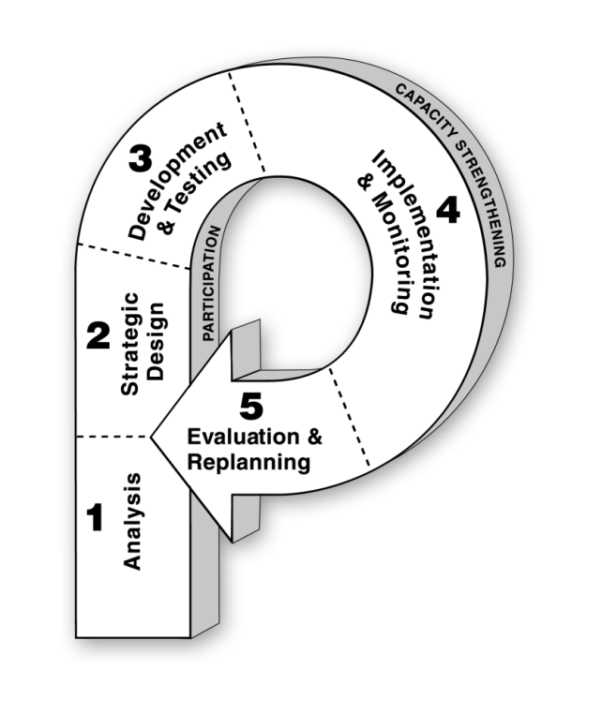
Design Process
4

Slide 5
Research — RCCS 2011
  With 30,000 SMCs done by RHSP and intensive promotion of SMC in RCCS, there is near universal knowledge about SMC.
  However, only 32% of non-Muslim RCCS men had accepted SMC by 2012.
Men coming for SMC:
  Were disproportionately
  younger (≤ 19)
  Had lower risk behavior profiles
RCCS community level:
HIV incidence = 1.1/100 per year
HIV prevalence = 12.2%
5

Slide 6
Research — “The Problem with Men”*
Satisfied SMC clients do not discuss SMC
Misconceptions:
  SMC requires a 6-month healing period.
  SMC causes persistent pain, decreased sexual satisfaction and infertility.
Information/messaging via town hall meetings focused on health aspects.
SMC has been framed as a medical issue to reduce HIV transmission.
The medicalized approach is not resonating with men, and it deters some men from accepting SMC.
*funding: BMGF and NICHD RO1
6

Slide 7
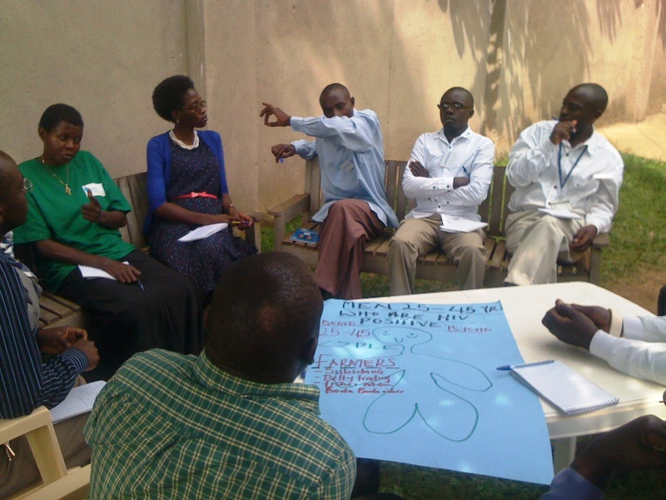
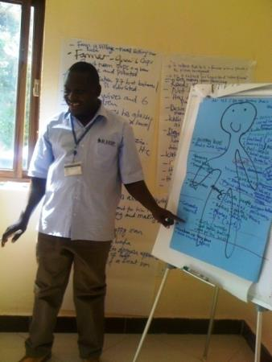
Design Workshop
7

Slide 8
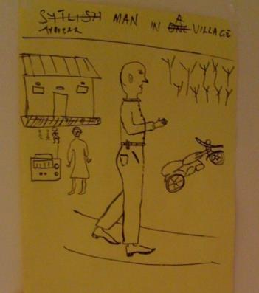
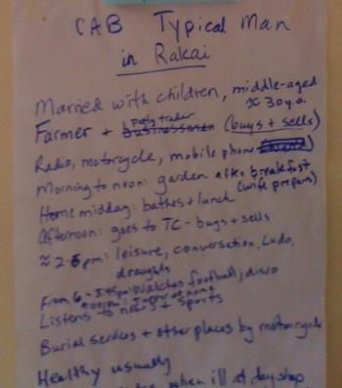
Design — Audience Profile
Ronald is a 30-year-old P.7 leaver. He is a farmer in a rural area in Rakai district. He has two wives and five children and also has extramarital partners. He spends much of his free time “drinking” and watching football. He wants to see that his children grow up with good morals and a fear of God. He believes in success and looks at the rich men in the community as his role models. He listens to soccer, politics and music on the radio, and he occasionally goes to the trading centre (town) to watch soccer at the video hall (Kibanda). He hates using condoms because he wants to have many children, and he enjoys sex more when it is “live.” He has never discussed HIV prevention with any of his wives/partners, has never had an HIV test and is not circumcised.
8

Slide 9
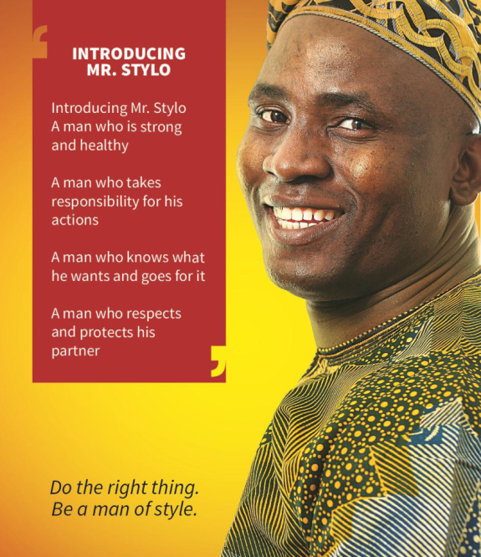
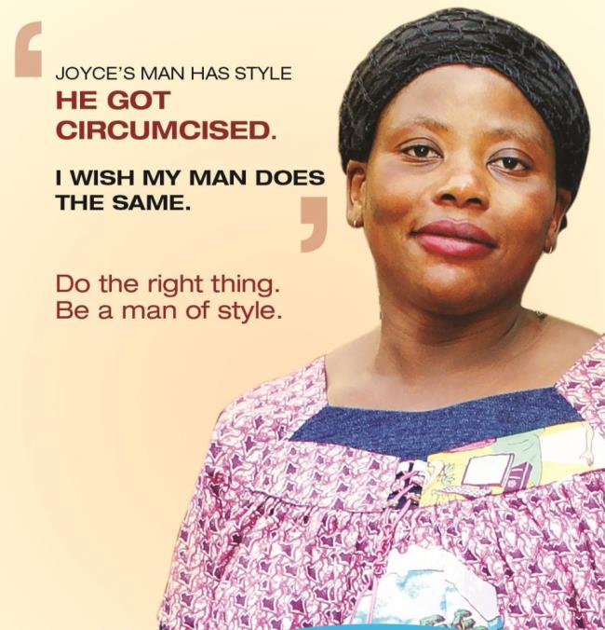
Creating Campaign Concepts
Some initial campaign concepts from which final executions will come
9

Slide 10
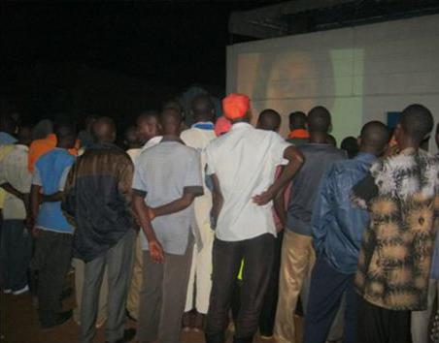
Implementation & Monitoring
Using entertainment-education:
  District-wide implementation through mass media
    “Stylish Man” radio programs and popular DJ mentions
  Experiential activations using the “Man Van” in randomized clusters :
    “Stylish Man” weeks and community extravaganza
  Community video clubs (Bibanda) show videos about “Stylish Man”
10

Slide 11
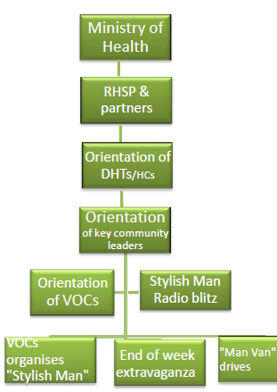
Implementation & Monitoring
Includes RHSP service delivery teams
Includes district leaders and health workers
Includes agriculture extension workers and successful business men
Stylish Man Week activities: games, sports, entertainment and tent services, Mr. Stylo Contest radio broadcast
11

Slide 12
Evaluation
Mass media campaign component
  District-wide implementation: evaluated in the 50 RCCS villages
  Comparison of knowledge, attitudes and SMC service acceptance/coverage rates in RCCS survey rounds prior to the campaign and after campaign roll-out (pre- and post- design)
Experiential “Man Van” component
  50 RCCS communities aggregated into 12 community clusters (geographically distanced to reduce contamination)
  Community clusters randomly assigned to intervention and control
  Comparison of knowledge and service coverage between arms
12

Slide 13



amosz@jhuccpug.org
+256 712 425004
Thank You!

