Slide 1




Zambia Ureport Case Study:
Designing, Implementing and Managing a T4D strategy for HIV and young people.
Prepared by
UNICEF Zambia

Slide 2
Outline
Issue and Opportunity
Framing the solution
Mobilizing support and creating momentum
Business Case Definition
High level Action Plan
Securing High Level commitment
Implementation and management
6 months results

Slide 3
The Issue (1)
- 40% of new HIV infections occur among Adolescents and youths (A&Y) aged 15-24 years.
- 3 HIV infections per hour; 72 per day; and 27,000 per year among A&Y (15-24 years)
27,000
# of new infection per year among A&Y 15-24 – 60% among females
72
# of new infection per day among A&Y in Zambia
=
3 HIV infection per hour - Zambia
Notes:
Getting to less than 1.5 by 2015

Slide 4
The Issue (2)
Slow progress in achieving HIV Prevention Priority Results for A&Y in Zambia
1- % of Young People 15-24 with Comprehensive Knowledge about HIV. | 2- % of Young People 15-24 with multiple partners who reported condom use at last sex | 3- % of Young People 15-24 who have had an HIV test and received results in the past 12 months | 4- % of Young men 15-24 who are circumcised
ZAMBIA (BSS 2009) Females: – 38% Male: – 41% | ZAMBIA (DHS 2007) Females: – 35% Male: – 41% | ZAMBIA (DHS 2007) Females: – 42 % Male: – 21% | ZAMBIA (DHS 2007) Male: – 11.5%
Target (NASF - 2015) Females: – 70% Male: – 70% | Target (NASF - 2015) Females: – 70% Male: – 70% | Target (NASF - 2015) Females: – 50% Male: – 50% | Target (NASF - 2015) Male: – 30%
National targets defined only for 15-49

Slide 5
The Issue (3)
Major bottlenecks -Limited transfer of knowledge and skills from teachers to adolescents (12-15 yrs) – SACMEQ III 2009 (ZAMBIA)
Bottleneck analysis – what are the barriers to knowledge transfer?

Slide 6
The Opportunity (1)
Rapid growth in Mobile Phone Penetration,
Zambia, 2000-2011, (Source, ZICTA)

Slide 7
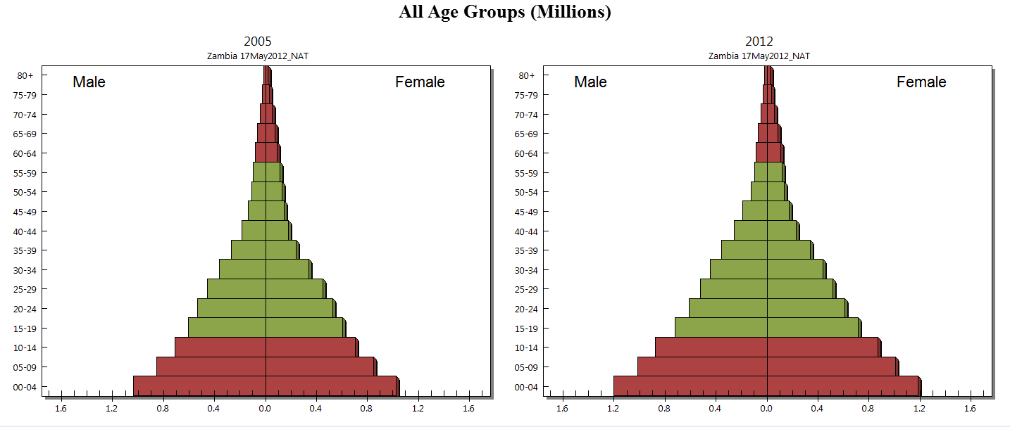
Zambia Demographic profile
3.8 million youths (15-30), about 50% males (2012 estimates)
Adolescents 10-19 yrs: 3.24 million (26%)
Young people 10-24 yrs: 4.6 million (30%)
25-29 years: 1.02 million
20-24 years: 1.36 million
15-19 years: 1.44 million
(Source, Spectrum projections 2012 informed by Census 2010)
10-14 years: 1.8 million

Slide 8
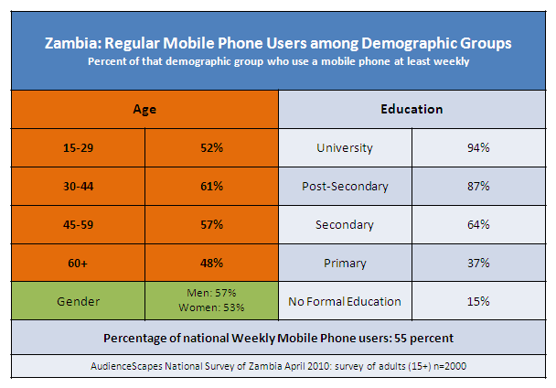
The Opportunity (2)
About half of the mobile phone users aged below 30 years,
Notes:
Youth and young adults (15‐29) are often assumed to be the leaders of mobile phone use, but
this is not entirely the case in Zambia. Although those 15 to 29 make up the largest segment of
overall mobile phone users, they do not show the highest rate of weekly (equivalent to
"regular") use‐that is found among those 30 to 44 (Figure 1.1), who probably have more
disposable income than their younger counterparts to spend on phones. This age/use pattern
holds true among various income levels, though it is most pronounced among the lowest
income group, as shown in Figure 1.1

Slide 9
The Opportunity (3)
More evidence of Effectiveness of SMS for Health promotion
Increasing evidence from recent experiences are supporting effectiveness of using SMS as catalyst for HIV education, and broader health promotion among adolescents and youths,
  Significant change on level of knowledge,
  Adoption of safer reproductive health and sexual behaviours including reducing sexual partners,
  Increased uptake of condom use, and uptake of STI/HIV test.
Megan S C Lim, Jane S Hocking, et al. Impact of text and email messaging on the sexual health of young people: a randomised controlled trial, J Epidemiol Community Health 2012;66:69e74. doi:10.1136/jech.2009.100396
Kelly L. L'Engle, Heather L. Vahdat, Elizabeth Ndakidemi et al. Evaluating feasibility, reach and potential impact of a text message family planning information service in Tanzania, Contraception (2012) (in-press)
Gold et al. Determining the Impact of Text Messaging for Sexual Health Promotion to Young People. Sexually Transmitted Diseases ; Volume 38, Number 4, April 2011
J. Gold1,2*, C. K. Aitken, et al. Mobile advertising to promote safer sex and sun safety, Health Education Research, March 29, 2011

Slide 10
Idea: Proposed solution
Zambia-Ureport: Strategic Objectives
Promote adolescents and youths participation in National HIV response by getting their opinions on issues that affect their vulnerability and risk to HIV, and their ability to mitigate AIDS impact at individual and community level.
Increase HIV comprehensive knowledge among adolescents and youth through an individualized two-way interactive SMS model that continuously informs advocacy and adolescents and youths sensitive HIV programming.
Increase demand for HIV high impact prevention services among adolescents and youths (Delayed sexual debut, HTC, MC, ART, Condoms)
Monitor availability, utilization and quality of adolescents and youths sensitive HIV services.

Slide 11
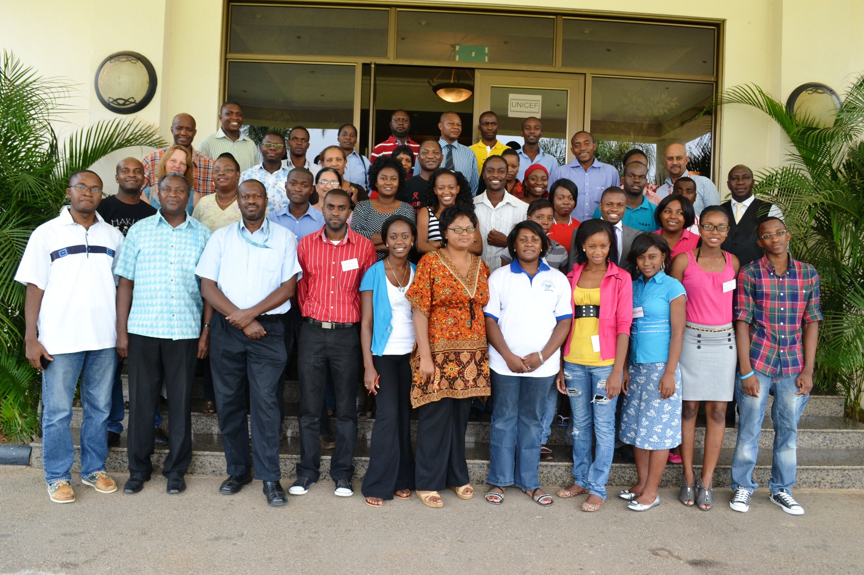
Design Workshop- Zambia U-Report, Oct 17-19th 2012
Mobilizing support and creating momentum

Slide 12
Business Case (1)
Zambia U-Report: Results Chain
NASF strategic results: Incidence of HIV is reduced by 50% by 2015 among young people
UNDAF Intermediary Outcome 1.1
Government and partners scale up prevention services to enable the reduction of new infections by 50% by 2015
Zambia U-Report Outcome:
Adolescents and Youths (girls and boys) adopt HIV preventive behaviors and double uptake of high impact HIV prevention services.
Output 1:
An effective sms-based mechanism to increase A&Y participation in National HIV prevention response is available.
Output 2:
Adolescents and Youths have increased comprehensive
knowledge of high impact HIV prevention measures and services
Output 3:
Adolescents and Youths demand for and are referred to HIV high impact prevention services
Notes:
Accountability for the project is at output level.
Assumptions:
1- Assume that high impact services are available and accessible at referral points;
2- there is an enabling environment (parents and teachers are supportive, sms it is free, that
1- System available
2- Young people know about the system
3- Young people utilize the system
4- Youth people increased knowledge of
5- Youth people increased utilization
M&E framework (
Baseline:
Kap survey with those who enroled

Slide 13
Business Case (2)
Zambia U-Report: Programmes Modules
Module 1: Knowledge Bank
Thematic data base on HIV and STI
Allow two-way interaction.
Dialogue initiated by U-Reporter (Spontaneous SMS requests)
Requests managed in real-time by SMS Counselors.
U-Reporters encouraged to share new information with other youth in their network.
U-Reporters referred to selected services delivery points in their area.
Will integrate a feature to address emergency SMS based on key words (e.g. defilement, rape, abuse, accidental exposure to HIV).
Module 2: Poll and Campaign
Opinion poll among U-Reporters on issues that affect demand/access and utilization of HIV prevention, treatment and care.
One thematic will be implemented for each poll, should always precede a SMS campaign targeting the U-Reporters community.
Polls response will be aggregated in the database, timely analyzed and disseminated to all stakeholders.
Feedback from opinion polls will also allow for evidence informed demand-driven campaigns.
Campaigns will combine SMS and other communication channels to address the gap identified during polls, and ensure equitable access to information for the most vulnerable adolescent and young people.
Notes:
Module 1-Knowledge Bank: this module will provide two-way interactions with U-Reporters. It will link request received through spontaneous SMS from U-Reported to the HIV and STI knowledge designed for the Zambia-U-Report. The knowledge bank will the accessed by SMS counselors who will build a youth friendly and personalized feedback SMS (160 characters in a defined format). U-Reporters will be prompted to forward new information learned with other young people in their phone network, their relatives or within the U-Reporters’ community. We anticipate that the most of the information requested by adolescent and youth through SMS will gravitate around effective mode of HIV prevention, access to youth friendly HIV prevention and treatment services, correcting misconceptions around HIV treatment and mode of transmission, stigma reduction. At the onset of the programme, the knowledge bank will include basic information (global and local HIV and STI burden and epidemiology, modes of transmission, modes of prevention including behavioral and biomedical, treatment, youth friendly HIV services locator, etc.). When required a pool of national HIV and STI experts will be consulted for providing inputs to SMS queries that are beyond the knowledge bank’s content and the technical level of the SMS counselor.
At specific time point, cloud analysis of SMS queries will highlight issues to be further developed or to be added de novo in the knowledge bank. To increase efficiency in managing spontaneous SMS requests, the knowledge bank will be gradually customized to allow for semi-automated SMS responses. For example, for any unsolicited SMS, the system could send a standard thematic-based menu requesting the U-Reported to request more information on any thematic by responding with a SMS including the thematic of interest. As part of the operating procedure for responding to SMS request, a maximum threshold of SMS interactions per U-Reporter per day will be set-up, to avoid abuse of the system (e.g. Maximum of 5-10 SMS per day based on the demand). Nevertheless, the module will include a functionality that will allow for flagging critical emergency SMS request (SMS containing some key words like defilement, rape, abuse, accidental exposure to HIV). In such cases an automated feedback with guidance will be sent to the U-Reporter for immediate action (the feedback will request also indicate the option of voice assistance through 990 call line).
Module 2: Poll and Campaign or PIDA (Participate, Influence Demand and Access) –
this module will provide a systematic approach for real-time polling/monitoring youth opinions on issues that affect demand/access and utilization of HIV prevention, treatment and care interventions. For each of the U-Report opinion polls, one thematic will be defined in consultation with key stakeholders including young people themselves, and the key questions (1-5 per poll) will be sent to U-Reporters. All active U-Reporters will be included in opinion polls based on specific polls inclusion criteria (age, sex, geographic location). The proposed hours/day to send opinion polls SMS is 17h00-18h00pm/Friday or 16h00-17h00pm/Saturday. U-Reporters feedback/opinions will be aggregated in the database, timely analysed and disseminated to all stakeholders in way that will inform and could influence policy dialogue/strategies formulation to address bottlenecks for youth-sensitive HIV services demand, access and utilization.
Opinion polls will be organized in synergy with SMS campaigns. Ideally a U-Report opinion poll should always precede a SMS campaign targeting the U-Reporters community. Feedback from opinion polls will also allow for evidence informed demand-driven communication for behavioural change interventions (using mass media and peer-education at community and school level) in targeted district working with local youth U-Reporters, local NGOs partners and through the decentralized units of the national youth development council from the Ministry of Youth and Sport, from Ministry of Education and from Ministry of Health and NAC. This strategy will not only address the gap identified during polls, but it will ensure equitable access to information for more young people (those who are not yet part the U-Report community, those who do not have a cell phone) in targeted areas.
Opinion polls on thematic related to knowledge on HIV and STI will be associated with automated feedback providing the right information to the U-Reporter as soon as the response is registered in the database.

Slide 14
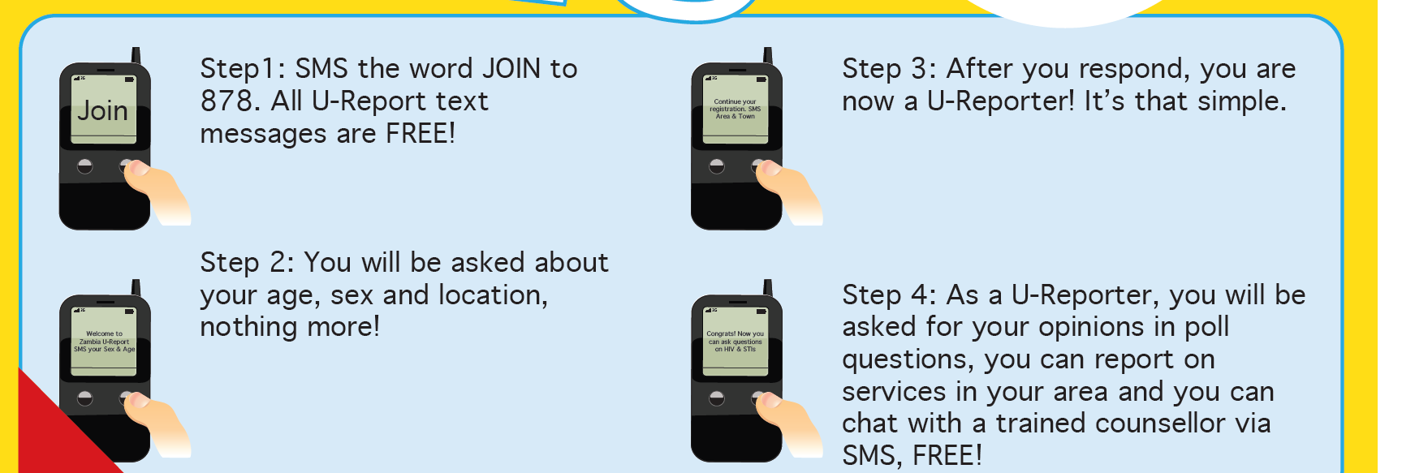
Zambia Ureport
Opt-in/Voluntary Registration by SMS

Slide 15












Module 1: Knowledge Bank
Ask, Learn and Share
B- Share/peers
1
SMS
6
2
A- Ask, Learn
Requests for HIV and STIs information (Spontaneous SMS requests)
SMS
5
3
4
SMS counselors
Personalized education/counseling
(age& sex sensitive
geography specific)
Notes:
this module will provide two-way interactions with U-Reporters. It will link request received through spontaneous SMS from U-Reported to the HIV and STI knowledge designed for the Zambia-U-Report. The knowledge bank will the accessed by SMS counselors who will build a youth friendly and personalized feedback SMS (160 characters in a defined format). U-Reporters will be prompted to forward new information learned with other young people in their phone network, their relatives or within the U-Reporters’ community. We anticipate that the most of the information requested by adolescent and youth through SMS will gravitate around effective mode of HIV prevention, access to youth friendly HIV prevention and treatment services, correcting misconceptions around HIV treatment and mode of transmission, stigma reduction. At the onset of the programme, the knowledge bank will include basic information (global and local HIV and STI burden and epidemiology, modes of transmission, modes of prevention including behavioral and biomedical, treatment, youth friendly HIV services locator, etc.). When required a pool of national HIV and STI experts will be consulted for providing inputs to SMS queries that are beyond the knowledge bank’s content and the technical level of the SMS counselor.
At specific time point, cloud analysis of SMS queries will highlight issues to be further developed or to be added de novo in the knowledge bank. To increase efficiency in managing spontaneous SMS requests, the knowledge bank will be gradually customized to allow for semi-automated SMS responses. For example, for any unsolicited SMS, the system could send a standard thematic-based menu requesting the U-Reported to request more information on any thematic by responding with a SMS including the thematic of interest. As part of the operating procedure for responding to SMS request, a maximum threshold of SMS interactions per U-Reporter per day will be set-up, to avoid abuse of the system (e.g. Maximum of 5-10 SMS per day based on the demand). Nevertheless, the module will include a functionality that will allow for flagging critical emergency SMS request (SMS containing some key words like defilement, rape, abuse, accidental exposure to HIV). In such cases an automated feedback with guidance will be sent to the U-Reporter for immediate action (the feedback will request also indicate the option of voice assistance through 990 call line).

Slide 16







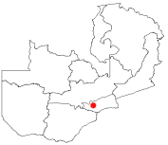
Module 2: Poll and Campaign
Participate, Influence, Demand and Share
D- Share/peers
6
SMS
3
2
A- Participate
Participate in Campaigns/opinion polls
(System Generated SMS, automated, semi-automated)
SMS
B- Influence
4
Policy
B- Influence
1
Campaign Design
5
C- Demand
SMS counselors
Service uptake
Notes:
Module 2: Poll and Campaign or PIDA (Participate, Influence Demand and Access) – this module will provide a systematic approach for real-time polling/monitoring youth opinions on issues that affect demand/access and utilization of HIV prevention, treatment and care interventions.
For each of the U-Report opinion polls, one thematic will be defined in consultation with key stakeholders including young people themselves, and the key questions (1-5 per poll) will be sent to U-Reporters. All active U-Reporters will be included in opinion polls based on specific polls inclusion criteria (age, sex, geographic location). The proposed hours/day to send opinion polls SMS is 17h00-18h00pm/Friday or 16h00-17h00pm/Saturday. U-Reporters feedback/opinions will be aggregated in the database, timely analysed and disseminated to all stakeholders in way that will inform and could influence policy dialogue/strategies formulation to address bottlenecks for youth-sensitive HIV services demand, access and utilization.
Opinion polls will be organized in synergy with SMS campaigns. Ideally a U-Report opinion poll should always precede a SMS campaign targeting the U-Reporters community. Feedback from opinion polls will also allow for evidence informed demand-driven communication for behavioural change interventions (using mass media and peer-education at community and school level) in targeted district working with local youth U-Reporters, local NGOs partners and through the decentralized units of the national youth development council from the Ministry of Youth and Sport, from Ministry of Education and from Ministry of Health and NAC. This strategy will not only address the gap identified during polls, but it will ensure equitable access to information for more young people (those who are not yet part the U-Report community, those who do not have a cell phone) in targeted areas.
Opinion polls on thematic related to knowledge on HIV and STI will be associated with automated feedback providing the right information to the U-Reporter as soon as the response is registered in the database.

Slide 17
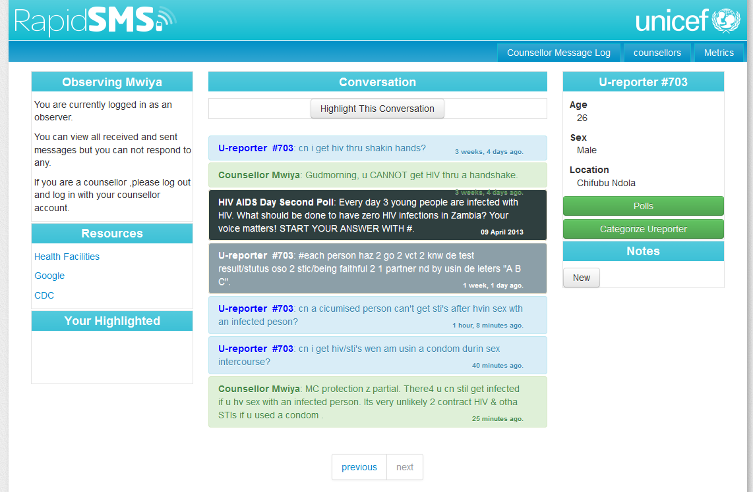
SMS Counselor Web-interface
Counseling Session
U-reporter Details
Opinion Poll & Answer
Quality Control Notes

Slide 18
High Level Action Plan
Timeline : Zambia U-Report for HIV Response among A&Y through SMS (2012-2017)
Phase 0: Planning
(May-November 2012)
- Design Workshop/IT platform/HR
- Partnership framework (NGO/CHAMP, 3 Mobiles Providers, SMS Cost negotiation)
Phase 1: Pilot and Evaluation
Piloting in 2 provinces Copperbelt and Lusaka (Dec 2012-Dec 2013)
Evaluation (Dec 2013-June 2014)
Phase 2: Scale-up
- Scale-up (2014-2016).
- Evaluation (2017)

Slide 19

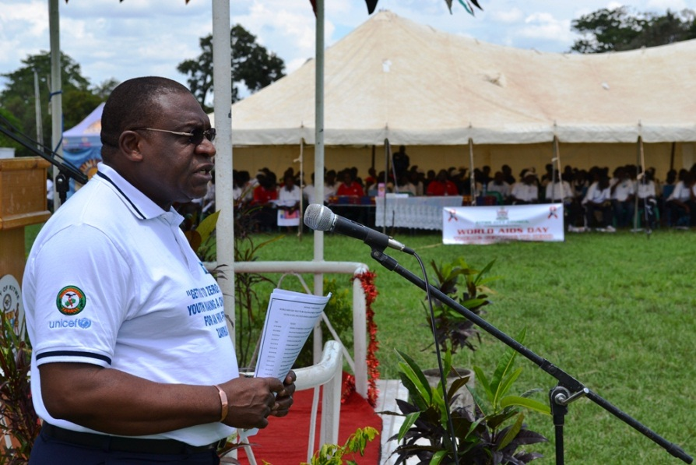
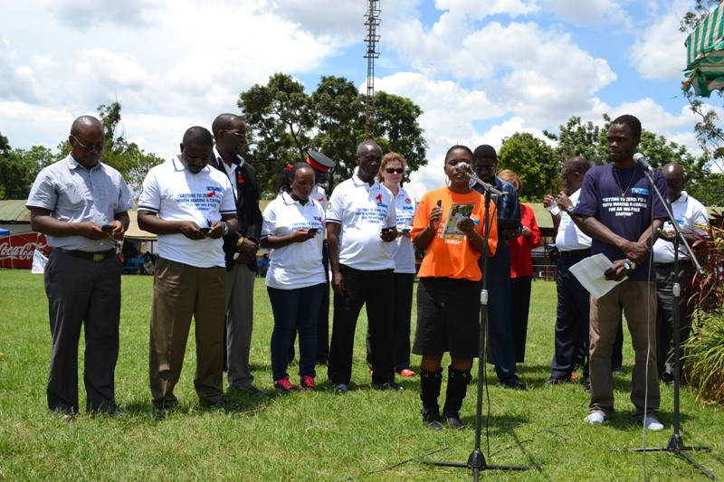
Securing High Level Commitment (1)
Official launch Kitwe (Copperbelt), Dec 1^{st,} 2012 on World AIDS Day
NAC Chairperson, Bishop Banda
UNICEF Representative, Dr Iyorlumun Uhaa
Live Demonstration of Registration steps by two youth representatives

Slide 20

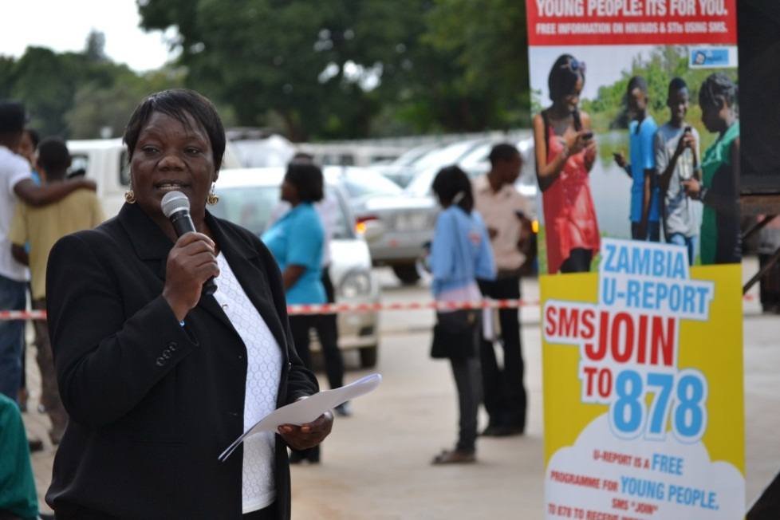
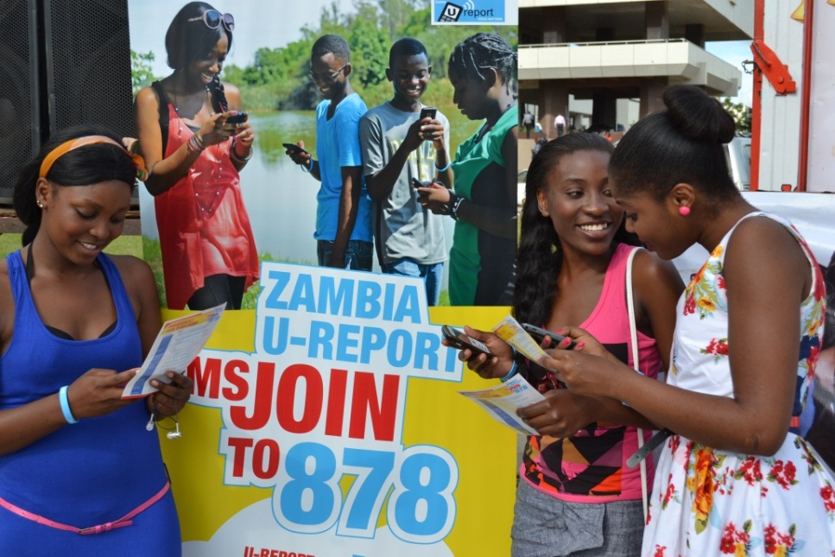
Securing High Level Commitment (2)
Official launch Lusaka, March 7^{th,} 2013 on National Youth Day
NAC Chairperson, Bishop Banda
Ministry of Youth and Sport Permanent Secretary, Ms. Agnes M. Musunga
Live Registration

Slide 21
Documenting 6 months RESULTS –

Slide 22
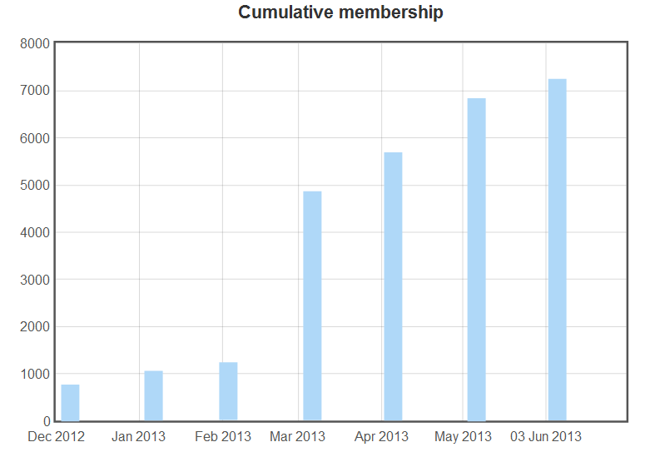
7,236 Ureporters; 62% of them engaged 17,755 SMS with the SMS counselors;

Slide 23
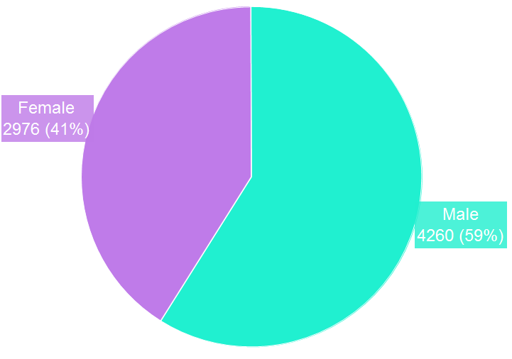
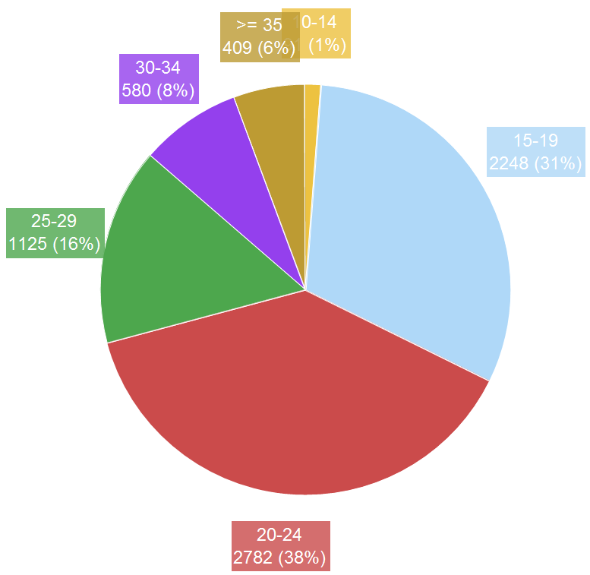
Ureporters Registration profile by sex and age, Dec 1st 2012-June 3rd 2013, Zambia (n=7,236)

Slide 24
Module 1- Knowledge Bank
Top 6 thematic issues from Ureporters SMS counseling
Analysis of 13,000 SMS from Ureporters (Dec 2012-May 2013),
Notes:
Data registered during the period Dec 1st 2012 – May 1st 2013 (5 months) from 5600 U-Reporters were analyzed. A total of 3,356 (60%) U-Reporters have engaged in conversation, generating 13,000 SMS requests to counselors.

Slide 25
Module 2- Poll/Campaign
Application to the HTC campaign (June 2013)
Example of the campaign module implementation.
You will soon receive some informational messages.
All U-reporters
Have you gone for an HIV test in the last 3 months?.
Respond with yes or no.
Hello. Did U know that in Lusaka….
No Group
Yes Group
No response group
3 weeks later
Have you gone for an HIV test ?
Respond with yes or no.
Remember to test often if you are sexually active.
Members of this group might get the same messages as the “No group” or another set of messages.
Knowing your HIV status …
Would you like to talk about why you got tested ?.
Respond with yes or no.
Go for an HIV test …

Slide 26
Module 2- Poll/Campaign
Application to the VMMC demand Creation
Tailored VMMC SMS intervention package designed and piloted to increase demand for VMMC among youth males 15-30 years; 2) Demand for VMMC increased by 3 times among participants receiving tailored VMMC SMS intervention package compared to a control group.

Slide 27
Evaluation design: The effects of providing tailored SMS on VMMC uptake among Ureporters aged 15-30 years
Three-arm randomized evaluation design
1
2
3
Routine on- demand SMS
250 men
Non-tailored VMMC SMS package
250 men
Tailored VMMC SMS package
250 men
Standard counselors feedback to SMS request
NO VMMC Intervention SMS package
NO additional encouragement to engage counselor
Standard U-Report counseling
Additional VMMC SMS intervention package
NOT Tailored to stage of change
Standard U-Report counseling
Additional VMMC messages
Tailored to the stage of change
Notes:
Whether and why?

Slide 28
Query SMS 1: Baseline: U-reporter, are you circumcised? (Y/N)
All eligible participants (non-circumcised male 15-24, willing to participate, residing in Lusaka and Chongwe districts)
1
2
3
Boosted VMMC SMS package
250 men
Routine on- demand SMS
250 men
Non-boosted VMMC SMS package
250 men
Query SMS 2: Are you ready to go for MC in the next days?
Yes
No
No
Yes
Query SMS 3: Do you plan to go for MC in future?
No
Yes
Yes
No
Intervention phase (weekly SMS sent by the programme based on stage A,B,C), and ongoing two-way interaction with counselors. Repeated on a quarterly basis.
Follow-up Month 3,6,9,12.
Query SMS 1: Are you circumcised?
No
Yes
Yes
No
No
Yes
Query SMS 2: Are you ready to go for MC in next days?
Query SMS 3: Do you plan to go for MC in future?
No
Yes
Yes
No
Stage A: - Pre-contemplation (No intention to go for MC)
Stage B- Contemplation (Intention to go for MC in the future)
Stage C- Preparation (Intention to go for MC in next days and steps taken towards that goal)

Slide 29
Zambia Ureport – T4D for HIV and Young people
Key functions for planning, implementation, M&E and coordination
ICT/T4D
  Software development/iterative process
  IT infrastructure installation and maintenance (servers, desktops, gateways)
  Data safety, security and confidentiality
  Mobile Phone Companies liason.
Comms/C4D
  Communication contents development
  Social mobilization for enrolment/promotion and marketing
  Engagement with social influencers (Brother for Life, Child Ambassadors)
  Web-public interface development/updating
Counseling and guidance/referral
  Real time information to build life skills/HIV competencies
  Counseling and guidance to create demand/referral to services
  Provide psychosocial support
M&E
  Data analysis (quantitative and qualitative) to inform policy and programme (MoRES)
  Track key indicators (process, outcomes, Impact)
  Survey and studies
HIV sectoral response (Health, Education, Child Protection)
  Thematic areas/questions for polling.
  Thematic areas and content for SMS campaign
  Promotion among target groups within sectors
  Utilize results of poll/campaign to inform policy and programming.
HIV Programme Coordination
  Management across sector,
  Enabling environment for collaboration (internal and external),
  Resources mobilization and allocation
  Strategic partnerships.

Slide 30
Illustration of the Zambia Ureport - Core functions for planning, implementation, M&E, and Coordination
Programme Coordination
Dep Rep Office
ICT/T4D
Operations
Programmes (H&N, Education, Child Protection, WASH)
Programme Sections
Comms/C4D
Comms. Section
M&E
SPPME Section
SMS Counseling /referral
NGO/CHAMP
Government Coordination
NAC , MoYS, MCDMCH, MoE, MGCD

Slide 31


“All young people have a right to comprehensive HIV information, and the means to act on this knowledge to achieve an AIDS-free Zambia.”
Bishop Banda, NAC Chairperson

