Slide 1
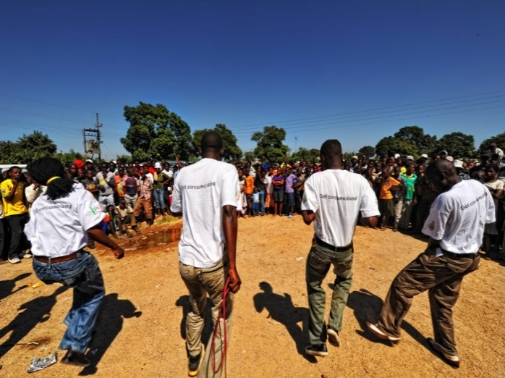
Voluntary Medical Male Circumcision Moving Communication
Forward
1

Slide 2
Moderator:
Kim Seifert-Ahanda, USAID/OHA
Presenters:
Daniel Makawa, MOH Zambia
Glory Mkandawire, Bridge II,
JHU/CCP Malawi
Amos Zikusooka , JHU/CCP Uganda
Pamela Chama, SFH Zambia, PSI Zambia
Steve Kretschmer and David Pring, IPSOS
Celeste Sandoval, UNAIDS
Sema Sgaier, BMGF
2

Slide 3
Objectives
This how to webinar will help participants succeed in VMMC demand creation.
Colleagues from Uganda, Zambia and Malawi will share their experiences and offer practical advice on two communication approaches:
Community engagement discussion will feature:
Zambia’s experience with traditional leaders
Malawi’s community platform with a focus on couple communication
The consumer- oriented marketing discussion will feature:
Uganda’s Stylish Man campaign, positioning VMMC in a new way
Zambia’s Men Who Care campaign
Research to understand your market, presented by Ipsos Marketing
3
3

Slide 4

Welcome and Introduction
Kim Seifert-Ahanda
USAID/OHA
(Moderator)
4
Notes:
Emmanuel: Could you remove the “Monitoring, Reporting and Quality of Services” at the bottom of Jason Title?

Slide 5

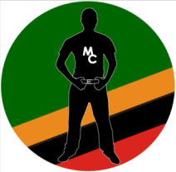
Male Circumcision in Zambia working with traditional leaders
Daniel Makawa
Ministry of Health
Zambia
5
Notes:
Emmanuel: Could you remove the “Monitoring, Reporting and Quality of Services” at the bottom of Jason Title?

Slide 6
Working effectively with traditional leaders is generating results in even the most challenging communities
Cultural attitudes toward male circumcision (MC) vary greatly by region in Zambia, even among uncircumcising tribes.
In uncircumcising tribes where tribal rivalries have created a negative perception of MC, demand creation is a challenge.
In these provinces, scaling up voluntary medical male circumcision (VMMC) is not possible unless the messages come through traditional leaders.
This presentation provides examples of approaches that are working in Zambia.
It has not been an easy process, but our hard work is paying off and we are finally starting to see results!
6

Slide 7
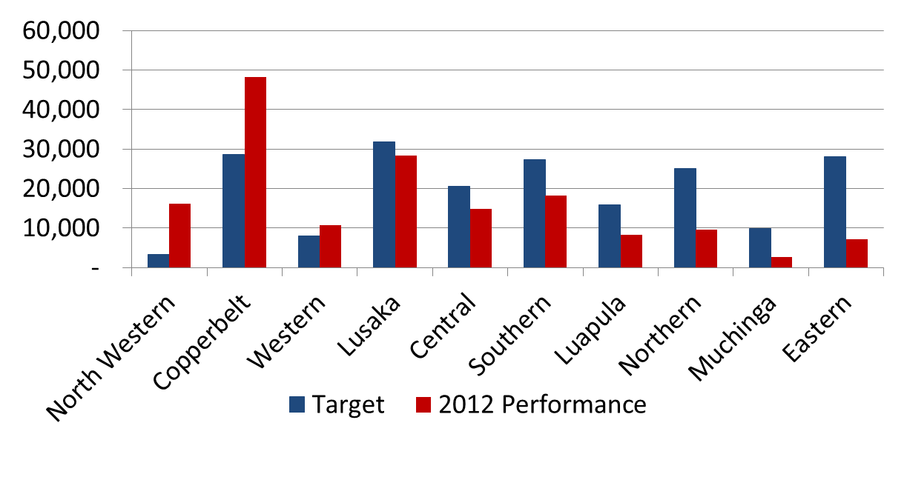
Zambia reached 88% of its annual target in 2012, but achievements varied greatly by province
Total VMMCs vs. target by province
Circumcising
Urban
Rural & uncircumcising
Only 26% of annual target
Low performance has been concentrated in rural, uncircumcising provinces where cultural barriers and misconceptions are strongest.
7

Slide 8
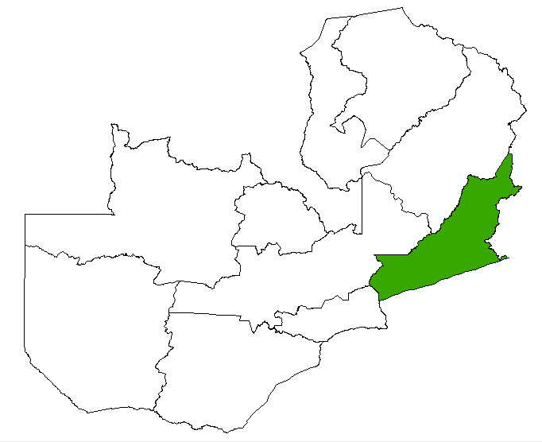
Case Study – Eastern Province
Negative cultural perception of MC led to high investment and low return
Eastern Province
Due to low MC prevalence, the target for Eastern Province is 280,791 over 4 years.
This is an average of 5,800 MCs per month.
In January 2012, the program was conducting an average of only 200 MCs per month due to cultural barriers.
This low productivity also led to high MC unit costs in the province.
HIV %
(MC %)
6.8%
(3.3%)
13.2%
(9.9%)
17.0%
6.9%
(14.4%)
(71.0%)
10.3%
17.5%
(3.2%)
(5.7%)
15.2%
(40.2%)
20.8%
14.5%
(4.4%)
(10.2%)
Source: ZDHS 2007 GRZ
Tables 13.12 and 14.5
8

Slide 9
Key lessons from work with traditional leaders in Eastern Province
Lesson 1: Work at the community level
  Communicate in the local language: If you don’t speak the language, you will be viewed as an outsider who is not in a position to comment on the cultural appropriateness of MC. Radio communication and community sensitizations must be delivered in the local language.
  Focus on mid-media and IPC: The appearance of one chief on TV as a national advocate generated very negative reactions from other tribes, especially in nearby communities. Advocacy by traditional leaders is most effective when restricted to their territory.
  One tribe at a time: Combining two tribes for a sensitization during Safe Motherhood Week led to arguments, and the workshop was not effective. Each chiefdom should be addressed separately according to their protocols.
  Link headmen to facility managers: If headmen and facility “in-charges” work together, both demand- and supply-side barriers can be easily tackled.
Continued…
9

Slide 10
Key lessons from traditional leaders (cont’d)
Lesson 2: Empower traditional leaders to take the lead
    Work through indunas: Messages delivered through community members carry more weight. Instead of using MOH staff, we sensitize indunas (advisers to chiefs), who act as facilitators during the sensitization of chiefs. This ensures that appropriate protocols are followed and that the process is viewed as being led by the community.
    Involve local leaders in target setting: When asked, local chiefs are willing to set and allocate campaign targets to their headmen.
    Ask local leaders to appoint mobilizers: Through a pilot run by PSI, we found that mobilizers appointed by headmen are more effective than satisfied clients!
Here are a few case studies to illustrate how we have put these principles into action
10

Slide 11
Example 1 – Petauke district
Local chiefs reinforce local language radio programs
Standard approach
New approach
Impact
Ads developed centrally in English and translated to local language
Local language call-in shows with expert medical staff
Chief Nyamphande was asked to record an ad in the local language
Ad played before and after local language call-in shows
In April, 473 circumcisions were conducted (compared to 176 in March)
April is peak harvest season in this district
to 176 in March
  By identifying an educated chief in a highly populated area where radio is accessible, we generated significant demand.
    Using the recognizable voices of local leaders will grab the attention of listeners.
    This is then followed up with a more interactive call-in show to directly address local concerns.
11

Slide 12
Example 2 – Nyimba district
Local chiefs involved in deciding how to set and achieve targets
Standard approach
New approach
Impact
The MOH sets district targets centrally and allocates to facilities based on outreach plans
Chief Ndake was consulted; he allocated target to his headmen
Headmen then actively engaged in mobilization
In 2 weeks, 234 clients were circumcised, compared to 62 in all of March
This was despite a delay due to funding
The previously unattainable target of 100/month was doubled in 2 weeks because we went to the chief and asked him how he thought the program should be implemented.
We now have a strong mobilization team in Nyimba district that is built on traditional structures.
12

Slide 13
Example 3 – Chikando rural health center
Headmen appoint health promoters (HPs)
Standard approach
New approach
Impact
PSI Zambia recruited satisfied clients to act as HPs (mobilizers)
Volunteers tended to be young adults
Headmen were sensitized and those who were supportive were asked to identify community members whom PSI would support to act as HPs
Older men selected
In their first month, three HPs mobilized 92 men, who were circumcised over 5 days
Each HP receives $80/month + $10 talk-time
  Asking headmen to appoint HPs resulted in selection of older men, who are proving to be more effective.
  At one facility where MC had never been provided, three mobilizers were able to attract 92 men from local villages in their first few weeks.
Continued…
13

Slide 14
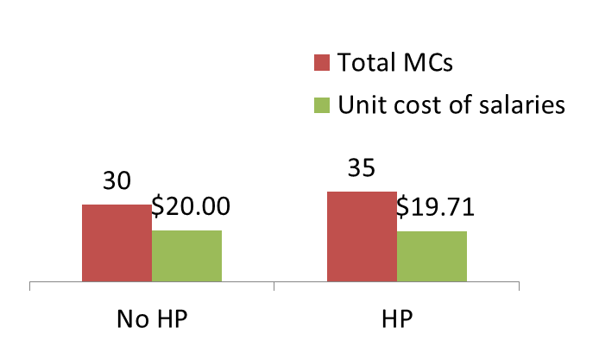
Example 3 (cont.) – Chikando rural health center
Investing in HPs is cost-effective, even for low volumes
Impact of HPs on salary costs per MC conducted
Illustrative example: Cost per MC of salaries and allowances for 2 providers for 3-day outreach, with and without HP*
Salary and allowances | No HP | HP
Provider salaries | $360 | $360
Provider allowance | $240 | $240
HP salary |  | $90
Total cost | $600 | $690
The total monthly compensation for one HP ($90) is less that 1 day’s overnight allowance for a health care worker.
If an HP can generate an additional 5 MCs in a month, for a facility where a 3-day outreach is conducted each month, the HP can actually reduce the cost of salaries and allowances per MC.
* Based on total cost for 3 days of $600 without an HP (salary cost of $60/day for 2 providers for 3 days=$360 + 3 days allowance =$240 for one of the providers who is assumed to have travelled from another facility) vs. $690 if the HP is employed for the month. Cost of driver and travel excluded.
14

Slide 15
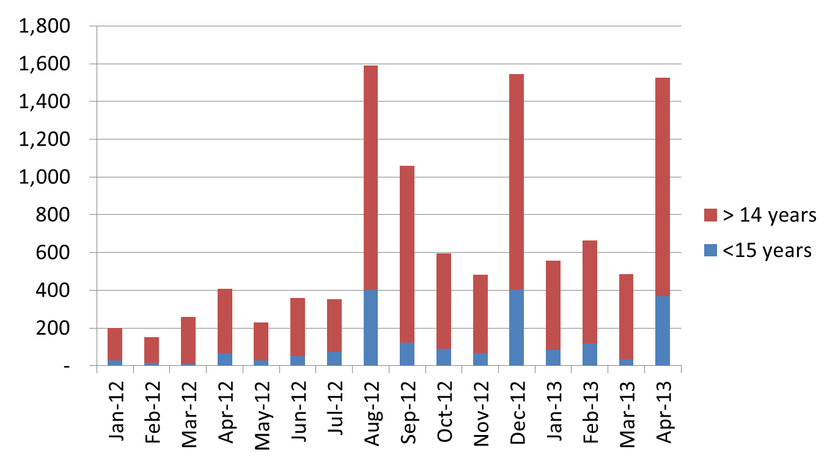
These initiatives are starting to translate into significant increases in uptake in Eastern Province
Monthly VMMCs conducted in Eastern Province*
Campaigns
* Note: Chart reflects MCs conducted by partners only, due to data limitations.
Continued advocacy among traditional leaders
15

Slide 16
Working with traditional leaders is challenging, but we have learned 2 key lessons that are informing our planning
Additional interventions we plan to pilot
Lesson 1: Work at the community level
  Setting up mobile clinics (tents) in communities where headmen request the service
  Providing better incentives for local HPs (e.g., bicycles)
  Integrating MC with other community outreach (e.g., cervical cancer screening)
Lesson 2: Empower traditional leaders to take the lead
  Involving local leaders in activity planning
  Scaling up use of indunas as sensitization agents
16

Slide 17
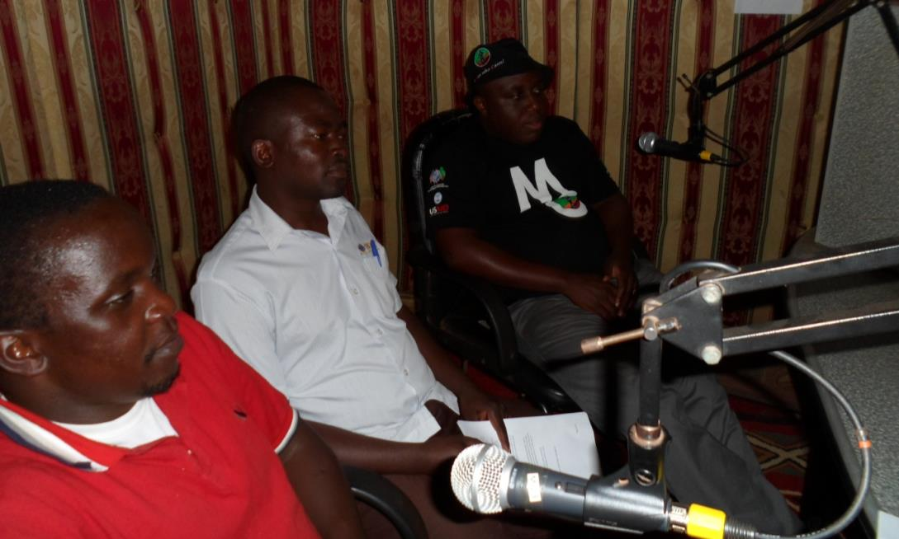
Zikomo! Thank you!
Dr. Makawa and headmen from Northern Province on radio call-in show
17

