Slide 1
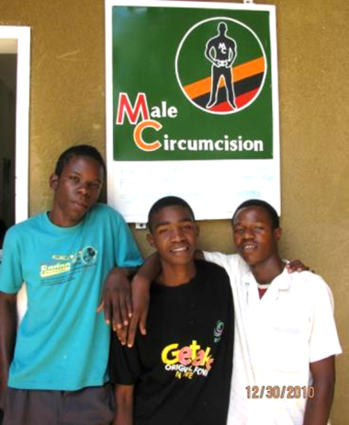

“A Man Who Cares?” Campaign
Pamela Chama
SFH Zambia
PSI Zambia
1
Notes:
Emmanuel: Could you remove the “Monitoring, Reporting and Quality of Services” at the bottom of Jason Title?

Slide 2
Content
Situation Analysis and Campaign Background
The Campaign Strategy
Communications Objectives
Campaign Design and Personality
Marketing Objectives (4 Ps)
Summary
2

Slide 3

Situation Analysis
HIV prevalence urban vs rural (19.7% vs 10.3%)
Low coverage of male circumcision (MC) 13% (ZDHS 2007)
1.9 million men and boys by 2015
Hygiene main reason men seeking MC services (SFH MIS data 2010)
Zambian men and women linked genital hygiene to STIs including HIV (PSI FoQus, 2008, Lukobo and Bailey 2007)
Women preferred circumcised men in Zambia (ZSBS 2010, TRaC 2007)
man who cares
3

Slide 4
Research component
Background
MC TRaC study laid vision for the MC brand.
The creative agency developed tagline and logo later. SFH pretested on the target audience.
Methodology
A combination of both quantitative and qualitative research methods was employed.
Stratified by age group; urban and rural.
Interpretation
Quantitative measures were analyzed and reported.
Qualitative components were synthesized.
Manly mood board
4

Slide 5
The Campaign – DELTA
Objective of the campaign:
➔ Increase uptake of MC
Launch the national MC logo
Provide links to vital information
Introduce 990 toll-free Talkline
Target audience: Prototype male
1. Primary Target: Men, 18- to 29-year-old urban and peri-urban males
2. Secondary Target: Teenagers
Functional benefit to be communicated:
➔ If the target “Danes” is circumcised, his penis will be easier to keep clean and he will be less likely to get some STIs, including HIV.
Emotional benefit to be communicated:
➔ For the target “Danes,” MC will give him the confidence to meet women who expect their spouse/partner to be circumcised.
Campaign personality
5

Slide 6
Campaign Design and Personality
Three components:
Electronic Media: TV and radio
Print Media: Journalist advocacy
Graphic Design: Posters and promotional materials
Encourage potential clients to call 990 toll-free hotline
Direct potential clients to service delivery sites to learn more about MC
Pre-tested campaign tone using a mood board – Clean, Healthy and In Control
6

Slide 7
Marketing Objectives “4 Ps”
Mid-Media:
“The university hall, packed with students, comes alive with a thick air of laughs and greetings as the SFH IPC team, all clad in VMMC T-shirts, finalize the setting up of the Mobile Video Unit (MVU). Within minutes, the room becomes quiet as the film starts. . .”
Mass-Media
Mid-Media
IPC
7

Slide 8
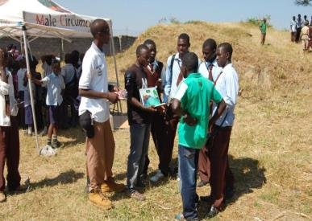
Marketing Objectives “4 Ps”
IPC:
“In the sweltering heat of October, Don Miyanda, an IPC Officer, sets the stage as he conducts a quiz around VMMC. Within a few minutes, Don draws attention to passersby at the bus terminal. ‘Here! Here!’ shouts one man in the crowd. . . . ‘I know the answer. . . . MC reduces the risk of a negative man getting HIV. . . . Now give me the T-shirt,’ he says amid laughter.”
Mass-Media
Mid-Media
IPC
8

Slide 9
Calls to 990 During October Campaign
A spike in calls to 990 in October did not translate into a spike in MC clients.
Awareness ≠ Doing.
MC Information
MC Counseling
9

Slide 10
Summary
Initiated a national conversation
Set the MC tone in the country
4,163 MCs – 148,601 since the 2010 campaign
Successfully launched national MC Logo
Success linked MC to the 990 toll-free line
Increased advocacy for MC
10

Slide 11

11

