Slide 1

Insight to Activation through Market Research
Steve Kretschmer and David Pring
IPSOS
1
Notes:
Emmanuel: Could you remove the “Monitoring, Reporting and Quality of Services” at the bottom of Jason Title?

Slide 2
Supply side to demand side
Understanding the customer
NEEDS
(Perceived?)
“PRODUCT”
(circumcised man)
ACTIVATION
2

Slide 3
Understanding needs
Consumer Driven
emotional
FUNCTIONAL
ethical
NEEDS
cultural
ASPIRATIONAL
Society Driven
3

Slide 4
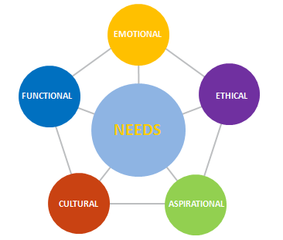
understanding needs
Influencers
Ecosystem
Barriers
Triggers
4

Slide 5
understanding needs
NEEDS
Current Knowledge
Stakeholders
Consumer Journey:
Decision process
Ecosystem – barriers/influencers/triggers
Ethnography
Segmentation (multivariate):
Attitudes
Needs
Behaviors
Socio-demographics
Targeting
ASPIRATIONAL
5

Slide 6
The “Aha”!
is
important
INSIGHT
is
IMPORTANT
Relates to something the consumer really cares about (or enjoys)
+
The
REVELATION of a significant gap between what consumers aspire to and what they perceive as available
is
personally
ENGAGING
The consumer should relate personally to the situation, not a general idea
+
RESONATES
with
daily life
A situation that really occurs in daily life (with a frequency that creates a real opportunity)
6

Slide 7

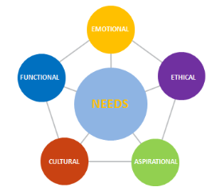
BRINGING THE INSIGHT TO LIFE aligning the offer to the needs
“PRODUCT”
TRACK
ACTIVATE
When, where, by what means
COMMUNICATE
How to best convey the winner(s) to the consumer
TEST/FORECAST
Define/size the most viable/biggest opportunity “bundle”
CONCEPTS
best expression of “offer” that is relevant, believable and differentiated
IDEA(S)
co-create, most likely to succeed as concepts from insights
INSIGHT(S)
REVELATION of a significant “aha” gap
7

Slide 8
INSIGHT TO ACTIVATION THROUGH Market Research
Customer-Centric:
  Focuses on understanding the needs of men
  Identifies how to position VMMC/MC to meet those needs
  Can place VMMC/MC on their vector of aspiration
Consumer Journey:
  Assesses men’s needs …
  … within their ecosystem of influencers
  Identifies key influencers, barriers and triggers to action
Segmentation:
  One size does not fit all!
  Provides for customized targeting of messaging and services to different men with different needs
A Systematic Approach
  Understanding Needs → Insights → Solutions → Tracking
8

