Slide 1
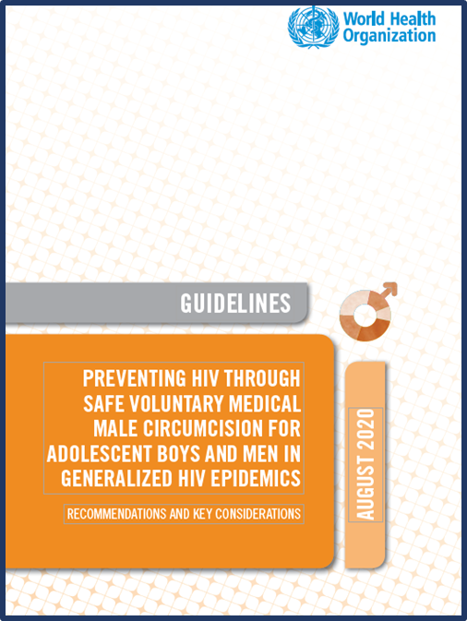


Modelling estimates that inform recommendations and programmes presented by
John Stover
Director, Center for Modeling and Analysis
Avenir Health
August 2020
Notes:
VMMC was first recommended in 2007 by WHO and UNAIDS. In 2020 that recommendation was updated and states that VMMC should continue to be promoted as an additional efficacious HIV prevention option within combination prevention for adolescents 15 years and older and for adult men in generalized epidemics to reduce the risk of heterosexually acquired HIV infection. Strong recommendation, high quality evidence.
Modelling studies informed that recommendation and inform country programming.

Slide 2
Outline
Guideline section 2.1.4 Modelling estimates of VMMC impact
HIV infections averted with VMMC already undertaken
VMMC within combination prevention including full ART coverage
  Country examples
Cost-effectiveness (section 2.2.3)
Guideline section 3.3.4
age and public health impact

Slide 3
Main points
VMMC has already averted a substantial number of HIV infections which is projected to increase given the life long partial protection offered by VMMC
VMMC remains a crucial intervention to achieve HIV prevention and epidemic control, even as other HIV prevention interventions including anti-viral treatment with secondary prevention effects, are scaled up

Slide 4
Number of VMMCs Conducted 2008-2019
Source: GAM, July 2020

Slide 5
Age Distribution of VMMCs Conducted in 2019
Source: GAM, July 2020

Slide 6
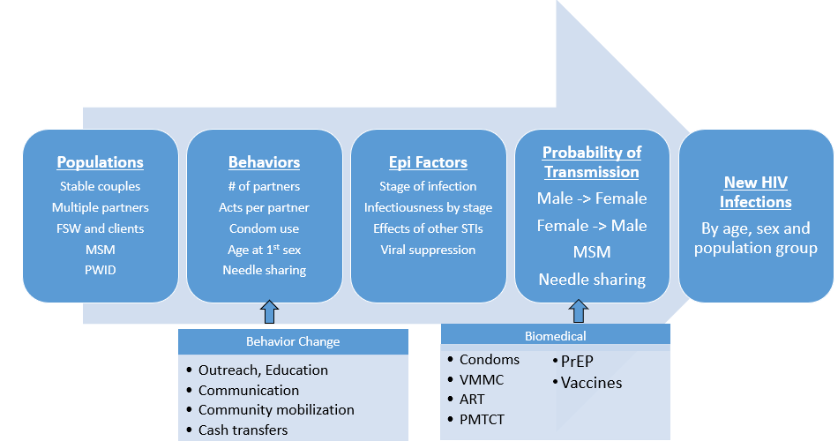
We used the Goals HIV simulation model to estimate the effects of VMMC on new infections

Slide 7
Methods
Goals model fit to data and historical trends for each of 14 countries
Two scenarios were simulated
  Actual historical trends
  Counterfactual: No VMMC conducted from 2008-2019. Circumcision prevalence remains at pre-2008 levels
Infections averted are estimated as the difference in new infections between the two scenarios

Slide 8
Infections averted by VMMCs already performed
5.7M
1.8M
340,000

Slide 9
Infections averted by VMMCs already performed
5.7M
1.8M
340,000
Notes:
The number of VMMCs required to avert one infection will decline in the future as the full benefits of the program are realized (as young men circumcised today age through their years of highest risk for HIV acquisition)

Slide 10
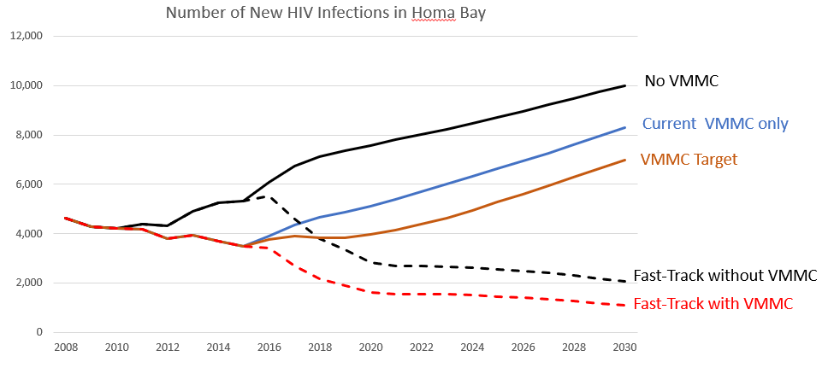
VMMC is a key component of Fast-Track
Even with scale-up of ART and other prevention interventions, VMMC will add additional impact
Notes:
VMMC remains a crucial intervention to achieve HIV prevention and epidemic control, even as other prevention interventions are scaled up.
Modelling also indicates that, when VMMC is scaled up as part of combination prevention including 90% ART coverage, VMMC still contributes to reducing HIV incidence. If no more VMMCs were to be conducted, the number of HIV infections averted by VMMC through 2018 would rise to about 1.5 million by 2030 and to 4.5 million by 2050, assuming that the coverage of other HIV interventions, including ART coverage, remains constant at current levels, or to 660 000 by 2030 and 1.0 million by 2050 if Fast Track targets are achieved for all interventions.
Scaling up VMMC was projected to add to the reductions in incidence attributable to the expansion of treatment to 90% – the more so if the level of treatment coverage were lower
Beyond modelling results, experience with ART programmes and evidence suggest that the preventive effect of VMMC will continue to be important. Real-world situations that contribute to lower viral suppression via ART include suboptimal adherence at times over a lifetime of ART use, service delivery limitations and drug resistance. Despite significant advances in the prevention and treatment of HIV, countries continue to experience serious gaps in ART service delivery, including suboptimal retention in treatment and care services, drug stock-outs and inadequate support for adherence to ART.

Slide 11
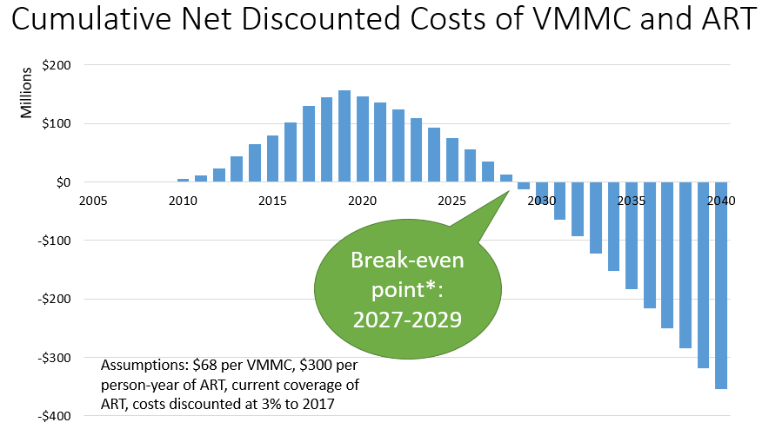
VMMC is cost saving
Source: Zambia MOH, The Impact of the VMMC Program in Zambia: Results from Mathematical Modeling, October 2018. Similar results were found for Kenya, South Africa and Zimbabwe
Notes:
VMMC programs require investment now but once the catch up phase is completed, the cost of maintaining coverage will be less than the savings derived from having fewer people needing treatment. In many countries the savings will exceed the investment costs before 2030.

Slide 12
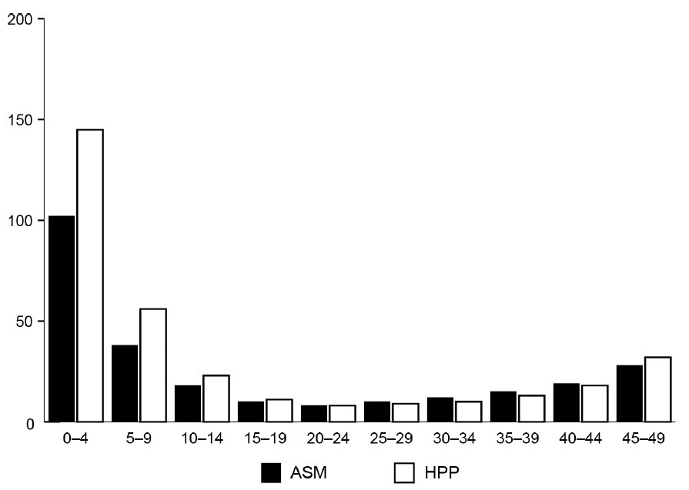
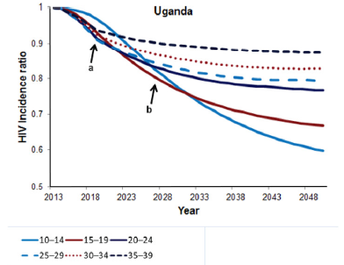
Age and public health impact
Zambia
DMPPT
Number of VMMC per infection averted by a program targeting a single five-year age group for the period 2010-2025 in Zambia from the ASM and DMPPT models. For this time period, the most efficient program is for the 20-24 age group.
HIV incidence (indexed to 2013) over 50 years for programs targeted to specific 5-year age groups. Targeting 25-34 age group produces the quickest impact. Targeting the 10-14 age group produces the greatest long-term impact.
Source: Kripke K, Opuni M, Schnure M, Sgaier S, Castor D, Reed J, et al. (2016) Age Targeting of Voluntary Medical Male Circumcision Programs Using the Decision Makers’ Program Planning Toolkit (DMPPT) 2.0. PLoS ONE 11(7): e0156909. doi:10.1371/journal.pone.0156909

Slide 13
Summary
VMMC program has already had impact
Benefits will grow significantly in the future
VMMC is efficient. As few as 10 VMMCs can prevent one new infection
VMMC will avert future treatment costs
VMMC is a key component of Fast-Track and will be important to ending AIDS as a public health threat by 2030

