Slide 1

HIV Leadership Forum
Exploring opportunities for collaboration
Susan Mochache: Board Member Global Fund
November, 2023

Slide 2
Setting the scene

Slide 3





We have unfinished business!
HIV remains major global health threat
40.4 million AIDS deaths since start of epidemic
630,000 AIDS deaths in 2022
Global targets in jeopardy
39 million people living with HIV in 2022
Sub-Saharan Africa saw 54% decrease since 2010
COVID-19 impacted prevention services
Leading cause of death in women 15-49 in Africa
Bold action needed to end AIDS by 2030

Slide 4




What do Global Fund HIV Investments look like?
Global Fund provides 28% of all international HIV financing
HIV prevention investments grew significantly
Condoms prevented STIs and HIV infections
PrEP allocations doubled but still not enough
Contraceptives including condoms averted 5.1 million STIs and 117,000 HIV infections
The Global Fund has invested $25.5 billion in HIV programs as of June 2030
From $705 million in 2018-2020 to over $850 million in 2021-2023
PrEP accounts for 3% of the HIV prevention budget at $24.1 million
AIDS-related deaths have been reduced by 72%, new infections by 61% through GF investments since 2002
In the absence of prevention measures and anti-retroviral drugs, deaths would have increased by 169% and new HIV infections by 125% during the same period
Source- Global Fund 2023

Slide 5
History, mandate, and how we can engage

Slide 6




The Africa Constituency Bureau (ACB)
ACB is an Africa-led organization
ACB provides policy support
ACB does evidence-based advocacy
ACB offers technical assistance
Established by African Health Ministers in 2012 to advocate for Africa in Global Fund governance
Ensures African priorities are safeguarded & integrated into Global Fund policies
Secures buy-in for African positions through engagement and advocacy
Strengthens Africa's capacity by coordinating regional expertise across diseases and systems
The ACB is also seeking to expand its presence beyond the GF to impacting other GHIs.

Slide 7
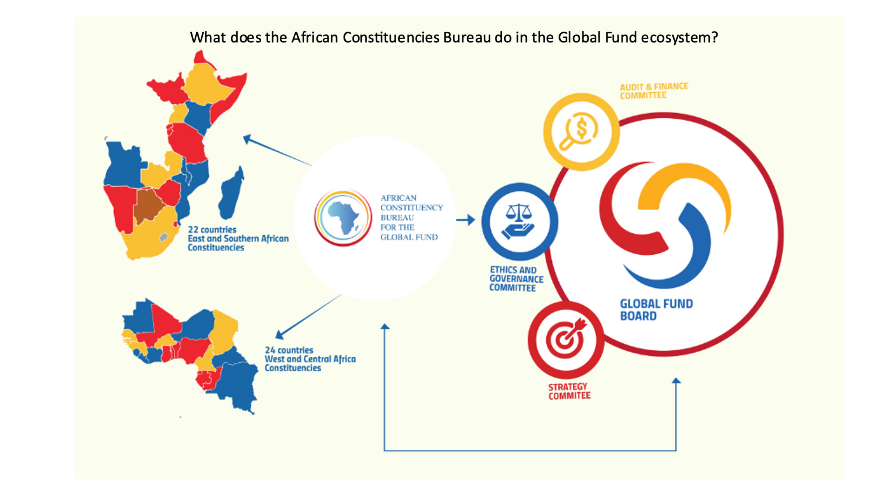

Slide 8
ACB Board Leadership
Susan Mochache
Kenya
Dr. Charles Mwansambo
Malawi
Margaret Mundia
Board Member representing East and Southern Africa Constituency
Alternate Board Member representing East and Southern Africa Constituency
Constituency Focal Point for East and Southern Africa Constituency
Dr. Jean Jacques Mbungani Democratic Republic of Congo
Dr. Magda Robalo
Guinea Bissau
Dr. Pepe Kilimalima
Constituency Focal Point for West and Central Africa Constituency
Alternate Board Member representing West and Central Africa Constituency
Board Member representing West and Central Africa Constituency

Slide 9





The ACB Mandate
Conducting policy policy research
Strong and effective board and committees
Research is done across HTM and health systems to inform GF governance decisions
Representation, diplomacy, advocacy
African Governments at the center
Mobilizing Africa voices
Get nuances of grant implementation successes, challenges and opportunities from countries
Increased engagement with African governments will contribute to greater GF/GHI decision making in Africa's interest
Generating consensus
Combine policy research, African voices and policy intelligence
Ultimately, we seek to influence policy change at GF and GHI governance decisions

Slide 10




How can you engage with the ACB?
Country Coordinating Mechanisms
Cluster Networks
Leverage HIV-focused groups like those for adolescent girls and young women
Engage CCMs and Ministries of Health to understand contemporary grant implementation issues
Regional Meetings
Annual Consultations
Work with RECs to advance priorities like HIV prevention co-financing
Pre-board meetings generate consensus on key GF policy issues
By engaging with the Africa Constituency Bureau across multiple levels, countries can amplify their positions to inform HIV resource allocation and prevention priorities.

Slide 11
ACB Partnership engagement
Generating HIV Prevention Priorities
Joint Advocacy
ACB has proximity to governance and decision-making. We can leverage this to generate priorities in HIV prevention together.
Advocate together on issues of mutual interests such as innovative financing, resource allocation for HIV prevention and leveraging GHIs to maximize impact etc
Join HIV Working Group
Country Engagement
Join our HIV thematic working group to inform policy discourses.
Help open doors in-country for the ACB to articulate our value proposition.

Slide 12
Challenges and opportunities
African voice needs to be better galvanized in Global Health institutions
Increased engagement within ourselves
Have better representation across GHI’s: We account for highest disease burden and largest beneficieries. 70% from GF but have only two seats
Put forward our best into the committees and Boards
Use networks such as NACC to address the key thematic issues and influence the agenda
Propose nominees for Global Fund Board
.

Slide 13
Thank you. Questions/comments?

