Slide 1
Action 1 - Conduct a data-driven assessment of HIV prevention programme needs and barriers
Question number (in the survey question-naire) | Road Map Baseline Survey components considered for overall Road Map Action scoring | Share of scores among the survey components scored | Ghana
1.1 | > Had the country prepared an up-to-date (since 2020) synthesis covering HIV epidemic patterns and HIV prevention response analysis? | All subnational > 0.5, some subnational > 0.4, national > 0.3
1.2 | > 1.2 Based on the available data on the synthesis above has the country held consultations and identified the most important barriers that are holding back HIV prevention in the country that you will use to define the action agenda for accelerating HIV prevention up to 2025? | Yes, policy and legal barriers; Yes, level of national leadership engagement; Yes, technical and capacity gas; Yes, funding and financing gaps
1.2.1 | > Listing of the identified barriers | Yes
 |  | Total score
Done
Not yet done
In progress

Slide 2
Action 2 - Adopt a precision prevention approach focused on the key and priority populations to develop national HIV prevention goals aligned 2025 targets
Question number (in the survey questionnaire) | Road Map Baseline Survey components considered for overall Road Map Action scoring | Share of scores among the survey components scored | Ghana
2.1 | >Based on the evidence-driven assessment under point 1, has the country developed or updated a national HIV Prevention Road Map or plan that covers the period up to 2025 or beyond? | Yes, a national strategic plan on HIV that reflects all the relevant priority pillars and populations of the 2025 Road Map
2.2 | > Set granular HIV prevention targets | Yes using the Global AIDS Strategy
2.3 | > Translate national targets to subnational targets | Yes
2.4 | > Differentiated HIV prevention packages | Yes
2.5 | > Packages for AGYW where relevant | No
2.7 | > Are SOPs (detailed implementation guidance for service providers or implementers) in place for the 5 prevention pillars? | (Missing SOP for AGYW, Transgender, PWID, Prisoners and boys and men)
 |  | Total score
Done
In progress
Not yet done

Slide 3

Action 3 - Define country investment needs for an adequately scaled HIV prevention response and ensure sustainable financing
Question number (in the survey question naire) | Road Map Baseline Survey components considered for overall Road Map Action scoring | Share of scores among the survey components scored | Ghana
3.1 | >Does the country have a budget/costed plan to achieve the 2025 HIV prevention targets/road map for all relevant priority pillars of prevention including key populations and other priority populations? | Yes
3.2 | >In the past 12 months, has a dialogue on addressing gaps in HIV prevention funding been held with key partners such as NAC, Ministry of Health, Ministry of Finance (or equivalent), Global Fund and PEPFAR? | Yes
 |  | Total score
Done
In progress
Not yet done

Slide 4
Action 4 - Reinforce HIV prevention leadership entities for multisectoral collaboration, oversight, and management of prevention responses
Question number (in the survey questionnaire) | Road Map Baseline Survey components considered for overall Road Map Action scoring | Share of scores among the survey components scored | Ghana
4.1 | >Is there a designated prevention leadership entity for multisectoral collaboration, oversight and management of the national HIV prevention response? | Yes
4.2 | >How often has the national HIV prevention Coalition /main multi-sectoral prevention working group met in the last 12 months? | Two or three times
4.3 | > Has the country developed milestones to reinforce HIV prevention leadership entities? | No
 |  | Total score
Done
In progress
Not yet done

Slide 5
Action 5 - Strengthen and expand community-led HIV prevention services and set up social contracting mechanisms
Question number (in the survey questionnaire) | Road Map Baseline Survey components considered for overall Road Map Action scoring | Share of scores among the survey components scored | Ghana
5.1 | > government convening of relevant communities | Yes
5.2 | > Public funds being allocated to NGOs | Yes, for NGOs and KP-led organisations using international resources
5.3 | > Are there any laws and policies that are in place that impact whether community organisations can register, raise funds, operate safely, etc (OR are there restrictions on NGOs receiving domestic/international funding) to provide community-led HIV prevention services for key and priority populations. | Yes
5.4 | > Are there set national targets for increasing the proportion of HIV prevention services delivered by community-led organisations? | No
5.5 | > Has the country developed milestones to strengthen and expand community-led HIV prevention services and set up social contracting mechanisms? | No
 |  | Total score

Slide 6
Action 6 - Remove social and legal barriers to HIV prevention services for key and priority populations
Question number (in the survey question-naire) | Road Map Baseline Survey components considered for overall Road Map Action scoring | Share of scores among the survey components scored | Ghana
6.1 | > 6.1 Does the national HIV prevention strategy clearly and explicitly identify and prioritize addressing legal, policy and structural barriers to HIV prevention service access - specifically for the following populations? | For sex workers; For gay men and other men who have sex with men; For AGYW; For adolescents boys and men
6.2 | > Has the country developed milestones to remove social and legal barriers to HIV prevention services for key and priority populations? | No
 |  | Total score
Done
In progress
Not yet done

Slide 7
Action 7 - Promote integration of HIV prevention into essential related services to improve HIV outcomes
Question number (in the survey question-naire) | Road Map Baseline Survey components considered for overall Road Map Action scoring | Share of scores among the survey components scored | Ghana
7.1 | > Has the country developed milestones to promote integration of HIV prevention into essential related services (SRHR, MNCHm mental health, TB, NCDs, Hepatitis) to improve HIV outcomes? | No
7.1.1 | > Are the milestones listed? | No
 |  | Total score
Done
In progress
Not yet done

Slide 8
Action 8 - Institute mechanisms for rapid introduction of new HIV prevention technologies and programme innovations
Question number (in the survey questionnaire) | Road Map Baseline Survey components considered for overall Road Map Action scoring | Share of scores among the survey components scored | Ghana
8.1 | > Has the country defined specific actions for the adoption of the following HIV prevention technologies and programme innovations as part of combination prevention packages? | - Antiretroviral drug releasing vaginal ring; - Long-acting PrEP regimens; - HIV self-testing; - Digital platforms and virtual meeting spaces - Multimonth dispensing of HIV prevention and treatment
8.2 | > Has the country developed milestones to institute mechanisms for rapid introduction of new HIV prevention technologies and programme innovations, identified in 8.1 above? | Yes
 |  | Total score

Slide 9
Action 9 - Establish real-time HIV prevention programme monitoring systems with regular reporting
Question number (in the survey questionnaire) | Road Map Baseline Survey components considered for overall Road Map Action scoring | Share of scores among the survey components scored | Ghana
9.1 | > Data triangulation for coverage of programmes | Yes
9.3 | > 9.3 Has the country HIV prevention scorecard been translated into subnational scorecard tool? | No
9.4 | > HIV prevention funding expenditure analysis done? | Yes
9.5 | > Cost-effectiveness in programe reviews in 2021 and 2022 | Yes
 |  | Total score
Done
In progress
Not yet done

Slide 10
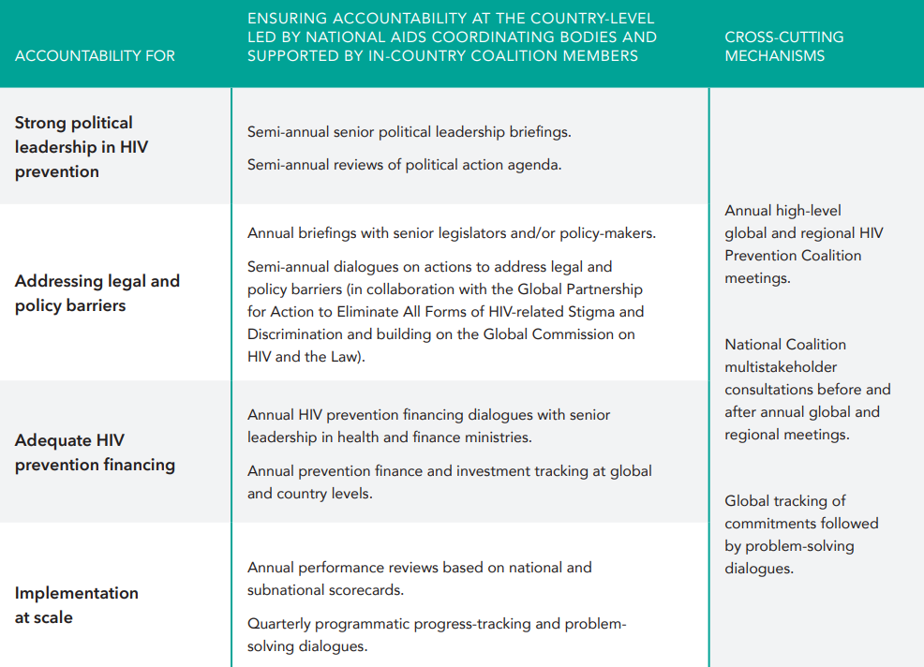
Sample accountability framework from the 2025 HIV Prevention Road Map
For country adaptation

Slide 11
Action 10 - Strengthen accountability of all stakeholders for progress in HIV prevention
Question number (in the survey question-naire) | Road Map Baseline Survey components considered for overall Road Map Action scoring | Share of scores among the survey components scored | Ghana
10.1 | > Table3 (refer to previous slide) of the 2025 Road Map followed | > 3/8 followed: - Annual senior senior political leadership briefings on HIV prevention - Annual prevention finance and investment tracking at global and country levels - Quarterly programmatic progress-tracking on HIV prevention and problem-solving dialogues
10.2 | > Is there a complete accountability framework developed in line with table 3 of the 2025 HIV Prevention Road Map, and who was consulted? | No
 |  | Total score
Done
In progress
Not yet done

