Slide 1
Adolescent girls and young women programming
Evidence, global guidance and tools
Hege Wagan, Senior Adviser UNAIDS

Slide 2
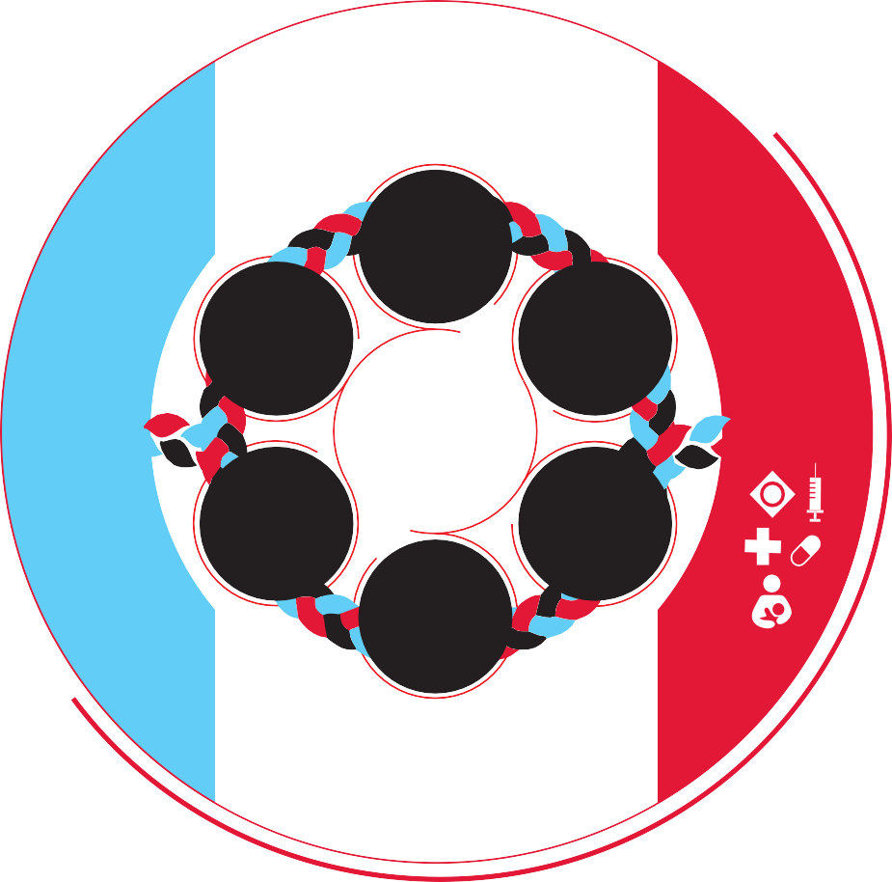
Global AIDS Strategy 2021-2026 sets out new targets including for combination HIV prevention & SRH
Reduce new HIV infections to under
370 000 by 2025​
Including new HIV infections among adolescent girls and young women to below 50 000
​
Less than
95%
10%
use combination prevention
90%
of countries have
95%
95%
of people living
punitive laws
of women access HIV and sexual and reproductive health services
with HIV and
and policies
of PLHIV know
their HIV status
people at risk are
linked to
Less than
PEOPLE LIVING WITH HIV AND COMMUNITIES AT RISK AT THE CENTRE
people-centred
10%
and
context-specific
experience
integrated
stigma and
95%
services
discrimination
95%
Less than
coverage of
services for eliminating vertical
transmission
of PLHIV who know their status initiate treatment
10%
experience
95%
gender inequality
on treatment are virally suppressed
and violence
Notes:
Together with the 10-10-10 targets

Slide 3
Adolescent girls and young women
Every week, around 4000 young women aged 15–24 years become infected with HIV. And 3100 of these are in Sub-Saharan Africa
  In sub-Saharan Africa, women and girls accounted for 62% of all new HIV infections in 2023.
  HIV incidence rate among adolescent girls and young women is more than three times that among adolescent boys and young men in at least 22 countries in sub-Saharan Africa.
Globally, about 1 in 3 (approximately 30%) of women have experienced physical and/or sexual violence by an intimate partner or sexual violence by a non-partner at some point in their lives.
  In some regions, women who have experienced physical or sexual intimate partner violence are 1.5 times more likely to acquire HIV than women who have not experienced such violence.

Slide 4
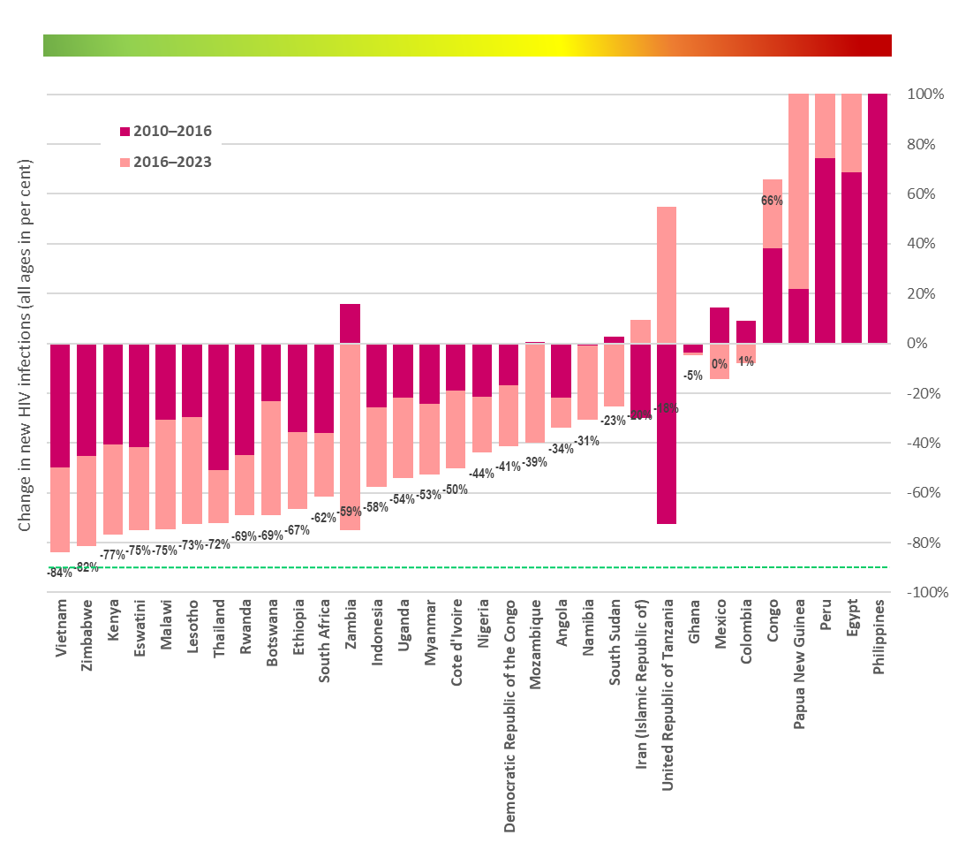
Encouraging but insufficient declines in the number of new infections among AGYW
Source: Further analysis of UNAIDS epidemiological estimates, 2024

Slide 5
AGYW thematic summary: Despite good examples, major gaps in prevention among young women (based on 2023 GPC report)
Indicator | Condom use with non-regular partners (young women, 15–24 years) | Condom use with non-regular partners (young men, 15–24 years, %) | % of priority districts (administrative areas) with dedicated programmes for young women & male partners (full package) | % of adolescent girls and young women in high HIV incidence communities reached with a comprehensive package of prevention intervention
Angola | 31 | 46 | id | id
Botswana | id | id | 56 | 4
Cameroon | 50 | 65 | id | 9
Central African Republic | id | id | id | id
Congo | 45 | 66 | id | id
Cote d'Ivoire | 42 | 67 | id | id
DRC | 25 | 33 | id | id
Eswatini | 55 | 74 | 80 | 100
Ethiopia | 22 | 51 | id | 17
Ghana | 20 | 44 | 20 | id
Kenya | 43 | 70 | 100 | 17
Lesotho | 84 | 83 | 90 | 34
Malawi | 53 | 73 | id | 21
Mozambique | 51 | 48 | 33 | 46
Namibia | 68 | 84 | 42 | 19
Nigeria | 38 | 62 | id | id
Papua New Guinea | 18 | 31 | id | id
Rwanda | 46 | 78 | id | 8
South Africa | 61 | 73 | 50 | 6
South Sudan | id | id | id | id
Uganda | 43 | 57 | 38 | 9
United Republic of Tanzania | id | id | id | 61
Zambia | 34 | 49 | 28 | 37
Zimbabwe | 54 | 81 | 89 | 17

Slide 6
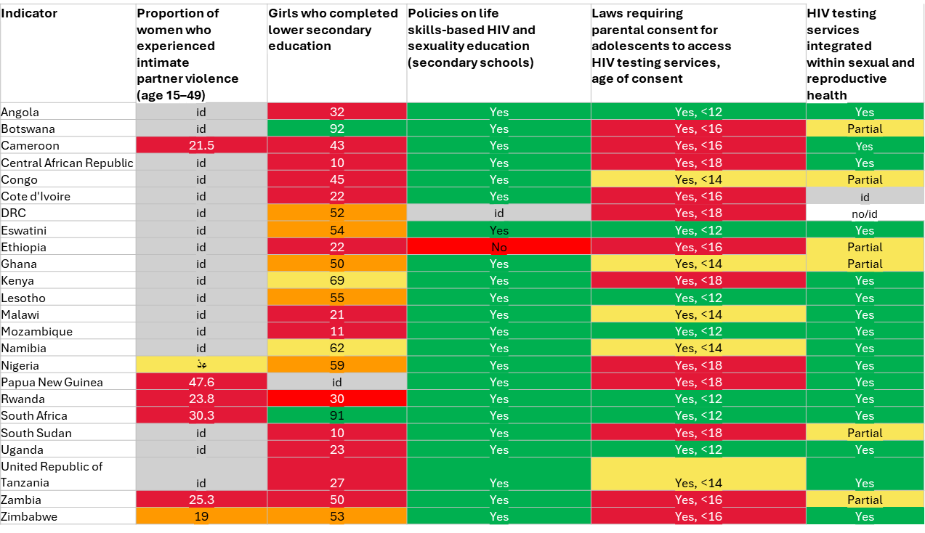
AGYW thematic summary: Despite good examples, major gaps in prevention among young women (based on 2023 GPC report)

Slide 7
HIV prevention among adolescent girls and young women & male partners: what have we learned
Need for more systematic approach to prioritization & programming
  Based on HIV incidence estimates, vary intensity of programmes in locations with different levels of HIV incidence
Proposed action was often small scale without focus (rather than scaled based on clear focus)
  Overly focused on contextual issues, rather than effective HIV prevention
  Missed opportunities in reaching women already using contraceptive services
Define clear theory of change (which outcomes in terms of prevention behaviours will lead to reduced HIV incidence). Accompanied by programme monitoring
Define a programme model that is viable & scalable in high-incidence locations: It’s not about biomedical vs. behavioral vs. structural, but an implementable mix of different programme elements
Ensure coordination and stewardship
Engage AGYW throughout

Slide 8
Education Plus, SRHR/HIV integration,
SRHR/HIV: GF SI, Together 4 SRHR (SSA)
Education Plus- high-level political advocacy drive to accelerate actions and investments to prevent HIV among AGYW in sub-Saharan Africa—with secondary education as the strategic entry point
  High level policy advocacy, Young womens leadership pillar, Think tank, data hub (Generate novel high-impact data projections and visuals), multi media communication

Slide 9
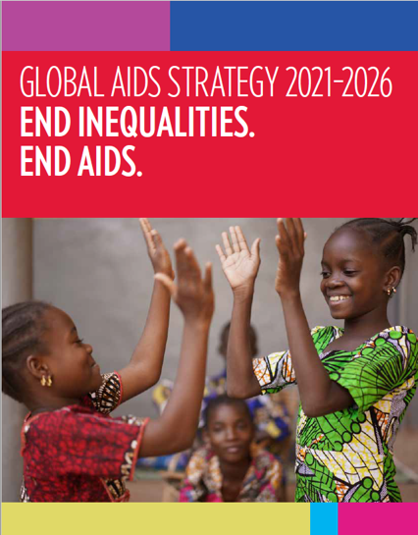
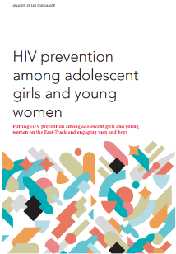
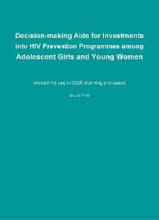
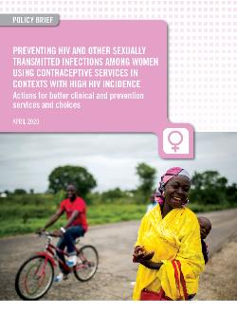
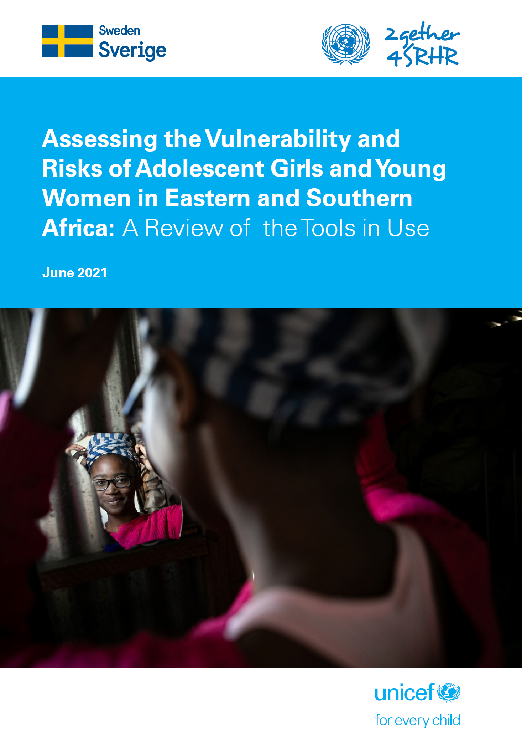
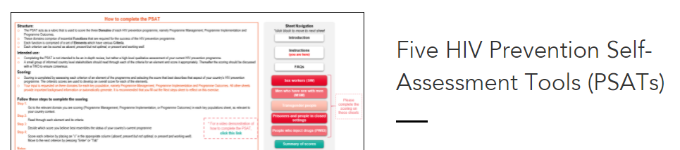
Guidance and tools: Location-population-age - behavioural categories
Programming guidance on HIV prevention among adolescent girls & young women (2016)
Decision-making aide for investments into HIV prevention programmes (2020)
Preventing HIV and other STIs among women using contraceptive services (2020)
Review of risk assessment tools (2021)
Prevention Self Assessment Tool (PSAT) for AGYW (2022)
Operational aid on developing population size estimates of adolescent girls, young women & men at higher risk of HIV (UPCOMING)
User Guide for Priority Population size estimation

Slide 10
Options MENU
Dimension of
change
HIV prevention
outcomes
Impact
Menu options
Condoms
Fewer partners/ more partner choice
(less risky partners)
School-based prevention
(in context of comprehensive sexuality education)
Norms, know how, skills
Core prevention programs
Interpersonal communication
Reduced
HIV incidence
Support choices of young
women who have agency
Pre-exposure prophylaxis
Safer sex negotiation (condom use)
HTS, ART, VMMC for men
Biological factors
Policy, legal change
Consistent use of ARVs for prevention (ART,U=U, PrEP, PEP)
Community mobilization
Reduce susceptibility
and transmissibility
Synergistic
effects on education, GBV, gender norms, SRHR
Multi- and new media
Policy & structural action
Cash transfers / incentives
Gender norms & GBV prevention
Structural factors
More men go for HIV/health services (HTS/ART & VMMC)
Sexual and reproductive health and rights
Enhance agency among
young women
Enhanced leadership

Slide 11
DELIVERING PACKAGES
Target population
Increasing complexity of needs
Individuals with acute distress
Individuals with multiple adversities
Differentiated:
Integrated & personalized combination of services
Targeted:
Services specific to distress
People move as their wellbeing changes
Whole population
100%
Universal:
General support
Adapted by Rudgard W. from NHS England's Comprehensive Model for Personalised Care: https://www.england.nhs.uk/wp-content/uploads/2019/01/shared-decision-making-summary-guide-v1.pdf
Notes:
Recognize Jane and Elona for the slide:
Kazak, A. E. (2006). Pediatric Psychosocial Preventative Health Model (PPPHM): Research, practice, and collaboration in pediatric family systems medicine. Families, Systems, & Health, 24(4), 381–395. doi:10.1037/1091-7527.24.4.381
Mandic, Sandra; Bengoechea, Enrique García; Coppell, KirstenJ.; Spence, JohnC. (2017). Clustering of (Un)Healthy Behaviors in Adolescents from Dunedin, New Zealand. American Journal of Health Behavior, 41(3), 266–275. doi:10.5993/AJHB.41.3.6
https://pubmed.ncbi.nlm.nih.gov/28376971/
https://twitter.com/Pers_Care/status/1306130917589647362/photo/1

Slide 12
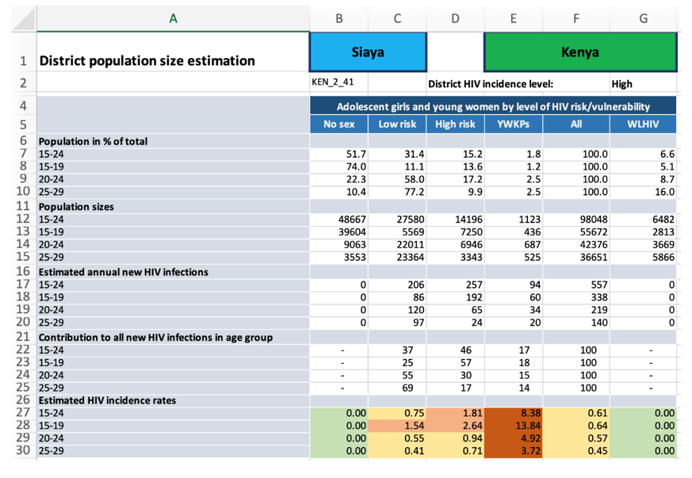
Population size estimates of adolescent girls, young women and other populations
New global targets disaggregated key populations and young people and adults (by sex, age, location and behaviors)
Guidance exist for population size estimates for key populations, but not for young women and other priority populations.
The approach introduce sub-national estimates, which integrate different dimensions (sex, age, location, behaviours)
  Current version focuses on young women 15-29
  For use in context of broader HIV risk analysis
Estimate the “denominator” – number of
AGYW at higher risk of acquiring HIV who need intensified
HIV prevention programmes
Sub-national population sizes estimates
as an entry point for setting targets

Slide 13
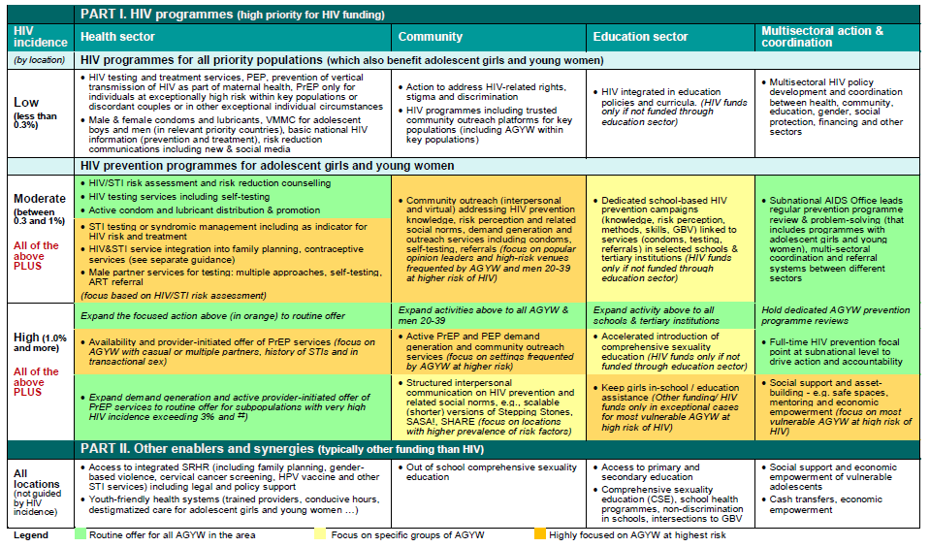
Need for differentiated application; Decision-making aide

Slide 14
A focused approach to HIV integration in contraceptive services
Strengthened HIV prevention using family planning platforms
Improving access where women are
Do not cite

Slide 15
Assessments at national and decentralized level, includes management system, programme components, M&E system, integration aspects
Support to implement the assessment at national and decentralized level is available

Slide 16





Delivery platforms for scaling up programs for adolescent girls, young women and men in settings with high HIV incidence:
National (new) media platforms supporting demand generation and normative change
Health sector platforms
(facilities, mobile services)
Youth-friendly services (trained providers, conducive hours, …)
Access to SRH/HIV services (incl. HIV/STI risk assessment, condoms, VMMC, HTS/ART, PEP, PrEP, GBV, cervical cancer screening, HPV vaccine…)
Integration of HIV into family planning & STI services,
Sub-national AIDS office
Makes it happen (leadership, financing)
Convenes monthly progress review (all platforms)
Follows through on problem-solving
Involves other sectors as needed (e.g. social & economic support, empowerment, keep girls in school, …)
Legend:
Yellow font … primary focus of HIV funding
White font … complementary health & development funding (potentially with contribution of HIV funding)
Education platforms
(schools, universities)
Community platforms
(lead NGO/CSOs)
Dedicated HIV prevention campaigns
(prevention knowledge, risk perception, self-efficacy, prevention methods, skills, GBV) with referrals/links to services
(Accelerated) Comprehensive sexuality education
Community mobilization & interpersonal communication on basic HIV prevention knowledge, risk perception and on transforming HIV related community & gender norms
Community-based demand generation and outreach HIV prevention services (condoms, self-tests for young women & male partners)
Active PrEP demand generation (for young women at highest risk)

Slide 17
Data informed multicomponent prevention programmes
Decentralised and accountable
Combination prevention package for AGYW and male partners (AYP) with AGYW engaged throughout.
Increase precision prevention programme coverage in highest-incidence locations and among the most at risk and vulnerable populations
Reinforce HIV prevention leadership institutions to facilitate multisectoral collaboration, oversight, and management of national HIV prevention responses
Strengthen programme monitoring and evaluation

Slide 18
Selected key resources for AGYW and their male partners
Adolescent girls and young women
HIV prevention among adolescent girls and young women, July 2016 – Unaids
Decision-making Aide for Investments into HIV Prevention Programmes among Adolescent Girls and Young Women – Unaids
Preventing HIV and other STIs among women and girls using contraceptive services in contexts with high HIV incidence, June 2020 – Unaids
AGYW Programme Self Assessment: Five HIV Prevention Self-Assessment Tools (PSATs) – Unaids
Key populations
Practical guidance for comprehensive HIV/STI programmes with sex workers, October 2013 – Unaids
Practical guidance for implementing comprehensive HIV and STI programmes with Transgender People, April 2016 – Unaids
Practical guidance for implementing comprehensive HIV and HCV programmes with People Who Inject Drugs, May 2017 – Unaids
VMMC/Men and Boys
Updated VMMC guidelines and recommendations including annexes
VMMC policy brief
Enhancing uptake of voluntary medical male circumcision among adolescent boys and men at higher risk for HIV: evidence and case studies available here
For more examples and resources see: https://hivpreventioncoalition.unaids.org/resources/

