Slide 1


Global HIV Prevention Coalition WG meeting
Advancing HIV Prevention testing and treatment with boys and men
Wole Ameyan
Global HIV, Hepatitis and Sexually Transmitted Infections Programmes
World Health Organization HQ

Slide 2
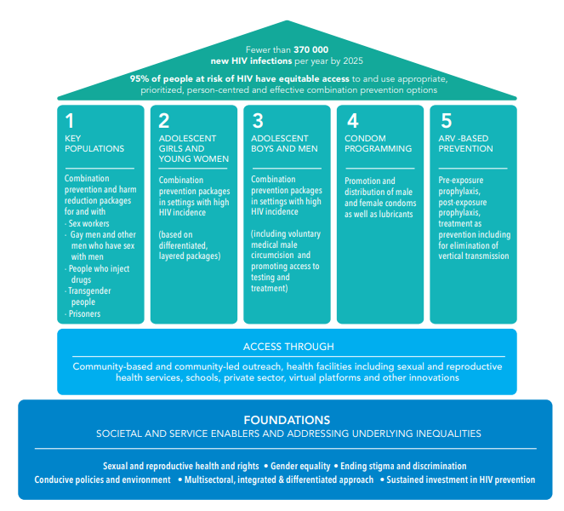
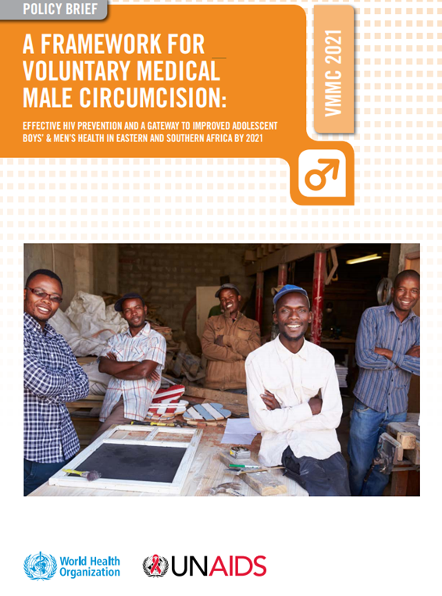

A tale of two strategic shifts - From VMMC to a broader boys’ and men’s agenda
Key shifts
Strategic shift from VMMC as stand-alone pillar towards combination prevention packages for boys and men
Expanded scope of the VMMC program to address other men’s health issue.
Comprehensive package for men and boys including community-based HIV testing, self-testing, ART, condoms, PrEP, PEP, CSE other SRHR, and harm reduction.
HIV Prevention 2025 Road Map
VMMC framework 2021

Slide 3
HIV testing and treatment: It is a case of inequality of access
HIV Testing and Treatment Cascade among WOMEN compared to MEN (AGED 15+ YEARS), 2021 (%)
Men
Women
Source: Global AIDS Monitoring 2021; UNAIDS epidemiological estimates, 2022

Slide 4
HIV testing and treatment: It is a case of widening inequality
Coverage of people receiving ART among WOMEN compared to MEN (AGED 15+ YEARS), from 2010 – 2021 (%)
Intensify test and treat efforts to have men on treatment and close the widening sex gap on ART coverage
Men
Women
Source: Global AIDS Monitoring 2021; UNAIDS epidemiological estimates, 2022

Slide 5
Regional averages unmask real gaps!
Source: Global AIDS Monitoring 2022; UNAIDS epidemiological estimates, 2022

Slide 6
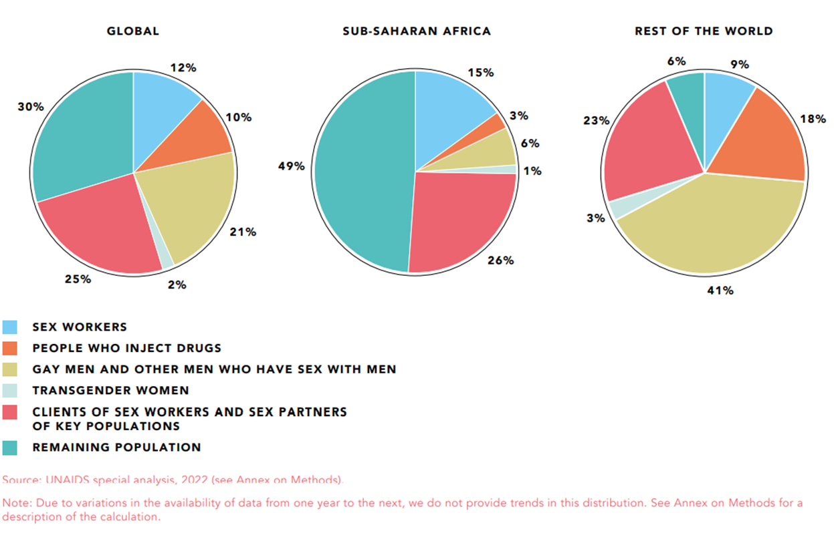
Male key populations bear quite the burden
Distribution of acquisition of new HIV infections by population, global, sub-Saharan Africa and rest of the world, 2021
Source: In Danger: UNAIDS Global AIDS Update 2022 https://www.unaids.org/en/resources/documents/2022/in-danger-global-aids-update

Slide 7
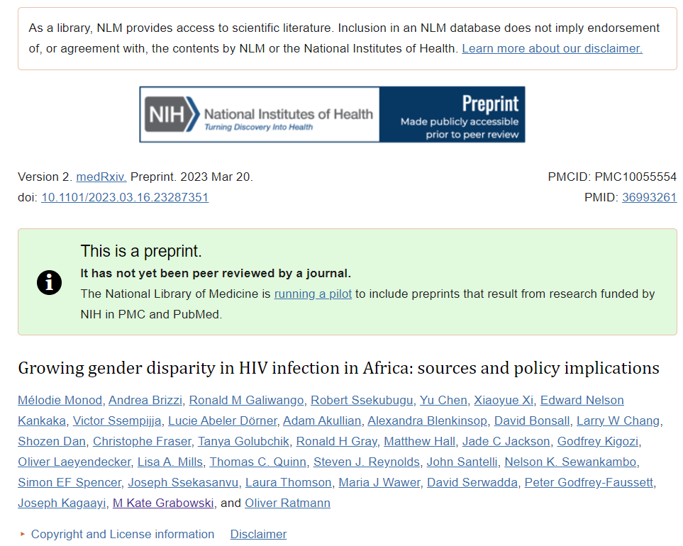
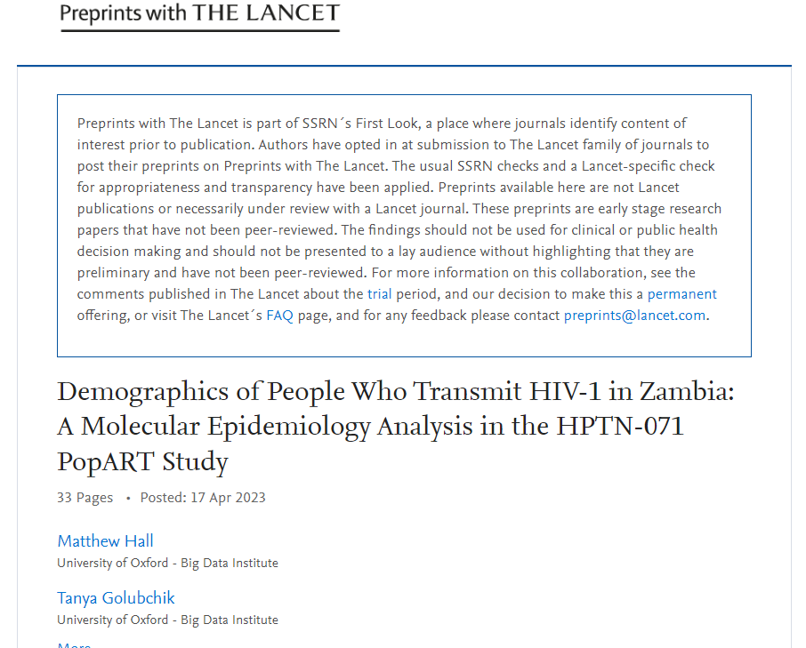
New studies show we need to ask ‘questions of the answers’
Viral suppression and transmission dynamics
Advanced HIV disease and transmission risk
New infections
Increasing majority of new infections arising from men, widening pre-existing gender disparity in HIV transmission
Intra-community transmission
Large majority of transmissions occurred between partners from the same community
Increasing transmission flows
Increasing contribution of transmission flows to AGYW by partners aged 25-40 years
Viral suppression rates were 1.5-2-fold higher among women than men
Pre-prints Mélodie Monod et al., 2023, Growing gender disparity in HIV infection in Africa: sources and policy implications; Matthew Hall et al., 2023 Demographics of People Who Transmit HIV-1 in Zambia: A Molecular Epidemiology Analysis in the HPTN-071 PopART Study
Closing the suppression gap in men would support the reduction of new infections by half among women
Men aged 25-40 should be the focus of treatment for prevention. This emphasis would improve the health of men as well as the health of their families and partners.
Access to HIV testing remains critical to ensure timeous testing following seroconversion and to support re-engagement and linkage to HIV prevention services
HIV services must be inclusive of men to ensure we reach global AIDS targets and end HIV as a public health threat by 2030

Slide 8
Shifting the tide – The TIDE rationale for a focus on men
Phylogenetic transmission dynamics show us who we need to focus on – MEN
Less access to prevention, testing and treatment services.
Close to a 10% gap and difference on 95-95-95
Its all about ending AIDS.
TRANSMISSION
dynamics
INEQUALITY
lens
DATA
gaps
ENDING AIDS

Slide 9

The quickest path to ending AIDS
So many paths but perhaps in line with current realities, we should be looking at the quickest and most sustainable path to ending AIDS
Doing things differently
It means a focus on novel populations (men) and innovations like never before
Switching off the tap!
The quickest path to ending AIDS
We need to attack frontally sources of new infections (men)
Focus on the bottom line
Access, quality and support. Be pragmatic on evidence-based interventions and less on ‘changing behaviour’

Slide 10
How to act? Changing the narrative - Poor health seekers or poor health services?
All men
(n – 1116)
Men needing HIV testing
(n –617)
Men do seek health services. Question is, are health systems designed to receive men?
Of all the men in study, 85% of those offered testing accepted
Among men in need of HIV testing who had attended a health facility, only 7% were offered HIV testing.
Highlights missed opportunities missed opportunities to reach men already engaged with the health system.
Study population
Made a facility visit
Offered HIV test during a facility visit
Tested for HIV during a facility visit
Kathryn Dovel et al., 2021, Frequency of visits to health facilities and HIV services offered to men, Malawi
Deliberate efforts to offer screening services to men should be prioritized as could improve programmatic efficiencies

Slide 11
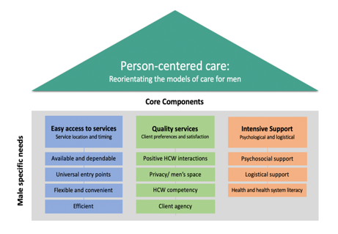
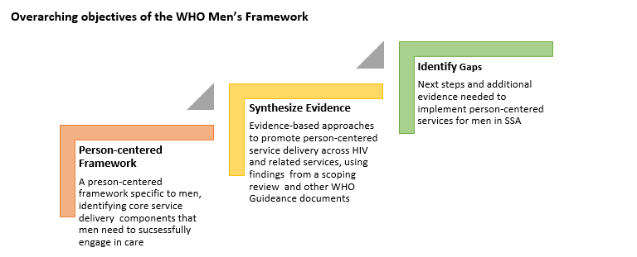
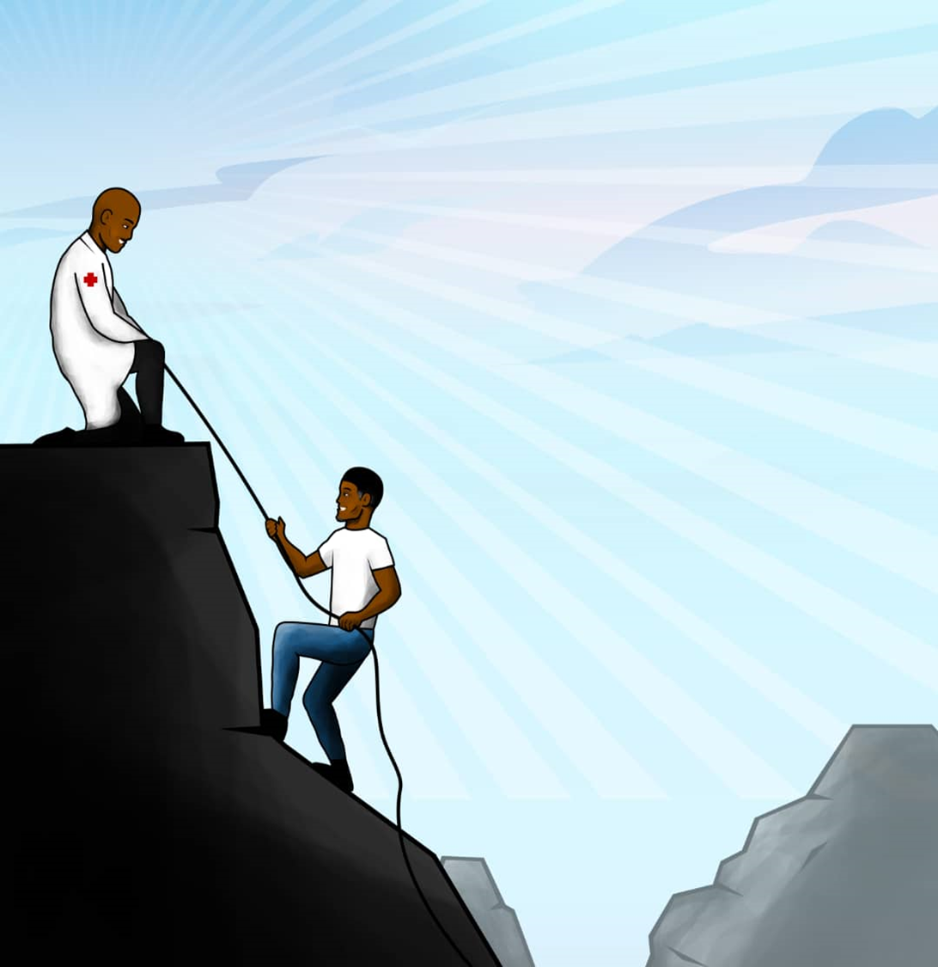
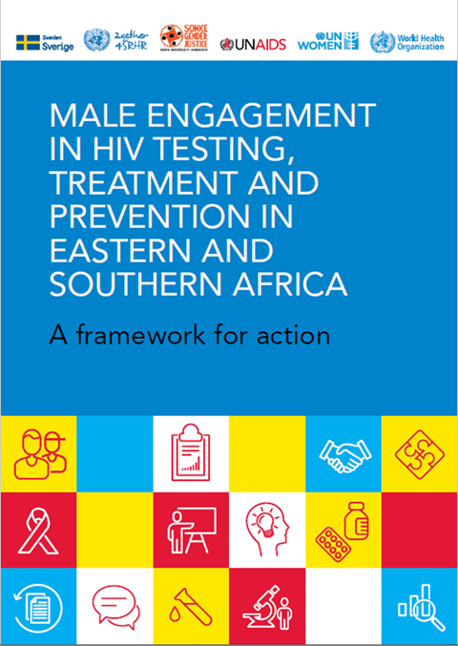
Coming up! A framework for engaging men with evidence-based interventions!
Building from 2021 ESA framework for action
WHO, in collaboration with UNAIDS developing a framework for engaging men with evidence-based interventions
Expected for launch in December.
To move the conversation from the realms of talk to action!

Slide 12
MENHT Workplan 2023
MENHT 2023 (Overseen by co-chairs of MENHT)
Work/activity | Type | Lead | Timeline
Men and HIV: A review and synthesis of evidence-based approaches to reaching men in sub-Saharan Africa | Technical document | Wole Ameyan, Lycias Zembe | Q4 2023 | Draft FINALIZED. In copy editing.
Reaching Men Through Faith Platforms | Implementation brief | Wole Ameyan, Muhammad Jamil | Q4 2024 | Drafted and reviewed. Ongoing for release 2024.
Follow up actions on the UNAIDS PCB thematic on men. | Follow up thematic | Lycias Zembe, Wole Ameyan | Q2 2023 | Done
MENHT webinar series | Webinar series | Lycias Zembe, Afsar Syed Mohammad, Shawn Malone, Anna Grimsrud, Wole Ameyan | Q1-Q4 2023 | Ongoing
MENHT newsletter | Quarterly brief journal | Shawn Malone, Lycias Zembe, Afsar Syed Mohammad, Anna Grimsrud, Wole Ameyan | Q1-Q4 2023 | First issue released
Implementing Men’s framework in country NSPs in ESA | Continuous support for development of NSPs | ALL | Q1-Q4 2023 | Ongoing
Conferences, Advocacy, visibility | As needed. Including men in major conferences, events. | Anna Grimsrud, Lycias Zembe, Wole Ameyan, Afsar Syed Mohammad | Q1-Q4 2023 | Ongoing
Current status

Slide 13
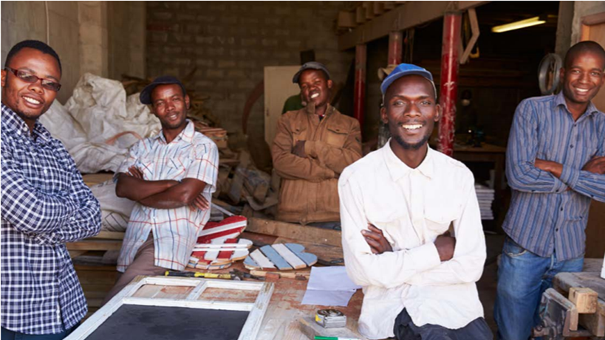
Key strategic issues
Package of services – narrow but meaningfully additive, evidence based and differentiated service package. HIV, STIs, TB…: leveraging the upcoming framework for reaching men
Dedicated funding: For implementation. Prioritized ‘impact funding’ towards identified high burden settings
Learning and coordination platform – the MENHT platform as a steppingstone to facilitating country adaptations
Partnerships and community led advocacy: To leverage combined expertise, resources, and reach to bring men into the forefront of evidence-based programming.
Sensitization rather than capacity building?
Innovation: innovative service delivery models and interventions
Data: implementation research and plugging data gaps
Structural interventions: Dealing with gender-based issues, behaviour change etc. without losing track of the bottom line
Think men, think diverse. Think all men. Masculinities could be toxic but being masculine itself is not. The key is to do away with inflexible definitions that put men in a box.
Think men, think changing the narrative. Shift from the blame game - Reframe the narrative of blame, vectors, stigma. Men do and can go for services but what happens when they get there??

