Slide 1
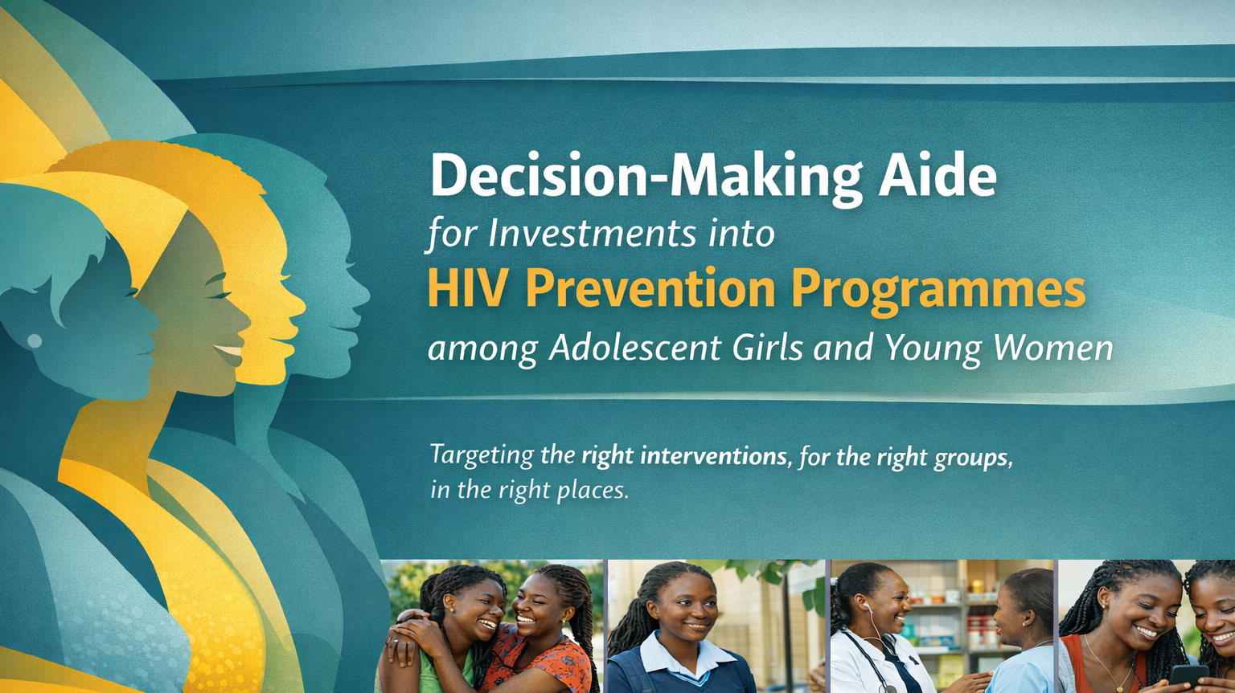
Souad Orhan
Programme Officer, HIV Prevention among young populations, UNAIDS

Slide 2
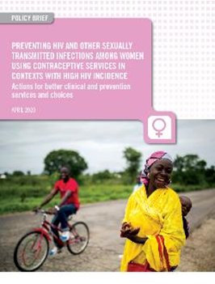
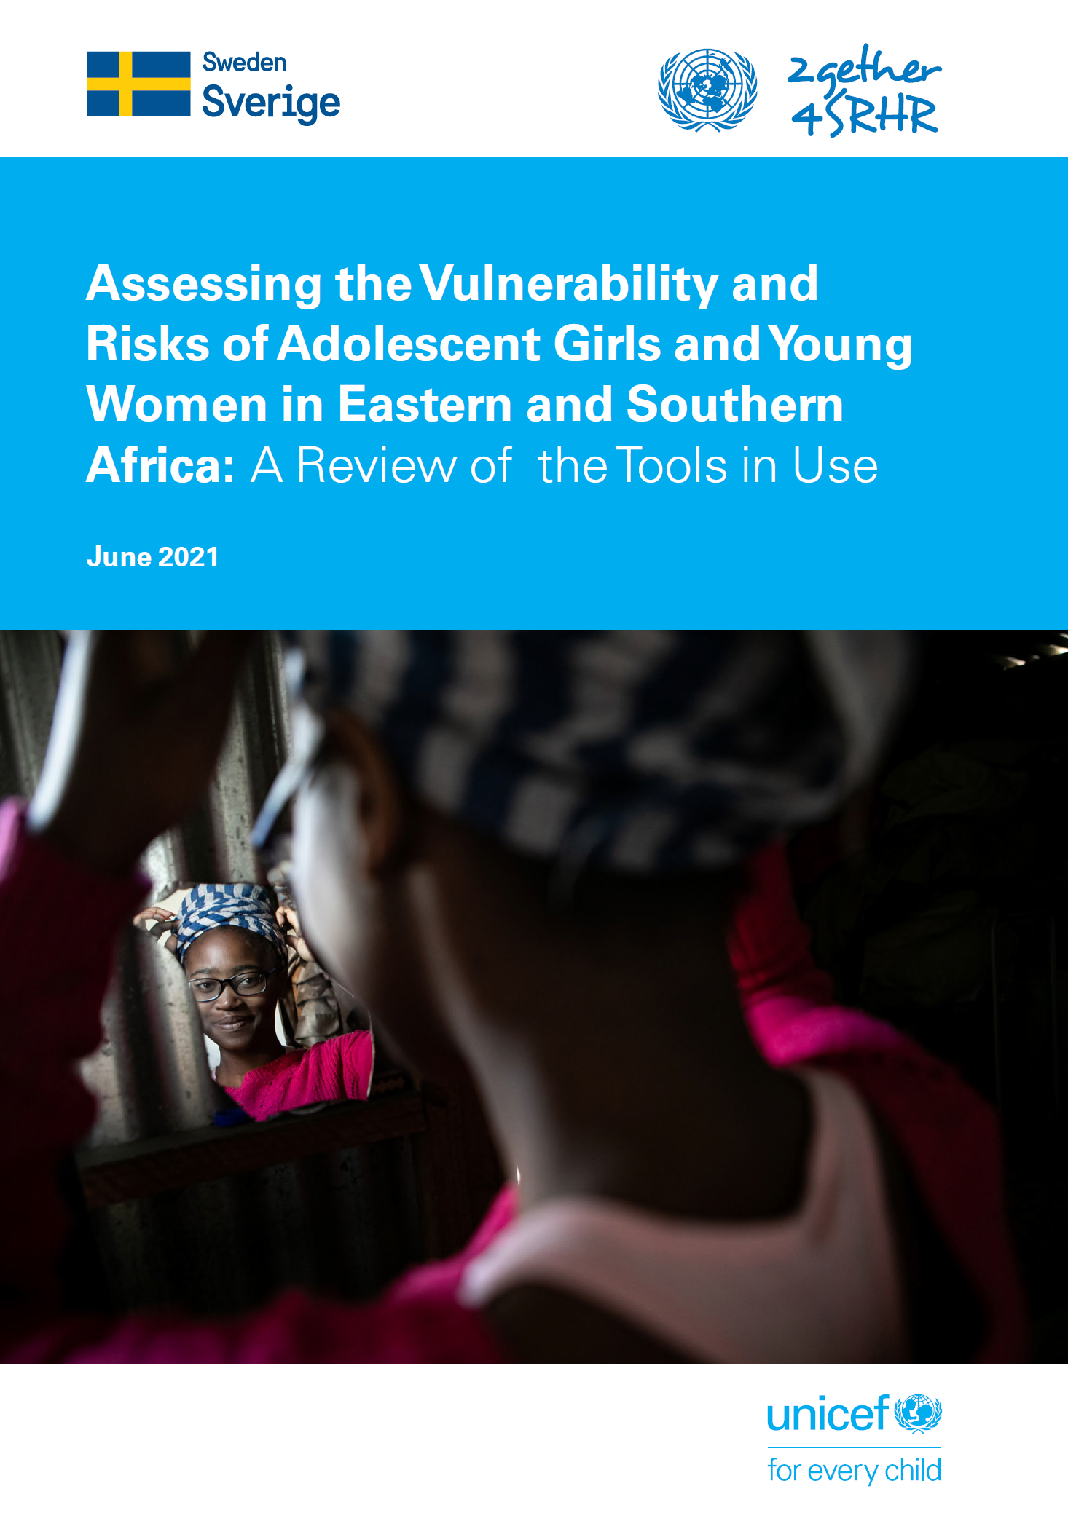
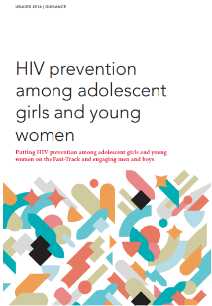
Why this aide, and what is different?
Builds on existing AGYW guidance and tools
Adds a practical prioritisation framework
Helps decide where to focus, for whom, and with what intensity
User Guide for Priority Population size estimation

Slide 3
Prioritisation matrix: Differentiated AGYW Prevention Packages by HIV Incidence Level
 | PART I. HIV programmes (high priority for HIV funding)
HIV incidence | Health sector | Community | Education sector | Multisectoral action & coordination
(by location) | HIV programmes for all priority populations (which also benefit adolescent girls and young women)
Low (less than 0.2%) | HIV testing and treatment services, PEP, prevention of vertical transmission of HIV as part of maternal health, PrEP only for individuals at exceptionally high risk within key populations or discordant couples or in other exceptional individual circumstances Male & female condoms and lubricants, VMMC for adolescent boys and men (in relevant priority countries), basic national HIV information (prevention and treatment), risk reduction communications including new & social media | Action to address HIV-related rights, stigma and discrimination HIV programmes including trusted community outreach platforms for key populations (including AGYW within key populations) | HIV integrated in education policies and curricula. (HIV funds only if not funded through education sector) | Multisectoral HIV policy development and coordination between health, community, education, gender, social protection, financing and other sectors
 | HIV prevention programmes for adolescent girls and young women
Moderate (between 0.2 and 0.5%) All of the above PLUS | HIV/STI risk assessment and risk reduction counselling HIV testing services including self-testing Active condom and lubricant distribution & promotion | Community outreach (interpersonal and virtual) addressing HIV prevention knowledge, risk perception and related social norms, demand generation and outreach services including condoms, self-testing, referrals (focus on popular opinion leaders and high-risk venues frequented by AGYW and men 20-39 at higher risk of HIV) | Dedicated school-based HIV prevention campaigns (knowledge, risk perception, methods, skills, GBV) linked to services (condoms, testing, referrals) in selected schools & tertiary institutions (HIV funds only if not funded through education sector) | Subnational AIDS Office leads regular prevention programme review & problem-solving (that includes programmes with adolescent girls and young women), multi-sectoral coordination and referral systems between different sectors
 | STI testing or syndromic management including as indicator for HIV risk and treatment HIV&STI service integration into family planning, contraceptive services (see separate guidance) Male partner services for testing: multiple approaches, self-testing, ART referral (focus based on HIV/STI risk assessment
High (0.5% and more) All of the above PLUS | Expand the focused action above (in orange) to routine offer | Expand activities above to all AGYW & men 20-39 | Expand activity above to all schools & tertiary institutions | Hold dedicated AGYW prevention programme reviews
 | Availability and provider-initiated offer of PrEP services (focus on AGYW with casual or multiple partners, history of STIs and in transactional sex) | Active PrEP and PEP demand generation and community outreach services (focus on settings frequented by AGYW at higher risk) | Accelerated introduction of comprehensive sexuality education (HIV funds only if not funded through education sector) | Full-time HIV prevention focal point at subnational level to drive action and accountability
 | Expand demand generation and active provider-initiated offer of PrEP services to routine offer for subpopulations with very high HIV incidence exceeding 2% ) | •Structured interpersonal communication on HIV prevention and related social norms, e.g., scalable (shorter) versions of Stepping Stones, SASA!, SHARE (focus on locations with higher prevalence of risk factors) | Keep girls in-school / education assistance (Other funding/ HIV funds only in exceptional cases for most vulnerable AGYW at high risk of HIV) | Social support and asset-building - e.g. safe spaces, mentoring and economic empowerment (focus on most vulnerable AGYW at high risk of HIV)
 | PART II. Other enablers and synergies (typically other funding than HIV)
All locations (not guided by HIV incidence) | Access to integrated SRHR (including family planning, gender-based violence, cervical cancer screening, HPV vaccine and other STI services) including legal and policy support Youth-friendly health systems (trained providers, conducive hours, destigmatised care for adolescent girls and young women …) | Out of school comprehensive sexuality education | Access to primary and secondary education Comprehensive sexuality education (CSE), school health programmes, non-discrimination in schools, intersections to GBV | Social support and economic empowerment of vulnerable adolescents Cash transfers, economic empowerment

Slide 4
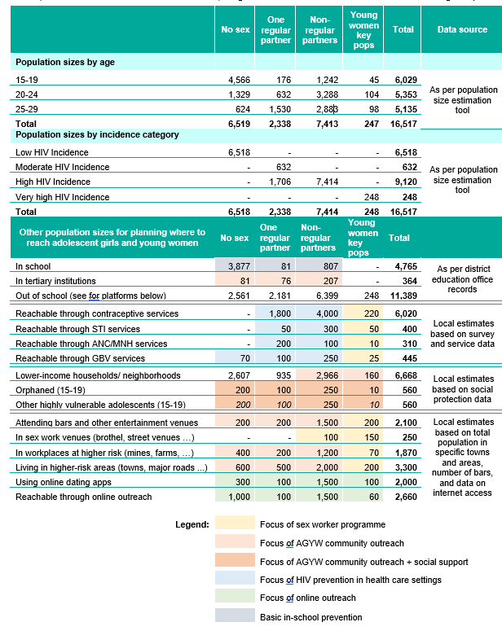
How is the Aide Relevant for GC8?
Identify priority districts, sub-populations and behavioural risk profiles.
Match prevention packages to incidence, risk and vulnerability
Use existing health, SRHR, education, community and online platforms to reach women
Strengthen delivery through coordination, referrals, costing and monitoring

