Slide 1
Estimating Prevention Needs and Setting Targets
Rob Glaubius, Carel Pretorius, John Stover
Avenir Health
October 21, 2026

Slide 2

The Prevention Needs tool in Spectrum
Each year your national HIV estimates team uses the Spectrum software with your latest survey, surveillance, and routine program data to produce official HIV estimates
The Prevention Needs tool was added to Spectrum for the 2026 HIV estimates round that completed earlier this year
This tool estimates need for four HIV prevention components
Here, we will discuss how this tool can be used to provide data elements for your national prevention plans

Slide 3
The Prevention Needs tool consolidates target-setting calculations in one place
Condoms
  Estimate national need for condoms
  Replicates need calculations from the Condom Needs Estimation Tool (CNET)
Voluntary medical male circumcision (VMMC)
  Subnational VMMC targets
  Replicates need calculations in DMPPT
Key populations
  Estimate numbers needing services
Pre-exposure prophylaxis (PrEP)
  Estimate need for PrEP by target population
  Replicates need calculations from PrEP-it

Slide 4
The tool operationalizes targets from the 2026-2031 Global AIDS Strategy
Service | 2030 Target
Condom use Female sex workers Men who have sex with men People with non-regular partners | 90% 75% 75%
Male circumcision coverage Males 15-29 | 90% in VMMC priority countries
Key population services | 90%
PrEP | Varies by population and HIV incidence rate
You can modify these values in the the software if you have different national targets

Slide 5
PrEP targets and needs estimation assumptions using a sliding scale for UNAIDS Target-Setting
Maximum target applies from HIV incidence of 2%
General rationale: the level of HIV incidence in specific sub-populations and their population sizes predict need for PrEP
Description |  | Young people and adults in district with elevated HIV | Key populations
 |  |  | Female sex workers | Men who have sex with men, transgender women | People who inject drugs, prisoners
Maximum target |  | 80% | 80% | 80% | 50%
HIV incidence rate thresholds (apply 2024 HIV baseline incidence rate up to 2030) | Maximum target applies from | 2%
 | Sliding scale for targets starts at | 0.2% | 0%
Other considerations for specific populations |  | Target applied to women 15-24 and 25-49 and men 15-24 and 25-49 separately. Target applied only in SSA where subnational estimates of incidence are available. |  | Apply minimum target of 20% of population size (including for male and transgender sex workers) | In most countries more than half of people who inject drugs use safe injecting equipment, therefore a maximum target of 50% in most settings
Overall minimum threshold* |  | 5 persons on PrEP per estimated new HIV infection in a country
* The overall minimum threshold corrects for uncertainty in sub-population assumptions, in particular population size and HIV incidence rates.

Slide 6
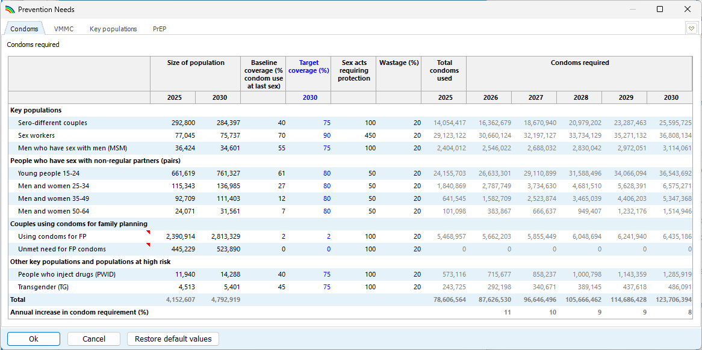
Prevention Needs Tool in Spectrum

Slide 7
Prevention Needs Tool in Spectrum
One tab per component
The VMMC tab is available for countries where VMMC has been prioritized

Slide 8
Prevention Needs Tool in Spectrum
Targets appear in blue and can be edited
Other editable inputs are shown in black
Calculated outputs show in grey and update automatically as edit inputs

Slide 9
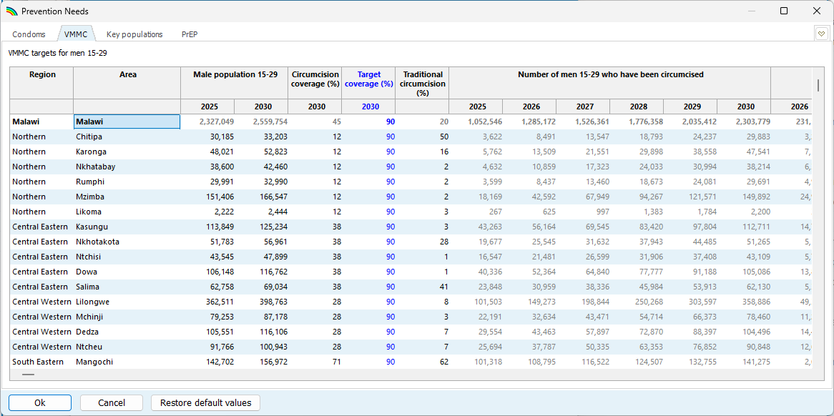
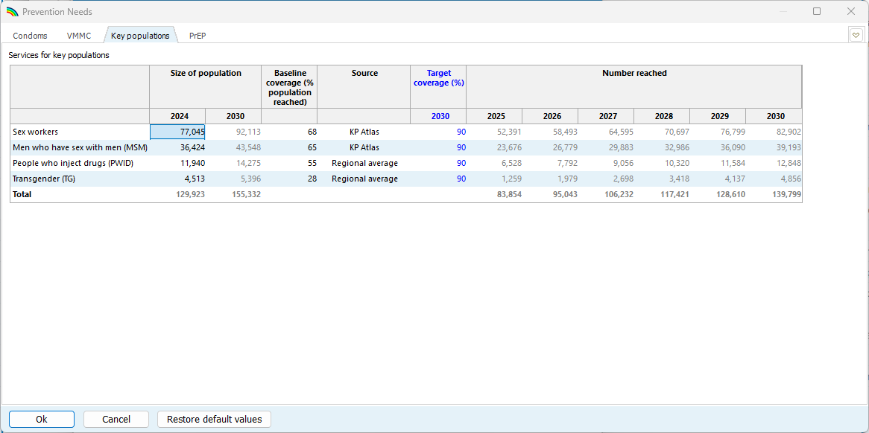
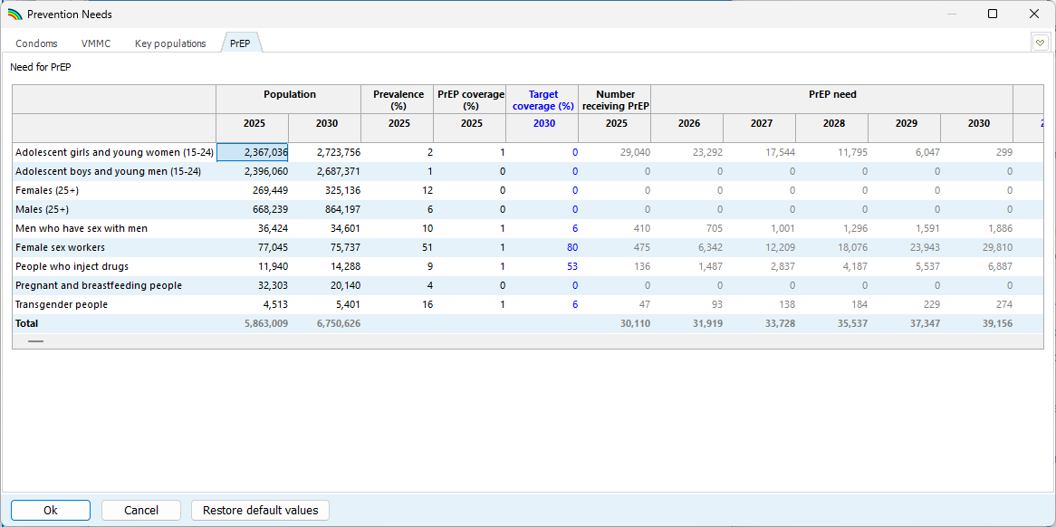
Each tab has similar structure

Slide 10
Data sources
Population sizes in the Prevention Needs tool are drawn from national household surveys, UN Population Division estimates, and your GAM submissions
Baseline coverage levels are also based on national surveys and GAM submissions

Slide 11
Closing reminders
The Prevention Needs tool provides a starting point for estimating need for HIV prevention services
This is automatically filled in with default values, but please compare the inputs to your other data and revise inputs as appropriate
Estimates of need will update automatically as you edit inputs

Slide 12
Thanks for your attention!

Slide 13
Supplementary slides

Slide 14
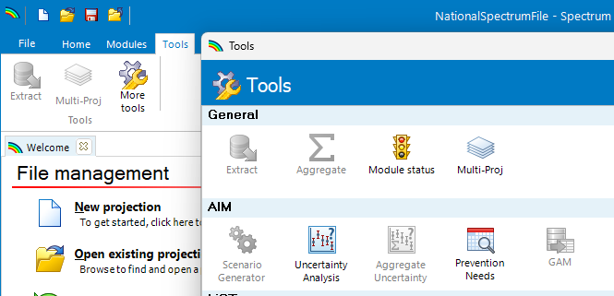
The Prevention Needs tool is available in Spectrum
Open your national Spectrum file
Navigate to the “Tools” tab
Click “More tools” to open the Tools window.
Click “Prevention Needs”

Slide 15
VMMC tab

Slide 16
Key populations tab

Slide 17
PrEP tab

Slide 18
PrEP tab
Scroll right to edit targets and view need for different PrEP methods (daily oral, CAB-LA, LEN, DPV ring)

Slide 19
Sources of Population Sizes
Population Group | Condoms | Key Populations | PrEP | VMMC | Source
Key populations (FSW, MSM, TG, PWID) | X | X | X |  | UNAIDS consensus estimates
Adolescents and youth (ages 15-24) | X |  | X |  | WPP 2024
Men and women 25-34, 35-49, 50+ | X |  | X |  | WPP 2024
Women using condoms for family planning | X |  |  |  | DHS
Women with unmet need for family planning | X |  |  |  | DHS
Men 15-29 by district |  |  |  | X | Naomi
Pregnant and breastfeeding people |  |  | X |  | GAM
Sero-different couples | X |  |  |  | Number of PLHIV from GAM. Proportion in sero-different partnerships estimated from HIV prevalence
X = indicates which models include each population

Slide 20
Sources of Current Service Coverage
Population Group | Condoms | Key Populations | PrEP | VMMC | Source
Condom use at last sex with non-regular partner | X |  |  |  | DHS, PHIA, or regional average
Women using condoms for family planning | X |  |  |  | DHS
Services for key populations |  | X |  |  | UNAIDS’ Key Population Atlas or regional average
Current PrEP use |  |  | X |  | GAM
Male circumcision coverage |  |  |  | X | DHS, PHIA input to 3MC model
Number of VMMC performed |  |  |  | X | GAM
X = indicates which models include each population

