Slide 1
GPC Webinar on prevention tools and guidance for GC8 Condom Programming Tools
Rosemary Mwesigwa Kindyomunda, UNFPA
April 27, 2026

Slide 2
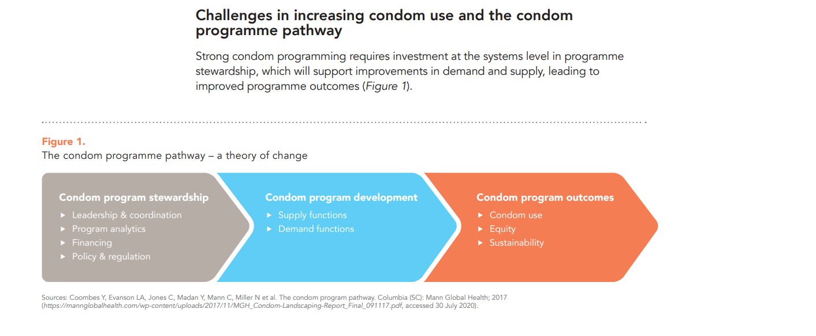
The Condom Programming Theory of Change – addressing the condom program crisis
Weak condom program stewardship/coordination
Inadvertent/subtle deprioritization
Stigmatization at institutional, societal & individual levels
Dependence on external funding, defunding/declining social marketing
Weak M&E systems, lack of data impacts advocacy/decision making
Constraining policy guidance
Over/under estimating condom needs
Weak distribution of free condoms to convenient user points
Weak condom targeting – to low, moderate, high risk groups
Weak commodity tracking/wastage
Lack of investment in demand generation
Weak integration with other prevention options to enhance choice
High unmet need yet low condom uptake
Low, inconsistent knowledge
Free condom threatens transition to sustainable markets
Notes:
44 Technical Assistances
Reinvigoration of Condom Programming Structures
Evidence based condom quantification and fore casting
Strengthened last mile distribution mechanisms
Relevant and effective demand generation
Innovation and sustainability plans included in GC7 Applications
Private sector engagement

Slide 3
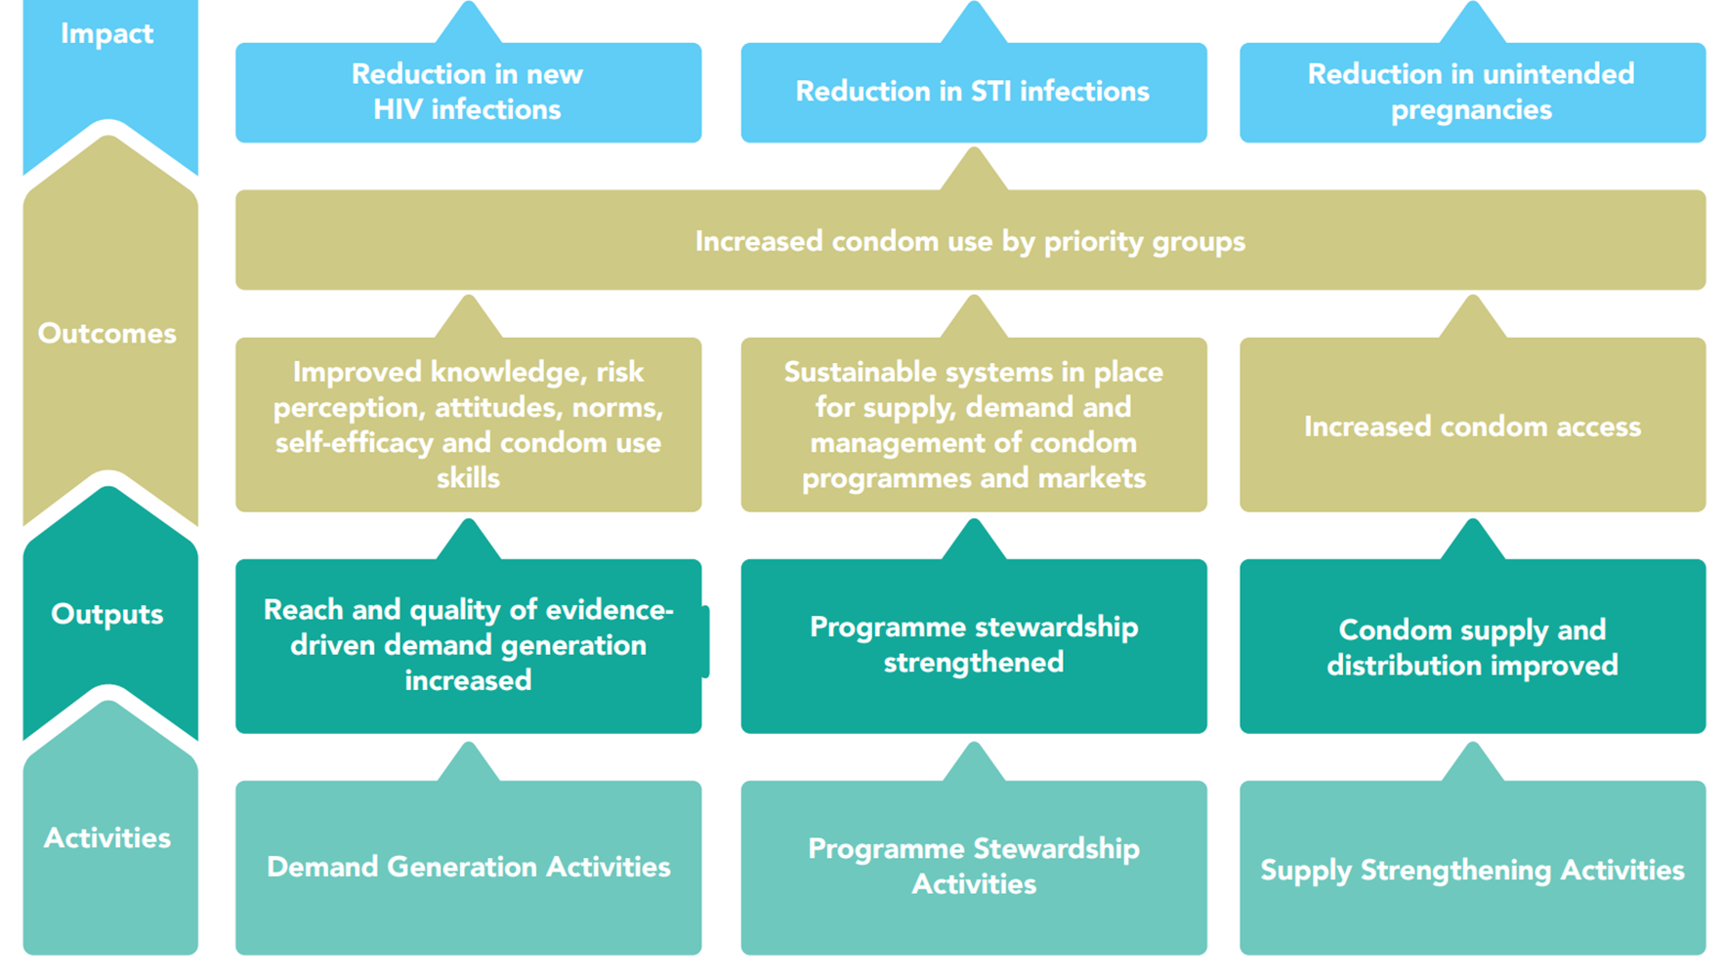

Condom program development and stewardship
Condom program results chain
Notes:
What we mean by program stewardship – it’s actually at the start of a pathway that leads to better program outcomes. Explain how that works.

Slide 4
New Generation Condom Programming – GC6 CSI learning and Programme Tools
Stewardship
Developing Effective Condom Programmes
Condom Programming package
Condom needs estimation toll (CNET)
Condom Needs Estimation Tool User Guide
Institutionalizing CNET – good practice Uganda
Condom Programme Stewardship Evaluation Tool (PSET)
Condom Programme Self-Evaluation Tool (PSAT)
Total Market Approach Playbook for sustainable condom access
Last mile distribution
Condom GIS Hotspot mapping & distribution (Uganda, Zambia)
Delivering condoms to the last mile – commodity real time tracking (Uganda)
KP-led condom micro-planning & last mile distribution (Pakachere, Malawi)
Integrated condom programming thru Community-led SRH/HIV programmes (PACE Uganda)
Demand generation
Toolkit to design condom social media campaign
Virtual demand creation good practice (Zambia)
Private sector Route to Market integrated condom demand creation and distribution (Mozambique)
Breaking barriers – integrated school condom campaigns, Mozambique

Slide 5
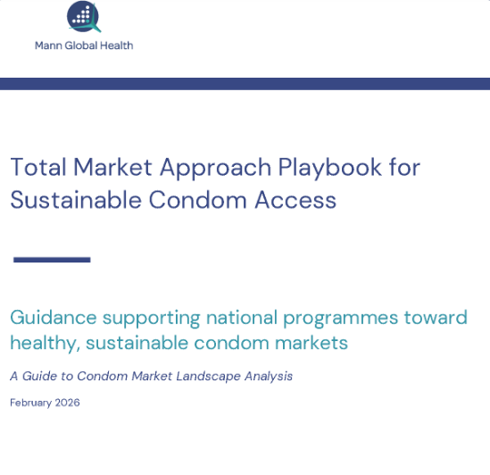
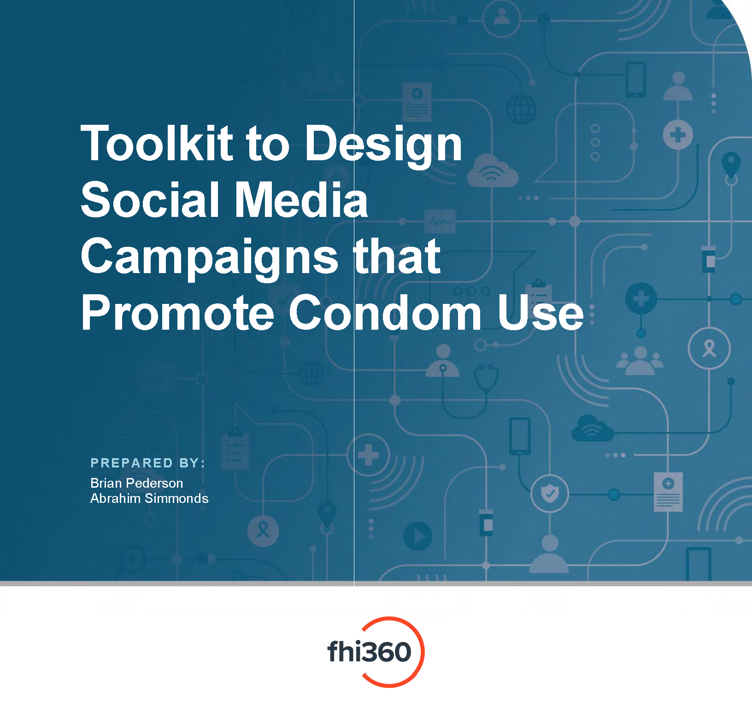
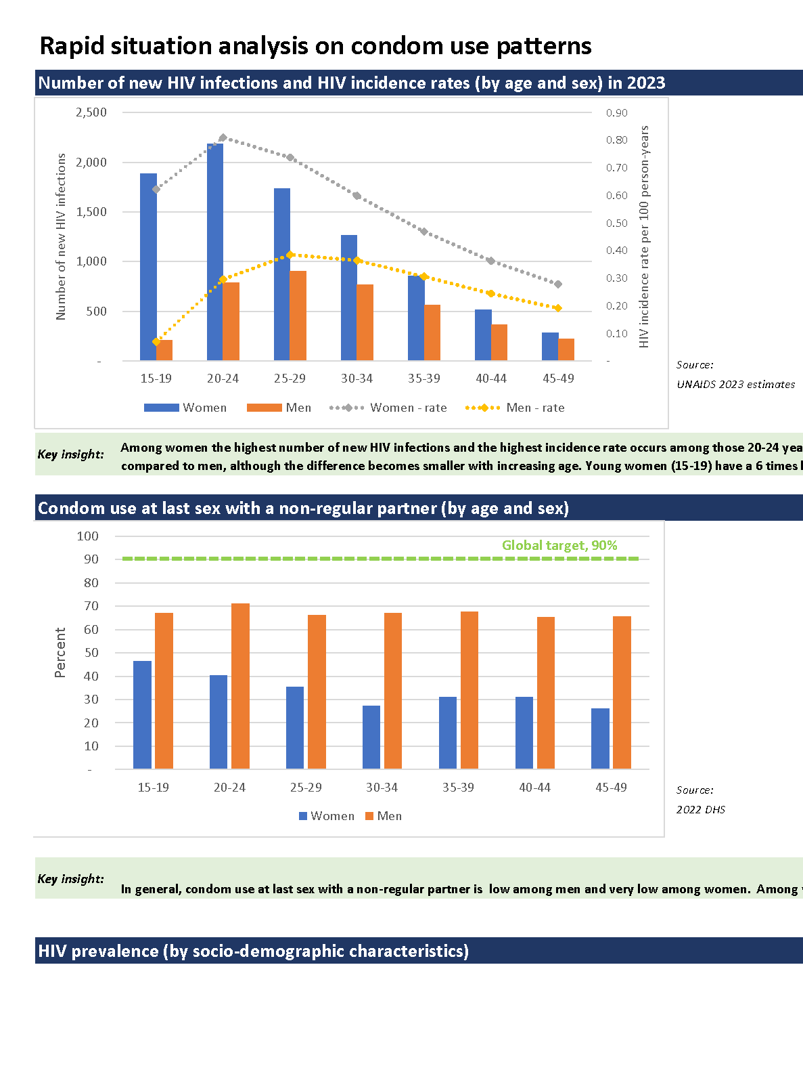
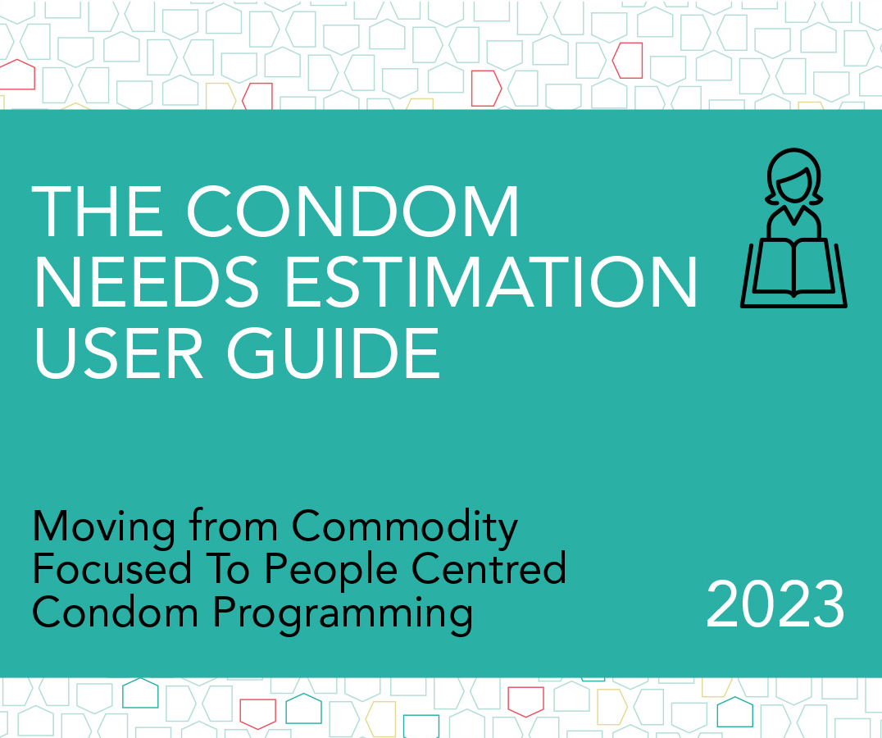

Condom programming – guidance and tools
For overall guidance …
For analyzing condom use …
For developing a TMA
For online demand generation
Rapid situation analysis dashboard
For estimating condom need …
For comprehensive planning
For stewardship planning & evaluation (CSI - GC6)
Notes:
What we mean by program stewardship – it’s actually at the start of a pathway that leads to better program outcomes. Explain how that works.

Slide 6
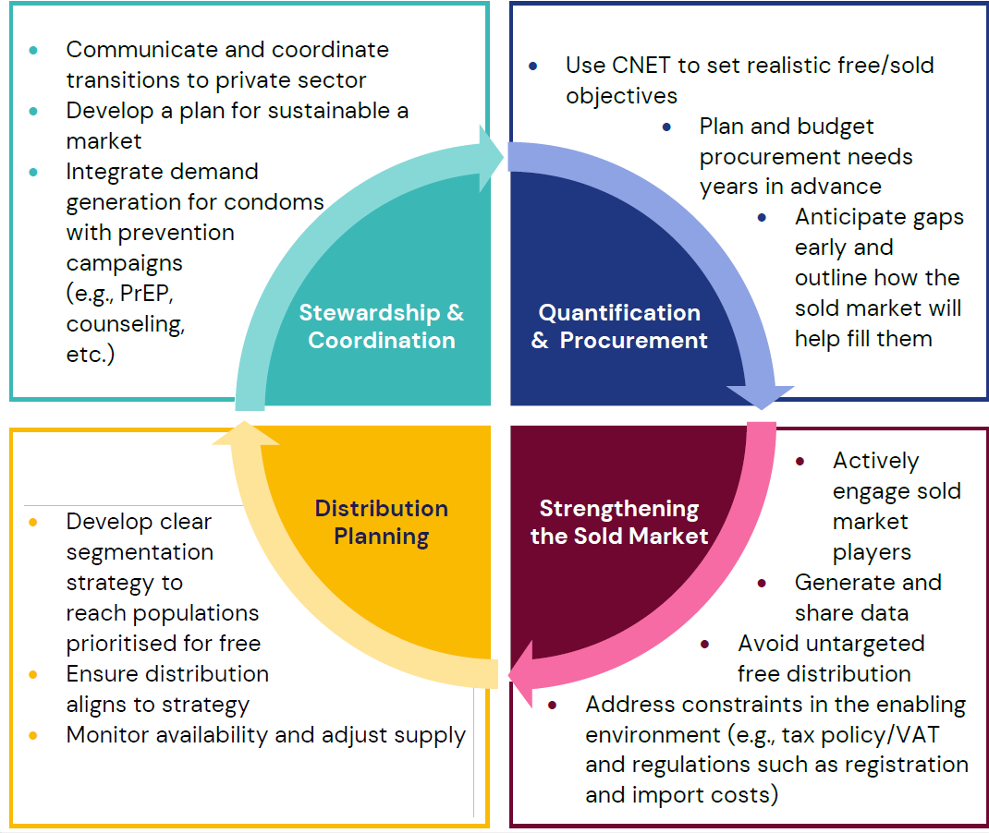
Key considerations for GC 8
Ensure sustained condom access and use
Supply important but only effective if essentials for stewardship and demand are in place
From total market approach playbook

