Slide 1





Understand outcomes for men documented as disengaged
Notes:
Pictures you see here were developed as part of a male-specific counseling strategy, with artwork from a local Malawian artist

Slide 2
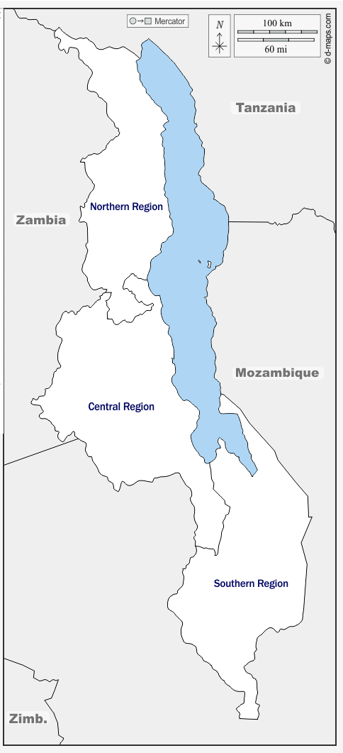
Tracing men identified as disengaged in medical charts
20 high-burden health facilities across Malawi
  All regions and facility types represented
Eligibility Criteria
  Male, ≥15 years
  Live within the facility catchment area
  Documented as defaulted between Aug 2020-Nov 2021
    Defined as one of the 3 categories of default (never initiated, never returned, defaulted)
Tracing activities (Sept 2021 - Dec 2021)
  Conducted by study staff (not routine providers)
  < Three tracing attempts per client
  Ascertain health outcomes using personal medical records or self-report (if records not available)
Facility included

Slide 3
Tracing attempts among men documented as disengaged
Men in need of tracing in the past 12-months (n=1303)
Has a phone | 290 (22%)
Median tracing attempts (IQR) | 2 (1-2)
Successfully traced | 682 (52%)
- Initiated but never returned: 44% successfully traced
Common reasons for failed tracing were:
Inaccurate residential details;
Moved outside facility catchment area;
Temporary travelled.

Slide 4
Outcomes among men successfully traced
53% silent transfer
46% active at study facility,
but poor documentation

Slide 5
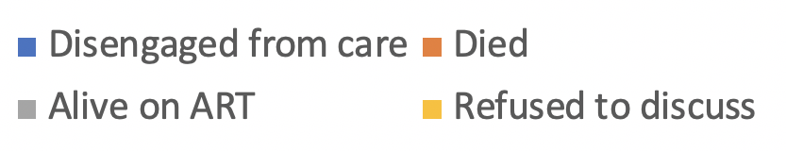
Outcomes among men successfully traced
Notes:
Never returned = 39 people

Slide 6
Explore
Characteristics of men disengaged from care

Slide 7
Characteristics of men who are disengaged
Of those traced, those who met criteria for 1/3 disengagement categories were screened and enrolled into Engage or IDEaL
Completed a survey on:
  Sociodemographics;
  History with HIV services and barriers to care;
  Social support and knowing individuals living with HIV
  Use of other health services
Baseline survey completed: Sept 2021 - Dec 2021
Facility included

Slide 8
Preliminary findings: Characteristics of those disengaged (n=416)
Variable | Total n(%)
Demographics
Median age (IQR) | 39 (35-46)
History with ART Services
Median time since first initiated ART (years, IQR) | 2.5 (2.1-3.0)
Median time outside of care prior to being traced (days, IQR) | 40 (25-52)
Multiple points of disengagement (cyclical engagement) (%, n) | 31% (129)
Know someone who is taking ARVs (friend or family) (%, n) | 81% (337)

Slide 9
Preliminary findings: Characteristics of those disengaged (n=416)
Variable | Total n(%)
Barriers to care
Anticipated stigma/discrimination from status disclosure | 73% (304)
Had not disclosed their HIV status to anyone besides their spouse | 41% (171)
Talk to someone in social network about HIV/ART at least once per month | 68% (283)
Never talk to someone about HIV/ART | 27% (112)
Believe most people experience side-effects from ART | 52% (216)
Mobility (>14 days spent away from home in the past 12-months) | 32% (133)
Median nights away from home (IQR) | 60 (30-90)

Slide 10
Travel among disengaged men
32 in-depth interviews with highly mobile men
13,14
Travel is essential
  28/32 traveled for income generation
  “If we have enough maize [food], we settle [stay home]”
Travel is unpredictable
  Work travel is highly vulnerable to whims of employer
  “when you are doing piece jobs you don’t have complete freedom to travel when you want”
Men make major efforts to stay in care
  28/32 brought meds while traveling, but 23/28 ran out while away
  Attempts: Guardian refills (11/32), emergency refills (8/32), returning from travel just to refill (8/32)
Men try to come back to care
  Immediately re-engaged upon return (8/23)
  Attempted to return but failed (6/23)
  Cited fear of provider treatment as their primary reason to avoid re-engaging (4/23)
Those who did come back experienced poor/rude treatment from providers (12/21)
  Largely due to previously missing appointments
  “… it was an abusive system of welcoming”

Slide 11
Facilitators to engagement
(40 in-depth interviews with men living with HIV)
Most frequently mentioned
Often mentioned
Occasionally mentioned
Rarely mentioned
Positive facility experiences
Follow-up by healthcare workers
Exposure to successful ART clients
Spouse
Support
Male support
Rarely mentioned
Occasionally mentioned
Increased access and decreased stigmatizing visits
Often mentioned
Initiation
Most frequently mentioned
Retention

Slide 12
Preliminary findings: Characteristics of those disengaged (n=416)
Variable | Total n(%)
Barriers to care
Anticipated stigma/discrimination from status disclosure | 73% (304)
Had not disclosed their HIV status to anyone besides their spouse | 41% (171)
Talk to someone in social network about HIV/ART at least once per month | 68% (283)
Never talk to someone about HIV/ART | 27% (112)
Believe most people experience side-effects from ART | 52% (216)
Mobility (>14 days spent away from home in the past 12-months) | 32% (133)
Median nights away from home (IQR) | 60 (30-90)
Facility visits impact…

Slide 13




Summary
Over 30% of men believed to be disengaged are actively in care
Defaulters comprise the majority of men who disengage from care (as compared to those never initiated or initiated and never came back)
  Most are mid- to older-age men (35-46years of age)
  Extended time on ART (2-3 years)
Men want to stay on ART, but barriers to care are significant
  Highly mobile population
  Fear of stigma (and therefore avoiding disclosure and social support)
  Fear of side effects
  Negative provider responses and other barriers to re-engagement

Slide 14
Remaining questions
Cyclical reality of care amidst massive social/familial pressures:
Length of time outside of care;
# of events outside of care (cyclical engagement)
What support is needed to reduce length of
disengagement?
Not Initiated
Not returned
Disengaged

Slide 15

Acknowledgements
Collaborating Institutions:
  Division of Infectious Diseases, David Geffen School of Medicine, UCLA
  Partners in Hope Medical Center, Lilongwe, Malawi
  Department of Global Health, School of Public Health, Boston University, Boston, USA.
Funding: Supported by The Bill and Melinda Gates Foundation, NIMH Grant No. R01-MH122308, Fogarty Grant No. K01-TW011484
Acknowledgements: We gratefully acknowledge the clients and providers who participated in multiple studies, and the Partners in Hope Care and Treatment Team who continue to make this body of research possible

Slide 16
References
UNAIDS 2021 epidemiological estimates.
Esacove AW. Good sex/bad sex: the individualised focus of US HIV prevention policy in sub-Saharan Africa, 1995-2005. Sociol Health Illn 2013; 35: 33–48.
Poulin M, Dovel K, Watkins SC. Men with Money and the “Vulnerable Women” Client Category in an AIDS Epidemic. World Dev 2016; 85: 16–30.
Dovel K, Balakasi K, Gupta S, Mphande M, Robson I, Khan S, Amberbir A, Stilson C, van Oosterhout JJ, Doi N, Nichols BE. Frequency of visits to health facilities and HIV services offered to men, Malawi. Bulletin of the World Health Organization. 2021 Sep 1;99(9):618.
https://dhsprogram.com/methodology/Survey-Types/SPA.cfm
Balakasi K, Nichols BE, Mphande M, Stillson C, Khan S, Kalande P, Robson I, Sanena M, Ng’ona K, van Oosterhout JJ, Dovel K. Individual-and Facility-Level Factors Associated with Facility Testing among Men in Malawi: Findings from a Representative Community Survey. Diagnostics. 2021 Jun;11(6):950.
Choko A, Balakasi K, Mphande M, Phiri K, Coates T, Kulich M, Robson I, van Oosterouht J, Sweat M, Hoffman R, Dovel K. Engaging Men Through HIV Self-Testing with Differentiated Care to Improve ART Initiation and Viral Suppression among Men in Malawi (ENGAGE): a study protocol for a randomized control trial. ClinicalTrials.gov Identifier: NCT04858243
Dovel K, Balakasi K, Hubbard J, Phiri K, Nichols B, Coates T, Kulich M, Robson I, Phiri S, Long L, Hoffman R, Choko A. Identifying efficient linkage strategies for HIV self-testing (IDEaL): a study protocol for an individually randomized control trial. ClinicalTrials.gov Identifier: NCT04858243
Nichols BE, de Nooy A, Benade M, Balakasi K, Mphande M, Rao G, Claassen CW, Khan S, Stillson C, Doi N, Dovel K. Facility-based HIV self-testing strategies may substantially increase number of men and youth tested for HIV in Malawi: results from a data-driven individual-based model. medRxiv. 2021 Jan 1.
unpublished. Thorp M, Balakasi K, Mphande M, Robson I, Khan S, Stillson C, Doi N, Nichols B.E, Dovel K. “Factors associated with men attending health facilities in Malawi: a community-representative survey”
Quinn C, Kadengye DT, Johnson CC, Baggaley R, Dalal S. Who are the missing men? Characterising men who never tested for HIV from population-based surveys in six sub-Saharan African countries. J Int AIDS Soc. 2019;22(10):e25398.
Ante-Testard PA, Benmarhnia T, Bekelynck A, et al. Temporal trends in socioeconomic inequalities in HIV testing: an analysis of cross-sectional surveys from 16 sub-Saharan African countries. The Lancet Global Health. 2020;8(6):e808-e818.
Sileo KM, Fielding-Miller R, Dworkin SL, Fleming PJ. What Role Do Masculine Norms Play in Men’s HIV Testing in Sub-Saharan Africa?: A Scoping Review. AIDS and Behavior. 2018;22(8):2468-2479.
Odeny TA, Penner J, Lewis-Kulzer J, Leslie HH, Shade SB, Adero W, Kioko J, Cohen CR, Bukusi EA. Integration of HIV Care with Primary Health Care Services: Effect on Patient Satisfaction and Stigma in Rural Kenya. AIDS Res Treat. 2013;2013:485715. doi: 10.1155/2013/485715. Epub 2013 May 7. PMID: 23738055; PMCID: PMC3664481.
Yeatman S, Chamberlin S, Dovel K. Women's (health) work: A population-based, cross-sectional study of gender differences in time spent seeking health care in Malawi. PLoS One. 2018 Dec 21;13(12):e0209586.

Slide 17
EXTRA

Slide 18
Malawi Health Service Guidelines: Annual recommendations by sex and time required
5
Notes:
5-17 visits, equating to 19-55 hrs

Slide 19
Rapidly Changing HIV Program in Malawi
Free ART program begins; largely confined to city hospitals.
Widespread decentralization and start of Option B+
Free ART program expands to district hospitals.
Dolutegravir-based regimen
as first-line ART Treatment
6-month dispensing for stable clients
Universal treatment
ART rollout
1990s
2002
2004
2006
2008
2010
2012
2016
2019
2020
HIV testing rollout
Testing offered free-of-charge and available in rural clinics
HIVST policy introduced
PMTCT is implemented in all antenatal clinics
Index testing prioritized
HIV testing available in urban centers- Oral swab test
Rollout of rapid blood tests
Testing available at government hospitals

Slide 20
Engage study flow
Enrollment and individual randomization (n=700)
Facility-based ART (fbART; n=350)
Home-based ART (hbART; n=350)
Visit 1. Facility escort and facility navigation to a nearby facility for facility-based ART initiation (30 day supply)
Visit 1. Home-based ART initiation (30 day supply) + male-specific male-specific, client-centered counseling
Visit 2-6. Standard of care facility-based ART distribution
Visit 2-3. Monthly home-based ART visits (30 day supply each visit) and male-specific, client-centered counseling
Visit 4. Facility escort and facility navigation to a nearby facility to join the facility-based ART program. Standard of care facility-based ART distribution
Visit 5-6. Standard of care facility-based ART distribution
Primary Outcomes: 6-month viral suppression
Secondary Outcomes: % initiate or re-engaged in ART; % retained at 12-months; % with unwanted disclosure

Slide 21
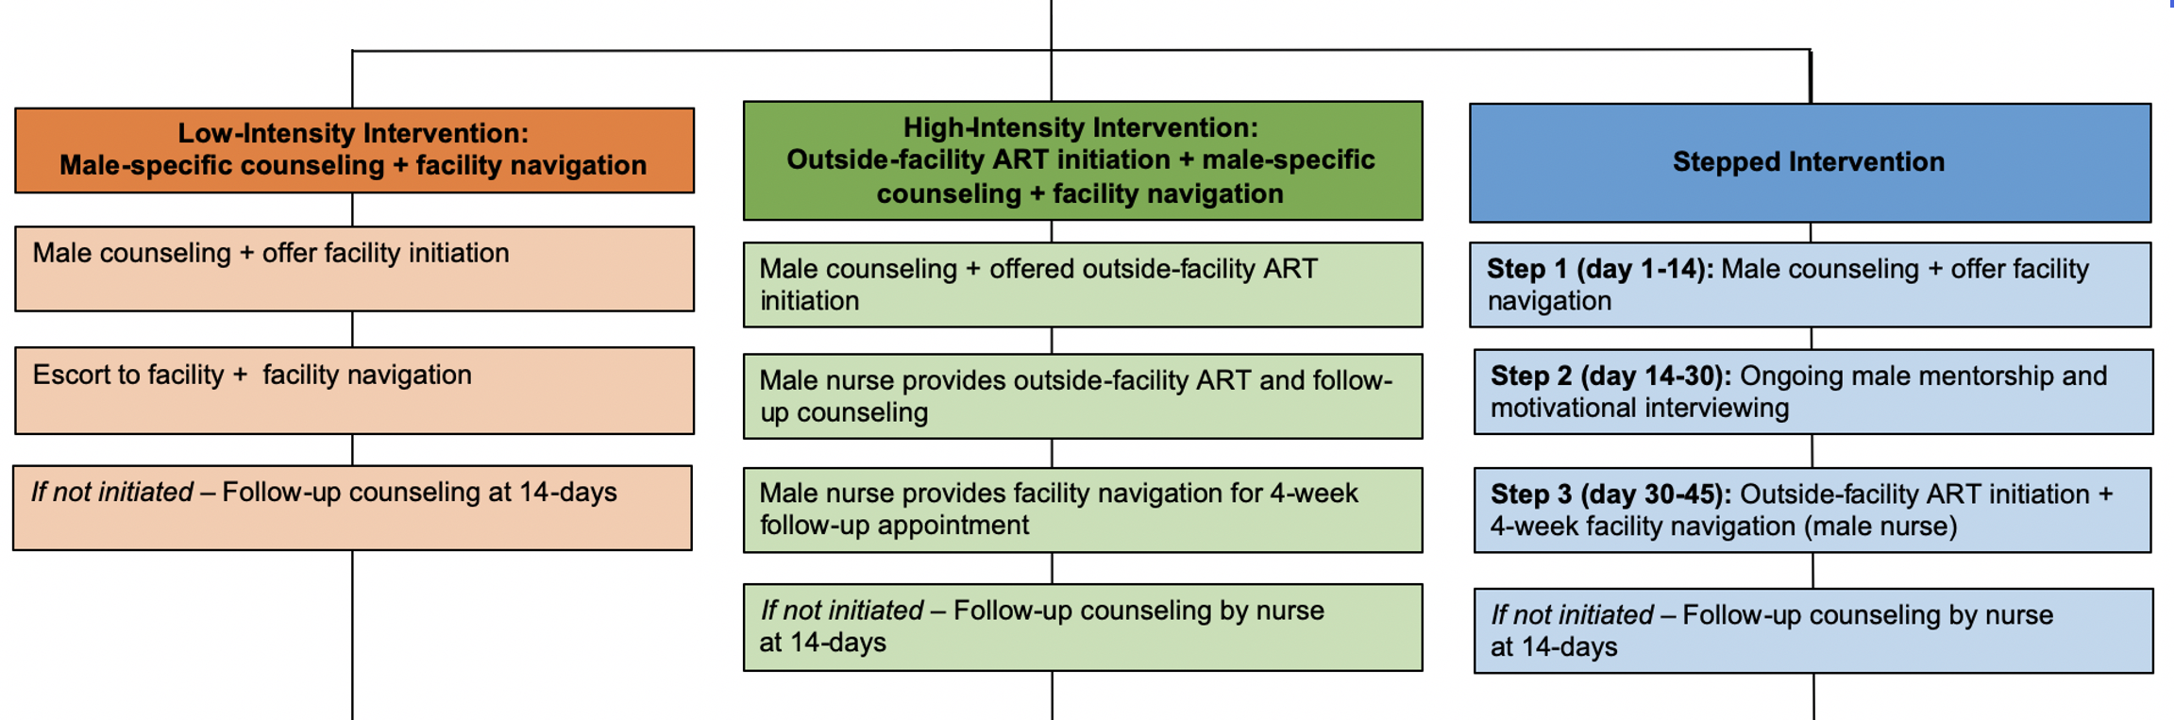
IDEaL study flow
Engage
Individual randomization (n=543)
Name
Aim: Test interventions to improve ART engagement
Intervention details
Location: 10 health facilities in Malawi
Status: Enrollment ongoing
Timeline: Data collection complete early 2024
Primary Outcomes: % 6-month retention
Secondary Outcomes: % (re-)initiated; % with adverse events

