Slide 1


Examining Age and Gender profiles of Viraemia:
The increasing Role of Men in African populations with high Antiretroviral Therapy Coverage
Andrea Brizzi
Imperial College London, UK
MENHT Webinar Series #10
Breaking Barriers and Bridging Gaps
22 August 2024

Slide 2
Background: UNAIDS suppression goals
Incidence reductions are crucial to achieve epidemic control by 2030.
Increasing suppression rates among PLHIV reduces transmission risk.
95-95-95 targets assess extent of suppression across subgroups of PLHIV and are used to direct interventions.
These do not account for the size of underlying population and of PLHIV, which are crucial to determine contributions to the burden of HIV and viraemia.
Subgroups of PLHIV...
… accounting for sizes

Slide 3
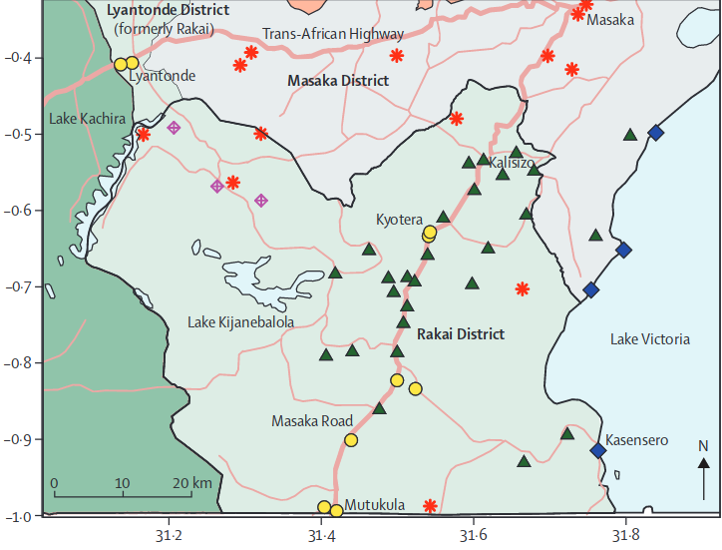
The Rakai Community Cohort Study
Population based, observational study.
4 survey rounds (2013 to 2019),
2 community types: fishing, inland
Population pyramids: atypical, typical
UTT start: 2013 , 2016.
Testing for HIV and unsuppressed viraemia
(>1,000cp/mL).
Endpoint: prevalence of HIV and viraemia,
age-gender profiles of population with HIV, and with viraemia.
Chang, 2016
Population census prior to each survey round.
Notes:
This talks focuses on data from the Rakai Community Cohort Study, a population based, observational study in Southwestern Uganda.
Here, we focus on 4 survey rounds, spanning from 2013 to 2019. Communities within the region are either hyperendemic fishing communities, or inland communities.
The population structures differ: fishing communities are characterised by a large proportion of working age individuals, while inland communities have expansive population pyramids more typical of Eastern Africa. Fishing communities received priority interventions, with scale up of UTT starting at the end of 2013, which was extended to inland communities in 2016.
Here, we analyse results from HIV tests and tests for unsuppressed viraemia, defined as having more than 1000 copies per ml.
The endpoint is the estimation of prevalences of HIV and viraemia, as well as the characterization of the age- and gender- profiles of the population living with HIV, and living with viraemia.
We manage to capture population sizes thanks to a census which is carried out prior to each survey round.

Slide 4
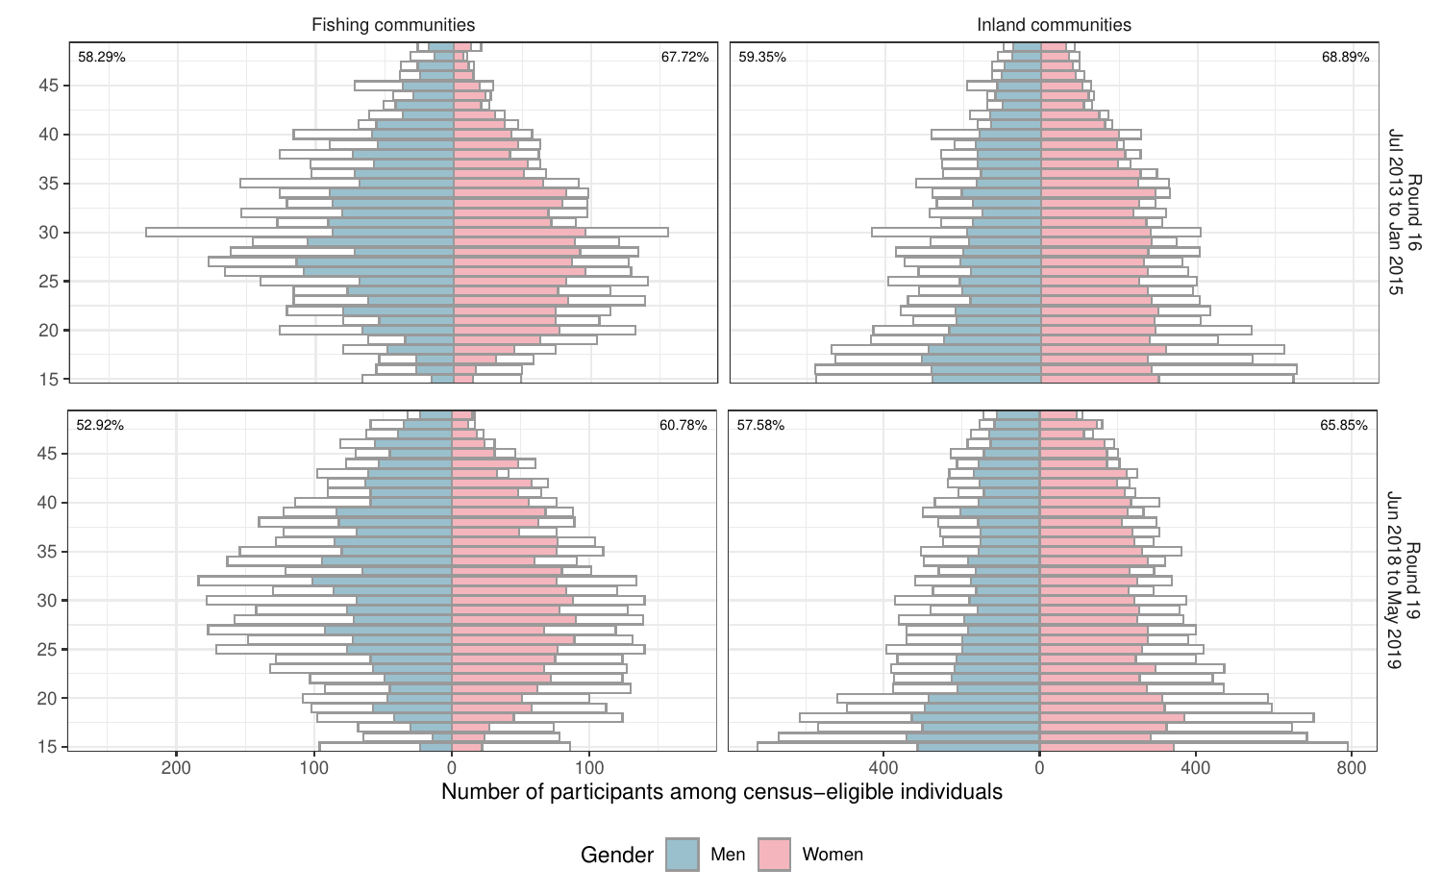
Population and participation
Chang, 2016
Notes:
This talks focuses on data from the Rakai Community Cohort Study, a population based, observational study in South Western Uganda.
Here, we focus on 4 survey rounds, spanning from 2013 to 2019. Communities within the region are either hyperendemic fishing communities, or inland communities.
The population structures differ: fishing communities are characterised by a large proportion of working age individuals, while inland communities have expansive population pyramids more typical of Eastern Africa. Fishing communities received priority interventions, with scale up of UTT starting at the end of 2013, which was extended to inland communities in 2016.
Here, we analyse results from HIV tests and tests for unsuppressed viraemia, defined as having more than 1000 copies per ml.
The endpoint is the estimation of prevalences of HIV and viraemia, as well as the characterization of the age- and gender- profiles of the population living with HIV, and living with viraemia.
We manage to capture population sizes thanks to a census which is carried out prior to each survey round.

Slide 5
Study numbers: participation and VLs
37,695 individuals participated at least once with
participation rates averaging 66.5% in women and 57.9% in men.
6,709 (17,8%) participants tested positive at least once.
13,849 of 13,928 (99.4%) of viral loads were measured.
Participation higher in women, high viral load coverage
Notes:
The raw numbers are summarised in this slide. Over 4 survey rounds, we censused about 80,000 unique individuals, 46% of which participated at least once. Of the participants, about 18% tested positive at least once, and for almost all visits of individuals with HIV we have viral loads.
To note, is a higher participation among women, and very high coverage of viral load.

Slide 6
Methods: age and gender profiles
We estimated age and gender specific prevalences of HIV and unsuppressed viraemia with a Bayesian binomial model, smoothing over age and accounting for non-participation.
We accounted for underlying population sizes by estimating age and gender profiles of people with HIV/viraemia.
These describe the distribution of burden, or the contributions of each population subgroup to the total number of people with HIV/viraemia.
Notes:
We estimated the age and gender specific prevalences of HIV and unsuppressed viraemia with a Bayesian model with binomial likelihood. The model smooths prevalences over age groups and accounts for non-participation to obtain estimates at the population-level.
To account for underlying population sizes, we estimated age and gender profiles of people with HIV and viraemia. These describe the distribution of the burden, or rather the contributions of each population subgroup to the total number of people with HIV or viraemia.

Slide 7
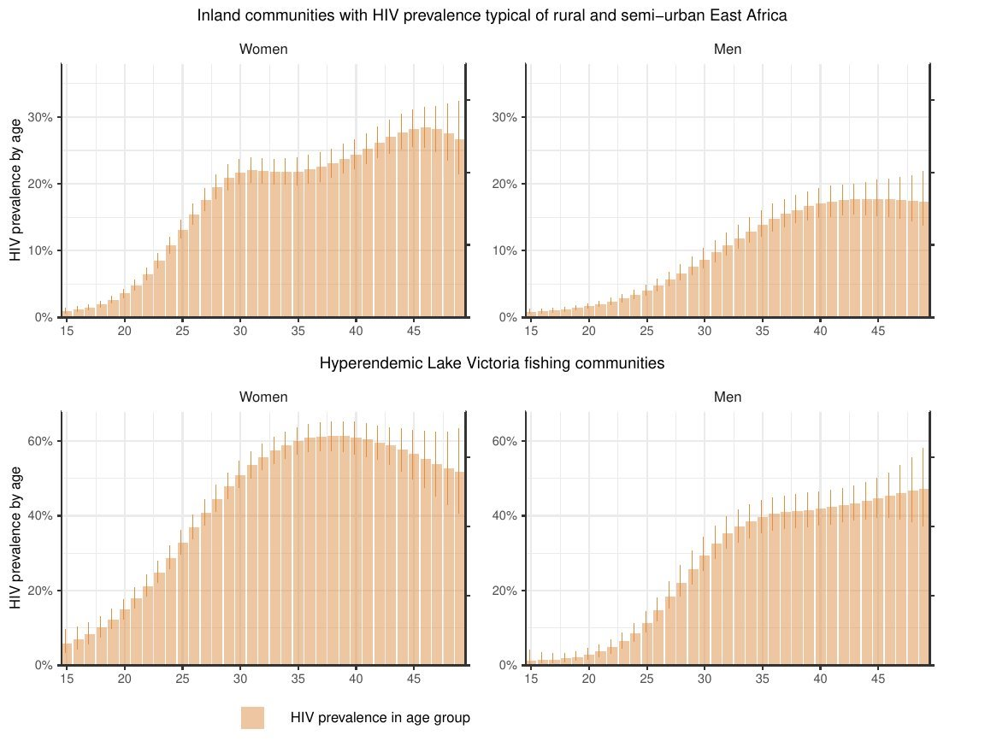
Inland
HIV prevalence
INLAND
 | Women | Men
2014 | 15.2% (14.6-15.9) | 9.5% (8.8-10.3)
2019 | 13.9% (13.2-14.6) | 7.8% (7.1-8.5)
FISHING
 | Women | Men
2014 | 44.3% (42.3-46.4) | 29.6% (27.7-31.5)
2019 | 40.5% (38.6-42.5) | 26.5% (24.7-28.5)
Fishing
Notes:
To exemplify the difference between the two measures, it is better to start with HIV burden.
Here, we report the age and gender specific prevalence of HIV in inland communities, on the top row, and in hyperendemic fishing communities, in the bottom rows.
On the left, we report the results for women, and on the right, the results for men.
As tipically the case in Eastern Africa, prevalence is higher in women, and increasing with age.
However, this measure doesn't take into account population pyramids, and the fact that more men live in fishing communities than women.

Slide 8
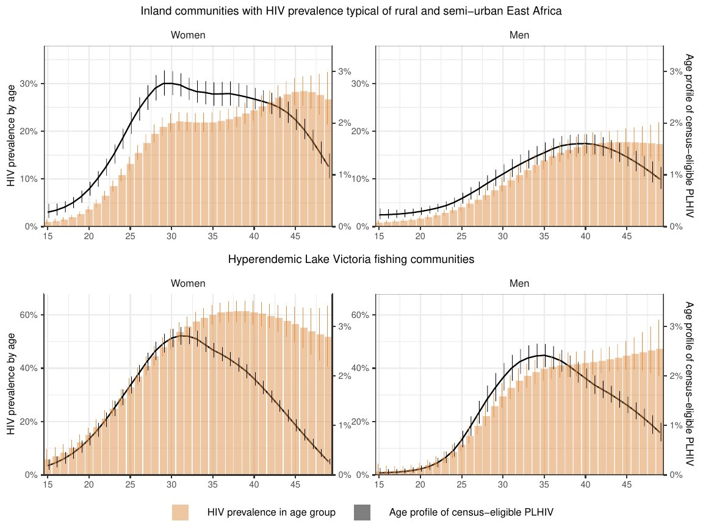
Inland
Inland
HIV prevalence
HIV burden profile
INLAND
 | Women | Men
2014 | 15.2% (14.6-15.9) | 9.5% (8.8-10.3)
2019 | 13.9% (13.2-14.6) | 7.8% (7.1-8.5)
FISHING
 | Women | Men
2014 | 44.3% (42.3-46.4) | 29.6% (27.7-31.5)
2019 | 40.5% (38.6-42.5) | 26.5% (24.7-28.5)
Fishing
Fishing
Notes:
As such, when we compute the contributions of each age- and gender- group, here in the black line, we notice that although prevalence is highest in individuals aged 40-50, there are more PLHIV who are 25 to 40 years old.
This is especially pronounced in fishing communities, composed mainly of working age individuals.
An additional finding of our study reveals the aging of population with HIV: the estimated median age of PLHIV increased over the study period by at least 2 years in each of these strata.

Slide 9
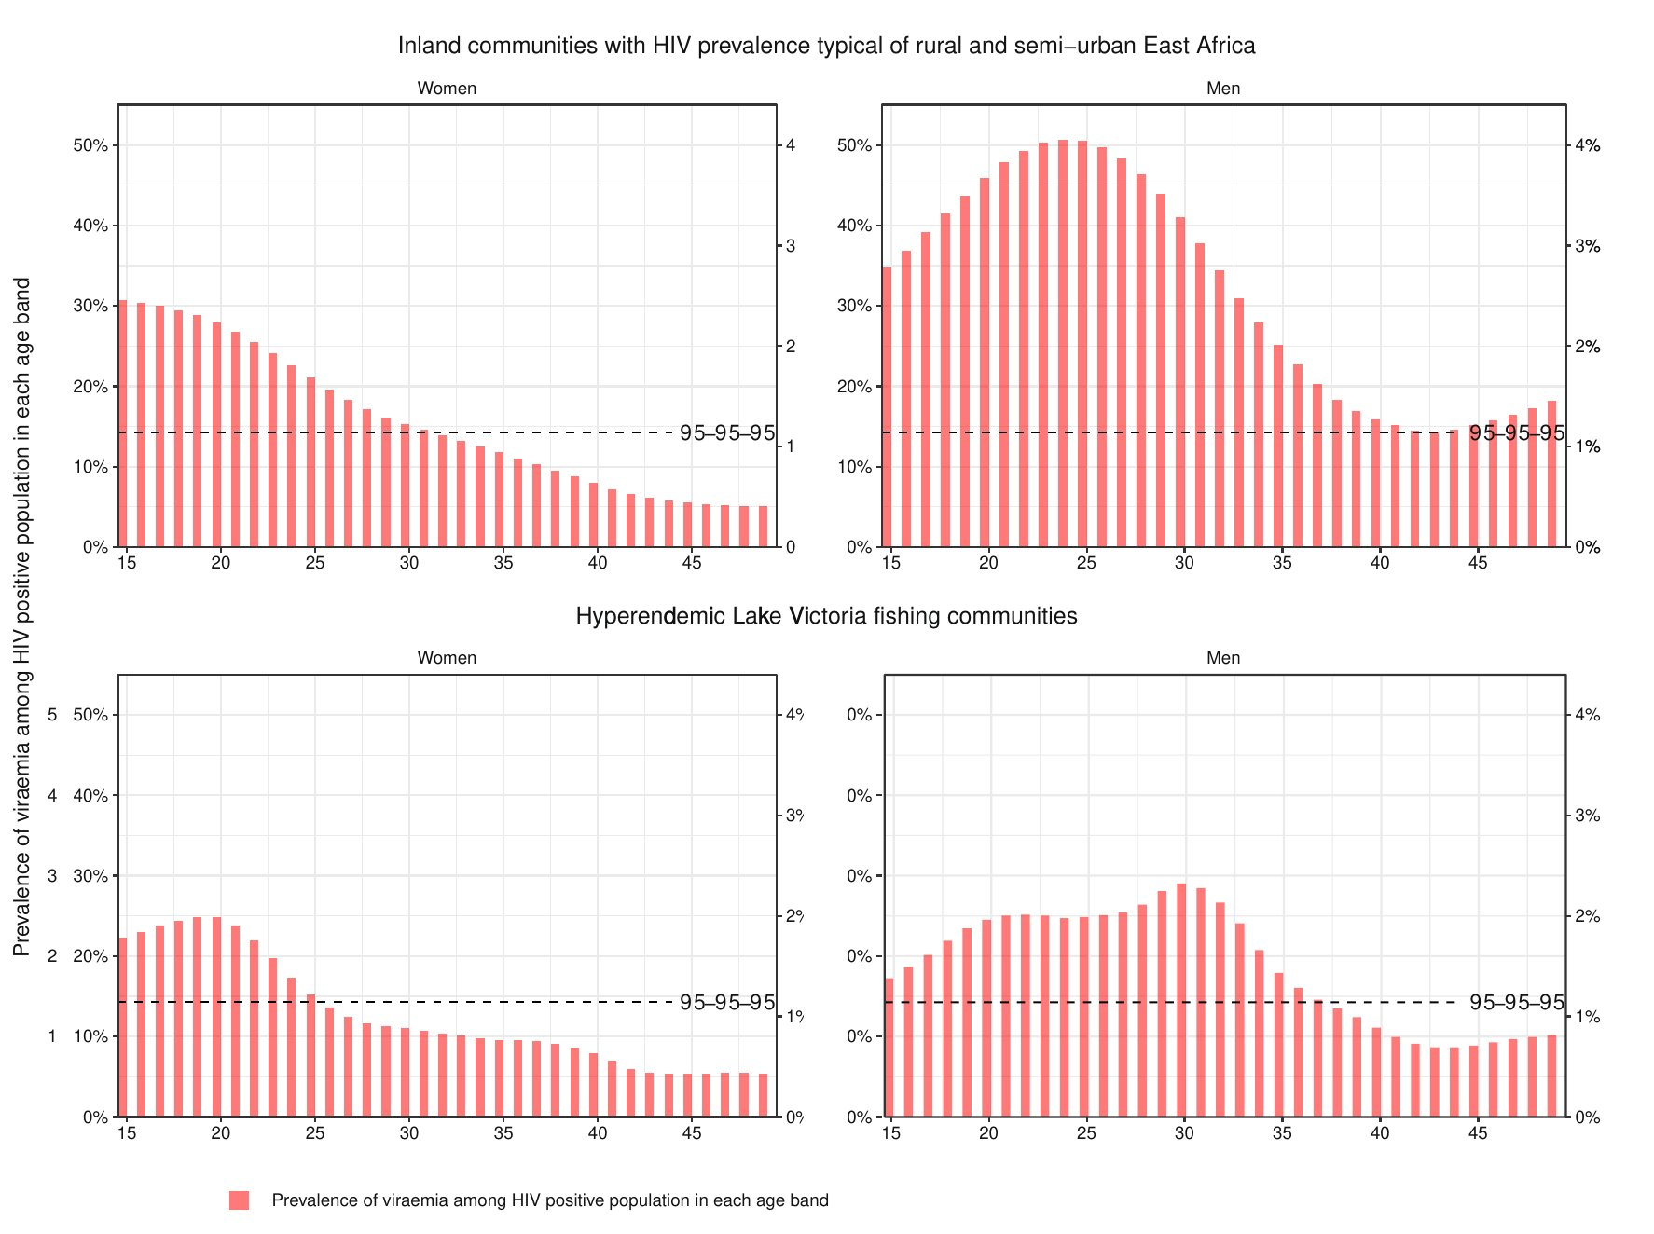
Inland
Inland
Prevalence
of viraemia
INLAND
 | Women | Men
2014 | 34.7 (32.3-37.1) | 50.7% (46.5-54.8)
2019 | 13.2% (11.5-15.0) | 26.3% (22.2-30.8)
FISHING
 | Women | Men
2014 | 44.0% (40.9-47.0) | 64.7% (60.8-68.5)
2019 | 11.4% (9.3-13.8) | 18.1% (14.5-22.3)
Fishing
Fishing
Prevalence of viraemia among PLHIV in each age band​
Notes:
An analogous and more relevant argument can be made for rates of unsuppressed viraemia.
These rates are shown in the red bars, again for inland and fishing communities, and for women in the left, and men on the right.
For reference, the 14% suppression rate implied by the 95-95-95 targets is shown as a dashed line, revealing that across all communities and genders, individuals aged 25 or less are not reaching the UNAIDS targets.
Further, rates of unsuppressed viraemia are lower in priority-targeted fishing communities, and in women.

Slide 10
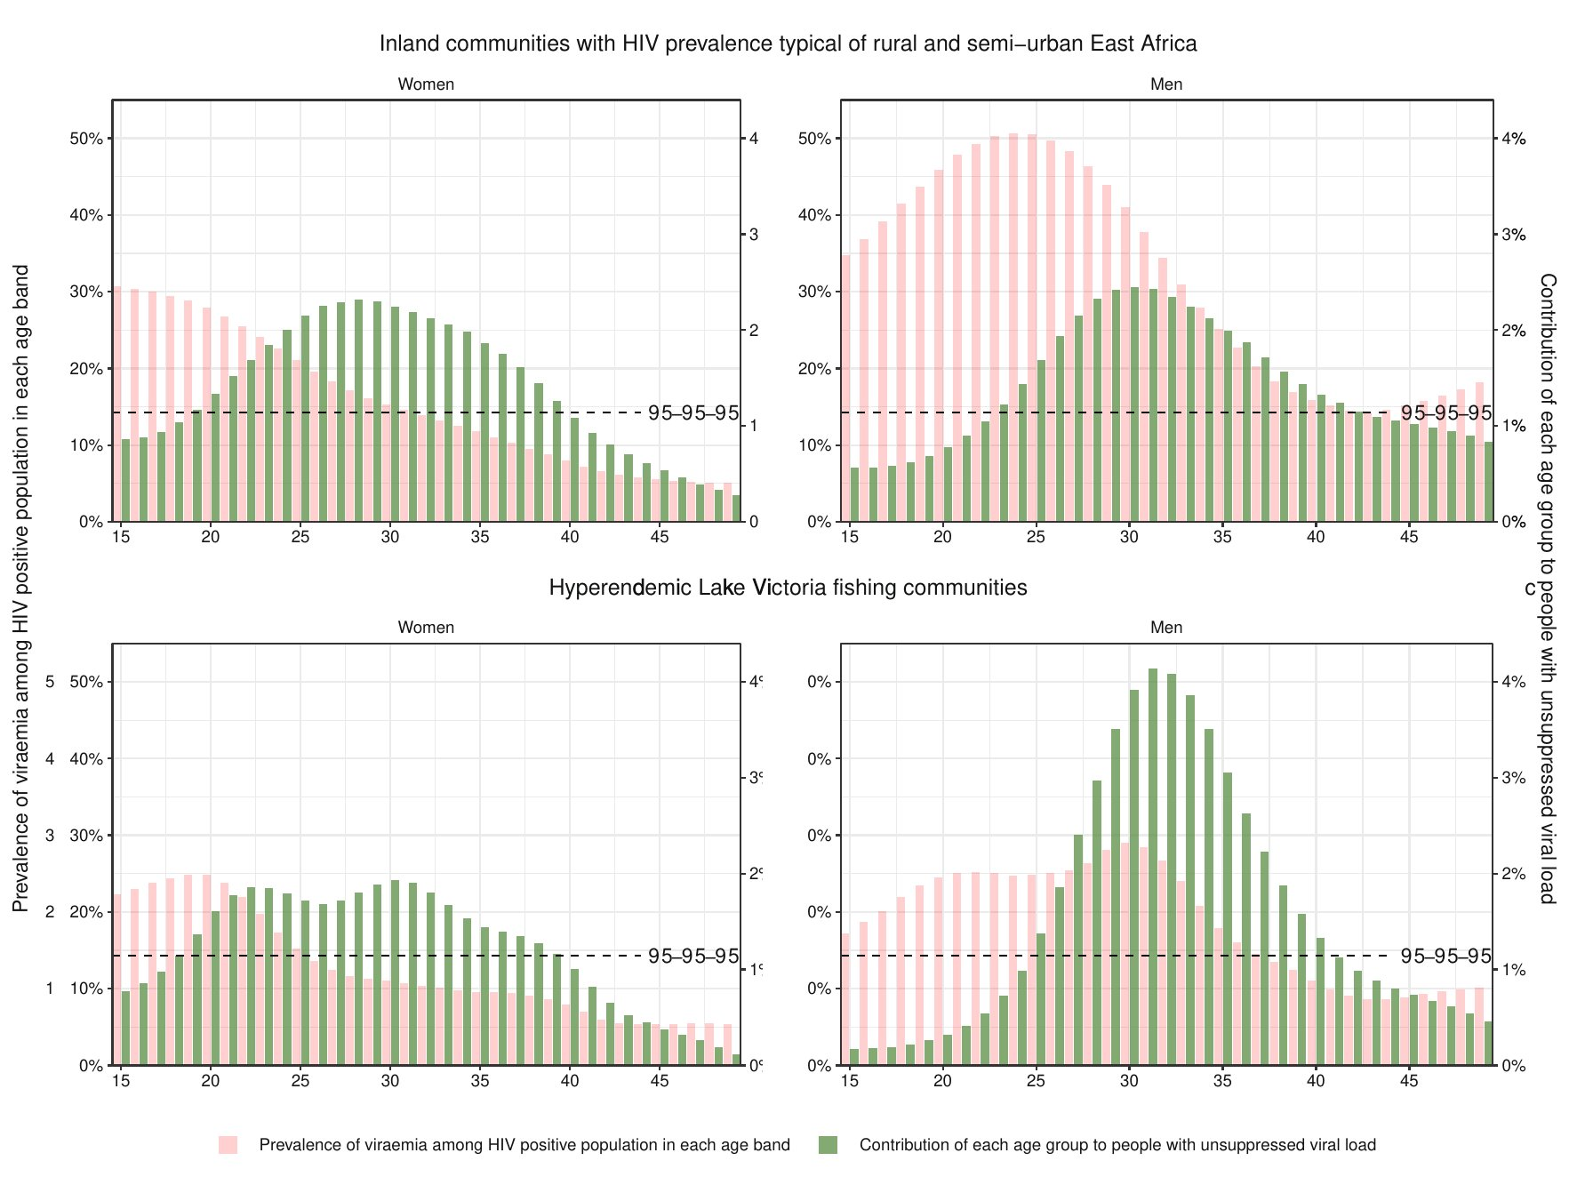
Inland
Viraemia burden profile
Inland
INLAND
 | Women | Men
2014 | 34.7 (32.3-37.1) | 50.7% (46.5-54.8)
2019 | 13.2% (11.5-15.0) | 26.3% (22.2-30.8)
FISHING
 | Women | Men
2014 | 44.0% (40.9-47.0) | 64.7% (60.8-68.5)
2019 | 11.4% (9.3-13.8) | 18.1% (14.5-22.3)
Fishing
Fishing
Prevalence of viraemia among PLHIV in each age band​
Notes:
But again, when we overlay the age and gender profile for individuals with viraemia the learning outcomes are different.
The contributions to the burden of viraemia are way smaller for individuals aged less than 25 as opposed to individuals aged 25 or more.
Further, men now contribute to more than 50% of the burden of viraemia. This proportion is even larger in fishing communities, where men represent more than half of the resident population.
It is also important to note that fishing communities still have a higher population viral load than inland communities, meaning the fraction of all individuals who have unsuppressed viraemia is larger.

Slide 11
What is viraemia telling us?
Although suppression rates among PLHIV are highest in fishing communities, there are more individuals with unsuppressed viraemia there as a proportion of the entire population.
Following scale-up of UTT there are more men with unsuppressed virus than women with unsuppressed virus
Although suppression rates are lowest among younger individuals, there are more individuals aged 25-34 than individuals aged 15-24 with unsuppressed viraemia.
95-95-95 targets should not be the main statistics used to prioritize interventions across subpopulations.
Notes:
To summarise our findings and our conclusions, we ask: what is viraemia telling us?
… rather, age and gender profiles for the burden of HIV and viraemia provide a more direct too to analyze which population subgroups contribute the most to HIV and viraemia burdens.

Slide 12


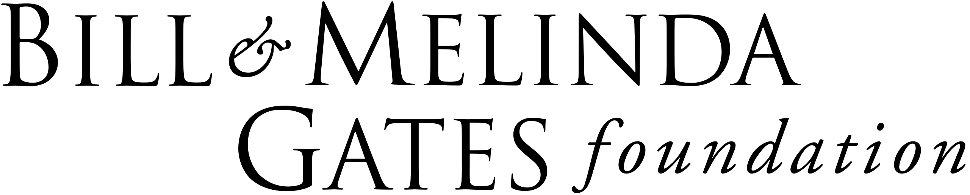




Acknowledgements
Rakai Health Sciences Program
Joseph Kagaayi
Robert Ssekubugu
Ronald M. Galiwango
Godfrey Kigozi
Gertrude Nakigozi
Fred Naguloda
Johns Hopkins University
M. Kate Grabowski
Steven J. Reynolds
Larry W. Chang
Oliver Laeyendecker
Thomas Quinn
Joseph G. Rosen
Imperial College London
Oliver Ratmann
Alexandra Blenkinsop
Mélodie Monod
Big Data Institute
Lucie Abeler-Dörner
Christophe Fraser
David Bonsall
Research Sponsors
Bill and Melinda Gates Foundation
National Institutes of Health
National Institute of Mental Health
National Institute for Allergy and Infectious Diseases
U.S. Centers for Disease Control and Prevention
EPSRC
RCCS Study Participants, Staff and Investigators!
https://pubmed.ncbi.nlm.nih.gov/38712115/

