Slide 1
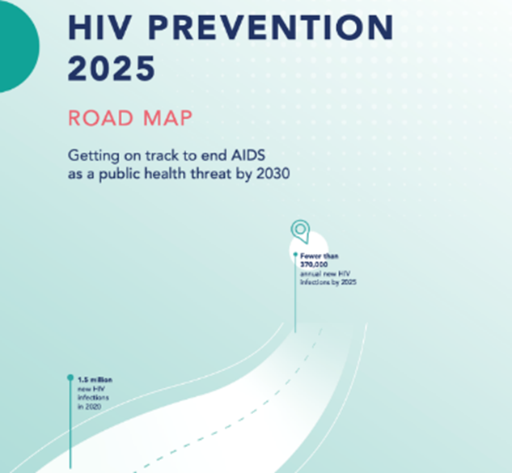
2025 HIV Prevention Road Map baseline survey:
Results Review and Milestones
Aurea Oradini
UNAIDS, Geneva
Accra, Ghana
15 February 2024

Slide 2
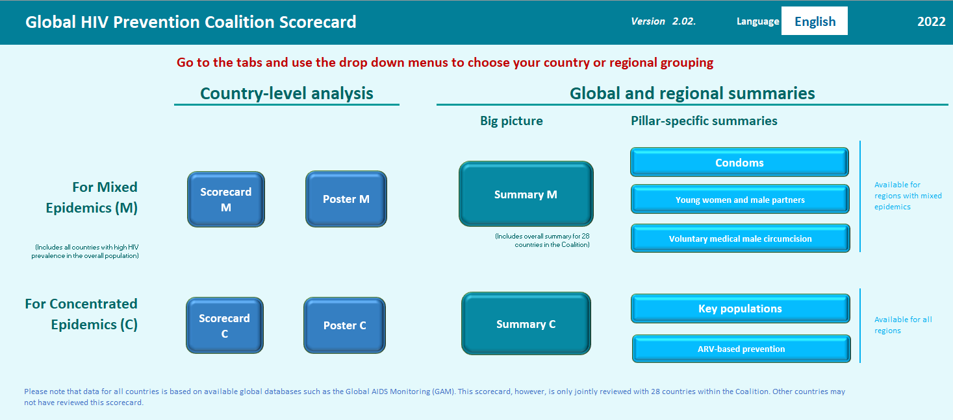
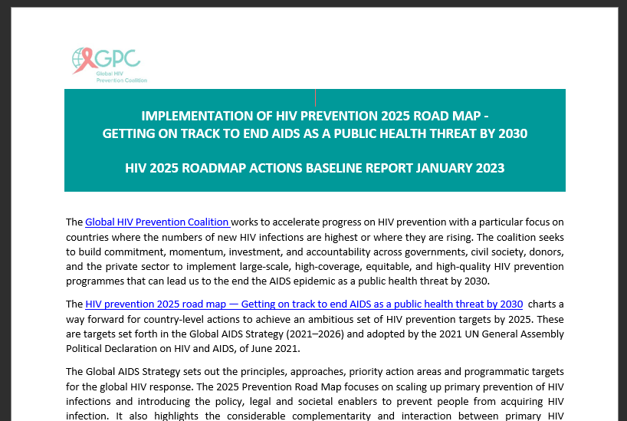


Monitoring progress in implementing the 2025 HIV Prevention Road Map
Data, both quantitative and qualitative, from various sources, predominantly GAM – program output, outcomes, and impact indicators
1
Country-reported responses (subjective) based on a survey questionnaire covering the 10 Roadmap actions – multiple choice and few text-based questions
The structure followed the 10 Roadmap 2025 actions and attempts to capture all the pillars where relevant
Each section attempts to drill down on specific roadmap actions in line with the milestones in the Roadmap document
2
Notes:
Open-Ended Questions (Text Input) – 20 questions
Multiple Choice Questions (Checkbox and Radio Buttons) – 32 questions

Slide 3
Why is a Road Map survey conducted?
provides a systematic way to assess the implementation of key actions in the 2025 HIV Prevention Road Map.
Document where countries are in relation to the 10-Point Action Plan of the 2025 HIV Prevention Road Map
Highlighting where progress has been made and identify remaining gaps
The GPC is also a platform for cross-learning; compiled survey results allow comparability across countries

Slide 4
How the survey was conducted
The survey was shared with countries between 9 - 28 March 2023
  28 GPC focus countries + 6 “new” countries
Recipients in each country included:
  UNAIDS Country Directors,
  UNAIDS HIV prevention focal points,
  UNFPA representatives,
  UNFPA HIV prevention focal points,
  National AIDS Commission Directors and their HIV prevention focal points,
  Ministry of Health HIV Prevention Focals points,
  UNAIDS RST Directors and their HIV Prevention Focal points
One response per country compiled by the HIV prevention TWG under the leadership of the National AIDS Councils or National AIDS Control Program or the prevention leadership entity.
Responses were received by the GPC Secretariat Team between 15 March and 12 May 2023
All results are verified by government programs before analysis and dissemination

Slide 5
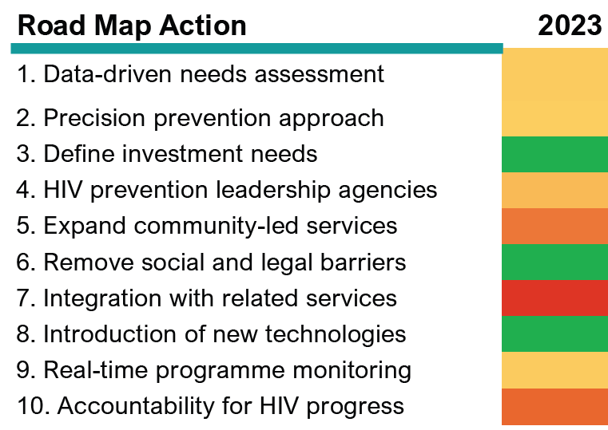
Baseline status of Ghana 10 HIV Prevention 2025 Road Map Actions

Slide 6
Where Ghana is at for each component of the Ten –Actions
In 2023
Done
In progress
Not yet done

Slide 7
Data analysis methodology
Overall Roadmap actions scoring matrix

Slide 8
Action 1 - Conduct a data-driven assessment of HIV prevention programme needs and barriers
Question number (in the questionnaire) | Components considered for scoring | Scoring | Comments
1.1 1.2 | > HIV prevention response epidemic patterns analysis > Consultation meetings to identify barriers conducted > Listing of the identified barriers | > 0.5 (different proportion of the 0.5 based on the level of analysis) > 0.25 > 0.25 | All subnational > 0.5, some subnational > 0.4, national > 0.3

Slide 9
Action 1 - Conduct a data-driven assessment of HIV prevention programme needs and barriers
2025 HIV Prevention Road Map Action | Question number (in the survey questionnaire) | Road Map Baseline Survey components considered for overall Road Map Action scoring | Share of scores among the survey components scored | Ghana
1. Data-driven needs assessment | 1.1 | > HIV prev response epidemic patterns analysis | >50% based on the level
 | 1.2 | > Consultation meetings to identify barriers | >25%
 |  | > Listing of the identified barriers | >25%
 |  |  | Total score
Done
Not yet done
In progress

Slide 10
Action 2 - Adopt a precision prevention approach focused on the key and priority populations to develop national HIV prevention goals aligned 2025 targets
Question number (in the questionnaire) | Components considered for scoring | Scoring | Comments
2.1 2.2 2.3 2.4 2.5 2.7 | > Developed a prevention Roadmap or strategy or plan > Set granular HIV prevention targets > Translate national targets to subnational targets > Differentiated HIV prevention packages > Packages for AGYW where relevant > SOPs or implementation guides in place for relevant pillars | > 0.5 > 0.2 > 0.6 > 0.8 > 0.8 > 0.8 | 2.5 where not applicable the country gets the score

Slide 11
Action 2 - Adopt a precision prevention approach focused on the key and priority populations to develop national HIV prevention goals aligned 2025 targets
2025 HIV Prevention Road Map Action | Question number (in the survey questionnaire) | Road Map Baseline Survey components considered for overall Road Map Action scoring | Share of scores among the survey components scored | Ghana
2. Precision prevention approach | 2.1 | > developed a prevention Road Map or plan | > 50%
 | 2.2 | > Set granular HIV prevention targets | > 20%
 | 2.3 | > Translate national targets to subnational targets | > 6%
 | 2.4 | > Differentiated HIV prevention packages | > 8%
 | 2.5 | > Packages for AGYW where relevant | > 8%
 | 2.7 | > SOPs or implementation guides in place for relevant pillars | > 8%
 |  |  | Total score
Done
In progress
Not yet done

Slide 12
Action 3 - Define country investment needs for an adequately scaled HIV prevention response and ensure sustainable financing
Question number (in the questionnaire) | Components considered for scoring | Scoring | Comments
3.1 3.2 | > Budget/costed HIV prevention plan developed > Dialogue to address HIV prevention funding gap | > 0.6 > 0.4

Slide 13
Action 3 - Define country investment needs for an adequately scaled HIV prevention response and ensure sustainable financing
2025 HIV Prevention Road Map Action | Question number (in the survey question naire) | Road Map Baseline Survey components considered for overall Road Map Action scoring | Share of scores among the survey components scored | Ghana
3. Define investment needs | 3.1 | > Budget/costed HIV prevention plan | > 60%
 | 3.2 | > Dialogue to address prevention funding gap | > 40%
 |  |  | Total score
Done
In progress
Not yet done

Slide 14
Action 4 - Reinforce HIV prevention leadership entities for multisectoral collaboration, oversight, and management of prevention responses
Question number (in the questionnaire) | Components considered for scoring | Scoring | Comments
4.1 4.2 4.3 | > Multi-sector HIV prevention leadership exist > The entity is functional shown by meetings held > Milestones developed to reinforce HIV prevention leadership entities | > 0.5 > 0.3 > 0.2 | If meeting was done two or more times > 0.3, if they met only once > 0.15, if they never met >0

Slide 15
Action 4 - Reinforce HIV prevention leadership entities for multisectoral collaboration, oversight, and management of prevention responses
2025 HIV Prevention Road Map Action | Question number (in the survey question-naire) | Road Map Baseline Survey components considered for overall Road Map Action scoring | Share of scores among the survey components scored | Ghana
4. HIV prevention leadership agencies | 4.1 | > Multi-sector HIV prevention leadership exist | >50%
 | 4.2 | > The entity is functional shown by meetings held | >30%
 | 4.3 | > Milestones developed to reinforce HIV prevention leadership entities | 20%
 |  |  | Total score
Done
In progress
Not yet done

Slide 16
Action 5 - Strengthen and expand community-led HIV prevention services and set up social contracting mechanisms
Question number (in the questionnaire) | Components considered for scoring | Scoring | Comments
5.1 5.2 5.3 5.4 5.5 | > Government convening of communities of KPs, young people, implementing partners and funders > Public funds being allocated to NGOs and community-led services > Any laws or policies impacting community organisations > Any targets set to increase proportion of services delivered by community-led organisations > Have milestones been developed to strengthen and expand community-led prevention services | > 0.2 > 0.2 > 0.2 > 0.2 > 0.2 | If laws are in place > 0 and if not > 0.2

Slide 17
Action 5 - Strengthen and expand community-led HIV prevention services and set up social contracting mechanisms
2025 HIV Prevention Road Map Action | Question number (in the survey questionnaire) | Road Map Baseline Survey components considered for overall Road Map Action scoring | Share of scores among the survey components scored | Ghana
5. Expand community-led services | 5.1 | > government convening of relevant communities | > 20%
 | 5.2 | > Public funds being allocated to NGOs | > 20%
 | 5.3 | > Any laws or policies impacting NGOs | > 20%
 | 5.4 | > Any targets set on community-led services | > 20%
 | 5.5 | > Milestones on community-led services | > 20%
 |  |  | Total score
Done
In progress
Not yet done

Slide 18
Action 6 - Remove social and legal barriers to HIV prevention services for key and priority populations
Question number (in the questionnaire) | Components considered for scoring | Scoring | Comments
6.1 6.2 | > Does the HIV prevention strategy clearly identify and prioritize addressing of legal, policy and structural barriers > Milestones to address the barriers | >0.6 > 0.4

Slide 19
Action 6 - Remove social and legal barriers to HIV prevention services for key and priority populations
2025 HIV Prevention Road Map Action | Question number (in the survey question-naire) | Road Map Baseline Survey components considered for overall Road Map Action scoring | Share of scores among the survey components scored | Ghana
6. Remove social and legal barriers | 6.1 | > Legal, policy and structural barriers in strategy | > 60%
 | 6.2 | > Milestone to address the barriers | > 40%
 |  |  | Total score
Done
In progress
Not yet done

Slide 20
Action 7 - Promote integration of HIV prevention into essential related services to improve HIV outcomes
Question number (in the questionnaire) | Components considered for scoring | Scoring | Comments
7.1 7.1.1 | > Are HIV prevention service integration milestone developed > Are the milestones listed | >0.7 >0.3 | 10% for each additional milestone

Slide 21
Action 7 - Promote integration of HIV prevention into essential related services to improve HIV outcomes
2025 HIV Prevention Road Map Action | Question number (in the survey question-naire) | Road Map Baseline Survey components considered for overall Road Map Action scoring | Share of scores among the survey components scored | Ghana
7. Integration with related services | 7.1 | > Integration milestone developed | > 70%
 | 7.1.1 | > Are the milestones listed | > 30%
 |  |  | Total score
Done
In progress
Not yet done

Slide 22
Action 8 - Institute mechanisms for rapid introduction of new HIV prevention technologies and programme innovations
Question number (in the questionnaire) | Components considered for scoring | Scoring | Comments
8.1 8.2 | > Defined specific actions to introduce new HIV prevention technologies > Are milestone developed and listed for introduction of new prevention technologies | > 0.6 > 0.4

Slide 23
Action 8 - Institute mechanisms for rapid introduction of new HIV prevention technologies and programme innovations
2025 HIV Prevention Road Map Action | Question number (in the survey questionnaire) | Road Map Baseline Survey components considered for overall Road Map Action scoring | Share of scores among the survey components scored | Ghana
8. Introduction of new technologies | 8.1 | > Actions for new prevention technologies | > 60%
 | 8.2 | > Milestone on new prevention technologies | > 40%
 |  |  | Total score
Done
In progress
Not yet done

Slide 24
Action 9 - Establish real-time HIV prevention programme monitoring systems with regular reporting
Question number (in the questionnaire) | Components considered for scoring | Scoring | Comments
9.1 9.3 9.4 9.5 | > Has the country done a data triangulation to determine coverage of programmes >Developed subnational Scorecards? > HIV prevention funding expenditure analysis done? > Cost-effectiveness incorporated into national prevention program reviews | > 0.4 > 0.1 > 0.4 > 0.1

Slide 25
Action 9 - Establish real-time HIV prevention programme monitoring systems with regular reporting
2025 HIV Prevention Road Map Action | Question number (in the survey questionnaire) | Road Map Baseline Survey components considered for overall Road Map Action scoring | Share of scores among the survey components scored | Ghana
9. Real-time programme monitoring | 9.1 | > Data triangulationfor coverage of programmes | > 40%
 | 9.3 | > Developed subnational Scorecards? | > 10%
 | 9.4 | > HIV prevention funding expenditure analysis done? | > 40%
 | 9.5 | > Cost-effectiveness in programe reviews | > 10%
 |  |  | Total score
Done
In progress
Not yet done

Slide 26
Action 10 - Strengthen accountability of all stakeholders for progress in HIV prevention
Question number (in the questionnaire) | Components considered for scoring | Scoring | Comments
10.1 10.2 | > Accountability (Table3) of the 2025 HIV Prevention Roadmap followed > Country developed an Accountability Framework in line with 2025 HIV Prevention Roadmap | > 0.1 for each of the 8 answers > 0.2 for yes developed and > 0.1 being developed

Slide 27
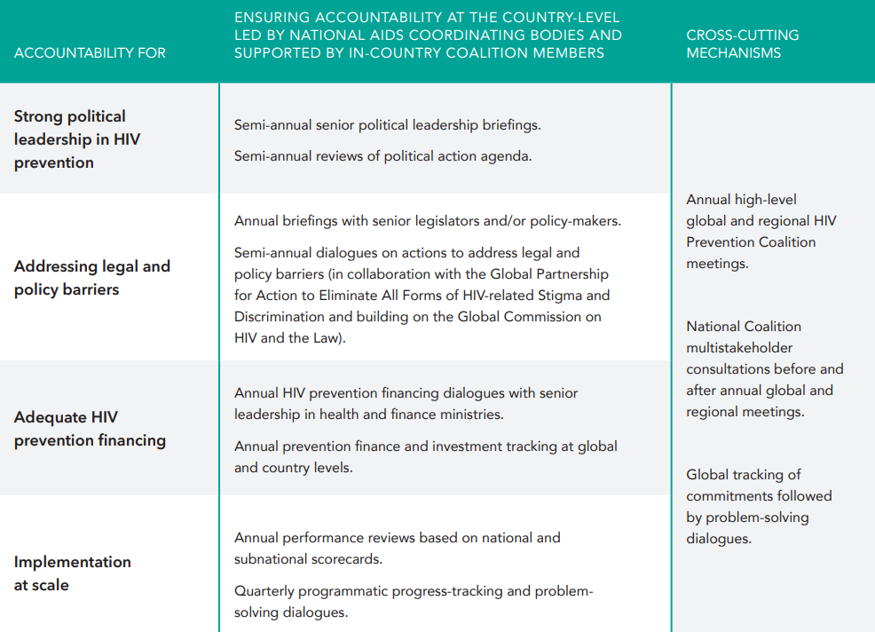
Sample accountability framework from the 2025 HIV Prevention
Road Map
For country adaptation

Slide 28
Action 10 - Strengthen accountability of all stakeholders for progress in HIV prevention
2025 HIV Prevention Road Map Action | Question number (in the survey question-naire) | Road Map Baseline Survey components considered for overall Road Map Action scoring | Share of scores among the survey components scored | Ghana
10. Accountability for HIV progress | 10.1 | > Table3 of the 2025 Road Map followed | > 10% per answer
 | 10.2 | > Accountability framework in line with Road Map | > 20% -yes, > 10% - in progress
 |  |  | Total score
Done
In progress
Not yet done

Slide 29
Baseline survey results
Roadmap actions survey results summary

Slide 30
Road Map Survey Response Scoring
Road Map Action 2. Adopt a precision prevention approach to develop national HIV prevention Goals and aligned 2025 targets
A thorough scoring method was used that considered all the different parts of a Road Map Action, as suggested in the 2025 HIV Prevention Road Map.
This helps to identify the precise gap among aspects of a Road Map Action that a country may require assistance to address.
Q# | Road map action component being assessed | Score | Lesotho | Uganda | South Africa
2.1 | > developed a prevention Road map or plan | -> 0.5 | 0.5 | 0.5 | 0
2.2 | > Set granular HIV prevention targets | -> 0.2 | 0.2 | 0 | 0.2
2.3 | > Translate national targets to subnational targets | -> 0.06 | 0.06 | 0 | 0.06
2.4 | > Differentiated HIV prevention packages | -> 0.08 | 0 | 0.08 | 0
2.5 | > Packages for AGYW where relevant | -> 0.08 | 0.08 | 0.08 | 0.08
2.7 | > SOPs or implementation guides in place for relevant pillars | -> 0.08 | 0.08 | 0.08 | 0.08
Overall score |  | 1.0 | 0.9 | 0.7 | 0.5

Slide 31
Baseline status of Ghana 10 HIV Prevention 2025 Road Map Actions

Slide 32
Where WCA GPC countries are with each component of each of the Ten –Actions
2023
Done
In progress
Not yet done

