Slide 1



The Global Condom Landscape
Perspectives on the context of condom programming in a shifting environment
Global Community of Practice, IAS July 2024

Slide 2



Setting the Stage
Epidemiology & Transmission Dynamics
2

Slide 3
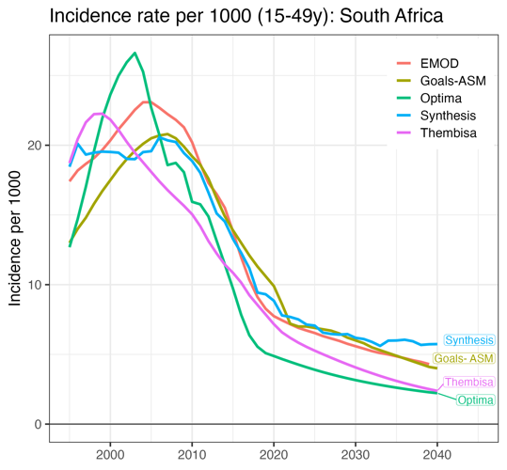
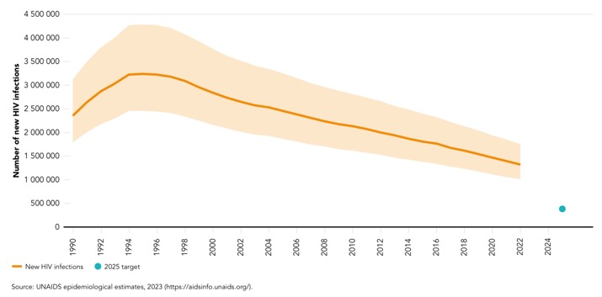
Modelling indicates incidence will decline, but at a slower rate - presenting challenges for prevention moving forward
Although incidence across sub-Saharan Africa (SSA) continues to rapidly decline… it is not on track to meet 2025 and 2030 targets.¹
A closer look at South Africa
Incidence is expected to decline … but the pace of decline will slow in 2025 as we:
Close in on saturation of ART and viral suppression based on successes of the past decade.
Benefit from decreasing HIV prevalence and corresponding decreasing viremia.
New HIV infections, global, 1990-2022 and 2025 target¹
Goals ASM (Age-Structured Model) :
¹ UNAIDS Epidemiological estimates. 2023. https://aidsinfo.unaids.org
² Assuming active programs maintain current treatment and prevention continue: Data presented at the HIV Modelling Consortium, MIHPSA Phase 1, UNAIDS Technical Consultation, 20-21 July 2023. Slides through Jeffrey Imai-Eaton
3

Slide 4
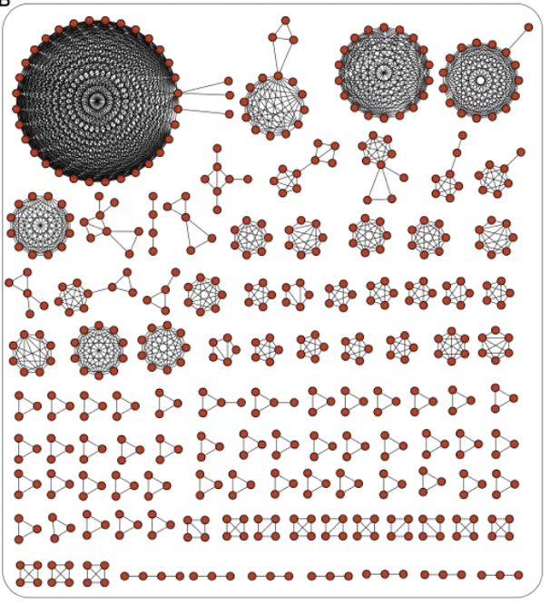
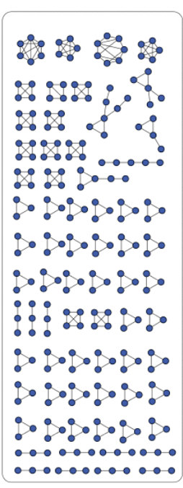

Small and Diffuse HIV Transmission Networks in Eastern and Southern Africa Result in an Epidemic of “Many Who Infect Few”
Clustering of HIV transmissions in Europe compared with diffuse clusters characterizing transmission in Zambia¹
Europe
Zambia
Broadly diffuse transmission clusters
4
¹ Jeffrey Imai-Eaton [2023]. HIV New Product Planning & Introduction and HIV Delivery Africa-based grantee convening 30 November 2023; HIV epidemiology trends: Where are we? Where are we headed?”, citing Abeler-Dörner et al (2019). in preparation

Slide 5
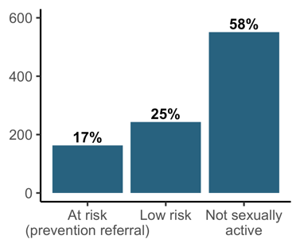
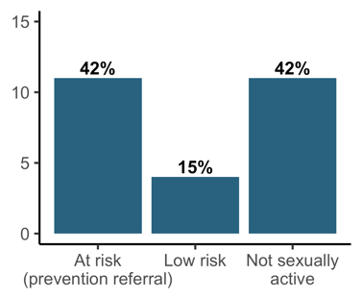
Increasingly Challenging to Identify Populations at High Risk of Contracting HSV-2 and HIV¹
Baseline
Prevention group allocation
(n = 960 women 15-24y)
One year follow-up
HSV-2/HIV infections
(n=26; 1 year follow-up)
A recent study in Zimbabwe found “half of incident infections in a 12-month period occurred among people reporting to have never had sex and were missed by risk differentiation at baseline.”¹
Adolescent girls and young women (AGYW) infected today were not engaging in high-risk sex just one year ago
Key Finding
Programmatic Implications
Although 42% of infections were among the 17% of “at risk” AGYW…
42% of new infections occurred in AGYW not sexually active at baseline assessment.
Risk tools are poor predictors of risk and, ultimately, HIV transmission.
Important to reach general populations with prevention messaging and products in high prevalence settings—lest they be missed by screening methods.
¹ Jeffrey Imai-Eaton [2023]. HIV New Product Planning & Introduction and HIV Delivery Africa-based grantee convening 30 November 2023; HIV epidemiology trends: Where are we? Where are we headed?, citing Louisa R Moorhouse Development of an HIV risk-differentiation tool for use in routine HIV testing services: Validation based on ability to predict HIV and HSV-2 acquisition in 12-months of follow-up in young men and women in eastern Zimbabwe –unpublished manuscript currently under review.
5
Notes:
This slide demonstrates the challenge of relying on individual risk factors to identify populations at greatest risk of HIV.
A longitudinal study with nearly 1,000 young women in Zimbabwe was used to validate a risk-differentiation tool with combined HIV incidence among HIV-negative populations. The study found that about half of new infections in a 12-month period occurred among people reporting to have never had sex— and were missed by risk differentiation at baseline. This reflects a combination of rapid changes in sexual behavior during a key period in a young women’s life course. Iindividual risk factors and the tools we rely on are poor predictors of infection.
Factors analyzed included in the tool: self-risk perception, having a known HIV-positive partner, having multiple sex partners in the past year, perception of partner risk, having a STI in the past year, transactional sex, and using injecting drugs.

Slide 6

Role of Condoms in the HIV Prevention,
STI, and FP Ecosystem
6

Slide 7
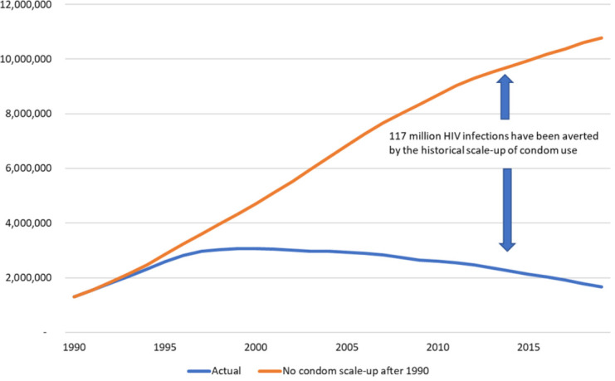
Condoms Matter: The Role of Condoms in Reducing HIV Incidence— Modeled Historic Experience (1 of 2)
Number of new HIV infections with varying levels of condom scale-up
Modeling of historic impact demonstrates that the annual number of new HIV infections would have increased to nearly 11 million by 2019 if condom use had remained at 1990 levels.
An estimated 117 million infections were averted from 1990–2019 due to condom use.
7
Stover J, Teng Y [2022]The impact of condom use on the HIV epidemic. Gates Open Res. 2022 Feb 11;5:91. https://www.ncbi.nlm.nih.gov/pmc/articles/PMC8933340/

Slide 8
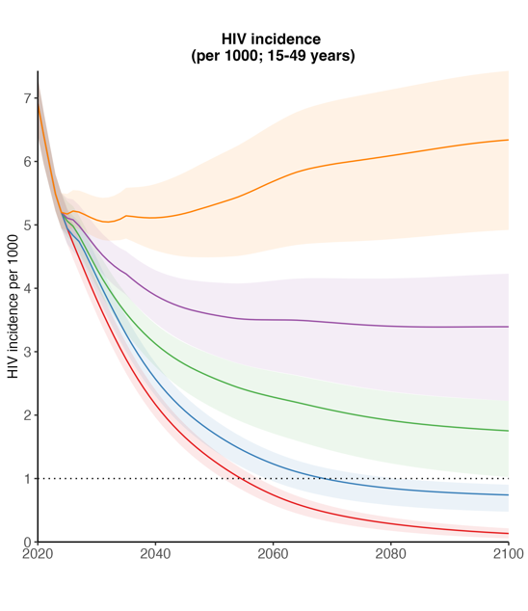
Condoms Matter: The Role of Condoms in Future Incidence Reduction—Modeled Scenarios (2 of 2)¹
Modeled impact of discontinuation of specific interventions with HIV testing & treatment at existing rates (South Africa, 2023)
Condom use reduces by 30% (+ discontinuation PrEP, voluntary medical male circumcision [VMMC])
A recent analysis in South Africa yielded insights on the relative role of various interventions on incidence, holding HIV testing constant.
Declines in condom use of 15% and 30% from existing use rates—and after discontinuing other interventions— result in significant increases in incidence.
Condom use reduces by 15% (+ discon. PrEP, VMMC)
“Changes in sexual risk could substantially increase infections and deaths over time. Maintaining current testing rates, reduced condom use by 14% resulted in an additional ~3.7 million infections and ~346,000 deaths between 2025–2075, compared with the status quo.”¹
Discontinue PrEP & VMMC
Discontinue PrEP (female SW [FSW], MSM, higher risk AGYW)
Continue current prevention
¹Jeffrey Imai-Eaton [2023]. HIV New Product Planning & Introduction and HIV Delivery Africa-based grantee convening
30 November 2023; HIV epidemiology trends: Where are we? Where are we headed?, Citing: Stefan P Rautenbach, et al. (2023). Future HIV epidemic trajectories in South Africa and long-term consequences of reductions in general HIV testing: A mathematical modelling study. MedRxiv, 2023.12.19.23300231. https://doi.org/10.1101/2023.12.19.23300231
8

Slide 9
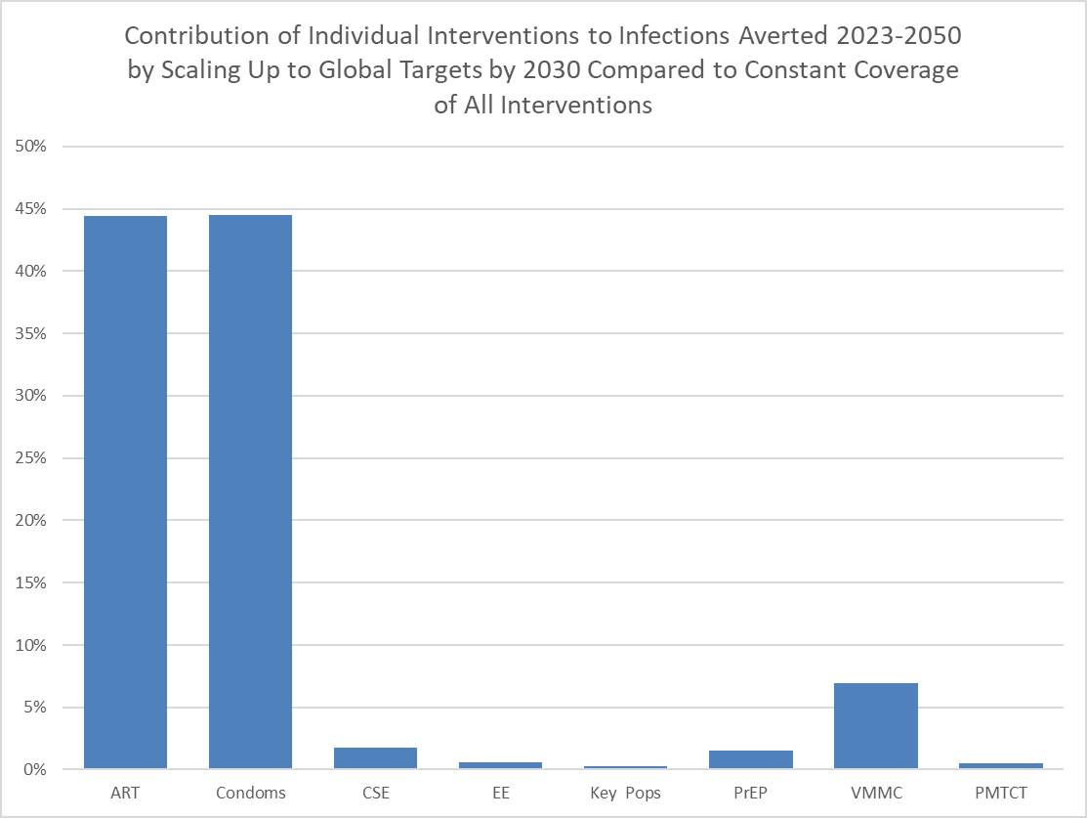
The Potential Contribution of Condoms to Reducing Future Infections in East and Southern Africa¹
This chart models the relative contribution of interventions to achieving global targets assuming they scale to Global targets.
- John Stover of Aviner health.¹
Condoms were modeled to contribute to more than 40% of HIV infections averted—if interventions reached the ambitious scale-up to to global targets.
The significant contribution of condoms is indicative of:
  The effectiveness of condoms as interventions.
  The relatively large existing gap between current use and ambitious targets
  Modeling based on scaling up condoms to reach targets of:
    90% use in key populations (KP) and in non-KP
    95% use among male clients of FSW
    70% among those with multiple partners in the last year
    50% among those with one partner in the last year.
CSE: comprehensive sexuality education
EE:
PMTCT: prevention of mother-to-child transmission
9
^{1.} John Stover [2023]. UNAIDS Technical Consultation, 20-21 July 2023 [Unpublished]

Slide 10

Bringing it together: Evolving Epidemiology and Behavioural insights bring challenges & opportunities to HIV Prevention
A compilation of the latest relevant epidemiological data and modeling¹ lays out a clearer path forward to support continued reductions in the incidence of HIV. New cases of HIV will be averted by:
3 Big Challenges Confronting Prevention
A slowing in the rate of decline of incidence means it will be more challenging, and more expensive, for every new HIV infection averted
Diffuse clusters of transmission characterizing the Africa epidemic hinders our ability to use targeted, ‘cluster busting approaches.
Risk tools don’t work so well to identify individual factors that are predictors of infection.
We need to reach more populations at moderate risk with low-cost prevention approaches.
Paired with behavioral interventions, Condoms are the most effective, low-cost prevention tool to reach more pops
10
¹ Jeffrey Imai-Eaton [2023]. HIV New Product Planning & Introduction and HIV Delivery Africa-based grantee convening 30 November 2023; HIV epidemiology trends: Where are we? Where are we headed?”, and emergent data from UNAIDS Technical Consultations.

Slide 11
Behavioral Trends
11

Slide 12
Worrisome Drops in Condom Use in Countries with Recent Data
Condom use at last NMNC sex: Overall among men ages 30-39¹
All four countries analyzed with recent DHS data demonstrate significant drops in the use of condoms during sex with a non-regular partner.
The drop ranged from 6% to 15%, and averages nearly 10% across the 4 countries
=
Proportion of men 30-39 using a condom at last NMNC sex has decreased since the last round of data collection.
12
¹ Demographic and Health Surveys; [Accessed December 2023] https://www.statcompiler.com/en/
²UNAIDS [2023] https://indicatorregistry.unaids.org/indicator/condom-use-last-high-risk-sex
Notes:
A rise in this indicator is an extremely powerful indication that condom promotion campaigns are having the desired effect in their principal target market. Asking about the most recent act of non-cohabiting sex minimizes recall bias and gives a good cross-sectional picture of the levels of condom use. It is recognized that consistent use of condoms is an important goal.

Slide 13
Use is declining in younger populations….
Condom use at last NMNC sex among young people in Zambia, Kenya, and Tanzania has dropped dramatically, likely driven in part by a newer generation missing out on the robust condom interventions and campaigns of the past.
Condom use during NMNC sex ^{1, 2}
13
¹ USAID. Demographic and Health Survey. [Accessed December 2023]. http://www.statcompiler.com
² South African National HIV Prevalence, Incidence, Behaviour and Communication Survey. [Accessed December 2023]. SABSSN V, VI
Notes:
Young women using a condom during premarital sex.
Young men using a condom during premarital sex ICF, 2015.
The DHS Program STATcompiler. Funded by USAID. http://www.statcompiler.com. September 11, 2023

Slide 14
Against a persistent gender gap
Condom use with NMNC partners among young people ages 15-24 remains low in many countries, with women consistently using condoms less frequently than their male peers.
In Rwanda, Tanzania, Uganda, and Zambia, condom use among women ages 15-24 is extremely low, at < 40% of women.
14
¹ ICAP. Population-based HIV Impact Assessment [Accessed December 2023]. https://phia-data.icap.columbia.edu/

Slide 15
Procurement and Supply Trends
15

Slide 16
Declining Procurement Supply
Total estimated global condom distribution in LMIC declined an average of 27% - 37% from peak procurement in 2011. The decline in distribution occurred as the population in African grew by 400 m, or 40%, since 2010.
Private sector contributions, which vary at an estimated ~5-10%+ of total distribution in SSA, are not estimated here.
Annual procurement down 27%
While distribution by SMOs declined by about 47% over the same period, (from ~3.5 billion condoms in 2011 to ~1.8 billion in 2022), SMOs still account for nearly half of condoms distributed in LMIC. Much of that decline can be attributed to social marketers distributing fewer free condoms.
Social marketing (all orgs)
Major donor funding
South Africa (RSA)
Donors include UNFPA, UNFPA Third Party Procurement (TPP), USG, and Global Fund. Data for donors are global procurement; condoms may not be distributed in that fiscal year. Data for social marketing organizations (SMOs) are reported distribution and per DKT social marketing statistics report. May be missing domestic funded condoms not procured under the TPP (aside from RSA).
16

Slide 17
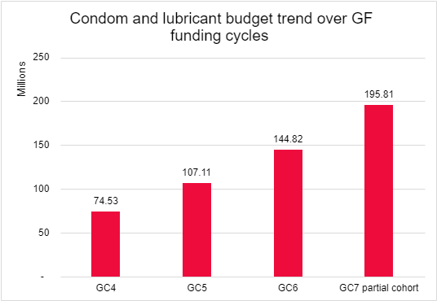
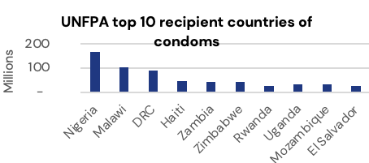
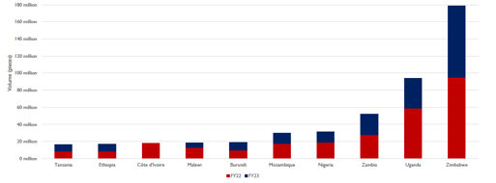
The “big 3” condom donors are challenged by shifting funding and epidemiology dynamics, and are working to bring alignment on a common strategic approach to support condom delivery, demand, and use.
Snapshot of Major Donors
 | USG Shifting funding strategies in play | UFFPA/UNFPA Third Party Procurement New policies to allow sale of commodities | Global Fund
Funding and procurement trends | Top 10 Countries: Condoms procured through the Condom Fund (FY22 & 23)
Program-matic highlights | About 75% of USG procurement is paid for from the Condom Fund (CF). The pending sunset of the CF could present a significant disruption as USAID missions have grown accustomed to relying on procurement outside their constrained country budgets. | A new policy allowing UNFPA-procured commodities to be sold will be piloted in 6-8 countries in 2024. The aim of this initiative is to further segment the market and complement the shift to sustainable programming. The TPP mechanism continues to play an important role in the provision of condoms. | Investment in condom programming increased 163% from GC4, even considering partial cohort for GC7*. Recent investment in the Condom Strategic Initiative provided valuable lessons learned on what modest investments in project management can yield (included as section of this report).
17

Slide 18

Insights & a Way Forward

Slide 19
Insights Summarized
 | A dearth of data (continues to) hinder decision making at global and country levels.
 | Integration of condoms is getting lost amongst other prevention & treatment priorities, leaving a new generation under- exposed to condom interventions
 | Insufficient investments in demand (continues to) inhibit uptake of condoms – particularly amongst women and young women
 | Despite declining funding, social marketers / social enterprises still play a significant – if diminished- role in condom delivery
 | Glimmers of ‘better practice’ demonstrate that a ”back to basics” approach can work
1
2
3
4
5
19
19

Slide 20
Recommendations
1
Build and agree on a shared strategy leveraging a segmented approach to address the shifting epidemic.
4
Integrate program stewardship in broader prevention management structures.
2
Support “back-to-basics” programs reflective of today’s funding and operating environment.
5
Reinvigorate partnerships with SMO/SEs and create space for the commercial sector.
3
Invest in champions, advocacy, and influencing others.
6
Integrate condom demand in the “prevention category.”
20

Slide 21







Contact us
www.mannglobalhealth.com
info@mannglobalhealth.com
Chris@mannglobalhealth.com
Nora@mannglobalhealth.com
www.linkedin.com/company/mannglobalhealth/
704 Hawks Landing Dr, Columbus, North Carolina, 28722, US.

