Slide 1
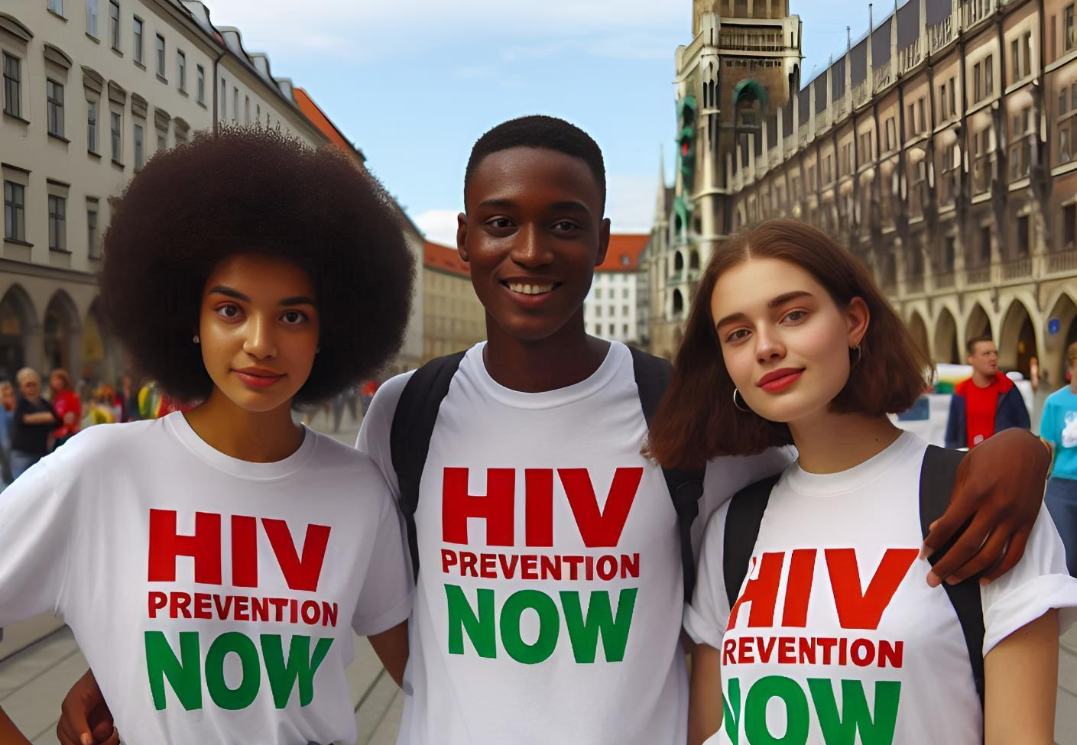

The Urgency of Now:
Update on global trends in HIV prevention

Slide 2
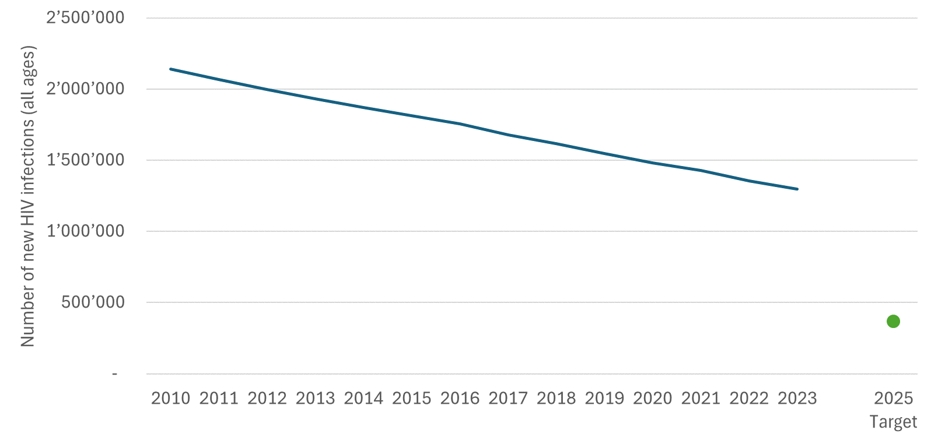
1.3 million new HIV infections in 2023: more than 3 times the 2025 target

Slide 3
Declines in new infections in sub-Saharan Africa, but not fast enough. Global targets will be missed, primarily due to stagnation in other regions
Change in the numbers of people (all ages) acquiring HIV, by region, 2010–2023
HIV has risen in eastern Europe and central Asia, the Middle East and North Africa and Latin America - only slow declines in Asia-Pacific
Source: UNAIDS epidemiological estimates, 2024 (https://aidsinfo.unaids.org/).

Slide 4
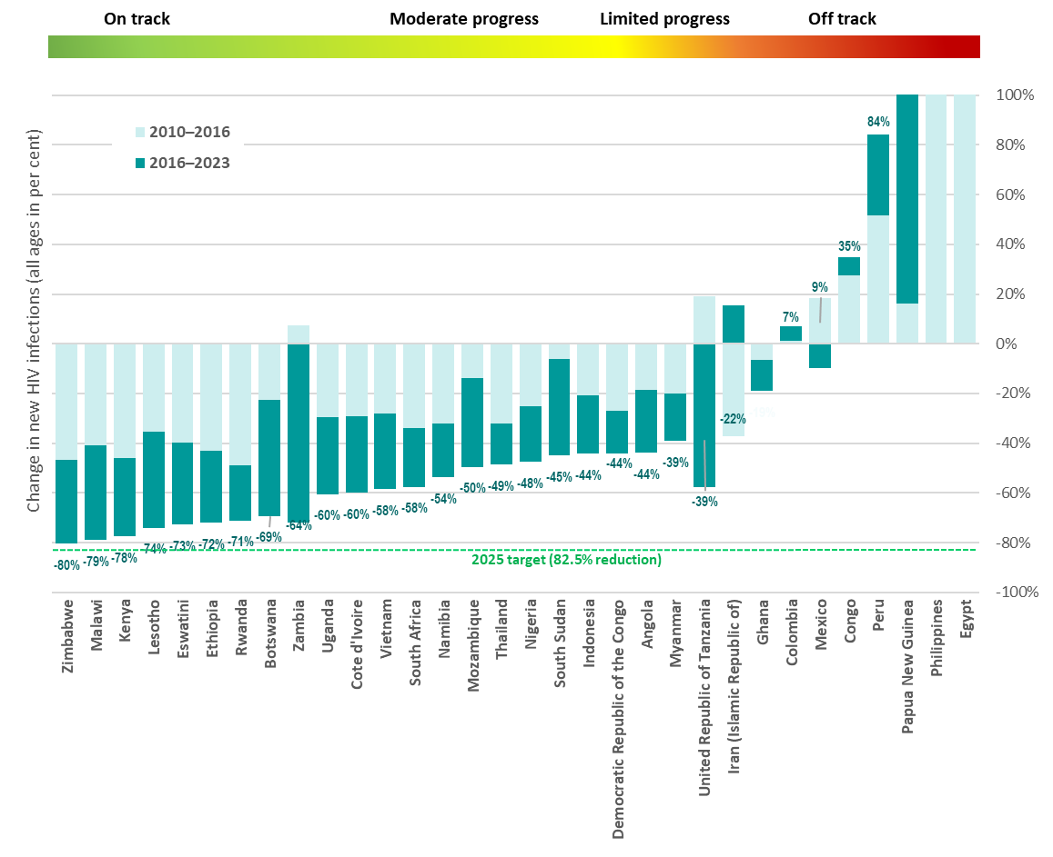
Large variation of progress
104% | 543%| 609%
.../... ..../... .../...
Eight GPC focus countries have reduced their annual number of new HIV infections by at least 66% since 2010.
The majority of countries need to accelerate to achieve 2025 targets.
*No 2024 estimates reported for Brazil, Cameroon and Central African Republic

Slide 5
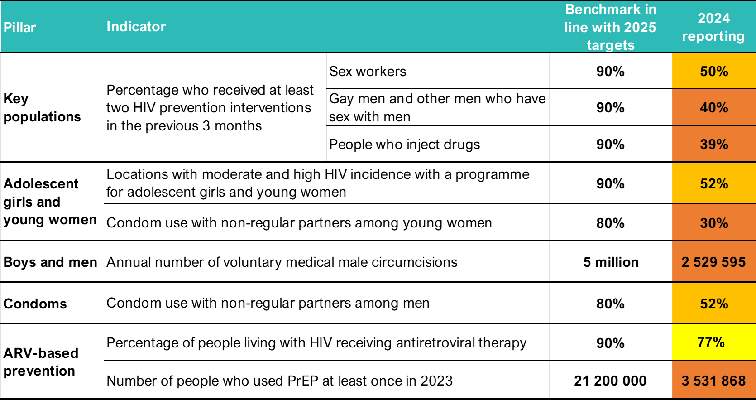
Prevention is off track to meet 2025 targets
Increasing
slowly overall
Decreasing over the past 5 years
77%
Increasing in most countries
Increasing rapidly, but far from target
^{[1]} Global 2025 targets for condom use vary by level of HIV incidence in a geographical area and by individual risk. They are set at 95% for people at highest risk and 70% and 50% for people a moderate and low risk. Since data presented here are for a population at high risk (people with non-regular partners) in an entire country, a benchmark of 80% has been included as a proxy for the targets.
^{[2]} The benchmark of 21.2 million users is based on the global PrEP targets, which translate into 10.6 million person-years of PrEP. An assumed average duration of PrEP use of 6 months per year thus yields the benchmark of 21.2 million users.
Source: UNAIDS epidemiological estimates, 2024 www.aidsinfo.unaids.org.

Slide 6
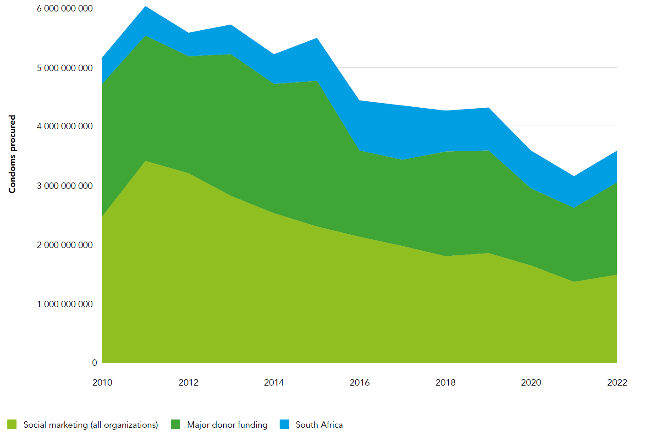
Trends in condom distribution via major condom procurers and distributors, 2010-2022
Declining investment and volumes in condom procurement and social marketing
A 27% reduction comparing 2010-16 and 2016-2022
A 37% reduction from the peak
Social marketing volumes reduced by half

Slide 7
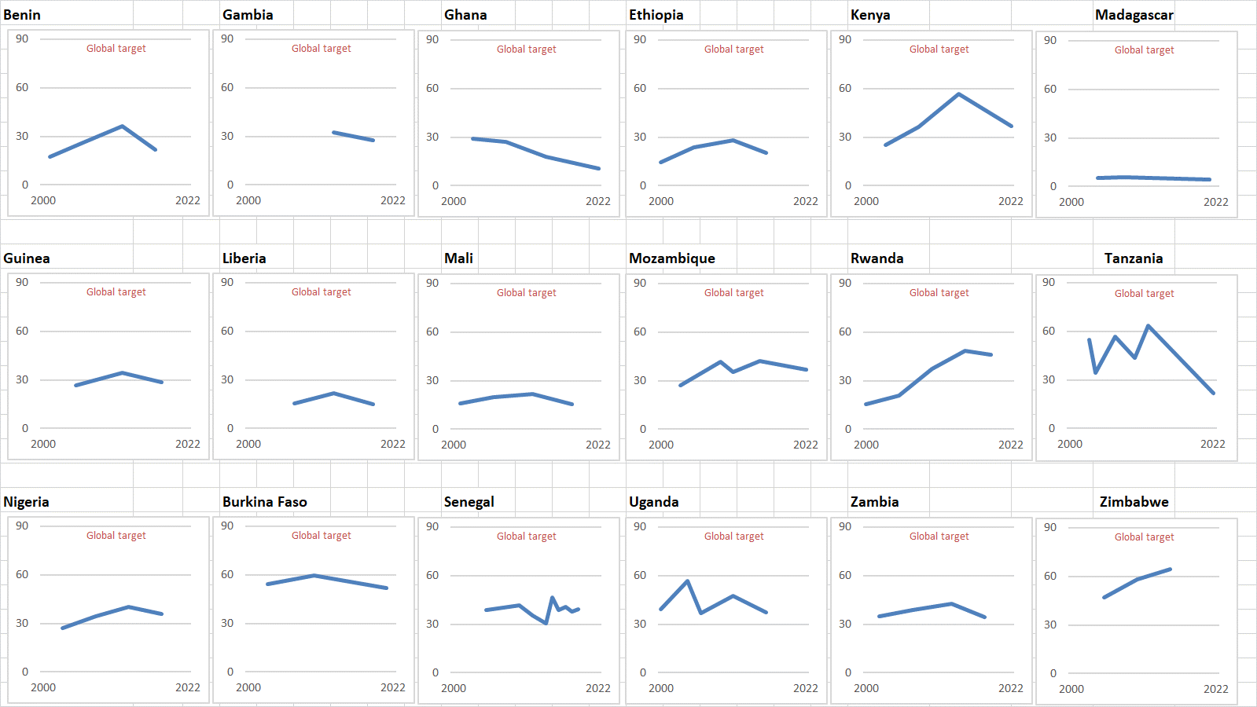
Gains made are being lost: Declines in condom use
Condom use at last higher risk sex (with a non-marital, non-cohabiting partner) [Women, 15-49]
Inequities in access
Women and men with lower income in Africa consistently left behind

Slide 8
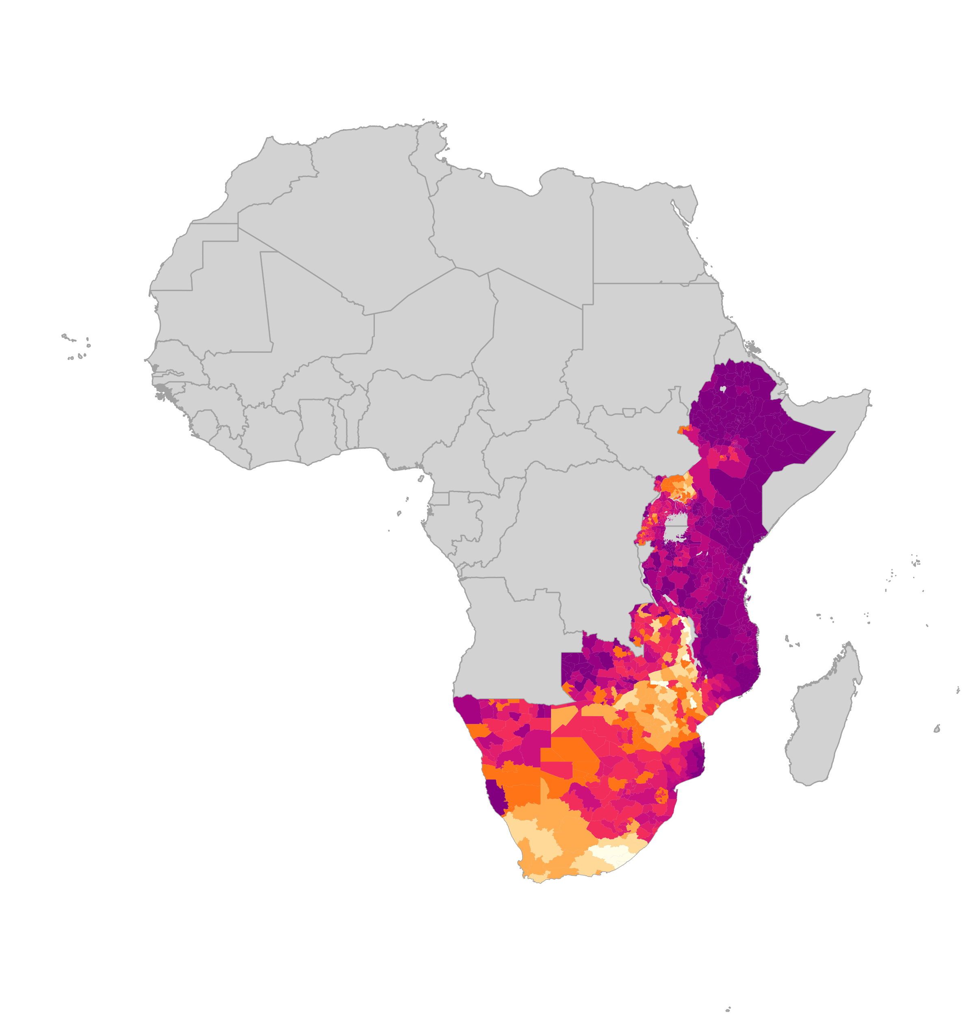
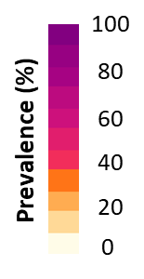

37.5 million men and boys accessed VMMC package of services by 2023 -
But VMMC, other prevention and treatment coverage for men & boys remains far from targets
Number of men and boys accessing VMMC package of services
Estimated coverage of VMMC among men 15-49
Integrated male SRHR for boys and men including HTS/ART and gender-transformative approaches
No full recovery after COVID-19
Sources: Coverage maps- special analysis by Avernir Health through the UNAIDS-led VMMC data workstream. Analysis done using DMPPT2 Tool and integrated 3MC model using data up and until 2023. VMMC progress over time: UNAIDS Global AIDS Monitoring, 2023; www.aidsinfo.unaids.org)

Slide 9
Growing numbers of people using PrEP: 3.5 million in 2023, but this is just 16% of estimated global need
Number of people using PrEP in 2023, relative to 2025 targets
Source: UNAIDS epidemiological estimates, 2024. www.aidsinfo.unaids.org.

Slide 10
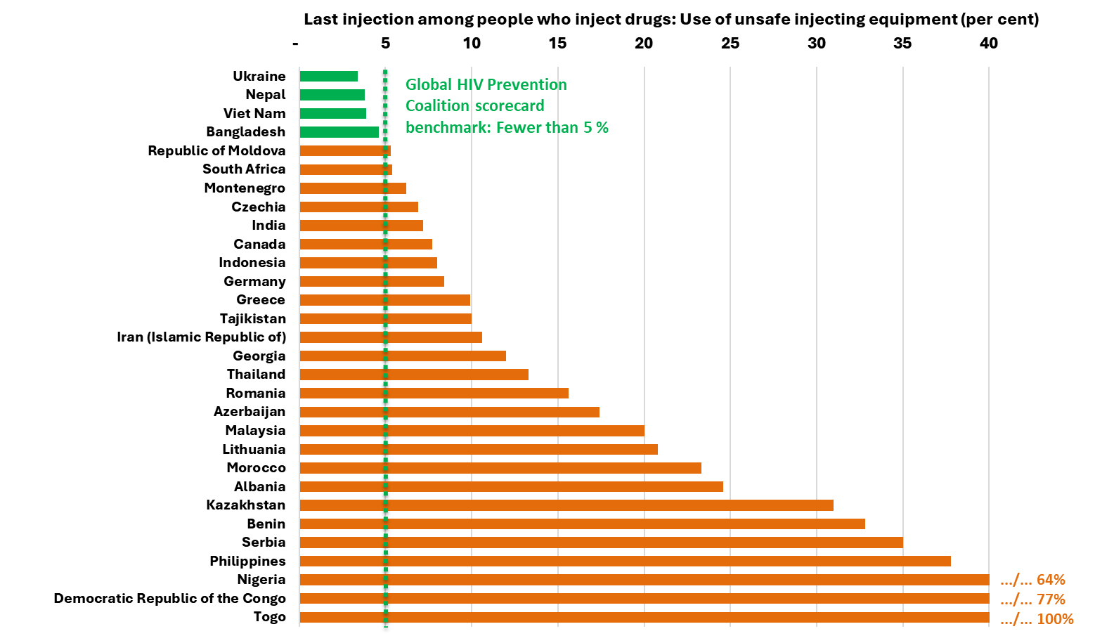
Access to safe injecting equipment remains too low
Four countries above GPC scorecard benchmark show it can be done

Slide 11
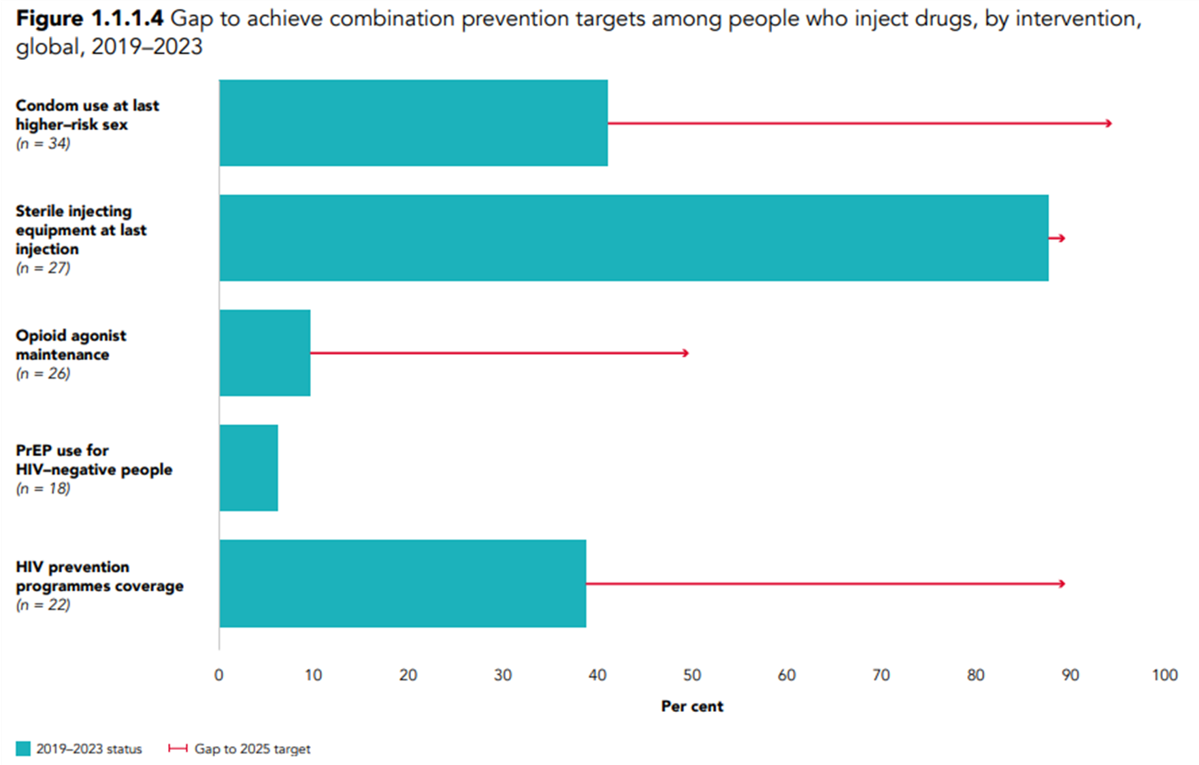
Other harm reduction targets: Good examples, but major gaps in coverage persist in majority of countries
Notes:
Of 22 reporting countries, 39% of PWID received ≥2 relevant prevention services in previous 3 months
>60% in only 5 countries (Albania, Kazakhstan, Nigeria, Thailand and United Republic of Tanzania)
3 countries met 2025 targets for 200 needles and syringes per person per year
In 12/27 reporting countries, ≥90% reported to PWID using safe injecting practices
In only 2 countries (Malaysia and Seychelles), ≥90% PWID reported to receive OAMT

Slide 12
What it takes to close the persistent prevention gap
To bridge the prevention gaps between countries and populations people-centered, effective, sustainable and resilient HIV prevention programmes at scale need:
(1) financial resources for making prevention options available and accessible;
(2) reliable, disaggregated data (including community-generated data) so planners can focus interventions with greater precision;
(3) people-centered design and communication: key populations; women & girls and men & boys in settings with high HIV
(4) differentiated service delivery and innovation and investment in trusted access platforms – country-led and community-led;
(5) addressing underlying behavioral and structural including rights related barriers to prevention access;
(6) strong and consistent political leadership.

Slide 13
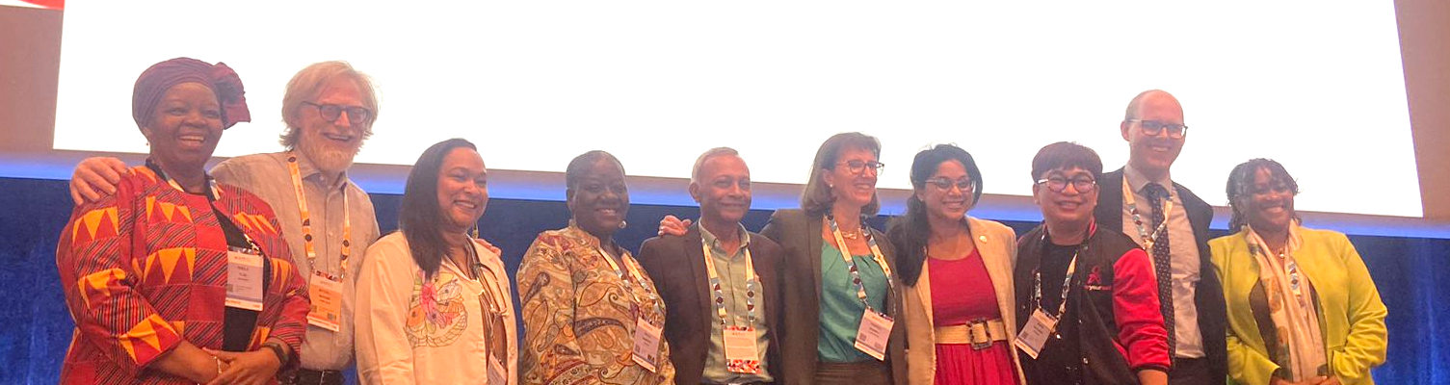
People-centred and sustainable HIV prevention:
Towards a new generation of prevention responses in a changing epidemic context
Presentation Title | Person Organization
Welcome and session objectives | Prof. Sheila Tlou, GPC co-chair Mitchell Warren, GPC co-chair
Changing patterns of HIV incidence and long-term projections to inform the future of prevention | Jeff Imai-Eaton, Harvard University
Key lessons from a decade of experience with people-centered and differentiated prevention in Kenya | Ruth Laibon, National Syndemic Diseases Council, Kenya
People-centred HIV prevention programming at community level in the Philippines | Ronivin Garcia Pagtakhan, Loveyourself, Philippines
Panel Discussion with senior leaders in the HIV response on sustainable HIV prevention responses | Angeli Achrekar, UNAIDS
 | Bience Gawanas, Global Fund Board vice-chair
 | Rebecca Bunnell, Principal Deputy U.S. Global AIDS Coordinator for PEPFAR
 | Yogan Pillay, BMGF – Director for HIV and TB
 | Solange Baptiste, IPTC – Executive Director
Questions & answers | Sheila Tlou, GPC co-chair
Way forward: The urgency of prevention now | Mitchell Warren, AVAC, GPC co-chair
Key messages:
Primary prevention & treatment both needed to achieve targets
Both scaled low cost prevention & highly effective focused prevention needed in the right mix
Country-led, differentiated, scaled prevention for all key & priority populations possible (Kenya example)
Scaled community models effective in reaching key populations (Philippines)

Slide 14
Other key themes advanced through GPC
Achieving scale and equity: models to simplify, normalize, and diversify PrEP service delivery
Cutting-edge prevention expertise for country and local program managers: How to access new and impactful HIV prevention resources
Men and HIV: Innovative strategies and challenges in addressing HIV among men: Insights and future directions
Key Populations Community of Practice (KP COP) Theme 10: How to use law reform to advance HIV prevention for key populations
Global Condom Community of Practice session: The relevance of condoms in an era of choice

Slide 15
Key points for sustainability
Strong political commitment to share financing responsibility and support inclusive multisectoral governance and policies.
A mix of domestic and international financing that is adequate, sustainable and equitable and that includes financing of community- led activities and services – and integration of prevention into health financing schemes
Predictable funding allocations for science- driven, high- impact prevention programmes that are backed by well-functioning surveillance and data systems.
Resilient capacity to deliver and manage integrated, differentiated and equitable HIV prevention interventions, adopt evidence-based approaches in line with international guidelines, and introduce innovations.
The removal of harmful laws and the implementation of enabling policies that support accessible, equitable, accessible and high- quality HIV services.

Slide 16
The Urgency of Now:
A moment of opportunity to turn around the prevention crisis
Red projection at current effort
Blue projections if countries meet 2025 prevention, treatment and enabler targets
The time to act is now:
If 1.3 million people continue to acquire HIV every year, the response will be more complex and costly in 2030 and 2050
Notes:
Background:
Lenacapavir: PURPOSE 1 study has announced results for cisgender women; full data analysis not available yet (Wednesday Gilead has a late breaker on Len).
PURPOSE 2, which included cisgender men and transgender women, started 3 months after PURPOSE 1. Results not yet available.
Access schemes that include low and middle income countries, including in sub-Saharan Africa, but also middle income countries in Asia-Pacific and Latin America given the KP epidemic who may otherwise miss out on lowest prices.

Slide 17
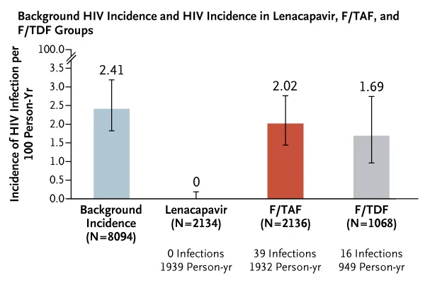
The Urgency of Now:
Accelerating long-acting PrEP choice & innovation
Access to PrEP is increasing but
only in a few countries
Landmark results for PURPOSE 1 study
of lenacapavir as PrEP: 100% efficacy
reported in cisgender women in
Uganda and South Africa
To accelerate the scale-up:
  Ensuring the affordability, availability, and access of different PrEP options and PEP
  Swiftly adopting decentralized and community delivery models
  Enabling legal and policy environments conducive to large-scale implementation.
Notes:
Background:
Lenacapavir: PURPOSE 1 study has announced results for cisgender women; full data analysis not available yet (Wednesday Gilead has a late breaker on Len).
PURPOSE 2, which included cisgender men and transgender women, started 3 months after PURPOSE 1. Results not yet available.
Access schemes that include low and middle income countries, including in sub-Saharan Africa, but also middle income countries in Asia-Pacific and Latin America given the KP epidemic who may otherwise miss out on lowest prices.

Slide 18
A moment of opportunity: A renewed prevention push to turn around the prevention crisis
People-centered and rights-based
Relevant prevention choices
A combination prevention investment push
More prevention users: ↑ to 95% of people in need
Fewer people acquiring HIV: ↓80%

Slide 19
Thank you
Please contact us for any questions using this email: hivpc@unaids.org

