Slide 1
Overview of prevention tools and guidance for GC8
Managing and planning HIV programs for key populations
27.04.2026

Slide 2

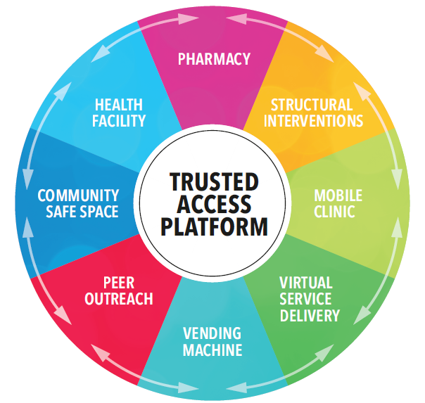
KP Priorities for GC8:
Optimize, Adapt and Integrate
Prioritize service delivery based on HIV incidence among KP and resource availability.
Protect coverage of essential prevention services for key populations by identifying efficiencies through optimization, adaptation and integration processes.
Continue to design programs for key populations based on a “trusted access platform approach," which combines multiple service delivery models, but rethinking opportunities offered by underutilized service delivery approaches (e.g online spaces, pharmacies).
Optimize and adapt existing strategies employed by the program supporting key populations, for instance carefully reviewing the performance of community outreach programs to ensure they are fit for purpose and assessing the cost effectiveness of strategies (e.g., standalone KP clinics, mobile clinics, drop-in centers, etc.) to inform what should be retained and what should be stopped.
Where possible, support the integration of programs for key populations into primary health care, identifying potential risks in advance and implementing appropriate strategies to address them (e.g., developing transition schedules, making health units competent for key populations).

Slide 3

Dedicated
KP clinic sites
Prioritizing access platforms for key populations
Mobile clinics
Drop-in centres
Other key venue presence:
Vending machines, bars, kiosks, events
Add …
Clinics
Other health facility-based modalities: Peer navigation,
KP rooms or days, sexual health clinics
Outreach
Service delivery approaches
Online
Additional online services (e-pharmacy, counselling)
Peer-led outreach in physical settings (differentiated based on need)
Peer-led outreach in virtual spaces
KP-competent health facilities
KP-competent pharmacies
Fewer resources More resources
Lower HIV incidence Higher HIV incidence
Actions to address human-rights & gender related barriers and create an enabling policy environment
Community engagement, leadership and accountability
Enablers
Enablers are a foundation that entail some actions that do not require extensive resources and others that do.
The specific needs should be considered based on the country’s legal and policy environment and resource availability .

Slide 4
Community Guides and Tools for GC8
Status (as of 21 Apr)
Jointly developed tools
GC8 Community Consultations (adaptation of existing community guide) (Via Libre) (drafting)
What must I know about GC8? (summary presentation) (GATE) (published – living document)
Sustainability, Transition and Co-Financing (adaptation of existing community guide) (EANNASO) (drafting)
Service Integration (new community guide) (Seven Alliance) (drafting)
Community Costing Tool (update of existing tool) (Frontline AIDS) (drafting, undesigned version available upon request annabelle.metzner@theglobalfund.org)
Individually developed tools
Guide to the Global Fund’s GC8 for Trans and Gender Diverse Communities (GATE) (published)
CS4ME GC7 guide (update planned by CS4ME) (drafting)
Young KPs and Youth Engagement in GC8 (update planned by Youth Consortium) (drafting)
GC8 Youth Engagement Guideline for AP Youth-led Organizations (published)
How PWUID can influence GC8 (update planned by INPUD) (drafting)
GC8 for SW-led Organizations (new guide, NSWP) (published)

Slide 5
Thank you!

