Slide 1

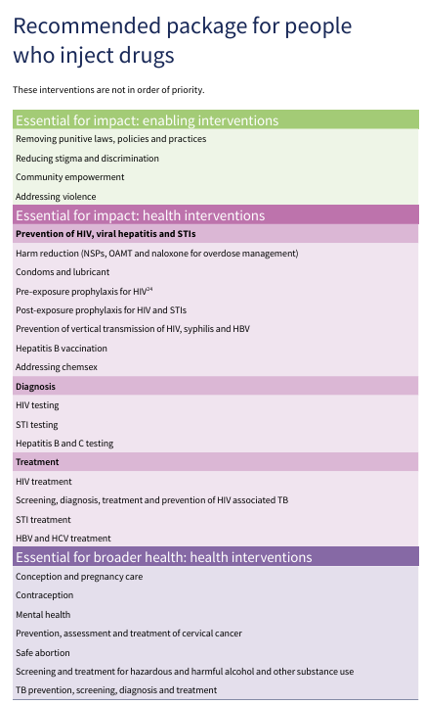
HARM REDUCTION IN GF GC8 AT GLANCE
Among programmatic essentials for GC8
Prioritized for GF investment:
Needle and syringe programs (NSP) for people who inject drugs
Opioid agonist maintenance (OAT) treatment for people with opioid dependence
Overdose prevention and management with naloxone
Hepatitis C virus (HCV) testing/treatment in harm reduction services in countries with high levels of HIV/HCV co-infection
PrEP/PEP in countries with limited access to NSP and OAT
Drug use related stigma, discrimination and criminalization increase barriers to HIV services and should be systematically addressed
WHO (2022) Consolidated guidelines on HIV, viral hepatitis and STI prevention, diagnosis, treatment and care for key populations

Slide 2
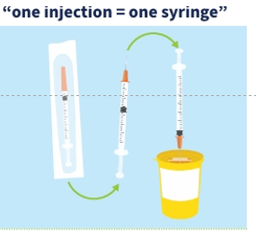
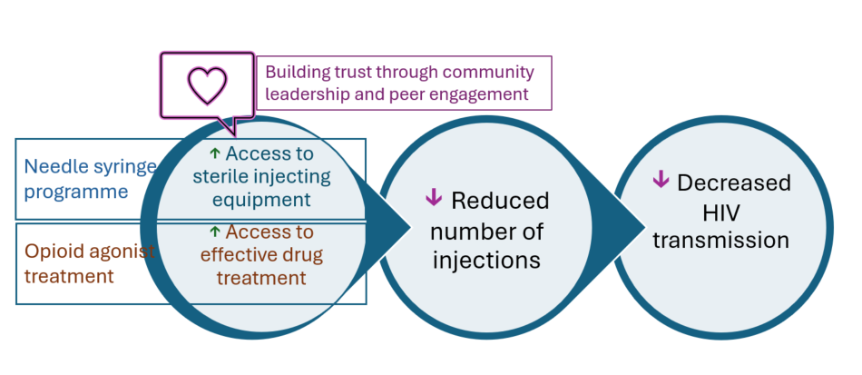
HOW IT WORKS
People who inject drugs have 34× higher risk of acquiring HIV than the general population
HIV transmission is driven by re-use/shared use of syringes and other injecting equipment
Harm reduction meets people who use drugs where they are
Services delivered where people live and use drugs
Respect, dignity, no punishment
Supporting positive change that is possible today
Community leadership & peer engagement are essential
Addressing structural barriers – such as removing criminal sanctions for drug use – help increase access to HIV services and gain efficiencies

Slide 3
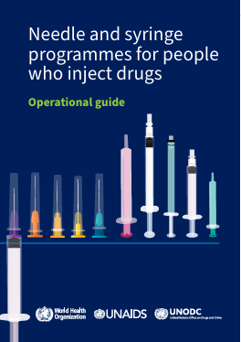
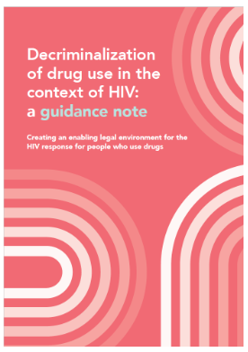
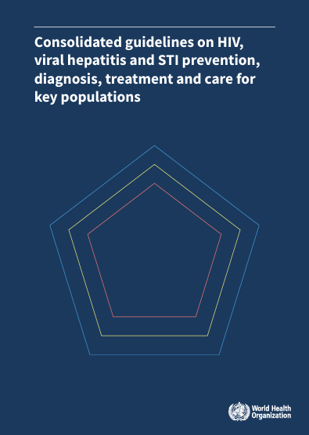
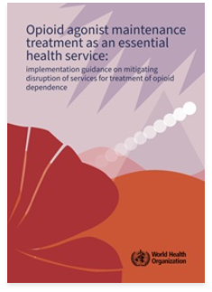
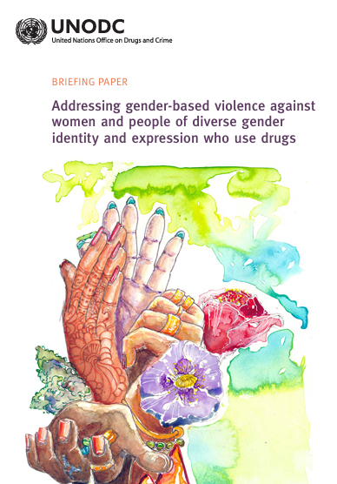
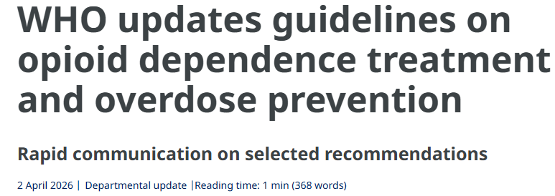
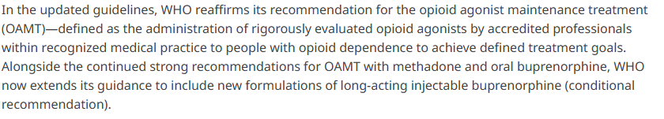
NEW TECHNICLA GUIDANCE
[No too] old but gold
Needle and syringe programmes for people who inject drugs: operational guide
New guidance note on decriminalizing drug use in the context of HIV | UNAIDS
Consolidated guidelines on HIV, viral hepatitis and STI for key populations - 2022
WHO’s new guidance on maintaining opioid agonist maintenance treatment as an essential health service
Gender-based violence against women and people of diverse gender identity and expression who use drugs

