Slide 1

The African HIV Control
Working Group
HIV Leadership Forum
Izukanji Sikazwe, CEO CIDRZ
Windhoek, Namibia
November 9th, 2023

Slide 2
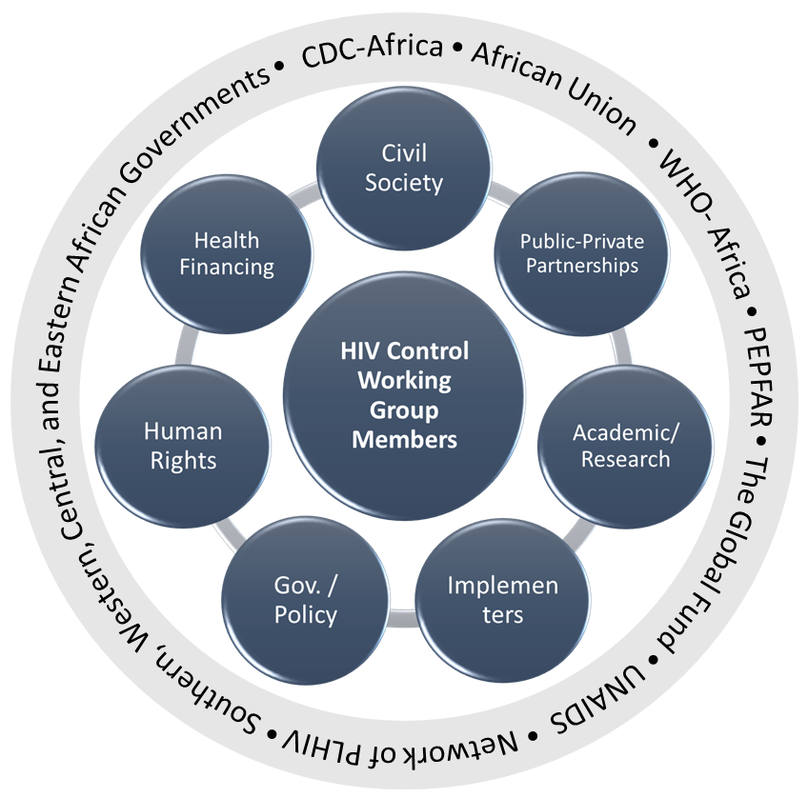
The African HCWG Aims & Shared Vision
Aim: A shared vision on how countries in Africa can prepare for long-term, sustainable HIV control
Intended outcomes:
  An effective African led HCWG that contributes to acceleration and coordination of government and stakeholder HIV/AIDS Control in Africa
  A Framework for reducing HIV as a public health threat and reprioritization of HIV prevention in Africa, including defining HIV Control, impacting attainment of 2030 targets.
  Recommendations that may impact policy formulation.
Notes:
Sub Saharan Africa has made notable progress towards achieving the 95:95:95 targets, Emtct, and working towards ending AIDS by 2030
Many challenges remain, including weak and unwieldy health systems, varying ownership of national HIV programmes, policy and unsupportive legislation, which threaten long-term sustainability of the HIV response, and ending HIV as a public health threat
In addition, the HIV response has largely been led by international experts
With funding support from Bill & Melinda Gates Foundation, an African led HCWG is being constituted
Aim: to develop a shared vision on how countries in Sub-Saharan Africa (SSA) can prepare for long-term, sustainable HIV control
HCWG composition:
diverse group of African experts with relevant experience in HIV programme implementation & research, health systems, finance, policy and governance, civil society and activists, and private sector engagement for health
Desired outcomes
An effective African led HCWG that contributes to acceleration and coordination of government and stakeholder HIV/AIDS Control in SSA.
A Framework for reducing HIV as a public health threat and reprioritization of HIV prevention in Sub -Saharan Africa, impacting attainment of 2030 targets.
Recommendations that may impact policy formulation.

Slide 3
HCWG Legitimacy & Unique Proposition
HCWG – independent and represent African voices
Developed because of key informant interviews conducted in 2021 and 2022
Membership representative of expert technocrats in Africa, that will work collaboratively with African Government leadership, policy bodies, community and funders
Constituted to offer policy guidance to key stakeholders driving the HIV response
Will be guided by Consultative Committee – constituted by members drawn for African Union, Africa CDC, UN Agencies, Funders & Community stakeholders

Slide 4
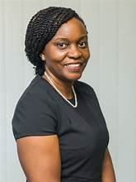
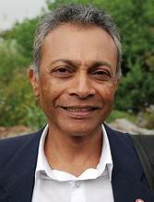
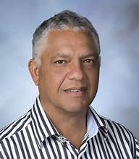

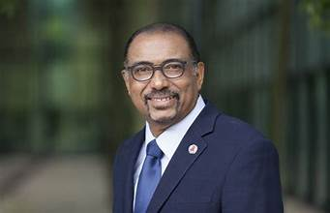



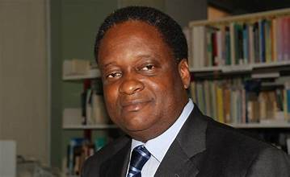
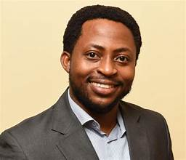
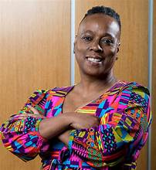

HCWG Members
Dr. Izukanji Sikazwe
Co-Chair
Prof. Yogan Pillay
Co-Chair
Dr. Alex Coutinho
Implementer
Adv. Sasha Stevenson
Human Rights
Dr. Michel Sidibe
Policy/ Snr Technocrat
Prof. Magda Robalo
Policy/ Government
Dr. Jekwu Ozoemene
PPP/ Business Sector
Dr Kawango Agot
Researcher/ Academia
Prof Pierre M’Pele
Researcher/Academia
Prof. John E. Ataguba
Health Finance
Damaris Kwamboka Nyamweya
Civil Society/ Youth
Yvette Raphael
Civil Society
Notes:
Co-Chairs: Yogan Pillay & Izukanji Sikazwe
HCWG membership: 11 diverse individuals with technical expertise in HIV research, programming, health systems & financing, community engagement
HCWG membership architype:
Drawn from academia, NGO’s, CSO’s groups – PLHIV & sub populations (AGYW, KP)
10 years+ experience HIV prevention and care continuum, including SRH/Behavioral Science, research or community initiatives
Deep understanding of SSA epidemic + country/region response
Deep understanding of government, regional & global policies and funding that influences SSA HIV response
Understand health systems & capabilities in SSA
Co-chairs selected members in consultation with stakeholders

Slide 5
  Current Priority Areas I
Thematic Group 1: HIV Control
  TORs
    Provide the HCWG with evidence-based advice and recommendations on HIV control efforts on the continent, including defining HIV Control for Africa
    Identify policy, research and implementation gaps that are not adequately addressed in the HIV response in the continent
    Advance forward-looking policy and programme implementation recommendations to support shaping the last mile approaches for attaining 2030 targets
    Provide technical documents, reports, and recommendations to the HCWG

Slide 6
  Current Priority Areas II
Thematic group 2: Leadership, Governance and Sustainability
  TORs:
    Define key principles of sustainability of the HIV response
    Identify successful governance models for successful implementation of HIV programs
    Recommend evidence based robust and successful professional development programs
    Review evidence required to achieve political, program and financial sustainability for HIV control
    Identify and leverage ongoing continental and global HIV control sustainability efforts
Two other Thematic Groups will be established as part of Phase II: HIV Prevention, Health & Community System Strengthening

Slide 7

Issues for the HCWG to consider – Prevention & Long-term HIV response sustainability
Prevention Targets
Sexual Reproductive Health
Successful Interventions
Despite progress, prevention targets are off track and SSA has majority of new infections globally
Behavioral and sexual health for Africa’s large adolescent/youth population. STI and HIV prevention
Successful prevention interventions in the region need to be identified and scaled for potential to boost prevention in the future.
Ownership
Key & Priority Populations
African governments & Community ownership of HIV prevention and ownership of the response
Unpacking Key & Priority Populations definitions, access to UHC and HIV prevention across different geo-locations
The Africa HIV Control
Working Group (HCWG)

Slide 8
Issues for the HCWG to consider – Treatment
Access & UHC
Treatment as Prevention
Addressing needs of PLHIV, maintaining HIV viral suppression, amidst competing co-morbidities
Increased assess across all domains, person-centered care, integration across diseases, leveraging UHC initiatives
HIV Vaccines & Cure
Advocacy & supporting Cure Research in Africa
Achieving & Surpassing Targets
Beyond 95:95:95
For all populations irrespective of geolocation, sexual orientation, gender, age
What does HIV control mean? How will countries get there? What targets do we work towards
The Africa HIV Control
Working Group (HCWG)

Slide 9
  Current Information Gathering Activities
Phase 2 KIIs to be undertaken focusing on African perspectives
  Defining HIV control from African context
  Unpacking levers required to achieve HIV Control and sustainability of HIV programs
  Focus on African stakeholders not adequately covered in Phase 1 KIIs i.e. program managers and leaders (NAC Directors), civil society, academics and technocrats, community representatives)
Position papers in development:
  HIV Control Definitions and the shortfalls when applied to Africa
  HIV Control Sustainability
Participation in key regional and global meetings (UNAIDS) for the post-2030 roadmap
HCWG Quarterly Meeting in December

Slide 10
  What will determine success of the HCWG
A clear African HIV Control Definition, with buy in across the continent
Incorporation of recommendations into policy bodies and other National Strategic Frameworks
Shift in funding to reflect investment in key priorities identified and adopted by African consensus
Participation of key stakeholders including community representatives in HCWG processes
Collaborative partnerships with key African and global players e.g. Africa CDC, WHO-Afro, UNAIDS, donors etc.

Slide 11
  Acknowledgements
We would like to acknowledge the participation of all HCWG Members and Thematic Group Members for their commitment to the aim and mission of the HCWG.
We would also like to acknowledge and thank key stakeholders across governments, funders, implementers, researchers, and civil society for their support and willingness to engage with the HCWG.
Funding for this work is provided by the Bill and Melinda Gates Foundation (BMGF) Investment ID: NV-004517.

