Slide 1
WHO Guidance on Integration of HIV prevention services
Clarice Pinto, Technical Officer, WHO
Department for HIV, Tuberculosis, Hepatitis and Sexually Transmitted Infections
27 April 2026

Slide 2

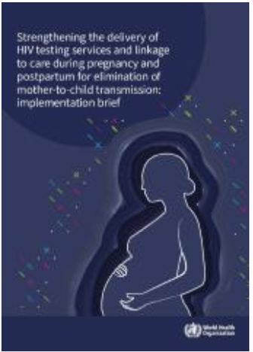
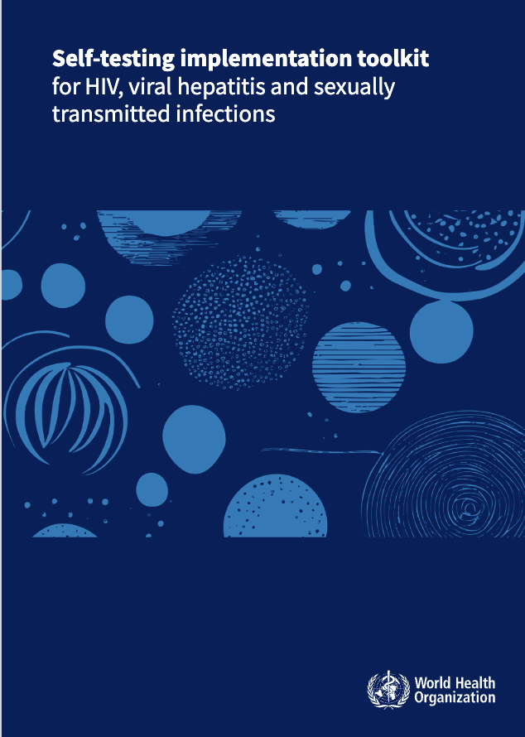
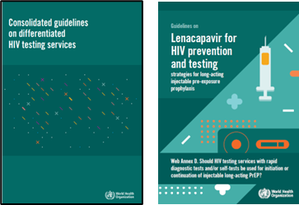
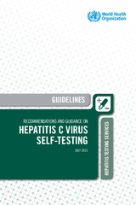
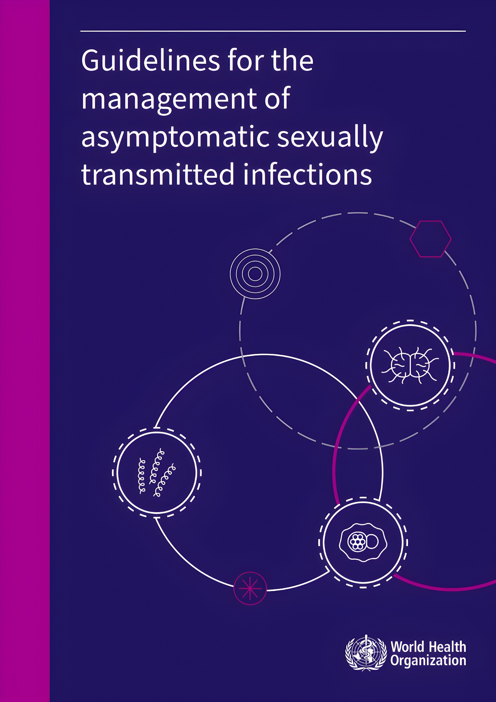
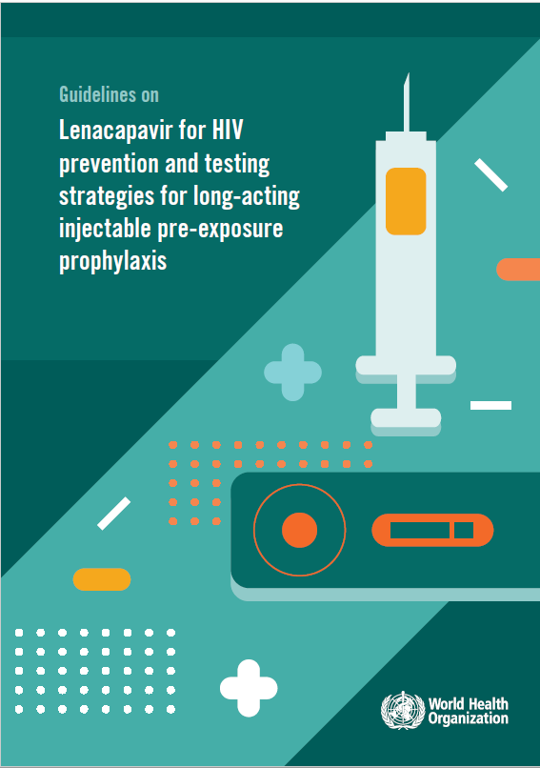
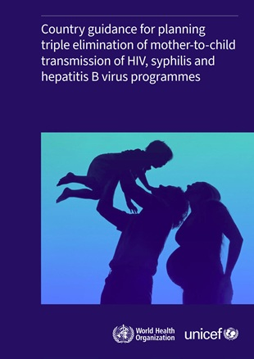
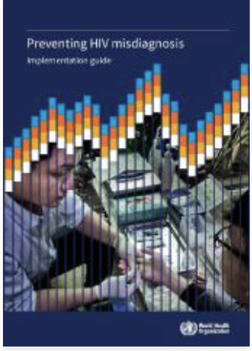
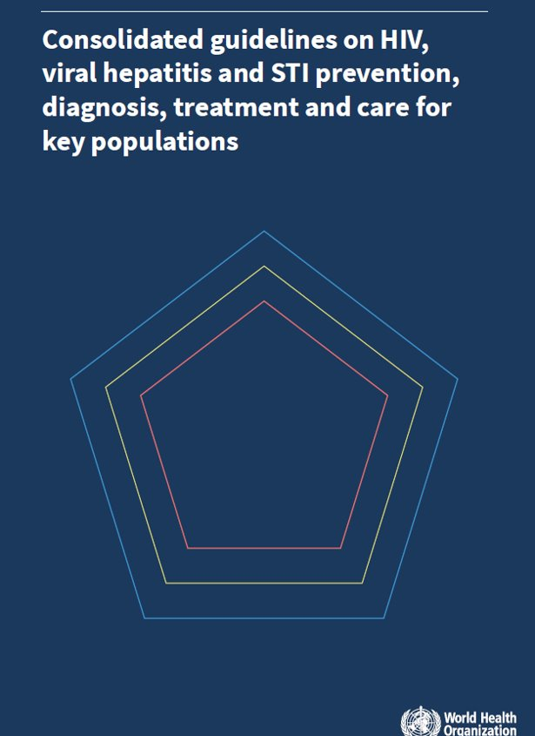
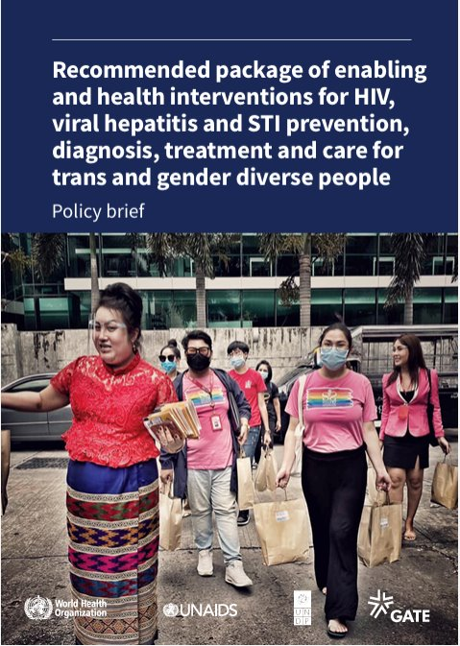
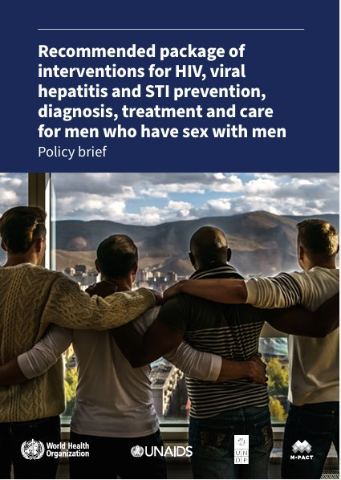
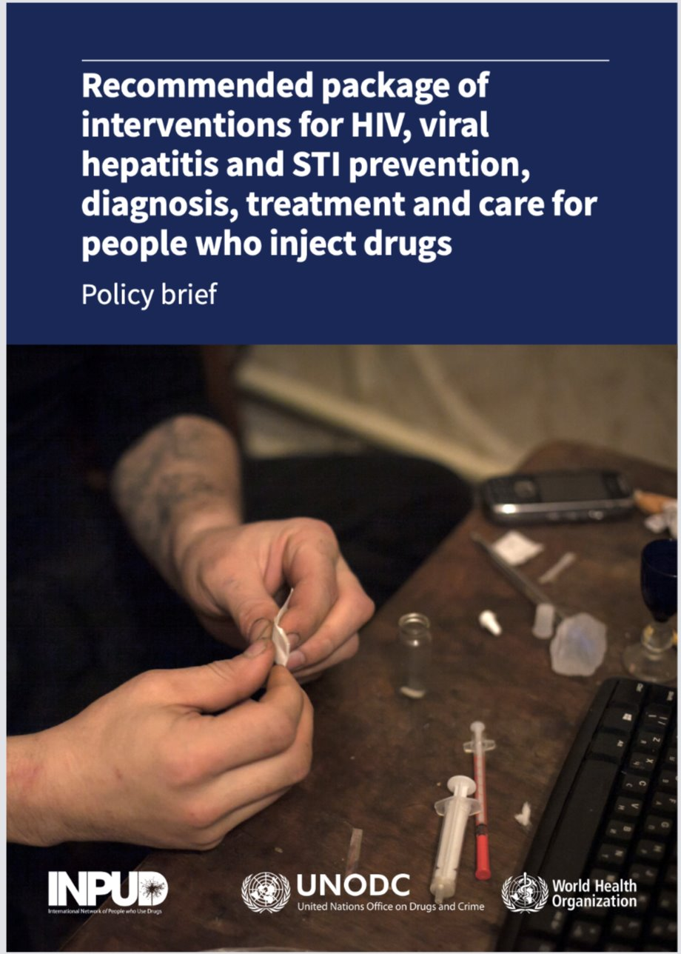
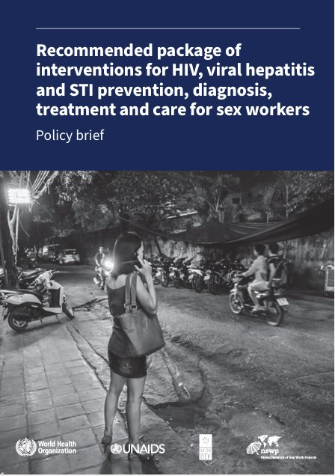
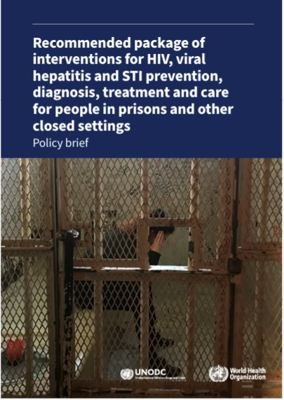
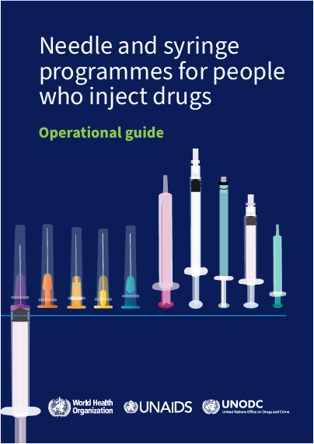
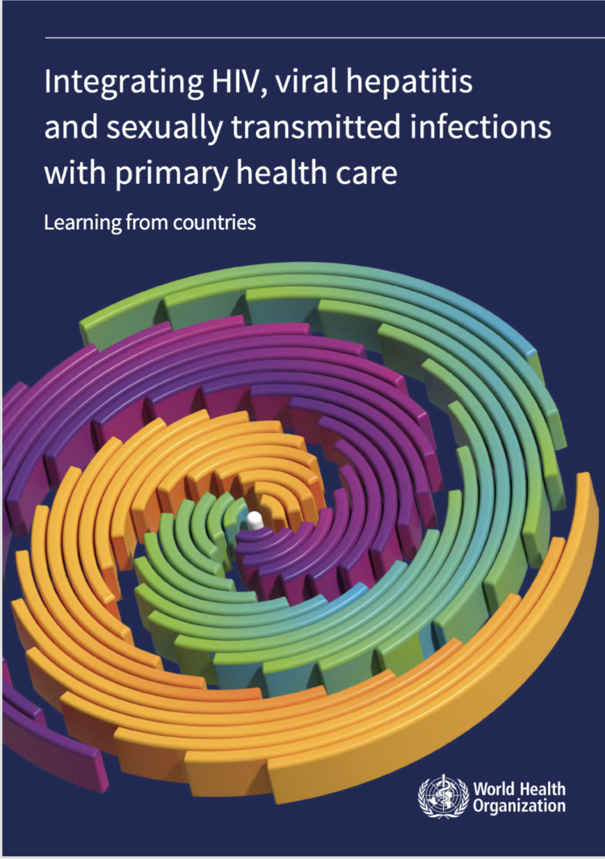
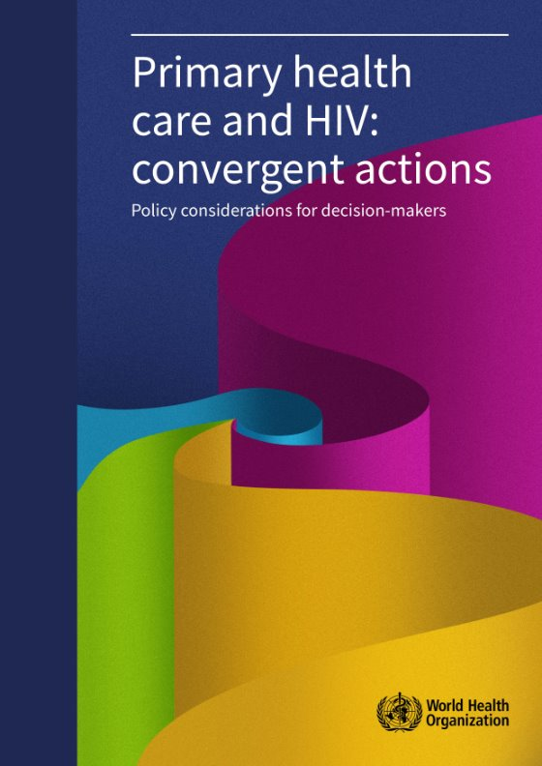
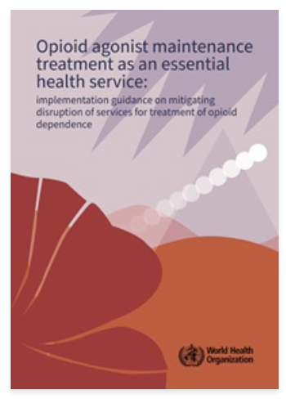
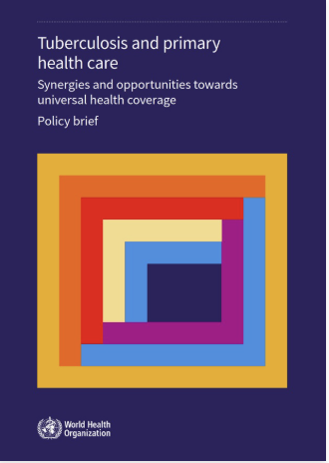

WHO Integration Publications Roadmap
Triple Elimination of Mother-to-Child Transmission
Testing and Prevention
Strengthening the delivery of HIV testing services and linkage to care during pregnancy and postpartum for elimination of mother-to-child transmission
Practical resource to countries working to adopt and scale-up WHO HIV testing guidance for pregnant and postpartum women. Country implementation examples, evidenced-based recommendations and policy guidance are provided throughout.
https://www.who.int/publications/i/item/9789240101371
Self-Testing Implementation Toolkit
An implementation toolkit supporting self care interventions for HIV, Hepatitis C, and Syphilis testing.
https://www.who.int/publications/i/item/9789240102323
Guideline on Lenacepavir (LEN) for HIV Prevention & and testing strategies for long-acting injectable PrEP
Offering LEN as an additional HIV prevention choice, as part of combination HIV prevention approaches.
HIV rapid diagnostic tests (RDTs) for individuals initiating or continuing long-acting injectable PrEP, such as LEN and long acting injectable cabotegravir (CAB-LA).
https://www.who.int/publications/i/item/9789240111608
https://www.who.int/tools/self-testing-implementation-toolkit-for-hiv-hcv-and-syphilis
Country guidance for planning triple elimination of mother-to-child transmission of HIV, syphilis and hepatitis B virus programmes
Guidance for planning country-specific programming to achieve the triple elimination of mother-to-child (or vertical) transmission of HIV, syphilis and hepatitis B virus
Country guidance for planning triple elimination
Key populations Services
https://www.who.int/publications/i/item/9789240092136
Harm Reduction Implementation
Integration within PHC
https://www.who.int/teams/global-hiv-hepatitis-and-stis-programmes/populations
Needle and Syringe Programmes (NSP) Operational Guide
Provides a structured framework for scaling up harm reduction services for people who inject drugs (PWID).
Step‑by‑step guidance on NSP service models and delivery options
Clear programme elements that translate into budget lines
https://iris.who.int/handle/10665/384810
Integrating HIV, Viral Hepatitis and STIs with PHC
highlights progress and lessons learned from efforts to converge, link and integrate these services with PHC in several low- and middle-income countries.
https://www.who.int/publications/i/item/9789240112957
https://www.who.int/publications/i/item/9789240052390
Tuberculosis and primary health care: synergies and opportunities towards universal health coverage
Explores the synergies and opportunities that arise from aligning the TB response with the principles of PHC, to jointly advance respective efforts to strengthen PHC and end TB as a public health threat
https://www.who.int/publications/i/item/9789240111295
Opioid agonist maintenance therapy
Call to protect OAMT continuity. It must not be interrupted, even in crises
Essential for sustainable, equitable access
https://www.who.int/publications/i/item/B09543
https://www.who.int/publications/i/item/9789240077065

Slide 3








1. Assess (Epidemic Profiling)
Define the Package.
Utilize epidemiological and program data to identify specific prevention needs.
Align packages (PrEP, PEP, condoms, HPV vaccines) to the actual disease burdens to ensure person-centered care.
A Framework for Integrated HIV Prevention Services:
Shifting from siloed disease verticals to person-centered PHC ecosystems driven by data
2. Map (Identify Entry Points)
Break the Silos.
Leverage existing opportunities where priority populations already seek care rather than building new structures.
3. Evaluate (Strengthen Capacity)
Bolster PHC Levers. Audit two critical capacities: workforce and commodities.
Train staff for multi-disease coverage (e.g., HIV and syphilis) and secure integrated supply chains for tools like dual rapid tests and HIV self-test kits.
6. Sustain (Monitor & Protect)
Remove Structural Barriers.
Secure long-term viability by dismantling stigma, discrimination, and restrictive age-of-consent laws.
Continuously monitor linkage to care to ensure integrated services reach those most at risk.
Integration Engine
4. Decide (Pathways)
Determine Viability.
Evaluate entry points against three critical criteria: System suitability, workforce readiness, and community trust.
Refer clients or systematically strengthen components if full integration requirements are unmet.
5. Implement (Execute Models)
Deploy Delivery Pathways.
Launch customized, evidence-based care models based on readiness: Co-delivery, Coordinated Referral, or Self-Care
Integration

Slide 4
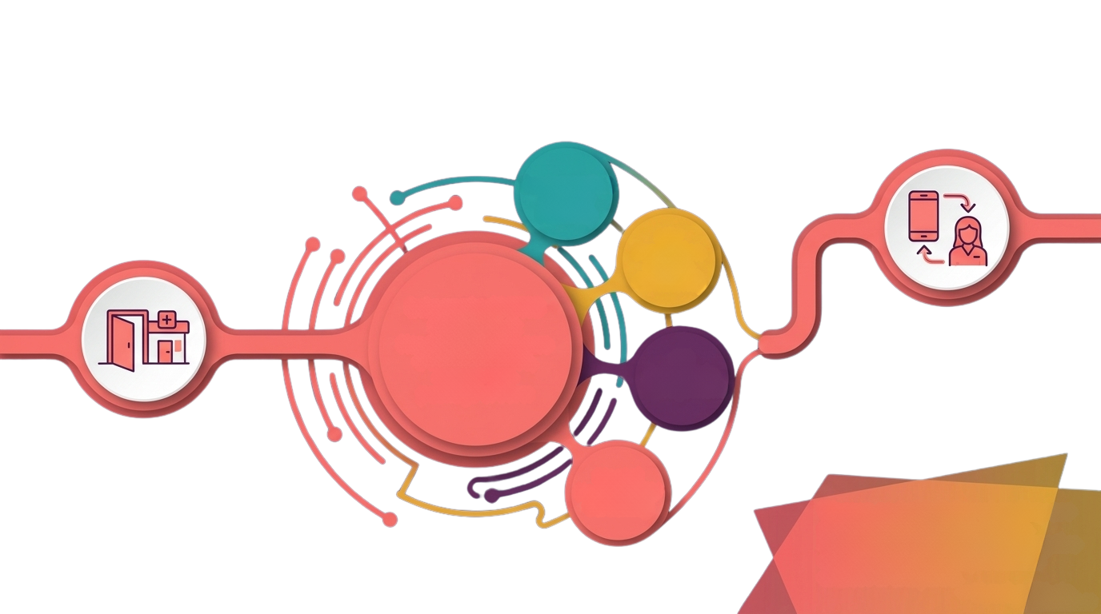
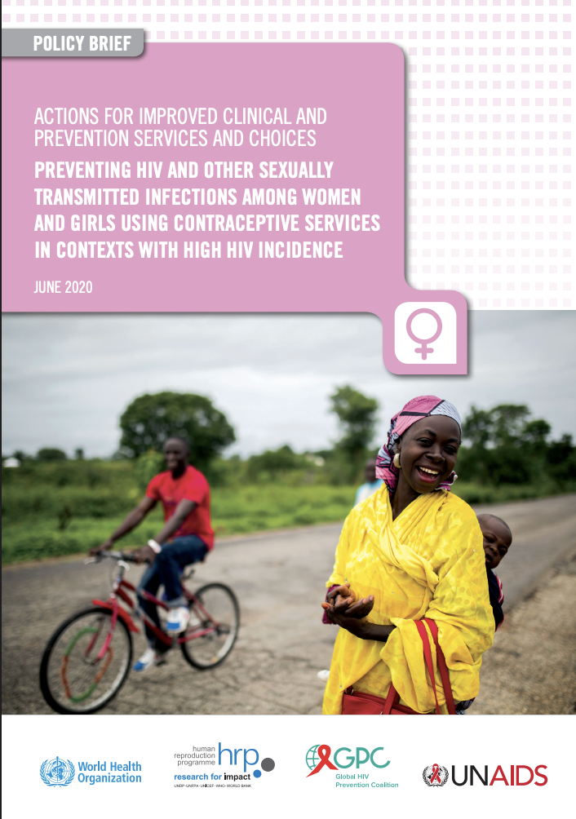
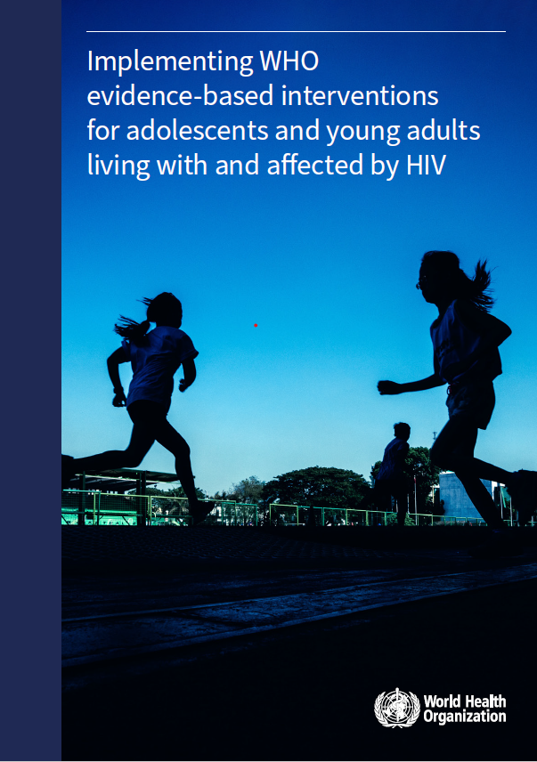
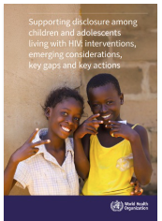

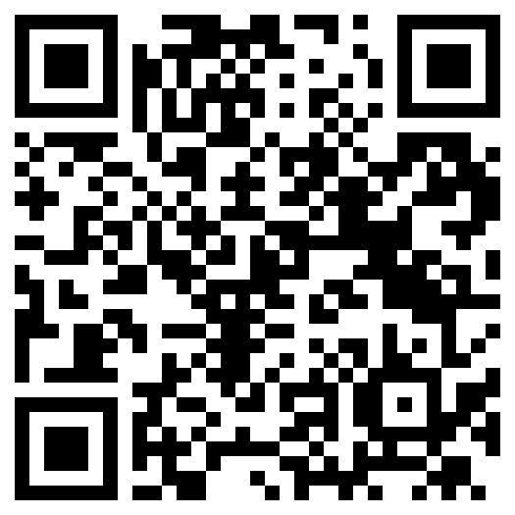
E.g. AGYW Integrated HIV Prevention Journey: Empowering Adolescent Girls and Young Women through Sexual & Reproductive Health (SRH) and HIV services
https://www.who.int/publications/i/item/WHO-UCN-HHS-19.58
SRH
(HPV vaccination Contraception /FP
HIV prevention
(PrEP & Condoms)
Integrated Screening:
Single visit triggers
a comprehensive,
stigma-free
package of care
Same-Day Management & Follow-up:
Commodities received on the spot.
CHW or digital health app is linked for additional support and continues access to services.
STI
Syndromic
Management
Routine SRH Visit:
AGYW visits a youth-friendly PHC facility seeking contraceptive services.
Mental
Health & GBV
Screening

Slide 5
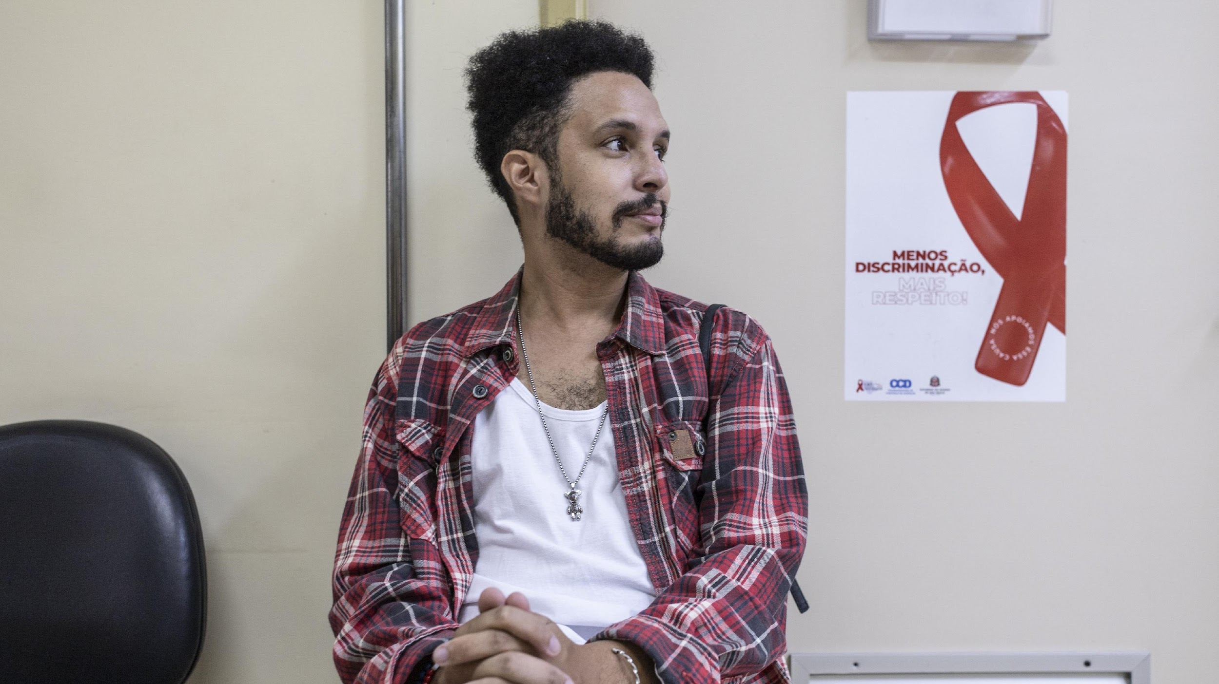

Thank you!
Thank you to all the technical groups and experts from WHO and other organizations who contributed to this work!

Slide 6
WHO Key Populations essential intervention packages
CATEGORY |  | INTERVENTIONS | MSM | SW | PRISONS/ CLOSED | PWID | TRANS & GD
Essential for impact: enabling interventions (Recommended to reduce structural barriers to health services access) |  | Removing punitive laws, policies and practices | ✓ | ✓ | ✓ | ✓ | ✓
 |  | Reducing stigma and discrimination | ✓ | ✓ | ✓ | ✓ | ✓
 |  | Community empowerment | ✓ | ✓ | ✓ | ✓ | ✓
 |  | Addressing violence | ✓ | ✓ | ✓ | ✓ | ✓
Essential for impact: health interventions (Demonstrated direct health impact) | Prevention | Harm reduction (needle/syringe, OAT, naloxone for overdose management) | (✓)* | (✓)* | ✓ | ✓ | (✓)*
 |  | Condoms and lubricant | ✓ | ✓ | ✓ | ✓ | ✓
 |  | PrEP for HIV | ✓ | ✓ | ✓ | ✓ | ✓
 |  | PEP for HIV/STIs | ✓ | ✓ | ✓ | ✓ | ✓
 |  | Vertical transmission prevention (HIV, syphilis, HBV) |  | ✓ | ✓ | ✓ | ✓
 |  | Hepatitis B vaccination | ✓ | ✓ | ✓ | ✓ | ✓
 |  | Addressing chemsex | ✓ | ✓ |  | ✓ | ✓
 | Diagnosis | HIV testing services | ✓ | ✓ | ✓ | ✓ | ✓
 |  | STI testing | ✓ | ✓ | ✓ | ✓ | ✓
 |  | Hepatitis B and C testing | ✓ | ✓ | ✓ | ✓ | ✓
 | Treatment | HIV treatment | ✓ | ✓ | ✓ | ✓ | ✓
 |  | HIV-associated TB: screen/diagnose/treat/prevent | ✓ | ✓ | ✓ | ✓ | ✓
 |  | STI treatment | ✓ | ✓ | ✓ | ✓ | ✓
 |  | Hepatitis B and C treatment | ✓ | ✓ | ✓ | ✓ | ✓
Essential for broader health: health interventions (Should be ensured, but do not have direct health impact) |  | Anal health | ✓ | ✓ | ✓ |  | ✓
 |  | Conception and pregnancy care |  | ✓ | ✓ | ✓ | ✓
 |  | Contraception |  | ✓ | ✓ | ✓ | ✓
 |  | Gender-affirming care |  |  |  |  | ✓
 |  | Mental health | ✓ | ✓ | ✓ | ✓ | ✓
 |  | Cervical cancer: prevent/screen/treat |  | ✓ | ✓ | ✓ | ✓
 |  | Safe abortion |  | ✓ | ✓ | ✓ | ✓
 |  | Hazardous/harmful alcohol & other substance use: screen/treat | ✓ | ✓ | ✓ | ✓ | ✓
 |  | TB: prevent/screen/diagnose/treat |  |  | ✓ | ✓
Supportive (Support the delivery of other interventions, such as creating demand, and providing information and education) |  | Service delivery: community-led; task sharing; integration; decentralization; self-care; virtual | ✓ | ✓ | ✓ | ✓ | ✓
This checklist can be a baseline to identify if essential and supportive interventions are included in programmes and where are there gaps that need to be covered.
Notes:
Achieving real impact requires delivering a complete package of enabling, preventive, diagnostic and treatment interventions, not isolated services.
This checklist can be a baseline to identify if essential and supportive interventions are included in programmes and where are there gaps that need to be covered.

