Slide 1
HIV Prevention Guidance in GC8
Izukanji Sikazwe, Head of HIV
27 April 2026

Slide 2
GC8 Strategic Shifts & Prioritization Guidance
The six GC8 strategic shifts
1
Set transition pathways
Determine timelines with predictable financing and focus on most challenging sustainability issues
The prioritization guidance supports national stakeholders in proposing high-impact use of Global Fund investments within national responses.
2
Place greater priority on lowest income, highest burden
Shift GF allocations where disease progress affects global progress
& domestic resources are most limited
3
Advance programmatic prioritization
Equip and support country-led rigorous prioritization & market shaping for introduction & scale of new innovations
Success depends on efficiency and optimization, making difficult trade-offs amid funding gaps, removing access barriers for high-risk groups, integration, rapidly innovating and adapting.
4
Accelerate integration
Invest in integrated program delivery within primary health care
5
Feature community systems & financing
Incentivize community systems integration and financing
6
Grow & optimize domestic resources
Use differentiated co-financing approaches and optimize pooled procurements market access by domestic markets

Slide 3
GC8 Global Fund guidance Accelerating impact in HIV Prevention amid growing challenges
Focus of Global Fund GC8 Guidance (now published)
Maximize impact under constrained financing through rigorous, country‑led prioritization — focusing Global Fund investments on highest‑burden settings and populations, accelerating integration and sustainability, and making tough trade‑offs to protect outcomes
HIV prevention:
Pressure is particularly acute for HIV prevention, making it critical that investments are fit for purpose. HIV prevention programs must be high‑impact, cost‑effective, and well‑targeted, with a strong focus on implementation
Prioritize interventions for people with the greatest HIV prevention needs and locations with the highest HIV incidence, and close access gaps in settings with high concentrations of KP* and adolescent girls and young women who are at particular risk in settings with moderate and high HIV incidence.
* Key Populations (KP) are defined by UNAIDS as those particularly vulnerable to HIV and frequently lack adequate access to services: gay men and other men who have sex with men, sex workers, transgender people, people who inject drugs and prisoners and other incarcerated people. Key and Vulnerable Populations (KVP) include KP, adolescent girls and young women (AGYW) and other vulnerable populations (OVP) at risk

Slide 4
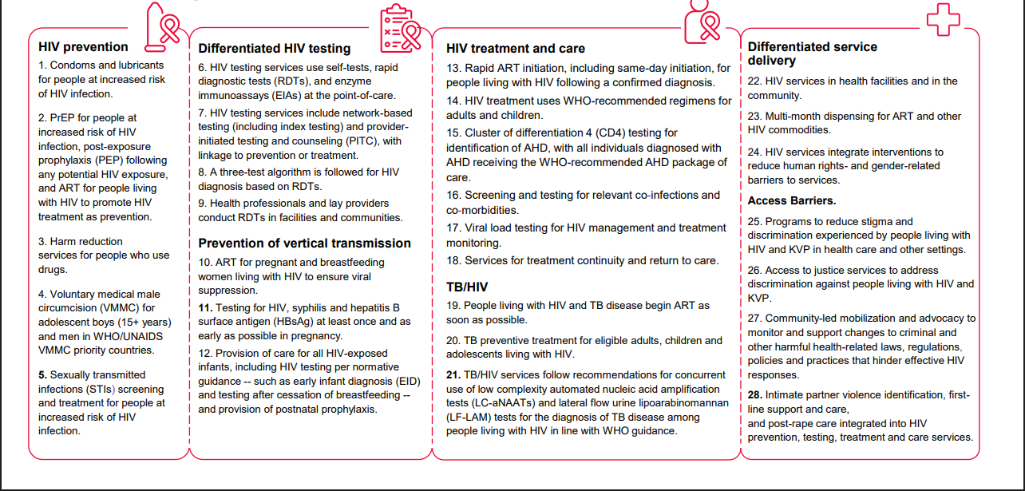
Program Essentials provide a framework for prioritizing context specific interventions
HIV Prevention Program Essentials
Condoms and lubricants for people at increased risk of HIV infection.
PrEP for people at increased risk of HIV infection, post-exposure prophylaxis (PEP) following any potential HIV exposure, and ART for people living with HIV to promote HIV treatment as prevention.
Harm reduction services for people who use drugs.
Voluntary medical male circumcision (VMMC) for adolescent boys (15+ years) and men in WHO/UNAIDS VMMC priority countries.
Sexually transmitted infections (STIs) screening and treatment for people at increased risk of HIV infection.
Program essentials are the core HIV interventions that must be in place in a country to protect lives and prevent reversals of progress — regardless of whether they are financed by the Global Fund, domestic resources, or other partners.
They are the baseline against which Global Fund investments are prioritized and made catalytic.

Slide 5
Integrated HIV Prevention Matching Funds
MF Objectives
Matching Funds Conditions
HIVST Expansion and Diversification: Expand geographic coverage and diversify HIVST kits to blood, urine and oral-fluid. PrEP Accessibility and Funding: Broaden access to oral and long-acting PrEP, capitalize on the LEN access investment. Maternal, reproductive and HIV Service Integration: Integrate sexual and reproductive health with HIV services to improve outcomes and system efficiency through tailored country approaches.
Country may access funds from the Matching Fund, provided it invests at least an equal amount of available Matching Funds from its country allocation in HIV pre-exposure prophylaxis interventions and HIV self-testing commodities.
HIVST and PrEP coverage indicators, with a minimum target of PrEP users during the grant reporting period as communicated by the Global Fund.
Planned procurement of a mix of oral- and blood- or urine-based WHO pre-qualified HIVST.
Where these products are used, evidence showing that national policies and strategies currently allow, or will be developed within the first year of the grant implementation period to allow, (1) a single HIV rapid diagnostic test for initiation and continuation of long-acting injectable PrEP; and (2) HIVST for initiation and continuation of Tenofovir-based oral PrEP and the Dapivirine Vaginal Ring.
Investments in targeted HIV prevention programs based on geographic and population‑level risk data from 2024 onwards.
Plans to increase the number of sites delivering integrated PrEP, HIVST and sexual and reproductive health services for HIV prevention, at primary health care and community level, compared to the number of sites at the end of 2025.
Nine Beneficiary Countries
Eswatini, Lesotho, Mozambique, Zimbabwe, Zambia, Malawi, Uganda, Kenya, Nigeria

Slide 6
Global Fund GC8
Core applicant guidance
HIV Prioritization Guidance and Enabling Impact Guidance - equip national stakeholders in determining additive, high impact Global Fund investments in national responses. Prioritization Guidance
Modular Framework - guides applicants and implementers to organize program activities into standard modules and interventions. Modular Framework

