Slide 1
Innovations in HIV prevention: with focus on key populations
Orientation and action planning workshop on new Global Prevention Coalition countries
Kigali, 24-26 October 2023
Maeve B. de Mello, BSc, PhD (pronouns she/her/hers)
Technical Officer – Key Populations & STI Prevention
Testing, Prevention and Population Unit
Global HIV, Hepatitis and STIs Programmes
demellmae@who.int

Slide 2

What is innovation in public health?
WHO defines health innovation as a new or improved solution with the transformative ability to accelerate positive health impact.
Solution can be health policies, practices, systems, products and technologies, services, and delivery methods that result in improved healthcare.

Slide 3
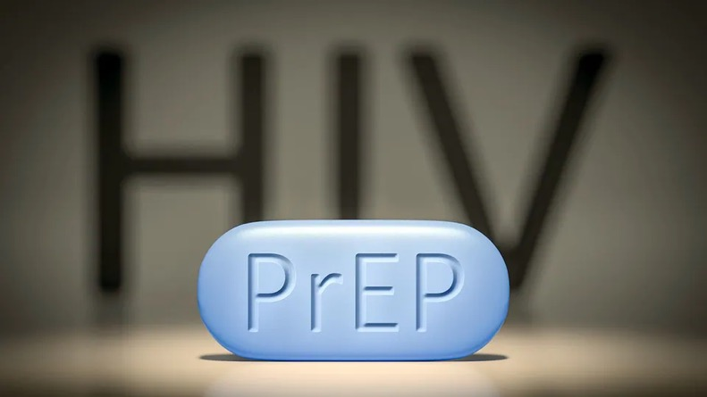
Innovations in PrEP: differentiation, simplification and choices
Thanks to the WHO PrEP team for the slides: Rachel Baggaley, Michelle Rodolph, Heather-Marie Schmidt (joint position with UNAIDS)

Slide 4
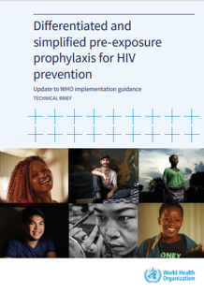
KEY WHO GUIDANCE on PrEP
2012
Conditional recommendation: oral PrEP
2015
Strong recommendation: oral PrEP for all individuals at substantial risk
2017
Event driven / 2+1+1 (ED-PrEP) guidance
2021
Conditional recommendation: Dapivirine vaginal ring (DVR)
2022
Conditional recommendation: Long acting injectable cabotegravir (CAB-LA)
2019
PrEP implementation tool
Differentiated & simplified PrEP (technical brief)
To accelerate PrEP scale-up and overcome barriers, we need differentiated and simplified PrEP services
Differentiated and simplified pre-exposure prophylaxis for HIV prevention: update to WHO implementation guidance

Slide 5
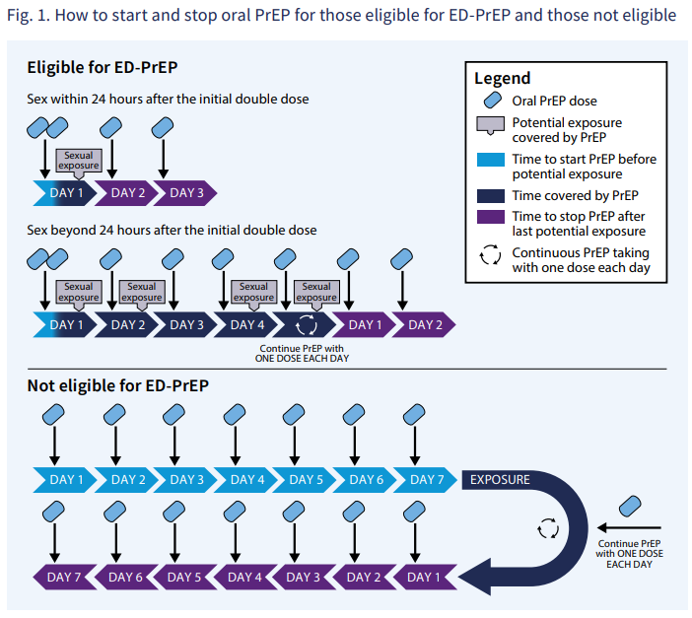
Starting, using and stopping oral PrEP
Dosing regimen
for all people assigned male at birth who are not taking hormones AND who have sexual exposure (as opposed to just MSM before)
Start: 2 doses 2-24h before sex
Continue with 1 dose every day
Stop: 1 dose for 2 days after last sex
For all other populations
Start: 7 days of 1 dose first exposure
Continue with 1 dose every day
Stop: 7 days of 1 dose after last sex
Viral hepatitis testing
HBV: Test once within 3 months of initiation
HCV: Test around within 3 months of initiation and every 12 months (where indicated)
Not a requirement for use or initiation
Simplified guidance for kidney function
Optional for those without comorbidities aged under 30 and, depending on resources, for those under 50
Assigned male at birth with sexual exposure & not taking gender affirming hormones
All other groups
Differentiated and simplified pre-exposure prophylaxis for HIV prevention: update to WHO implementation guidance
Notes:
Key points
Expanded eligibility for ED-PrEP to prevent sexual acquisition of HIV
HBV infection: not a contraindication for ED-PrEP
Not eligible for ED-PrEP: Start daily oral PrEP with 7 doses and stop with 7 doses
Starting and stopping is the same irrespective of whether the intention is to use PrEP for one event, multiple or daily

Slide 6
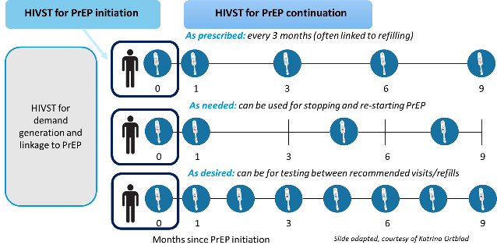
HIV self-testing for PrEP
HIVST an additional testing option to complement HIV testing strategies for oral PrEP and DVR. Role for HIVST with CAB-LA currently unclear.

Slide 7
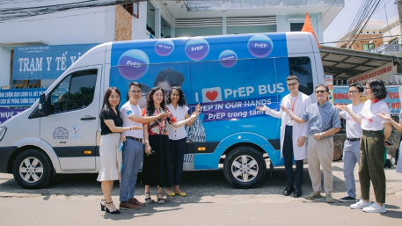
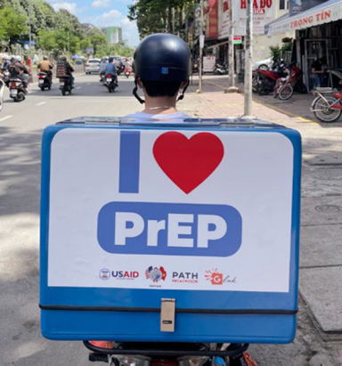
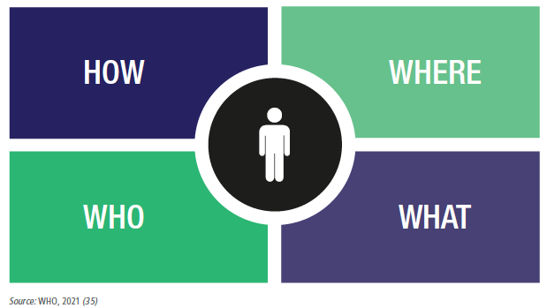
Differentiated service delivery supports scale-up, access, acceptability
Task sharing/shifting make the best use of available human resources
Supported by:
Appropriate clinical oversight and referral pathways
Logistics systems
Adequate infrastructure
Integrated data systems
WHEN

Slide 8
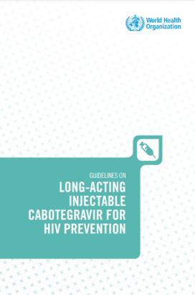
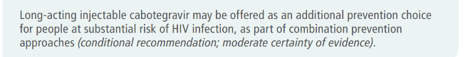
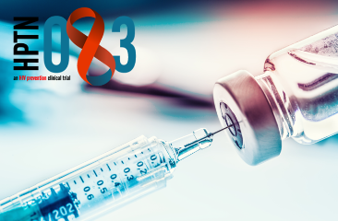
WHO new recommendation: Long-acting injectable cabotegravir (CAB-LA)
Intramuscular injection every 8 weeks
Phase III trials showed high efficacy
Approved by USA, AUS, ZIM, RSA, EMA + 8 others (+ pending in 11 countries)
Voluntary licensing agreement with Medicine Patent Pool to identify generic manufacturer
Outstanding critical issues
Drug resistance
Safety during pregnancy and breastfeeding
HIV testing
Limited representation of some key populations

Slide 9

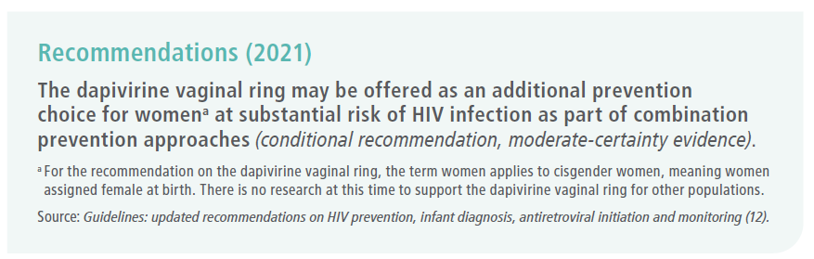
PrEP: dapivirine vaginal ring (DPV-VR)
Women-initiated, easy to use, silicone vaginal ring containing dapivirine (NNRTI)
DPV is released from the ring into the vagina slowly over 1 month
Should be continuously worn for 1 month and then replaced
The risk of HIV-1 infection is reduced 24 hours after ring insertion
WHO suggests DPV-VR to be given priority for women at substantial risk of HIV infection
High price currently but fewer health system resources
Regulatory approval in several African countries (plus pending)
Global Fund procurement
Important to have choices

Slide 10

HIV PEP
Thanks to WHO team: Rachel Baggaley & Virginia MacDonald

Slide 11
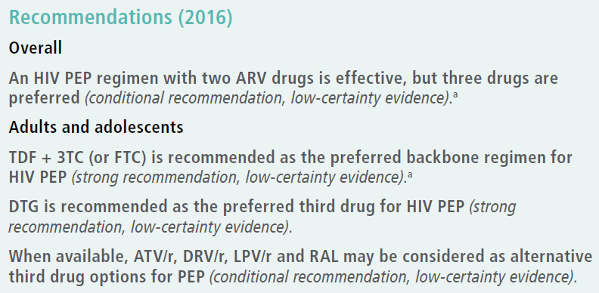
Rethinking HIV PEP, beyond occupational and violence
Current issues:
Community awareness of PEP is low
Availability of PEP limited
People jump through hoops to get PEP
PEP is under-utilized
PEP is often started late
Completion rate is sub-optimal
When thinking about PEP
Think about STIs and emergency contraception
Using a “PEP contact” to think about longer term prevention, incl. PEP to PrEP
Upcoming WHO guidelines (2024)
HIV PEP should be offered and initiated as early as possible for all individuals with exposure that has the potential for transmission, preferably within 72 hours.
To improve completion rates, adherence support and a full 28-day course of medication at the first clinic visit should be provided.

Slide 12

Virtual interventions to support the HIV response
Thanks to WHO team: Purvi Shaw (joint position with UNAIDS) and Rachel Baggaley

Slide 13





What are Virtual Interventions
Interventions that use any of the strategies or approaches virtually without coming face to face with the client is called virtual interventions.
This can be internet-based outreach, social media posts, simple phone-based counseling, mailing a HIV ST kit, SMS or a virtual doctor consultation
With the experience of COVID -19, globally HIV programs are looking for ways to mitigate the impact on the HIV programs
Virtual interventions help programs to continue providing services to the populations without coming to the facility.

Slide 14
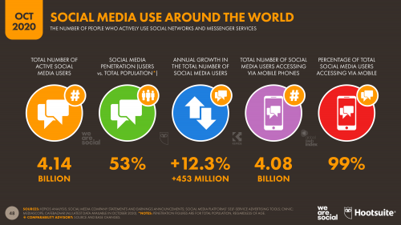
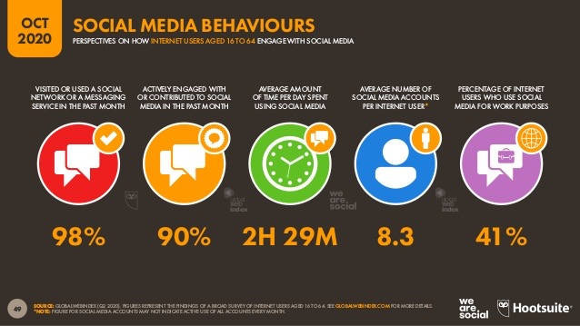
Potential benefits of going virtual
4.14 billion active social media users
2.5 hours on social media
Reach broader audience
Targeted reach
Improved efficiency
Less time consuming

Slide 15




Virtual interventions: systematic review of 3 different types of interventions
Outreach through online platforms: conducted through the internet (website or app, accessed through any device).
Online case management: online methods to conduct risk screening, referral, appointment scheduling and reminders for prevention, testing and treatment services, adherence support, follow-up, counselling, telemedicine and home delivery of services.
Targeted online health information: information/education, behaviour change communication, or health service advertisements delivered through Facebook, dating apps, etc where data can be mined to target specific messages to different KP or where targeted messages, which aim to bring about behaviour change by motivating or mobilizing followers to get tested or learn about prevention, can be passed through social media influencers.

Slide 16
Virtual interventions findings
Online outreach | - More unreached people getting reached - No difference in use of prevention services (condom use) - Increase in HIV testing
Online case management | - No difference in use of prevention services - Uncertain about the impact on uptake of repeat HIV testing - Modest improvement or no difference in treatment initiation - No difference in treatment retention/completion
Targeted health information | - Uncertain about the impact on use of prevention services - May be no difference in uptake of testing services
- At least comparable outcomes
- Probably cost saving and convenient
- Is complimentary to traditional face to face services

Slide 17
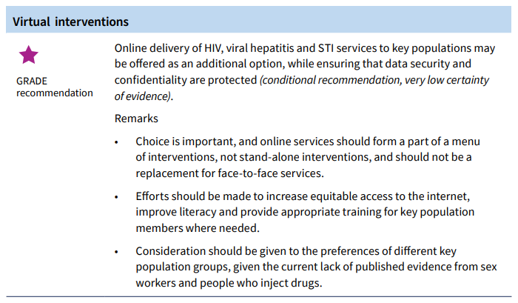
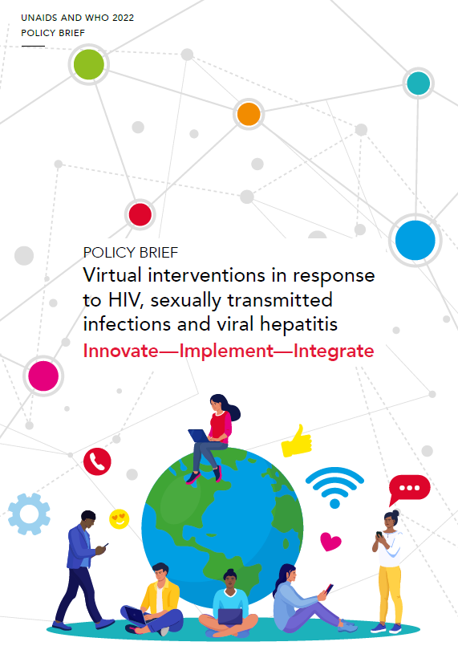

New recommendations on service delivery: Online delivery

Slide 18
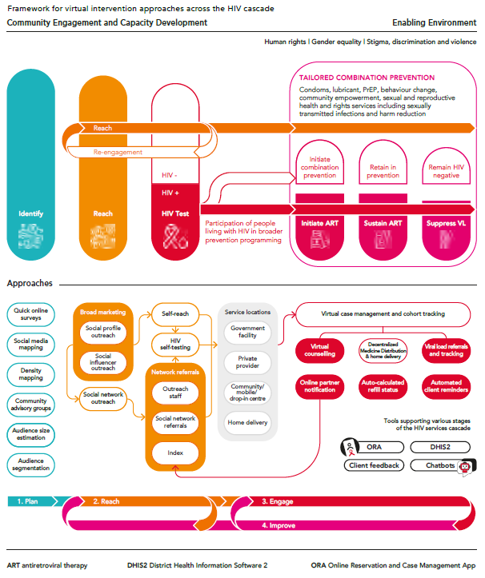
Framework for virtual intervention approaches across the HIV cascade
Source: Virtual HIV interventions: a budgeting and programming aid. Washington, DC and Geneva: FHI 360, Global HIV Prevention Coalition, and Joint United Nations Programme on HIV/AIDS; 2022 (https://hivpreventioncoalition.unaids.org/resource/3332/).

Slide 19
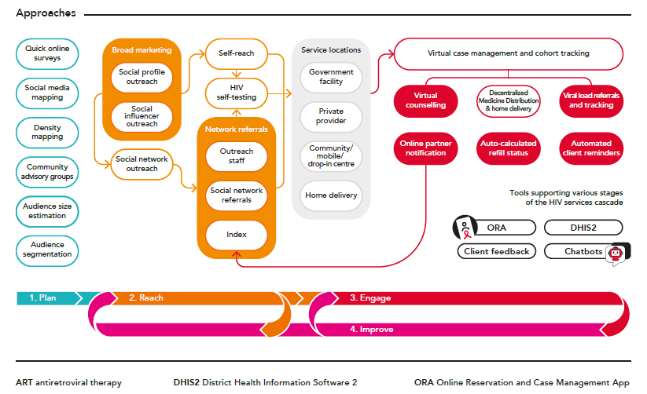
Source: Virtual HIV interventions: a budgeting and programming aid. Washington, DC and Geneva: FHI 360, Global HIV Prevention Coalition, and Joint United Nations Programme on HIV/AIDS; 2022 (https://hivpreventioncoalition.unaids.org/resource/3332/).

Slide 20
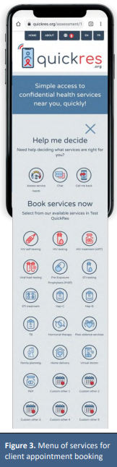
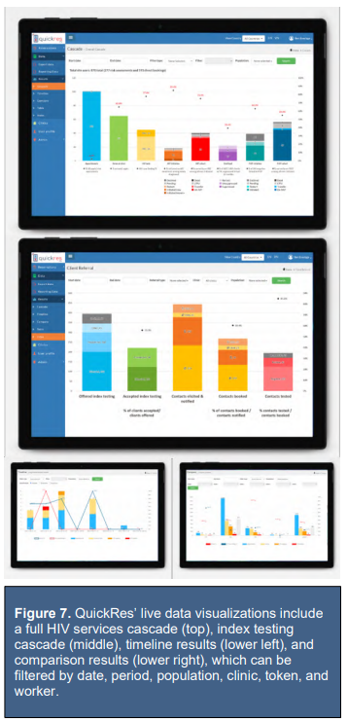
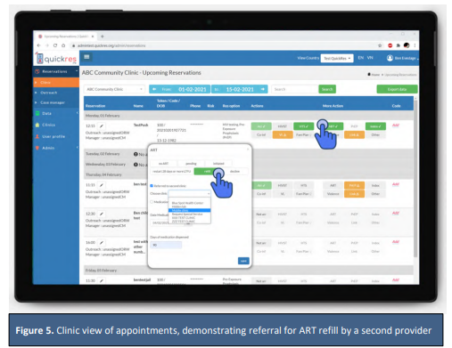
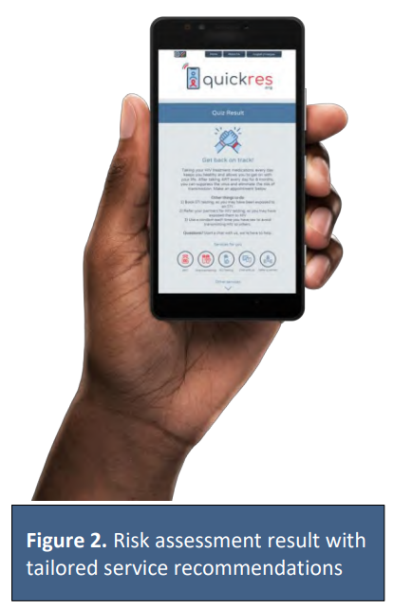
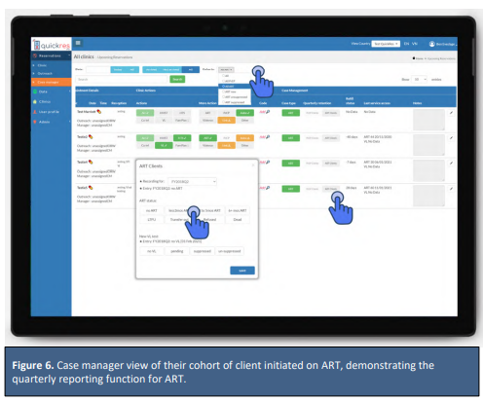
FHI360 QuickRes
Also monitors online outreach and marketing efforts
Demand creation for services is also critical!
Source: https://www.fhi360.org/sites/default/files/media/documents/resource-quickres-technical-guide-march-2021.pdf

Slide 21




Amanda Selfie
From youth to youth: The first transgender chatbot in Latin America developed to address sexual health and PrEP issues. Available 24/7 on Facebook Messenger and WhatsApp
I communicate with youth and answer general questions on sexual heath, gender identity, HIV/STI prevention and PrEP
I schedule appointments consultations using Google Calendar
I interact with adolescents enrolled in PrEP to mobilize PrEP retention and adherence.
I identify adolescents at increased risk of HIV infection (quiz)
and I indicate PrEP1519 clinics
Amanda Selfie, the chatbot used by the PrEP1519 project to create demand for PrEP and STI services among Brazilian adolescents from key populations (https://prep1519.org/en/amanda-selfie/)

Slide 22

STIs

Slide 23
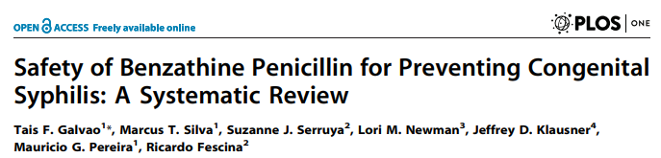
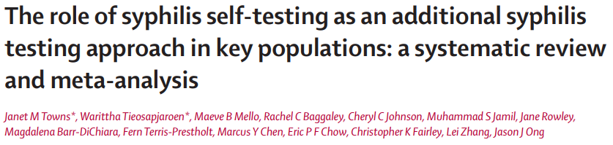
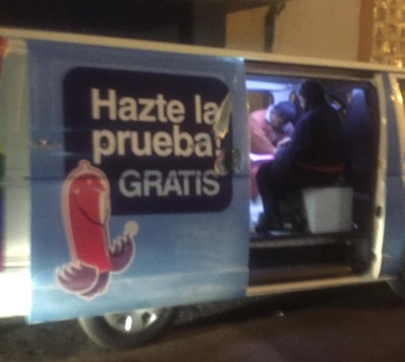
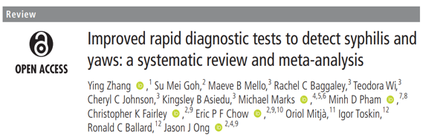
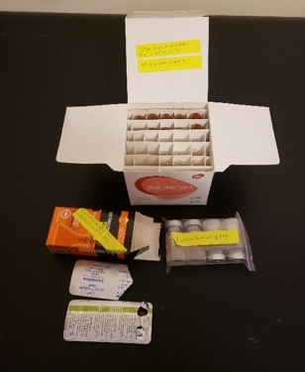
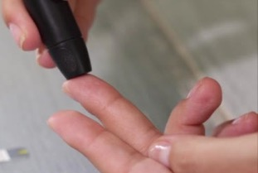
New WHO testing services recommendations
Syphilis self-testing
Dual treponemal/non-treponemal RDTs
Partner services strategies, including EPT
Conclusion: No reports of adverse reactions were found among 3,466,780 patients.
**
Sex Transm Infect 2022;98:608–616.
https://sti.bmj.com/content/sextrans/98/8/608.full.pdf
Bolivia

Slide 24

PLEASURE MATTERS: sex positive approaches

Slide 25
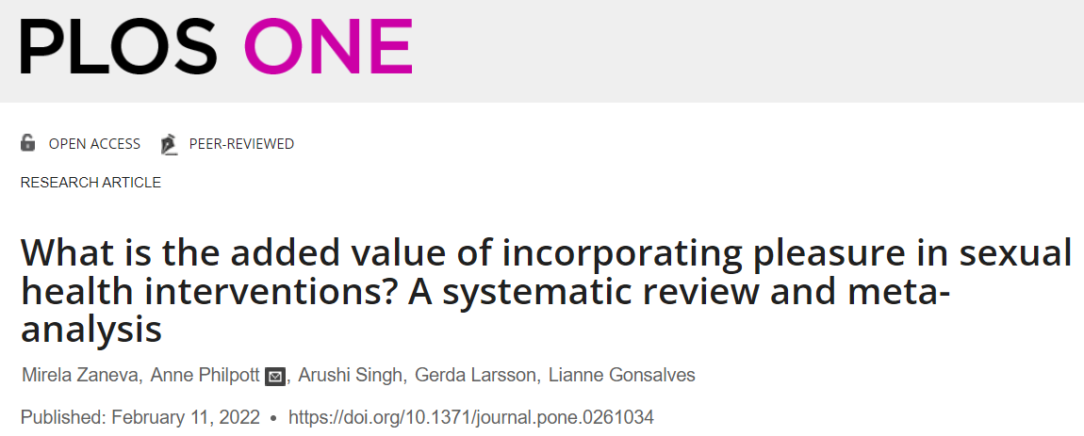
Incorporating sexual pleasure within SRHR interventions increases condom use.
“Despite billions of dollars invested into Sexual and Reproductive Health and Rights efforts, the effect of incorporating sexual pleasure, a key driver of why people have sex, in sexual health interventions is currently unclear.”

Slide 26


“A primary message to persons who are at elevated risk for HIV has been to focus on risk reduction, sexual risk behaviors, and continued condom use, rarely capitalizing on the positive impact on sexuality, intimacy, and relationships that PrEP affords.”
HIV PrEP use is associated with:
increasing emotional intimacy, closeness, and connectedness;
increasing sexual options and opportunities;
removing barriers to physical closeness and physical pleasure; and
reducing sexual anxiety and fears.
PrEP motivations and outcomes focused on sexual satisfaction, sexual pleasure, sexual quality, and sexual intimacy.

Slide 27

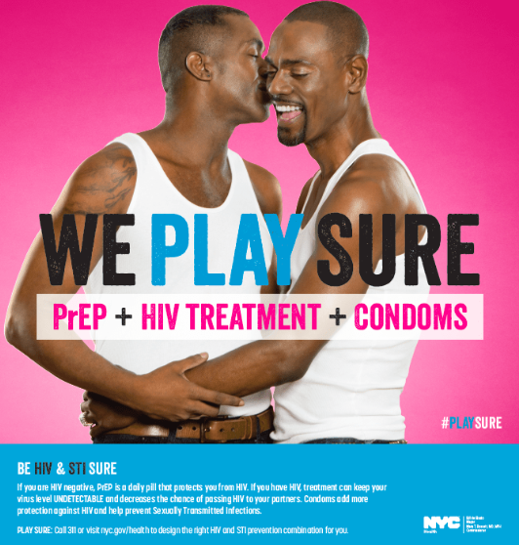
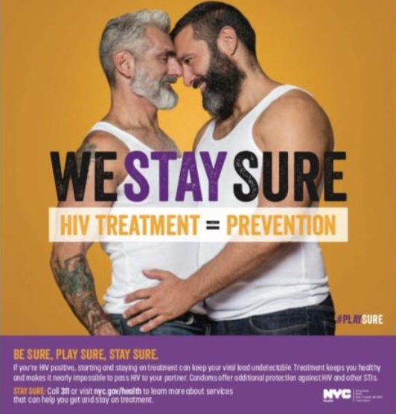



PrEP4Love
Chicago
"Love is contractible. Lust is transmittable. Touch is contagious. Catch feelings, not HIV."
Designer: Adriana Bertini. IG/FB @adribertini

Slide 28
Questions?

