Slide 1
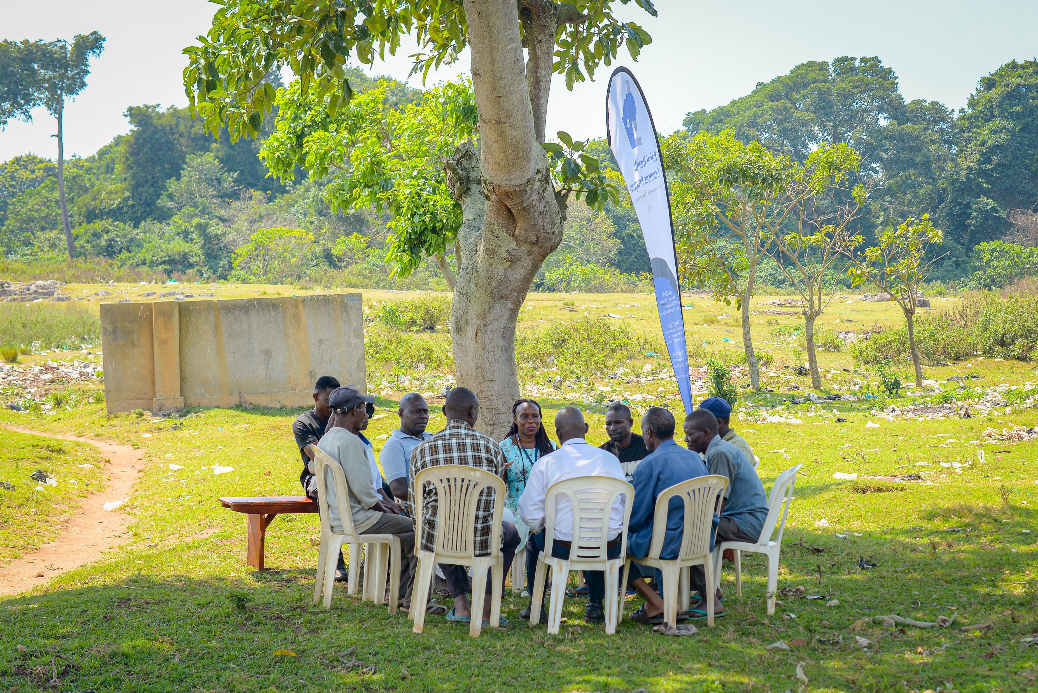






Insights into male HIV transmission in African epidemics from population HIV epidemiologic and genomic studies
Edward Kankaka on behalf of the PANGEA-HIV consortium
Notes:
Thank you for the opportunity to present today and lovely introduction. Today I will be presenting key, summary findings on HIV-transmission in declining eastern and southern African HIV epidemics from the PANGEA-HIV consortium .

Slide 2
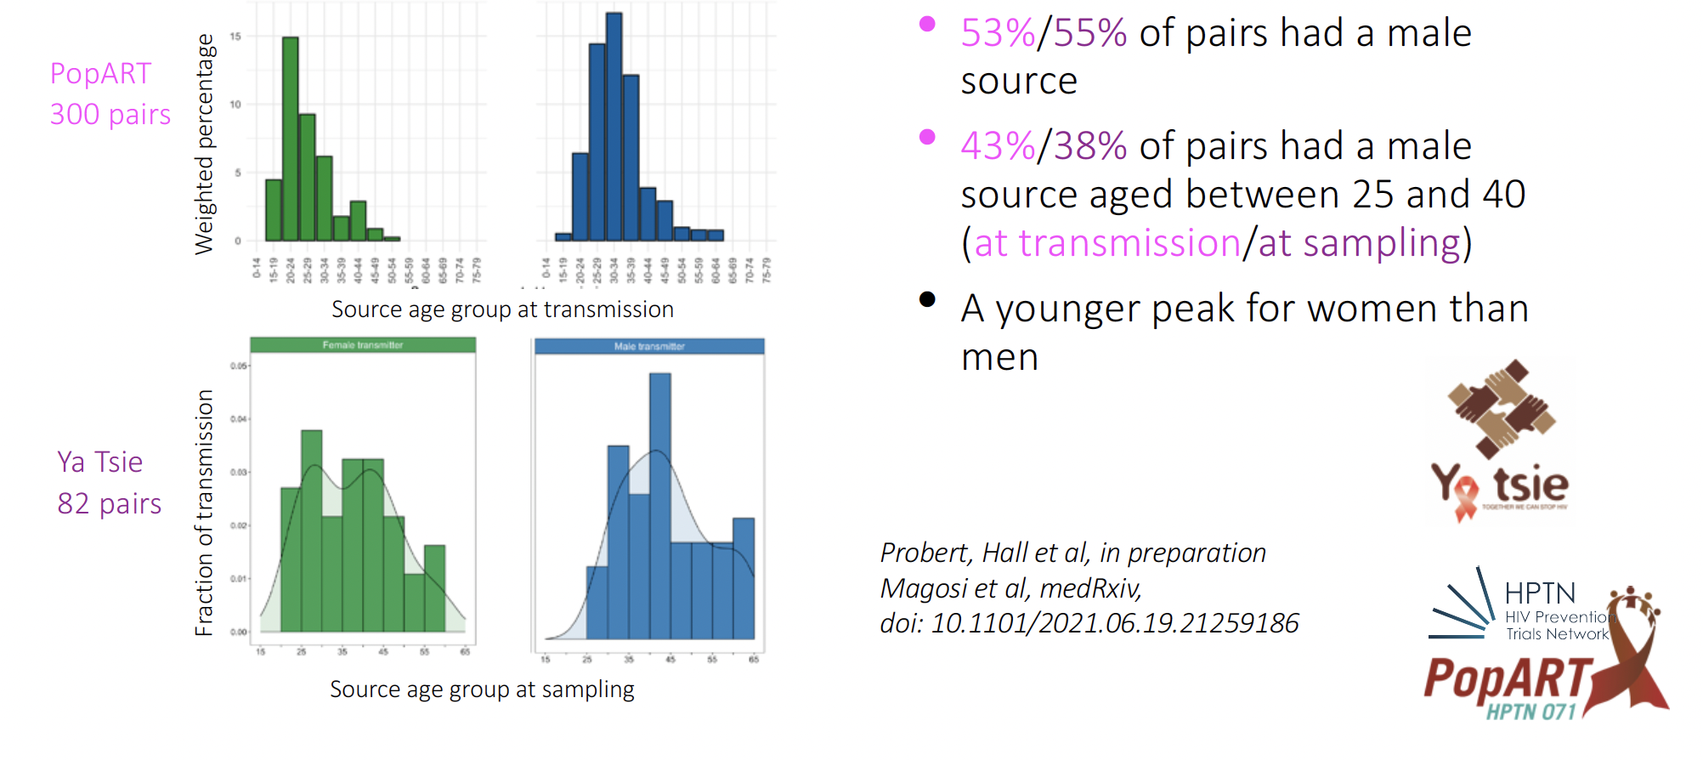
Phylogenetic insights: Most onward HIV transmission arise from men 25+ years
Female to Male
Male to Female
Notes:
In this slide, we are looking at CROSS-SECTIONAL DATA showing the age and gender profile of transmission sources in the PopART study in the top row and the Ya Tsie study in the bottom row. Female to male transmissions are shown green and male to female transmission in blue. The green and blue in each row sum to 100%. You can see in both cases more blue than green. In PopART 53% of transmission pairs identified in our phylogenetic networks had a male source of transmission and in Botswana that proportion was 55%. Now, this may not seem like a lot – 53/55% - but its important to keep in mind that in both of these settings, like most of Africa, HIV burden is highly concentrated among women. So even though women make up a majority of HIV cases in these settings, men make up the majority of HIV transmission sources. Most of these male transmission sources in the PoPART setting were between the ages of 25 and 40, which is similar to that observed in Botswana. In contrast, women generally tended to transmit at younger ages.

Slide 3
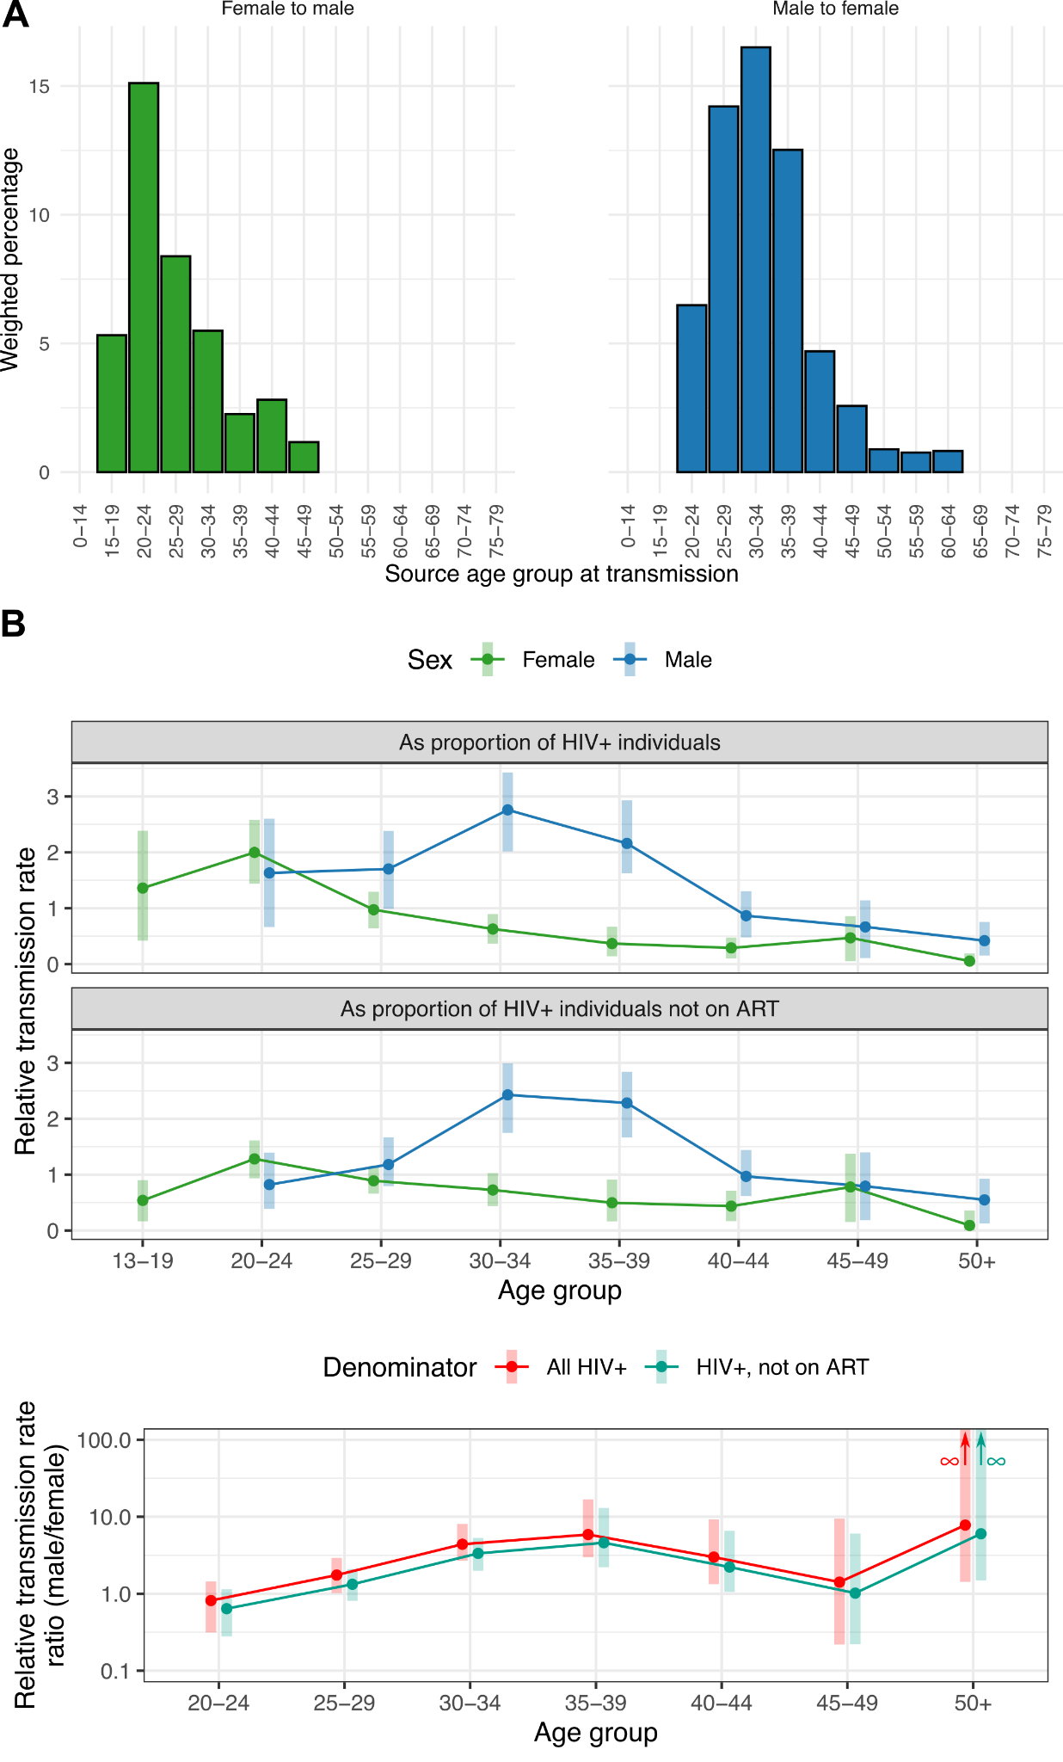
HPTN-071: High risk of onward transmission from men 25-40 relative to other age groups
Hall, Golubchik et al – HPTN 071 (PopART) – similar findings from Rakai (Ratmann), and from Ya Tsie (Magosi)
Notes:
This slide here is taking a deeper dive on the HPTN071 PoPART data and looking at the relative likelihood of being a transmitter as proportion of all persons living with HIV in the top row and as a proportion all persons living with HIV not on ART in the bottom row. And you can see this blue line of men have a much higher likelihood of being classified as a transmitter given their proportion in the population, particularly between the ages of 25 and 40.

Slide 4

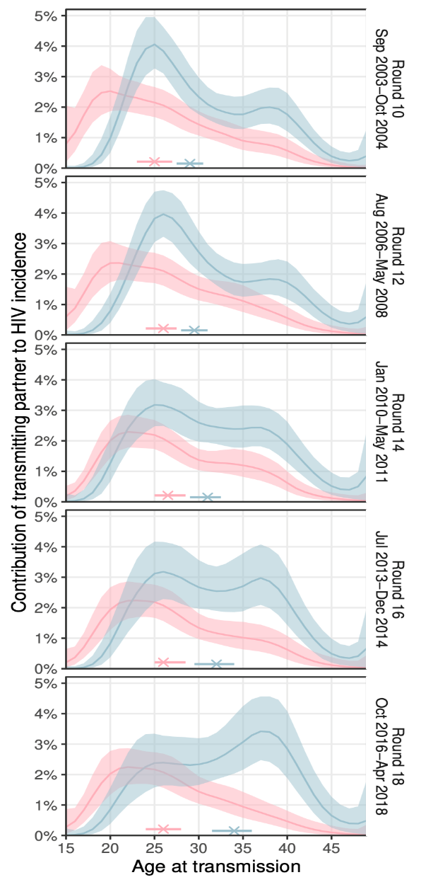
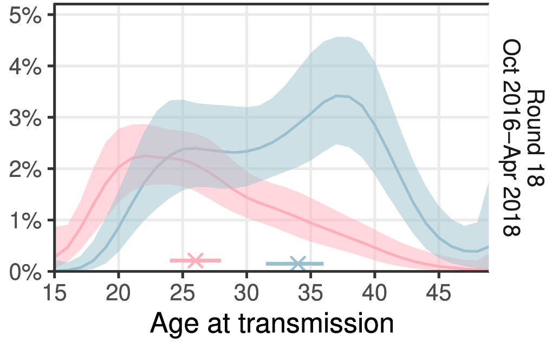
Trends in HIV transmission by age and gender in Uganda: Transmission from men is increasing
Age profile of male sources (blue), and female sources (pink)
Blue + red = 100%
%transmission from men
2003: 57.9% [56.1-59.6]
2011: 61.9% [60.2-63.7]
2018: 62.8% [60.2-65.2]
median age of sources
Proportion of transmissions from men is increasing
Transmissions from men are shifting to older ages
Key take aways:
Notes:
Here in contrast to prior slides, we are looking at LONGITUDINAL genomic surveillance data. These data were collected in southern Uganda
In the top left here, we are looking at the age and gender profile of HIV transmission sources with men in blue and women in pink in 2018. Here the blue and pink lines add up to 100%, so we are looking at the % contribution of men and women of a particular age to overall transmission. Median age of transmission male and female transmission sources is denoted on the x axis with an X with 95% confidence bars. Here, the sum under the blue curve is larger than that under the pink curve - again indicating men are more likely to transmit.
If we move over to the right, what you can see is this left figure all the way at the bottom (so this is 2018) and starting at the top we go all the way back to 2003. Over this time frame, the proportion of transmission arising from men has been steadily and significantly increasing, which you can see in the gray boxes. The peak age of the male transmission sources has also shifted by nearly a half decade upwards, peaking at around 25 in 2004 and nearly a decade older at 35 in the most recent time frame.
Our key takeways, are (1) that men just like the earlier two southern African cohorts are more likely to transmit, (2) the proportion of transmissions from men is increasing, are (3) the age of onward male transmission is generally shifting older as the epidemic matures.

Slide 5
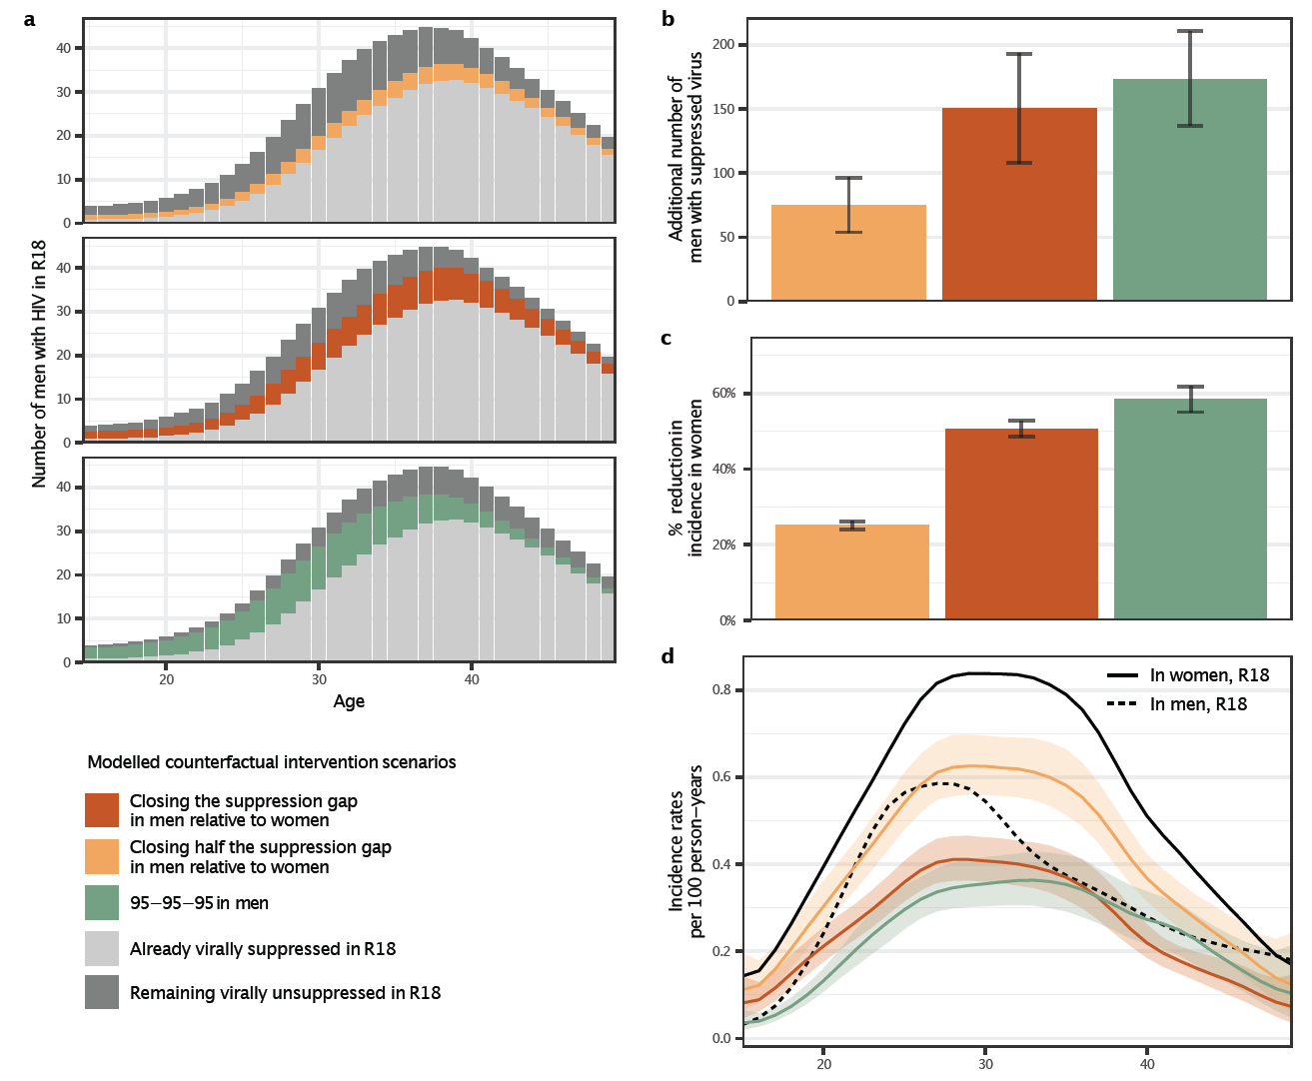
Closing gender disparities in viral suppression could avert half of new female cases
Closing gender gap in viral suppression: Counterfactual simulations of modelled intervention scenarios on inferred transmission flows
Only a small number of men needed to treat to achieve substantial reductions in female HIV incidence
Monod et al. medRxiv. 2023. Under review.
Notes:
I don’t have time to show viral load suppression data here, but I’m sure that many of you here appreciate that the reason men are more likely to transmit is in part because they are much less likely than women to be virally suppressed.
Using phylogenetic data on transmission and viral suppression data by age and gender from the Rakai study we modeled various intervention strategies for closing gender disparities in transmission.
One of those strategies was closing the HIV viral suppression gap between men and women, which is shown in the dark orange here in the figures, and highlighted in the red box in the middle left panel. The height of the bars show the total number of men living with HIV by age. In light gray we have suppressed men and in dark grey we have unsuppressed men. The dark orange bars represents the additional number of unsuppressed men needed to treat to close HIV suppression gaps between men and women and you can see in this scenario its really not that many additional men. However, were we to treat these men. we would have achieved a 50% reduction in HIV incidence among women which you can see in the dark orange bar in the middle panel on the right.

Slide 6
Summary conclusions from PANGEA phylogenetic analyses
Men are predominantly transmitting and increasingly so relative to women as the HIV epidemic declines in ESA.
Closing viral suppression gap between men and women could avert large numbers of new female infections and reduce male mortality.
Notes:
Our summary conclusions are as follows.
Despite women having substantially higher HIV burden, men account for most onward HIV transmission in Africa. They appear to be increasingly doing so as the epidemic declines.
We also find that closing HIV suppression gaps between men and women could avert large numbers of new female infections and importantly also reduce male mortality.
However, this is not all quite as simple as finding male super spreaders and getting them on to treatment. We see very limited clustering of infections, at least at a local level, compared to European or US epidemics, indicting that the African epidemics are mostly likely geographically diffuse and one in which cluster busting strategies might not be very effective.
Lastly, I would like to emphasize the importance of regular and strategic measurement, such as that in institutions contributing to PANGEA, to inform interventions in HIV programs such as interventions targeting men.
Effective interventions require knowledge of what the problem is, where, how much, who is affected (and who is affected more)
But these are moving targets which require regular measurement to keep track and ensure appropriate and effective interventions.

Slide 7
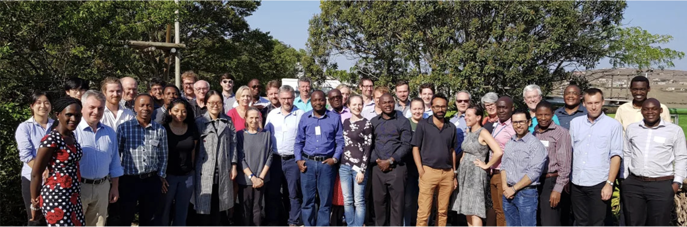

Thank you !
Notes:
This work is that of hundreds of people. I would just likely to specifically thank Dr. Christophe Fraser, who is the PI of the consortium, Lucie Abeler Dorner, program manager for PANGEA, and all of our PANGEA collaboarotors.
,
I’m happy to take questions.

