Slide 1


Increasing support and partnerships with key HIV populations
Welcome to the In-Reach Online Training
Introductory Module

Slide 2
Acknowledgements
This updated In-Reach training was developed by UNDP with the support of the Interagency Working Group on Key Populations: UNFPA, UNODC, WHO, UNAIDS Secretariat, GNP+ (Global Network of People Living with HIV), NSWP (Global Network of Sex Work Projects), INPUD (International Network of People who Use Drugs), MPact (Global Action for Gay Men’s Health and Rights) and IRGT (Global Network of Transgender Women and HIV).
The training is an updated and adapted version of an earlier In-Reach training on working with and supporting key populations. It is an online course with a modified version designed for both online training and face-to-face meetings at country level.
The training was written by Dr Cheikh Traore. It was edited by James Baer.
Copyright: UNDP, 2023.
INTRODUCTORY MODULE

Slide 3
Introduction
This training is designed for:
UN country and regional directors
Senior managers
Programme staff
Technical staff
Consultants, interns and volunteers
It is relevant across the whole SDG 2030 policy and programming Agenda, but especially so for staff involved in HIV, sexual and reproductive health and rights, and gender.
In this introductory module you will cover the following topics:
What is In-Reach and why is it needed?
How to navigate the In-Reach curriculum
Understanding key populations: Who they are and why they are particularly at higher risk of HIV
Understanding and addressing bias, prejudice, stigma and discrimination
Leading courageous conversations on key populations, both within our agency, and with government counterparts and other stakeholders
INTRODUCTORY MODULE

Slide 4
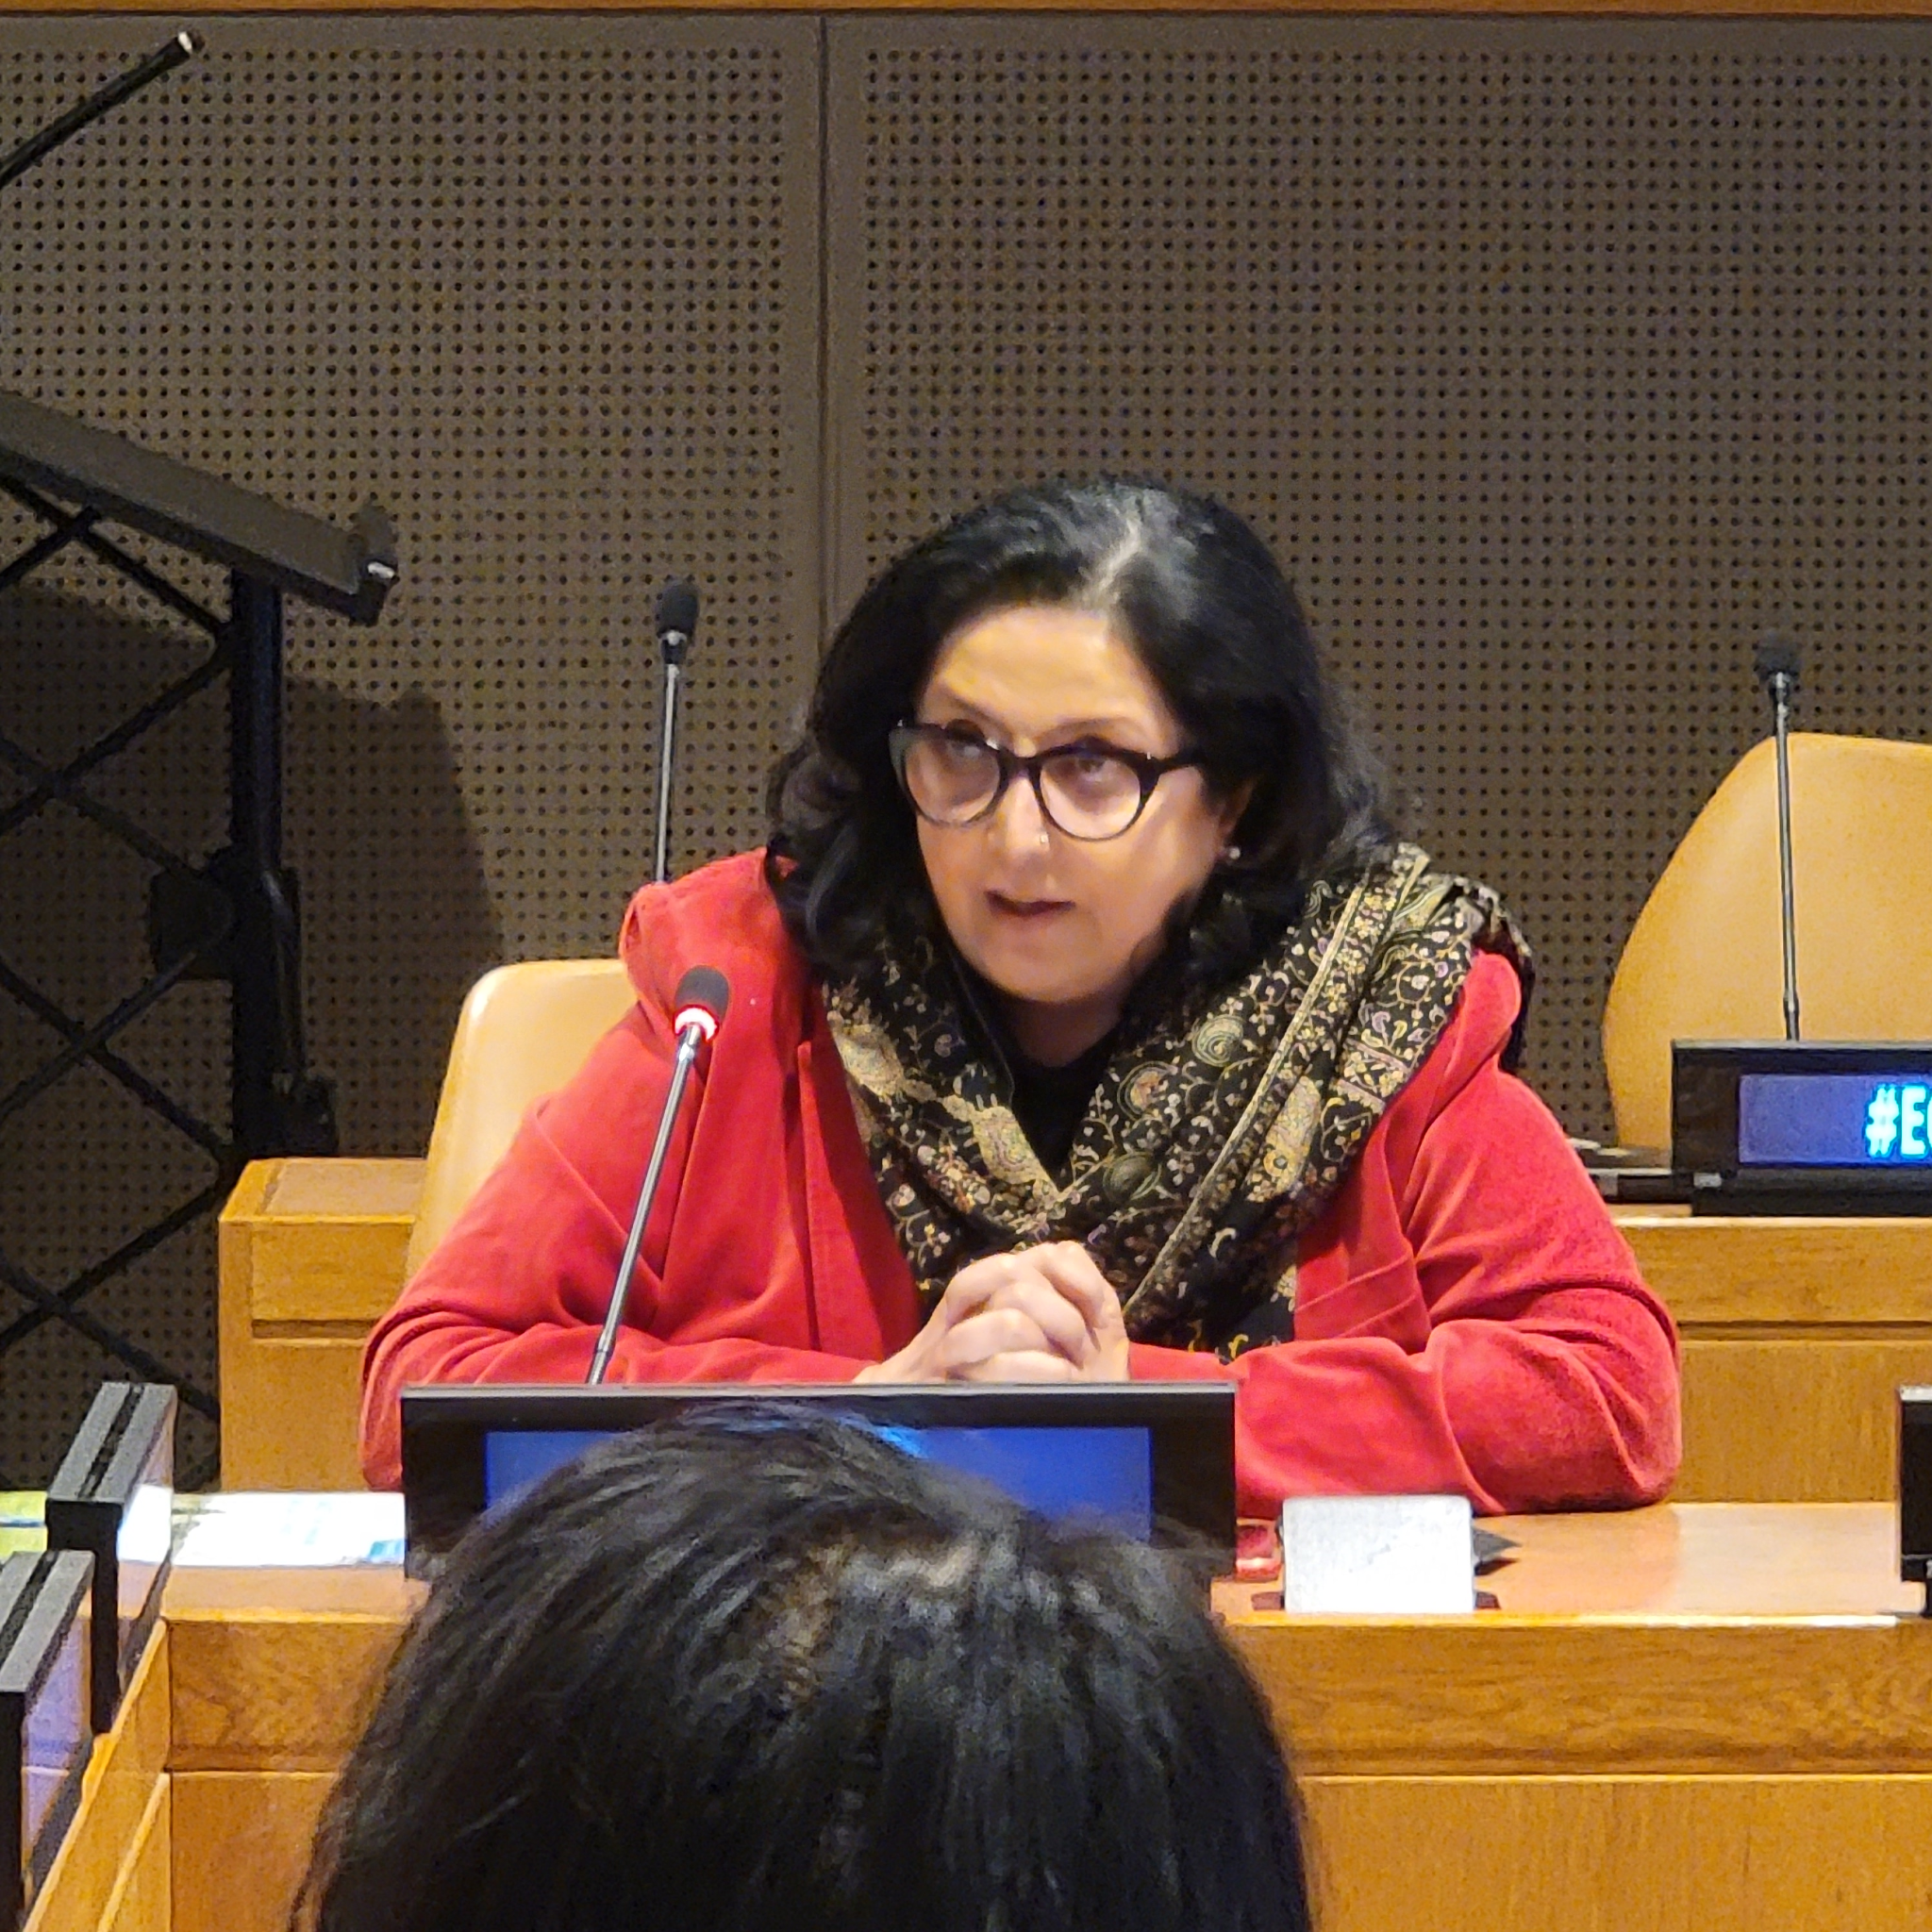
Welcome Message from the Director, HHG
INTRODUCTORY MODULE

Slide 5
Part 1: What is In-Reach and why is it needed?
Context and goals
Content in the In-Reach curriculum
Understanding key populations

Slide 6
What is this In-Reach training about?
The In-Reach training is designed to strengthen the capacity of UN staff to support and work with key populations to respond to HIV, viral hepatitis and other sexually transmitted infections (STIs), and to address their human-rights concerns.
The In-Reach training contains modules on the first five of these key populations (see right). It also has a module on adolescents and young people from these five key populations, who are particularly vulnerable because it is harder for them to obtain the information and services they need.
Key populations are those individuals and communities who are most at risk of HIV:
Sex workers of all genders
Gay, bisexual, and other men who have sex with men
People who use drugs
Transgender and gender-diverse people
People in prisons and other closed settings
People living with HIV are always considered a key population
PART 1 | CONTEXT AND GOALS

Slide 7

Why is In-Reach needed?
Globally, 70% of all new HIV infections occur among key populations and their sexual partners.
Progress in reducing infections among key populations is hampered by persistent punitive and restrictive laws, stigma, discrimination, exclusion, violence, denial of human rights and criminalisation.
These factors make it harder for key populations to adopt healthy behaviours such as protected sex and safe use of drugs, and harder for them to access health and other services, reducing their health and wellbeing
PART 1 | CONTEXT AND GOALS

Slide 8
Why In-Reach can help
Without strengthened support for key populations and addressing the challenges they face, we will fall short of the global goal of eliminating HIV by 2030.
Many UN Country Teams have limited experience working with key populations, engaging them in community-led responses or brokering dialogue between key populations and state authorities.
The In-Reach training aims to make you more confident and knowledgeable in supporting key populations and addressing the issues they face.
PART 1 | CONTEXT AND GOALS

Slide 9
What are the goals of the training?
The In-Reach training aims to:
Help you understand the health and rights issues that affect key populations, the challenges they face, that make them more vulnerable to HIV, viral hepatitis, other STIs, and coinfections such as tuberculosis
Equip you with the latest policy updates, UN guidance, programme resources and rights-based practices to tackle inequalities and exclusion of key populations
Increase your capacity to recognise bias, and reduce stigma and prejudice against key populations within UN organisations and in the community, and from service providers
Increase your ability to conduct courageous conversations with government counterparts, community leaders and other partners on supporting key populations
Increase your capacity to support the delivery of better quality and more inclusive services for key populations, and improve their access to services.
PART 1 | CONTEXT AND GOALS

Slide 10
Documents and tools
In-Reach builds on several key global policy documents and tools:
The Global AIDS Strategy 2021-2026
The WHO Consolidated guidelines on HIV, viral hepatitis and STI prevention, diagnosis treatment and care for key populations (2022)
The four key population HIV implementation tools – the SWIT, MSMIT, TRANSIT and IDUIT (see Modules 2-5 for details)
The In-Reach training also includes country experiences in research, policy, programming and advocacy for key populations, conducted by communities, governments, NGOs, academics and UN agencies.
PART 1 | CONTEXT AND GOALS

Slide 11
Part 1: What is In-Reach and why is it needed?
Context and goals
Content of the In-Reach curriculum
Understanding key populations

Slide 12
The In-Reach curriculum modules
Introductory Module
What is In-Reach, and why is it needed?
Understanding and overcoming bias, prejudice and discrimination
Module 1
KEY ELEMENTS OF PROGRAMMING WITH KEY POPULATIONS
1.1 Epidemiology, vulnerability and strategic information
1.2 Community empowerment
1.3 Health-sector interventions
1.4 Critical enablers
1.5 Human rights
Module 2
Sex workers
Module 3
Men who have sex with men
Module 4
People who inject drugs
Module 5
Transgender and gender-diverse people
Module 6
People in prisons and other closed settings
Module 7
Adolescent and young key populations
PART 1 | CONTENT OF THE IN-REACH CURRICULUM

Slide 13
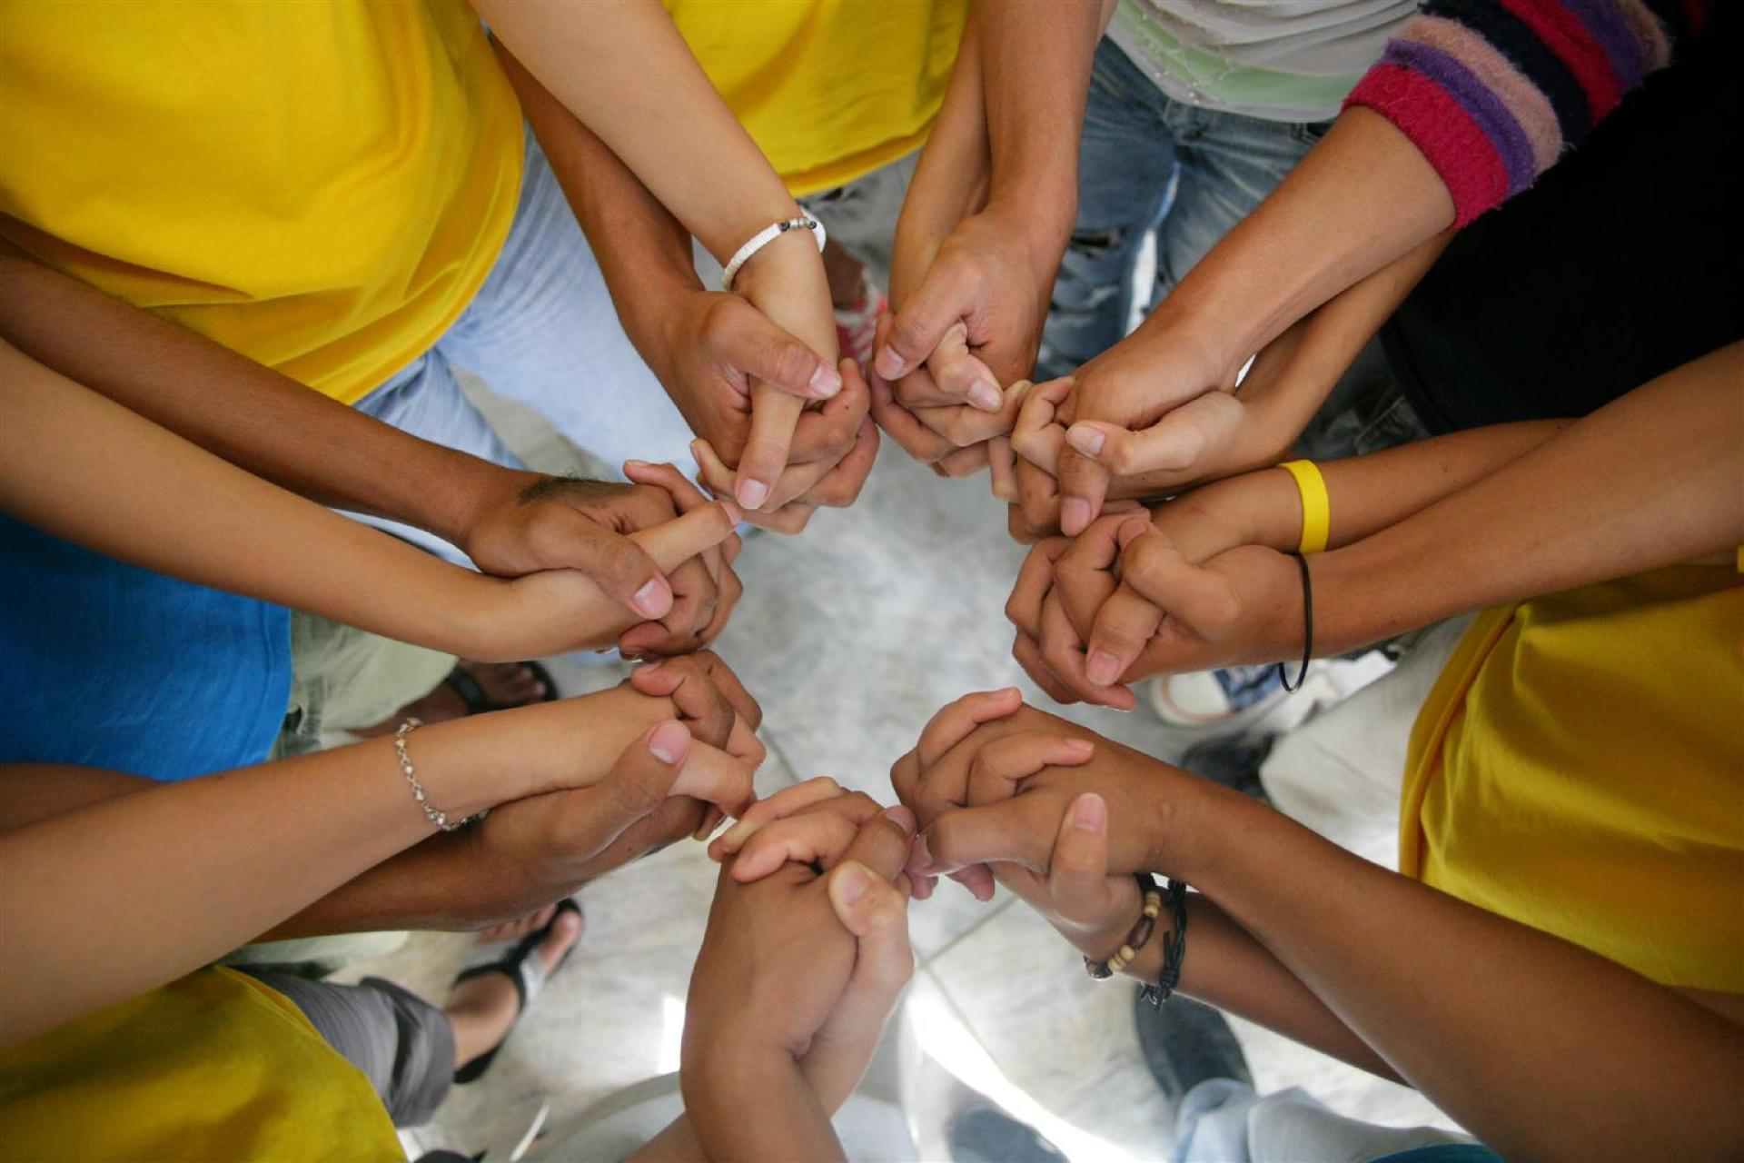
What you will find within each module
Definition of key terms
Explanation of what makes each key population vulnerable to HIV
Programme case examples
Descriptions of normative UN guidance
Exercises with multiple-choice questions
Hyperlinks to other helpful resources
Take-home messages
Lists of additional resources
PART 1 | CONTENT OF THE IN-REACH CURRICULUM

Slide 14
Part 1: What is In-Reach and why is it needed?
Context and goals
Content of the In-Reach curriculum
Understanding key populations

Slide 15
Key populations are at greater risk of HIV infection
than members of the general population
Source: Global AIDS Update 2022 (UNAIDS, 2022)
35 times
30 times
28 times
14 times
5 times
35 times
30 times
28 times
14 times
5 times
People who inject drugs have 35 times greater risk of acquiring HIV than adults who do not inject drugs
Female sex workers have 30 times greater risk of acquiring HIV than adult women (15-49) in the general population
Gay, bisexual and other men who have sex with men have 28 times greater risk of acquiring HIV than adult men (15-49) in the general population
Transgender women have 14 times greater risk of acquiring HIV than adult women (15-49) in the general population
People in prison are 5 times more likely to be living with HIV than adults in the general population
PART 1 | UNDERSTANDING KEY POPULATIONS

Slide 16
What makes key populations
vulnerable to HIV?
Key populations face legal and social challenges, including exclusion, stigma, discrimination, criminalisation and violence.
These factors increase their vulnerability to HIV and reduce their access to essential services for HIV prevention, diagnosis and treatment, and to other health and social services.
This makes it much more difficult for key populations to protect their health, safety and well-being.
PART 1 | UNDERSTANDING KEY POPULATIONS

Slide 17
Key populations and their sexual partners accounted
for 70% of new HIV infections globally in 2021
Outside sub-Saharan Africa, key populations account for 94% of all new infections.
Key populations and their partners account for:
>88% of new HIV infections in Western and Central Europe and North America
78% of new HIV infections in Asia and the Pacific
51% of new HIV infections in sub-Saharan Africa.
Source: Global AIDS Update 2022 (UNAIDS, 2022)
PART 1 | UNDERSTANDING KEY POPULATIONS

Slide 18
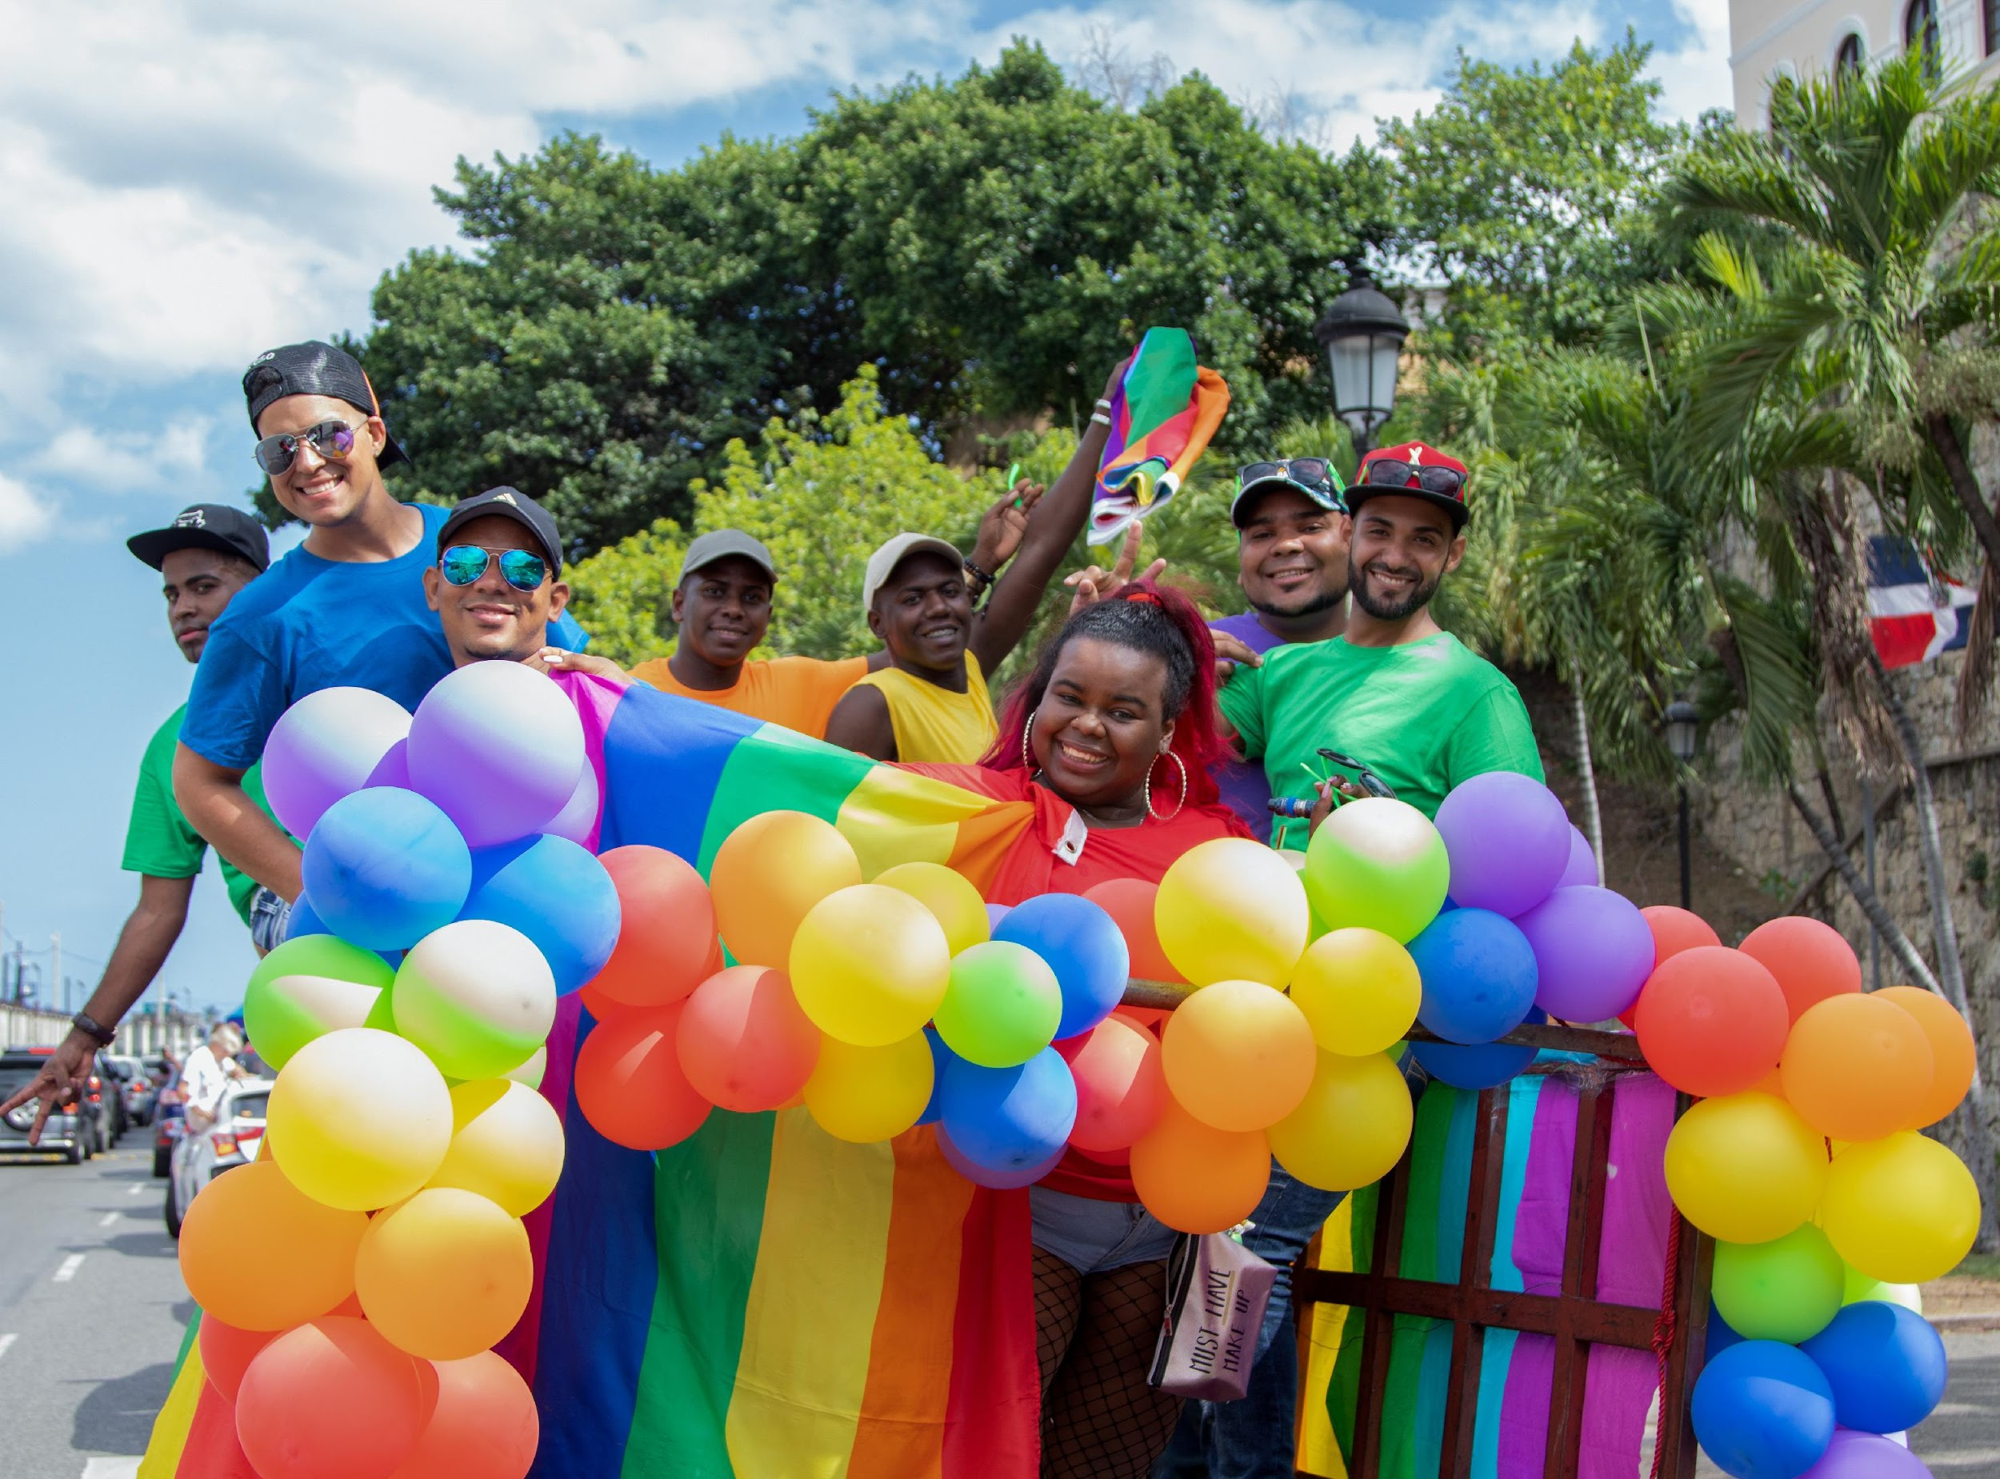
Key populations are key to the solution
Key populations are central to effective HIV responses. They must be included in all HIV programming efforts.
The Global AIDS Strategy and the 2021 Political Declaration on HIV and AIDS call for organisations led by key populations to deliver more of HIV prevention, care and treatment services.
This training will help you understand how to include and support key populations in the design and delivery of community-led responses.
Image: UNDP Dominican Republic
PART 1 | UNDERSTANDING KEY POPULATIONS

Slide 19
Part 2: Understanding and overcoming bias, prejudice, stigma and discrimination
Introduction
Exercise: Opening questions
Exploring bias
Going deeper on bias, prejudice, stigma and discrimination
Addressing bias, prejudice, stigma and discrimination
Leading courageous conversations on bias, prejudice, stigma and key populations within our agencies and with government counterparts and other stakeholders

Slide 20
Introduction
In this part of the module you will learn about:
Bias, stigma and prejudice, and how they contribute to discrimination and inequalities
How we can clarify our values on same-sex relations, gender/gender identity, substance use, sex work and incarceration
Addressing bias and prejudice within ourselves and our organisations
Conducting advocacy in support of key populations within our organisation, and with government counterparts, community leaders and other partners
PART 2 | INTRODUCTION

Slide 21
Part 2: Understanding and overcoming bias, prejudice, stigma and discrimination
Introduction
Exercise: Opening questions
Exploring bias
Going deeper on bias, prejudice, stigma and discrimination
Addressing bias, prejudice, stigma and discrimination
Leading courageous conversations on bias, prejudice, stigma and key populations within our agencies and with government counterparts and other stakeholders

Slide 22
Exercise 1: Opening questions (1)
1. It’s OK for me to express my disapproval of certain social groups when I’m at work, because that’s simply part of who I am.
Agree
Disagree
Unsure
2. I cannot imagine a situation in my life that would cause me to experience discrimination by another person or organisation.
Agree
Disagree
Unsure
PART 2 | EXERCISE: OPENING QUESTIONS

Slide 23
Exercise 1: Opening questions (2)
3. Individuals may be prejudiced against certain groups in the population, but it’s not possible for an organisation to discriminate against someone: the rules will always be applied to everyone in the same way.
Agree
Disagree
Unsure
4. Most people develop their opinions about sexual morality or drug use on the basis of objective information and are not influenced by the views of their families or communities.
Agree
Disagree
Unsure
PART 2 | EXERCISE: OPENING QUESTIONS

Slide 24
Framing questions: responses
Irrespective of personal opinions or beliefs, UN staff and consultants are required to treat all individuals and groups with respect and without discrimination, including on the basis of sexual orientation, gender identity and expression (SOGIE), HIV status, or belonging to key population group(s).
Although you may never have been aware of being discriminated against, consider if you were living in a different location. Your nationality, ethnicity, gender or accent might cause people to discriminate against you. How about if you acquired a disability, or when you are old?
An organisation’s policies or practices can actually have a discriminatory effect, whether by design or unintentionally.
It is normal that our families and communities influence our thinking e.g. about sex and drugs. However, sometimes they – like everyone – lack comprehensive, objective information on these topics, and may hold discriminatory views.
PART 2 | EXERCISE: OPENING QUESTIONS

Slide 25
Part 2: Understanding and overcoming bias, prejudice and discrimination
Introduction
Exercise: Opening Questions
Exploring bias, prejudice, stigma and discrimination
Going deeper on bias, prejudice, stigma and discrimination
Addressing bias, prejudice, stigma and discrimination
Leading courageous conversations on bias, prejudice, stigma and key populations within our agencies and with government counterparts and other stakeholders

Slide 26
Exercise 2: Our own experience of bias
Think about an occasion in your work life or private life when you felt that someone was biased against you for any of the following reasons:
Your sex, age, religion, race or ethnicity
Your physical characteristics (such as height, weight, hair, or skin colour)
Your language or accent
The clothing you wear
Your sexual orientation, or your gender identity or expression
A disability or physical limitation
Your health status (such as HIV status or another health issue) or mental health status
Your use of alcohol or drugs.
PART 2 | EXPLORING BIAS

Slide 27
Exercise 2: Our own experience of bias
Briefly describe the occasion.
What made you think the other person was biased against you?
How did it make you feel?
PART 2 | EXPLORING BIAS

Slide 28
Exercise 3: Exploring our own biases
Think about each of the following situations:
One of your colleagues used to drink alcohol or use drugs. They now leave the office a bit early each day to attend support group meetings.
One of your colleagues is open about being in a same-sex relationship. A photo of this staff member and their partner is prominently displayed in their office, showing the two of them smiling with their arms around one another.
PART 2 | EXPLORING BIAS

Slide 29
Exercise 3: Exploring our own biases
For each situation just described:
What are your reactions and thoughts about these colleagues?
How would your opinions affect the way you work with them, or your judgment of how well they can do their job?
Do you think other UN colleagues might share your responses and opinions? Why, or why not?
Note: No one will see your responses. It is common for people to hold personal biases or prejudices about certain groups. We encourage you to be honest with yourself, rather than responding in a way that you believe others would prefer.
PART 2 | EXPLORING BIAS

Slide 30
Take-home message: Clarifying our
values and attitudes
With these short exercises, you have explored some of the values that you or colleagues may hold about stigmatised populations or behaviours.
Issues such as sex work, same-sex relationships, homosexuality, or drug use are often taboo subjects. Bias and negative attitudes about key populations are visible in public discourse and the media. It is possible that some staff within our organisations hold similar negative opinions.
An important step that we can all take at an individual level is to clarify our values on consensual same-sex sexual activity among adults, gender/gender identity, substance use, sex work and incarceration.
We can then take steps to address any biases or prejudices that may be present, to ensure an impartial, accepting and inclusive approach to our development work.
PART 2 | EXPLORING BIAS

Slide 31
Part 2: Understanding and overcoming bias, prejudice and discrimination
Introduction
Exercise: Opening Questions
Exploring bias, prejudice, stigma and discrimination
Going deeper on bias, prejudice, stigma and discrimination
Addressing bias, prejudice, stigma and discrimination
Leading courageous conversations on bias, prejudice, stigma and key populations within our agencies and with government counterparts and other stakeholders

Slide 32
Bias, prejudice and stigma, and how they
contribute to discrimination and inequalities
Now let’s take a closer look at four related concepts:
Bias
Prejudice
Stigma
Discrimination
and see how they can impact key populations, and our organisations’ work with themkey populations.
PART 2 | GOING DEEPER ON BIAS, PREJUDICE, STIGMA AND DISCRIMINATION

Slide 33
Where do bias and prejudice
come from? (1)
Bias: Inclination or prejudice for or against one person or group, especially in a way considered to be unfair (Oxford English Dictionary)
We all have unconscious biases about people.
Our biases can be based on the values, attitudes and practices of our families, cultures or religions, our education, the media and our personal experiences.
Biases cause us to feel more comfortable with some groups of people, and less comfortable with others.
  For example, we may feel uncomfortable around people of a different sexual orientation, or people who engage in sex work.
Because biases are often adopted unconsciously, we may be unaware that we have them.
PART 2 | GOING DEEPER ON BIAS, PREJUDICE, STIGMA AND DISCRIMINATION

Slide 34
Where do bias and prejudice
come from? (2)
Biases are closely related to prejudice – an adverse opinion or leaning formed without just grounds or before sufficient knowledge (Merriam-Webster Dictionary).
  For example, we may have an unfounded believe that people who have been in prison are incapable of leading an honest life, or that people who use drugs don’t care about protecting themselves against HIV.
If we hold such an opinion without having enough information to know whether it’s accurate – and without seeking out that information – it’s a prejudice.
PART 2 | GOING DEEPER ON BIAS, PREJUDICE, STIGMA AND DISCRIMINATION

Slide 35
Bias and prejudice can lead to stigma
Prejudices may be privately held opinions, or are sometimes expressed openly, eg by family, friends, colleagues or in public forums.
Bias and prejudices that are openly expressed can lead to stigma of individuals or groups to whom these negative opinions are directed towards – ie, stigma is the pejorative labelling, stereotyping or naming of a certain group (WHO Key Populations Consolidated Guidelines, 2022).
An example of a stigmatising behavior is if a health worker is judgmental or negative about certain groups of people.
Examples of stigmatising language include calling sex workers “prostitutes”, or people who use drugs “junkies”.
PART 2 | GOING DEEPER ON BIAS, PREJUDICE, STIGMA AND DISCRIMINATION

Slide 36
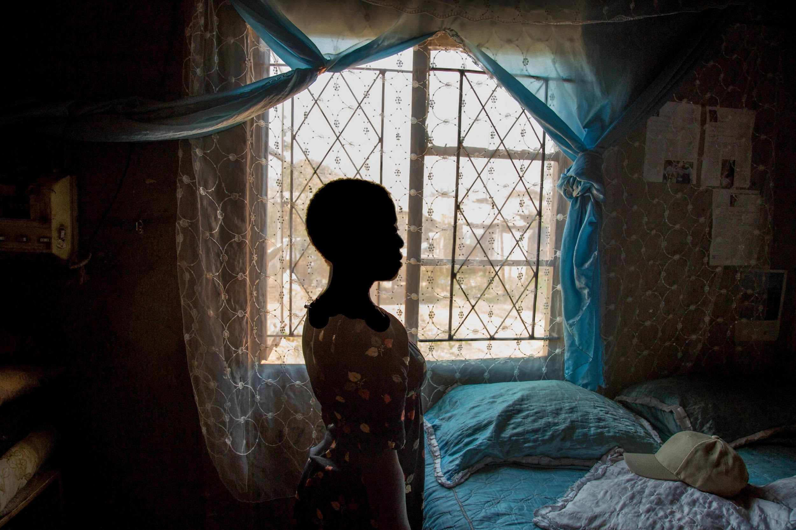
Stigma can lead to discrimination
Stigma can lead to discrimination –
“unfair and unjust action towards an individual or group on the basis of real or perceived status or attributes, a medical condition, socioeconomic status, employment, drug use, gender, race, sexual identity, age or other perceived differences or characteristics. [Discrimination] has the effect or purpose of impairing or nullifying the recognition, enjoyment or exercise – on an equal basis with others – of all human rights and fundamental freedoms [of persons being discriminated against]”.
WHO Key Populations Consolidated Guidelines, 2022
Image: UNDP Zimbabwe / Cynthia R Matonhodze
PART 2 | GOING DEEPER ON BIAS, PREJUDICE, STIGMA AND DISCRIMINATION

Slide 37
Part 2: Understanding and overcoming bias, prejudice and discrimination
Introduction
Questions to frame this session
Exploring bias
Going deeper on bias, prejudice, stigma and discrimination
Addressing bias, prejudice, stigma and discrimination
Advocating against bias, prejudice, stigma and key populations within our agencies and with government counterparts and other stakeholders

Slide 38
Impact of bias and prejudice on
stigma and discrimination
It is common for people to hold biases and prejudices against certain groups of people, and these can cause exclusion of stigmatised persons, from our lives, our organisations, and even more broadly from mainstream society.
Bias and prejudice can also result in responses that may have negative impacts on key populations.
People from key populations are often particularly subjected to stigma, discrimination and negative attitudes related to their behaviour, sexual orientation, gender identity or engagement in sex work – and doubly so if also living with HIV, viral hepatitis or STIs.
WHO Key Populations Consolidated Guidelines, 2022
PART 2 | ADDRESSING BIAS, PREJUDICE, STIGMA AND DISCRIMINATION

Slide 39

Addressing discrimination
Stigma and discrimination impact the goals of the UN because they cause some groups – including key populations – to have unequal access to human rights, including the right to health.
UN staff must uphold the universal values and principles of the UN relating to equality, fairness, inclusion and respect for all human rights.
The Secretary-General reminds us in his Call to Action on Human Rights that as UN staff, we are obliged to work with all groups and to reduce discrimination and promote enabling environments for key populations. Click on the image above to view the video, or see here for the YouTube Link.
PART 2 | ADDRESSING BIAS, PREJUDICE, STIGMA AND DISCRIMINATION

Slide 40
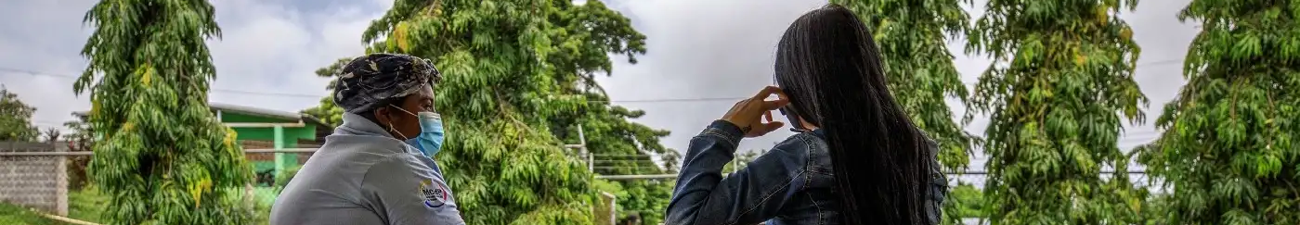
Addressing prejudice
and discrimination
As UN staff, we are required to act professionally, without prejudice or discrimination towards anyone, including our colleagues, and those we serve through our development work.
Becoming aware of our biases can help us question any prejudices we may hold. This self awareness is a first step to adjusting our attitudes.
Image: UNDP Panama / Grey Díaz
PART 2 | ADDRESSING BIAS, PREJUDICE, STIGMA AND DISCRIMINATION

Slide 41
Addressing our own biases
Recognise that we all have biases.
Identify and learn about your own biases. The values clarification exercise you did earlier is a good starting point.
Consider that as UN staff it is important that we act professionally in our work without bias or discrimination of others, irrespective of our own personal beliefs or values
Decide which values and biases you will make a real effort to address first.
Expose yourself to positive images and information about others.
Meet others who are different from you!
PART 2 | ADDRESSING BIAS, PREJUDICE, STIGMA AND DISCRIMINATION

Slide 42
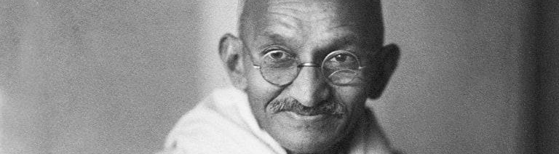
Words matter! (1)
One common way in which bias, prejudice and discrimination manifest themselves is through the language and the words we use.
Your beliefs become your thoughts,
Your thoughts become your words,
Your words become your actions,
Your actions become your habits,
Your habits become your values,
Your values become your destiny.
― Mahatma Gandhi
PART 2 | ADDRESSING BIAS, PREJUDICE, STIGMA AND DISCRIMINATION

Slide 43
Words matter! (2)
Words can create a welcoming, respectful and inclusive work environment and better relationships with key populations.
But words can also hurt people and create an unsafe, unwelcoming environment – and poor relationships with organisations of key populations.
In any language, a variety of words are used to name and describe sex work, sexual orientation, gender identity, substance use, race, disability or incarceration.
These words may be considered respectful, neutral or disrespectful by individuals who belong to key populations.
Sometimes it matters who is using a word. People may refer to themselves in a certain way, but it may be objectionable for others to use the same terms about them.
The best way to check the appropriateness of a word is to ask a member of the group being referred to - how they prefer to be called and what words do they find offensive or stigmatising. There are also resources that list generally agreed and preferred language, as well as terminology that should be avoided. (UNAIDS Terminology Guidelines}
PART 2 | ADDRESSING BIAS, PREJUDICE, STIGMA AND DISCRIMINATION

Slide 44
Part 2: Understanding and overcoming bias, prejudice and discrimination
Introduction
Questions to frame this session
Exploring bias
Going deeper on bias, prejudice, stigma and discrimination
Addressing bias, prejudice, stigma and discrimination
Leading courageous conversations on bias, prejudice, stigma and key populations within our agencies and with government counterparts and other stakeholders

Slide 45
Addressing stigma and discrimination
requires work at several levels
Personal
Change thoughts and feelings; clarify your values, increase awareness & openness to learning.
Interpersonal
Enhance skills, communications, patterns; impact behaviour and relationships.
Framework for Addressing and Dismantling Stigma & Discrimination
Cultural
Create inclusive environments representative of and welcoming to your organisation’s diversity; celebrate and harnessutilise differences.
Institutional
Identify structural barriers and implement policies, practices & programmes that support equitable outcomes.
Source: UNHRC
PART 2 | LEADING COURAGEOUS CONVERSATIONS

Slide 46
Skills for leading courageous
conversations
When issues of stigma, discrimination or violence are raised, or when new key population programmes are being launched, UN staff often must speak to government officials or broker dialogues between them and key populations.
We can develop a number of skills to enable constructive and productive discussions and dialogue.
PART 2 | LEADING COURAGEOUS CONVERSATIONS

Slide 47
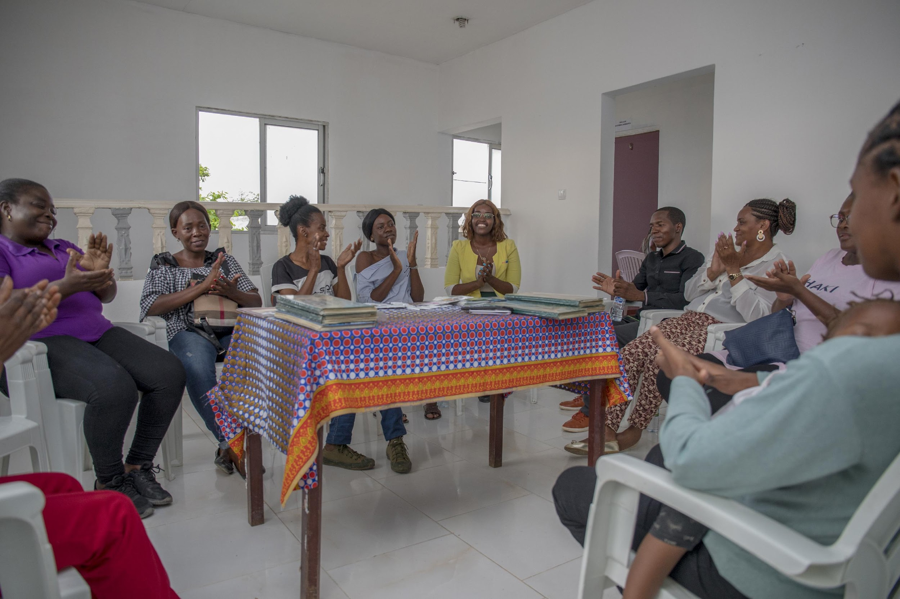
Leading courageous conversations:
Personal skills
Take value clarification and attitudinal change exercises regarding sex work, same-sex relations, substance use, gender diversity and incarceration.
Be open to discussing challenging topics, even if they make you feel uncomfortable. Practice and become familiar with talking about sensitive issues.
Become an ally – someone who speaks out and stands up for a group that is discriminated against.
Meet local key population leaders and organisations in your duty station and inform yourself about the inequalities they experience and the impact on their health, human rights and well-being.
Image: UNDP Angola
PART 2 | LEADING COURAGEOUS CONVERSATIONS

Slide 48
Leading courageous conversations:
Interpersonal approaches
UN officials can adopt rights-based attitudes and approaches to conduct dialogues on sensitive issues affecting key populations. Try the following approaches:
Consider whether you are in a duty station where cultural norms on these issues are different from those of your home country.
Remind your interlocutors that you are not trying to change their core beliefs, but instead asking them to consider how their actions may impact the human rights of key population members.
Be sensitive to the implications of your rank, power, privilege and group membership.
If necessary, be prepared to share your own past experiences of being challenged or uncomfortable with sensitive or “taboo” topics, and how you overcame this.
Use storytelling about key populations’ experiences to change thoughts and feelings. (Be sure to maintain the anonymity and confidentiality of key population individuals).
PART 2 | LEADING COURAGEOUS CONVERSATIONS

Slide 49
Leading courageous conversations:
Organisational culture
Promoting a culture of diversity and inclusion in our organisation can help dismantle taboos and open the space for courageous conversations both within and outside our organisations.
Diversity means actively welcoming and encouraging staff with different values, attitudes, cultural perspectives, beliefs, racial/ethnic perspectives, backgrounds, ages, genders, nationalities, sexual orientations, gender identities, HIV status, and physical or mental abilities.
Promoting diversity, inclusion and a culture of openness can help UN agencies have better relationships with key populations.
As UN staff, we can take personal steps to promote an inclusive and stigma-free organisation through training. For example, you could organise a “UN for ALL” workshop for your colleagues.
PART 2 | LEADING COURAGEOUS CONVERSATIONS

Slide 50
Leading courageous conversations:
Country institutions
During dialogues and conversations with government counterparts, it is important to remind your audience about commitments made by UN Member States regarding key populations. These commitments are reflected in:
The 2021 Political Declaration on HIV/AIDS
National HIV/AIDS and STI strategies
Constitutional provisions referring to the equality of citizens
As part of the decade of achieving the Sustainable Development Goals, countries have made commitments to reduce inequalities, protect the rights of all people, pay attention to the needs of disadvantaged communities and leave no one behind.
Several countries have also accepted specific recommendations regarding key populations from Treaty Bodies, such as CEDAW on sex workers, and the UPR.
PART 2 | LEADING COURAGEOUS CONVERSATIONS

Slide 51
Take-home messages
The In-Reach Training is for all UN staff involved in policy development and programming on all the SDGs. It is particularly relevant for those working on HIV, sexual and reproductive health and rights, and gender related issues and the SDGs.
Because of criminalisation, stigma and discrimination, key populations in all regions experience greater vulnerabilities to HIV and violence.
Bias, prejudice, stigma and discrimination are major factors fueling inequalities. They can be barriers to the enjoyment of human rights and better health outcomes.
While most people have unconscious bias against certain groups, UN staff must uphold the universal values and principles of the UN relating to equality, fairness, inclusion and respect of human rights for all.
We can take several actions at the personal, interpersonal, cultural and institutional levels to address bias, prejudice, stigma and discrimination.
TAKE-HOME MESSAGES

Slide 52
Module review questions
TAKE-HOME MESSAGES

Slide 53
Further information and resources (1)
Political Declaration on HIV and AIDS (United Nations, 2021)
Global AIDS Strategy 2021-2026 (UNAIDS, 2021)
Consolidated Guidelines on HIV, Viral Hepatitis and STI Diagnosis, Prevention, Treatment and Care for Key Populations (WHO, 2022)
HIV Prevention 2025: Roadmap (Global HIV Prevention Coalition, 2022)
UNDP HIV and Health Strategy (2025-2025)
UN FOR ALL workshop: This training is designed for UN staff and offers the opportunity to discuss bias, stigma, harmful language and discrimination in the context of the UN workplace
SESSION 1.1 | FURTHER INFORMATION AND RESOURCES

Slide 54
Further information and resources (2)
The Global Partnership to End All Forms of HIV Related Stigma and Discrimination
Secretary-General’s Call To Action on Human Rights
End inequalities — Zero Discrimination Day brochure (UNAIDS, 2021)
Confronting discrimination: Overcoming HIV-related Stigma and Discrimination in Healthcare Settings and Beyond (UNAIDS, 2017)
UNAIDS Terminology Guidelines (UNAIDS, 2015)
Words Matter! Language Statement & Reference Guide (International Network of People who Use Drugs [INPUD] & Asian Network of People who Use Drugs [ANPUD], 2020)
All Ally’s Guide to Terminology: Talking about LGBT People and Equality (Movement Advancement Project, 2017)
SESSION 1.1 | FURTHER INFORMATION AND RESOURCES

