Slide 1
Kenya VMMC Analysis
Presented by John Davis
Avenir Health
21 November 2024

Slide 2
Methodology

Slide 3
Scenarios
 | Description | Years VMMCs performed | Years impact measured
Scenario 0 | Stop all VMMCs after 2023 | 2024-2028 | 2024-2050
Scenario 1 | Achieve 90% coverage targets for 15-29 age group | 2024-2028 | 2024-2050
Scenario 2 | Maintain current total annual VMMC volume, with 95% of volume allocated to the 15-29 age group | 2024-2028 | 2024-2050
Scenario 3 | Maintain ½ of current total annual VMMC volume, with 95% of volume allocated to the 15-29 age group. | 2024-2028 | 2024-2050

Slide 4
Modeling (VMMC)
+ unit cost
DMPPT (Excel)
Program cost
Convert VMMC volume to coverage and vice-versa
Goals ASM
Infections averted*
Goals estimates HIA per VMMC
* Infections averted measured 2024 - 2050, with 3% discounting. For cost-effectiveness calculation, program costs are also discounted.

Slide 5
PrEP Comparison
For comparison, ran two PrEP scenarios:
Oral PrEP
50% coverage for MSM and FSW
30% coverage for AGYW
55% adherence for AGYW and FSW
75% adherence for MSM
100% efficacy
Long-acting PrEP
Same coverage
95% adherence for all groups
100% efficacy
In both scenarios, PrEP is administered for 5 years then discontinued. Impact is measured through 2050.

Slide 6
Unit costs
VMMC: $41.43 (for life)
Oral PrEP: $82 per person-year
Long-Acting PrEP: $234 per person-year
Bottom line: VMMC is relatively inexpensive compared to PrEP and it provides protection for life.

Slide 7
Results

Slide 8
Key Results
VMMC is relatively cost-effective compared to PrEP.
~3x more cost-effective than oral PrEP and ~6x more cost-effective than CAB-LA.
Kisumu and Homa Bay are the most cost-effective counties for VMMC
In Kisumu and Turkana, current VMMC volumes will meet 90% targets.
In Homa Bay, Migori, and Siaya, coverage will stagnate or decline without increased VMMC volume.
Achieving 90% coverage in these counties would avert up to 3x more infections (Migori) compared to status quo.

Slide 9
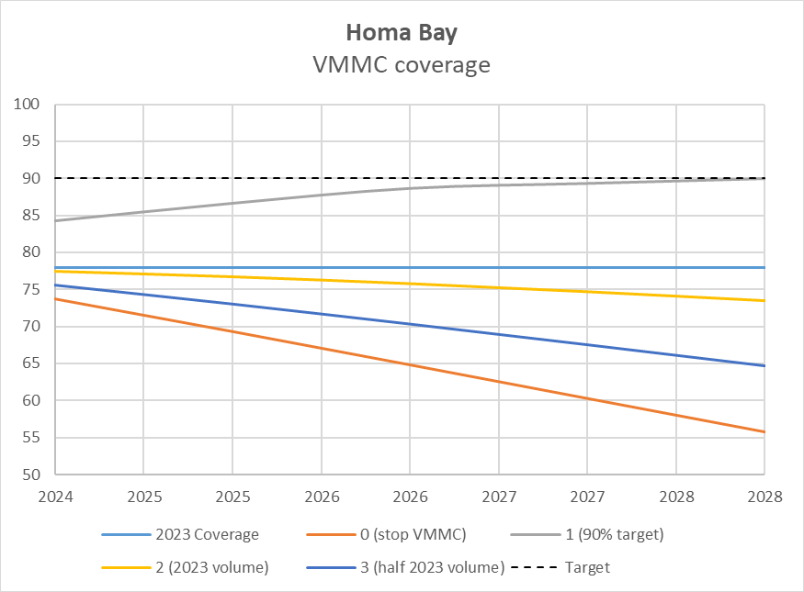
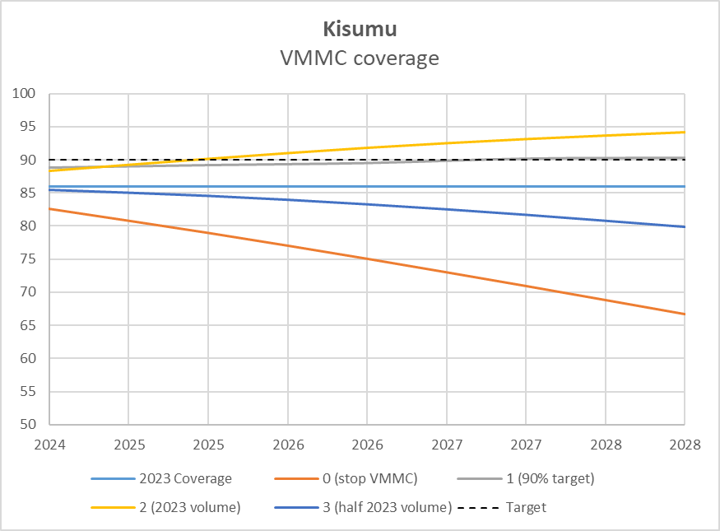
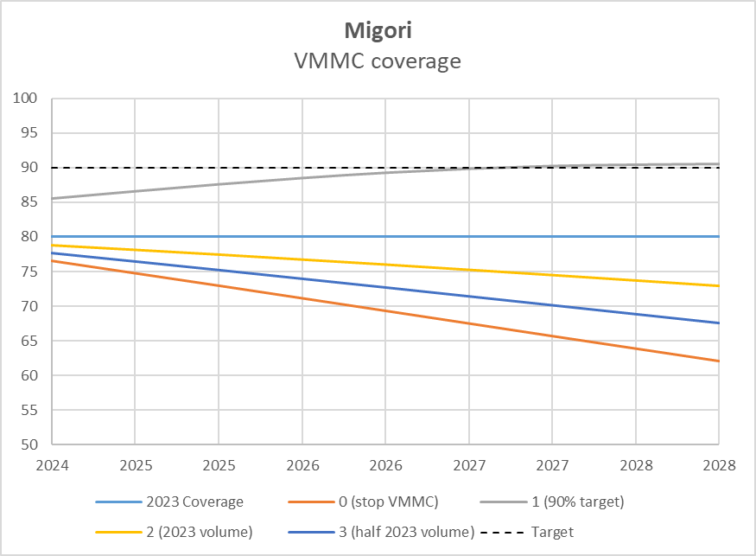
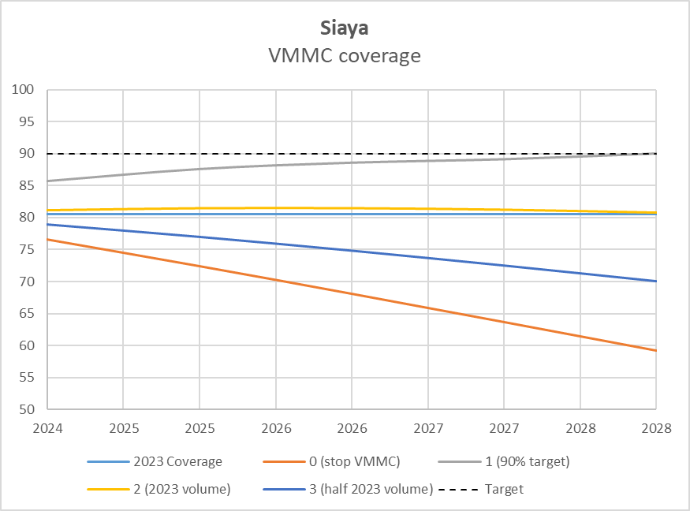
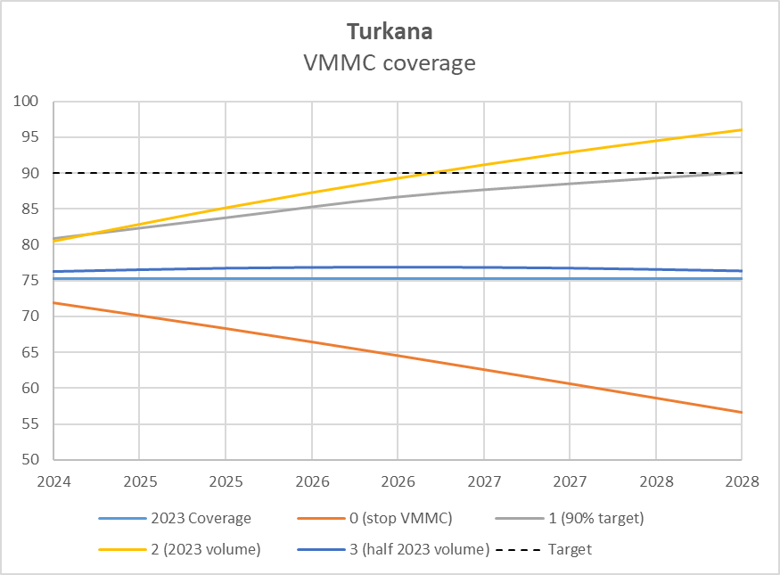
Coverage

Slide 10
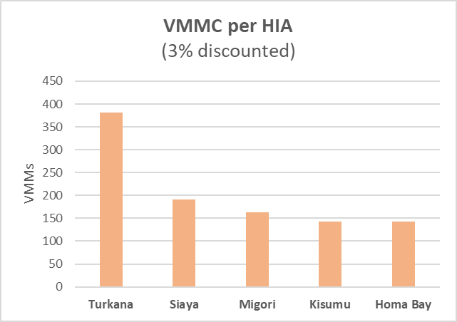
VMMCs per infection averted
Variation in VMMC per HIA is due to difference in HIV incidence between counties, e.g. Turkana has the lowest incidence and therefore requires the most VMMCS to avert an infection.

Slide 11
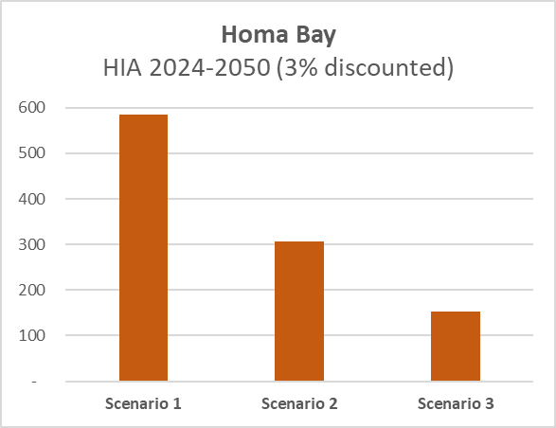
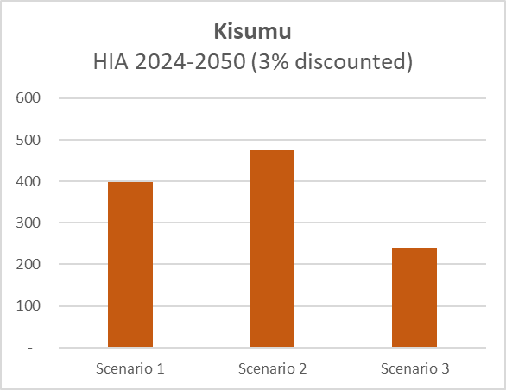
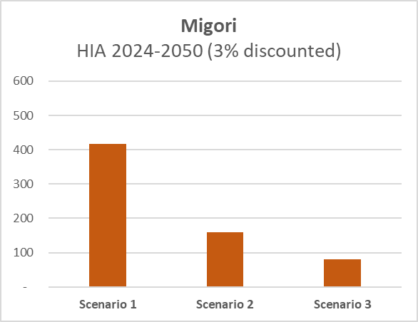
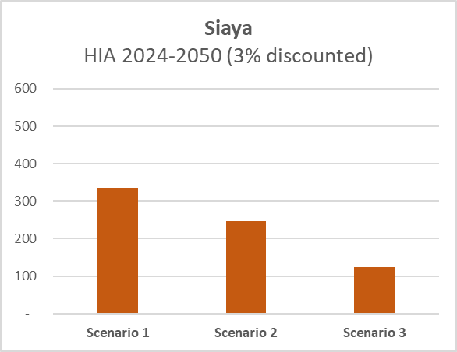
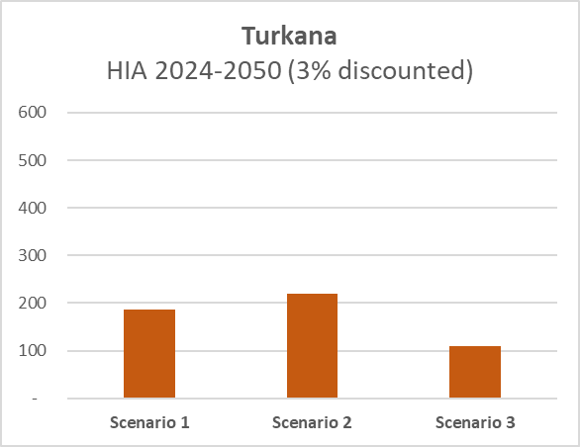
HIV infections averted

Slide 12
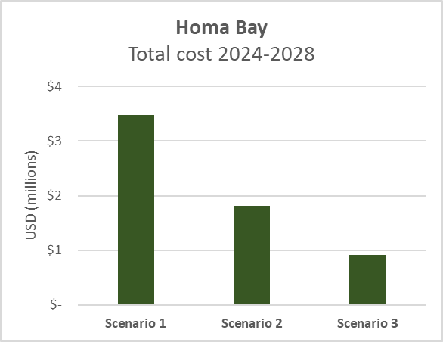
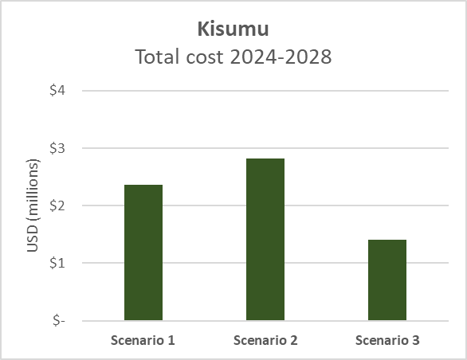
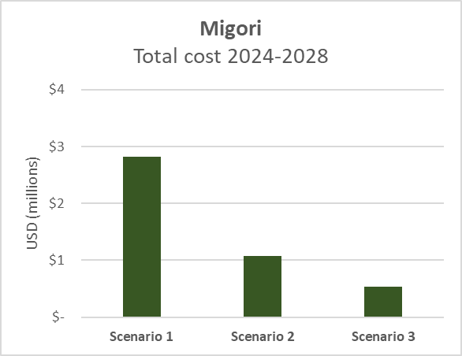
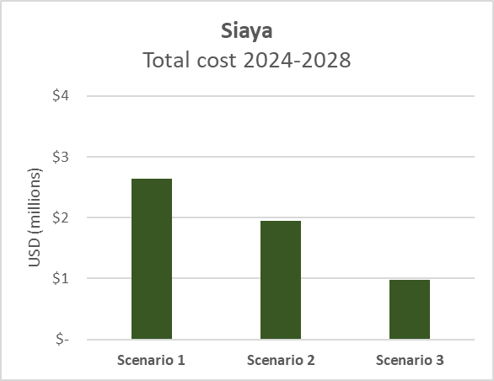
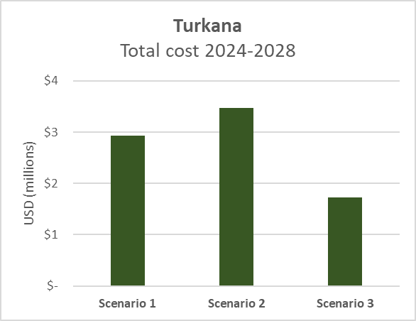
Total costs

Slide 13
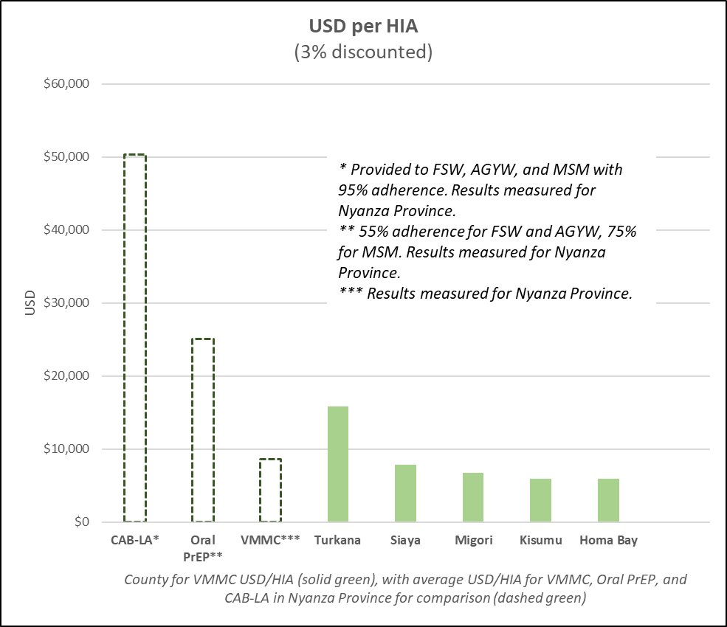
Cost effectiveness of VMMC and PrEP

Slide 14
PrEP in the Goals model
Effectiveness = Efficacy * Adherence
Efficacy is the true biological efficacy if used perfectly (unknown).
Adherence measures the reduction in efficacy based on actual product use when product is in hand. This is the definition used for Goals; others might use adherence to describe a combination of continuation and imperfect use.
Goals does not explicitly model continuation; this is reflected implicitly in the average population coverage.

Slide 15
Implementation costs per year (USD, undiscounted)

Slide 16
Modeling (PrEP)
Goals ASM
Infections averted*
+ cost per PYP
PYP dispensed**
Program costs
* Infections averted measured 2024 - 2050, with 3% discounting. For cost-effectiveness calculation, program costs are also discounted.
** PYP = person-years of PrEP, or cumulative duration of PrEP use in a population

Slide 17
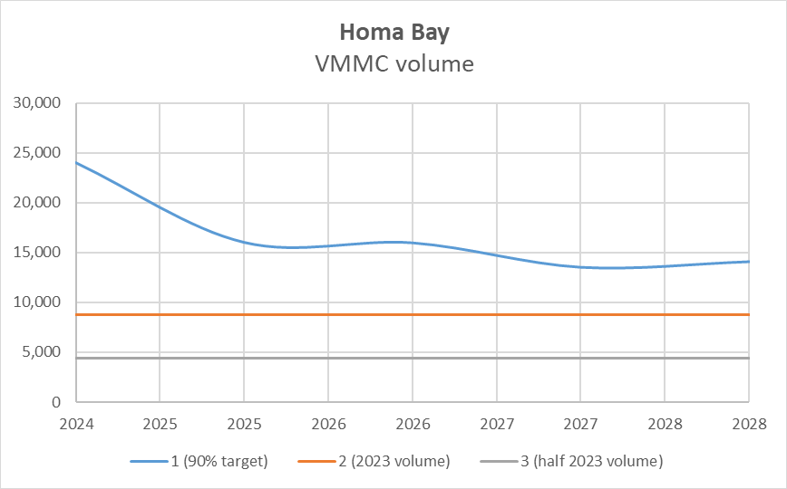
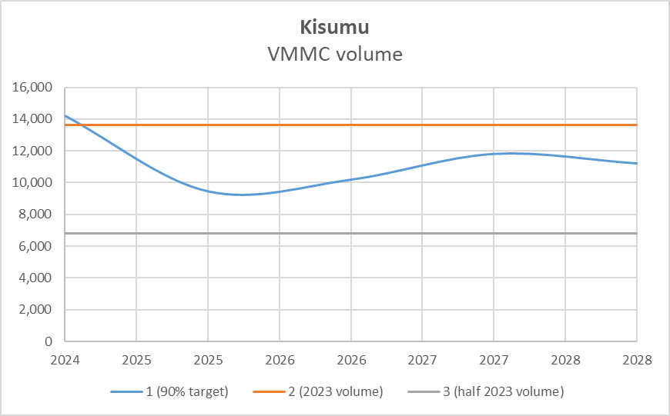
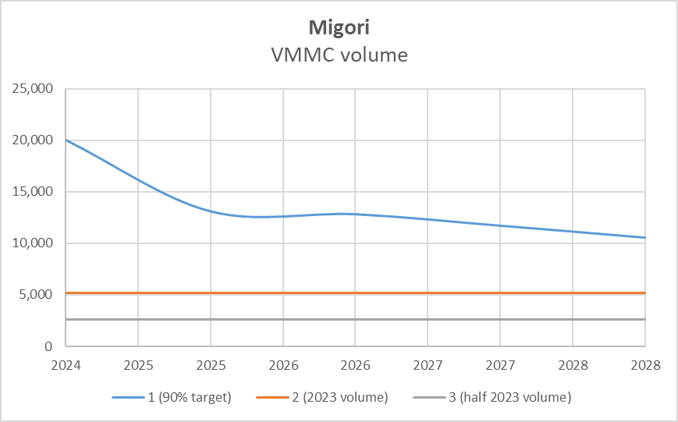
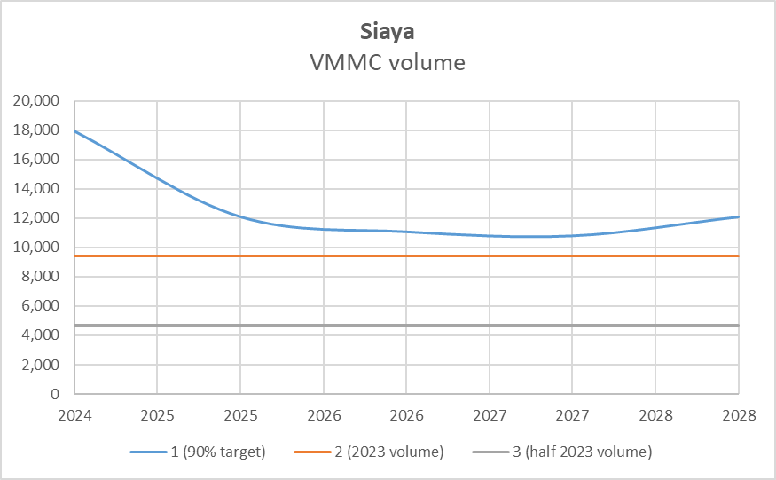
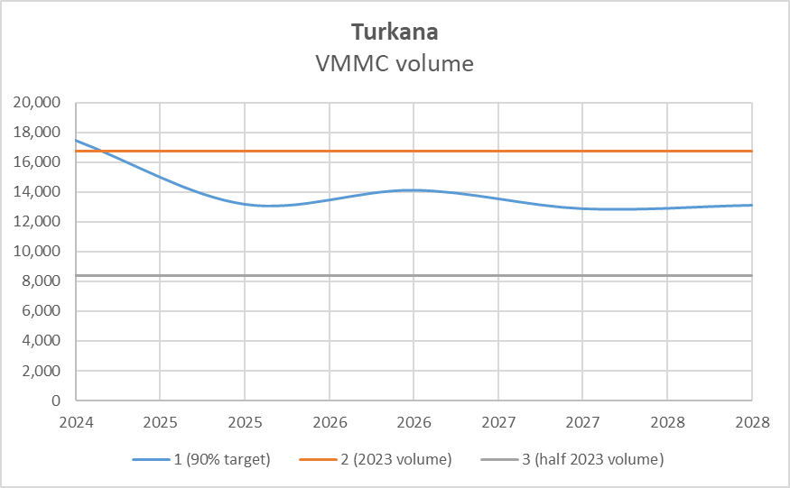
VMMC volume

