Slide 1
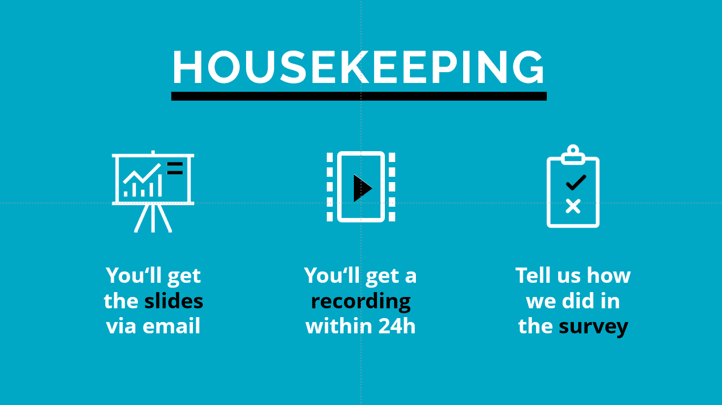




Global Men and HIV Technical Working Group (MENHT)
Webinar Series - Episode #10
Housekeeping and webinar resources
You will get the recording after the meeting
Let us all engage and have a good webinar
Date: 22 August 2024
Time: 14h00 – 15h00 CET
English

Slide 2
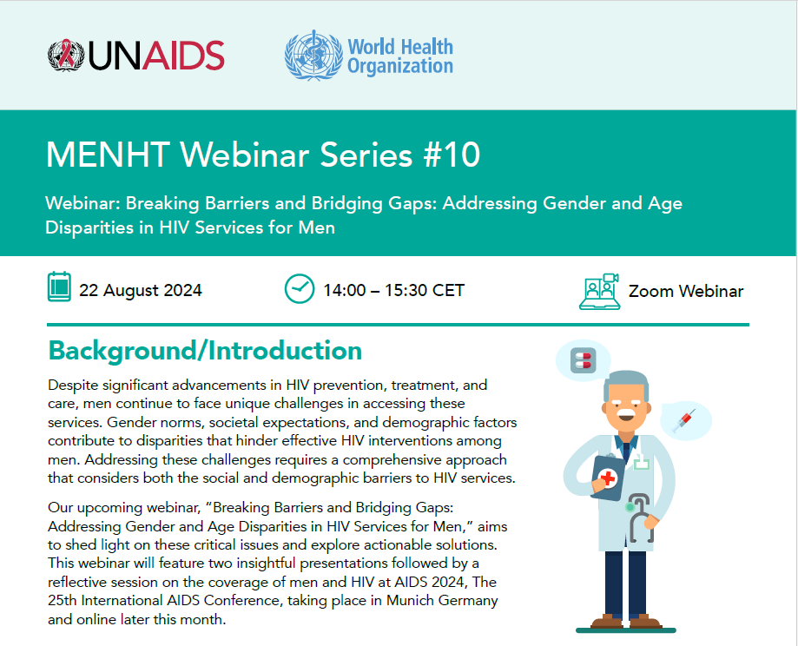
GLOBAL MEN AND HIV TECHNICAL WORKING GROUP WEBINAR #10
Breaking Barriers and Bridging Gaps: Addressing Gender and Age Disparities in HIV Services for Men
Gift Dlamini (He/Him)
Programmes Manager at Kwakha Indvodza (The Male Mentoring Organisation) and member of MenEngage, Eswatini.
Andrea Brizzi
PhD student at Imperial College
London, part of the StatML Program, UK

Slide 3


Global Men and HIV Technical Working Group (MENHT)
March 24, 2021

Slide 4

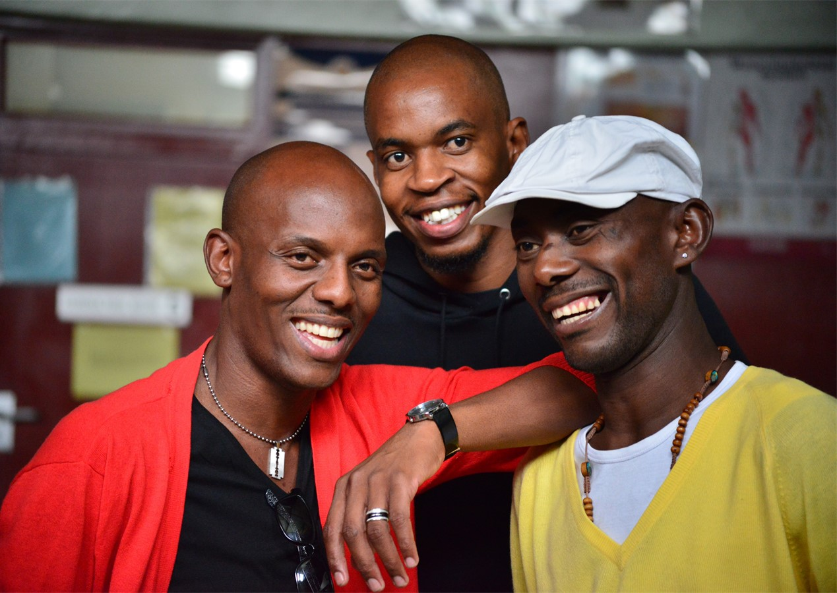
About MENHT
To coordinate activities related to improving outcomes for men across HIV cascade and support advocacy efforts with global partners and key stakeholders
To support development of operational guidance for improving HIV services for men including identifying interventions and review of technical documents
Identify, collect and share best practices, case example and tools for reaching men
For dissemination of guidance, briefs and lessons learned and support scale up of effective interventions including providing technical assistance
A standing body of stakeholders and partners to support global and country engagement and galvanize action to mitigate the men gap

Slide 5

Men are lagging on progress in the 95-95-95 targets
Testing and treatment cascade among women and men, Global, 2023
Men are consistently falling behind in achieving the 95-95-95 targets compared to women.
Only 83% of men living with HIV know their status,
72% are on treatment, and
67% are virally suppressed
This gap highlights the urgent need for targeted interventions to better engage men in HIV testing, treatment, and care services.
Source: Further analysis of UNAIDS epidemiological estimates, 2024
Notes:
Introduction: Despite significant strides in the global HIV response, men are consistently falling behind in achieving the 95-95-95 targets compared to women.
Key Data: Only 83% of men living with HIV know their status, 72% are on treatment, and 67% are virally suppressed, compared to higher percentages among women.
Implications: This gap highlights the urgent need for targeted interventions to better engage men in HIV testing, treatment, and care services.

Slide 6

Regions show differential men lag in progress towards the 95-95-95 targets
Source: Further analysis of UNAIDS epidemiological estimates, 2024
Notes:
This slide calculates and illustrates the percentage gap between females and males for the 95-95-95 targets across different regions.
Key Observations:
In some regions, the gap is quite large, indicating a significant lag in men's progress compared to women.
For instance, in Eastern Europe and Central Asia, the gap is particularly pronounced.
Actionable Insights: Addressing these gender disparities requires targeted interventions that focus specifically on the needs of men in these regions.

Slide 7
Absolute numbers of undiagnosed men by region
Source: Further analysis of UNAIDS epidemiological estimates, 2024
Notes:
Undiagnosed Men: This slide shows the absolute number of men living with HIV who are undiagnosed in different regions.
Key Regions:
Asia and the Pacific – Highest number of undiagnosed men – mostly men from key population epidemics
Eastern and Southern Africa: Second highest number of undiagnosed men, highlighting a critical area for intervention.
Western and Central Africa: Also significant numbers of undiagnosed men.
Urgency: Addressing these undiagnosed cases is crucial for controlling the epidemic and reaching global HIV targets.

Slide 8


Webinar outline
1
Welcome and introductions – Lycias Zembe, GPC, UNAIDS
2
Men and HIV Dialogues – Gift Dlamini, Kwakha Indvodza, Eswatini
3
Examining Age and Gender Profiles of Viraemia: The Increasing Role of Men in African Populations with High Antiretroviral Therapy (ART) Coverage – Andrea Brizzi, Imperial College London, UK
5
Questions and discussions – All, Facilitated by Afsar Mohammad Syed, ILO
6
Closing remarks – Wole Ameyan, WHO

Slide 9
QUESTIONS

