Slide 1
Making sense of the numbers
Orientation and Training on AGYW Decision-Making Tool on HIV Prevention Programming and Inequality Framework
Andreas Jahn, MD PhD
Capital Hotel, Lilongwe 2023-06-14

Slide 2
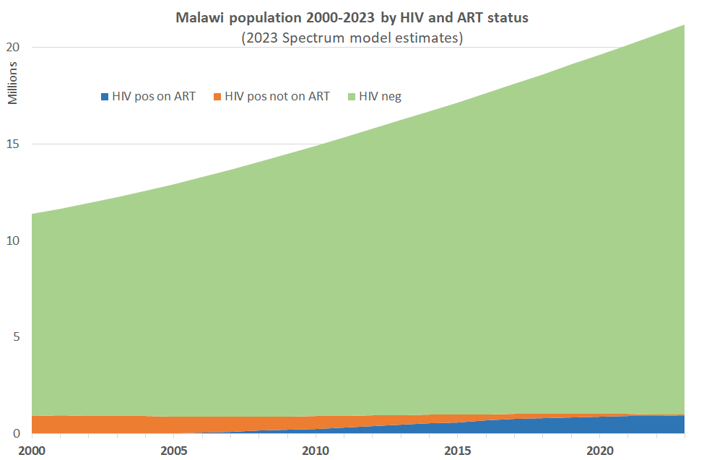
HIV negative population:
At risk of HIV infection
Target for primary prevention interventions
HIV positives not on ART
Source of new infections
Target for treatment as prevention
HIV positives on ART
No risk of new infections
Target for retention and adherence support

Slide 3
Key measures
How many?
New infections, deaths, PLHIV,…
How common?
Prevalence, incidence, mortality,…
How effective?
Odds ratio, rate ratio, …
What impact?
Attributable proportion (% reduction / increase), …
Is it worth the investment?
Cost per infection averted, …

Slide 4
How many
What is in the numerator
What is in the denominator
PLHIV
PLHIV currently alive in defined population
At specific point in time (31st Dec 2022)
None
New infections,
new deaths
Events in defined population
During specific period (in 2023)
None

Slide 5
How common
What is in the numerator
What is in the denominator
Prevalence
PLHIV currently alive in defined population
At specific point in time (31st Dec 2022)
Total population (HIV pos and neg) in Malawi
At specific point in time (31st Dec 2022)
Incidence
New infections in defined population
During specific period (in 2023)
Total population at risk of getting infected in Malawi = only HIV negatives
Length of period e.g. 1 year
Mortality
Total deaths from HIV in defined population
During specific period (in 2023)
Total population living in Malawi (HIV pos and neg)
Length of period e.g. 1 year

Slide 6
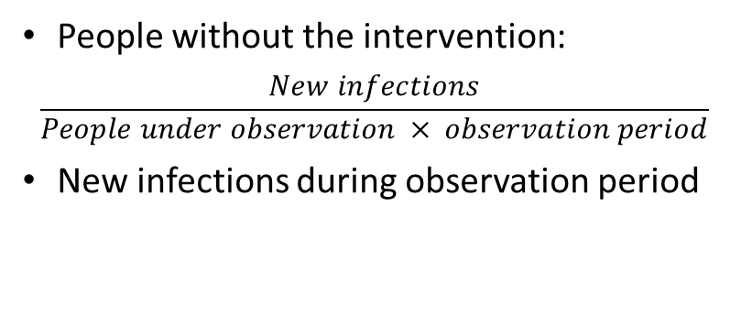
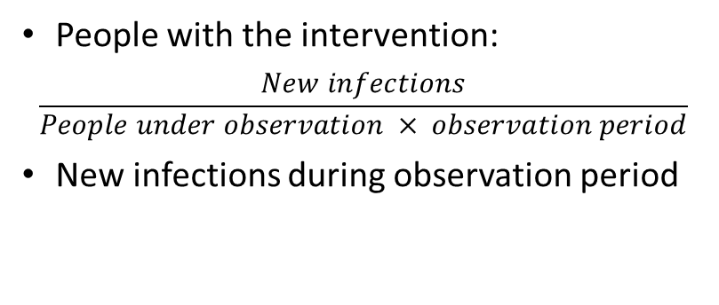
How effective
What is in the numerator
What is in the denominator
Odds ratio
People with the intervention:
Infected people divided by uninfected people
At specific point in time
People without the intervention:
Infected people divided by uninfected people
At specific point in time
Incidence rate ratio
People with the intervention:
$$\frac{New infections}{People under observation × observation period}$$
New infections during observation period
People without the intervention:
$$\frac{New infections}{People under observation × observation period}$$
New infections during observation period

Slide 7
What impact
What is in the numerator
What is in the denominator
Attributable proportion
People who have been reached with the intervention:
Odds or incidence rate
Total population in need of the intervention:
Odd or incidence rate
“Background” odds or incidence that happened without the intervention
Impact depends on:
Strength of effect of the intervention
Scalability / coverage of an intervention

Slide 8
Is it worth the investment
What is in the numerator
What is in the denominator
Cost per infection / death averted
Average cost per person reached with the intervention
Can be one-off or cost per period
Total infections or deaths averted by the intervention
Cost-effectiveness depends on:
Average cost per person reached
Strength of effect of the intervention
There is often opportunity cost: investment in one intervention may weaken others

Slide 9
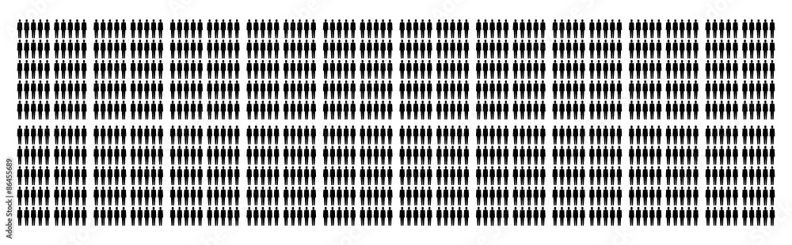
How much is 0.3% annual HIV incidence?
3 in a group of 1000 uninfected people get infected during a 1-year period

Slide 10
What is the average transmission risk? Contact with HIV positive person, not virally suppressed
Exposure type | Per exposure | Cumulative risk 100 exposures
Needle sharing | 0.63% | 47%
Needle stick | 0.23% | 21%
Receptive anal intercourse | 1.38% | 75%
Insertive anal intercourse | 0.11% | 10%
Receptive penile-vaginal intercourse | 0.08% | 8%
Insertive penile-vaginal intercourse | 0.04% | 4%
Receptive penile-vaginal intercourse with STI | 0.24% | 21%
Insertive penile-vaginal intercourse with STI | 0.12% | 11%
Oral intercourse | 0-0.04% | 0-4%

Slide 11
HIV Prevention Interventions
Biomedical
Non-Biomedical
ART
PMTCT
VMMC
PrEP
PEP
Condoms
Microbicides
(HIV testing)
SBCC
CSE
KP outreach
Community mobilization
Peer support
Norms change
PWID needle exchange
PWID opiate substitution
Structural
Cash transfer
Education
Income/ asset generation
GBV care

Slide 12
How do non-biomedical prevention interventions work?
Delayed sexual debut
Less frequent intercourse
Fewer different partners
More condom use
Less risky partner choice (age difference, promiscuity, STI, etc.)
Increased uptake of biomedical interventions

Slide 13
How effective are prevention interventions?
Intervention | Risk reduction
ART (viral suppression) | 100%
PEP (when completed) | 80%
Oral PrEP MSM (average adherence) | 77%
Oral PrEP heterosexual (average adherence) | 55%
Injectable PrEP (CAB-LA) | 93%
Condoms heterosexual (consistent use) | 80%
Condoms MSM | 63-91%
VMMC heterosexual (protection for the man) | 50-60%
VMMC (protection for the woman) | inconclusive
VMMC for MSM | inconclusive
KP outreach (through increased condom use) | 10-45%
DREAMS package (South Africa) | <5%

Slide 14
How many infections averted by giving oral PrEP for 1 year to 1000 people with 0.3% incidence?
1 ½ infections averted:
55% effectiveness for 3 people

Slide 15
Why does risky behavior ≠ HIV incidence?
Risk of HIV acquisition depends strongly on probability of contact with viraemic person (population viral load)
Prevalence of viraemic adults in Malawi
2000: 13.1%
2023: 0.4%
Promiscuous condomless sex in 2000 was much riskier than in 2023
Location matters: CLOVE study (Blantyre 2021):
2% of general population at health facility viraemic
4% of population attending venues viraemic

Slide 16
Why do we need HIV estimates and mathematical modelling?
Key indicators cannot be directly measured
HIV incidence, impact of prevention interventions: would need huge cohort study with repeated HIV testing
Routine recency surveillance finds <5% of estimated new infections
PLHIV cannot be directly enumerated: extrapolation from prevalence survey (small sample) applied to demographic projection
Incomplete death reporting, causes mostly unknown
Time trends and changes need past and future estimates
Scenarios, impact and cost-effectiveness can only be explored with model calculations

Slide 17
How do we know it’s true?
Human biases
Availability bias: If a recent event or a vivid example is easily recalled, it may be overestimated in terms of probability or importance.
Optimism bias: we believe that positive events are more likely to happen to them while negative events are less likely.
Loss aversion: Stronger emotional response to losses than to gains. Potential losses are perceived as more significant than they objectively are.
Herd mentality: we follow the actions and opinions of the majority.
Cognitive dissonance: conflicting information or evidence that challenges existing beliefs or behaviors causes discomfort, leading us to downplay or ignore the evidence.
Lack of statistical reasoning: Probability, uncertainty, and complex data can be counter-intuitive and challenging to grasp
Emotional factors: Strong emotions can cloud judgment

Slide 18
Making use of estimates and data
Program managers should make rational evidence-based decisions
Know your cognitive biases
Follow the science
Objectively assess quality of scientific evidence
GRADE criteria, etc.
Look at uncertainty bounds / confidence intervals
100% certain that HIV prevalence is between 0-100%: useful?
95% certain adult 15+ prevalence in 2023 is between 7.3-8.2%: useful!
Triangulate data and information
Consider “opportunity cost”: are investments made for maximum population benefit?

