Slide 1
Module 1: Key elements of programming with key populations
Session 1.1: The HIV epidemiology and vulnerability of key populations, and the importance of strategic information
In-Reach Online Training | Increasing support and partnerships with key populations at risk of HIV

Slide 2
Introduction
In most countries, inadequate coverage, poor service quality and human rights barriers continue to undermine responses to HIV, viral hepatitis and STIs for key populations.
WHO recommends that all countries should prioritise reaching key populations, support them to lead the response and provide equitable, accessible and acceptable services to these groups.
MODULE 1 | INTRODUCTION

Slide 3
Refresher: Who are key populations?
Key populations are those individuals and communities who are disproportionately impacted by HIV in all epidemic settings:
Sex workers of all genders
Gay, bisexual and other men who have sex with men
People who use drugs
Transgender and gender-diverse people
People in prisons and other closed settings
MODULE 1 | INTRODUCTION

Slide 4
Key global targets for HIV prevention,
diagnosis and treatment
The Global AIDS Strategy has set ambitious targets. By 2025:
95% of people at risk of HIV infection – including key populations – use appropriate, prioritised, person-centred and effective combination prevention options
95–95–95 testing and treatment targets achieved within all subpopulations – including key populations – and age groups:
95% of people living with HIV know their HIV status
95% of people living with HIV and who know their HIV status are on antiretroviral therapy (ART)
95% of people who are on ART have suppressed viral loads (viral suppression)*
For more on these targets, see Session 1.3.
*Viral suppression means that ART has reduced the amount of HIV virus in a person’s body to the point where it is no long transmissible via sexual contact, and they are unlikely to become sick themselves. This is known as U=U (undetectable = untransmissible).
MODULE 1 | INTRODUCTION

Slide 5
Key elements of programming with
nd for key populations
When planning interventions with and for key populations, there are some important questions to ask:
Which key populations and which subgroups within key populations are disproportionately affected? (for example particular age groups, genders or ethnic groups)
Which strategies and interventions need to be tailored for use with these populations? Are existing strategies adequate to meet their needs?
Who will implement the programmes ?
How will key populations be engaged?
What financial resources are available, and are they adequate for a response to the needs of key populations?
The five sessions in Module 1 will help to address these questions.
Source: Consolidated guidelines on HIV, viral hepatitis and STI prevention, diagnosis, treatment and care for key populations (WHO, 2022)
MODULE 1 | INTRODUCTION

Slide 6
What Module 1 covers
Session 1.1 The HIV epidemiology and vulnerability of key populations, and the importance of strategic information
Session 1.2 Community empowerment and community-led responses
Session 1.3 The comprehensive package of health-sector interventions with and for key populations
Session 1.4 Understanding and investing in critical enablers
Session 1.5 HIV and human rights
MODULE 1 | INTRODUCTION

Slide 7
Session 1.1: The HIV epidemiology and vulnerability of key populations, and the importance of strategic information
Questions to frame this section
HIV epidemiology of key populations
Key populations’ vulnerability to HIV
Using strategic information for policy and programming
Take-home messages
Session review questions
Further information and resources

Slide 8
Framing questions
1. Key populations have at least five times greater risk of acquiring HIV than adults in the general population.
Agree
Disagree
Unsure
2. Key populations can generally access health-care services as easily as anyone else.
Agree
Disagree
Unsure
SESSION 1.1 | QUESTIONS TO FRAME THIS SESSION

Slide 9
Framing questions
3. Criminal laws against sex work, drug use and same-sex sexual relations help lower rates of HIV infections.
Agree
Disagree
Unsure
4. Accurate data on key populations can help improve programmes to protect them from HIV.
Agree
Disagree
Unsure
SESSION 1.1 | QUESTIONS TO FRAME THIS SESSION

Slide 10
Framing questions: responses
Correct. Men who have sex with men have 28 times higher risk to acquire HIV than the general population. People who inject drugs 35, female sex workers 30, transgender people 14, and people in prisons and other closed settings five times higher risk.
Incorrect. Several factors – including laws and discriminatory attitudes – create barriers to health-care access for key populations.
Incorrect. Research has shown that laws criminalising sex work, drug use and same-sex relations are associated with higher rates of HIV infection in these populations.
Correct. Demographic and behavioural information can help us advocate for and design effective policies and programmes to reduce HIV among key populations.
SESSION 1.1 | QUESTIONS TO FRAME THIS SESSION

Slide 11
Session 1.1: The HIV epidemiology and vulnerability of key populations, and the importance of strategic information
Questions to frame this section
HIV epidemiology of key populations
Key populations’ vulnerability to HIV
Using strategic information for policy and programming
Take-home messages
Session review questions
Further information and resources

Slide 12
Key populations and their sex partners account
for the majority of new HIV infections globally
Key populations and their sexual partners accounted for 70% of new HIV infections globally in 2021.
Outside sub-Saharan Africa, key populations and their sexual partners account for 94% of all new infections.
Key populations and their sexual partners account for:
>88% of new HIV infections in Western and Central Europe and North America
78% of new HIV infections in Asia and the Pacific
51% of new HIV infections in sub-Saharan Africa.
Source: Global AIDS Update 2022 (UNAIDS, 2022)
SESSION 1.1 | HIV EPIDEMIOLOGY OF KEY POPULATIONS

Slide 13
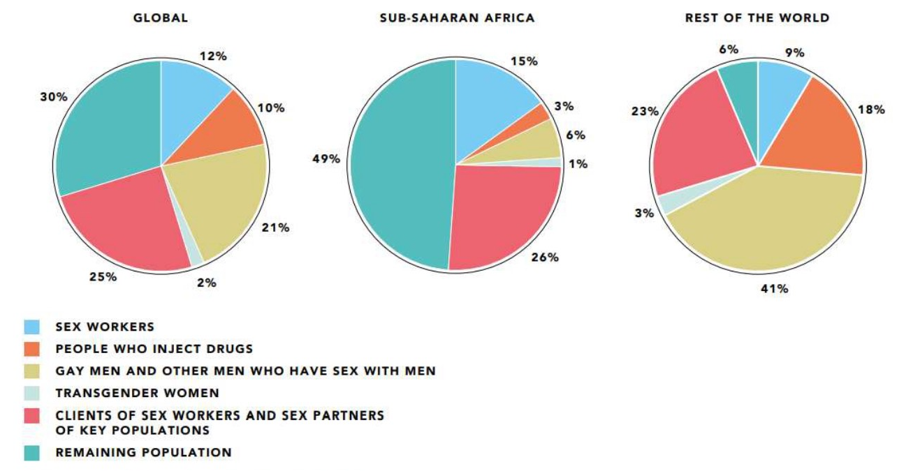
Distribution of acquisition of new HIV infections by
population: global, sub-Saharan Africa and rest of world, 2021
Source: Global AIDS Update 2022 (UNAIDS, 2022)
SESSION 1.1 | HIV EPIDEMIOLOGY OF KEY POPULATIONS

Slide 14
Key populations are at greater risk of HIV
infection than members of the general population
35 times
Source: Global AIDS Update 2022 (UNAIDS, 2022)
30 times
28 times
14 times
5 times
35 times
30 times
28 times
14 times
5 times
People who inject drugs have 35 times greater risk of acquiring HIV than adults who do not inject drugs
Female sex workers have 30 times greater risk of acquiring HIV than adult women (15-49) in the general population
Gay, bisexual and other men who have sex with men have 28 times greater risk of acquiring HIV than adult men (15-49) in the general population
Transgender women have 14 times greater risk of acquiring HIV than adult women (15-49) in the general population
People in prison are 5 times more likely to be living with HIV than adults in the general population
SESSION 1.1 | HIV EPIDEMIOLOGY OF KEY POPULATIONS

Slide 15
Viral hepatitis and sexually transmitted
infections are important, too
As well as HIV, key populations are also disproportionately affected by viral hepatitis and sexually transmitted infections (STIs).
The risk behaviours and vulnerabilities of key populations and their networks influence the dynamics of viral hepatitis and some STI epidemics as well as the HIV epidemic.
There is increasing acknowledgement of the importance of addressing these co-infections among key populations in an integrated way.
SESSION 1.1 | HIV EPIDEMIOLOGY OF KEY POPULATIONS

Slide 16
Session 1.1: The HIV epidemiology and vulnerability of key populations, and the importance of strategic information
Questions to frame this section
HIV epidemiology of key populations
Key populations’ vulnerability to HIV
Using strategic information for policy and programming
Take-home messages
Session review questions
Further information and resources

Slide 17
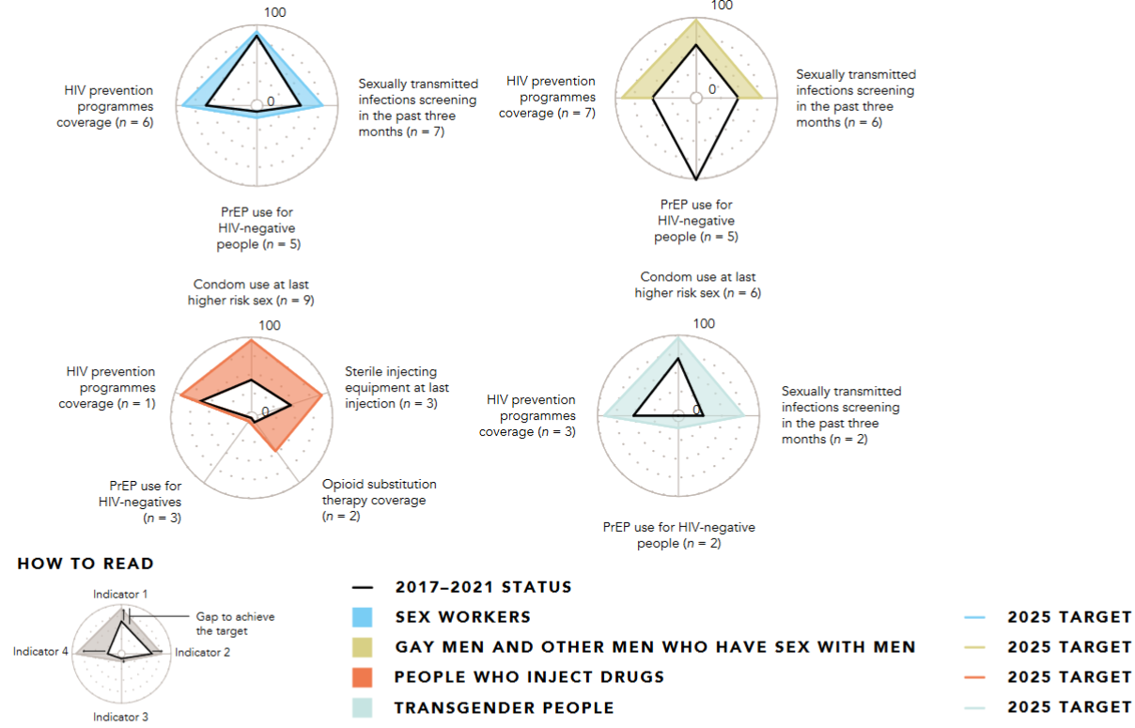
Prevention services for key populations
are unevenly accessible
Gap in achievement of combination prevention targets in countries of Western and Central Africa Region, by key population, 2017-2021
Source: Global AIDS Update 2022 (UNAIDS, 2022)
Across countries and regions, important HIV prevention services for key populations are unevenly accessible or entirely absent.
When prevention programmes for key populations are provided at scale, they perform relatively well.
Scaled, trusted and innovative community access, and rights support are needed to achieve the 2025 global targets.
SESSION 1.1 | KEY POPULATIONS’ VULNERABILITY TO HIV

Slide 18
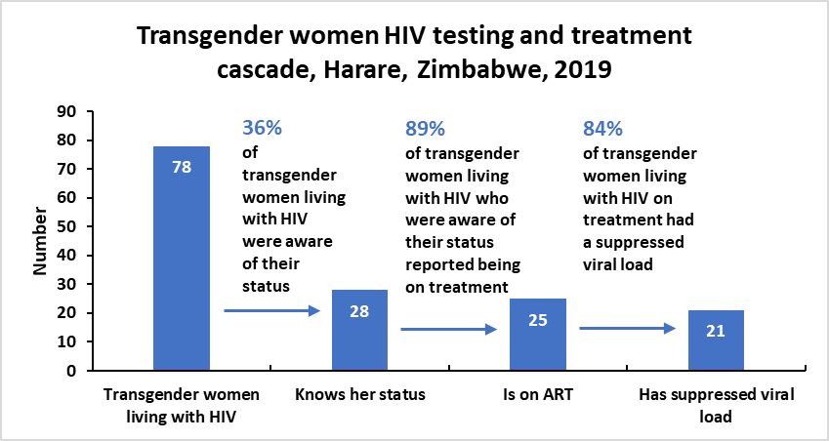
Key populations have unequal access to
services compared with the general population
Progress on the 95-95-95 targets for women (aged 15+ years) in Zimbabwe, 2019
100
90
80
70
60
50
40
30
20
10
0
95
94
79
95% of women living with HIV knew their HIV status
94% of women living with HIV who are aware of their status were on treatment
79% of women living with HIV on treatment had a suppressed viral load
Source: Harris T, et al. HIV care cascade: Men who have sex with men & transgender women/genderqueer, Zimbabwe. Conference on Retrovirology and Opportunistic Infections (CROI). Boston (MA), 8-11 March 2020. Abstract 1097.
SESSION 1.1 | KEY POPULATIONS’ VULNERABILITY TO HIV

Slide 19

Societal factors increase key populations’
vulnerability to HIV
In most countries, key populations are subject to marginalisation, stigma, discrimination, criminalisation, and violence.
These factors make it harder for key populations to adopt healthy behaviours such as protected sex and safe injecting of drugs, and harder for them to access services.
As a result, it is more difficult for key populations to protect themselves against HIV, viral hepatitis and STIs.
Image: UNDP Panama / Grey Díaz
SESSION 1.1 | KEY POPULATIONS’ VULNERABILITY TO HIV

Slide 20
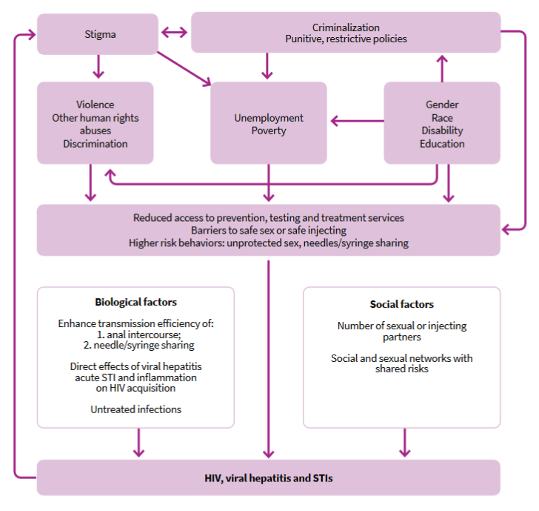
Biological and social factors play a role in HIV risk, but vulnerability is greatly affected by societal factors and by socioeconomic status.
Source: Consolidated guidelines on HIV, viral hepatitis and STI prevention, diagnosis, treatment and care for key populations (WHO, 2022)
SESSION 1.1 | KEY POPULATIONS’ VULNERABILITY TO HIV

Slide 21
Unequal access to services is a
vulnerability
Coverage and use of combination HIV prevention among gay, bisexual and other men who have sex with men in recent years ranged from 27% in Asia and the Pacific to 53% in Western and Central Africa.
Coverage of HIV prevention among transgender people ranged from 28% in Eastern and Southern Africa to 77% in Europe and Central Asia.
In 2021, more than 1.6 million people worldwide were using oral pre-exposure prophylaxis (PrEP). This is a two-fold increase, despite the COVID-19 pandemic, but it is far short of the 2025 target of 10 million.
“When (they) understood our identity as sex workers, (they) completely refused to provide health services; most of the time doctors ignored us.”
-Sex worker, Bangladesh
Source: Global AIDS Update 2022 (UNAIDS, 2022)
SESSION 1.1 | KEY POPULATIONS’ VULNERABILITY TO HIV

Slide 22
Intersectional vulnerabilities increase
the risk for key populations
Intersectional means that someone has multiple vulnerabilities which compound their risk
For example, a sex worker may also inject drugs; or a transgender woman may sell sex; many sex workers are mobile and lack support; many key population individuals are poor, some have HIV.
Such individuals can experience multiple, intersecting forms of stigma and discrimination that prevent them from protecting their health and well-being.
Gender, race and socioeconomic status are further aspects of identity that affect intersectional vulnerability.
SESSION 1.1 | KEY POPULATIONS’ VULNERABILITY TO HIV

Slide 23
Think about intersecting vulnerabilities
In the context where you work, what difficulties in accessing HIV prevention, diagnosis or treatment might be faced by:
A man who has sex with men who is a member of an ethnic minority?
A person in prison who injects drugs?
A transgender person who is unemployed?
A teenage girl who is pregnant?
A sex worker who is homeless?
SESSION 1.1 | KEY POPULATIONS’ VULNERABILITY TO HIV

Slide 24
Criminalisation is associated with
poorer HIV outcomes
A study by the HIV Policy Lab* found that the HIV response was less successful in countries with laws that criminalise same-sex sex, sex work and drug use.
Criminalisation of same-sex sex was associated with 11% lower knowledge of HIV status and 8% lower viral suppression among people living with HIV
Sex work criminalisation was associated with 10% lower knowledge of HIV status and 6% lower viral suppression.
Drug use criminalisation was associated with 14% lower levels of both.
Criminalising all three of these areas was associated with 18-24% worse outcomes.
*The HIV Policy Lab is a collaboration of academic, UN and civil society organisations to track, measure and improve the HIV-related law and policy environment in countries around the world.
Source: HIV Policy Lab
SESSION 1.1 | KEY POPULATIONS’ VULNERABILITY TO HIV

Slide 25
Non-discrimination, human rights and GBV
prevention are associated with better HIV outcomes
Countries with laws advancing non-discrimination, human rights institutions, and responding to gender-based violence had better HIV outcomes.
Non-discrimination protections were associated with 10% higher knowledge of HIV status and 11% higher viral suppression among people living with HIV.
Independent human rights institutions were associated with 3% higher knowledge of HIV status and 3% higher viral suppression.
Gender-based violence laws were associated with 16% higher knowledge of HIV status and 16% higher viral suppression.
Source: HIV Policy Lab
SESSION 1.1 | KEY POPULATIONS’ VULNERABILITY TO HIV

Slide 26
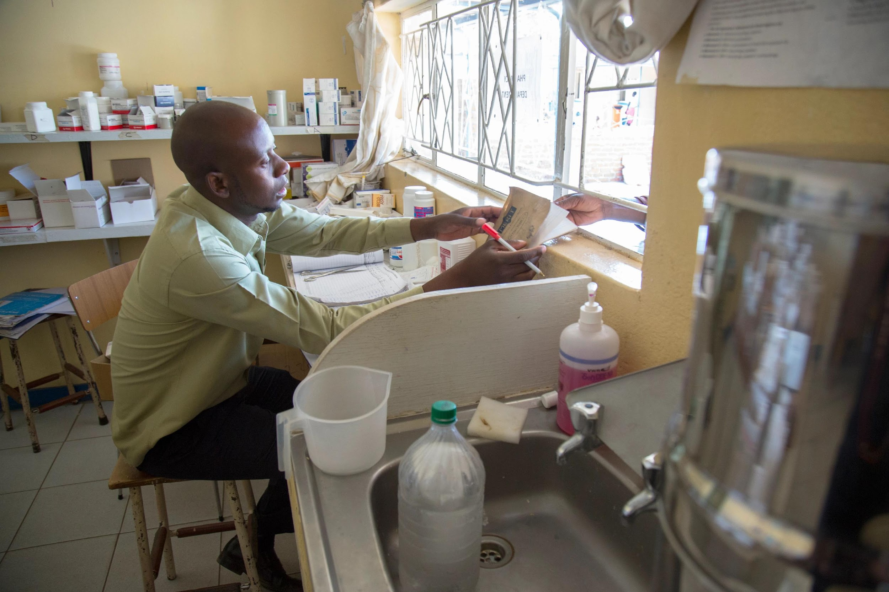
The COVID-19 pandemic has had a negative
impact on HIV prevention for key populations
In a survey across 55 countries by the Global Network of Sex Work Projects, a majority of respondents in every region except Europe reported reduced access to condoms, lubricants and services for screening and treating STIs during the Covid-19 pandemic.
A global survey among gay, bisexual and other men who have sex with men using a social networking app during April and May 2020, found that many reported interruptions to HIV prevention services, including condoms and PrEP (pre-exposure prophylaxis).
Image: UNDP Zimbabwe
SESSION 1.1 | KEY POPULATIONS’ VULNERABILITY TO HIV

Slide 27
Session 1.1: The HIV epidemiology and vulnerability of key populations, and the importance of strategic information
Questions to frame this section
HIV epidemiology of key populations
Key populations’ vulnerability to HIV
Using strategic information for policy and programming
Take-home messages
Session review questions
Further information and resources

Slide 28
Obtaining good strategic information
about key populations
In order to develop effective programmes for key populations at local or national level, it is essential to obtain good strategic information about their health and rights, most notably regarding:
HIV, STIs, viral hepatitis and other health outcomes
Access to sexual and reproductive health, harm reduction and other services
Impact of
COVID-19
Human rights-related barriers to health
SESSION 1.1 | USING STRATEGIC INFORMATION FOR POLICY AND PROGRAMMING

Slide 29
Sources of strategic information
The most common and useful sources of information, including on key populations, are:
Population size estimates
Behavioural and sero-surveillance surveys
Community-led data collection
National budgets for prevention, testing, treatment and care
Gender assessments and legal environment assessments
People Living with HIV Stigma Index
Programmatic and administrative data, desk reviews and expert consultations
SESSION 1.1 | USING STRATEGIC INFORMATION FOR POLICY AND PROGRAMMING

Slide 30
Data on barriers to service access
Efforts should be made to support countries to assess the barriers faced by key populations to accessing health and other services, which can be assessed on an annual basis.
In addition to the Stigma Index 2.0 survey method produced by the Global Network of People Living with HIV, UN agencies have produced guidance to conduct gender assessments and Legal Environment Assessments (LEA).
Results from such efforts can be used to identify bottlenecks and guide scale up programmes.
SESSION 1.1 | USING STRATEGIC INFORMATION FOR POLICY AND PROGRAMMING

Slide 31
The role of UN staff in strategic
information
UN staff can advocate for the collection of strategic information, especially:
Key population size estimates
Prevalence of HIV, viral hepatitis and STIs
Data on knowledge, attitudes and behaviours of key populations, service providers and others impacting key populations’ health and well-being
Wherever possible, all data should be disaggregated by age and gender.
It is important to engage key populations in the data collection process.
A mixture of quantitative and qualitative information increases understanding of hidden or intersecting vulnerabilities.
In many settings, data on key populations are incomplete and may be difficult to gather. However, this should not be used as a reason to delay initiatives to improve the health of key populations.
SESSION 1.1 | USING STRATEGIC INFORMATION FOR POLICY AND PROGRAMMING

Slide 32
The importance of “Doing No Harm”
In criminalised and stigmatised contexts, data collection – whether for research or for programme planning and implementation – must always be done in a way that does no harm and respects the vulnerabilities, concerns and preferences of key populations.
Some good practices:
Any new action to collect data must be designed and implemented collaboratively with key population communities themselves.
The use of geo-mapping techniques for size estimations should be carefully evaluated. Key populations should be consulted about the handling of potentially identifying data by government agencies.
SESSION 1.1 | USING STRATEGIC INFORMATION FOR POLICY AND PROGRAMMING

Slide 33
Session 1.1: The HIV epidemiology and vulnerability of key populations, and the importance of strategic information
Questions to frame this section
HIV epidemiology of key populations
Key populations’ vulnerability to HIV
Using strategic information for policy and programming
Take-home messages
Session review questions
Further information and resources

Slide 34
Take-home messages
Key populations and their sexual partners account for more than 70% of all new HIV infections globally.
The risks faced by key populations to HIV, viral hepatitis and STIs are often the result of several intersecting vulnerabilities, notably stigma, discrimination and punitive laws. The resulting exclusion and marginalisation make it harder for key populations to access services and protect their health and well-being.
The COVID-19 pandemic has also had a detrimental impact on key populations’ situation and service provision for them.
The UN has an important role to advocate for the collection of strategic information on key populations, their risks, human rights-related challenges, funding levels and barriers to accessing services.
SESSION 1.1 | TAKE-HOME MESSAGES

Slide 35
Session 1.1: The HIV epidemiology and vulnerability of key populations, and the importance of strategic information
Questions to frame this section
HIV epidemiology of key populations
Key populations’ vulnerability to HIV
Using strategic information for policy and programming
Take-home messages
Session review questions
Further information and resources

Slide 36
Session review questions
SESSION 1.1 | SESSION REVIEW QUESTIONS

Slide 37
Session 1.1: The HIV epidemiology and vulnerability of key populations, and the importance of strategic information
Questions to frame this section
HIV epidemiology of key populations
Key populations’ vulnerability to HIV
Using strategic information for policy and programming
Take-home messages
Session review questions
Further information and resources

Slide 38
Further information and resources
IN DANGER: UNAIDS Global AIDS Update 2022 (UNAIDS, 2022)
Key Populations Atlas (UNAIDS)
Consolidated Guidelines on HIV, Viral Hepatitis and STI Diagnosis, Prevention, Treatment and Care for Key Populations (WHO, 2022)
Biobehavioral Survey Guidelines (Global HIV Strategic Information Working Group, 2017)
Guidelines on Estimating the Size of Populations Most at Risk to HIV (UNAIDS, WHO, 2011)
Recommended Population Size Estimates of Men Who Have Sex with Men (UNAIDS & WHO, 2020)
Biobehavioural Survey Guidelines for Populations at Risk of HIV (Global HIV Strategic Information Working Group, 2017)
Consolidated HIV Strategic Information Guidelines (WHO, 2020)
Global AIDS Monitoring 2022: Indicators for Monitoring Progress on the 2021 Political Declaration on HIV and AIDS (UNAIDS, 2021)
Establishing Community-led Monitoring of HIV Services (UNAIDS, 2021)
Mapping and Population Size Estimates of Sex Workers: Proceed with Extreme Caution (Global Network of Sex Work Projects, 2015)
SESSION 1.1 | FURTHER INFORMATION AND RESOURCES

Slide 39



