Slide 1


Module 1: Key elements of programming with key populations
Session 1.4: Understanding and investing in critical enablers
In-Reach Online Training | Increasing support and partnerships with key populations at risk of HIV

Slide 2
Introduction
The WHO Key Populations Consolidated Guidelines, 2022 note that “all key populations reported criminalisation, stigma and discrimination as persistent barriers to accessing health services and remaining in treatment, as well as being driving factors in perpetuating vulnerability, human rights abuses and poor health outcomes.”
This session describes the kinds of interventions that can be undertaken to tackle socio-structural factors that limit access to health services for key populations, and how the UN can support these interventions.
SESSION 1.4 | INTRODUCTION

Slide 3
Session 1.4: Understanding and investing in critical enablers
Questions to frame this session
The 10-10-10 targets in the Global AIDS Strategy
What are critical enablers?
Why critical enablers are needed
The UN’s role in investing in critical enablers
Take-home messages
Session review questions
Further information and resources

Slide 4
Framing questions
1. Societal enablers are good but optional: HIV programmes for key populations can succeed without them.
Agree
Disagree
Unsure
2. In countries with laws against gender-based violence, more people living with HIV manage to access and remain on the medicines that keep them healthy. Agree
Disagree
Unsure
SESSION 1.4 | QUESTIONS TO FRAME THIS SESSION

Slide 5
Framing questions
3. The 10-10-10 targets recommend that less than 10% of key populations should experience stigma and discrimination.
Agree
Disagree
Unsure
4. There is no need to educate people about HIV-related stigma in the workplace or schools.
Agree
Disagree
Unsure
SESSION 1.4 | QUESTIONS TO FRAME THIS SESSION

Slide 6
Framing questions: responses
Incorrect. WHO and UNAIDS have identified societal enablers as key to improving key populations’ access to essential health and social services.
Correct. Laws and programmes to counter gender-based violence help people living with HIV – especially women – to access continue on treatment.
Correct. This is a target that all countries should be aiming to reach by 2025, as part of the 2021 Political Declaration on HIV and AIDS.
Incorrect. HIV stigma is a barrier to health-care access, so learners in schools, and people in workplaces, should be equipped to reduce stigma.
SESSION 1.4 | QUESTIONS TO FRAME THIS SESSION

Slide 7
Session 1.4: Understanding and investing in critical enablers
Questions to frame this session
The 10-10-10 targets in the Global AIDS Strategy
What are critical enablers?
Why critical enablers are needed
The UN’s role in investing in critical enablers
Take-home messages
Session review questions
Further information and resources

Slide 8
Another look at the global targets
for 2025
STRUCTURAL
HIV SERVICES |  | INTEGRATION | SOCIETAL ENABLERS
95% of people at risk of HIV infection use appropriate, prioritised, person- centred and effective combination prevention options | 95–95–95 testing and treatment targets achieved within all sub-populations and age groups | 90% of people living with HIV and people at risk linked to people-centred and context-specific integrated services for other communicable diseases, noncommunicable diseases, sexual and gender-based violence, mental health and other services they need for their overall health and well-being | 10–10–10 targets achieved for removing social and legal impediments that limit access to or use of HIV services
 | 95% of people who are living with HIV know their HIV status 95% of people who are living with HIV and know their HIV status are on antiretroviral therapy 95% of people who are on antiretroviral therapy have suppressed viral loads | Sex workers, gay and other men who have sex with men: 90% have access to HIV services integrated with (or linked to) STI, mental health and IPV programmes, SGBV programmes that include PEP and psychological first aid Transgender people: 90% of transgender people have access to HIV services integrated with or linked to STI, mental health, gender- affirming therapy, IPV programmes, and SGBV programmes that include PEP, emergency contraception and psychological first aid People who inject drugs: 90% have access to comprehensive harm reduction services (including HIV services) integrating or linked to hepatitis C, HIV and mental health services People in prison and other closed settings: 90% have access to integrated TB, hepatitis C and HIV services | Less than 10% of countries have punitive legal and policy environments that deny or limit access to services. Less than 10% of people living with HIV and key populations experience stigma and discrimination. Less than 10% of women, girls, people living with HIV and key populations experience gender inequality and violence.
Source: Global AIDS Strategy 2021-2026 (UNAIDS, 2021)
SESSION 1.4 | THE 10-10-10 TARGETS IN THE GLOBAL AIDS STRATEGY

Slide 9
Addressing societal enablers
The 10-10-10 targets in the Global AIDS Strategy are called societal enablers because they provide a pathway for countries to remove barriers that get in the way of:
Supportive legal and policy environments
Access to justice
Gender equality
A society free of the stigma and discrimination
Universal access or use of HIV and other health services
SESSION 1.4 | THE 10-10-10 TARGETS IN THE GLOBAL AIDS STRATEGY

Slide 10
Session 1.4: Understanding and investing in critical enablers
Questions to frame this session
The 10-10-10 targets in the Global AIDS Strategy
What are critical enablers?
Why critical enablers are needed
The UN’s role in investing in critical enablers
Take-home messages
Session review questions
Further information and resources

Slide 11
To help reach the 10-10-10 targets, WHO
recommends a package of critical enablers
Essential for impact: Critical enablers
 | MSM | PWID | TGD | SW | PRIS
Removing punitive laws, policies and practices | x | x | x | x | x
Reducing stigma and discrimination | x | x | x | x | x
Community empowerment | x | x | x | x | x
Addressing violence | x | x | x | x | x
MSM = gay, bisexual and other men who have sex with men | PWID = people who inject drugs | TGD = transgender people | SW = sex workers | PRIS = people in prison and other closed settings
SESSION 1.4 | WHAT ARE CRITICAL ENABLERS?

Slide 12
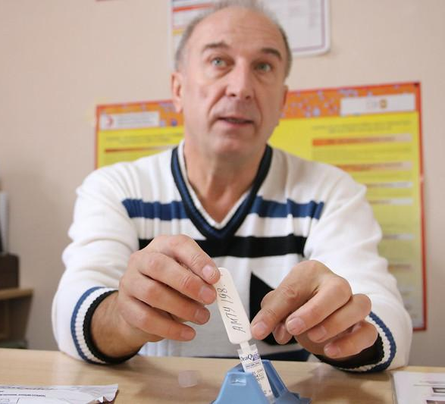
What are critical enablers?
Critical enablers are strategies, activities and approaches to improve the accessibility, acceptability, uptake, equitable coverage, effectiveness and efficiency of HIV, viral hepatitis and STI services.
Enablers operate at many levels – individual, community, institutional, societal and national, regional and global.
In essence, critical enablers (WHO) are the same as societal enablers (Global AIDS Strategy).
Image: UNDP Kyrgyzstan
Source: Consolidated guidelines on HIV, viral hepatitis and STI prevention, diagnosis, treatment and care for key populations (WHO, 2022)
SESSION 1.4 | WHAT ARE CRITICAL ENABLERS?

Slide 13
Why are critical enablers important?
Critical enablers are needed because criminalisation and stigmatisation of key populations, and discrimination and violence against them, are barriers to their access to health and other services.
This leads to poorer health outcomes, including for HIV, STIs and viral hepatitis.
Critical enablers can be divided into:
Programme enablers, e.g. ensuring that health services for key populations and people living with HIV are provided without stigma
Societal enablers, e.g. the decriminalisation of HIV transmission
This session focuses on societal enablers.
SESSION 1.4 | WHAT ARE CRITICAL ENABLERS?

Slide 14
Examples of critical enablers
Laws and policies
Addressing stigma and discrimination
Community empowerment
Addressing violence against key populations
Moving towards decriminalising key populations
Anti-stigma, antidiscrimination and protective policies
Programmes led by key-population organisations
Policies preventing violence against key populations
Age of consent to services
Professional and competent services for key populations
Support for persons experiencing violence
Laws and policies allowing freedom of association
Recognition of transgender people in the law
Training and sensitisation of health workers and law enforcement officers
Access to justice and legal literacy and support for key populations
SESSION 1.4 | WHAT ARE CRITICAL ENABLERS?

Slide 15
Country investments in critical enablers
Czechia, the Netherlands, Portugal and Switzerland have decriminalised drug use and drug possession for personal use. They have also invested significantly in harm reduction programmes. New cases of HIV among people who inject drugs are low.
In Argentina, a study on the impact of law reforms to allow change of gender on identity documents found that after the law was introduced, reports of stigma and discrimination against transgender women fell from approximately 80% to around 30%. Prior to the law, almost half of transgender women reported needing to abandon their education due to stigma. This dropped to 4% after the law was introduced.
Sources: HIV and People who Use Drugs. Human Rights Fact Sheet Series No. 2; HIV and Transgender and Other Gender-Diverse People. Human Rights Fact Sheet Series No. 4 (UNAIDS, 2021)
SESSION 1.4 | WHAT ARE CRITICAL ENABLERS?

Slide 16
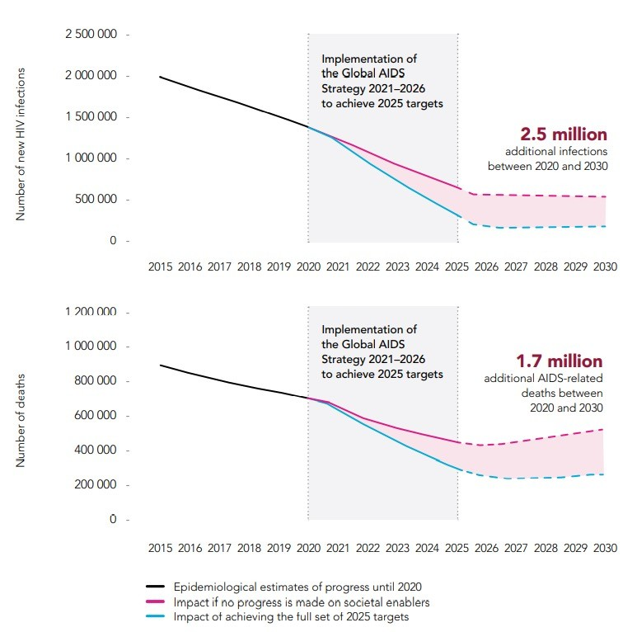
Investing in critical enablers
saves lives
HIV infections and AIDS-related deaths estimated through 2020, and modelled predictions of the infections and deaths by 2030, if the 2025 targets for societal enablers are or are not achieved
Source: Beyrer, C. Presentation on societal enablers
SESSION 1.4 | WHAT ARE CRITICAL ENABLERS?

Slide 17
Session 1.4: Understanding and investing in critical enablers
Questions to frame this session
The 10-10-10 targets in the Global AIDS Strategy
What are critical enablers?
Why critical enablers are needed
The UN’s role in investing in critical enablers
Take-home messages
Session review questions
Further information and resources

Slide 18
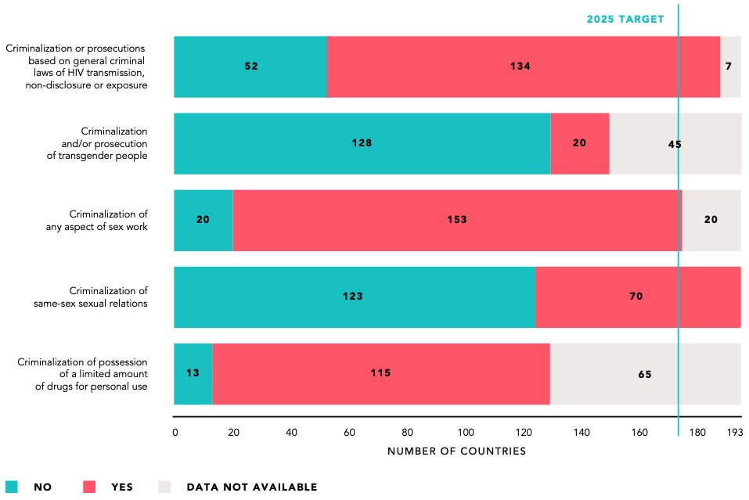
Many countries have discriminatory
and punitive laws
Global AIDS Strategy target: By 2025, all countries to the left of the green line will also be green on this chart, i.e. “No criminalisation of the key population”
Source: Global AIDS Update 2022 (UNAIDS, 2022)
SESSION 1.4 | WHY CRITICAL ENABLERS ARE NEEDED

Slide 19
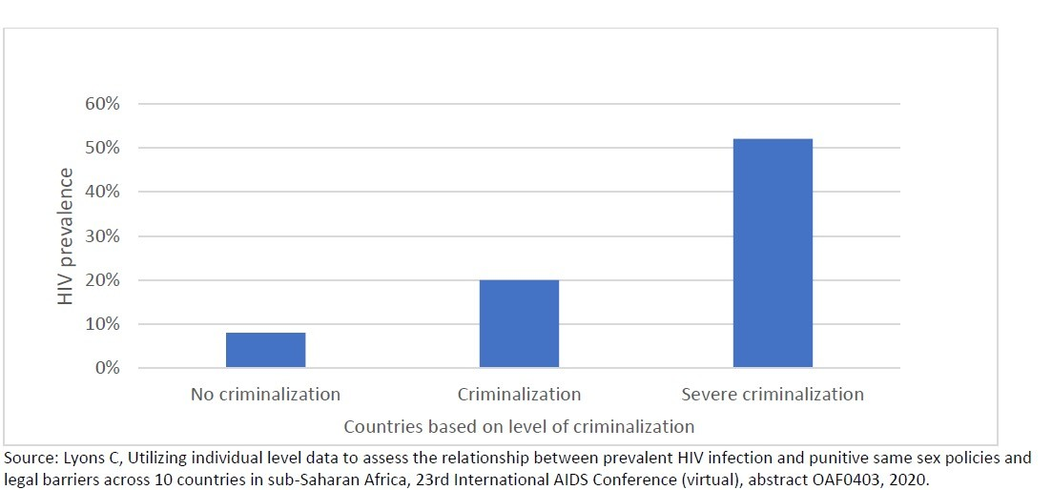
Punitive laws and policies increase
vulnerability to HIV
Research across 10 countries in sub-Saharan Africa found an association between the level of criminalisation of same-sex relations and HIV prevalence among gay, bisexual and other men who have sex with men.
SESSION 1.4 | WHY CRITICAL ENABLERS ARE NEEDED

Slide 20
Stigma and discrimination perpetuate
inequalities in access to health care
People living with HIV who perceive high HIV stigma are more likely to present late for HIV care
In some countries more than 40% of transgender persons report avoiding health-care facilities because they fear stigma and discrimination
PREVENTION
Stigma or fear of stigma leads to non-disclosure of HIV status and undermines ART adherence
All people
TESTING
Knowledge of status among people living with HIV
HIV CARE
People living with HIV presenting for HIV care
ART
People living with HIV receiving ART
VIRALLY SUPPRESSED
People living with HIV who are virally suppressed
Lack of confidentiality undermines HIV testing uptake in some countries
Fear of stigma is a key barrier to initiating lifelong ART among pregnant women living with HIV in some settings
SESSION 1.4 | WHY CRITICAL ENABLERS ARE NEEDED

Slide 21
Hostile social and legal environments
often lead to violence
Violence against key populations may be committed by:
Police, military personnel, prison guards
Individuals seeking to punish key populations
Employers, health-care providers, bankers, landlords
Teachers, students and staff within schools
Intimate partners and family members
Extortion groups, militias, religious extremists
Psychological violence can be perpetrated online by faith and other community leaders and the media
SESSION 1.4 | WHY CRITICAL ENABLERS ARE NEEDED

Slide 22
Supporting a safe operating
environment
Hostile environments and rights violations affects not only the safety and security of key populations, but also of allied programme and service providers.
In many countries, community organisations led by key populations take precautions against possible risks of violence, cyberattacks or raids by law-enforcement agencies. These measures include:
Trainings
Policies and guidelines
Risk assessment tools
WHO recommends regular training of health-care workers on confidentiality to preserve the safety and dignity of service users from stigmatised groups.
SESSION 1.4 | WHY CRITICAL ENABLERS ARE NEEDED

Slide 23
How can UN organisations
support safety?
UN organisations can partner with community-led organisations to advocate with law enforcement agencies, policymakers and other authorities for an end to discriminatory policies and practices that endanger the physical, mental and economic well-being of key populations.
Sensitisation trainings with law enforcement agencies, policymakers and leaders in the the wider community, conducted with key populations representatives, can help ensure more acceptance of diversity, and greater inclusion of key populations.
SESSION 1.4 | WHY CRITICAL ENABLERS ARE NEEDED

Slide 24
Session 1.4: Understanding and investing in critical enablers
Questions to frame this session
The 10-10-10 targets in the Global AIDS Strategy
What are critical enablers?
Why critical enablers are needed
The UN’s role in investing in critical enablers
Take-home messages
Session review questions
Further information and resources

Slide 25
The UN’s role in investing in
critical enablers
UN staff involved in HIV and human rights responses have an important role to play to promote an enabling environment for key populations. This especially includes advocating against violence and promoting access to justice for key populations.
There are proven interventions that can be deployed to reduce stigma and discrimination in a range of settings.
UN agencies can advocate for countries to join the Global Partnership to End All Forms of HIV Related Stigma and Discrimination.
SESSION 1.4 | THE UN’S ROLE IN INVESTING IN CRITICAL ENABLERS

Slide 26
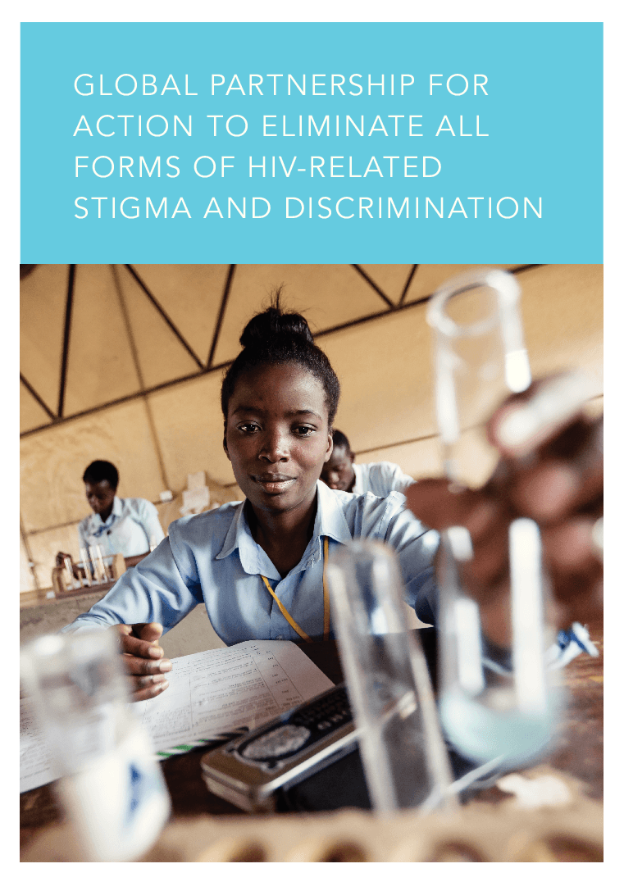
6 important settings for interventions
to reduce stigma and discrimination
The Global Partnership for Action to Eliminate all Forms of HIV-Related stigma and Discrimination recommends interventions in these settings:
Communities and households
The justice sector
The education sector
Emergency and humanitarian settings
Health-care settings
The workplace
SESSION 1.4 | THE UN’S ROLE IN INVESTING IN CRITICAL ENABLERS

Slide 27
Case study: The Justice sector
In Côte d’Ivoire, UNDP, the Global Fund and the NGO ENDA supported the production of a Legal Environment Assessment (LEA). The report systematically documented Ivorian laws and their impact on the country’s HIV response. Its recommendations to lawmakers included reforms to existing laws affecting people who use drugs.
CONAD-CI, a civil society coalition of people who use drugs and allied organisations successfully used the LEA evidence to advocate for legal reform.
A new law was adopted in May 2022 on the fight against illicit drug trafficking and use. For the first time, the law recommends a therapeutic injunction as an alternative to incarceration. Under the new law, penalties for drug use have also been considerably reduced.
Source: Le Sénat adopte la loi sur la lutte contre le trafic et l’usage illicites des stupéfiants (Agence Ivorienne de Presse, 2022)
SESSION 1.4 | THE UN’S ROLE IN INVESTING IN CRITICAL ENABLERS

Slide 28
Case study: The Education sector
Quality comprehensive sexuality education (CSE), provided to young people both in and out of school, provides them with accurate knowledge about HIV transmission and emphasises the importance of equal rights for people living with HIV and key populations.
CSE is now being extended to “out-of-school” settings, which increases the access of young key populations to accurate information on HIV, STIs and other sexual and reproductive health issues.
In contrast, lack of access to CSE perpetuates HIV-related stigma and discrimination.
SESSION 1.4 | THE UN’S ROLE IN INVESTING IN CRITICAL ENABLERS

Slide 29
Health-care settings
Stigma and discrimination are commonly experienced by key populations in health-care settings. According to the People Living with HIV Stigma Index, this deters people from seeking health services and prevents them from realising their right to health.
The Global Partnership for Action to Eradicate All forms of HIV-Related Stigma and Discrimination recommends that discrimination in health-care settings should be monitored, including the experiences of health service users, as well as the attitudes of staff.
Health-care workers can be educated to adopt competencies in human rights and medical ethics, regardless of their religion, personal philosophy, opinion or moral principles. Such training can include topics such as patient autonomy, informed consent, occupational health issues and labour rights for health-care workers (including non-clinical staff), plus welfare issues of key populations who are service providers.
SESSION 1.4 | THE UN’S ROLE IN INVESTING IN CRITICAL ENABLERS

Slide 30
Case study: The Workplace
The US President’s Emergency Plan for AIDS (PEPFAR) conducted a 1-day gender and sexual-diversity training session for its staff in 38 countries. The training covered some of the intersecting stigmas in the context of HIV. The aim was to improve attitudes towards gender and sexual minorities and meeting their needs in the workplace.
The training included four modules that addressed:
Health and policy considerations for gender and sexual minorities
Gender and sexual diversity concepts
The experiences and insights of members of and advocates for the lesbian, gay, bisexual and transgender community, and
Discussions on meaningful engagement.
SESSION 1.4 | THE UN’S ROLE IN INVESTING IN CRITICAL ENABLERS

Slide 31
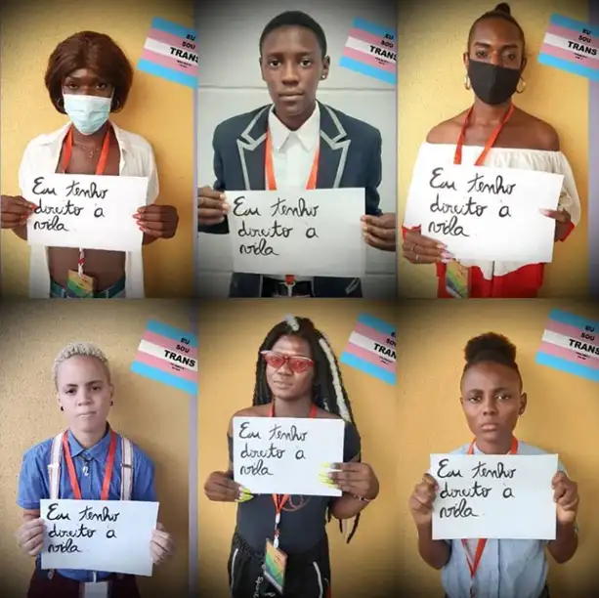
Advocacy – an important approach
As UN staff, we can encourage our organisation to join local advocacy efforts led by key populations. Advocacy constituents and target audiences may include:
Key population communities and allies
Donors, public health officials and policymakers
Advocacy activities may include:
Community organising
Lobbying and sensitising policymakers
Raising public awareness
Documenting experiences through community-led monitoring
Trainings
Demonstrations
Litigation
Circulating evidence of risk, vulnerability and harm
Image: “I have the right to live” campaign organised by Movimento Eu Sou Trans in 2021 / Imanni da Silva
SESSION 1.4 | THE UN’S ROLE IN INVESTING IN CRITICAL ENABLERS

Slide 32

Advocacy opportunities supported
by the UN
SESSION 1.4 | THE UN’S ROLE IN INVESTING IN CRITICAL ENABLERS

Slide 33
Session 1.4: Understanding and investing in critical enablers
Questions to frame this session
The 10-10-10 targets in the Global AIDS Strategy
What are critical enablers?
Why critical enablers are needed
The UN’s role in investing in critical enablers
Take-home messages
Session review questions
Further information and resources

Slide 34
Take-home messages
Societal enablers are important components of the 2025 global AIDS targets. The “10-10-10” targets encourage countries to have enabling laws, policies and public education campaigns that:
Dispel the stigma and discrimination that surrounds HIV,
Empower women and girls to claim their sexual and reproductive health and rights,
End the marginalisation of people disproportionately affected by HIV.
These enablers are highly relevant to key populations to create supportive sociocultural environments. Community empowerment and mobilisation is not possible without this.
UN organisations can support a variety of interventions recommended by UNAIDS and the Global Partnership to Eradicate All Forms of HIV-Related Stigma and Discrimination.
The UN leads several human rights campaigns, which could support advocacy efforts led by key populations.
SESSION 1.4 | TAKE-HOME MESSAGES

Slide 35
Session 1.4: Understanding and investing in critical enablers
Questions to frame this session
The 10-10-10 targets in the Global AIDS Strategy
What are critical enablers?
Why critical enablers are needed
The UN’s role in investing in critical enablers
Take-home messages
Session review questions
Further information and resources

Slide 36
Session 1.4: Understanding and investing in critical enablers
Questions to frame this session
The 10-10-10 targets in the Global AIDS Strategy
What are critical enablers
Why critical enablers are needed
The UN’s role in investing in critical enablers
Take-home messages
Session review questions
Further information and resources

Slide 37
Further information and resources
IN DANGER: UNAIDS Global AIDS Update 2022 (UNAIDS, 2022)
Consolidated Guidelines on HIV, Viral Hepatitis and STI Diagnosis, Prevention, Treatment and Care for Key Populations (WHO, 2022)
Remove Laws that Harm, Create Laws that Empower – Zero Discrimination Day 1 March 2022 (UNAIDS, 2022)
Evidence for Eliminating HIV-Related Stigma and Discrimination (UNAIDS, 2020)
End inequalities — Zero Discrimination Day brochure (UNAIDS, 2021)
Confronting discrimination: Overcoming HIV-related Stigma and Discrimination in Healthcare Settings and Beyond (UNAIDS, 2017)
UNAIDS Gender Assessment Tool: Towards a Gender-transformative HIV Response (UNAIDS, 2019)
Kavanaugh MK, et al. Law, criminalisation and HIV in the world: have countries that criminalise achieved more or less successful pandemic response? BMJ Global Health. 2021; 6(8):e006315.
Resources on human rights, key populations and HIV are listed at the end of Module 1, Session 1.5
SESSION 1.4 | FURTHER INFORMATION AND RESOURCES

